Slide 1
Why Desktop
Linux Does Not Suck.
(Not Even a Little)

Slide 2
Why.
Linux is great for 1 million reasons. Here's 5.
  It's fast.
  It's customizable.
  It's stable.
  It's open.
  It's, generally, pretty bad-ass.

Slide 3
Big, big releases
Ubuntu 12.04
Fedora 17
OpenSUSE 12.1
Linux Mint 12

Slide 4
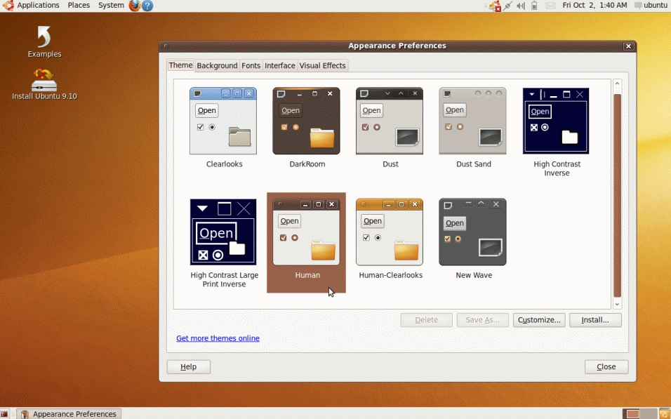
2009

Slide 5
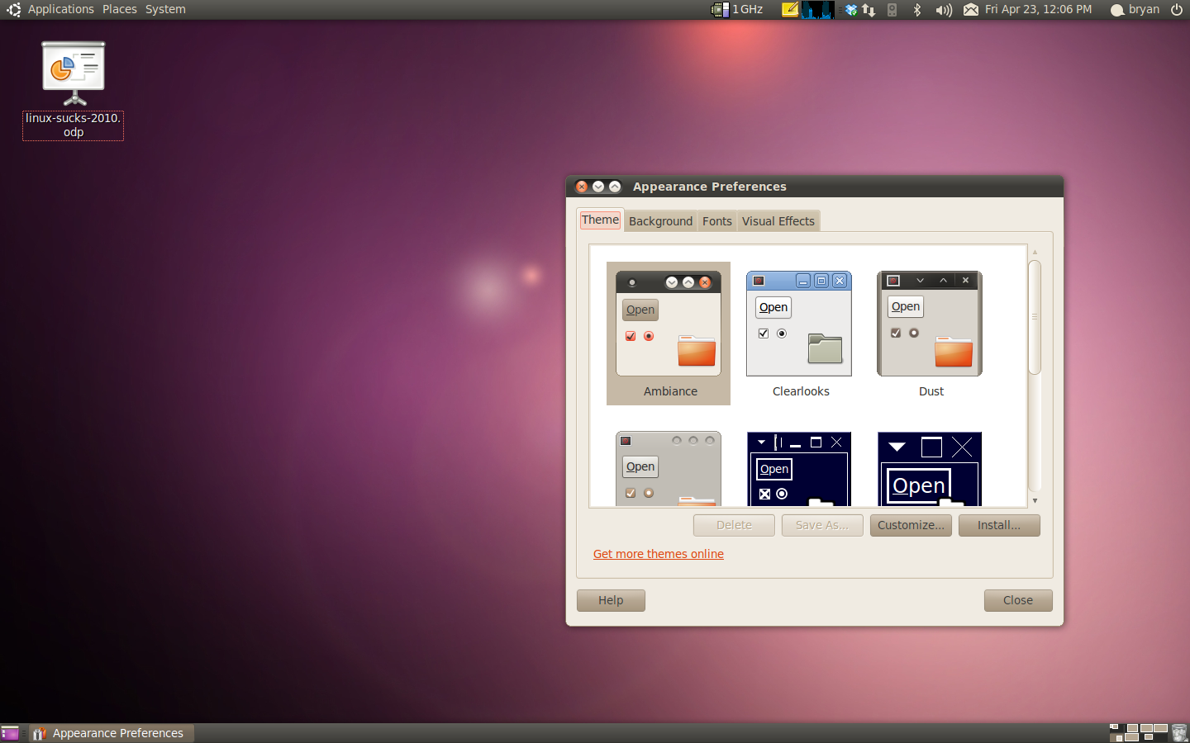
2010

Slide 6
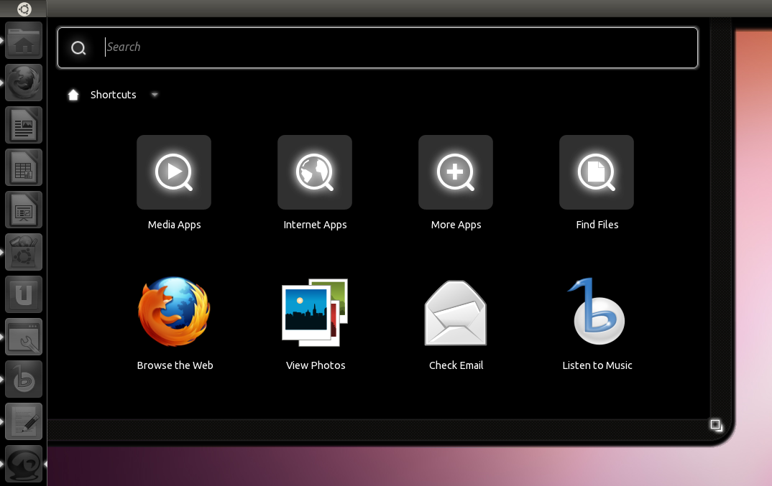
2011

Slide 7
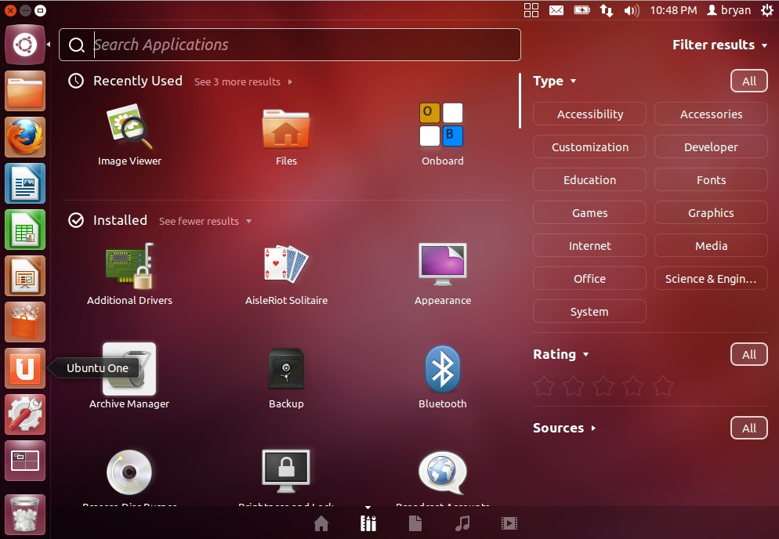
2012

Slide 8
Reasons Dumb People
Say Linux Sucks
Driver issues.
Updates that broke core functionality.
Perhaps the lack of particular software (or type of software) forces you to use another OS.
Distro's change the entire user experience on you.
Licensing Problems.
Not enough great software.
These people are all wrong. And dumb.

Slide 9
Our Names Are AWESOME
Precise Pangolin!
Quantal Quetzal!!
Beefy Miracle!!!
Hells yes! Those names take BALLS.

Slide 10
The Changing Experience
Gnome Shell? Unity? KDE 4?
Existing Linux Users vs Newbs.
Choice is awesome.
If It Aint Broke, Break It And Build Something Even Cooler!
Innovation is Cool.

Slide 11
Driver Issues
”I tried Linux, but my WiFi didn't work on my iBook.”
”Oh yeah? What distro was that?”
”Red Hat 5, I think”
Moral of the story: Drivers are less of a problem on Linux than on Windows nowadays. So tell people to try it again and pick a new distro.

Slide 12
Packaging Sucks
”I'd love to release my software for Linux, but it takes so long to build packages for all those different distros!”
”Just release a .tar.gz and let your users figure it out.”
”Really?”
”Yeah. Linux users aren't retarded.”

Slide 13
Barrier Applications
”I'd use Linux. But I don't like Gimp. If only I could run Photoshop on Linux!”
”You can. Wine.”
”Oh, in that case I also need...”
”Wine.”
”What about...”
”Shh. Wine.”

Slide 14
Barrier Applications
”But Wine doesn't work for the latest version of AutoCAD!”
”Good point! VirtualBox.”
”But I don't like virtualization! It's slow!”
”Running Windows in a VM means you can roll-back to previous snapshots if you get a virus.”
”Oohhh. I should do that.”
”Yes. You should.”

Slide 15
Games
”I'd use Linux if I could play Linux Tycoon.”
OH WAIT.
Seriously. Games aren't an issue anymore.
Humble Bundles.
Me. (*cough* Lunduke.com cough)

Slide 16
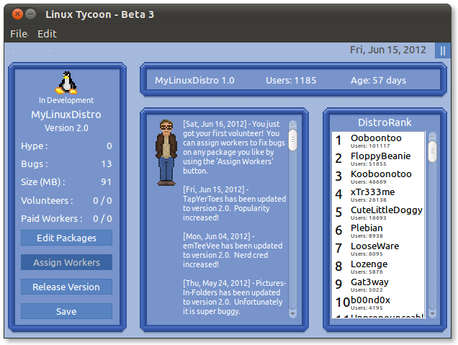
Seriously.
Is there a ”Windows Tycoon” or a ”Mac Tycoon”?
No. There is not. Boom.

Slide 17
Application Stores
Like iTunes and the Mac App Store?
Try Ubuntu. It has something a lot like that. Only it's faster, better looking and filled with stuff you don't (usually) have to pay for (unless you want to).

Slide 18
Your house is filled with Linux
Tivo?
Android phone?
Your cable box?
Odds are, you're running Linux already. So just embrace it everywhere and make things easier on yourself.
Linux Action Show has a ”Runs Linux” segment... over 200 episodes so far. And still more things that ”Run Linux”.

Slide 19
Feel free to yell at me
www.Lunduke.com
www.JupiterBroadcasting.com
www.Twitter.com/BryanLunduke
gplus.to/bryanlunduke

