Slide 1
Why Linux Does Not Suck.
Not Even A Little.

Slide 2
Linux is Awesome.
So, stop being mean to it or I will punch you in your stupid face.

Slide 3

FINALLY.
X11
Wayland
Mir

Slide 4
Ambition! I like it!
“It'll probably be packaged in F15”
Fedora mailing list post about Wayland, circa November, 2010.

Slide 5
Sweet! Choice is good!
GNOME Shell
KDE Plasma
Unity
Cinnamon
Mate
“That existing Desktop Environment would be easy to tweak to meet our needs? Ah, bag it! Let's fork and create a completely new one!”

Slide 6
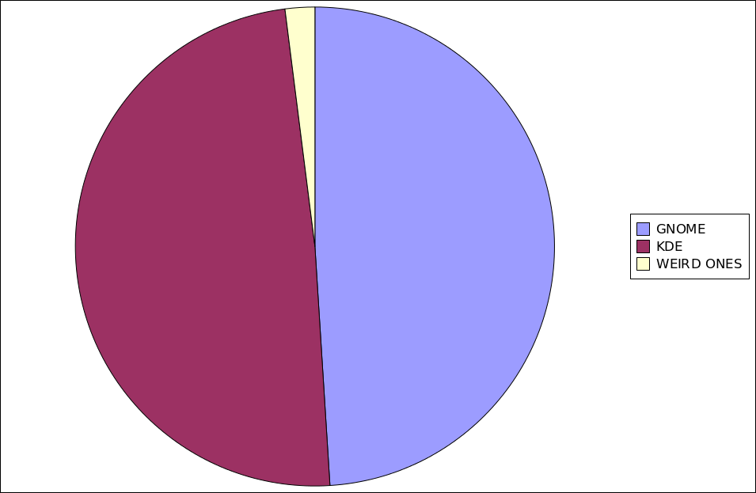
The old and busted...

Slide 7
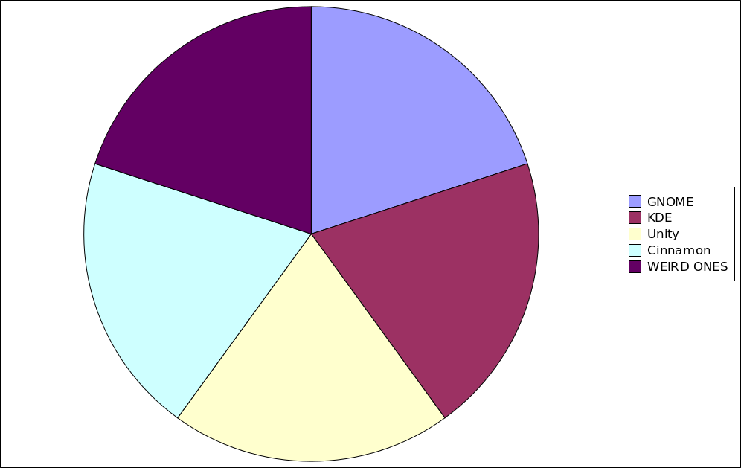
The new hotness!

Slide 8
Weeeeell...
Duplication of effort.
Breaking things that work.
User base fragmentation.
Developer fragmentation.
Marketing problems.
But so worth it!

Slide 9
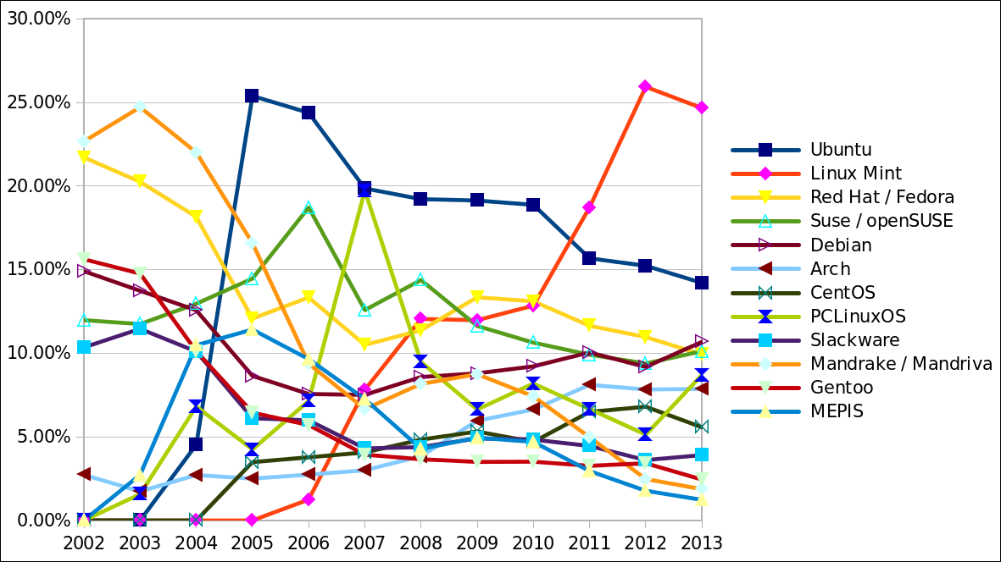
How exciting!

Slide 10
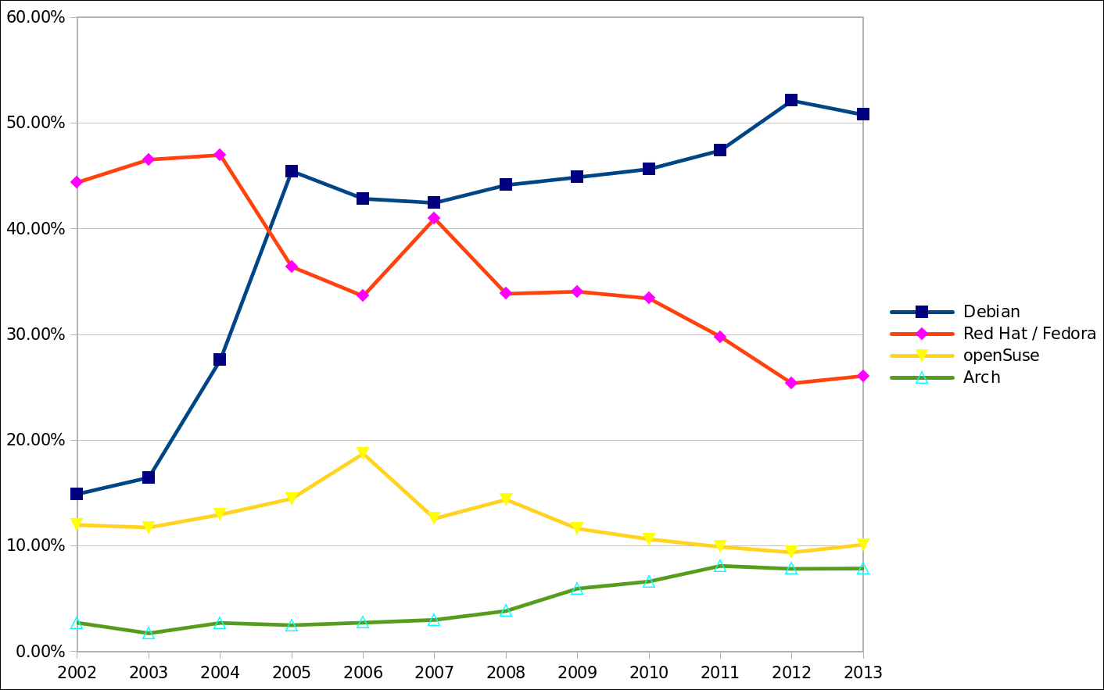
Change can be good.

Slide 11
Question for the audience:
Name one good reason that all Linux Distro's don't use the same package format.

Slide 12
TRICK QUESTION!

Slide 13
BADICAL.
Spherical Cow
Schrödinger's Cat
Raring Ringtail
Saucy Salamander
(Though, I miss the Beefy Miracle...)

Slide 14
Think about this...
Sales from the Ubuntu Software Center for March :
  #1 App – Stormcloud – 150 copies sold.
  #10 App – Linux Tycoon – 23 copies sold.
Sales from Steam during the launch sale :
  Defenders Quest – 335 copies sold.
  (This is more than the Mac version sold during the same period.)
… We're talking about sales of commercial Linux apps...

Slide 15
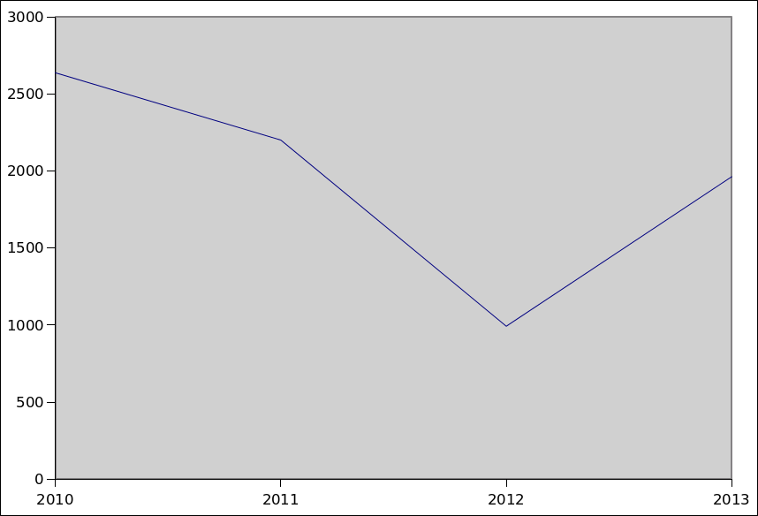
It's not nuthin'!
Ardour Monthly Donations Snapshot

Slide 16
The king is dead, long live the king
Maemo
MeeGo
Moblin
WebOS
OpenMoko
LiMo
Ubuntu Touch, Android, Plasma/Mer, Tizen?

Slide 17
Let me summarize myself...
“We've solved our old problems, so let's find new things to come up with amazing solutions for.”

Slide 18
How To Yell At Me
Email – bryan@lunduke.com
Website – www.Lunduke.com
Twitter – www.twitter.com/BryanLunduke
G+ – gplus.to/bryanlunduke
In person (I'm right there)

