Slide 1
Why Linux (Always) Sucks
(And what we can do to fix it.)

Slide 2
Linux is Awesome.
Except when it sucks and I want to punch it in its stupid face.

Slide 3

WHAT THE $#@! IS GOING ON?
X11
Wayland
Mir

Slide 4
“It'll probably be packaged in F15”
Fedora mailing list post about Wayland, circa November, 2010.

Slide 5
OK. Now you're messing with me.
GNOME Shell
KDE Plasma
Unity
Cinnamon
Mate
“That existing Desktop Environment would be easy to tweak to meet our needs? Ah, bag it! Let's fork and create a completely new one!”

Slide 6
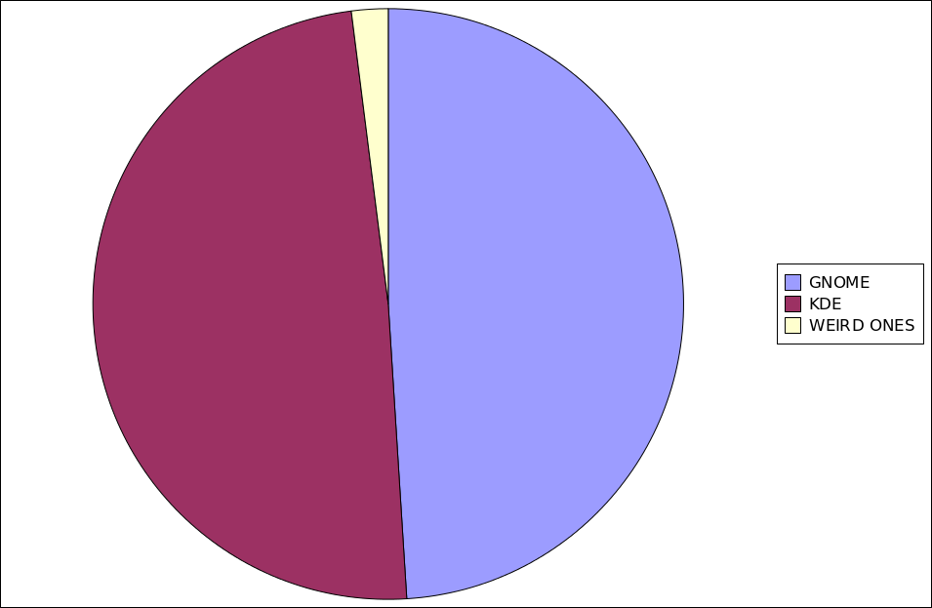
That's easy enough...

Slide 7
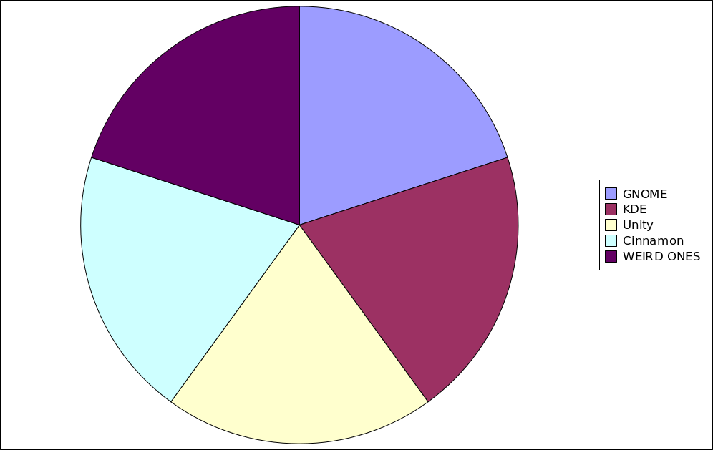
AH, MAN!

Slide 8
I MEAN, WHAT THE HELL.
Duplication of effort. ← Bad.
Breaking things that work. ← Bad.
User base fragmentation. ← Bad.
Developer fragmentation. ← Bad.
Marketing problems. ← Bad.
“Hey Bryan, which desktop environment should I use?”
“I DON'T KNOW ANYMORE.”

Slide 9
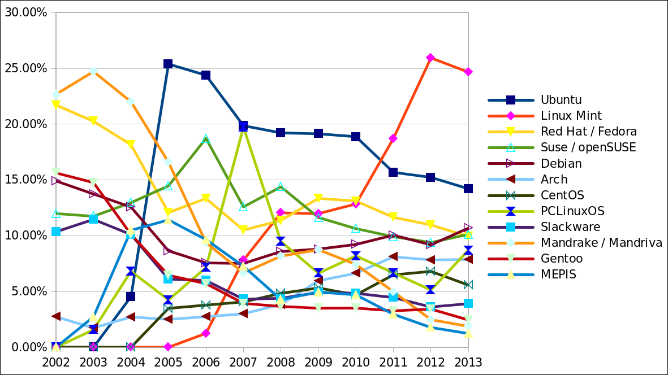
STOP MAKING MY EYES BLEED

Slide 10
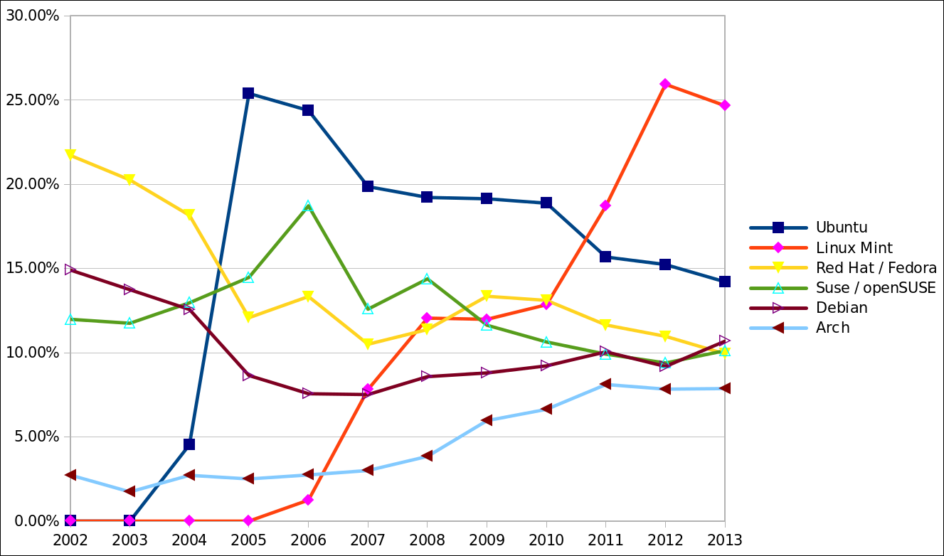
Phew...

Slide 11
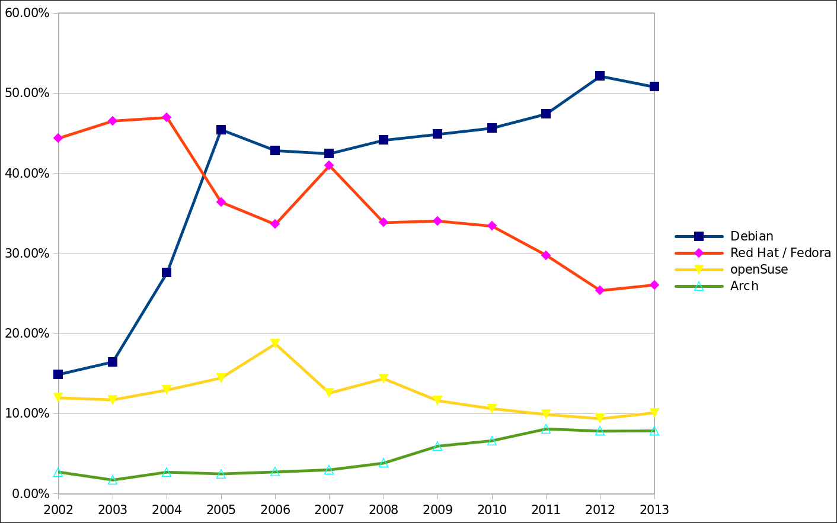
Even better.

Slide 12
Question for the audience:
Name one good reason that all Linux Distro's don't use the same package format.

Slide 13
...
Spherical Cow
Schrödinger's Cat
Raring Ringtail
Saucy Salamander

Slide 14
I'm rich, mother ******'s!
Sales from the Ubuntu Software Center for March :
  #1 App – Stormcloud – 150 copies sold.
  #10 App – Linux Tycoon – 23 copies sold.
Sales from Steam during the launch sale :
  Defenders Quest – 335 copies sold.
  (This is more than the Mac version sold during the same period.)

Slide 15
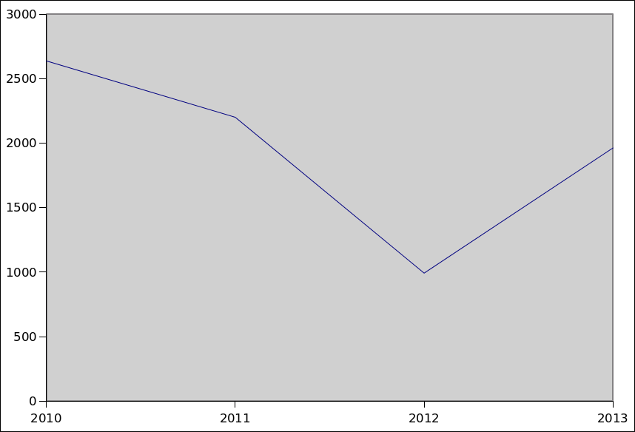
So, that's how much per year?
Ardour Monthly Donations Snapshot

Slide 16
Dead, dead, dead, dead...
Maemo
MeeGo
Moblin
WebOS
OpenMoko
LiMo
Ubuntu Touch, Android, Plasma/Mer, Tizen?

Slide 17
Let me summarize myself...
“We've solved driver issues and usability problems, so let's find new and exciting ways to make our lives harder.”

Slide 18
How To Yell At Me
Email – bryan@lunduke.com
Website – www.Lunduke.com
Twitter – www.twitter.com/BryanLunduke
G+ – gplus.to/bryanlunduke
In person (I'm right there)

