Slide 1
Linux Sucks.
cope

Slide 2
Who the hell is this guy?
Social Media Marketing Manager for SUSE.
Writer for Network World.
Author of :
  A kids book - “Linux for Hank”.
  Not a kids book - “Linux is Badass”.
  Other terrible books.
Co-host of Bad Voltage.
I don’t know. Some other stuff probably.

Slide 3
Disclaimer.
What follows is the worst thing ever.
Any young children that watch this have terrible parents.
Do not tell anyone that I did this.

Slide 4
Now. Let’s talk about things that suck.

Slide 5
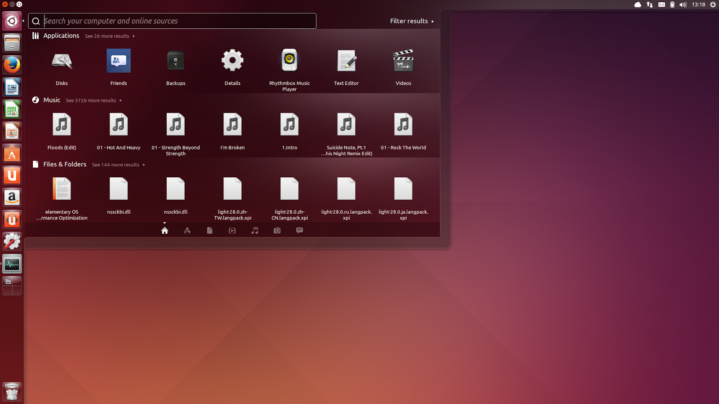
Ubuntu.

Slide 6

Ubuntu One.

Slide 7
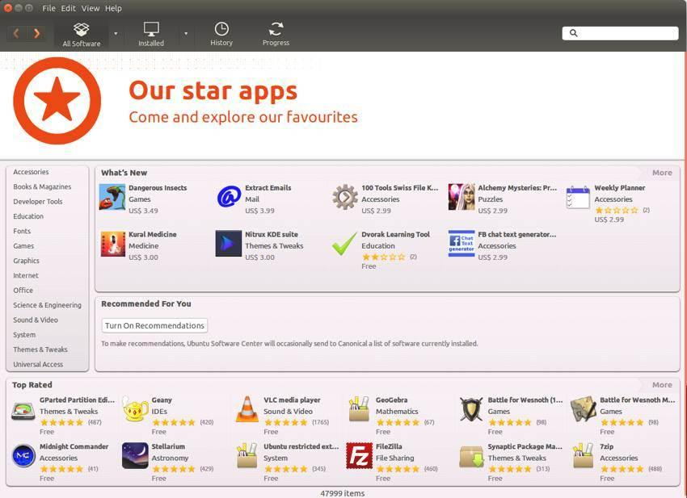
The Ubuntu Software Center.

Slide 8
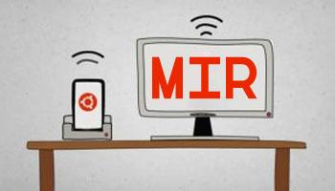
Mir.

Slide 9

Wayland.

Slide 10

Fedora.

Slide 11
Stop Forking, Dammit.
OpenSSL -> LibreSSL
GNOME -> Cinnamon
WebKit -> Blink
Contributing to an existing project is easier than forking and managing your new fork.
Forking is dumb.
Notes:
Adding 1 new word to someone elses dictionary vs copying the entire dictionary and maintaining it yourself.

Slide 12
The Display Server.
HOLY CRAP X11 IS OLD.

Slide 13
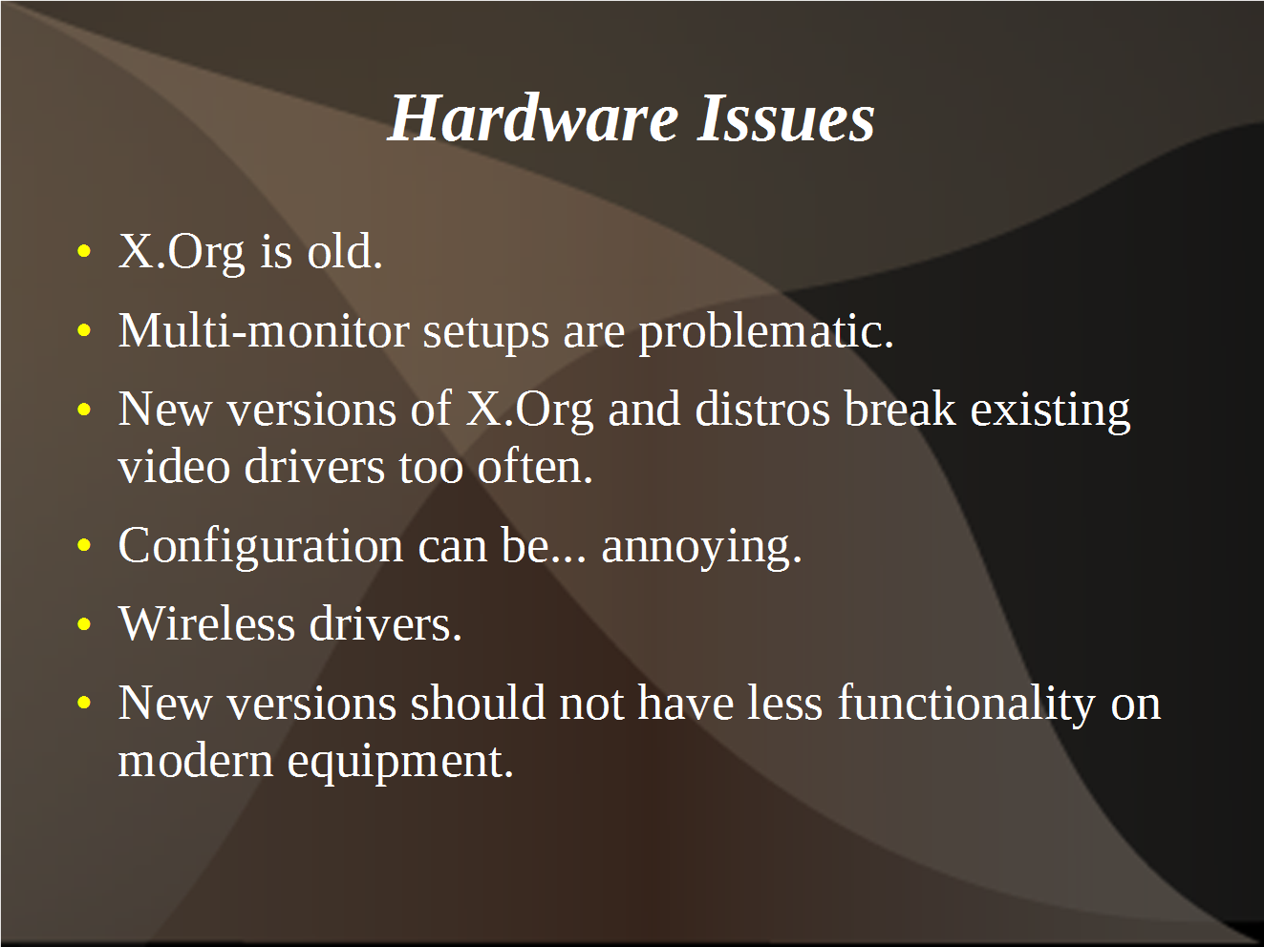
The Display Server.

Slide 14
The Display Server.
HOLY CRAP X11 IS OLD.
Where the hell is Wayland?
Mir? Seriously, Canonical? WTF?

Slide 15
“Not Invented Here”
Unity
Mir
Stop replacing good, working software with nearly identical, brand new software.
This slide is mostly for Canonical.
Stop being so Canonical-y, Canonical.
Notes:
Teddy Ruxpin creepy story.

Slide 16
The Names. They Suck.
Heisenbug.
Trusty Tahr.
Utopic Unicorn.
This is mostly your fault, Fedora and Ubuntu.
You guys suck.

Slide 17
The Mythical Man Month.
Thousands of unpaid developers throwing code, part time, into a giant, Internet-y vat of software.
WHAT COULD POSSIBLY GO WRONG?
Notes:
Foursquare -> Dodgeball story

Slide 18
The Funding.
Full time developers don’t work for free.
Money has to come from somewhere.
Those who pay get power.
Too much power makes you go all wacky.

Slide 19
Ubuntu.

Slide 20
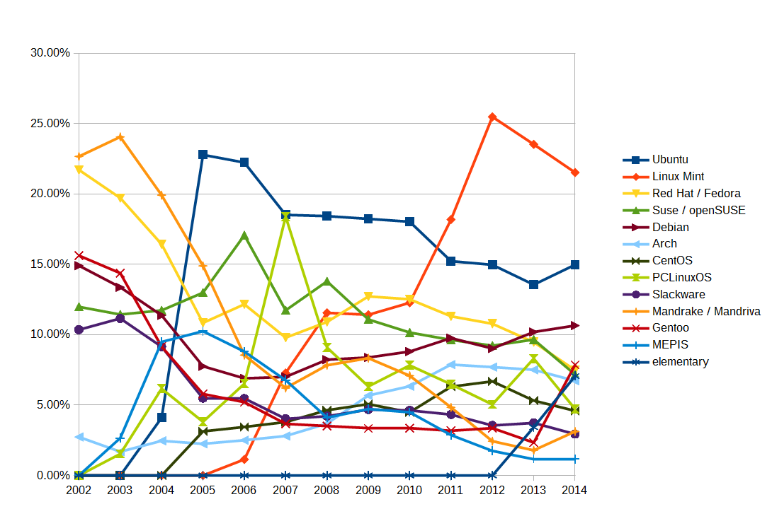
I Hate This Slide.

Slide 21
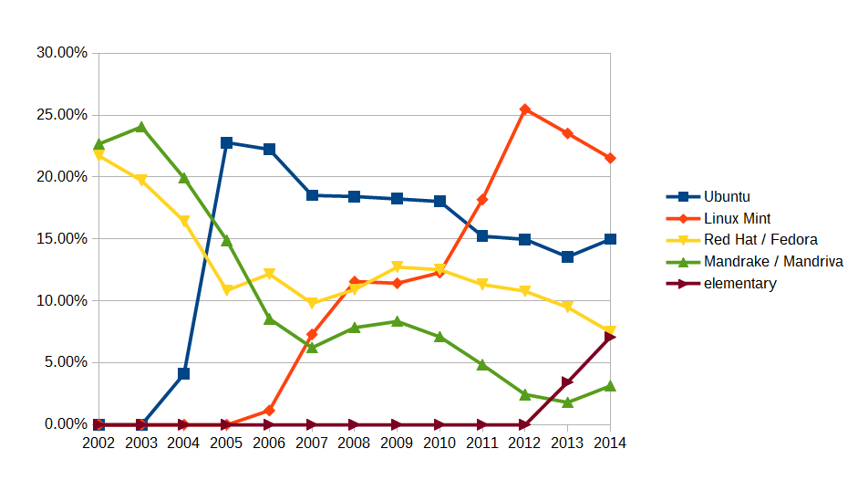
The Trends.

Slide 22
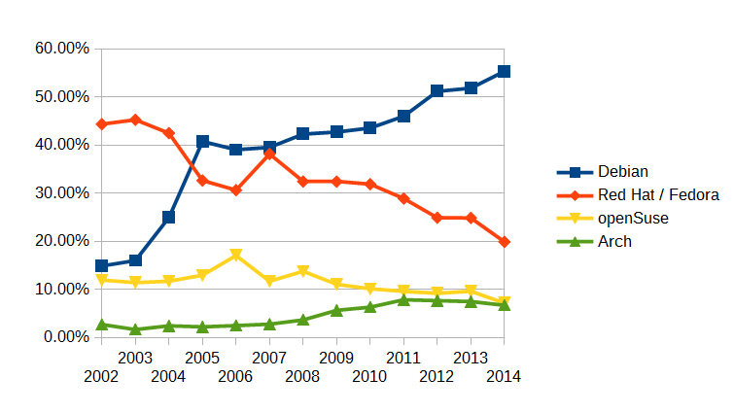
The Trends.

Slide 23
Linux Sucks.
is something assholes say

Slide 24
Forks! Wooo!
OpenSSL -> LibreSSL
GNOME -> Cinnamon
WebKit -> Blink
Contributing to an existing project is easier than forking and managing your new fork.
But sometimes you just gotta do it!

Slide 25
The Display Server.
HOLY CRAP X11 IS RELIABLE.

Slide 26
The Display Server.

Slide 27
The Display Server.
HOLY CRAP X11 IS RELIABLE.
Take your time with Wayland!
Mir? Way to go Canonical!

Slide 28
“Not Invented Here”
Unity
Mir
The heart wants what the heart wants.
Hey Canonical. You go, girl.

Slide 29
The Names. So Great.
Heisenbug.
Trusty Tahr.
Utopic Unicorn.
Thank you, Fedora and Ubuntu.
You guys rule.
(Please rename everything “Beefy Miracle”.)

Slide 30
The Mythical Man Month.
Thousands of unpaid developers throwing code, part time, into a giant, Internet-y vat of software.
… And it works.
Wait. Really?
Notes:
Remember that dodgeball story? You know what? Those kids were playing fucking dodgeball. Awesome.

Slide 31
The Funding.
Full time developers don’t work for free.
Money has to come from somewhere.
Those who pay get power.
Too much power makes you… take chances.

Slide 32
Ubuntu.

Slide 33
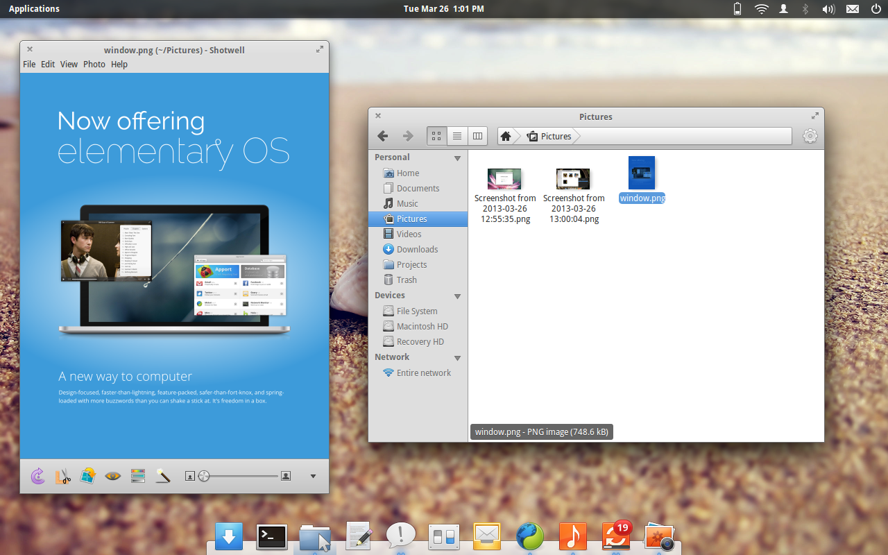
elementary.

Slide 34
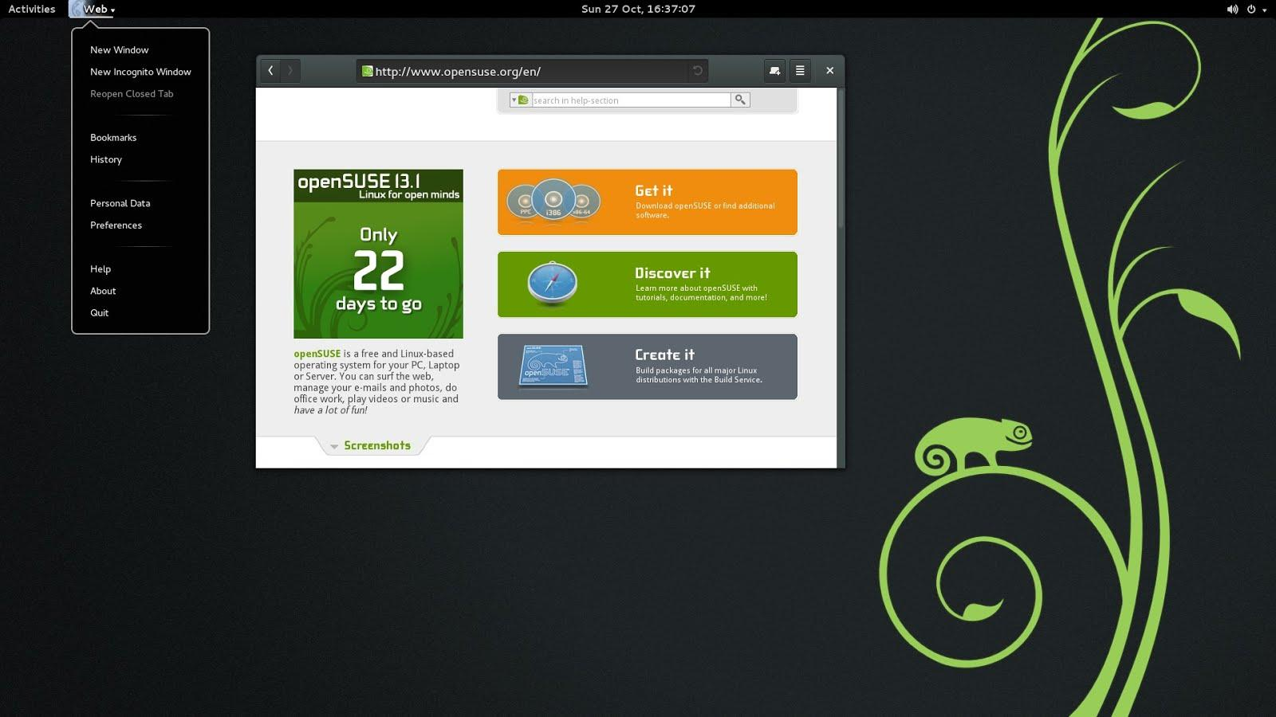
openSUSE.

Slide 35
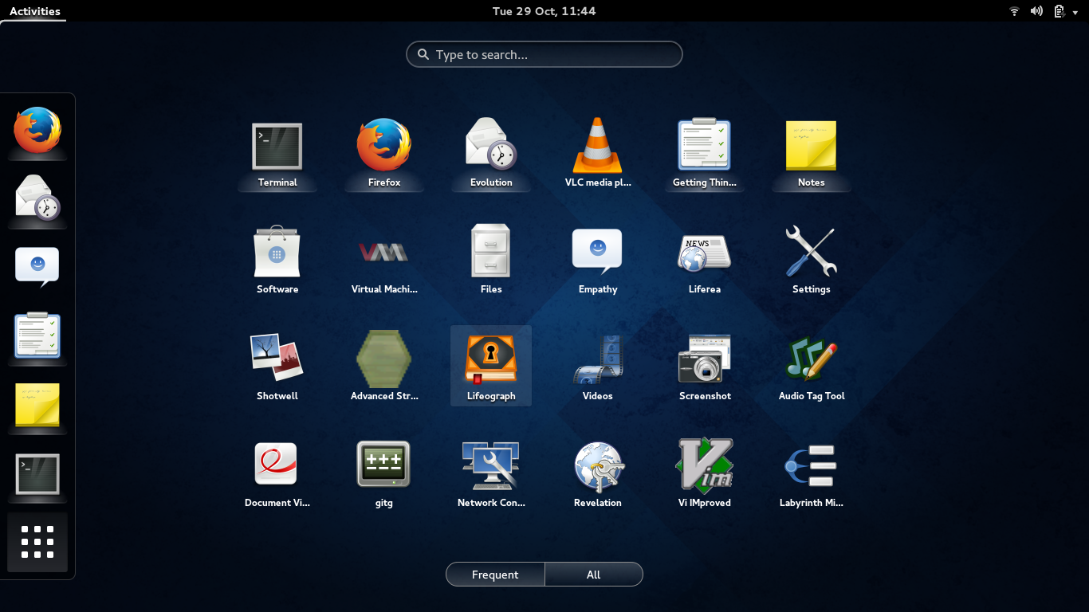
Fedora.

Slide 36
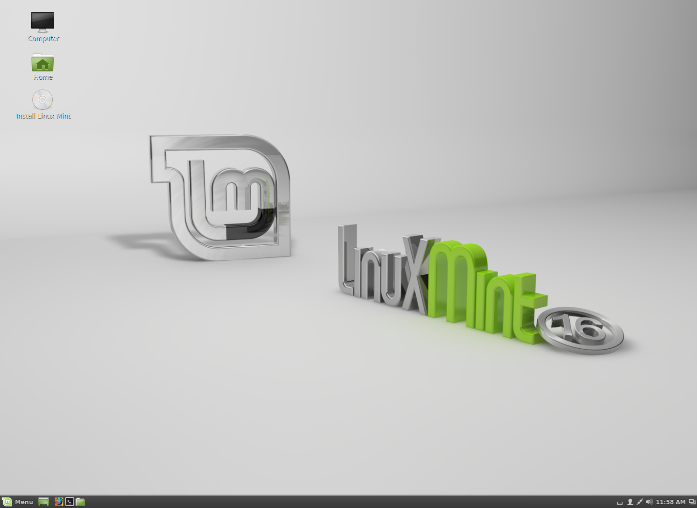
Mint.

Slide 37
I Still Hate This Slide.

Slide 38
The Trends.

Slide 39
The Trends.

Slide 40
Places You Can Yell At Me.
www.Lunduke.com
www.twitter.com/BryanLunduke
plus.google.com/+BryanLunduke

