Slide 1
Why Desktop
Linux (Still) Sucks.
And What We Can Do To Fix It.

Slide 2
Let's get this out of the way...
We all like Linux.
Linux is great.
  It's fast.
  It's customizable.
  It's stable.
  It's open.
  It's, generally, pretty bad-ass.
  It has come a LONG way in the last year.

Slide 3
Big, big releases
Ubuntu 9.10 & 10.04
Fedora 12
openSUSE 11.2
Mandriva 2010

Slide 4
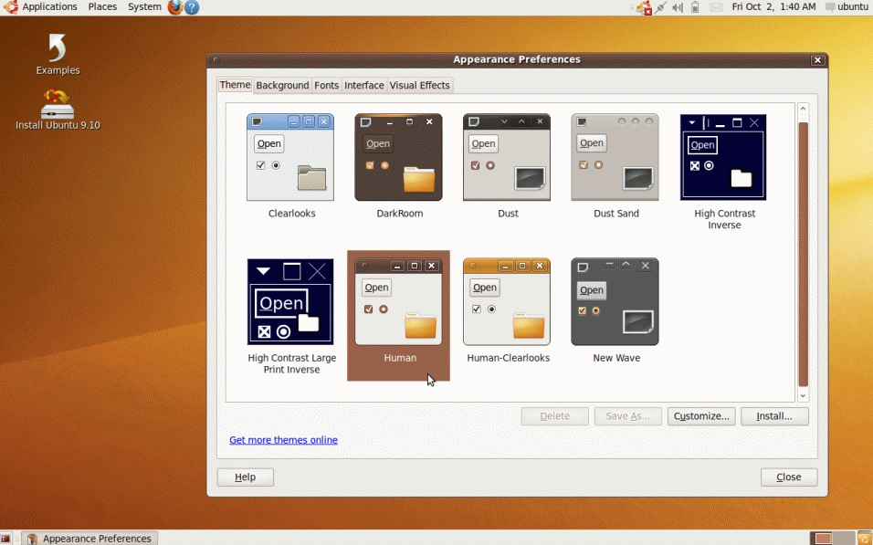
2009

Slide 5
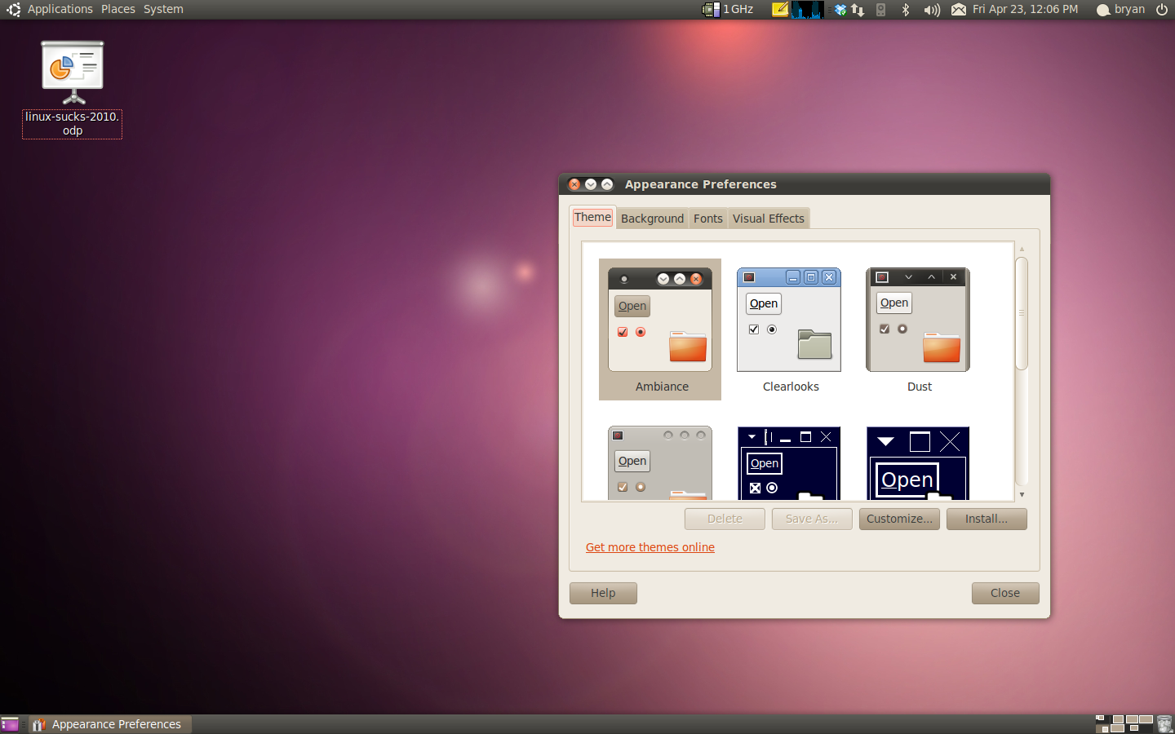
2010

Slide 6
But. Seriously. Linux Sucks.
Ever have audio problems?
How about Wi-Fi issues?
Maybe updates that broke core functionality?
Perhaps the lack of particular software (or type of software) forces you to use another OS?
Long story short: Linux Sucks.
But let's get specific: Why? And how do we fix it?

Slide 7
Stuff we won't talk about
Linux as a server.
Mobile Linux (Phones, PDAs, Tablets).
Embedded Linux (Routers, etc.).
Marketting.

Slide 8
Audio Problems
ALSA?
Pulse?
Gstreamer?
Open Sound System?
aRts (Analog Real Time Synthesizer)?
Phonon?
Are you kidding me?
Still? This is still a problem?

Slide 9
Audio Problems - FIXED
No. More. Duplicating. Effort.
Do not create a new audio framework.
Do not create a new framework that wraps other audio frameworks.
The real key is which API developers use.
Pick one. Here, I'll show you how easy it is:
Gstreamer. There. Done.
Now everyone just use that.

Slide 10
Hardware Issues
X.Org is old.
Multi-monitor setups are problematic.
New versions of X.Org and distros break existing video drivers too often.
Configuration can be... annoying.
Wireless drivers.
New versions should not have less functionality on modern equipment.

Slide 11
Hardware Issues - FIXED
Distros need to stop revving X.Org so often.
If modern video cards work with a current release of a distro (or X.Org)... do not release the new version of that distro (or X.Org) if that video card is no longer fully supported.
Same goes for Wireless Cards and all other hardware.

Slide 12
Packaging Sucks
.Deb?
.RPM?
.tar.gz?
Ubuntu, Fedora, Arch, OpenSuse, PCLinuxOS, Gentoo... Often need different packages for each.
Many people duplicating effort packaging same software for different formats and distros.

Slide 13
Packaging - FIXED
Let's just freaking standardize.
LSB (Linux Standard Base) says RPM is it.
Deb is far more popular (as Ubuntu is in the lead usage wise).
But, really, it doesn't matter. Just pick one and everybody freaking use it.
If every distro can utilize the same packages – awesome.
Great. But what is the right decision?

Slide 14
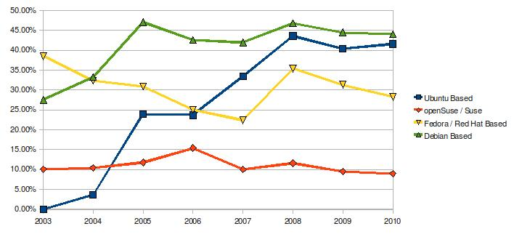
The 7 Year Trend

Slide 15
Audio Editing
We have lots of projects.
Most of them are not even functional.
A few are somewhat usable:
  Audacity?
  ReZound?
  Jokosher?
  Ardour? (This is my personal preference)
Where is our GarageBand? Our Audition?

Slide 16
Audio Editing
The problem is that these are not simple tools.
They require a large investment in time and developer resources.
This hurts to say :
  The current open source development model has failed to deliver these advanced, and necessary, tools.
  Linux is not even on par with Windows and MacOS from the mid 1990's.

Slide 17
Audio Editing
Projects must be funded in order to succeed.
The funding must be reliable.
… Let's come back to this topic in a bit.

Slide 18
Video Editing
Things have changed a LOT in the last year.
PiTiVi.
OpenShot Video Editor.
KDEnlive
Lightworks.

Slide 19
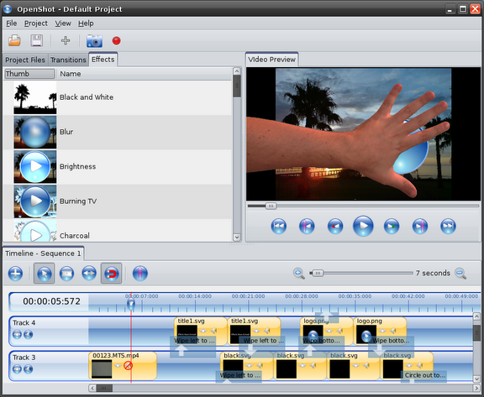
OpenShot

Slide 20
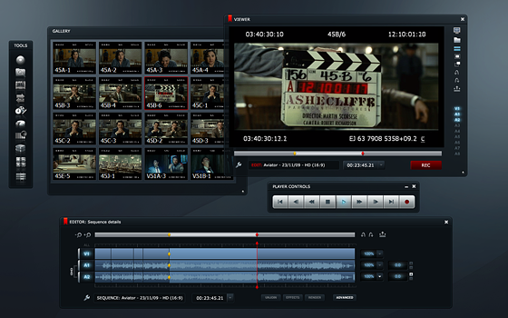
Lightworks

Slide 21
The Big But...
Despite these (massive) strides, video editing has a ways yet to go.
Would we recommend that our family (or friends... or clients...) use Linux to edit videos?
One year ago I would not have thought we could get this far in just one year.

Slide 22
What about Application X?
There are key applications (and types of applications) that are vital to many lines of work.
CAD, Pro-level design, Image Management
Animation, Screenwriting, etc.
”What about Photoshop?”
Large applications, that require a large resource investment.

Slide 23
What about Game X?
Many of us keep Windows around just for games.
Games are huge. They drive system adoption.
Some have come to Linux (Doom 3, Neverwinter Nights, Penny Arcade Adventures).
The list is small.
Sales are not large enough for most developers and publishers to consider a Linux port.
Open Source games don't cut it.

Slide 24
Large Software Projects...
All of these applications are extremely large.
There have been many, many attempts at Open Source projects to address these needs.
The time and resource (manpower, etc.) requirements for these projects make their success unlikely.
So we must fund these projects. But how?

Slide 25
Funding Key Projects
Open Source with Donations?
Open Source with Corporate Funding?
Open Source plus Paid Services?
Closed Source?
Commercial with Source Available?
Sure! Anything! But let's think about numbers for a second.

Slide 26
What does it cost?
Hypothetical: Let's make a Video Editor (ala iMovie, Windows Movie Maker, etc.).
Let's say it we need 3 developers and 1 tester.
Each person earns $75k per year.
That works out to (without graphics design, documentation, marketting, server admin, project management or support) : $300,000 per year.
Developers need to eat.

Slide 27
Why not spread the work out?
More developers does not equal more productivity.
A team of 5 dedicated, full time developers is typically going to be more productive than 50 developers who only putz a little on the weekend.
The Open Source projects that are commercially backed and funded tend to be the most active and have the most momentum. (Look at the Kernel, Gnome, Mono, etc.)
Developers need to eat.

Slide 28
A Quick Case Study
The most advanced audio editor for Linux is Ardour.
The developer is attempting to work on it full time (which is needed).
Monthly donation subscriptions: $2638 (Up from $2019 one year ago!).
That's only $31,656 per year. Not enough to rely on for living expenses.
Developers need to eat.

Slide 29
So how do we fix it?
We, as Linux users, need to accept that software costs money to make.
We then need to either:
  Donate to Open Source projects in the amount roughly equalling what we'd pay to a commercial product.
  Or purchase closed source software for Linux in order to encourage the companies to bring more to Linux.
  Or both.

Slide 30
Okay. Sure. But HOW?
Major distros and companies (Canonical, Novell, Red Hat, Nokia, etc.) need to get involved:
  Encourage people to donate to specific projects that their customers would most benefit from.
  Active fund raisers (Linux Fund and the Linux Foundation have done well here).
  Build software stores into their distros. (Canonical is doing this)
  Make commercial third party software more prominent on their websites.
Some people won't like it. Cope.

Slide 31
Application Stores
The Ubuntu Software Center is a great start.
(Did we all just decide to forget Click N Run?)
But software sales do not yet happen in the Ubuntu Software Center (slated for 10.10).
What will happen then? Well we, as Linux users, embrace convenient software purchasing?

Slide 32
Feel free to yell at me
www.Lunduke.com
www.JupiterBroadcasting.com
www.Twitter.com/BryanLunduke

