Slide 1
Why Desktop
Linux Sucks.
(Less Than Before)
...And What We Can Do To Fix It.

Slide 2
Let's get this out of the way...
We all like Linux.
Linux is great.
  It's fast.
  It's customizable.
  It's stable.
  It's open.
  It's, generally, pretty bad-ass.

Slide 3
Big, big releases
Ubuntu 10.10 & 11.04
Fedora 13
OpenSUSE 11.4
Debian 6.0
Linux Mint 10

Slide 4
Big, big releases
Gnome 3
Unity
KDE 4.6

Slide 5
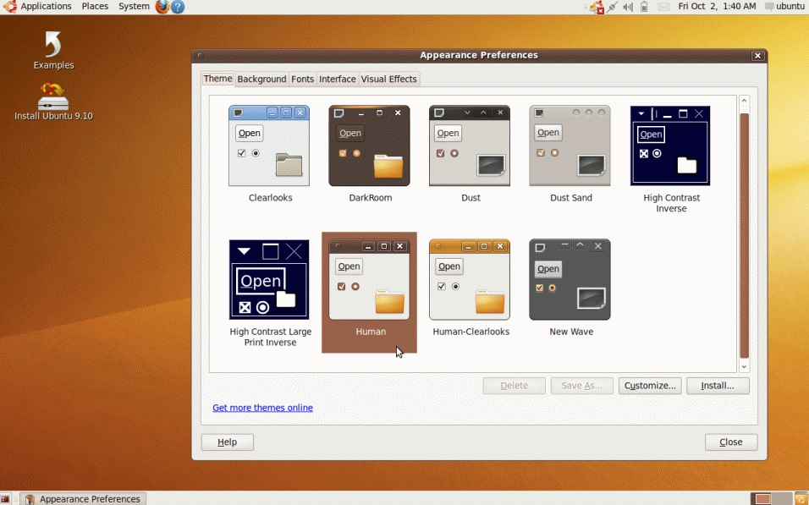
2009

Slide 6
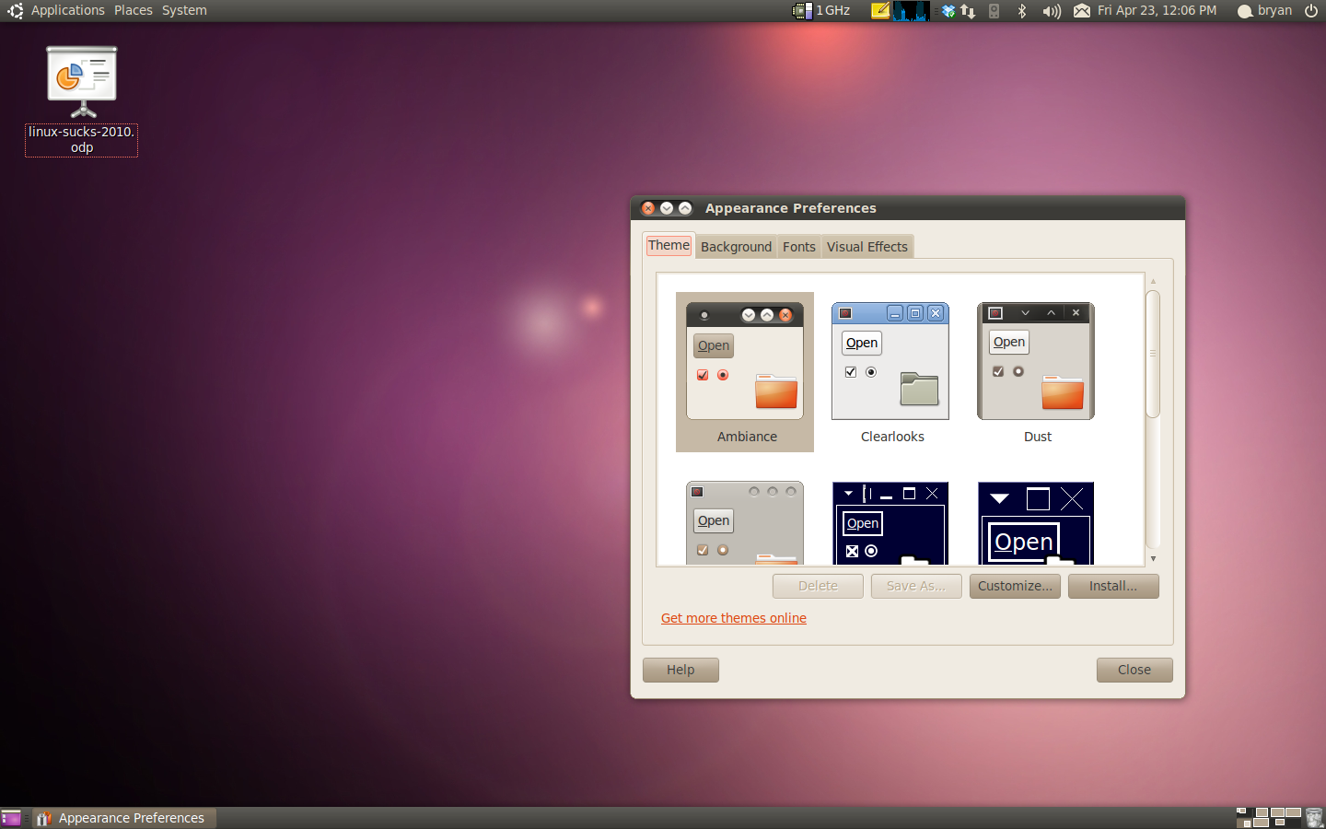
2010

Slide 7
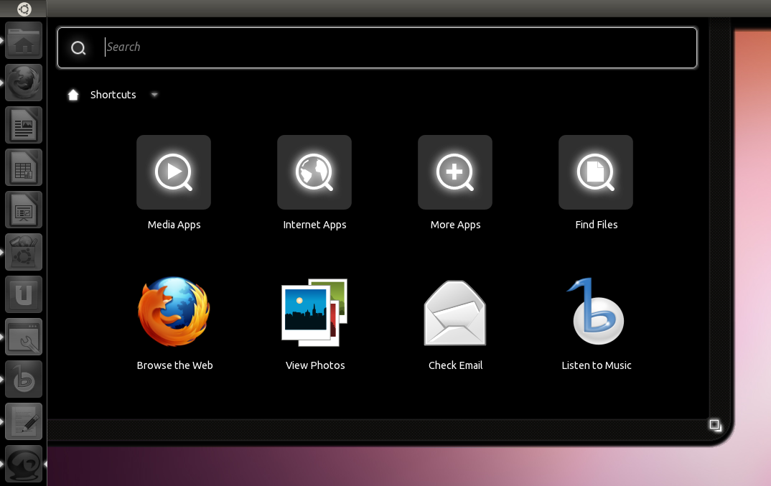
2011

Slide 8
But. Seriously. Linux Sucks.
Driver issues?
Maybe updates that broke core functionality?
Perhaps the lack of particular software (or type of software) forces you to use another OS?
Distro's change the entire user experience on you?
Long story short: Linux Sucks.
But let's get specific: Why? And how do we fix it?

Slide 9
Stuff we won't talk about
Linux as a server.
Mobile Linux (Phones, PDAs, Tablets).
Embedded Linux (Routers, etc.).
Marketting.

Slide 10
Stuff we won't talk about
Linux as a server.
Mobile Linux (Phones, PDAs, Tablets).
Embedded Linux (Routers, etc.).
Marketting.

Slide 11
The Changing Experience
Gnome 3? Unity? KDE 4?
Existing Linux Users vs Newbs.
Choice vs Fragmentation.
Duplication of Effort?
If It Aint Broke Don't Fix it (And other folksy wisdom).
Innovation is Cool. I think.

Slide 12
Hardware Issues
X.Org is old.
Multi-monitor setups are problematic.
New versions of X.Org and distros break existing video drivers too often.
Configuration can be... annoying.
Wireless drivers.
New versions should not have less functionality on modern equipment.

Slide 13
Hardware Issues - FIXED
Distros need to stop revving X.Org so often.
If modern video cards work with a current release of a distro (or X.Org)... do not release the new version of that distro (or X.Org) if that video card is no longer fully supported.
Same goes for Wireless Cards and all other hardware.
Wayland?

Slide 14
Packaging Sucks
.Deb?
.RPM?
.tar.gz?
Ubuntu, Fedora, Arch, OpenSuse, PCLinuxOS, Gentoo... Often need different packages for each.
Many people duplicating effort packaging same software for different formats and distros.

Slide 15
Packaging - FIXED
Freaking standardize already.
LSB (Linux Standard Base) says RPM is it.
Deb is far, far more popular.
But, really, it doesn't matter. Just pick one and everybody freaking use it.
If every distro can utilize the same packages – awesome.
Great. But what is the right decision?

Slide 16
The 9 Year Trend

Slide 17
The 9 Year Trend

Slide 18
Audio Editing
We have lots of projects.
Most of them are not even functional.
A few are somewhat usable:
  Audacity?
  ReZound?
  Jokosher?
  Ardour? (This is my personal preference)
Where is our GarageBand? Our Audition?

Slide 19
Audio Editing
The problem is that these are not simple tools.
They require a large investment in time and developer resources.
This hurts to say :
  The current open source development model has failed to deliver these advanced, and necessary, tools.
  Linux is not even on par with Windows and MacOS from the mid 1990's.

Slide 20
Audio Editing
Projects must be funded in order to succeed.
The funding must be reliable.
… Let's come back to this topic in a bit.

Slide 21
Video Editing
Things continue to improve... slowly.
PiTiVi.
OpenShot Video Editor.
KDEnlive.
Cinelara.
Lightworks?

Slide 22
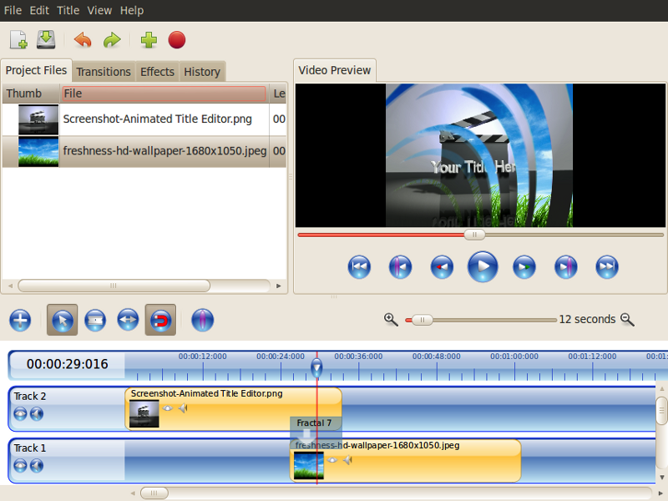
OpenShot

Slide 23
The Big But...
Despite these improvements, video editing has a ways yet to go.
Would we recommend that our family (or friends... or clients...) use Linux to edit videos?
Can Jupiter Broadcasting move its entire workflow to Linux?

Slide 24
What about Application X?
There are key applications (and types of applications) that are vital to many lines of work.
CAD, Pro-level design, Image Management
Animation, Screenwriting, etc.
”What about Photoshop?”
Large applications, that require a large resource investment.

Slide 25
What about Game X?
Many of us keep Windows around just for games.
Games are huge. They drive system adoption.
Some have come to Linux (Doom 3, Neverwinter Nights, Penny Arcade Adventures).
The list is small.
Sales are not large enough for most developers and publishers to consider a Linux port.
Open Source games don't cut it.

Slide 26
Large Software Projects...
All of these applications are extremely large.
There have been many, many attempts at Open Source projects to address these needs.
The time and resource (manpower, etc.) requirements for these projects make their success unlikely.
So we must fund these projects. But how?

Slide 27
Funding Key Projects
Open Source with Donations?
Open Source with Corporate Funding?
Open Source plus Paid Services?
Closed Source?
Commercial with Source Available?
Sure! Anything! But let's think about numbers for a second.

Slide 28
What does it cost?
Hypothetical: Let's make a Video Editor (ala iMovie, Windows Movie Maker, etc.).
Let's say it we need 3 developers and 1 tester.
Each person earns $75k per year.
That works out to (without graphics design, documentation, marketting, server admin, project management or support) : $300,000 per year.
Developers need to eat.

Slide 29
Why not spread the work out?
More developers does not equal more productivity.
A team of 5 dedicated, full time developers is typically going to be more productive than 50 developers who only putz a little on the weekend.
The Open Source projects that are commercially backed and funded tend to be the most active and have the most momentum. (Look at the Kernel, Gnome, Mono, etc.)
Developers need to eat.

Slide 30
A Quick Case Study
The most advanced audio editor for Linux is Ardour.
The developer is attempting to work on it full time (which is needed).
Monthly donation subscriptions: $2201 (Down from $2638 one year ago).
That's only $26,412 per year. Not enough to rely on for living expenses.
Developers need to eat.

Slide 31
So how do we fix it?
We, as Linux users, need to accept that software costs money to make.
We then need to either:
  Donate to Open Source projects in the amount roughly equalling what we'd pay to a commercial product.
  Or purchase closed source software for Linux in order to encourage the companies to bring more to Linux.
  Or both.

Slide 32
Okay. Sure. But HOW?
Major distros and companies (Canonical, Novell, Red Hat, Nokia, etc.) need to get involved:
  Encourage people to donate to specific projects that their customers would most benefit from.
  Active fund raisers (Linux Fund and the Linux Foundation have done well here).
  Build software stores into their distros. (Canonical did this).
  Make commercial third party software more prominent on their websites.
Some people won't like it. Cope.

Slide 33
Application Stores
The Ubuntu Software Center is a great start.
Software has been for sale for a few months. Small in numbers.
Can we, as Linux users, embrace this?

Slide 34
Feel free to yell at me
www.Lunduke.com
www.JupiterBroadcasting.com
www.Twitter.com/BryanLunduke

