Slide 1
Multi-Channel Integrated Circuits for Use in Research with Radioactive Ion Beams
Dr. George L. Engel
Department of Electrical and Computer Engineering
Southern Illinois University Edwardsville
CAARI 2010 Conference Fort Worth, Texas August 12, 2010

Slide 2


Inter-University Collaboration
Dr. George L. Engel
Southern Illinois University Edwardsville
Department of Electrical and Computer Engineering
IC Design Research Laboratory
Edwardsville, IL 62026-1801
Email: gengel@ee.siue.edu
URL: http://www.ee.siue.edu/~gengel/research.htm
Dr. Lee G. Sobotka
Washington University in Saint Louis
Department of Chemistry
Nuclear Reactions Group
St. Louis, MO 63130-4899
Email: lgs@wuchem.wustl.edu
Notes:
Our research objective is to design a custom microchip which can be used by nuclear physicists when they perform experiments. In these experiments, they use detectors to sense radiation. Often times, these experiments require that the physicists identify the type of radiation that struck the detector, and determine whether it was an alpha particle, gamma-ray, or some other type of particle.

Slide 3
Design Team
Southern Illinois University Edwardsville:
Dr. George Engel
Michael Hall (graduate student)
Justin Proctor (graduate student)
Vikram Vangapally (graduate student)
Naveen Duggireddi (graduate student)
Dinesh Dasari (graduate student)
Nagendra Sai Valluru (graduate student)
James Brown (undergraduate student)
Mytheri Nethi (graduate student)
Muthu Sadisivam (graduate student)
Mahadevan Ganesan (graduate student)
Mohamedsha Malikasari (graduate student)
Washington University in St. Louis:
Dr. Lee Sobotka
Jon Elson (electronics specialist)
Dr. Robert Charity
Rebecca Shane (graduate student)

Slide 4
Research Goals
Our goal is to develop a family of multi-channel custom integrated circuits (ICs) suitable for use in a wide variety of low- and intermediate-energy nuclear physics experiments.
The ICs should be useful in experiments where energy, relative timing, and position information is desired.
Particle identification using pulse shape discrimination should also be supported.
Notes:
Our research objective is to design a custom microchip which can be used by nuclear physicists when they perform experiments. In these experiments, they use detectors to sense radiation. Often times, these experiments require that the physicists identify the type of radiation that struck the detector, and determine whether it was an alpha particle, gamma-ray, or some other type of particle.

Slide 5
Why design custom chips?
The need for high-density signal processing in the low- and intermediate-energy nuclear physics community is widespread.
No commercial chips were identified which were capable of doing precisely what the researchers wanted.
The scientists deemed it necessary for the “experimenter” to be in the “designer’s seat.
We envision a “toolbox” of IC circuits, useful for researchers working with radioactive ion beams, which could be composed in different ways to meet the researchers’ evolving needs and desires.

Slide 6
What have we accomplished thus far?
First chip was an analog-shaped and peak-sensing chip known as HINP16C (Heavy-Ion Nuclear Physics – 16 Channel) and is intended for use with solid-state detectors.
The second chip, christened PSD8C (Pulse Shape Discrimination – 8 Channel), was designed to logically complement (in terms of detector types) the HINP16C chip and is a multi-sampling, PSD-enabling IC.
Notes:
Our research objective is to design a custom microchip which can be used by nuclear physicists when they perform experiments. In these experiments, they use detectors to sense radiation. Often times, these experiments require that the physicists identify the type of radiation that struck the detector, and determine whether it was an alpha particle, gamma-ray, or some other type of particle.

Slide 7
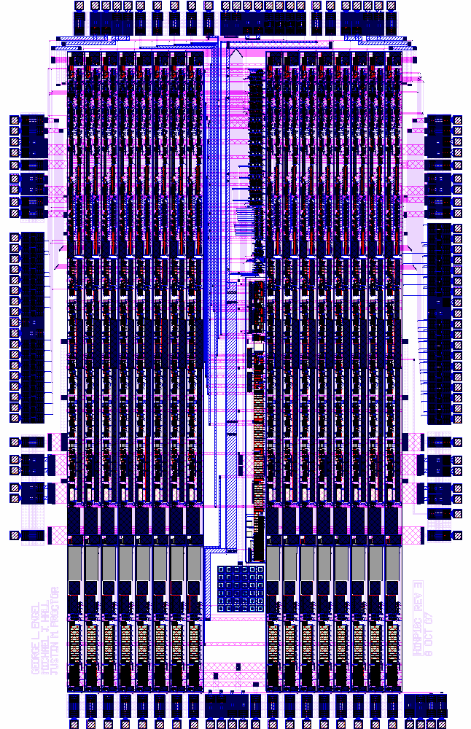
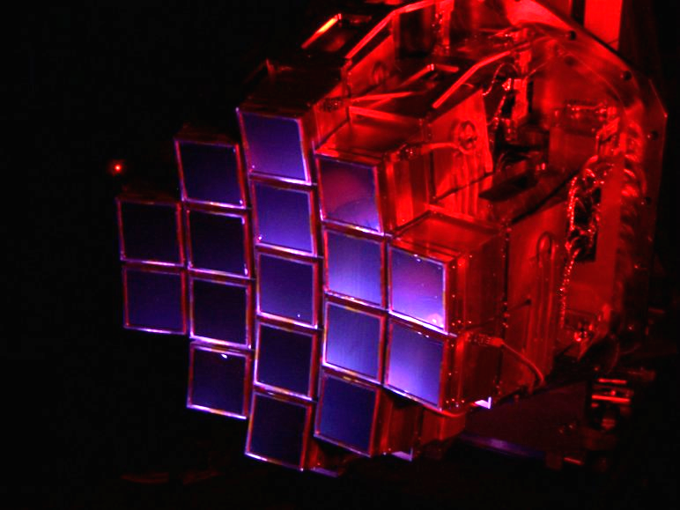
HiRA (High-Resolution Array) Detector Array at MSU
A series of HINP16C ICs currently services the array.
HINP16C-Rev 3 layout. The biasing and circuits used for configuring the IC as well as for readout are located in the center (“common” channel) of the chip. Eight channels lie to the left of this “common” area, and eight channels lie to the right.
The IC is 4 mm x 6.4 mm. HINP16C is packaged in a 14 x 14 mm, 128 lead thin quad flat pack. The chip’s power consumption is about 800 mW

Slide 8
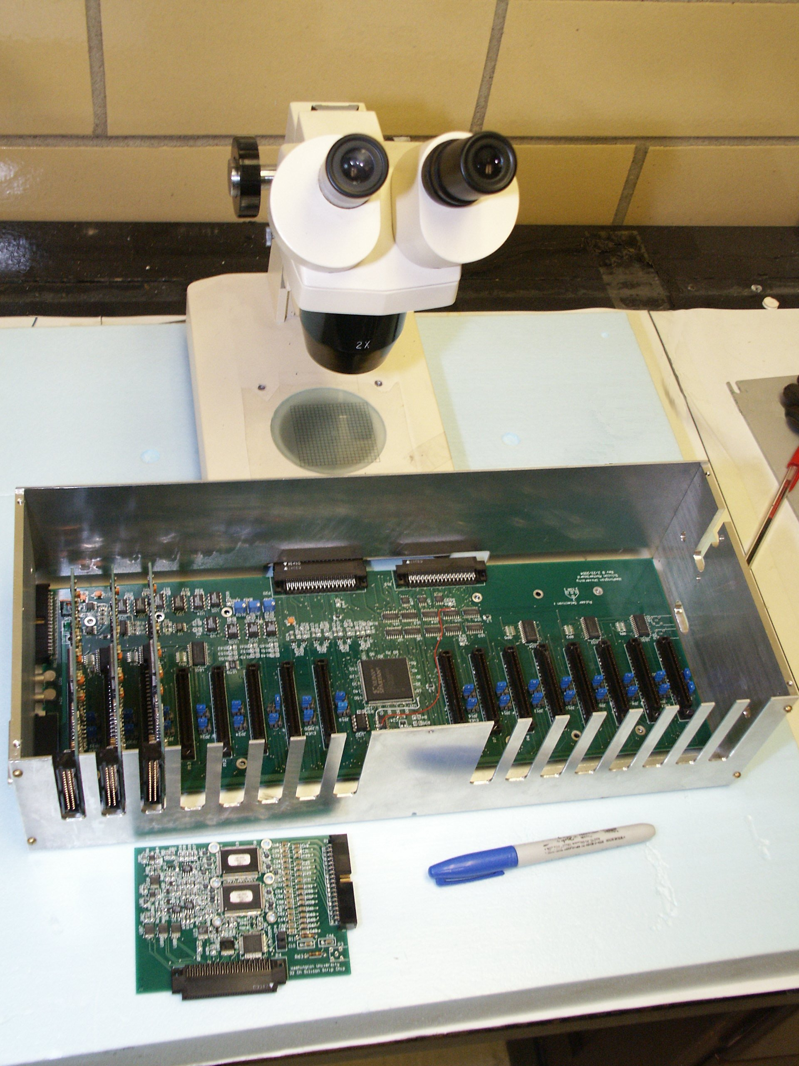
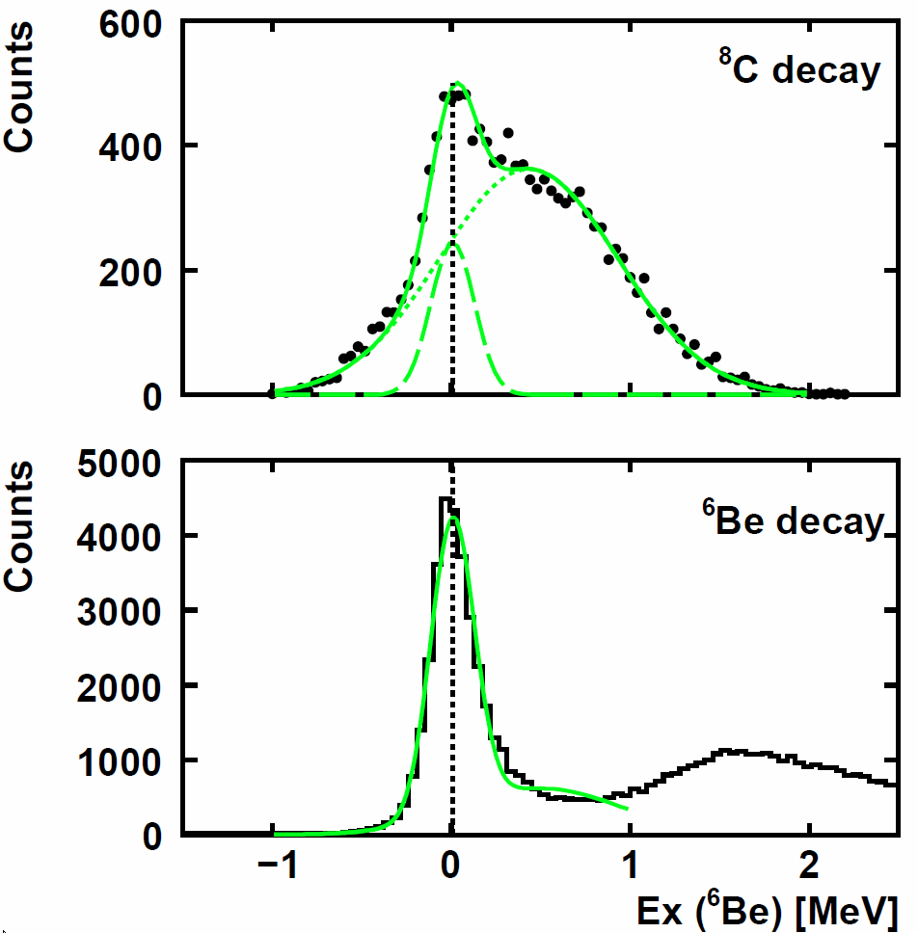
Results for the study of ⁶Be and ⁸C. The current version of the HINP16C chip was used for a 5-particle correlation study of the decay of ⁸C (into an alpha and 4 protons) .

Slide 9
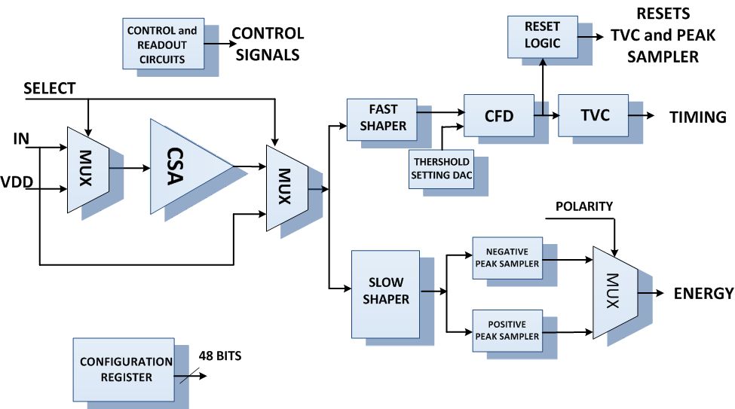
Tour of HINP16C
If event is not selected for read-out, the channel resets itself after user specified delay
Nowlin CFD.
Dynamic offset nulling
Can select one of two time constants: 250 ns, 620 ns
Two time ranges: 500 ns, 2µs
LOW (0.1 mV/fC) and HIGH gain mode (0.5 mV/fC)
6 bits
Step size of 30 keV
Full scale is 1 Mev
Selects between internal and external CSA
Peaking time: 1.2 µs
Return to baseline: < 20 µs
Searches for peak when CFD fires or can be forced to look for peak
Channel enables, chip ID, polarity, gain mode, TVC mode, etc.
Notes:
Here is the layout of an earlier IC that was developed in our lab by former graduate students and is currently being used in Physics experiments around the country. This IC was designed for a different class of experiments than the chip that we are in the process of designing now. On the right, is a detector array that was constructed at Michigan State University and currently uses the IC shown on the left. The chip that we are currently developing will also use a detector array like the one seen here. When a reaction takes place, the particles involved in the reaction will fire off in some direction, and strike the detector array. When the particle strikes a detector, it will create a pulse that is distinctive to its type.

Slide 10
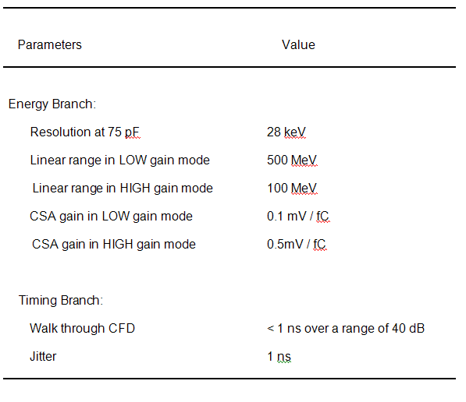
HINP16C Performance

Slide 11
HINP16C Integrated Circuit
The first generation HINP16C chip is fully described in
G.L. Engel, M. Sadasivam, M. Nethi, J.M. Elson, L.G. Sobotka, R.J. Charity (2007) A Multi-Channel Integrated Circuit for Use in Low- and Intermediate-Energy Nuclear Physics - HINP16C, Nucl. Instru. Meth. A, 573, 418-426
Notes:
Here is the layout of an earlier IC that was developed in our lab by former graduate students and is currently being used in Physics experiments around the country. This IC was designed for a different class of experiments than the chip that we are in the process of designing now. On the right, is a detector array that was constructed at Michigan State University and currently uses the IC shown on the left. The chip that we are currently developing will also use a detector array like the one seen here. When a reaction takes place, the particles involved in the reaction will fire off in some direction, and strike the detector array. When the particle strikes a detector, it will create a pulse that is distinctive to its type.

Slide 12
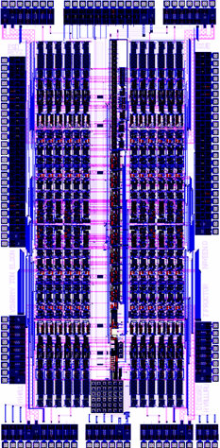
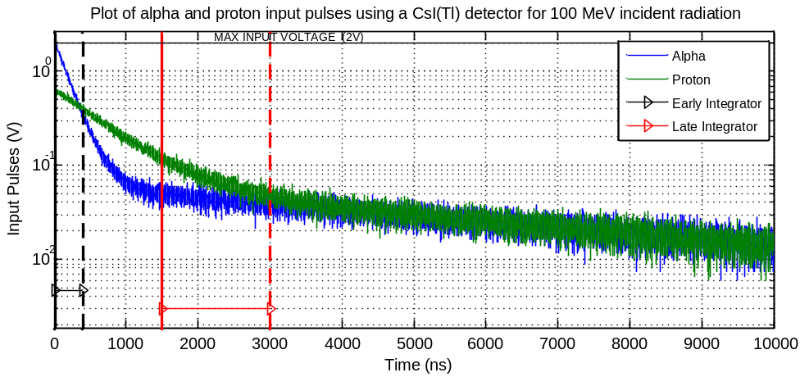
PSD8C Chip
Pulse Shape Discrimination using gated integrators.
Each PSD8C channel contains 3 gated integrators.
Layout of PSD8C (Rev. 2.0). IC is 2.8 mm x 5.7 mm. PSD8C is packaged in a 14 x 14 mm, 128 lead thin quad flat pack. Power consumption is 65 mW in low-bias mode.

Slide 13
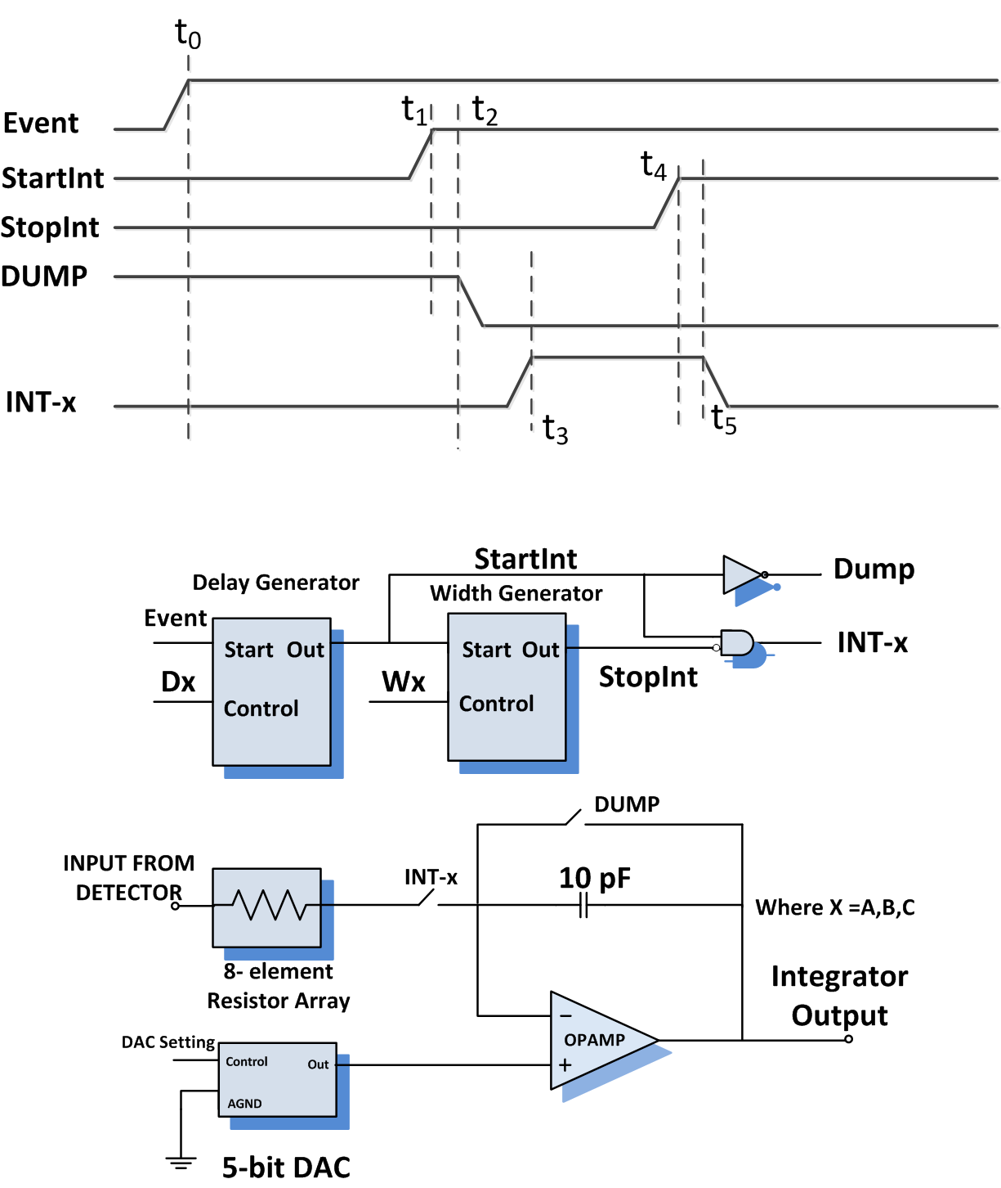
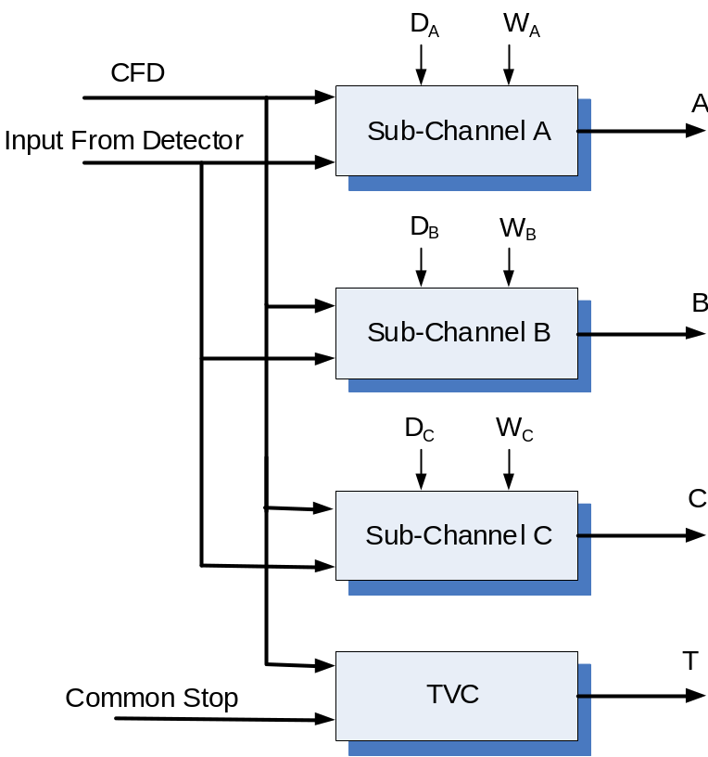
20 ns – 70 ns
50 ns – 300 ns
200 ns – 1.5 µs
1 µs – 10 µs
500 Ω – 100 kΩ (1-2-5 sequence)
+/- 25 mV
PSD8C Channel
PSD8C Sub-Channel

Slide 14
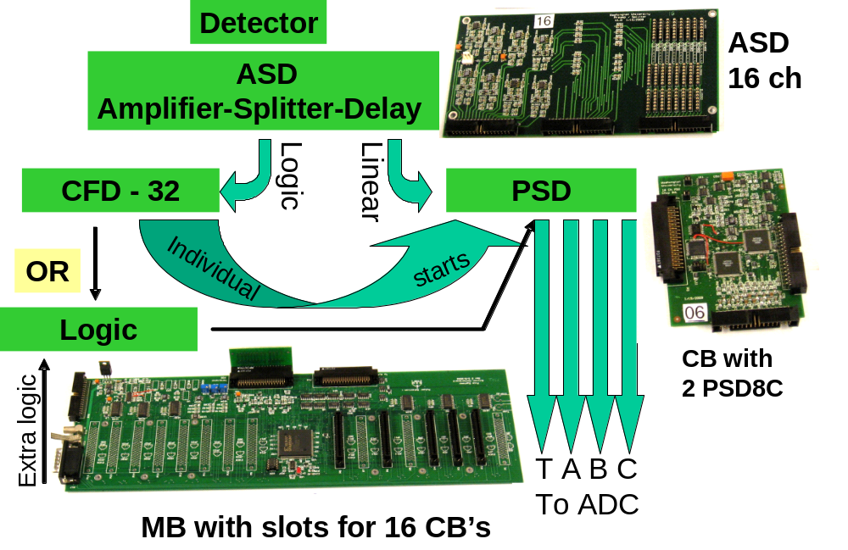
Pulse Shape Discrimination (PSD) System

Slide 15
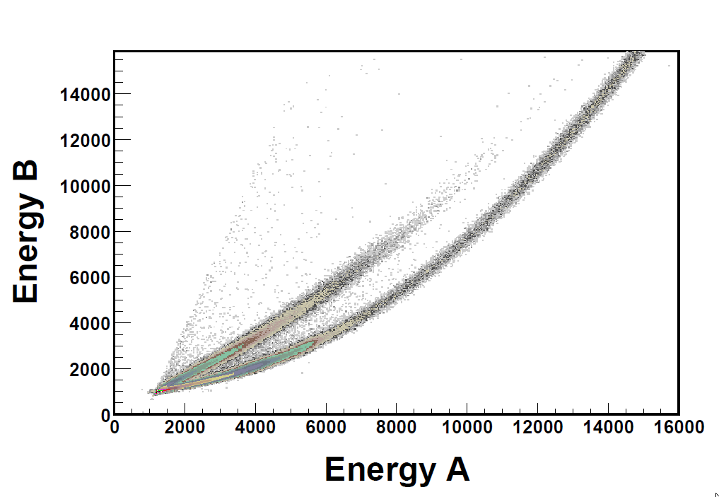
Neutron – Gamma Ray Discrimination
PSD map taken with a BC501A liquid scintillator detector. The abscissa captures the integral with a prompt gate of 400 ns duration, while the ordinate is integral resulting from an equal length gate starting approximately 100 ns after the start of the prompt gate. The bottom locus corresponds to gamma rays while the top to neutrons. For an energy reference, the Compton edge of ¹³⁷Cs has an abscissa channel value of 2850.
Notes:
Here is the layout of an earlier IC that was developed in our lab by former graduate students and is currently being used in Physics experiments around the country. This IC was designed for a different class of experiments than the chip that we are in the process of designing now. On the right, is a detector array that was constructed at Michigan State University and currently uses the IC shown on the left. The chip that we are currently developing will also use a detector array like the one seen here. When a reaction takes place, the particles involved in the reaction will fire off in some direction, and strike the detector array. When the particle strikes a detector, it will create a pulse that is distinctive to its type.

Slide 16
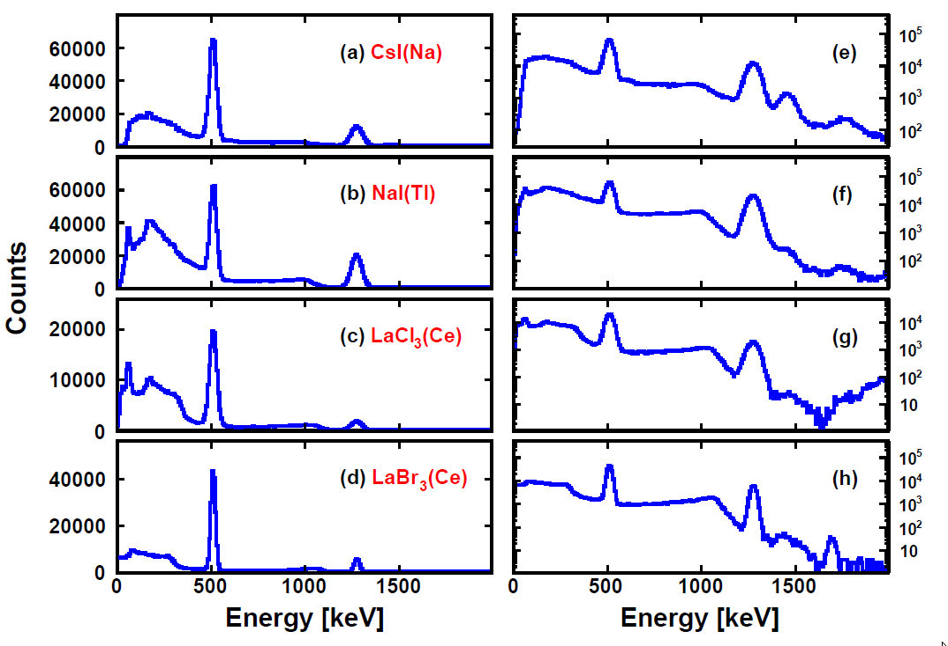
Energy Spectra Using PSD8C
From top to bottom the spectra are from a) CsI(Na) (3”x3”x4”), b) NaI(Tl) (2” diameter x 3”), c) LaCl₃(Ce) (1”dia. x 1”), and d) LaBr₃(Ce) (1” dia. x 1”). Spectra are shown with both linear and logarithmic ordinates. The trigger rate for these data was approximately 1kHz and the gate widths were approximately: a) 600 ns, b) 2000 ns, c) 300 ns , and d) 125 ns. In some cases external (i.e. ⁴⁰K) and internal (likely α-emitters) background features as well as the sum peak are observed.
Notes:
Here is the layout of an earlier IC that was developed in our lab by former graduate students and is currently being used in Physics experiments around the country. This IC was designed for a different class of experiments than the chip that we are in the process of designing now. On the right, is a detector array that was constructed at Michigan State University and currently uses the IC shown on the left. The chip that we are currently developing will also use a detector array like the one seen here. When a reaction takes place, the particles involved in the reaction will fire off in some direction, and strike the detector array. When the particle strikes a detector, it will create a pulse that is distinctive to its type.

Slide 17
PSD8C Integrated Circuit
The PSD8C chip is fully described in
G.L. Engel, M.J. Hall, J.M. Proctor, J.M. Elson, L.G. Sobotka, R. Shane, R.J. Charity (2009) Design and Performance of a Multi-Channel, Multi-Sampling, PSD-Enabling Integrated Circuit, Nucl. Instru. Meth. A, 612, 161-170

Slide 18
Who is using the ICs?
Nuclear Physics groups at
Washington University (WU),
Michigan State University (MSU),
Indiana University (IU),
Texas A&M University (TAMU),
Oak Ridge National Laboratory (ORNL),
Louisiana State University (LSU), and
Florida State University (FSU)
are either using HINP16C or will be doing so by summer of 2010.
A group at Los Alamos National Laboratories (LANL) is helping us evaluate PSD8C performance.
Notes:
Here is the layout of an earlier IC that was developed in our lab by former graduate students and is currently being used in Physics experiments around the country. This IC was designed for a different class of experiments than the chip that we are in the process of designing now. On the right, is a detector array that was constructed at Michigan State University and currently uses the IC shown on the left. The chip that we are currently developing will also use a detector array like the one seen here. When a reaction takes place, the particles involved in the reaction will fire off in some direction, and strike the detector array. When the particle strikes a detector, it will create a pulse that is distinctive to its type.

Slide 19
Conclusions
Since 2001, our university-based group has been working on a “toolbox” of IC circuits useful for researchers working with radioactive ion beams.
The circuits which we have designed can be composed in different ways to meet the researchers’ evolving needs and desires
To date, the group has produced two micro-chips: one analog shaped and peak sensing (HINP16C) while the other multi-sampling and PSD-enabling (PSD8C).

Slide 20
Acknowledgements
Early work on HINP16C was supported in part by an NSF MRI grant to build the High Resolution Si Array (HiRA) and the U.S. Department of Energy under Grant No. DE-FG02-87ER-40316.
The support for the PSD8C chip development was from NSF Grant #06118996 while the implementation support came from the U. S. Department of Energy, Division of Nuclear Physics under grant # DOE-FG02-87ER-40316.
Currently, work on PSD8C is sponsored by a grant from LANL. For the latter we are indebted to Dr. Mark Wallace.

Slide 21
Questions
???

