Slide 1
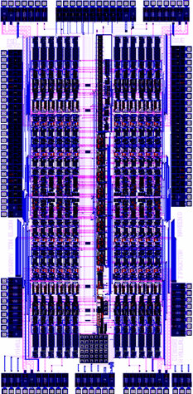
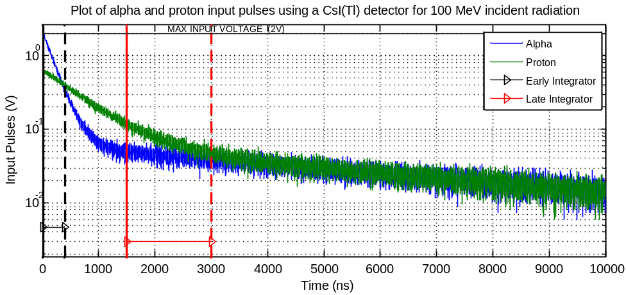
PSD8C Chip
Pulse Shape Discrimination using gated integrators.
Each PSD8C channel contains 3 gated integrators.
Layout of PSD8C (Rev. 2.0). IC is 2.8 mm x 5.7 mm. PSD8C is packaged in a 14 x 14 mm, 128 lead thin quad flat pack. Power consumption is 65 mW in low-bias mode.

Slide 2
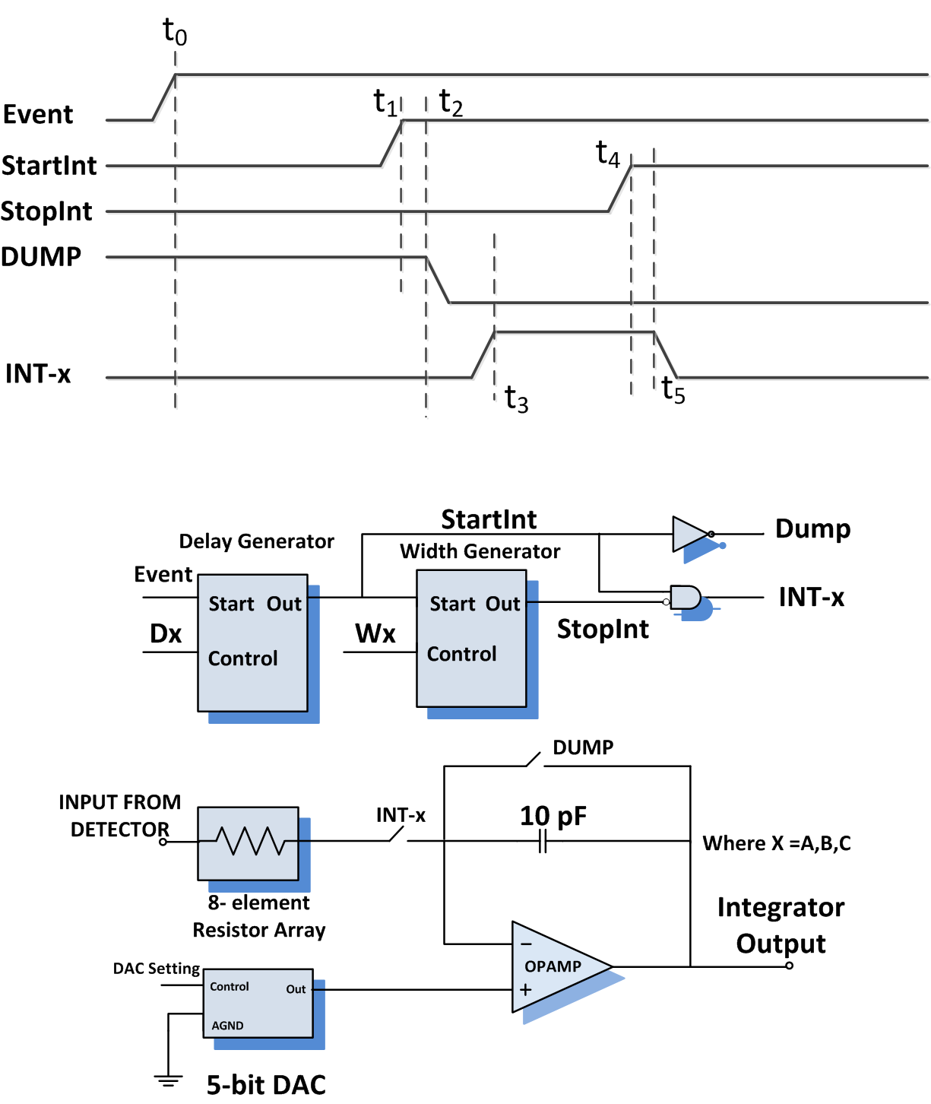
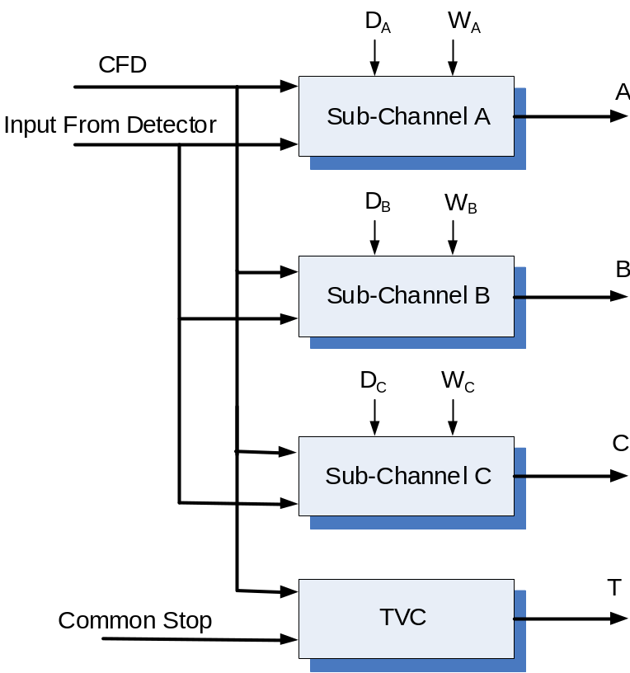
PSD8C Channel
PSD8C Sub-Channel

Slide 3
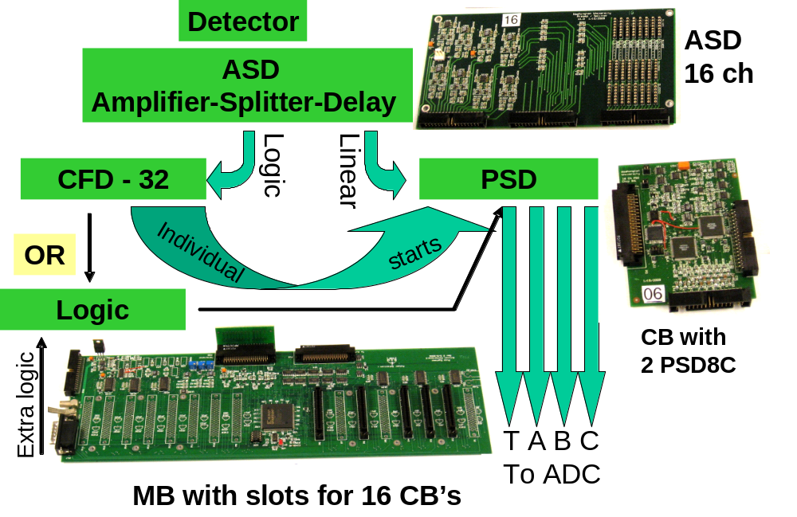
Pulse Shape Discrimination (PSD) System

Slide 4
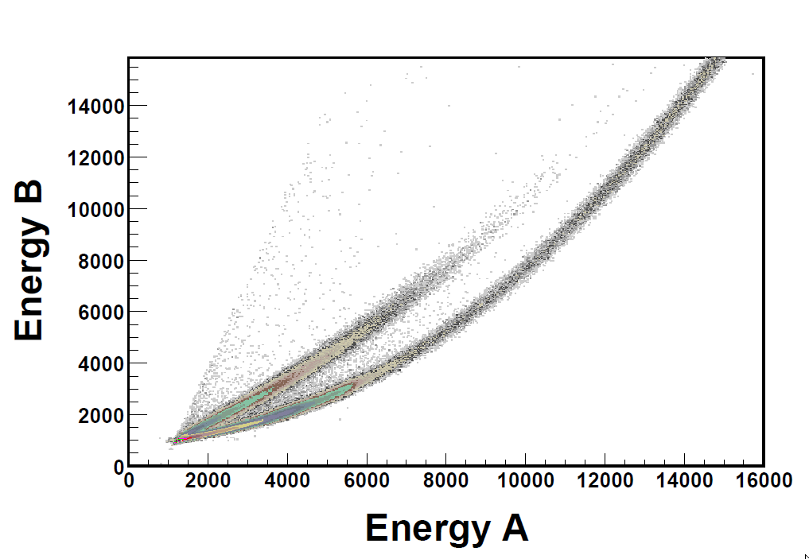
Neutron – Gamma Ray Discrimination
PSD map taken with a BC501A liquid scintillator detector. The abscissa captures the integral with a prompt gate of 400 ns duration, while the ordinate is integral resulting from an equal length gate starting approximately 100 ns after the start of the prompt gate. The bottom locus corresponds to gamma rays while the top to neutrons. For an energy reference, the Compton edge of ¹³⁷Cs has an abscissa channel value of 2850.
Notes:
Here is the layout of an earlier IC that was developed in our lab by former graduate students and is currently being used in Physics experiments around the country. This IC was designed for a different class of experiments than the chip that we are in the process of designing now. On the right, is a detector array that was constructed at Michigan State University and currently uses the IC shown on the left. The chip that we are currently developing will also use a detector array like the one seen here. When a reaction takes place, the particles involved in the reaction will fire off in some direction, and strike the detector array. When the particle strikes a detector, it will create a pulse that is distinctive to its type.

Slide 5
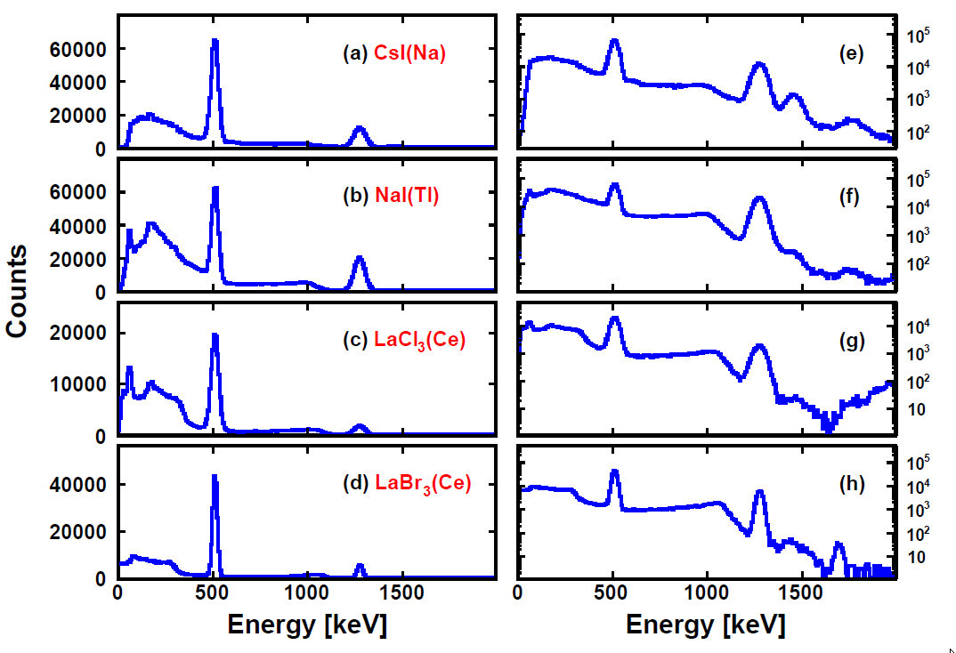
Energy Spectra Using PSD8C
From top to bottom the spectra are from a) CsI(Na) (3”x3”x4”), b) NaI(Tl) (2” diameter x 3”), c) LaCl₃(Ce) (1”dia. x 1”), and d) LaBr₃(Ce) (1” dia. x 1”). Spectra are shown with both linear and logarithmic ordinates. The trigger rate for these data was approximately 1kHz and the gate widths were approximately: a) 600 ns, b) 2000 ns, c) 300 ns , and d) 125 ns. In some cases external (i.e. ⁴⁰K) and internal (likely α-emitters) background features as well as the sum peak are observed.
Notes:
Here is the layout of an earlier IC that was developed in our lab by former graduate students and is currently being used in Physics experiments around the country. This IC was designed for a different class of experiments than the chip that we are in the process of designing now. On the right, is a detector array that was constructed at Michigan State University and currently uses the IC shown on the left. The chip that we are currently developing will also use a detector array like the one seen here. When a reaction takes place, the particles involved in the reaction will fire off in some direction, and strike the detector array. When the particle strikes a detector, it will create a pulse that is distinctive to its type.

