Slide 1
A 16 Channel Programmable
Constant Fraction Discriminator IC
Progress Report
June 15, 2018
Bryan Orabutt, MSEE Candidate
Dr. George Engel, ECE Professor

Slide 2
Outline
Features
Specifications and Performance Targets
Process
Layout to Date
Pinout and Configuration Registers
Common Channel
Signal Channel
Summary

Slide 3
Features
Sixteen CFD (Constant Fraction Discriminator) channels.
Supports signals of both polarities (relative to AGND)
Will accommodate input pulses with 10 – 90 % risetimes from 2 ns to 100 ns.
Leading edge discriminator in each channel has 4-bit programmable threshold
Digital one-shot outputs can be one of 4 (2-bit) programmable widths (50ns, 100 ns, 200ns, 500ns) along with a 5-bit programmable lockout time (100 ns to 3.1 us) to avoid false triggers.
Digital OR and fast analog multiplicity output.

Slide 4
Design Specifications
Low walk and jitter for input amplitudes from 15 mV to 1.5 V. Performance targets provided on following slide.
Must work correctly with pulse repetition rates up to 1 kHz
Must operate from a single 3.3 – 3.6 Volt supply.
Should include on-chip 3-bit programmable analog signal ground generator (1.65 V +/- 250 mV). Step size approx. 60 mV.
Power consumption not to exceed 250 mW.
Should be packaged in a 64 pin QFP plastic package.

Slide 5
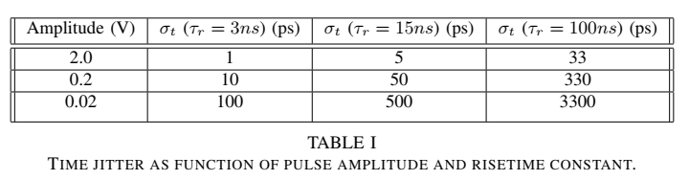
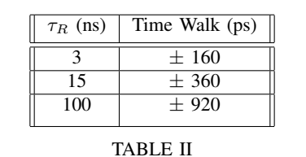
Performance Targets
Changes to 15 mv to 1.5 V
Changed to 1.5 ns to 50 ns

Slide 6
IC Process
Austrian Fab House AMS-AG
0.35 micron feature size, 4 metal layers, NWELL
Double poly capacitors
High resistance poly 2 layer (1200 Ohms per square)
Available through MOSIS ($2000 per square mm)
Approximately 4 runs per year
Excellent PDK (Process Design Kit) with digital and analog standard cell libraries
Supports Cadence IC6 tools including Cadence Auto Place and Route and the Silicon Encounter tools.
Models for Monte Carlo simulations provided.

Slide 7
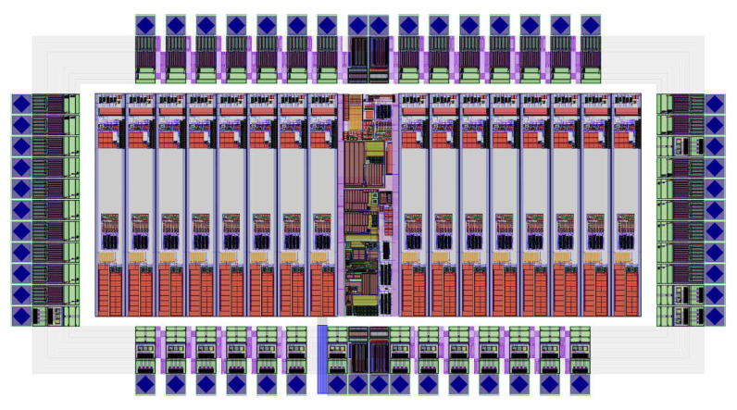
UNDER CONSTRUCTION!!!!
1.9 X 3.5 mm = 6.6 mm²
Cost of $13,200 (24?) PLUS PACKAGING

Slide 8
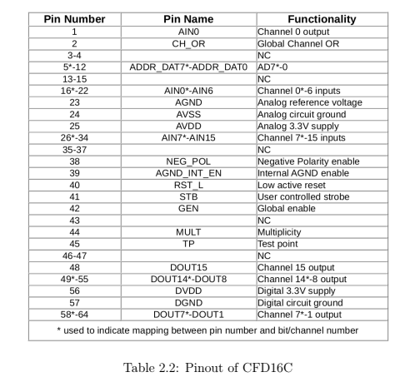
Pinout

Slide 9
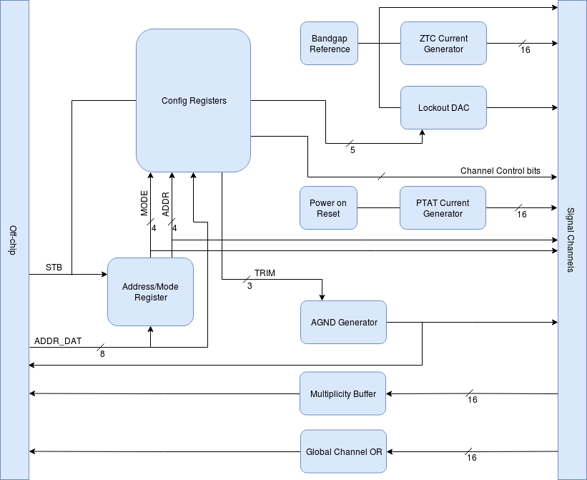
Common Channel
10 uF ext. cap
on AGND pin

Slide 10
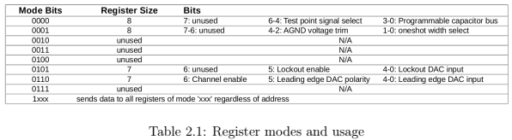
Configuration Registers

Slide 11
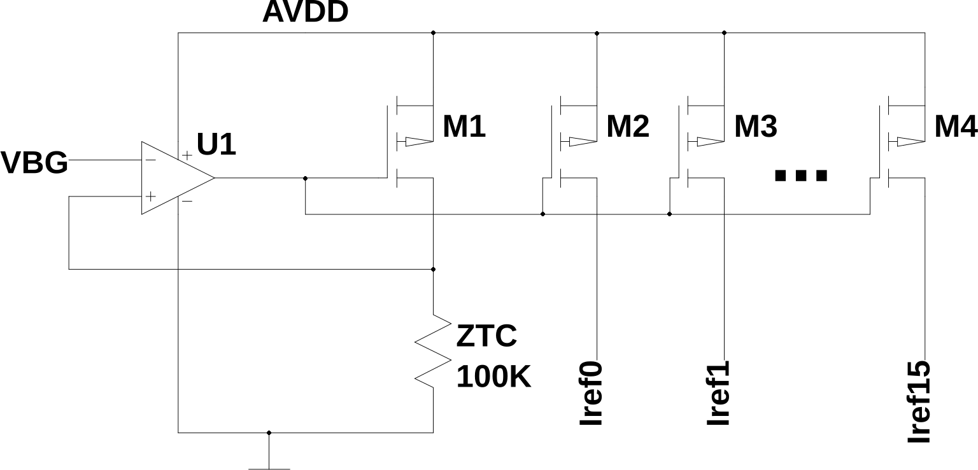
ZTC
12 uA temperature independent current used by the DACs and by the one-shot.

Slide 12
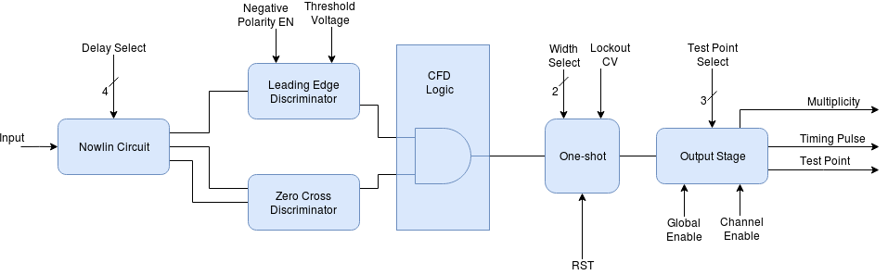
Channel
Planning on adding one more bit.

Slide 13
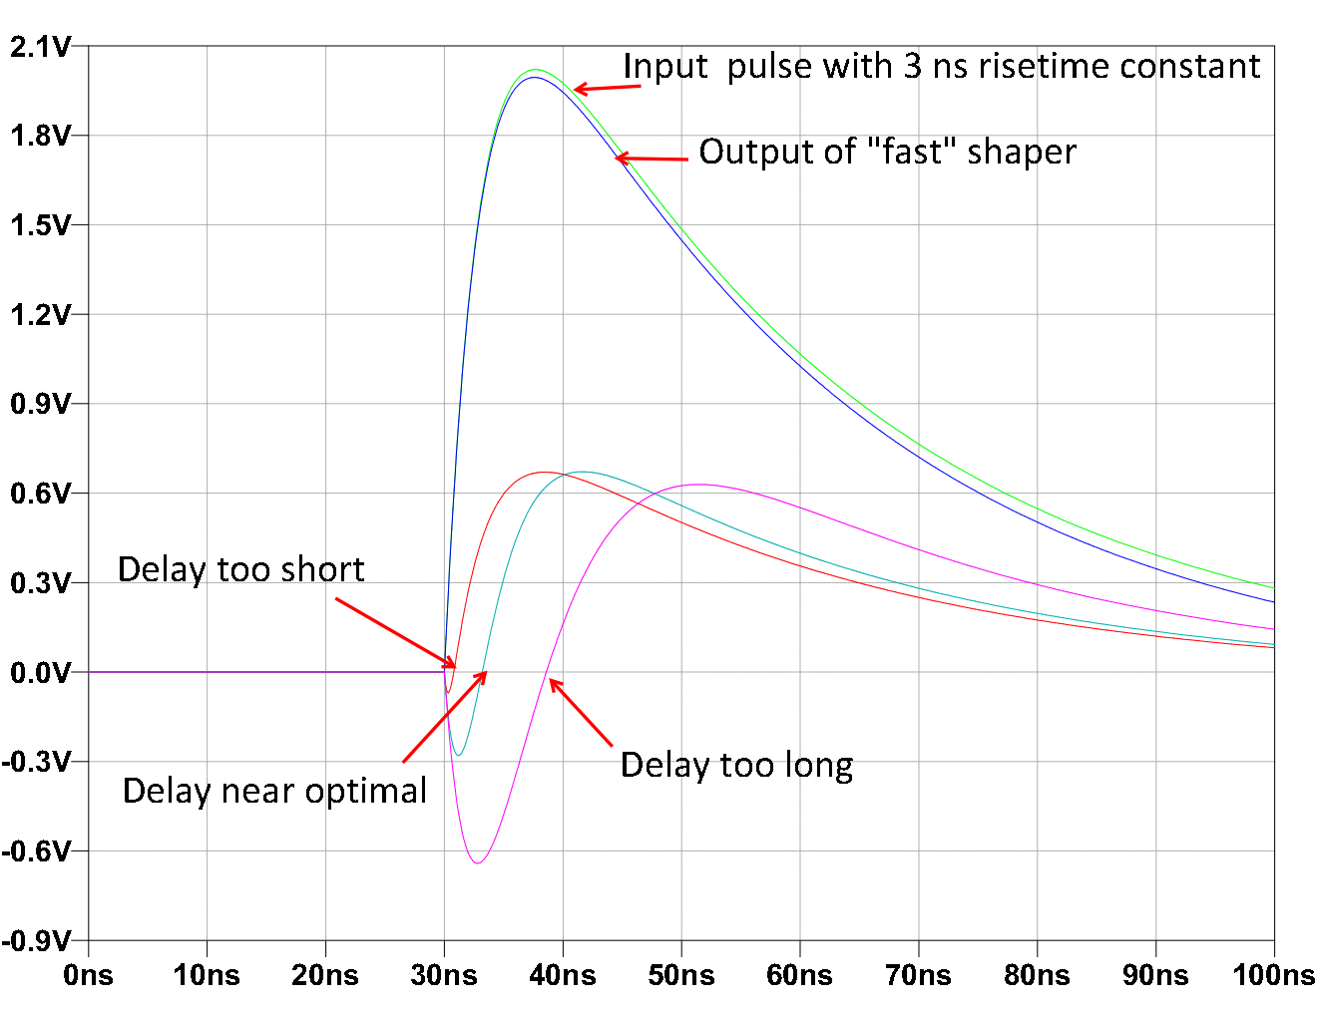
Nowlin
Nowlin delay time constant should be about same value as the the risetime constant.

Slide 14
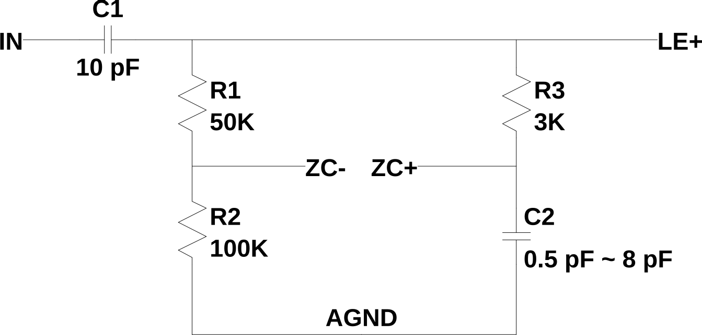
Nowlin Circuit
Current Nowlin circuit but there it has PROBLEMS!
The ZC circuit looks like 5 KW for noise purposes.

Slide 15
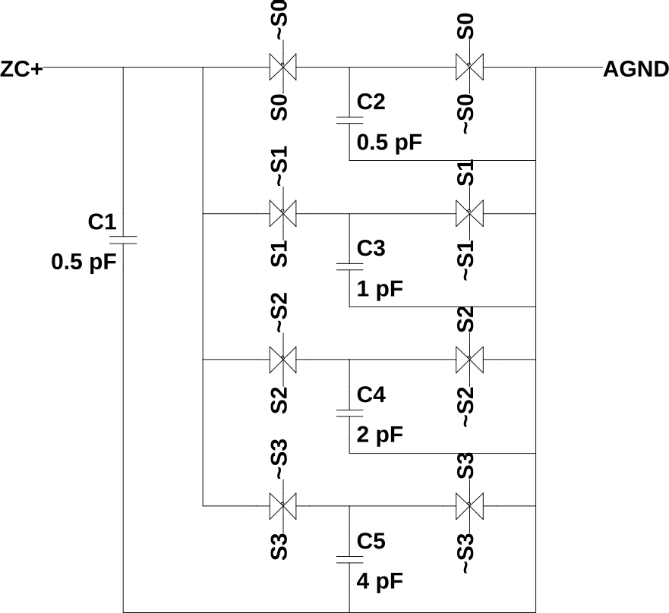
PCA

Slide 16
UNDER CONSTRUCTION!!!!
1.9 X 3.5 mm = 6.6 mm²
Cost of $13,200 (24?) PLUS PACKAGING

Slide 17
Revised Nowlin Circuit
Current Nowlin circuit but there it has PROBLEMS!
The ZC circuit looks like 5 KW for noise purposes.
Increase C1 to 20 pF
Change to 1K but
Also have a 6K option.
Have a {2K, 4K} option.
Jitter for 3 ns risetime constant will then be about 150 ps (1 sigma) for 15 mV input.

Slide 18
Time Constants
0.5ns, 1ns, 1.5ns, … 8 ns
OR
3ns, 6ns, 9ns, … 48 ns

Slide 19
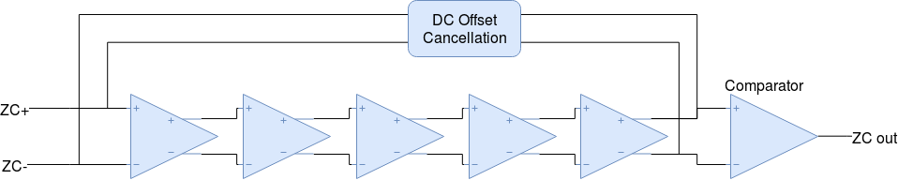
Zero-Cross Detector

Slide 20
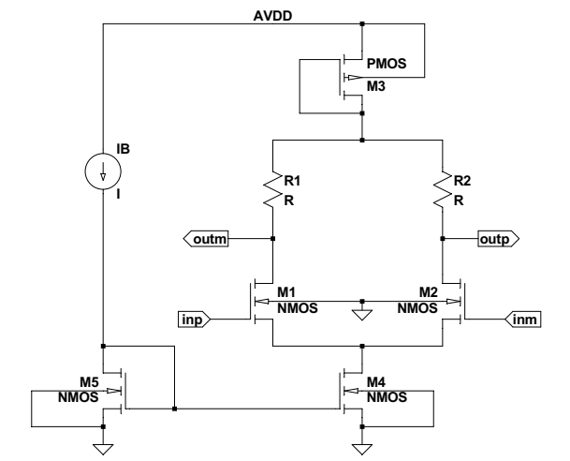
Zero-Cross Detector Amplifier
46 uA

Slide 21
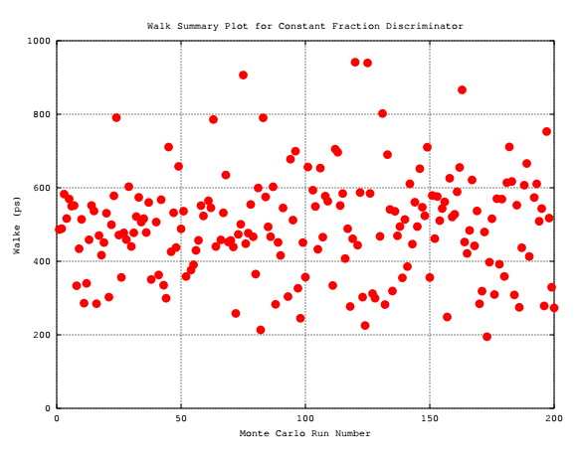
Walk Performance Summary

Slide 22
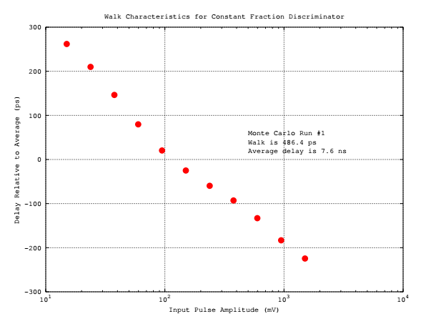
Typical Walk

Slide 23
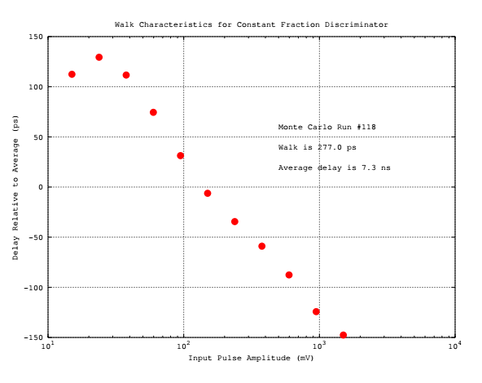
Low-Walk Case

Slide 24
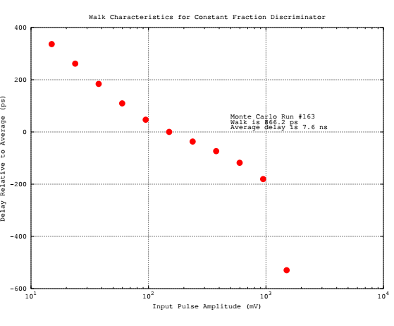
High-Walk Case

Slide 25
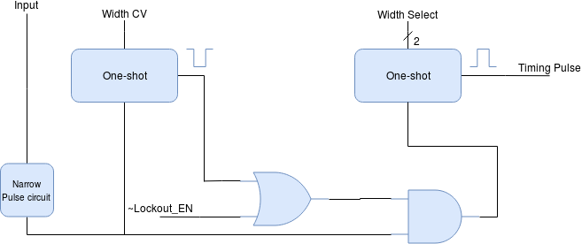
One-Shot
100 ns to 3.1 us in 100 ns steps (5-bits)
50ns, 100 ns, 200 ns, 500 ns (2 bits)

Slide 26
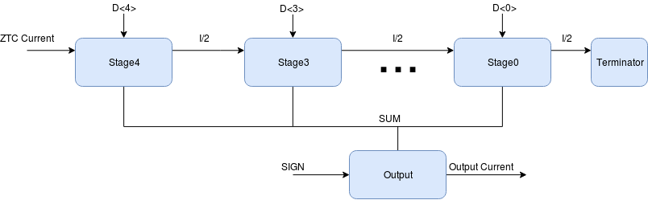
Current DAC

Slide 27
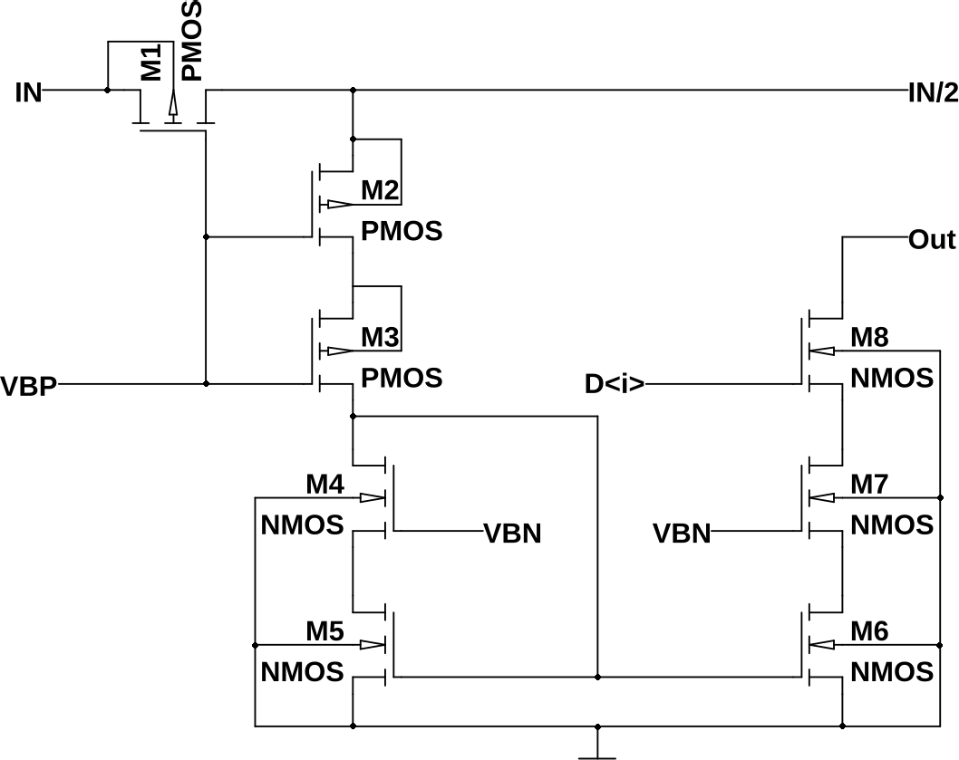
1 Bit of DAC

Slide 28
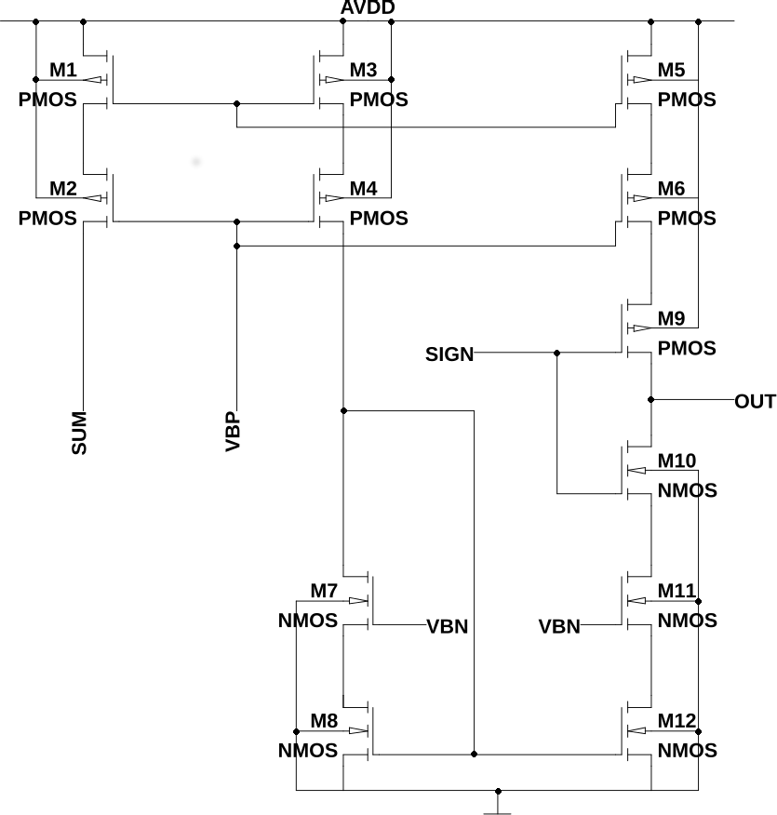
DAC Output Stage

Slide 29
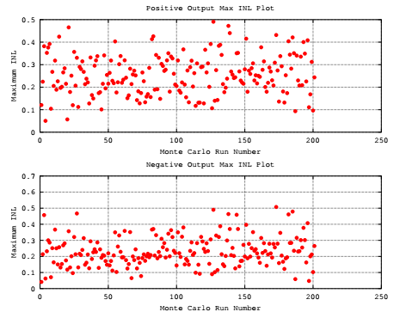
DAC INL

Slide 30
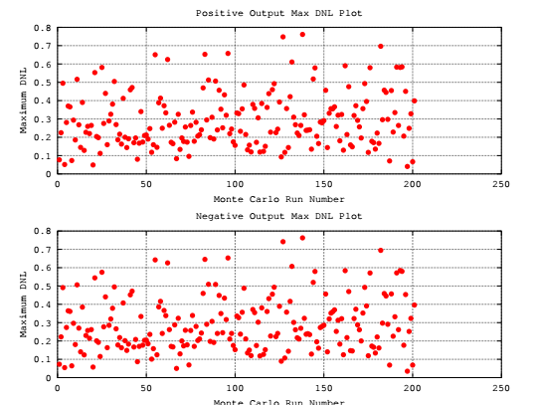
DAC DNL

Slide 31
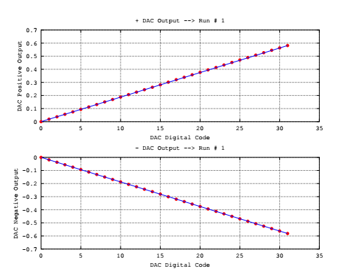
DAC With Low DNL

Slide 32
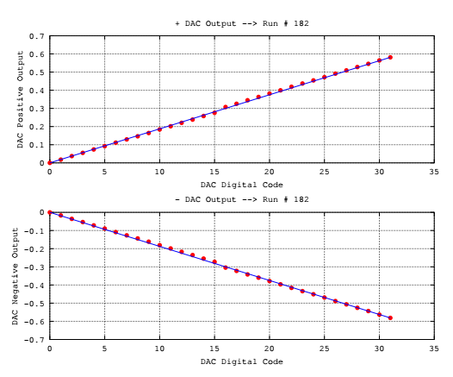
DAC with High DNL

Slide 33
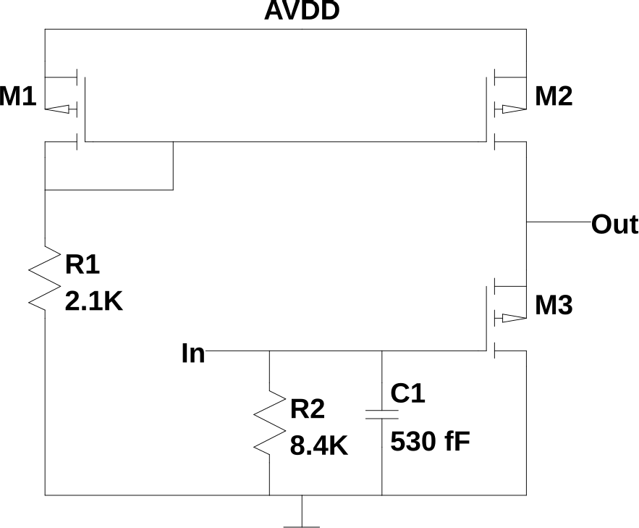
Mutliplicity Buffer
10-90 & risetime of 25 ns
with 10-20 pF load.
2 mA bias
Step size is 100 mV.
Compensation capacitor.

Slide 34
Summary
We plan to submit the chip in early November!
Much work still needs to be completed!

