Slide 1
Automatic Pet Feeder
Bryan Orabutt & Gan Xu

Slide 2

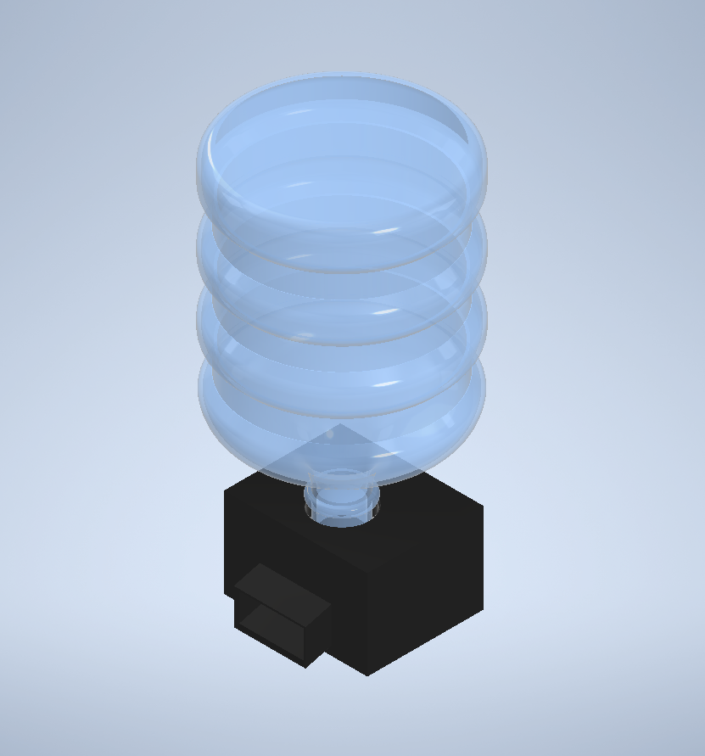

Concept
Pet feeder will automatically dispense food for pets.
Amount controlled by user
Time/number of feedings controlled by user
Amazon Echo/Alexa will allow easy control of device
Low power battery operated.

Slide 3
Embedded
For the device to be battery operated, a low quiescent current draw is needed.
ESP32 microcontroller is supported by FreeRTOS and offers deep sleep modes for reduced power consumption.
Motors and sensors need to be powered off when not in use.
If we cant get AWS working on ESP32 we will use Raspberry Pi and run off wall power supply

Slide 4
Machine Learning
Use camera to detect and match pets to their profile if there are multiple pets in the house, adjust the food amount for each pet.
Based on the food leftover measurement each time, can give user suggestions on food portions adjustments to fit individual pet’s needs.
Based on the pets body metrics and dieting amount, learning on pets behavior and automatically enable slow feeding to avoid digestive upset or detect atypical pattern and possibly related health issues.

Slide 5
Hardware & Equipment
IoT capable microcontroller
Espressif ESP32 using FreeRTOS
Raspberry Pi (backup plan)
Amazon Echo
Servo motors or stepper motors
Weight sensors
Camera
Multimeter, oscilloscope, and other test equipment.
3D printer for parts fabrication

Slide 6
Project Timeline
0%
Oct 13 - Dec 4
53 days
Machine learning
0%
Sep 22 - Dec 4
74 days
Analytics implementation
0%
Oct 13 - Nov 16
35 days
Alexa integration
0%
Sep 22 - Oct 5
14 days
AWS integration
0%
Sep 8 - Sep 21
14 days
Small scale prototyping
0%
Sep 8 - Oct 31
54 days
Mechanical design + fabrication
2019
Sep
Oct
Nov
Dec
2019
Today
Sep 12
Nov 21
Proposal
Demo 2
Oct 17
Dec 5
Demo 1
Final Demo
Both
Bryan
Gan

Slide 7
Questions?

