Slide 1
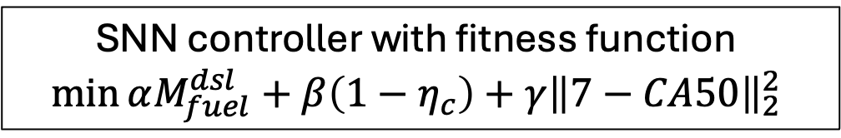
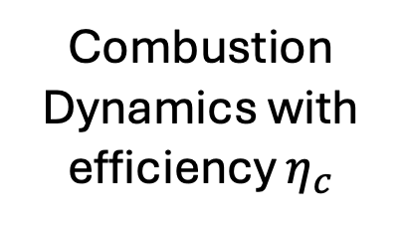
SNN controller with fitness function
$$\min{αM_{fuel}^{dsl}}+β\left(1−η_{c}\right)+γ{\left\|7−CA50\right\|}_{2}^{2}$$
+
+
Combustion
Dynamics with efficiency $η_{c}$
Combustion
Timing

