Slide 1
Dual fuel combustion model

Slide 2
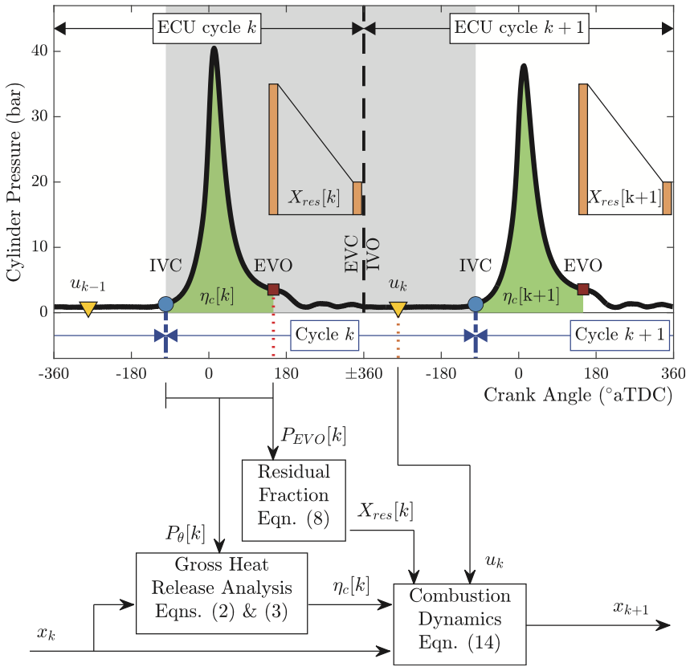
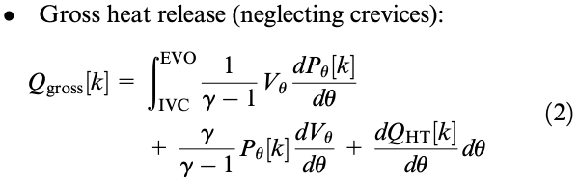

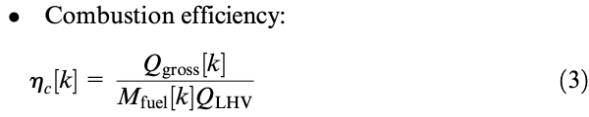




Previous engine model
Cylinder pressure during combustion
$$P_{θ}[k]$$
$$X_{res}[k]$$
$$Q_{gross}[k]$$
$$η_{c}[k]$$
Residual ammonia
Residual diesel
Residual air
PFI Ammonia
DI diesel
Fresh air
In cylinder mass

Slide 3
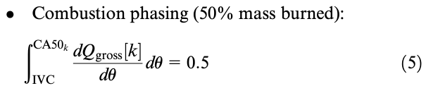
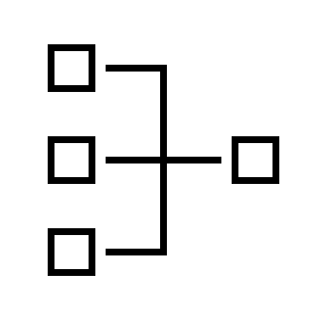

Previous engine model
Cylinder pressure during combustion
$$P_{θ}[k]$$
DI diesel timing
$$Q_{gross}[k]$$
$$CA50[k]$$
$$pdf\left(CA50\left[k+1\right]\right)=f(CA50\left[k\right],DI_{timing\left[k\right]},DI_{quanity}[k])$$
neural network

Slide 4
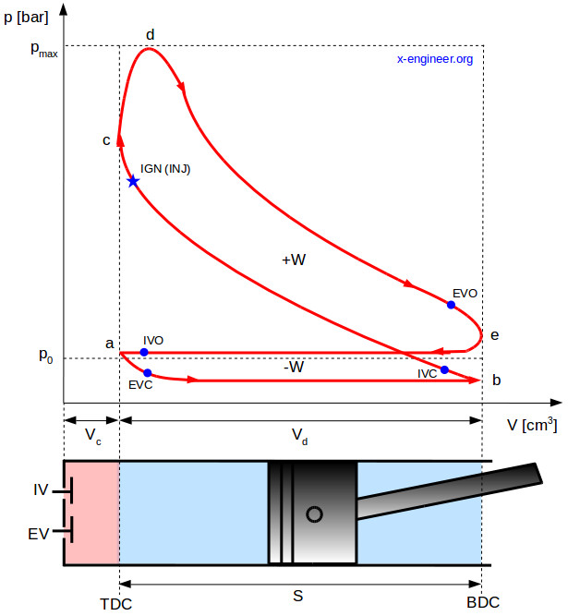
Graphical way of identifying valve timing
EVO: right before blowdown
IVC: right after compression starts

Slide 5
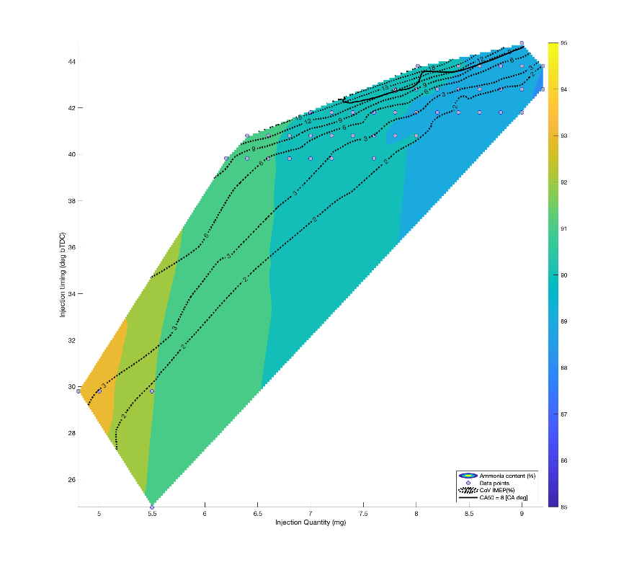
region of interest

