Slide 1
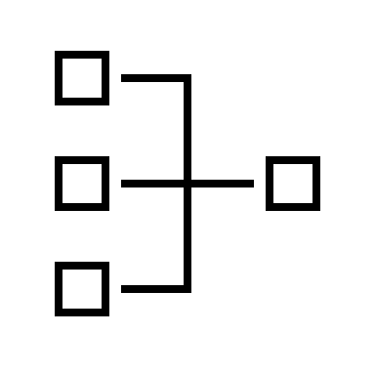
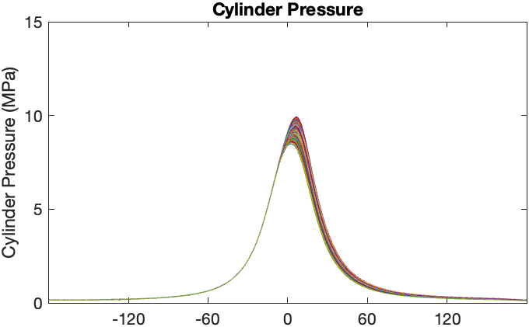
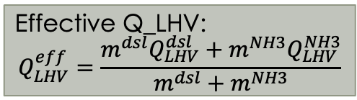
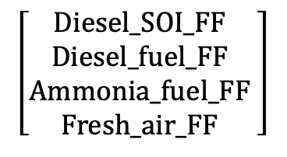
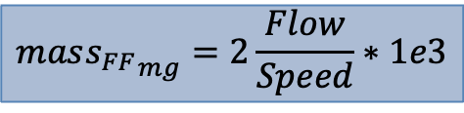
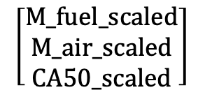
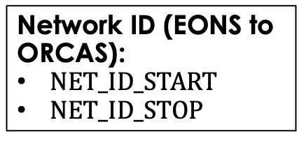
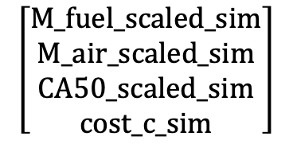

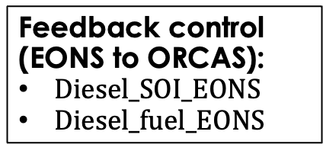
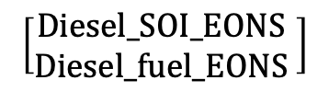
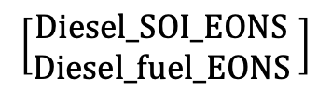
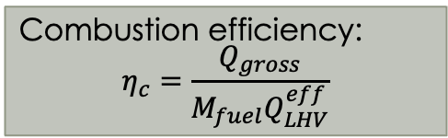
Oak Ridge Combustion Analysis System (ORCAS)
CAN comms
EONS in a BOX
Use measured engine state to calculate diesel fuel control through the SNN (Sim Scheduler?)
$$cost=α{\left(CA50−7.5\right)}^{2}+{\left(η_{c}−1\right)}^{2}$$
System states (ORCAS to EONS):
M_fuel_scaled
M_air_scaled
CA50_scaled
Combustion efficiency:
$$η_{c}=\frac{Q_{gross}}{M_{fuel}Q_{LHV}^{eff}}$$
$$\left[\begin{matrix}M_fuel_scaled \\ M_air_scaled \\ CA50_scaled\end{matrix}\right]$$
$$\left[\begin{matrix}Diesel_SOI_EONS \\ Diesel_fuel_EONS \end{matrix}\right]$$
Q_gross, X_res
Feedback control (EONS to ORCAS):
$Diesel_SOI_EONS$
$Diesel_fuel_EONS$
Use feedforward engine commands to run simulator and retrain SNNs (EONS?)
CA50
$$\left[\begin{matrix}Diesel_SOI_EONS \\ Diesel_fuel_EONS \end{matrix}\right]$$
Effective Q_LHV:
$$Q_{LHV}^{eff}=\frac{m^{dsl}Q_{LHV}^{dsl}+m^{NH3}Q_{LHV}^{NH3}}{m^{dsl}+m^{NH3}}$$
Nominal input values (ORCAS to EONS):
Diesel_SOI_FF
Diesel_fuel_FF
Ammonia_fuel_FF
Fresh_air_FF
$$\left[\begin{matrix}Diesel_SOI_FF \\ Diesel_fuel_FF \\ Ammonia_fuel_FF \\ Fresh_air_FF \end{matrix}\right]$$
Engine
Simulator
(Python)
$$\left[\begin{matrix}M_fuel_scaled_sim \\ M_air_scaled_sim \\ CA50_scaled_sim \\ cost_c_sim\end{matrix}\right]$$
$$mas{s_{FF}}_{mg}=2\frac{Flow}{Speed}∗1e3$$
Eng. Speed
Flow sensors
Cost function (ORCAS to EONS):
cost_c
Will the cost function be used in the sim modifier?
x6.72
SOI feedback:
Diesel_SOI_EONS
Network ID (EONS to ORCAS):
$NET_ID_START$
$NET_ID_STOP$
x2.26
Mass feedback:
Diesel_fuel_EONS

Slide 2
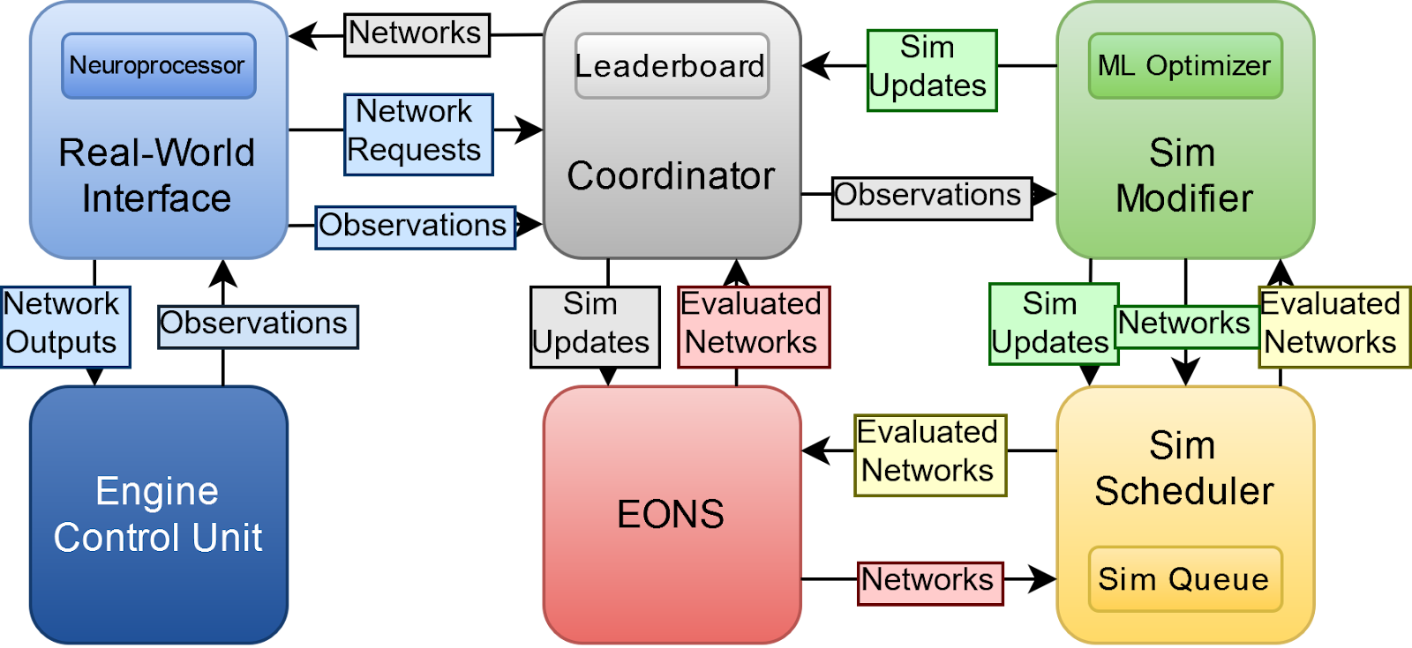
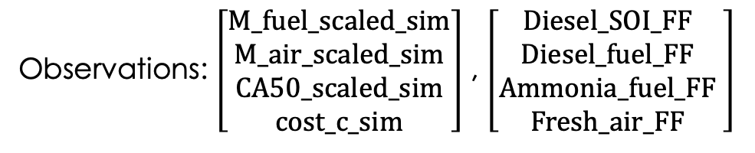

Observations: $\left[\begin{matrix}M_fuel_scaled_sim \\ M_air_scaled_sim \\ CA50_scaled_sim \\ cost_c_sim\end{matrix}\right]$ , $\left[\begin{matrix}Diesel_SOI_FF \\ Diesel_fuel_FF \\ Ammonia_fuel_FF \\ Fresh_air_FF \end{matrix}\right]$
Network output: $\left[\begin{matrix}Diesel_SOI_EONS \\ Diesel_fuel_EONS \end{matrix}\right]$

Slide 3
CAN frames
ID 1: STATE_1, 8 byte IEEE Float (ORCAS to EONS)
Bits 0-64: FUEL_MASS_SCALED
ID 2: STATE_2, 8 byte IEEE Float (ORCAS to EONS)
Bits 0-64: AIR_MASS_SCALED
ID 3: STATE_3, 8 byte IEEE Float (ORCAS to EONS)
Bits 0-64: CA50_SCALED
ID 4: COST_STAGE, 8 byte IEEE Float (ORCAS to EONS)
Bits 0-64: COST_C
ID 5: CONTROL, 8 byte IEEE Float (EONS to ORCAS)
Bits 0-31: DIESEL_SOI_EONS
Bits 32-64: DIESEL_FUEL_EONS
ID 6: NET_ID, 8 byte Unsigned Integer (EONS to ORCAS)
Bits 0-31: NET_ID_START
Bits 32-64: NET_ID_STOP
ID 7: FF_SOI, 8 byte IEEE Float (ORCAS to EONS)
Bits 0-64: DIESEL_SOI_FF
ID 8: FF_DIESEL, 8 byte IEEE Float (ORCAS to EONS)
Bits 0-64: DIESEL_FUEL_FF
ID 9: FF_AMMONIA, 8 byte IEEE Float (ORCAS to EONS)
Bits 0-64: AMMONIA_FUEL_FF
ID 10: FF_AIR, 8 byte IEEE Float (ORCAS to EONS)
Bits 0-64: FRESH_AIR_FF

