Slide 1

Modeling Robert Renzoni Vineyards Wine Quality
By Brittnay Blackmon and Bryan Pruneda

Slide 2
Analyzing Wine Properties
The BIG Four
pH, Sulfur Dioxide, Residual Sugar, and Acidity
Our Goal
Compare two models and their accuracy
Models are MLR and RF

Slide 3
Testing Wine Quality Linearly
Predicted Quality off of three key components
Correlation between pH and volatile Acidity
Correlation between Free Sulfur Dioxide and Citric Acid
In conjunction with Residual Sugar
Model Mean Absolute Error
MAE is 0.709

Slide 4
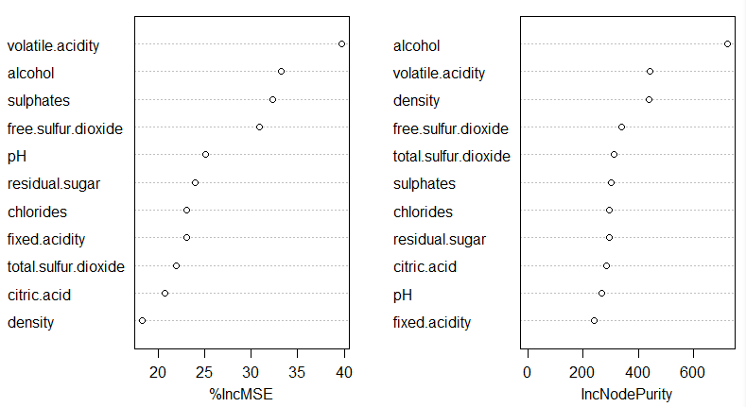
Predicting Wine Quality Randomly
Predicted Quality based on Random Grouping
Made into 100 different groups each creating predictions and checked
Every group having up to 5 randomized features
Identifying Feature Importance
Model Mean Absolute Error
MAE is 0.070

