Slide 1

Talent Management Review
DDSAnalytics
October, 21, 2024
Bryan Pruneda

Slide 2

Background
DDSAnalytics is an analytical talent company that aims to be on the forefront in its industry
Frito Lay wishes to leverage and predict employee turnover rate
We have been tasked with finding factors that lead to high levels of attrition

Slide 3

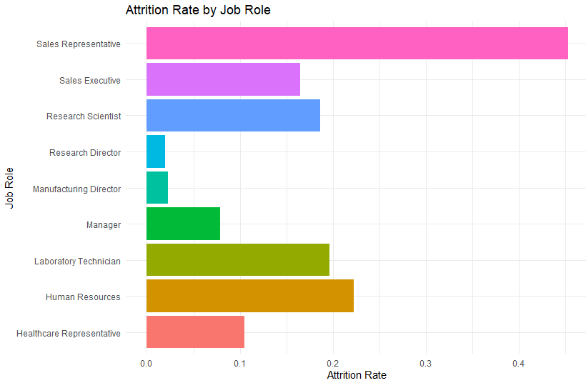
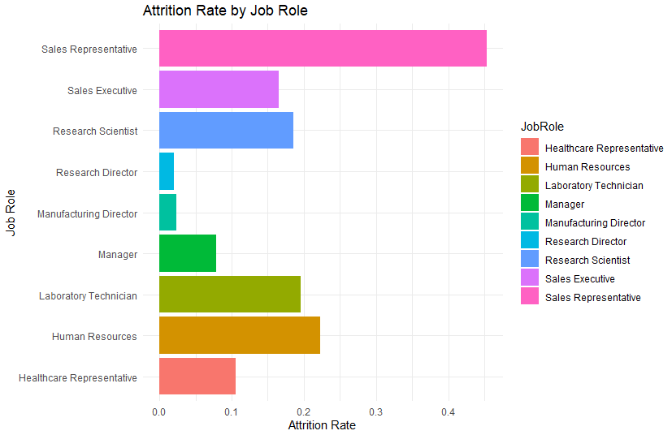
Assessment Data
Frito Lay Data
Quick Preview
Breaks down 870 Employees spread apart several sectors
Organized by 36 Categories and fully filled out
Includes multiple scaled categories such as environmental satisfaction

Slide 4
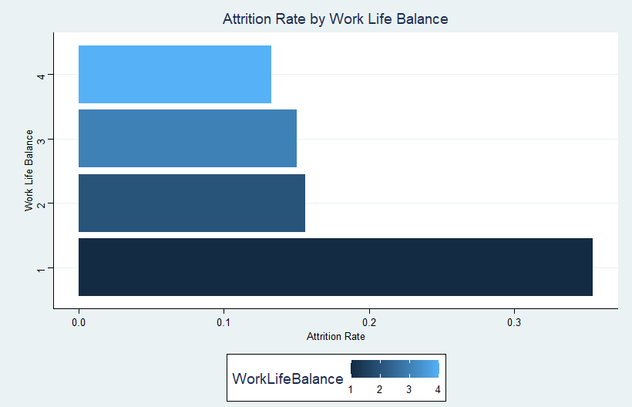
1st Factor
Work Life Balance
Poor separation of work and home life have double the attrition of those with great balance

Slide 5
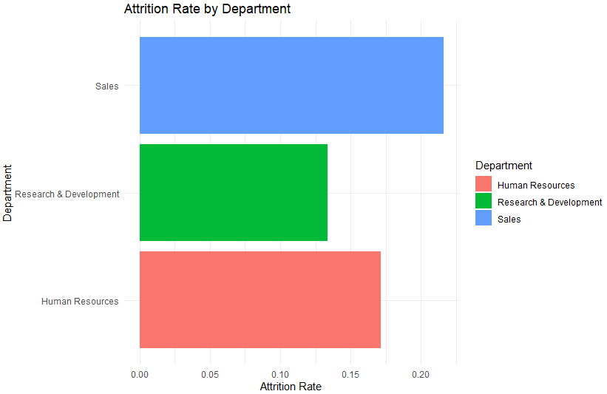
2nd Factor
“Eat what you Kill” departments have higher attrition then those with stable pay structures
Employee jobs that match their studies are more willing to stay at their role
The education of those who left the company broke down to 48% Life Sciences, 33% Medical, and 18% Marketing.

Slide 6
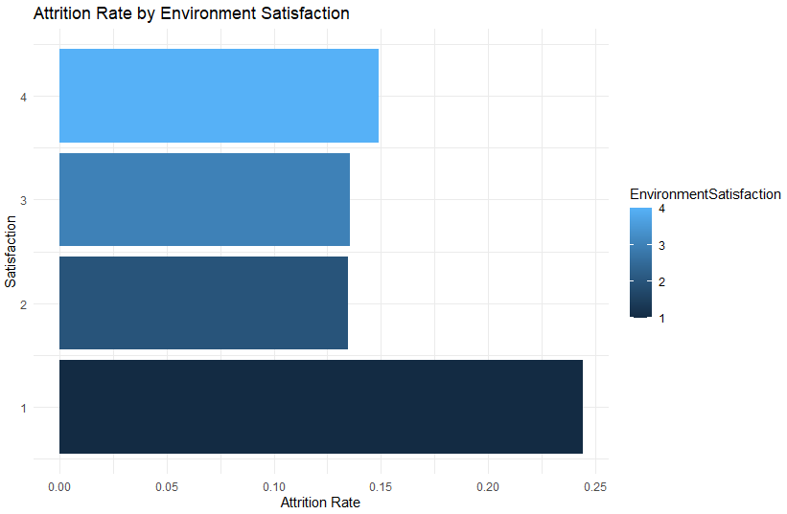
3rd Factor
Employees with frustrations regarding their work environment had 10% greater attrition than their counterparts

Slide 7
Candidate Predictability
A Naïve Bayes Attrition model consisting of JobRole, Department, and EnvironmentSatisfaction
A Naïve Bayes Attrition model consisting of JobRole, Department, and Work Life Balance
Sensitivity: 0.63 vs 0.60
Specificity: 0.61 vs 0.62
Accuracy: 0.63 vs 0.60
F1: 0.28 vs 0.11

Slide 8
Thank You
Bryan Pruneda
bpruneda@mail.smu.edu

