Slide 1


2022 Code on the Beach Azure Logic Apps Workshop
Bryan Soltis – Microsoft Cloud Solution Architect

Slide 2


Slide 3
Serverless in Azure
Azure Functions
Single executions
Durable functions
Azure Logic Apps
Workflows
Integrations
Platform as a Service (PaaS)
Web Apps
Mobile Apps
APIs
Software as a Service (SaaS)
Office365
Dynamics CRM
Databases
Azure SQL Database
Azure Cosmos DB
Anything where you don’t worry about/access the OS
https://aka.ms/2022COTBLogicApps

Slide 4
Azure Logic Apps
Low Code / No Code workflows
Rapid development
Integrate services/systems
Quickly configure complex workflows
Detailed reporting / logging
https://aka.ms/2022COTBLogicApps

Slide 5
Identifying a Workflow
Business process
Machine to Machine communication
Event processing
Manual workflows
Data manipulation/replication
Recurring actions
System integrations
B2B/B2C
Notifications
https://aka.ms/2022COTBLogicApps

Slide 6
Workflows
Recipes vs Blank Templates
Connect Functions, Logic Apps, CRM, Office
Automated executions
“Peek-lock receive a Service Bus Message and complete it”
“Process and Post a message when an FTP file is uploaded”
“Once a day, process Azure Storage files and send a summary”
“Watch Twitter for a hastag and translate it to Klingon”
https://aka.ms/2022COTBLogicApps

Slide 7













Sample Approach
API writes message to Service Bus
Logic App picks up Service Bus message
Logic App sends message to Function for processing
If processed, send a notification email with message details
?

Slide 9
Get the Labs!
https://aka.ms/2022COTBLogicApps
https://aka.ms/2022COTBLogicApps

Slide 10
#1: Basic HTTP Request
Level: Beginner
Audience: General
Easy to implement in any environment
Basic data handling
https://aka.ms/2022COTBLogicApps

Slide 11
#2: Convert Azure Blob Storage JSON to CSV
Level: Moderate
Audience: Developer / Data
Interaction with Azure Blob Storage
JSON data handling
https://aka.ms/2022COTBLogicApps

Slide 12
#3: Deploy a container on a schedule
Level: Moderate
Audience: Developer / Infrastructure
Requires deploying Azure Container Instance
Requires an Azure Container Registry (indluded in lab)
https://aka.ms/2022COTBLogicApps

Slide 13
#4: Call An Azure Function and Post to Slack
Level: Advanced
Audience: Developer
Interaction with Azure Functions
Requires building/deploying an Azure Function (demo source code provided in lab)
Data Manipulation
https://aka.ms/2022COTBLogicApps

Slide 14
#5: Automate GitHub Pull Reuqest Merging
Level: Moderate
Audience: General/Developer
Interaction with GitHub/Slack team
Requires GitHub project
Requires Slack team (demo team provided in lab)
https://aka.ms/2022COTBLogicApps

Slide 15
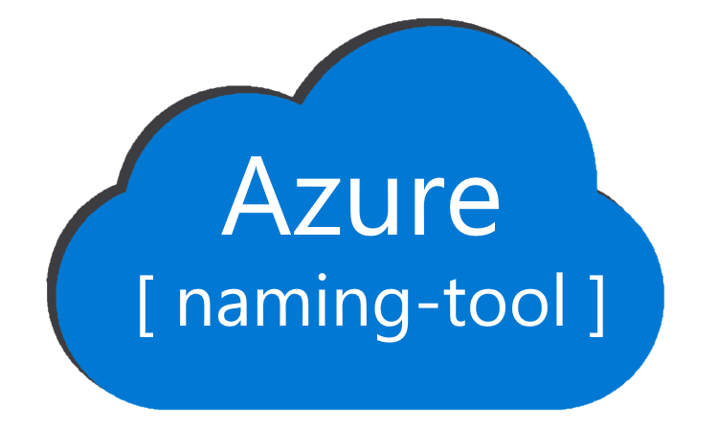
Shameless Plug
http://aka.ms/azurenamingtool

Slide 16


Slide 17
Bryan Soltis Microsoft Cloud Solution Architect
@bryan_soltis https://github.com/bryansoltis
http://soltisweb.com

