Slide 1
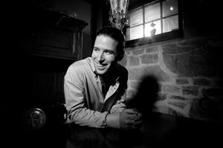
110+ Murdered: in Epstein Cover-up
Why / How they Alfredo Rodriguez:
Epstein's personal BUTLER who stole the 97-page "BLACK BOOK" — prosecutors called it "The Holy Grail."
The book contained 1,500+ names including Bill Clinton, Donald Trump, and Prince Andrew.
Rodriguez said he NEEDED the book as "LIFE INSURANCE" — he believed his life was in danger.
He got 18 MONTHS in prison for hiding it — the same sentence as Epstein himself.
His widow said: "He knew ALL about Prince Andrew." Dead at 60 from rare cancer. Secrets went to the grave.
Alfredo Rodriguez
Read List Here:
https://intelligencemurders.com/epstein
https://intelligencemurders.com/epstein
https://intelligencemurders.com/epstein
https://intelligencemurders.com/epstein
https://intelligencemurders.com/epstein
https://intelligencemurders.com/epstein
https://intelligencemurders.com/epstein
https://intelligencemurders.com/epstein
https://intelligencemurders.com/epstein
Dead at Age 60

Slide 2
- Virginia Giuffre — Top Epstein accuser. Posted "not suicidal." Died by gunshot
in Australia. Father says "somebody got to her." $20M+ missing from estate.
- Carolyn Andriano — Key Maxwell trial witness. Mother says she was drug-free.
Second Epstein victim to die in a Palm Beach hotel room.
- Mark Middleton — Clinton aide who arranged Epstein's White House access. Found
hanged and shot. Death records sealed by judge.
- Steve Bing — Major Clinton donor ($25M to Foundation). Named in Epstein files.
Fell from 27th floor. Trust named Clinton Foundation as sole beneficiary.
- Daniel Anderl — Federal judge's 20-year-old son. Shot at home 4 days after his
mother was assigned the Epstein-Deutsche Bank case. Gunman had intel ties.
- Jeffrey Epstein — Found hanged in jail. Guards asleep, cameras failed, brother
says murder.
- Leigh Skye Patrick — Lured to Epstein's mansion at 16. Died of heroin overdose
in Palm Beach hotel. Twin sister said addiction "started with Epstein."
- Michael Hastings — Rolling Stone journalist working on CIA Director Brennan
story. Mercedes exploded at high speed. Richard Clarke said crash "consistent
with car cyber attack."
- Nikolai Mushegian — MakerDAO co-founder. Tweeted about CIA/Mossad sex
trafficking ring in Puerto Rico; drowned 4 hours later.
- Ashley Haynes — Found in Arkansas River with 58-lb concrete block tied to
ankle with extension cord. Died 4 months before Middleton.
- Steven Hoffenberg — FBI cooperator who exposed Epstein's blackmail operation.
Found dead in apartment after 7+ days.
- Trevor Moore — Comedy Central comedian who delivered Epstein "kill switch"
theory to millions. Fell from balcony at 2:30 a.m.
- Christopher Sign — ABC News journalist who broke the Clinton-Lynch tarmac
meeting story. Found dead at home. Had received death threats.
- Philip Haney — DHS whistleblower on trafficking. Died of gunshot, ruled
suicide. Family doubts ruling.
- Andrew "Chef Andy" Stewart — Epstein's personal chef. Maria Farmer called him
"the holy grail — he knew everything." Died just as lawyers sought to subpoena
him.
- Isaac Kappy — Named Hollywood pedophiles publicly. Said "if I die, it wasn't
suicide." Fell from bridge.
- Tracy Twyman — Continued Kappy's research into elite pedophilia. Left a dead
man's switch. Found hanged in garage.
- Thomas Bowers — Deutsche Bank executive who personally managed Epstein's
money. Found hanged at home.
- Jonathan Nichols — Oklahoma state senator who authored the death penalty for
repeat child molesters. Died of gunshot wound to chest the same week as
Collins-Smith.
- Chris Cornell — Backed child trafficking documentary. Wife disputes suicide
ruling. Found hanged.
- Chester Bennington — Cornell's close friend. Died by same method on Cornell's
birthday.
- Anthony Bourdain — Vocal against abusers in entertainment. Found hanged in
France with no warning.
- Peter Smith — Republican operative. Died in hotel 10 days after WSJ interview
about Clinton emails. Left note saying "NO FOUL PLAY WHATSOEVER."
- Deputy Chief Steven Silks — NYPD officer who allegedly viewed Weiner laptop
contents. First of 4 NYPD deaths in 22 days.
- Det. Joseph Calabrese — NYPD detective who allegedly viewed Weiner laptop.
Died day after Silks.
- Officer Michael Caddy — NYPD, age 29. Allegedly viewed Weiner laptop.
- Officer Kevin Preiss — NYPD. Allegedly viewed Weiner laptop.
- Sgt. Terrence McAvoy — NYPD. Allegedly viewed Weiner laptop.
- Johnny Rios — NYPD. Allegedly viewed Weiner laptop.
- Robert Echeverria — NYPD. Allegedly viewed Weiner laptop.
- Aaron Swartz — Reddit co-founder. Built SecureDrop whistleblower tool. Found
hanged facing 35 years. MIT accepted Epstein money during his prosecution.
- Andrew Breitbart — Called out Podesta as "underage sex slave op
cover-upperer." Dead at 43 a year later. Coroner's tech died of arsenic
poisoning after signing autopsy.
- Mary Kennedy — RFK Jr.'s ex-wife and Maxwell friend. Flew on Epstein's plane.
Epstein emailed "whoops" upon learning of her death.
- Ted Gunderson — Former FBI SAC who investigated Franklin scandal and elite
blackmail for decades. Described "brownstone operations" years before Epstein
was exposed.
- Nancy Schaefer — Georgia state senator who exposed CPS child trafficking. Shot
in the back with untraceable gun. Was completing documentary expose.
⏺ Here's the filtered list of Americans, murdered suspiciously (SUSPICIOUS or higher)
within the last 20 years (2006+), with a substantial connection making them a target:
- Jeffrey Epstein — 2019, HIGHLY SUSPICIOUS. Sex-trafficking kingpin found dead in
federal custody before trial. Both cameras failed, guards asleep.
- Mark Middleton — 2022, HIGHLY SUSPICIOUS. Clinton White House aide who signed Epstein
into the White House. Found hanged at remote Arkansas ranch with shotgun wound.
- Steve Bing — 2020, HIGHLY SUSPICIOUS. Hollywood producer and major Clinton donor who
provided Clinton's personal 737. Fell from 27th floor. Named in Epstein file releases.
- Carolyn Andriano — 2023, HIGHLY SUSPICIOUS. Epstein victim and accuser. Found dead in
West Palm Beach hotel at age 36.
- Leigh Skye Patrick — 2017, HIGHLY SUSPICIOUS. Epstein victim found dead in West Palm
Beach hotel room at age 29.
- Daniel Anderl — 2020, HIGHLY SUSPICIOUS. 20-year-old son of Judge Esther Salas, who had
just been assigned the Epstein-Deutsche Bank case. Gunman came to their home.
- Philip Marshall — 2013, HIGHLY SUSPICIOUS. Author investigating CIA drug running and
9/11. Found shot dead in his California home alongside his two children and dog. Ruled
murder-suicide.
- Michael Hastings — 2013, HIGHLY SUSPICIOUS. Journalist investigating CIA and military.
Told friends he was being investigated by the FBI hours before his car exploded at high
speed in LA.
- Mark McCandlish — 2021, HIGHLY SUSPICIOUS. Aerospace illustrator who testified about
classified antigravity craft. Shot in head at home days before scheduled Senate
Intelligence Committee testimony.
- Amy Eskridge — 2022, HIGHLY SUSPICIOUS. NASA rocket scientist in Huntsville, Alabama
found dead at age 35 under suspicious circumstances.
- John Rossi — 2016, HIGHLY SUSPICIOUS. Aerospace engineer found dead at Redstone Arsenal
in Huntsville, Alabama.
- Michael Zebuhr — 2006, HIGHLY SUSPICIOUS. Engineering student researching
unconventional energy. Shot and killed in Minneapolis at age 25.
- Job Price — 2012, HIGHLY SUSPICIOUS. US soldier found dead at forward operating base in
Afghanistan under unexplained circumstances.
- Abdulrahman al-Awlaki — 2011, HIGHLY SUSPICIOUS. 16-year-old American citizen killed by
CIA drone strike in Yemen without charge or trial. Son of Anwar al-Awlaki.
- Anwar al-Awlaki — 2011, CONFIRMED. American citizen killed by CIA drone strike in
Yemen. First known deliberate killing of a US citizen by the US government without trial.
- Andrew Breitbart — 2012, SUSPICIOUS. Conservative media founder who publicly called out
Podesta's connection to underage trafficking. Died at 43 of sudden heart attack.
Coroner's technician died of arsenic poisoning weeks later.
- Christopher Sign — 2021, SUSPICIOUS. ABC News anchor who broke the Clinton-Lynch tarmac
meeting story. Died at 45, ruled suicide. Had received death threats.
- Isaac Kappy — 2019, SUSPICIOUS. Actor who publicly accused Hollywood figures of
pedophilia and claimed to possess Epstein blackmail files. Fell from Arizona bridge 60
days before Epstein's arrest. Repeatedly stated on video "if I die, it wasn't suicide."
- Nancy Schaefer — 2010, SUSPICIOUS. Georgia state senator who exposed CPS child
trafficking networks. Shot in back. Ruled murder-suicide while she was completing a
documentary exposé.
- Seth Rich — 2016, SUSPICIOUS. DNC staffer shot twice in the back in Washington DC.
Nothing stolen. Case remains unsolved.
- Peter Smith — 2017, SUSPICIOUS. Republican operative found dead of helium asphyxiation
in Minnesota hotel 10 days after WSJ interview. Left note saying "NO FOUL PLAY
WHATSOEVER." Mueller investigation sought his testimony.
- Thomas Bowers — 2019, SUSPICIOUS. Deutsche Bank executive who processed Epstein's
financial transactions. Found hanged at his Malibu home.
- Aaron Swartz — 2013, SUSPICIOUS. Reddit co-founder who built SecureDrop whistleblower
tool. Found hanged at 26 while facing 35 years in prison for downloading academic
articles. Father said "he was killed by the government."
- Philip Haney — 2020, SUSPICIOUS. DHS whistleblower who exposed the shutdown of Muslim
surveillance programs. Found shot dead in California park-and-ride lot.
- Philip Leonard — 2024, SUSPICIOUS. Los Alamos National Laboratory employee found dead
near the facility. Part of a cluster of suspicious deaths near weapons labs.
- Jonathan Nichols — 2019, SUSPICIOUS. Oklahoma state senator who authored child abuse
protection laws and pushed death penalty for repeat child molesters. Found dead of
gunshot wound to chest.
- Steven Hoffenberg — 2022, SUSPICIOUS. Epstein's early business partner who helped build
the financial fraud operation. Found dead at home in Connecticut.
- Andrew Stewart — 2020, SUSPICIOUS. Epstein's personal chef described as "the holy grail
— he knew everything." Died in his sleep as lawyers sought to subpoena him.
- Joseph Calabrese — 2019, SUSPICIOUS. NYPD detective who allegedly viewed contents of
the Weiner laptop. Part of a cluster of 4+ NYPD deaths in 22 days.
- Steven Silks — 2019, SUSPICIOUS. NYPD Deputy Chief allegedly connected to Weiner laptop
review. First in a rapid cluster of NYPD suicides.
- Karl Wolfe — 2018, SUSPICIOUS. Former Air Force sergeant who testified publicly about
seeing NASA photographs of structures on the far side of the moon.
- Fred Bell — 2011, SUSPICIOUS. Physicist and UAP whistleblower who died two days after
filming an interview about classified programs for Jesse Ventura's show.
- Jacob Prichard — 2025, SUSPICIOUS. Connected to Air Force Research Laboratory. Found
dead in West Milton, Ohio as part of October 2025 AFRL death cluster.
- Jaymee Prichard — 2025, SUSPICIOUS. Connected to AFRL cluster. Found dead in car trunk
at same West Milton location.
- Jaime Gustitus — 2025, SUSPICIOUS. AFRL-connected, found dead in Sugarcreek Township,
Ohio. Part of the same October 2025 cluster.

Slide 3
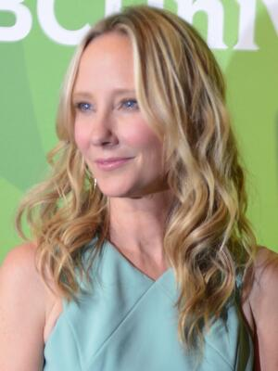
110+ Murdered: in Epstein Cover-up
Why / How they Anne Heche:
Drove her car at HIGH SPEED into a house in LA — massive FIREBALL engulfed the vehicle and the home.
Had just starred in a child trafficking film. Viral posts said "she KNEW TOO MUCH."
Was a childhood sexual abuse SURVIVOR who spoke publicly about her father raping her.
Died in the 2022 DEATH CLUSTER — same year as Brunel (hanged), Middleton (hanged + shot), and Hoffenberg (found dead).
Cocaine and marijuana found in her system. Ruled accidental. She was 53 with three sons.
Anne Heche
Dead at Age 53
Read List Here:
https://intelligencemurders.com/epstein
https://intelligencemurders.com/epstein
https://intelligencemurders.com/epstein
https://intelligencemurders.com/epstein
https://intelligencemurders.com/epstein
https://intelligencemurders.com/epstein
https://intelligencemurders.com/epstein
https://intelligencemurders.com/epstein
https://intelligencemurders.com/epstein

Slide 4
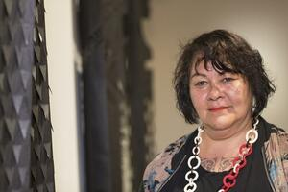
110+ Murdered: in Epstein Cover-up
Why / How they Gina Hutchinson:
Age 33. Found dead of a SHOTGUN wound to the head at a Buddhist monastery. Ruled suicide.
She was one of Keith Raniere's EARLIEST sexual abuse victims — first targeted when she was approximately 14 or 15 years old.
Raniere told her she must "leave her body" to achieve SPIRITUAL TRANSCENDENCE — language that could constitute encouraging suicide.
Her hands were NOT PROPERLY TESTED for gunpowder residue. She was not known to OWN firearms.
Just FOUR MONTHS later, another woman connected to Raniere — Kristin Snyder — DISAPPEARED and was never found.
Gina Hutchinson
Read List Here:
https://intelligencemurders.com/epstein
https://intelligencemurders.com/epstein
https://intelligencemurders.com/epstein
https://intelligencemurders.com/epstein
https://intelligencemurders.com/epstein
https://intelligencemurders.com/epstein
https://intelligencemurders.com/epstein
https://intelligencemurders.com/epstein
https://intelligencemurders.com/epstein
Dead at Age 33

Slide 5
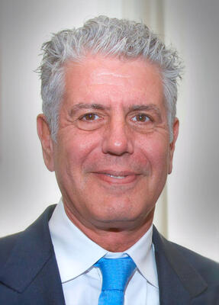
110+ Murdered: in Epstein Cover-up
Why / How they Anthony Bourdain:
Found HANGED in his French hotel room at age 61. No narcotics in his system. No signs of struggle.
One of the most VOCAL public advocates against powerful abusers — defended #MeToo accusers against Harvey Weinstein.
His best friend Eric Ripert said there were NO WARNING SIGNS. His mother said no indication of suicidal thoughts.
His death was the FIFTH in the 2017-2018 celebrity cluster: Cornell, Bennington, Avicii, Spade, then Bourdain — all within 13 months.
His girlfriend Asia Argento was photographed with another man days before. The prosecution said it was "impulsive."
Anthony Bourdain
Read List Here:
https://intelligencemurders.com/epstein
https://intelligencemurders.com/epstein
https://intelligencemurders.com/epstein
https://intelligencemurders.com/epstein
https://intelligencemurders.com/epstein
https://intelligencemurders.com/epstein
https://intelligencemurders.com/epstein
https://intelligencemurders.com/epstein
https://intelligencemurders.com/epstein
Dead at Age 61

Slide 6
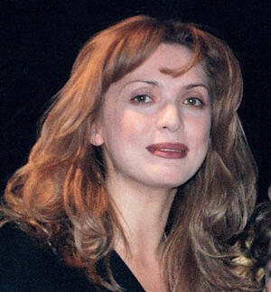
110+ Murdered: in Epstein Cover-up
Why / How they Anastasia Drozdova:
Young Ukrainian model who JUMPED from an apartment building in Kyiv — ruled suicide.
Her friend Ruslana Korshunova died the EXACT same way ONE YEAR earlier — fell from the 9th floor in New York.
Korshunova had flown on Epstein's PRIVATE JET to his island at age 18.
Both women attended "Rose of the World" cult sessions in Moscow — both had DRAMATIC personality changes after.
Two young models. Same social circle. Same method of death. One year apart.
Anastasia Drozdova
Read List Here:
https://intelligencemurders.com/epstein
https://intelligencemurders.com/epstein
https://intelligencemurders.com/epstein
https://intelligencemurders.com/epstein
https://intelligencemurders.com/epstein
https://intelligencemurders.com/epstein
https://intelligencemurders.com/epstein
https://intelligencemurders.com/epstein
https://intelligencemurders.com/epstein

Slide 7
110+ Murdered: in Epstein Cover-up
Why / How they Arthur Shapiro:
TWO BULLETS fired point-blank into his head as he fled a secret meeting in his red BMW at a Columbus CEMETERY.
He was Les Wexner's financial lawyer — WEEKS away from being questioned by the IRS about illegal tax shelters.
After his murder, Jeffrey Epstein TOOK HIS POSITION managing Wexner's BILLIONS — the foundation of Epstein's entire empire.
Prime suspect Berry Kessler was a CONVICTED murder-for-hire organizer with an FBI-documented link to Epstein.
The murder remains UNSOLVED. A Columbus official was charged with ordering the DESTRUCTION of the police report.
Arthur Shapiro
Dead at Age 43
Read List Here:
https://intelligencemurders.com/epstein
https://intelligencemurders.com/epstein
https://intelligencemurders.com/epstein
https://intelligencemurders.com/epstein
https://intelligencemurders.com/epstein
https://intelligencemurders.com/epstein
https://intelligencemurders.com/epstein
https://intelligencemurders.com/epstein
https://intelligencemurders.com/epstein

Slide 8
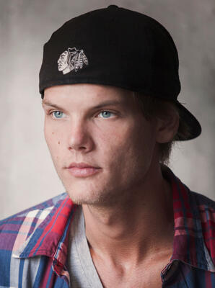
110+ Murdered: in Epstein Cover-up
Why / How they Avicii Tim Bergling:
World-famous DJ dead at 28 from self-inflicted wounds with BROKEN GLASS in an Oman hotel room.
His 2015 music video "For a Better Day" EXPLICITLY depicted a child trafficking ring being exposed and destroyed.
He said: "The promise of a better life traps families and children into being used as tools for the most DESPICABLE people on Earth."
His family called him a "FRAGILE artistic soul" who "could not go on any longer."
Third death in the 2017-2018 cluster — Cornell, Bennington, Avicii, Spade, Bourdain — all dead within 13 months.
Avicii Tim Bergling
Dead at Age 28
Read List Here:
https://intelligencemurders.com/epstein
https://intelligencemurders.com/epstein
https://intelligencemurders.com/epstein
https://intelligencemurders.com/epstein
https://intelligencemurders.com/epstein
https://intelligencemurders.com/epstein
https://intelligencemurders.com/epstein
https://intelligencemurders.com/epstein
https://intelligencemurders.com/epstein

Slide 9
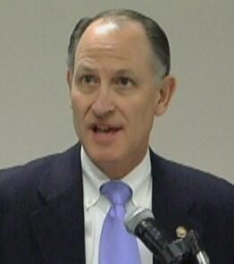
110+ Murdered: in Epstein Cover-up
Why / How they Berry Kessler:
PRIME SUSPECT in the murder of Arthur Shapiro — the man whose death gave Epstein control of Wexner's billions.
Convicted of masterminding TWO separate murder-for-hire plots. A judge called him a "clever, cunning and merciless KILLER."
FBI documents reference a POSSIBLE LINK between Kessler and Jeffrey Epstein.
Died at age 84 in a Georgia federal prison — before he could EVER be questioned about the Shapiro-Epstein connection.
A Columbus official was CHARGED with ordering the destruction of the Shapiro homicide report.
Berry Kessler
Dead at Age 84
Read List Here:
https://intelligencemurders.com/epstein
https://intelligencemurders.com/epstein
https://intelligencemurders.com/epstein
https://intelligencemurders.com/epstein
https://intelligencemurders.com/epstein
https://intelligencemurders.com/epstein
https://intelligencemurders.com/epstein
https://intelligencemurders.com/epstein
https://intelligencemurders.com/epstein

Slide 10
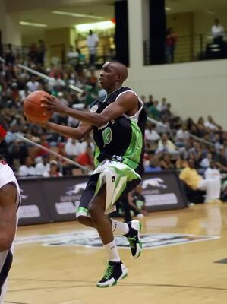
110+ Murdered: in Epstein Cover-up
Why / How they Aaron Owen:
His sister Alisha was about to TESTIFY in the Franklin child abuse case, naming powerful Nebraska politicians and businessmen.
He died HOURS before her court appearance — widely seen as a WARNING to silence her.
He (Aaron) found HANGED in his jail cell at age 17 — held on a JOYRIDING charge.
Signs of a BEATING before the "suicide" — yet the case was never pursued.
Alisha refused to recant. She got 9 to 15 YEARS for "perjury" — longer than the man she accused.
Aaron Owen
Dead at Age 17
Read List Here:
https://intelligencemurders.com/epstein
https://intelligencemurders.com/epstein
https://intelligencemurders.com/epstein
https://intelligencemurders.com/epstein
https://intelligencemurders.com/epstein
https://intelligencemurders.com/epstein
https://intelligencemurders.com/epstein
https://intelligencemurders.com/epstein
https://intelligencemurders.com/epstein

Slide 11
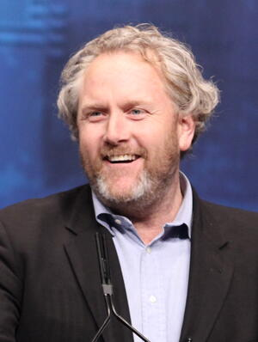
110+ Murdered: in Epstein Cover-up
Why / How they Andrew Breitbart:
Dropped DEAD of heart failure at age 43 while walking near his home — hours after telling a friend he had EXPLOSIVE videos to release.
In 2011 he tweeted: "How prog-guru John Podesta isn't household name as world class UNDERAGE SEX SLAVE OP cover-upperer is beyond me."
Eyewitness said his face was BRIGHT RED — consistent with POISONING, not cardiac arrest, where victims turn blue or gray.
The coroner's technician who handled his AUTOPSY died of suspected ARSENIC POISONING weeks later.
He broke the original Weiner sexting scandal — the laptop that later allegedly tied to Epstein-adjacent networks.
Andrew Breitbart
Dead at Age 43
Read List Here:
https://intelligencemurders.com/epstein
https://intelligencemurders.com/epstein
https://intelligencemurders.com/epstein
https://intelligencemurders.com/epstein
https://intelligencemurders.com/epstein
https://intelligencemurders.com/epstein
https://intelligencemurders.com/epstein
https://intelligencemurders.com/epstein
https://intelligencemurders.com/epstein

Slide 12
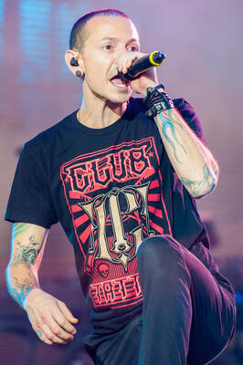
110+ Murdered: in Epstein Cover-up
Why / How they Chester Bennington:
Linkin Park's lead singer found HANGED at age 41 — on what would have been Chris Cornell's 53rd BIRTHDAY.
Cornell died the EXACT same way just TWO MONTHS earlier. Bennington gave his eulogy.
Both were allegedly connected to an unreleased documentary EXPOSING child sex trafficking in elite circles.
Bennington was sexually abused starting at AGE 7 and was open about wanting to expose child exploitation.
Part of the 2017-2018 death cluster: Cornell, Bennington, Avicii, Spade, Bourdain — FIVE hangings or self-inflicted deaths in 13 months.
Chester Bennington
Dead at Age 41
Read List Here:
https://intelligencemurders.com/epstein
https://intelligencemurders.com/epstein
https://intelligencemurders.com/epstein
https://intelligencemurders.com/epstein
https://intelligencemurders.com/epstein
https://intelligencemurders.com/epstein
https://intelligencemurders.com/epstein
https://intelligencemurders.com/epstein
https://intelligencemurders.com/epstein

Slide 13
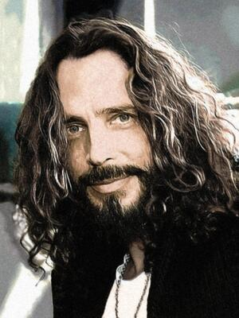
110+ Murdered: in Epstein Cover-up
Why / How they Chris Cornell:
Soundgarden vocalist found HANGED in his MGM Grand hotel room at age 52 — hours after performing a concert.
His wife hired a forensic expert who said the suicide ruling was PREMATURE and questions remain UNANSWERED.
Allegedly backing a child trafficking DOCUMENTARY before his death. The project reportedly HALTED after he died.
She told him he sounded "unlike himself" on their last call. He may have taken extra ATIVAN — a drug that impairs judgment.
Two months later, his best friend Chester Bennington hanged himself on Cornell's BIRTHDAY. Same method. Same year.
Chris Cornell
Dead at Age 52
Read List Here:
https://intelligencemurders.com/epstein
https://intelligencemurders.com/epstein
https://intelligencemurders.com/epstein
https://intelligencemurders.com/epstein
https://intelligencemurders.com/epstein
https://intelligencemurders.com/epstein
https://intelligencemurders.com/epstein
https://intelligencemurders.com/epstein
https://intelligencemurders.com/epstein

Slide 14
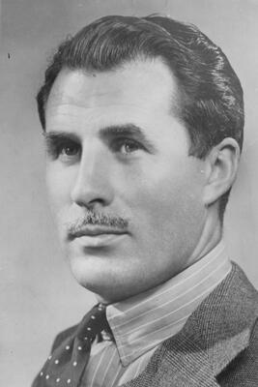
110+ Murdered: in Epstein Cover-up
Why / How they Christine Van Hees:
16-year-old Brussels girl TORTURED, murdered, and set on FIRE in the basement of an abandoned mushroom farm in 1984.
Neighbors heard her screaming "MOM!" — no one called police.
A witness later identified Marc Dutroux and Michel Nihoul as participants in her KILLING — with details matching non-public evidence.
The judge who DISMISSED the testimony was Nihoul's wife's former LAWYER. His sister was the GODMOTHER of Nihoul's child.
The statute of limitations expired in 2014. Her murder remains UNSOLVED. She would have been 59 today.
Christine Van Hees
Dead at Age 16
Read List Here:
https://intelligencemurders.com/epstein
https://intelligencemurders.com/epstein
https://intelligencemurders.com/epstein
https://intelligencemurders.com/epstein
https://intelligencemurders.com/epstein
https://intelligencemurders.com/epstein
https://intelligencemurders.com/epstein
https://intelligencemurders.com/epstein
https://intelligencemurders.com/epstein

Slide 15
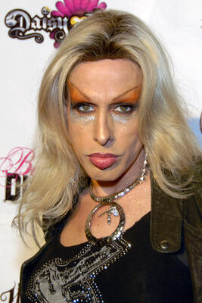
110+ Murdered: in Epstein Cover-up
Why / How they Alexis Arquette:
Transgender actress from the famous Arquette family — appeared in Pulp Fiction and The Wedding Singer.
Publicly ACCUSED multiple Hollywood A-listers of secret misconduct and hypocrisy.
Was "gearing up" to write a TELL-ALL MEMOIR exposing what she called Hollywood's DIRTIEST SECRETS.
Hollywood figures were reportedly TERRIFIED her unfinished writings would be published.
Dead at 47 from cardiac arrest related to HIV. Her death fits the pattern — Cornell, Bennington, Kappy — all spoke up, all gone.
Alexis Arquette
Dead at Age 47
Read List Here:
https://intelligencemurders.com/epstein
https://intelligencemurders.com/epstein
https://intelligencemurders.com/epstein
https://intelligencemurders.com/epstein
https://intelligencemurders.com/epstein
https://intelligencemurders.com/epstein
https://intelligencemurders.com/epstein
https://intelligencemurders.com/epstein
https://intelligencemurders.com/epstein

Slide 16
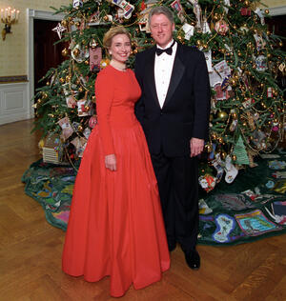
110+ Murdered: in Epstein Cover-up
Why / How they Christopher Sign:
ABC News anchor who BROKE the story of the secret Clinton-Lynch TARMAC meeting during the Hillary email investigation.
Found DEAD at age 45 in his Alabama home — ruled suicide. Survived by a wife and THREE YOUNG SONS.
Reported receiving SIGNIFICANT death threats after the story. His family's credit cards were HACKED.
He established SECRET CODE WORDS with his children as a security measure against the threats.
Wrote the book "Secret on the Tarmac" detailing everything. Former Alabama football player. Dead five years later.
Christopher Sign
Dead at Age 45
Read List Here:
https://intelligencemurders.com/epstein
https://intelligencemurders.com/epstein
https://intelligencemurders.com/epstein
https://intelligencemurders.com/epstein
https://intelligencemurders.com/epstein
https://intelligencemurders.com/epstein
https://intelligencemurders.com/epstein
https://intelligencemurders.com/epstein
https://intelligencemurders.com/epstein

Slide 17
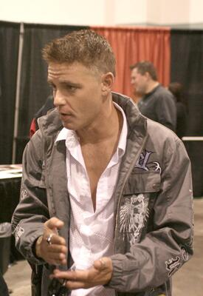
110+ Murdered: in Epstein Cover-up
Why / How they Corey Haim:
1980s teen heartthrob from The Lost Boys — allegedly RAPED on a film set at age 13 by an older actor.
Spiraled into 25 years of addiction. Obtained 553 PILLS from multiple doctors in his final 32 days.
Dead at 38 of pneumonia and heart disease — his body destroyed by decades of drug abuse triggered by CHILDHOOD SEXUAL TRAUMA.
He died before #MeToo could give him a platform to NAME his abusers. His friend Corey Feldman later named names.
His mother said he called her screaming as a teenager: "MOM, come and get me! He's not getting off me!"
Corey Haim
Dead at Age 38
Read List Here:
https://intelligencemurders.com/epstein
https://intelligencemurders.com/epstein
https://intelligencemurders.com/epstein
https://intelligencemurders.com/epstein
https://intelligencemurders.com/epstein
https://intelligencemurders.com/epstein
https://intelligencemurders.com/epstein
https://intelligencemurders.com/epstein
https://intelligencemurders.com/epstein

Slide 18
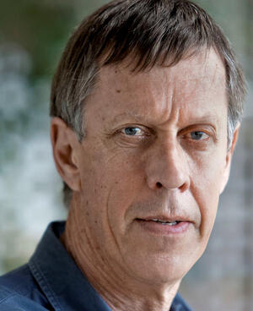
110+ Murdered: in Epstein Cover-up
Why / How they Craig Spence:
DC lobbyist who ran a SEXUAL BLACKMAIL ring — bugged his mansion to RECORD powerful government officials in compromising situations.
Arranged UNAUTHORIZED midnight White House tours with male escorts — including a 15-YEAR-OLD BOY he called his "son."
Found dead in a Boston Ritz-Carlton at age 49, dressed in a TUXEDO with Mozart playing and a CIA clipping about protecting agents.
Told friends he would be KILLED. Barricaded his hotel door. Wrote on the mirror: "Consider this my RESIGNATION."
His operation is the DIRECT PRECURSOR to Epstein's. Same model: sex, surveillance, and blackmail of the powerful.
Craig Spence
Dead at Age 49
Read List Here:
https://intelligencemurders.com/epstein
https://intelligencemurders.com/epstein
https://intelligencemurders.com/epstein
https://intelligencemurders.com/epstein
https://intelligencemurders.com/epstein
https://intelligencemurders.com/epstein
https://intelligencemurders.com/epstein
https://intelligencemurders.com/epstein

Slide 19
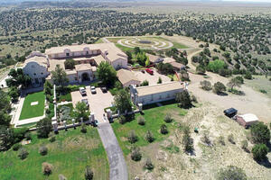
110+ Murdered: in Epstein Cover-up
Why / How they Brice Karen Gordon:
New Zealand couple who managed Epstein's 7,560-acre ZORRO RANCH for nearly TWO DECADES — they saw everything.
After Epstein's death and Maxwell's arrest, they VANISHED. No address. No social media. Complete ghosts.
A former employee said: "I can't believe Karen and Brice have hardly been spoken about. They're GHOSTS."
An anonymous employee alleged two foreign girls were BURIED near the ranch. The Gordons would know.
Zorro Ranch is the ONLY Epstein property that was NEVER RAIDED by the FBI. New Mexico is now subpoenaing them.
Brice Karen Gordon
Read List Here:
https://intelligencemurders.com/epstein
https://intelligencemurders.com/epstein
https://intelligencemurders.com/epstein
https://intelligencemurders.com/epstein
https://intelligencemurders.com/epstein
https://intelligencemurders.com/epstein
https://intelligencemurders.com/epstein
https://intelligencemurders.com/epstein

Slide 20
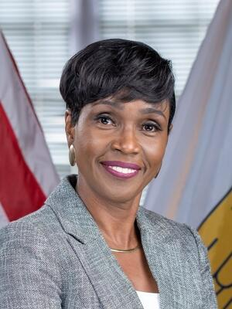
110+ Murdered: in Epstein Cover-up
Why / How they Denise George:
USVI Attorney General who aggressively sued Epstein's estate and JPMorgan Chase — FIRED just FOUR DAYS after filing the JPMorgan lawsuit.
Told the FBI she felt THREATENED after pursuing the case. The governor pressured her: "I can't get you to LET THIS GO?"
Text messages show the governor texting Epstein directly: "We got u" and "For u absolutely."
Secured a $105 MILLION settlement from Epstein's estate — the governor wanted her to settle for $80M.
Former first lady was allegedly on Epstein's PAYROLL at $200,000/year and helped weaken sex offender monitoring laws.
Denise George
Read List Here:
https://intelligencemurders.com/epstein
https://intelligencemurders.com/epstein

Slide 21
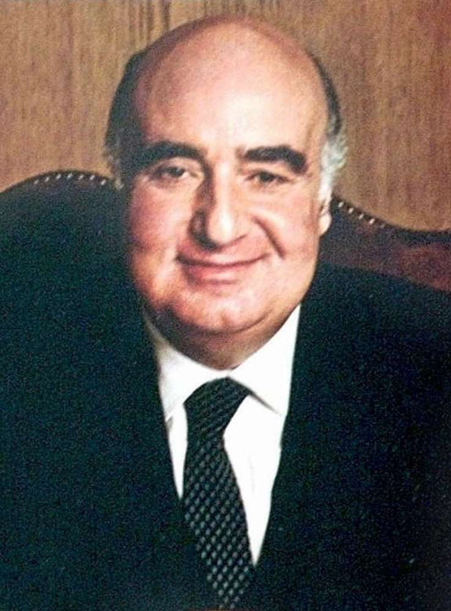
110+ Murdered: in Epstein Cover-up
Why / How they Edmund Safra:
Billionaire banker DIED of smoke inhalation in an arson fire at his Monaco penthouse. Age 67.
He was actively cooperating with the FBI on a $21.4 BILLION Russian money laundering investigation through his Republic National Bank.
His nurse confessed to starting the fire to "stage a rescue" — a motive that strains credulity for someone employed only a SHORT TIME.
The fire killed BOTH Safra and the only other witness in the panic room — nurse Vivian Torrente.
His bank had connections to financial networks documented as ADJACENT to Epstein's intelligence-linked operations.
Edmund Safra
Read List Here:
Dead at Age 67
https://intelligencemurders.com/epstein
https://intelligencemurders.com/epstein
https://intelligencemurders.com/epstein
https://intelligencemurders.com/epstein
https://intelligencemurders.com/epstein
https://intelligencemurders.com/epstein
https://intelligencemurders.com/epstein
https://intelligencemurders.com/epstein

Slide 22

110+ Murdered: in Epstein Cover-up
Why / How they Efrain Stone Reyes:
Epstein's LAST CELLMATE — transferred out just ONE DAY before Epstein was found dead. Age 51.
Attorney General William Barr PERSONALLY questioned him about Epstein's death, telling him: "I owe you a favor."
Said the bunk frames were NOT TALL ENOUGH to allow for hanging — "It just didn't seem right."
Died of COVID-19 WEEKS after talking to federal investigators probing Epstein's death.
His niece said guards were "treating him like crap" and making him SLEEP ON THE FLOOR after he was questioned.
Efrain Stone Reyes
Dead at Age 51
Read List Here:
https://intelligencemurders.com/epstein
https://intelligencemurders.com/epstein
https://intelligencemurders.com/epstein
https://intelligencemurders.com/epstein
https://intelligencemurders.com/epstein
https://intelligencemurders.com/epstein
https://intelligencemurders.com/epstein
https://intelligencemurders.com/epstein

Slide 23
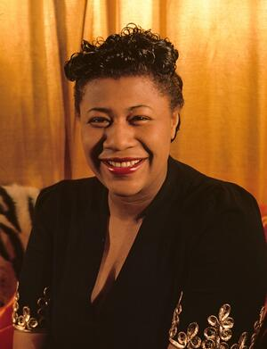
110+ Murdered: in Epstein Cover-up
Why / How they Ella Rich:
SHOT TO DEATH alongside her fiance Frank Yassenoff in Columbus, Ohio. Both murders UNSOLVED since 1970.
Their business partner Berry Kessler was SUSPECTED but never charged — the same man later CONVICTED of a murder-for-hire.
Kessler was also the PRIME SUSPECT in the Arthur Shapiro murder — the killing that created Epstein's OPENING to Les Wexner's fortune.
Police files from the Yassenoff-Rich murder WENT MISSING during the Shapiro investigation.
A judge later called Kessler "a clever, cunning and MERCILESS KILLER."
Ella Rich
Read List Here:
https://intelligencemurders.com/epstein
https://intelligencemurders.com/epstein
https://intelligencemurders.com/epstein
https://intelligencemurders.com/epstein
https://intelligencemurders.com/epstein
https://intelligencemurders.com/epstein
https://intelligencemurders.com/epstein
https://intelligencemurders.com/epstein

Slide 24
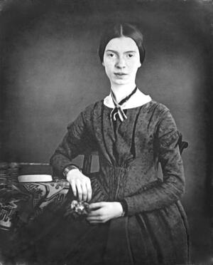
110+ Murdered: in Epstein Cover-up
Why / How they Emily Smith:
Page Six editor at the New York Post who received an EMAIL from a former MCC inmate claiming Epstein was MURDERED inside his prison.
The email described DISABLED CAMERAS, a "GOON SQUAD" that recorded killings, and direct DEATH THREATS against the inmate.
The email was followed by 24 FULLY REDACTED PAGES in the 2026 DOJ Epstein files — no explanation given.
The inmate wrote: "They will come into your room at night and beat you over the head with a FIRE EXTINGUISHER and KILL YOU."
Despite receiving firsthand witness claims, NO STORY was ever published by the New York Post.
Emily Smith
Read List Here:
https://intelligencemurders.com/epstein
https://intelligencemurders.com/epstein
https://intelligencemurders.com/epstein
https://intelligencemurders.com/epstein
https://intelligencemurders.com/epstein
https://intelligencemurders.com/epstein
https://intelligencemurders.com/epstein
https://intelligencemurders.com/epstein

Slide 25
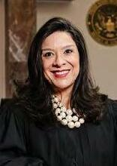
110+ Murdered: in Epstein Cover-up
Why / How they Esther Salas:
Federal judge assigned the Epstein-Deutsche Bank case on July 15, 2020. FOUR DAYS LATER a gunman murdered her 20-year-old son Daniel at their front door.
Her husband was SHOT THREE TIMES and critically wounded. She was in the basement and survived.
The gunman had INTELLIGENCE TIES — worked for Kroll Associates in Moscow, the "CIA of Wall Street," which had DIRECT business ties to Deutsche Bank.
Gunman found dead the next day. The case SETTLED quietly for $26.25 million — NO Epstein client list ever produced.
Four people connected to Epstein's Deutsche Bank finances have DIED — Broeksmit, Bowers, Anderl, and Val Broeksmit.
Esther Salas
Read List Here:
https://intelligencemurders.com/epstein
https://intelligencemurders.com/epstein
https://intelligencemurders.com/epstein
https://intelligencemurders.com/epstein
https://intelligencemurders.com/epstein
https://intelligencemurders.com/epstein
https://intelligencemurders.com/epstein
https://intelligencemurders.com/epstein

Slide 26
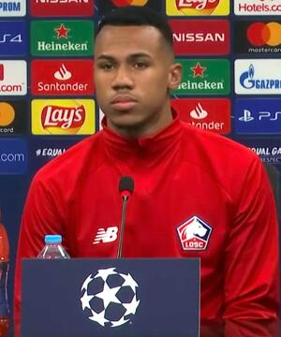
110+ Murdered: in Epstein Cover-up
Why / How they Gabriel Magee:
JPMorgan VP who FELL from the 33-story bank headquarters in London's Canary Wharf. Age 39. Ruled suicide.
Worked in JPMorgan's fixed income technology for TEN YEARS — overlapping exactly with the bank's $1 BILLION in suspicious Epstein transactions.
Died just TWO DAYS after Deutsche Bank exec William Broeksmit was found HANGED — part of a cluster of banker deaths in 2014.
FIVE current JPMorgan employees and TWO former employees died under unusual circumstances in just SIX MONTHS.
JPMorgan later paid $365 MILLION in settlements to Epstein victims and the USVI.
Gabriel Magee
Dead at Age 39
Read List Here:
https://intelligencemurders.com/epstein
https://intelligencemurders.com/epstein
https://intelligencemurders.com/epstein
https://intelligencemurders.com/epstein
https://intelligencemurders.com/epstein
https://intelligencemurders.com/epstein
https://intelligencemurders.com/epstein
https://intelligencemurders.com/epstein

Slide 27
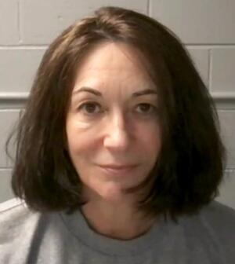
110+ Murdered: in Epstein Cover-up
Why / How they Ghislaine Maxwell:
The ONLY convicted Epstein co-conspirator still alive. Serving 20 years. Her brother says publicly: "She's NOT suicidal."
Met with Deputy AG for NINE HOURS under limited immunity — but provided NO incriminating information about high-profile individuals.
Invoked the FIFTH AMENDMENT before Congress. Her lawyer said she'd "speak fully and honestly" only if Trump grants CLEMENCY.
Her lawyers are fighting release of 90,000 PAGES of documents. She named FOUR unindicted co-conspirators and alleged 25 SECRET SETTLEMENTS.
Epstein found hanged. Brunel found hanged. She is the LAST ONE who knows everything — and she's behind bars.
Ghislaine Maxwell
Read List Here:
https://intelligencemurders.com/epstein
https://intelligencemurders.com/epstein
https://intelligencemurders.com/epstein
https://intelligencemurders.com/epstein
https://intelligencemurders.com/epstein
https://intelligencemurders.com/epstein
https://intelligencemurders.com/epstein
https://intelligencemurders.com/epstein
https://intelligencemurders.com/epstein

Slide 28
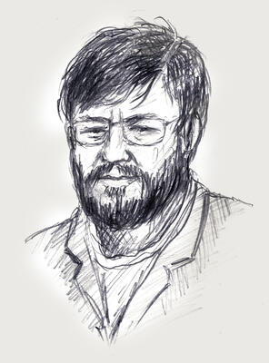
110+ Murdered: in Epstein Cover-up
Why / How they Hubert Massa:
Belgium's CHIEF PROSECUTOR overseeing the Dutroux pedophile case. Age 53. SHOT HIMSELF in the mouth. Ruled suicide.
He died on the SAME DAY he returned from a meeting with the Justice Minister about the Dutroux case.
Two eight-year-old girls STARVED TO DEATH in Dutroux's dungeon while police searched the house and HEARD THEM SCREAMING but did nothing.
His death was one of approximately 20 SUSPICIOUS DEATHS of witnesses and officials connected to the Dutroux case.
No suicide note was ever reported. He was simultaneously overseeing the assassination case of politician Andre Cools.
Hubert Massa
Dead at Age 53
Read List Here:
https://intelligencemurders.com/epstein
https://intelligencemurders.com/epstein
https://intelligencemurders.com/epstein
https://intelligencemurders.com/epstein
https://intelligencemurders.com/epstein
https://intelligencemurders.com/epstein
https://intelligencemurders.com/epstein
https://intelligencemurders.com/epstein
https://intelligencemurders.com/epstein

Slide 29
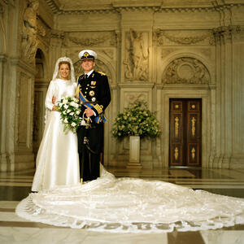
110+ Murdered: in Epstein Cover-up
Why / How they Ines Zorreguieta:
Age 33. Younger sister of QUEEN MAXIMA of the Netherlands. Found HANGED in her Buenos Aires apartment. Ruled suicide.
Died June 6, 2018 — ONE DAY after Kate Spade and TWO DAYS before Anthony Bourdain. All three died by HANGING in the same week.
She worked with Argentina's National Secretariat for CHILDREN, YOUTH, and FAMILY and with the United Nations.
Her father served under Argentina's MILITARY DICTATORSHIP responsible for 30,000-40,000 disappearances during the "Dirty War."
Her psychology thesis was titled "Gender differences and their relation to SUICIDE" — eight years before her own death by the method she studied.
Ines Zorreguieta
Dead at Age 33
Read List Here:
https://intelligencemurders.com/epstein
https://intelligencemurders.com/epstein
https://intelligencemurders.com/epstein
https://intelligencemurders.com/epstein
https://intelligencemurders.com/epstein
https://intelligencemurders.com/epstein
https://intelligencemurders.com/epstein
https://intelligencemurders.com/epstein
https://intelligencemurders.com/epstein

Slide 30
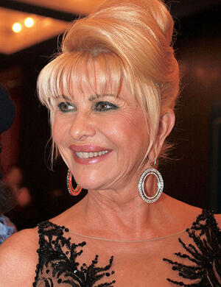
110+ Murdered: in Epstein Cover-up
Why / How they Ivana Trump:
Donald Trump's first wife. Age 73. Found DEAD at the bottom of her Manhattan townhouse staircase. Ruled accidental.
#EPSTEINED trended on Twitter with over 8,000 tweets after her death was announced.
Died in 2022 — the same year as Brunel (HANGED), Val Broeksmit (FOUND DEAD), Mark Middleton (HANGED), and Hoffenberg (DEAD).
Her death delayed NY Attorney General DEPOSITIONS of the Trump family in a civil investigation.
Buried at Trump National Golf Club in Bedminster, NJ — a plot that some noted could provide TAX BENEFITS for the property.
Ivana Trump
Read List Here:
https://intelligencemurders.com/epstein
https://intelligencemurders.com/epstein
https://intelligencemurders.com/epstein
https://intelligencemurders.com/epstein
https://intelligencemurders.com/epstein
https://intelligencemurders.com/epstein
https://intelligencemurders.com/epstein
https://intelligencemurders.com/epstein
https://intelligencemurders.com/epstein

Slide 31
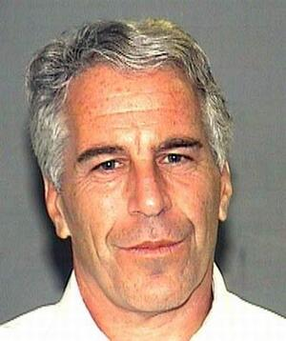
110+ Murdered: in Epstein Cover-up
Why / How they Jeffrey Epstein:
Found HANGED in his federal jail cell while awaiting trial on sex trafficking charges. Age 66. Guards ASLEEP. Cameras MALFUNCTIONING.
A broken HYOID BONE — more commonly associated with HOMICIDE by strangulation than suicide by hanging.
2026 surveillance logs show an ORANGE-COLORED FIGURE moving toward Epstein's locked tier at 10:39 PM the night he died — NEVER mentioned in official reports.
Guards FALSIFIED check-in records. He was removed from SUICIDE WATCH despite a prior attempt weeks earlier.
His brother calls it MURDER. "Epstein didn't kill himself" became the most widespread meme in modern history.
Jeffrey Epstein
Dead at Age 66
Read List Here:
https://intelligencemurders.com/epstein
https://intelligencemurders.com/epstein
https://intelligencemurders.com/epstein
https://intelligencemurders.com/epstein
https://intelligencemurders.com/epstein
https://intelligencemurders.com/epstein
https://intelligencemurders.com/epstein
https://intelligencemurders.com/epstein
https://intelligencemurders.com/epstein

Slide 32
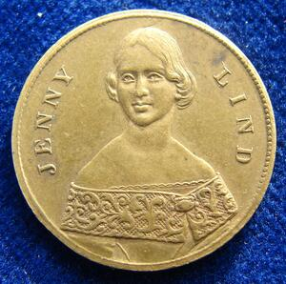
110+ Murdered: in Epstein Cover-up
Why / How they Jenny Moore:
Former police officer turned independent journalist investigating ELITE CHILD TRAFFICKING in Washington, DC.
Filed reports with BOTH the FBI and Department of Homeland Security about trafficking allegations — WEEKS before she was found dead.
Found dead in a DC-area hotel room of an "apparent seizure." Police said NOTHING SUSPICIOUS.
She had interviewed a man who claimed he was "PIMPED OUT" to private elite events in DC as a YOUTH.
Her death fits the pattern: Isaac Kappy, Tracy Twyman, Max Spiers — all researchers investigating elite trafficking, all DEAD.
Jenny Moore
Read List Here:
https://intelligencemurders.com/epstein
https://intelligencemurders.com/epstein
https://intelligencemurders.com/epstein
https://intelligencemurders.com/epstein
https://intelligencemurders.com/epstein
https://intelligencemurders.com/epstein
https://intelligencemurders.com/epstein
https://intelligencemurders.com/epstein
https://intelligencemurders.com/epstein

Slide 33
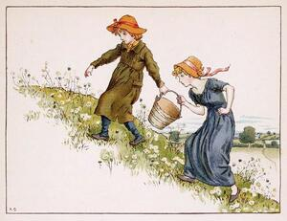
110+ Murdered: in Epstein Cover-up
Why / How they Jill Dando:
Britain's most famous TV journalist. Age 37. EXECUTED with a single bullet to the head on her own doorstep. Case UNSOLVED for 26 years.
She had compiled a DOSSIER on a pedophile ring inside the BBC and handed it to senior management — they DID NOTHING.
Years later, the BBC was proven to have harbored JIMMY SAVILE, who abused HUNDREDS on BBC premises for 40 years.
The killing was a professional "HARD CONTACT EXECUTION" — gun pressed against the skull to muffle the shot. Neighbors heard nothing.
The only man convicted spent 8 years in prison before being ACQUITTED. The real killer was never caught.
Jill Dando
Dead at Age 37
Read List Here:
https://intelligencemurders.com/epstein
https://intelligencemurders.com/epstein
https://intelligencemurders.com/epstein
https://intelligencemurders.com/epstein
https://intelligencemurders.com/epstein
https://intelligencemurders.com/epstein
https://intelligencemurders.com/epstein
https://intelligencemurders.com/epstein
https://intelligencemurders.com/epstein

Slide 34
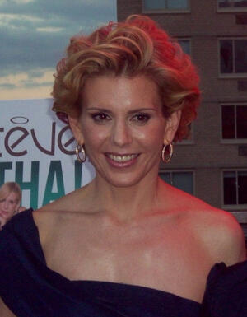
110+ Murdered: in Epstein Cover-up
Why / How they Andrew Stewart:
Epstein's PERSONAL CHEF who "traveled everywhere with them for years" — Epstein and Maxwell.
Victim Maria Farmer called him the "HOLY GRAIL" of the case: "He knew EVERYTHING."
Died PEACEFULLY IN HIS SLEEP at age 62 — just as lawyers were seeking to SUBPOENA him.
His name appears in the Epstein FLIGHT LOGS. No cause of death was ever publicly disclosed.
He died between Epstein's death and Maxwell's arrest — during the most CRITICAL window for witnesses.
Andrew Stewart
Dead at Age 62
Read List Here:
https://intelligencemurders.com/epstein
https://intelligencemurders.com/epstein
https://intelligencemurders.com/epstein
https://intelligencemurders.com/epstein
https://intelligencemurders.com/epstein
https://intelligencemurders.com/epstein
https://intelligencemurders.com/epstein
https://intelligencemurders.com/epstein
https://intelligencemurders.com/epstein

Slide 35
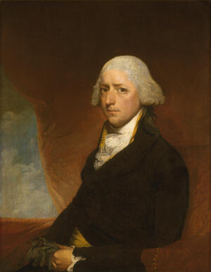
110+ Murdered: in Epstein Cover-up
Why / How they John Ashe:
Former president of the UN General Assembly. Age 61. A BARBELL CRUSHED HIS THROAT at home. Ruled accidental.
He was DAYS away from his corruption trial involving $1.3 million in bribes from a major CLINTON FOUNDATION donor.
The UN initially said he died of a HEART ATTACK — then the medical examiner corrected it to traumatic ASPHYXIA with laryngeal fractures.
His bribe-payer had been involved in illegal donations to Democrats in the 1990s "CHINAGATE" scandal.
He was ALONE when it happened. A barbell crushing the throat is one of the RAREST causes of death on record.
John Ashe
Read List Here:
https://intelligencemurders.com/epstein
https://intelligencemurders.com/epstein
https://intelligencemurders.com/epstein
https://intelligencemurders.com/epstein
https://intelligencemurders.com/epstein
https://intelligencemurders.com/epstein
https://intelligencemurders.com/epstein
https://intelligencemurders.com/epstein
https://intelligencemurders.com/epstein

Slide 36
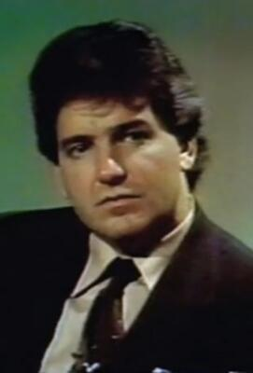
110+ Murdered: in Epstein Cover-up
Why / How they John Connolly:
Former NYPD detective turned investigative journalist. Co-authored FILTHY RICH with James Patterson — one of the FIRST major Epstein exposes.
Had an "unending ROLODEX" — moved among Hollywood, Wall Street, politicians, and police for decades.
Died at 78 of a "brief illness" during renewed investigation into the Epstein network.
Appeared in the documentary WHO KILLED JEFFREY EPSTEIN with decades of accumulated knowledge about the case.
His death is considered LIKELY NATURAL given his age — but his knowledge of the Epstein case was extraordinary.
John Connolly
Dead at Age 78
Read List Here:
https://intelligencemurders.com/epstein
https://intelligencemurders.com/epstein
https://intelligencemurders.com/epstein
https://intelligencemurders.com/epstein
https://intelligencemurders.com/epstein
https://intelligencemurders.com/epstein
https://intelligencemurders.com/epstein
https://intelligencemurders.com/epstein
https://intelligencemurders.com/epstein

Slide 37
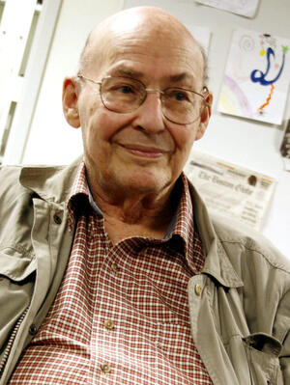
110+ Murdered: in Epstein Cover-up
Why / How they Marvin Minsky:
MIT co-founder of artificial intelligence and Turing Award winner. Named in Epstein COURT FILINGS.
Virginia Giuffre testified that Maxwell directed her to have SEX with the 73-year-old Minsky when she was 17.
Epstein's "CLOSEST FRIEND at MIT" — even visited Epstein IN JAIL, according to MIT Media Lab co-founder.
MIT scientist Richard Stallman RESIGNED after defending Minsky, saying the victim "likely presented herself as willing."
Died at 88 of cerebral hemorrhage. Not suspicious — but his ties show how DEEP Epstein infiltrated elite academia.
Marvin Minsky
Dead at Age 88
Read List Here:
https://intelligencemurders.com/epstein
https://intelligencemurders.com/epstein
https://intelligencemurders.com/epstein
https://intelligencemurders.com/epstein
https://intelligencemurders.com/epstein
https://intelligencemurders.com/epstein
https://intelligencemurders.com/epstein
https://intelligencemurders.com/epstein
https://intelligencemurders.com/epstein

Slide 38
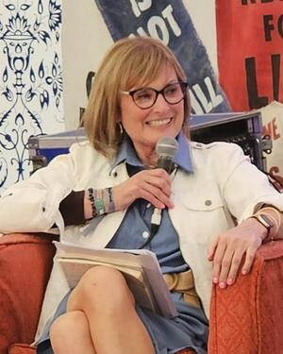
110+ Murdered: in Epstein Cover-up
Why / How they Mary Kennedy:
RFK Jr.'s ex-wife found HANGED in her barn at age 52. She knew Ghislaine Maxwell through charity work.
When Eva Dubin emailed Epstein about her death, Epstein replied: "WHOOPS."
She flew on Epstein's private plane at least TWICE — once to Palm Beach, once to South Dakota with her children.
She gave her sisters RFK Jr.'s diary documenting 37 affairs with instructions: "PUBLISH IT if anything happens to me."
Lost custody of her four kids, financially cut off, husband dating another woman. Two PRIOR suicide attempts in the 1980s.
Mary Kennedy
Dead at Age 52
Read List Here:
https://intelligencemurders.com/epstein
https://intelligencemurders.com/epstein
https://intelligencemurders.com/epstein
https://intelligencemurders.com/epstein
https://intelligencemurders.com/epstein
https://intelligencemurders.com/epstein
https://intelligencemurders.com/epstein
https://intelligencemurders.com/epstein
https://intelligencemurders.com/epstein

Slide 39
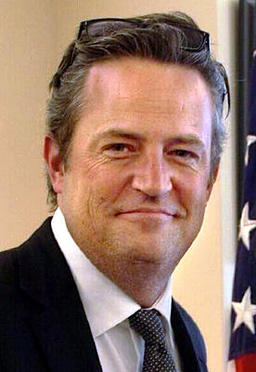
110+ Murdered: in Epstein Cover-up
Why / How they Matthew Perry:
Friends star found FACE DOWN in his hot tub at age 54. His assistant injected him with ketamine SIX TO EIGHT TIMES a day.
FIVE people CRIMINALLY CHARGED — including two doctors and a dealer called the "KETAMINE QUEEN."
His doctor texted: "I wonder how much this MORON will pay." Charged $2,000 per vial that cost $12 wholesale.
The Ketamine Queen's FULL CLIENT LIST of Hollywood elite has NEVER been disclosed. Hollywood was "QUAKING."
Perry once said: "When I die, I don't want Friends to be the first thing mentioned. I want it to be that I HELPED people."
Matthew Perry
Dead at Age 54
Read List Here:
https://intelligencemurders.com/epstein
https://intelligencemurders.com/epstein
https://intelligencemurders.com/epstein
https://intelligencemurders.com/epstein
https://intelligencemurders.com/epstein
https://intelligencemurders.com/epstein
https://intelligencemurders.com/epstein
https://intelligencemurders.com/epstein
https://intelligencemurders.com/epstein

Slide 40
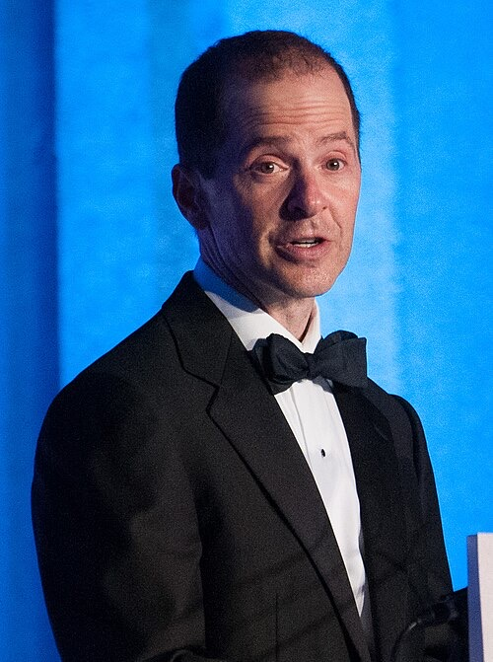
110+ Murdered: in Epstein Cover-up
Why / How they Max Spiers:
British researcher investigating ELITE PEDOPHILIA. Told his mother: "Your boy's in trouble. If anything happens to me, INVESTIGATE."
Found DEAD on a sofa in Warsaw, Poland TWO DAYS later. Age 39.
Polish police ruled "NATURAL CAUSES" without conducting a proper post-mortem. UK coroner called the investigation "WHOLLY INCOMPETENT."
Actual cause: pneumonia combined with TWICE the therapeutic dose of Xanax and potentially FATAL levels of oxycodone.
His mother said: "Max had been DIGGING in dark places and I fear that somebody wanted him DEAD."
Max Spiers
Read List Here:
https://intelligencemurders.com/epstein
https://intelligencemurders.com/epstein
https://intelligencemurders.com/epstein
https://intelligencemurders.com/epstein
https://intelligencemurders.com/epstein
https://intelligencemurders.com/epstein
https://intelligencemurders.com/epstein
https://intelligencemurders.com/epstein
https://intelligencemurders.com/epstein

Slide 41
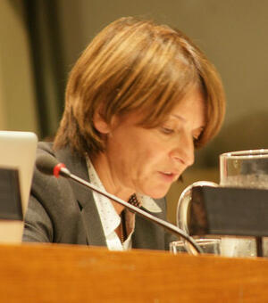
110+ Murdered: in Epstein Cover-up
Why / How they Mona Juul:
Norwegian ambassador. Epstein WILLED $5 MILLION to EACH of her children — approximately $10 million total.
RESIGNED from her diplomatic post in February 2026 after the DOJ file releases exposed her family's ties.
Norway's economic crime authority RAIDED her Oslo residence and launched a CORRUPTION investigation.
Her husband Terje Rod-Larsen was described as Epstein's "TOP DIPLOMATIC FIXER" — also under investigation.
Part of Norway's Epstein RECKONING: a former PM charged, Crown Princess named 1,000 times in files, national crisis.
Mona Juul
Read List Here:
https://intelligencemurders.com/epstein
https://intelligencemurders.com/epstein
https://intelligencemurders.com/epstein
https://intelligencemurders.com/epstein
https://intelligencemurders.com/epstein
https://intelligencemurders.com/epstein
https://intelligencemurders.com/epstein
https://intelligencemurders.com/epstein
https://intelligencemurders.com/epstein

Slide 42
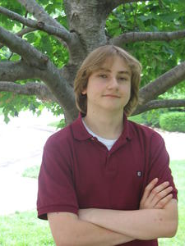
110+ Murdered: in Epstein Cover-up
Why / How they Nikolai Mushegian:
Tweeted: "CIA and Mossad and pedo elite are running a sex trafficking ring out of PUERTO RICO. They will TORTURE ME TO DEATH."
FOUR HOURS LATER his body was found in the ocean. Age 29. Fully clothed with his WALLET still on him.
He was a crypto PIONEER — co-founded MakerDAO, helped create the DAI stablecoin. Donated $1.4M to Carnegie Mellon.
Puerto Rico is the SAME Caribbean region where Epstein ran his documented trafficking operation.
Police ruled it a RIPTIDE accident. No further investigation despite the most PRECISELY timed warning tweet in history.
Nikolai Mushegian
Read List Here:
https://intelligencemurders.com/epstein
https://intelligencemurders.com/epstein
https://intelligencemurders.com/epstein
https://intelligencemurders.com/epstein
https://intelligencemurders.com/epstein
https://intelligencemurders.com/epstein
https://intelligencemurders.com/epstein
https://intelligencemurders.com/epstein
https://intelligencemurders.com/epstein
Dead at Age 29

Slide 43
150+ Murdered: by Intelligence Services
Why / How they Max Spiers:
Texted his mother: "Your boy's in TROUBLE. If anything happens to me, INVESTIGATE." Dead TWO DAYS later at age 39.
Vomited TWO LITRES of BLACK FLUID before dying in a Warsaw apartment.
A British coroner called the Polish police investigation "WHOLLY INCOMPETENT" — the body was left overnight with NO examination.
Was investigating elite PEDOPHILE RINGS and government mind control programs — about to speak at a conference on who REALLY controls the world.
Lethal opioids and a Turkish sedative were in his system — but the SOURCE of the drugs was never established.
Max Spiers
Read List Here:
Dead at Age 39
https://intelligencemurders.com/intel

Slide 44

110+ Murdered: in Epstein Cover-up
Why / How they Ashley Haynes:
Found DROWNED in the Arkansas River with a 58-POUND CONCRETE BLOCK strapped to her ankle by an EXTENSION CORD.
Ruled SUICIDE. A yoga teacher who went paddleboarding and never came back.
Four months later, Clinton aide Mark Middleton was found dead — ALSO with an extension cord — in the same state.
Both deaths in ARKANSAS. Both involving extension cords. Both ruled suicide.
Police said "no signs of foul play." She was 47 years old.
Ashley Haynes
Dead at Age 47
Read List Here:
https://intelligencemurders.com/epstein
https://intelligencemurders.com/epstein
https://intelligencemurders.com/epstein
https://intelligencemurders.com/epstein
https://intelligencemurders.com/epstein
https://intelligencemurders.com/epstein
https://intelligencemurders.com/epstein
https://intelligencemurders.com/epstein
https://intelligencemurders.com/epstein

Slide 45
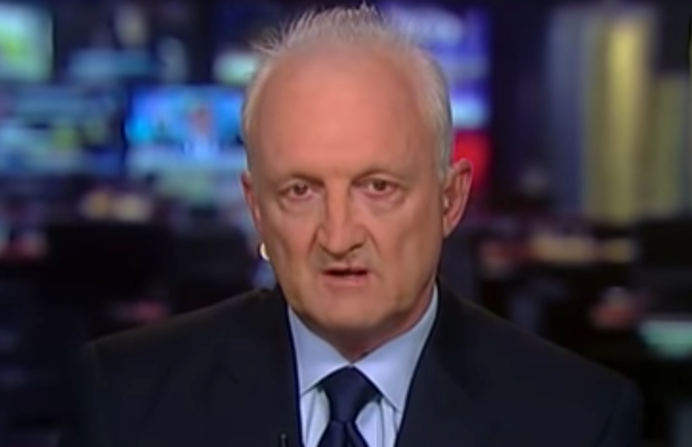
110+ Murdered: in Epstein Cover-up
Why / How they Philip Haney:
DHS whistleblower who testified the Obama-era government ordered him to DELETE hundreds of files on trafficking networks.
Found SHOT DEAD in a California park-and-ride lot at age 66. Took TWO YEARS to officially rule it suicide.
He had told many people: "If I am ever found dead of a 'suicide,' NEVER BELIEVE IT for a minute."
He was ENGAGED to be married, booking speaking events, working on a new book, and planning a trip to Israel.
His family "SERIOUSLY DOUBTS" the suicide conclusion. The FBI seized thumb drives and a laptop from his motorhome.
Philip Haney
Read List Here:
https://intelligencemurders.com/epstein
https://intelligencemurders.com/epstein
https://intelligencemurders.com/epstein
https://intelligencemurders.com/epstein
https://intelligencemurders.com/epstein
https://intelligencemurders.com/epstein
https://intelligencemurders.com/epstein
https://intelligencemurders.com/epstein
https://intelligencemurders.com/epstein

Slide 46
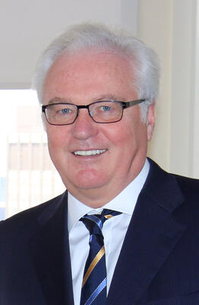
110+ Murdered: in Epstein Cover-up
Why / How they Vitaly Churkin:
Russian UN Ambassador for 11 YEARS. Collapsed at the Russian Mission in Manhattan. Dead at 64.
The U.S. State Department BLOCKED the release of his autopsy results. "Diplomatic immunity survives his DEATH."
Died one day before his 65th BIRTHDAY. No widely reported prior illness.
First of SEVEN Russian diplomats and officials dead within NINE months in 2016-2017.
Former Director of National Intelligence James Clapper called it a "CURIOUS PATTERN" of Russian deaths.
Vitaly Churkin
Dead at Age 64
Read List Here:
https://intelligencemurders.com/epstein
https://intelligencemurders.com/epstein
https://intelligencemurders.com/epstein
https://intelligencemurders.com/epstein
https://intelligencemurders.com/epstein
https://intelligencemurders.com/epstein
https://intelligencemurders.com/epstein
https://intelligencemurders.com/epstein
https://intelligencemurders.com/epstein

