Slide 1
⏺ Here's the filtered list of Americans, murdered suspiciously (SUSPICIOUS or higher)
within the last 20 years (2006+), with a substantial connection making them a target:
- Jeffrey Epstein — 2019, HIGHLY SUSPICIOUS. Sex-trafficking kingpin found dead in
federal custody before trial. Both cameras failed, guards asleep.
- Mark Middleton — 2022, HIGHLY SUSPICIOUS. Clinton White House aide who signed Epstein
into the White House. Found hanged at remote Arkansas ranch with shotgun wound.
- Steve Bing — 2020, HIGHLY SUSPICIOUS. Hollywood producer and major Clinton donor who
provided Clinton's personal 737. Fell from 27th floor. Named in Epstein file releases.
- Carolyn Andriano — 2023, HIGHLY SUSPICIOUS. Epstein victim and accuser. Found dead in
West Palm Beach hotel at age 36.
- Leigh Skye Patrick — 2017, HIGHLY SUSPICIOUS. Epstein victim found dead in West Palm
Beach hotel room at age 29.
- Daniel Anderl — 2020, HIGHLY SUSPICIOUS. 20-year-old son of Judge Esther Salas, who had
just been assigned the Epstein-Deutsche Bank case. Gunman came to their home.
- Philip Marshall — 2013, HIGHLY SUSPICIOUS. Author investigating CIA drug running and
9/11. Found shot dead in his California home alongside his two children and dog. Ruled
murder-suicide.
- Michael Hastings — 2013, HIGHLY SUSPICIOUS. Journalist investigating CIA and military.
Told friends he was being investigated by the FBI hours before his car exploded at high
speed in LA.
- Mark McCandlish — 2021, HIGHLY SUSPICIOUS. Aerospace illustrator who testified about
classified antigravity craft. Shot in head at home days before scheduled Senate
Intelligence Committee testimony.
- Amy Eskridge — 2022, HIGHLY SUSPICIOUS. NASA rocket scientist in Huntsville, Alabama
found dead at age 35 under suspicious circumstances.
- John Rossi — 2016, HIGHLY SUSPICIOUS. Aerospace engineer found dead at Redstone Arsenal
in Huntsville, Alabama.
- Michael Zebuhr — 2006, HIGHLY SUSPICIOUS. Engineering student researching
unconventional energy. Shot and killed in Minneapolis at age 25.
- Job Price — 2012, HIGHLY SUSPICIOUS. US soldier found dead at forward operating base in
Afghanistan under unexplained circumstances.
- Abdulrahman al-Awlaki — 2011, HIGHLY SUSPICIOUS. 16-year-old American citizen killed by
CIA drone strike in Yemen without charge or trial. Son of Anwar al-Awlaki.
- Anwar al-Awlaki — 2011, CONFIRMED. American citizen killed by CIA drone strike in
Yemen. First known deliberate killing of a US citizen by the US government without trial.
- Andrew Breitbart — 2012, SUSPICIOUS. Conservative media founder who publicly called out
Podesta's connection to underage trafficking. Died at 43 of sudden heart attack.
Coroner's technician died of arsenic poisoning weeks later.
- Christopher Sign — 2021, SUSPICIOUS. ABC News anchor who broke the Clinton-Lynch tarmac
meeting story. Died at 45, ruled suicide. Had received death threats.
- Isaac Kappy — 2019, SUSPICIOUS. Actor who publicly accused Hollywood figures of
pedophilia and claimed to possess Epstein blackmail files. Fell from Arizona bridge 60
days before Epstein's arrest. Repeatedly stated on video "if I die, it wasn't suicide."
- Nancy Schaefer — 2010, SUSPICIOUS. Georgia state senator who exposed CPS child
trafficking networks. Shot in back. Ruled murder-suicide while she was completing a
documentary exposé.
- Seth Rich — 2016, SUSPICIOUS. DNC staffer shot twice in the back in Washington DC.
Nothing stolen. Case remains unsolved.
- Peter Smith — 2017, SUSPICIOUS. Republican operative found dead of helium asphyxiation
in Minnesota hotel 10 days after WSJ interview. Left note saying "NO FOUL PLAY
WHATSOEVER." Mueller investigation sought his testimony.
- Thomas Bowers — 2019, SUSPICIOUS. Deutsche Bank executive who processed Epstein's
financial transactions. Found hanged at his Malibu home.
- Aaron Swartz — 2013, SUSPICIOUS. Reddit co-founder who built SecureDrop whistleblower
tool. Found hanged at 26 while facing 35 years in prison for downloading academic
articles. Father said "he was killed by the government."
- Philip Haney — 2020, SUSPICIOUS. DHS whistleblower who exposed the shutdown of Muslim
surveillance programs. Found shot dead in California park-and-ride lot.
- Philip Leonard — 2024, SUSPICIOUS. Los Alamos National Laboratory employee found dead
near the facility. Part of a cluster of suspicious deaths near weapons labs.
- Jonathan Nichols — 2019, SUSPICIOUS. Oklahoma state senator who authored child abuse
protection laws and pushed death penalty for repeat child molesters. Found dead of
gunshot wound to chest.
- Steven Hoffenberg — 2022, SUSPICIOUS. Epstein's early business partner who helped build
the financial fraud operation. Found dead at home in Connecticut.
- Andrew Stewart — 2020, SUSPICIOUS. Epstein's personal chef described as "the holy grail
— he knew everything." Died in his sleep as lawyers sought to subpoena him.
- Joseph Calabrese — 2019, SUSPICIOUS. NYPD detective who allegedly viewed contents of
the Weiner laptop. Part of a cluster of 4+ NYPD deaths in 22 days.
- Steven Silks — 2019, SUSPICIOUS. NYPD Deputy Chief allegedly connected to Weiner laptop
review. First in a rapid cluster of NYPD suicides.
- Karl Wolfe — 2018, SUSPICIOUS. Former Air Force sergeant who testified publicly about
seeing NASA photographs of structures on the far side of the moon.
- Fred Bell — 2011, SUSPICIOUS. Physicist and UAP whistleblower who died two days after
filming an interview about classified programs for Jesse Ventura's show.
- Jacob Prichard — 2025, SUSPICIOUS. Connected to Air Force Research Laboratory. Found
dead in West Milton, Ohio as part of October 2025 AFRL death cluster.
- Jaymee Prichard — 2025, SUSPICIOUS. Connected to AFRL cluster. Found dead in car trunk
at same West Milton location.
- Jaime Gustitus — 2025, SUSPICIOUS. AFRL-connected, found dead in Sugarcreek Township,
Ohio. Part of the same October 2025 cluster.

Slide 2
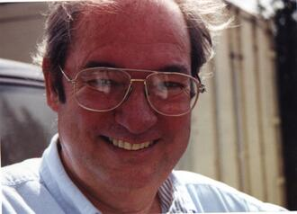
150+ Murdered: by Intelligence Services
Why / How they William Cooper:
Author of "Behold a Pale Horse" — SHOT and KILLED by sheriff's deputies at age 58 in Eagar, Arizona.
Former Naval intelligence who claimed to have seen classified documents about alien contact and government cover-ups.
Predicted a major terror attack months before 9/11 — naming Osama bin Laden as the likely scapegoat.
Shot during an attempted arrest at his home — but the circumstances of the confrontation are disputed.
Had been broadcasting from his hilltop home for years, exposing what he said was a global conspiracy.
Said for years he expected to be KILLED — and he was right.
William Cooper
Read List Here:
Dead at Age 58
https://intelligencemurders.com/intel

Slide 3
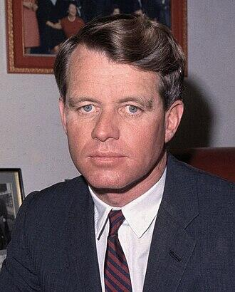
150+ Murdered: by Intelligence Services
Why / How they Robert F Kennedy:
U.S. Senator and presidential candidate ASSASSINATED at age 42 in Los Angeles — June 1968.
Dean Warwick claimed he was about to name RFK's real killer on stage — then COLLAPSED and DIED mid-sentence.
The official story blames Sirhan Sirhan — but forensic evidence suggests shots from behind, where Sirhan was not.
Some researchers connect his assassination to his potential access to classified UFO programs had he become president.
His brother JFK was killed five years earlier — two Kennedys, both assassinated during the peak of UFO secrecy.
Robert F Kennedy
Read List Here:
https://intelligencemurders.com/intel
Dead at Age 42

Slide 4
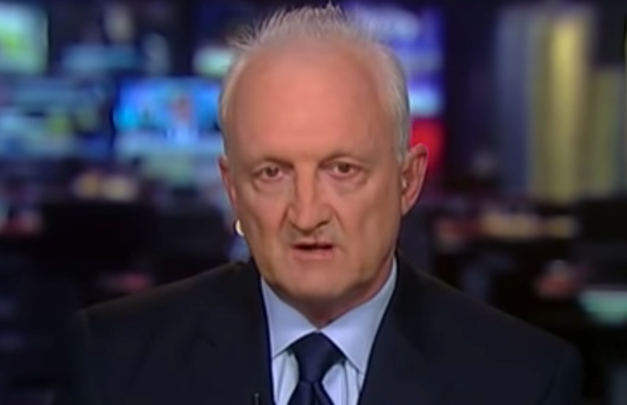
150+ Murdered: by Intelligence Services
Why / How they Philip Haney:
DHS founding member and terrorism whistleblower — found SHOT DEAD in a California park-and-ride lot at age 66.
Alleged the Obama administration ordered the DELETION of intelligence records that could have PREVENTED the San Bernardino attack.
His family "SERIOUSLY DOUBTS" the suicide ruling. Friends say the devout Christian explicitly said he would NEVER take his own life.
He was ENGAGED to be married and reportedly preparing to reveal ADDITIONAL classified information at the time of his death.
Ruled suicide after a TWO-YEAR investigation — but investigators found a note with passwords, not a suicide note.
Philip Haney
Read List Here:
Dead at Age 66
https://intelligencemurders.com/intel

Slide 5
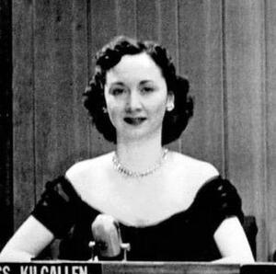
150+ Murdered: by Intelligence Services
Why / How they Dorothy Kilgallen:
America's most famous journalist — syndicated to 20 MILLION readers. Found dead of a barbiturate overdose at age 52. Ruled "circumstances undetermined."
She was investigating the JFK ASSASSINATION and told friends she was about to "BREAK THE CASE WIDE OPEN."
She secured the ONLY private interview with Jack Ruby — the man who killed the man accused of killing the President.
Her INVESTIGATION FILE — described as a thick folder of documents — VANISHED after her death and has NEVER been found.
Found in a room that WASN'T her bedroom, fully dressed and made up — inconsistent with her known habits. No real investigation was ever conducted.
Dorothy Kilgallen
Dead at Age 52
Read List Here:
https://intelligencemurders.com/intel

Slide 6
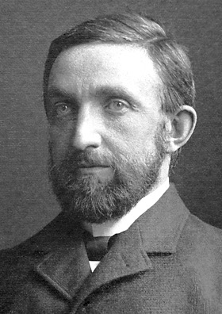
150+ Murdered: by Intelligence Services
Why / How they Philip Leonard:
Los Alamos nuclear weapons lab HIGH-EXPLOSIVES chemist — killed at age 44 in a head-on collision on the road TO the lab.
Another driver crossed the DOUBLE YELLOW LINE into his lane. No public explanation for WHY has ever been released.
His specialty was the most CLASSIFIED research at LANL — explosive compounds used in nuclear WARHEAD design.
His death came at the START of a cluster of defense scientist deaths in the New Mexico corridor throughout 2024-2025.
A SECOND defense scientist in the same New Mexico corridor was MURDERED just weeks later — Christopher Fallen of the Air Force Research Lab.
Philip Leonard
Read List Here:
Dead at Age 44
https://intelligencemurders.com/intel

Slide 7
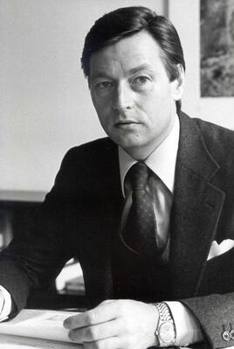
150+ Murdered: by Intelligence Services
Why / How they Alfred Herrhausen:
Chairman of Deutsche Bank killed by a MILITARY-GRADE bomb hidden in a child's knapsack on a bicycle.
Killed 21 DAYS after the Berlin Wall fell. Was scheduled to present his reunification plan the NEXT DAY.
The bomb used an INFRARED TRIGGER that distinguished his armored car from the lead vehicle — military precision.
He said weeks before: "I know there is a group of people who have an INTEREST in my death."
Case remains COMPLETELY UNSOLVED — no arrests, no trial, no accountability after 35+ years.
Alfred Herrhausen
Read List Here:
Dead at Age 59
https://intelligencemurders.com/intel

Slide 8
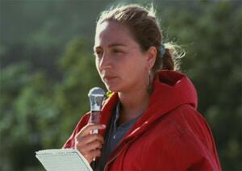
150+ Murdered: by Intelligence Services
Why / How they Ilaria Alpi:
Italian journalist, age 32. AMBUSHED by a 7-man commando in Mogadishu. Shot EXECUTION-STYLE in the temple.
She was investigating ILLEGAL ARMS trafficking and TOXIC WASTE dumping involving Italian intelligence (SISMI).
The only man convicted served 17 YEARS in prison — then was ACQUITTED and awarded 3.1 MILLION euros.
That wrongfully convicted man was later KILLED BY A CAR BOMB in Mogadishu in 2022.
Her cameraman's final footage has NEVER been recovered — the attackers wanted the evidence destroyed.
Ilaria Alpi
Read List Here:
Dead at Age 32
https://intelligencemurders.com/intel

Slide 9
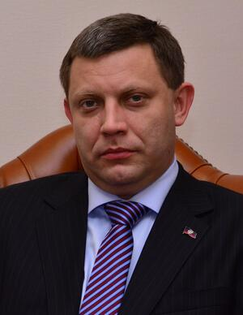
150+ Murdered: by Intelligence Services
Why / How they Alexander Zakharchenko:
Blown up by a BOMB hidden inside a cafe he visited DAILY in Donetsk. Age 42.
The bomb was concealed in a LIGHTING FIXTURE above his usual seat — someone knew his exact habits.
Both Ukraine AND Russia have been accused. His own security apparatus was likely PENETRATED.
His successor was installed within DAYS — someone was READY for his removal.
Part of a pattern: separatist leaders in Donbas were being ELIMINATED one by one.
Alexander Zakharchenko
Read List Here:
https://intelligencemurders.com/intel
Dead at Age 42

Slide 10
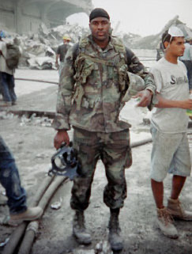
150+ Murdered: by Intelligence Services
Why / How they Jason Thomas:
Cancer researcher with DEPARTMENT OF DEFENSE contracts through Novartis. Age 45. Found dead in a FROZEN LAKE.
Disappeared December 2025 after leaving behind his wallet, phone, and Apple Watch — watch was in the MAILBOX.
His body was submerged in ice for THREE MONTHS, severely limiting forensic evidence.
Part of a CLUSTER of scientist deaths in 2025-2026 that drew CONGRESSIONAL attention.
Both parents died within ONE HOUR of each other weeks before. Official cause of death STILL NOT RELEASED.
Jason Thomas
Read List Here:
Dead at Age 45
https://intelligencemurders.com/intel

Slide 11
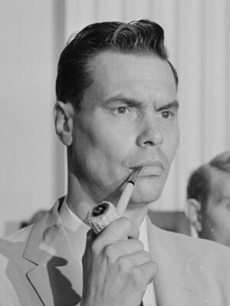
150+ Murdered: by Intelligence Services
Why / How they George Lincoln Rockwell:
Political assassination & SHOT FROM A ROOFTOP at a laundromat parking lot. Age 49. A US Army COUNTERINTELLIGENCE AGENT was an eyewitness.
The FBI's COINTELPRO program was actively INFILTRATING and fomenting INTERNAL CONFLICT in his organization at the time.
The convicted killer was an EXPELLED former member
The evidence was ENTIRELY CIRCUMSTANTIAL. The killer NEVER confessed.
The same COINTELPRO program coordinated the killing of Black Panther leader Fred Hampton two years later — proving the FBI was willing to FACILITATE assassinations.
George Lincoln Rockwell
Read List Here:
https://intelligencemurders.com/intel
Dead at Age 49

Slide 12
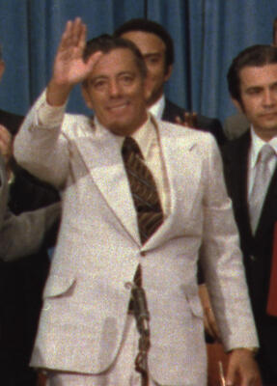
150+ Murdered: by Intelligence Services
Why / How they Omar Torrijos:
Panama's leader who won the CANAL back from America — killed in a plane crash at age 52, just TWO YEARS after signing the treaty.
Ecuador's president died in a NEARLY IDENTICAL plane crash just 68 DAYS earlier — both had defied US economic interests.
A former CIA insider wrote: "When Torrijos refused to be CORRUPTED, the CIA escalated to ASSASSINATION."
Key investigative documents DISAPPEARED during the 1989 US invasion of Panama — when American forces DESTROYED the defense headquarters.
His death cleared the way for CIA asset Manuel NORIEGA to seize power — until the US invaded AGAIN to remove him.
Omar Torrijos
Read List Here:
Dead at Age 52
https://intelligencemurders.com/intel

Slide 13
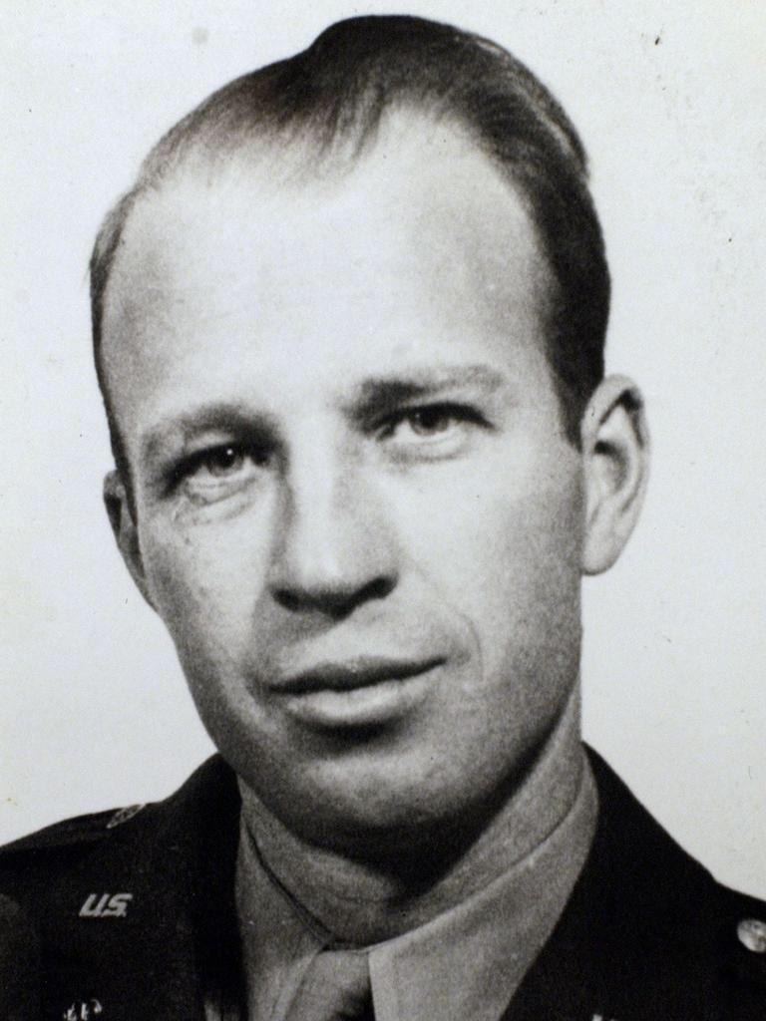
150+ Murdered: by Intelligence Services
Why / How they Frank Olson:
FELL from a 13th-floor hotel window at age 43 — CIA scientist dosed with LSD under MKULTRA nine days earlier.
His family fought for DECADES to prove it was murder, not suicide.
A 1994 exhumation found a previously undetected CRANIAL INJURY consistent with a blow to the head before the fall.
The CIA admitted in 1975 they had secretly dosed him with LSD. His "suicide" was the cover story.
Manhattan DA reopened the case as a HOMICIDE investigation in 1996.
Worked on biological weapons at Fort Detrick — knew secrets the CIA could not afford to let out.
Frank Olson
Read List Here:
Dead at Age 43
https://intelligencemurders.com/intel

Slide 14
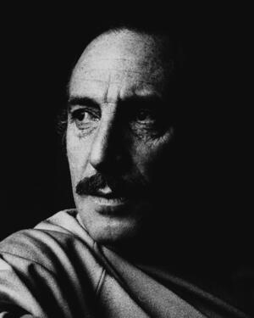
150+ Murdered: by Intelligence Services
Why / How they Orlando Letelier:
Chilean diplomat — killed by a CAR BOMB on Embassy Row in Washington, DC, less than 2 km from the WHITE HOUSE.
His 25-year-old American colleague Ronni Moffitt DROWNED in her own blood from shrapnel that pierced her throat.
Declassified CIA documents state: "PINOCHET PERSONALLY ORDERED" the assassination.
Kissinger BLOCKED a State Department warning to Condor nations FIVE DAYS before the bombing — a warning that could have PREVENTED it.
The American-born assassin who BUILT the bomb served only 62 MONTHS in prison and got a new identity through witness protection.
Orlando Letelier
Read List Here:
Dead at Age 44
https://intelligencemurders.com/intel

Slide 15
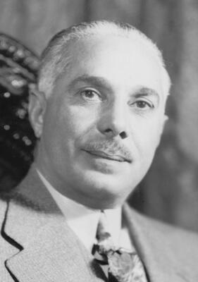
150+ Murdered: by Intelligence Services
Why / How they Rafael Trujillo:
CIA SUPPLIED the weapons. Dominican dictator ambushed and machine-gunned in his car on a highway.
Ruled for 31 YEARS. Murdered the Mirabal sisters. Ordered the Parsley Massacre killing up to 30,000 Haitians.
CIA's internal report admitted "quite extensive Agency involvement" — then PUBLICLY claimed only a "faint connection."
Kennedy sent a cable saying the US "cannot condone assassination" — TWO DAYS before the hit. Weapons already delivered.
Church Committee confirmed this as ONE OF FIVE CIA assassination plots against foreign leaders.
Rafael Trujillo
Read List Here:
Dead at Age 69
https://intelligencemurders.com/intel

Slide 16
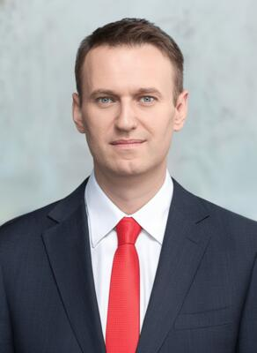
150+ Murdered: by Intelligence Services
Why / How they Alexei Navalny:
Survived FSB NOVICHOK poisoning in 2020, then TRICKED his assassin into confessing on a recorded phone call.
Died in an ARCTIC prison at age 47. Five European nations confirmed he was poisoned with FROG TOXIN.
Appeared HEALTHY at a court hearing ONE DAY before his death. Russia claims "cardiac arrhythmia."
His anti-corruption videos exposing Putin's $1.35 BILLION palace got 130 MILLION views on YouTube.
His wife vowed to continue his work. "If they decide to KILL me, it means we are incredibly STRONG."
Alexei Navalny
Read List Here:
Dead at Age 47
https://intelligencemurders.com/intel

Slide 17
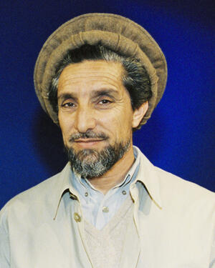
150+ Murdered: by Intelligence Services
Why / How they Ahmad Shah Massoud:
Assassinated EXACTLY 2 DAYS before 9/11. Al-Qaeda hid a BOMB inside a stolen TV camera.
Known as the "LION of Panjshir" — the most feared guerrilla commander the Soviets ever faced.
WARNED the European Parliament months earlier that a MASSIVE attack on America was coming.
Killed by fake journalists who asked: "What will you do with Osama bin Laden?" Then DETONATED the bomb.
His death removed the ONE Afghan leader who could have cooperated with the US response to 9/11.
Ahmad Shah Massoud
Read List Here:
https://intelligencemurders.com/intel
Dead at Age 48

Slide 18
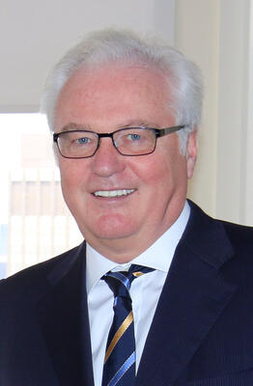
150+ Murdered: by Intelligence Services
Why / How they Vitaly Churkin:
Russia's UN Ambassador died SUDDENLY in New York, one day before his 65th birthday. Autopsy results SUPPRESSED.
The NYC Medical Examiner said cause of death needed "further study" — then the US State Department BLOCKED the release.
Russia also opposed disclosure, saying the results could "HURT HIS REPUTATION." A cryptic comment that fuels speculation.
His death came during a cluster of at least SIX Russian diplomat deaths in a four-month period.
Two governments — the US AND Russia — actively conspired to keep the public from knowing HOW he died.
Vitaly Churkin
Read List Here:
Dead at Age 64
https://intelligencemurders.com/intel

Slide 19
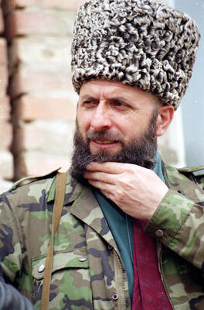
150+ Murdered: by Intelligence Services
Why / How they Zelimkhan Yandarbiyev:
Former Chechen president killed by a CAR BOMB in Qatar. His 13-year-old son was in the car and critically injured.
Age 51. Poet, children's author, and father of Chechen independence. Assassinated after Friday PRAYERS at a mosque.
Two GRU agents CAUGHT, TRIED, and CONVICTED by a Qatari court — found to have acted on orders from Russia's Defense Minister.
Russia forced Qatar to send the agents HOME. They got a HEROES' WELCOME in Moscow and were NEVER imprisoned.
Russian prison officials openly said the Qatari life sentence was "IRRELEVANT" in Russia.
Zelimkhan Yandarbiyev
Read List Here:
Dead at Age 51
https://intelligencemurders.com/intel

