Slide 1
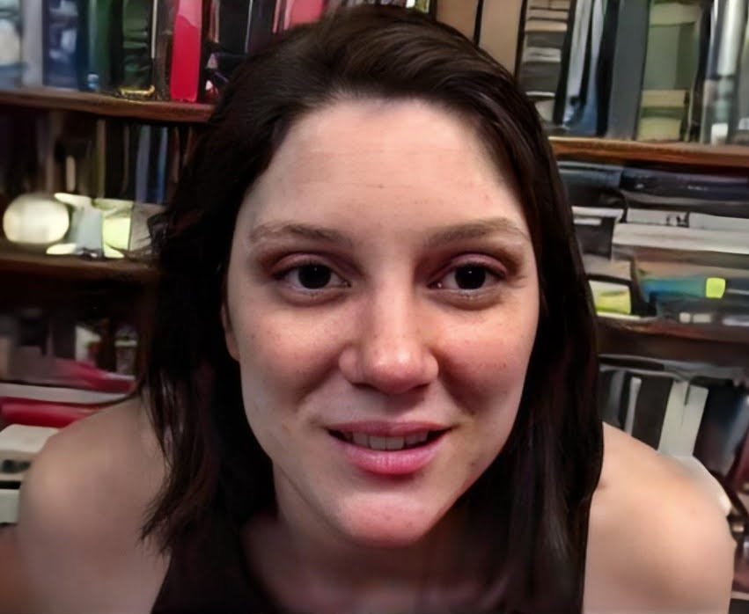
60+ Murdered: Energy Inventors Silenced
Why / How they Amy Eskridge:
Anti-gravity researcher found DEAD of a gunshot wound at age 34 in Huntsville, Alabama — ruled SUICIDE.
Co-founded the Institute for Exotic Science. Her father was a NASA plasma fusion engineer at Redstone Arsenal.
She WARNED publicly about "men in black" forces that come for anyone cracking the veil too wide.
A retired UK intelligence officer alleged she was MURDERED with directed energy weapons by a private aerospace company.
Body RAPIDLY CREMATED. No autopsy details released. No police reports. Someone who spoke with her 4 hours before does NOT believe it was suicide.
Her institute CEASED operations after her death. The research died with her.
Amy Eskridge
Read List Here:
Dead at Age 34
https://uapmurders.com/energy

Slide 2
- Michael Zebuhr (2006) — Directed energy researcher, age 25, shot
execution-style during a "robbery" where robbers already had the purse. His
advisor received an email: "We've done it before and we will do it again."
- Arie DeGeus (2007) — Clean energy inventor found dead of heart failure in
airport parking lot, en route to Europe to secure major funding. Associates say
he was in good health.
- Zachary Warfield (2011) — Former CIA science/weapons analyst with MIT
propulsion credentials, age 35, died in boating accident on the Potomac after
visiting plasma battery inventors.
- Fred Bell (2011) — Nuclear physicist and fusion researcher, died of heart
attack within 48 hours of filming interview with Jesse Ventura about classified
directed-energy beam weapon technology.
- James Allen (2013) — Filmmaker of "Zero Point" documentary on antigravity/ZPE
testimony. Dead within 3 months of cancer diagnosis. Blood reportedly contained
12 heavy metals and radioisotopes at toxic levels including thorium and uranium.
- John Rossi (2016) — Two-star general commanding U.S. Army Space and Missile
Defense at Redstone Arsenal, found hanged two days before three-star promotion.
Connects to Amy Eskridge and Ning Li at Huntsville.
- Mark McCandlish (2021) — Aerospace illustrator and ARV/Flux Liner researcher,
gunshot wound to head ruled suicide. Reportedly had offered to testify before
Senate Intelligence Committee about electrogravitic propulsion.
- Amy Eskridge (2022) — Anti-gravity researcher, age 34, co-founder of Institute
for Exotic Science in Huntsville. Gunshot ruled suicide. Was uncovering secrets
at Redstone Arsenal. Retired UK intel officer alleged she was "murdered by a
private aerospace company." Case included in Congressional UAP testimony.
- Monica Jacinto Reza (2025) — Co-inventor of Mondaloy superalloy, JPL NASA
Technical Fellow. Vanished on hike; FLIR-negative, scent trail terminated, body
never recovered. Part of AFRL cluster.
- Melissa Casias (2025) — LANL employee, DOE advisory board. Factory-reset both
phones, walked into wilderness four days after Reza. Not found.
- 1st Lt. Jaime Gustitus (2025) — AFRL 711th Human Performance Wing, Air Force
Academy 2022, Top Secret/SCI clearance, age 25. Shot by AFRL colleague with no
established motive. Part of AFRL cluster.
- Jaymee Prichard (2025) — AFLCMC finance specialist at Wright-Patterson.
Strangled by husband (also AFRL). Part of the same Wright-Patterson triple-death
event.
- Carl Grillmair (2026) — Caltech/IPAC astronomer working on dual-use infrared
detection. Shot at home. Killer's armed trespass charges dismissed 11 days
before murder. Part of AFRL cluster.
- William Neil McCasland (2026) — Retired USAF Major General, former AFRL
Commander, SAPOC executive secretary. Vanished from Albuquerque. Phone and
glasses left behind. FBI searching. WikiLeaks emails show him coordinating with
Podesta and Skunk Works.

Slide 3
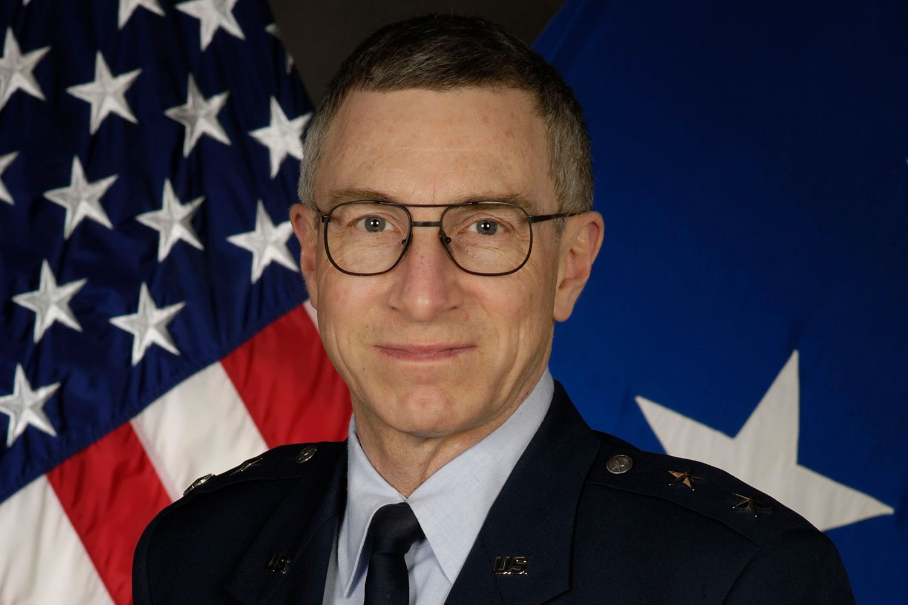
60+ Murdered: Energy Inventors Silenced
Why / How they William Neil McCasland:
Former commander of the entire Air Force Research Laboratory — VANISHED from his Albuquerque home on February 27, 2026.
Executive secretary of the Special Access Program Oversight Committee — he knew EVERY SAP in the Department of Defense.
Named in WikiLeaks Podesta emails coordinating UAP disclosure with the Clinton campaign.
Left behind his phone, glasses, and wearable devices. FBI is searching.
Eight months earlier, the inventor of the superalloy HIS BUDGET funded also VANISHED. Two gone.
William Neil McCasland
Read List Here:
https://uapmurders.com/energy

Slide 4

60+ Murdered: Energy Inventors Silenced
Why / How they Aaron Salter Jr:
SHOT and KILLED at age 55 while working as a security guard at a Buffalo, NY supermarket.
Retired Buffalo police officer who had demonstrated a WATER-POWERED CAR on local TV just two months before the shooting.
He was one of 10 victims in the Tops supermarket mass shooting — but he's the only one who had just gone public with free energy tech.
Confronted the gunman and FIRED BACK, hitting his body armor — died a hero trying to protect shoppers.
Same pattern as Stanley Meyer — go public with water-car tech, end up DEAD.
Aaron Salter Jr
Read List Here:
Dead at Age 55
https://uapmurders.com/energy

Slide 5
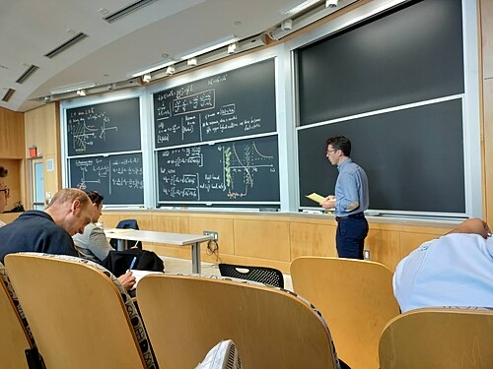
60+ Murdered: Energy Inventors Silenced
Why / How they Nuno Loureiro:
MIT plasma physicist and fusion center director SHOT DEAD outside his apartment in Brookline, MA — age 47.
Portuguese-born professor, one of the world's leading plasma physicists. Director of MIT's Plasma Science and Fusion Center.
KILLED in December 2025 — part of a cluster of scientist deaths in the same period.
His work on plasma physics sits at the heart of fusion energy — the technology that replaces ALL fossil fuels.
A world-class fusion scientist shot dead outside his home. The future of energy, MURDERED on a sidewalk.
Nuno Loureiro
Read List Here:
Dead at Age 47
https://uapmurders.com/energy

Slide 6
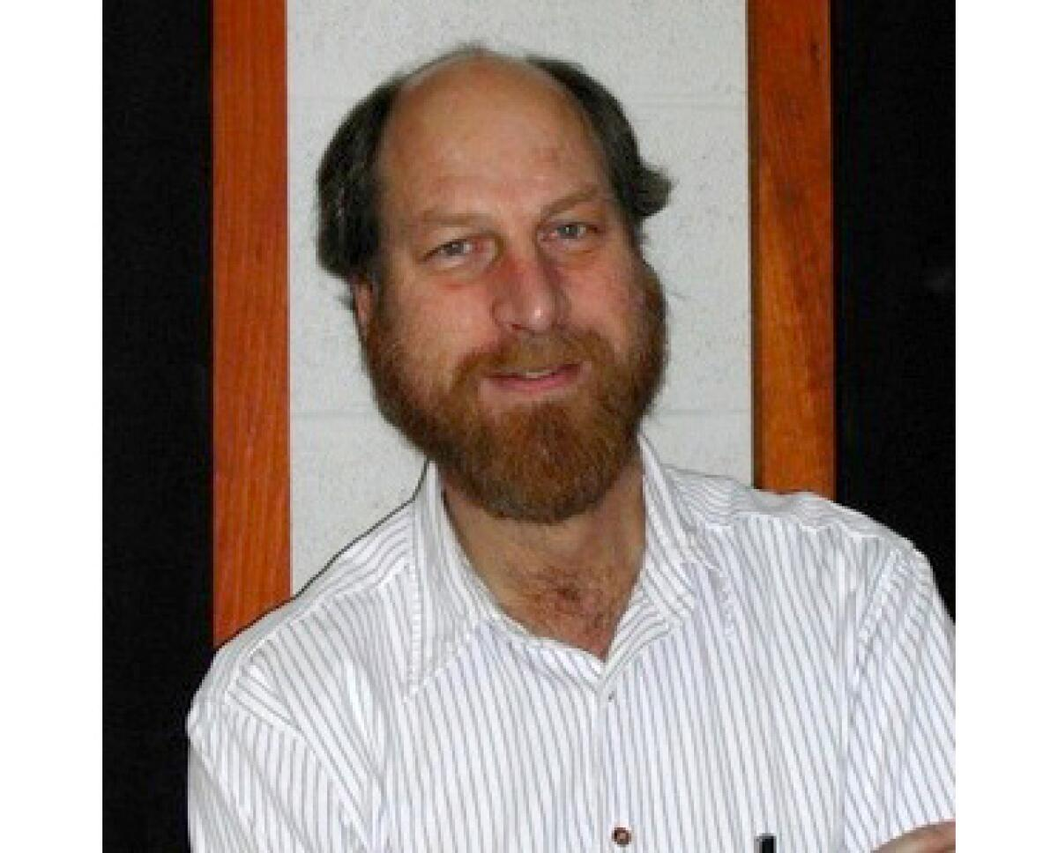
60+ Murdered: Energy Inventors Silenced
Why / How they Carl Grillmair:
Caltech astrophysicist SHOT DEAD on his front porch at 6:10 AM — age 67, Llano, California.
147 peer-reviewed papers. NASA medal. Instrument specialist for the NEO Surveyor space telescope.
The suspect had been ARRESTED on his property two months earlier with a loaded, unregistered rifle.
Those charges were DISMISSED eleven days before the killing. Eleven days later, the suspect was back with a gun.
His infrared detection work finds asteroids — and enemy satellites. Same math, different customer.
Carl Grillmair
Read List Here:
Dead at Age 67
https://uapmurders.com/energy

Slide 7
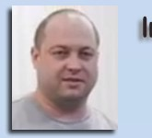
60+ Murdered: Energy Inventors Silenced
Why / How they Andrii Slobodian:
Ukrainian inventor of the MG10 perpetual magnet generator — DEAD from carbon monoxide poisoning in a Seoul apartment fire.
His 10-kilowatt magnetic generator needed NO conventional energy input — pure permanent magnet power.
The fire was blamed on a malfunctioning air conditioning unit. CO poisoning in a small apartment.
His company Infinity SAV CEASED all operations after his death — the technology DIED with him.
Carbon monoxide is the energy inventor killer: Lester Hendershot and his son both died of CO, Morris Jessup too.
Andrii Slobodian
Read List Here:
https://uapmurders.com/energy

Slide 8
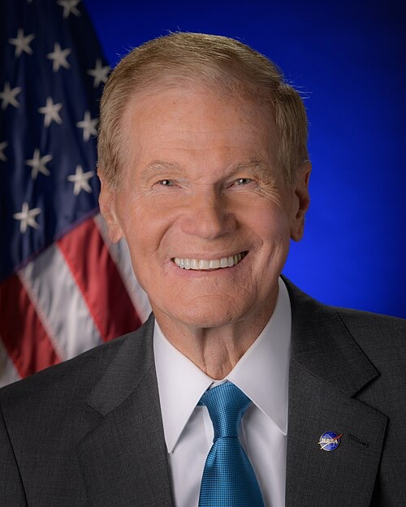
60+ Murdered: Energy Inventors Silenced
Why / How they Bill Yelon:
Invented a solid-state electromagnetic wave device producing MORE energy than it consumed.
DIED SUDDENLY in 2018 — shortly after announcing his breakthrough device.
Same pattern: Stanley Meyer DIED after investor meeting. Arie DeGeus DIED heading to get funding. Eugene Mallove KILLED before media appearance.
Almost no records of his existence survive. No patents, no papers, no media coverage.
Announce a free energy device, then DIE. The pattern is the message.
Bill Yelon
Read List Here:
https://uapmurders.com/energy

Slide 9
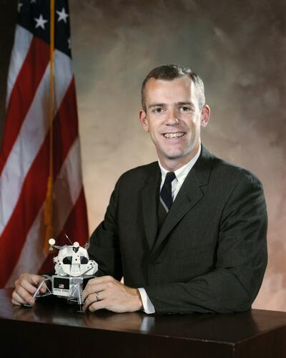
60+ Murdered: Energy Inventors Silenced
Why / How they Brian OLeary:
Former NASA ASTRONAUT and Princeton/Cornell physics professor — diagnosed with cancer and DEAD in just SIX DAYS. (CIA has quick-moving Cancel to kill quickly)
Co-founded the New Energy Movement advocating for zero-point energy and free energy technology.
His credentials made him IMPOSSIBLE to dismiss as a crank — that made him dangerous.
Moved to Ecuador after his colleague Eugene Mallove was BEATEN TO DEATH in 2004.
From diagnosis to death in under a week at age 71. The fastest cancer you've never heard of.
Brian OLeary
Read List Here:
Dead at Age 71
https://uapmurders.com/energy

Slide 10
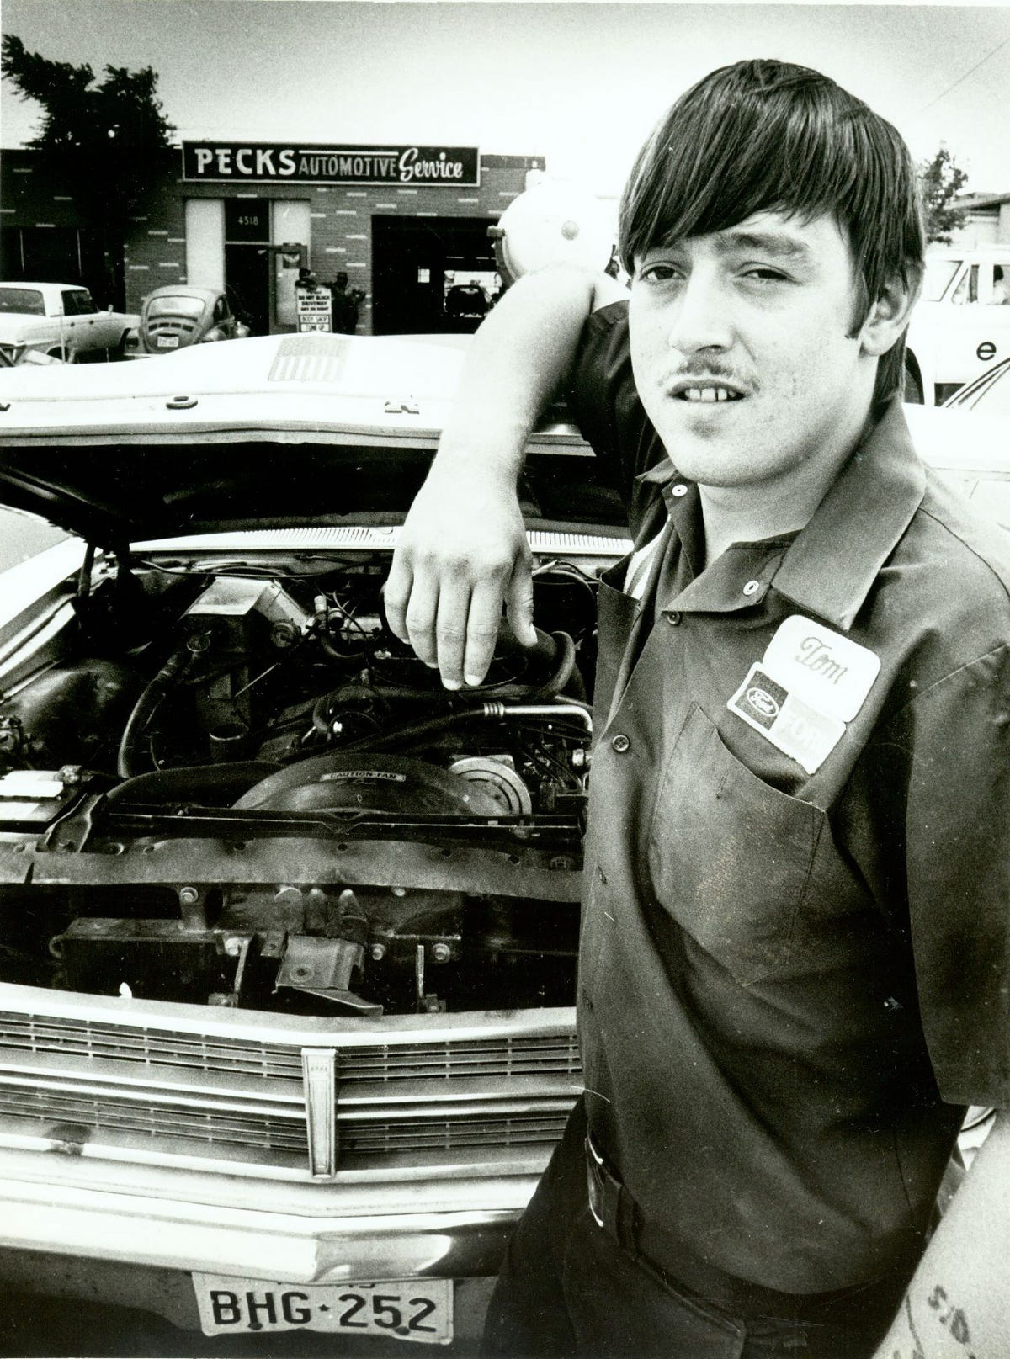
60+ Murdered: Energy Inventors Silenced
Why / How they Tom Ogle:
Demonstrated 100+ MPG on live TV by driving 200 miles on 2 gallons — then SHOT outside a bar at ~24.
Told his attorney people were DRUGGING his drinks. Found dead of a Darvon and alcohol OVERDOSE. Ruled suicide.
His fuel vapor system attracted national attention and investor interest in El Paso, Texas.
The SEC hit his business partners with an injunction. Then he was shot. Then he was drugged. Then he was DEAD.
Demonstrated it on national TV. Shot. Drugged. Dead at 24. Ruled "suicide." The playbook in action.
Tom Ogle
Read List Here:
https://uapmurders.com/energy
Dead at Age 28

Slide 11
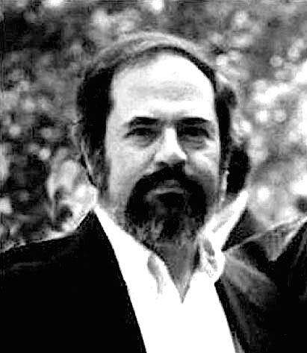
60+ Murdered: Energy Inventors Silenced
Why / How they Eugene Mallove:
BEATEN TO DEATH at age 56 — crushed trachea, 32 LACERATIONS to his face from a blunt instrument.
The most prominent cold fusion advocate in America. Former MIT science writer. Founded Infinite Energy magazine.
KILLED days before a scheduled Coast to Coast AM radio appearance reaching millions of listeners.
Was actively lobbying Congress and the Department of Energy for renewed cold fusion funding.
His murder was blamed on former tenants in a "housing dispute." The most savage housing dispute in history.
Eugene Mallove
Read List Here:
Dead at Age 56
https://uapmurders.com/energy

Slide 12
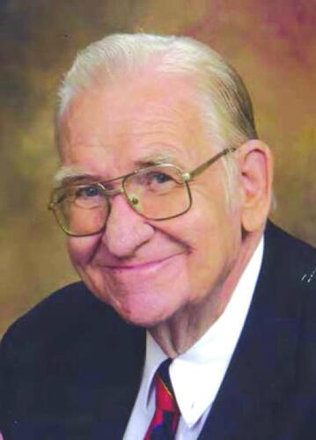
60+ Murdered: Energy Inventors Silenced
Why / How they Boyd Bushman:
Lockheed Martin senior scientist with 26 patents and a 40-year defense career — waited until his DEATHBED to talk.
Recorded a video claiming direct involvement in ANTIGRAVITY research and reverse-engineering exotic propulsion at Area 51.
He was so AFRAID of retaliation that he stayed silent his entire career — only spoke when he was already dying.
His claims align with David Grusch's 2023 congressional testimony about secret reverse-engineering programs.
Died at 78 of natural causes. The suppression isn't always murder — sometimes it's a LIFETIME OF SILENCE.
Boyd Bushman
Read List Here:
Dead at Age 78
https://uapmurders.com/energy

Slide 13
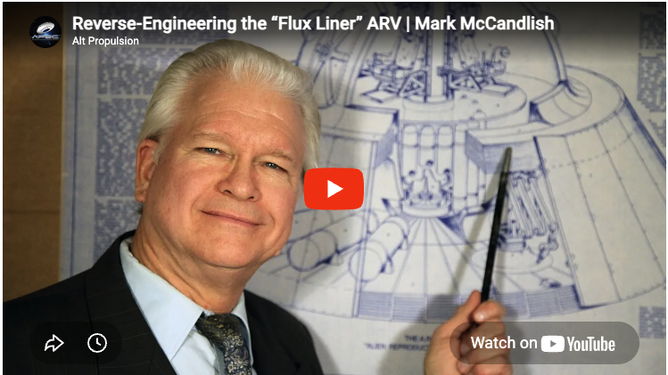
60+ Murdered: Energy Inventors Silenced
Why / How they Mark McCandlish:
Aerospace illustrator SHOT in the head at age 65 — ruled SUICIDE with his own 9mm SIG Sauer P226.
Had offered to testify before the Senate Intelligence Committee about the Alien Reproduction Vehicle.
Described electrogravitic propulsion technology — zero-point energy harnessed for craft propulsion.
His testimony would have connected classified energy tech to UAP reverse-engineering programs.
Offer to testify before the Senate about antigravity craft, then a bullet to the head. Ruled suicide.
Mark McCandlish
Read List Here:
Dead at Age 65
https://uapmurders.com/energy

Slide 14
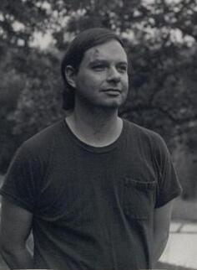
60+ Murdered: Energy Inventors Silenced
Why / How they Bruce DePalma:
MIT-educated physicist who invented the N-Machine — DIED weeks before the official test of his device.
Claimed his generator produced MORE energy than it consumed — 4:1 ratio or higher.
Astronaut Edgar Mitchell warned him: "CIA... you might get your HEAD blown off."
FLED the United States to New Zealand after a lifetime of suppression and death threats.
Bled to death internally at age 62. When the N-Machine was tested after his death — without his calibration knowledge — it FAILED.
Bruce DePalma
Read List Here:
Dead at Age 62
https://uapmurders.com/energy

Slide 15
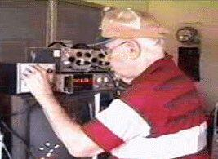
60+ Murdered: Energy Inventors Silenced
Why / How they Floyd Sweet:
Invented the Vacuum Triode Amplifier — claimed 500 watts output from 33 MICROWATTS input.
Received DEATH THREATS and became increasingly reclusive and fearful in his later years.
The day he DIED, unknown men came to his house, had coffee, and left. Hours later his wife found him dead.
The NEXT DAY, authorities showed up and CONFISCATED all research materials, devices, and notes.
Died at 83 of a "heart attack." Men visit, inventor dies, research vanishes. Textbook suppression.
Floyd Sweet
Read List Here:
Dead at Age 83
https://uapmurders.com/energy

Slide 16
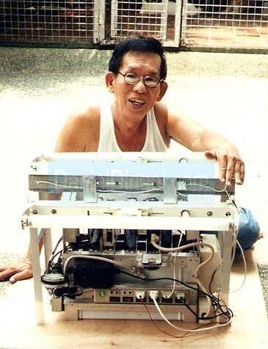
60+ Murdered: Energy Inventors Silenced
Why / How they Daniel Dingel:
Filipino inventor who demonstrated a WATER-POWERED CAR for over 40 years to media and government officials.
Convicted of FRAUD at age 82 and sentenced to 20 years in prison — a death sentence for an old man.
DIED in custody in 2010 at age 84. The technology died with him.
He was only prosecuted AFTER entering a partnership that would have commercialized the tech.
Multiple water fuel inventors have been KILLED or silenced. Dingel was neutralized through the legal system.
Daniel Dingel
Read List Here:
Dead at Age 84
https://uapmurders.com/energy

Slide 17
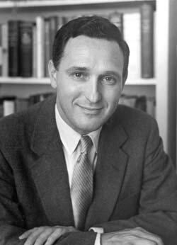
60+ Murdered: Energy Inventors Silenced
Why / How they Andrija Puharich:
FELL down a flight of stairs and DIED at age 76 — a physician with 50+ patents and CIA connections.
Held U.S. Patent for splitting water molecules into hydrogen fuel — technology that threatened Big Oil.
His home and laboratory were DESTROYED BY ARSON in 1979 — he blamed the CIA and fled to Mexico.
Allegedly received direct CIA ASSASSINATION THREATS and capitulated after a meeting with Rockefeller interests.
Died broke, waiting for a Social Security check, unable to afford to move after an eviction. From 50 patents to poverty.
Andrija Puharich
Read List Here:
Dead at Age 76
https://uapmurders.com/energy

Slide 18
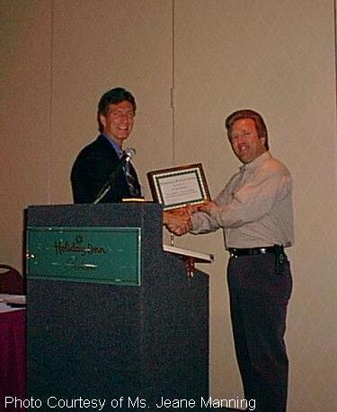
60+ Murdered: Energy Inventors Silenced
Why / How they Paul Brown:
Inventor of the Nucell resonant nuclear battery — KILLED in an automobile accident in Boise, Idaho.
His device converted nuclear decay directly into AC electricity without radioactive waste. Designed to last 25 YEARS.
Before his death: home ROBBED three times, VANDALIZED four times, twice falsely accused of drug manufacturing, mother's car PIPE-BOMBED.
In 1991 he wrote a public letter saying he was being "PERSECUTED" and appealing for awareness.
Robbed, vandalized, framed, bombed, then dead in a car "accident." That's not bad luck — that's a campaign.
Paul Brown
Read List Here:
https://uapmurders.com/energy

Slide 19
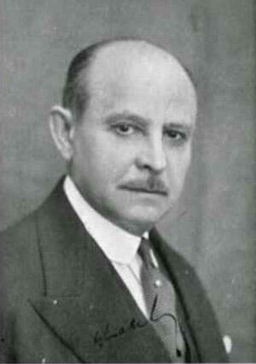
60+ Murdered: Energy Inventors Silenced
Why / How they Georges Lakhovsky:
STRUCK and KILLED by a limousine in New York at age 72 — just as his electromagnetic therapy device was producing results in hospital trials.
Inventor of the Multi-Wave Oscillator, a device treating cancer with electromagnetic resonance.
Within weeks of his death, his equipment was ORDERED REMOVED from every hospital using it.
Patients were told the therapy was "no longer available." The machines simply VANISHED.
Killed while his tech was gaining credibility. Dead inventor, removed machines, silenced patients.
Georges Lakhovsky
Read List Here:
https://uapmurders.com/energy
Dead at Age 72

Slide 20
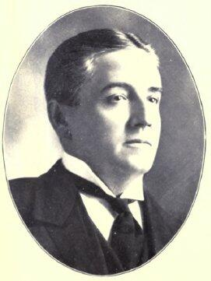
60+ Murdered: Energy Inventors Silenced
Why / How they George Taylor Fulford:
Major General Electric shareholder KILLED in a car crash one week after announcing he'd fund Tesla's wireless energy project.
Became Canada's FIRST automobile fatality at age 53. His chauffeur survived.
After his death, his GE stock ended up in ROCKEFELLER hands. Tesla's Wardenclyffe Tower was starved of capital.
The Fulford family has maintained for over a CENTURY that the crash was arranged.
Fund Tesla's free energy project, die in a car "accident" seven days later. In 1905.
George Taylor Fulford
Read List Here:
https://uapmurders.com/energy
Dead at Age 53

Slide 21
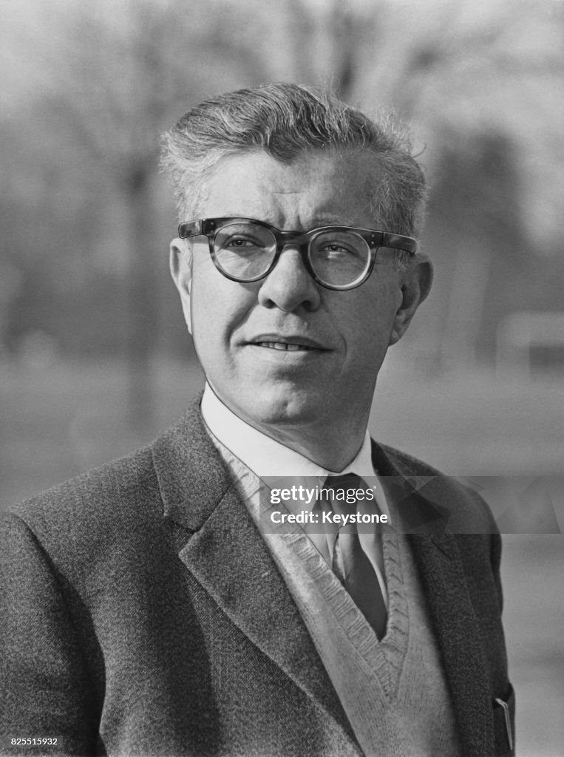
60+ Murdered: Energy Inventors Silenced
Why / How they Fred Bell:
Nuclear physicist found DEAD within 48 hours of filming a TV interview about classified DEATH RAY technology.
Interviewed by Jesse Ventura for Conspiracy Theory — dropped "several BOMBSHELLS" about directed-energy weapons.
Early career included high-temperature fusion experiments and nuclear particle bombardment at Michigan's cyclotron.
Official cause: heart disease and obesity. Ventura publicly expressed SKEPTICISM about the ruling.
Film an interview about classified energy weapons on Monday, be DEAD by Wednesday. At age 68.
Fred Bell
Read List Here:
Dead at Age 68
https://uapmurders.com/energy

Slide 22
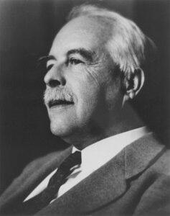
60+ Murdered: Energy Inventors Silenced
Why / How they Gilbert N Lewis:
Found DEAD in his Berkeley lab at age 70 — near a broken line of liquid HYDROGEN CYANIDE.
Pioneering chemist who coined the word "photon" and did foundational work on thermodynamics.
Coroner ruled "coronary artery disease" — IGNORING the cyanide at the scene.
Had just lunched with his decades-long professional rival Irving Langmuir, who won the Nobel Prize Lewis deserved.
Nominated for the Nobel Prize 35 TIMES and never received it. Dead near cyanide, but officially a heart attack.
Gilbert N Lewis
Read List Here:
Dead at Age 70
https://uapmurders.com/energy

Slide 23
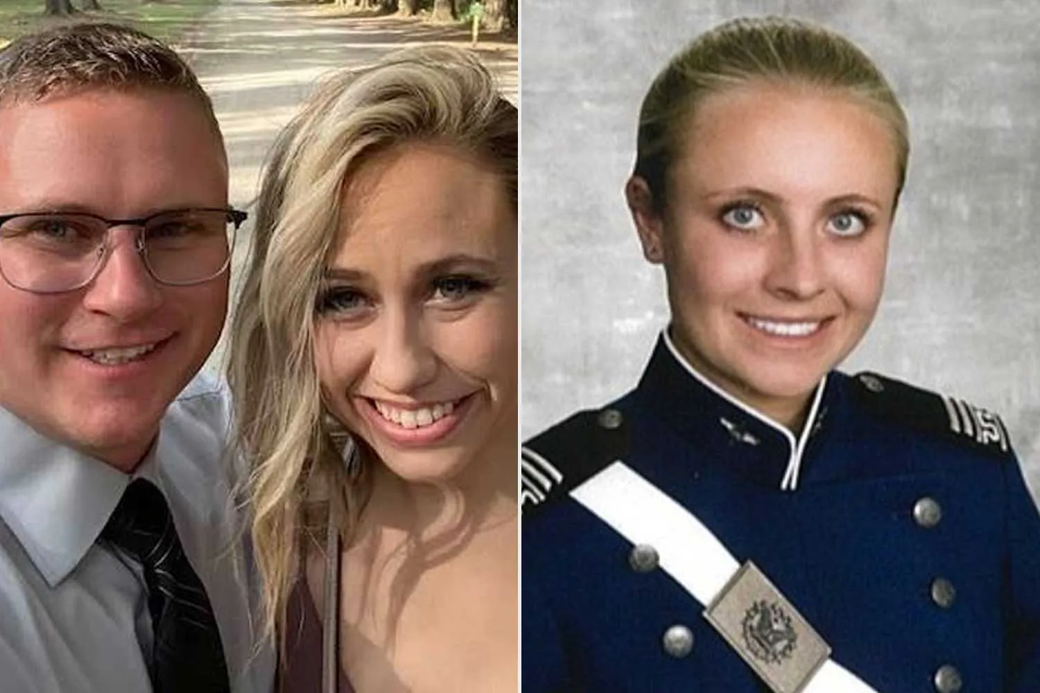
60+ Murdered: Energy Inventors Silenced
Why / How they Jacob Prichard:
AFRL Sensors Directorate employee who KILLED his wife, SHOT his colleague, then KILLED himself — age 34.
Three Wright-Patterson Air Force Base employees DEAD in one night — October 25, 2025.
No motive has EVER been established. AFOSI (Air Force counterintelligence) is investigating.
His wife Jaymee was STRANGLED and placed in his trunk. His colleague Jaime Gustitus was SHOT 5-7 times.
Part of a cluster: NINE AFRL-connected people dead or disappeared in nine months.
Jacob Prichard
Read List Here:
https://uapmurders.com/energy
Dead at Age 34

Slide 24
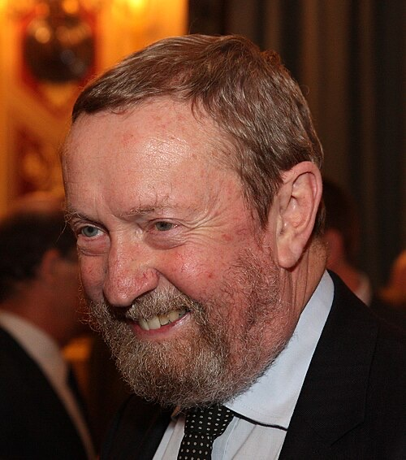
60+ Murdered: Energy Inventors Silenced
Why / How they John Bedini:
Free energy pioneer DIED SUDDENLY at age 67 — only FOUR HOURS after his brother Gary also died.
Pioneered electromagnetic energy recovery devices for decades. None ever reached the market.
Two brothers dead on the same day, four hours apart. What are the odds?
His devices demonstrated energy recovery that mainstream physics said was IMPOSSIBLE.
A lifetime of invention, and nothing made it to market. Then both brothers dead in one day.
John Bedini
Read List Here:
Dead at Age 67
https://uapmurders.com/energy

Slide 25
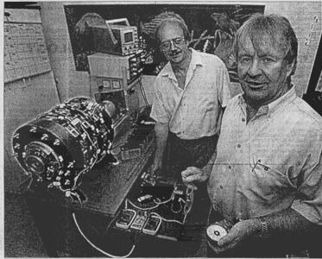
60+ Murdered: Energy Inventors Silenced
Why / How they John Christie:
Australian co-inventor of the Lutec 1000 overunity electromagnetic device — VANISHED, then confirmed dead in 2017.
His partner Lou Britz also DIED under poorly documented circumstances.
The Lutec 1000 received Australian media attention in the early 2000s — then both inventors DISAPPEARED.
No mainstream obituary. No official cause of death. Just social media posts saying he "vanished then died."
Two inventors. One device. Both dead. No explanation. No product ever reached the market.
John Christie
Read List Here:
https://uapmurders.com/energy

Slide 26
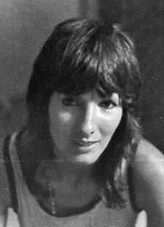
60+ Murdered: Energy Inventors Silenced
Why / How they Karen Silkwood:
KILLED in a car crash at age 28 while driving to meet a New York Times journalist with nuclear safety documents.
Dents and scrape marks on her bumper — she was FORCED OFF THE ROAD by another vehicle.
The documents she was carrying about missing PLUTONIUM and safety violations were NEVER FOUND.
She had been deliberately CONTAMINATED with plutonium in the days before her death.
Her family sued Kerr-McGee and settled for $1.38 million. The company never admitted a thing.
Karen Silkwood
Read List Here:
Dead at Age 28
https://uapmurders.com/energy

Slide 27
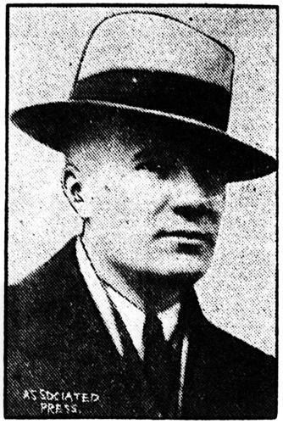
60+ Murdered: Energy Inventors Silenced
Why / How they Lester Hendershot:
Invented a "fuelless motor" that drew power from Earth's magnetic field — made FRONT-PAGE headlines in 1928.
Found DEAD of carbon monoxide poisoning in his car. Ruled SUICIDE.
His son Mark also died of carbon monoxide in his car — TEN YEARS APART. Father and son, same method.
Was paid $25,000 to STOP building generators. Attracted attention from Lindbergh and the U.S. military.
Shocked by his own device in 1928 — 2,000 volts, temporarily paralyzed. Vocal cords reportedly severed.
Lester Hendershot
Read List Here:
Dead at Age 62
https://uapmurders.com/energy

Slide 28
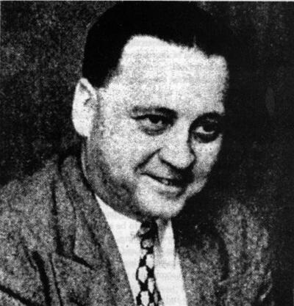
60+ Murdered: Energy Inventors Silenced
Why / How they Morris Jessup:
Found DEAD of carbon monoxide poisoning at age 59 — hose from exhaust to car window. Ruled SUICIDE.
The night before, he called a friend in HIGH SPIRITS about a breakthrough in his antigravity research.
He arranged a lunch meeting for the next day. He never made it — found dead that afternoon.
The Office of Naval Research had his annotated book on antigravity technology REPRINTED by a military contractor.
In high spirits about a breakthrough one night, dead of CO poisoning the next afternoon. Classic pattern.
Morris Jessup
Read List Here:
Dead at Age 59
https://uapmurders.com/energy

Slide 29
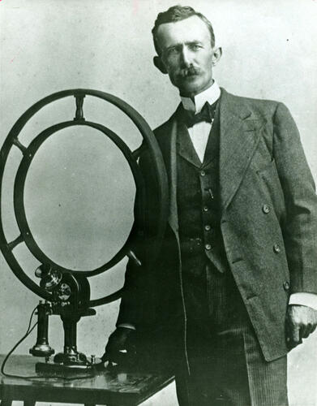
60+ Murdered: Energy Inventors Silenced
Why / How they Nathan Stubblefield:
Earth battery inventor found DEAD ALONE in his shack — STARVED to death, body gnawed by his starving cat.
Business partners DEFRAUDED him of 500,000 shares of stock. Competitors stole credit for his wireless telephone.
He destroyed his remaining prototypes so nobody else could PROFIT from them.
His earth battery drew electrical power directly from the GROUND — technology that died with him in 1928.
Not assassinated — financially destroyed over decades until he starved to death in isolation at 67.
Nathan Stubblefield
Read List Here:
Dead at Age 67
https://uapmurders.com/energy

Slide 30
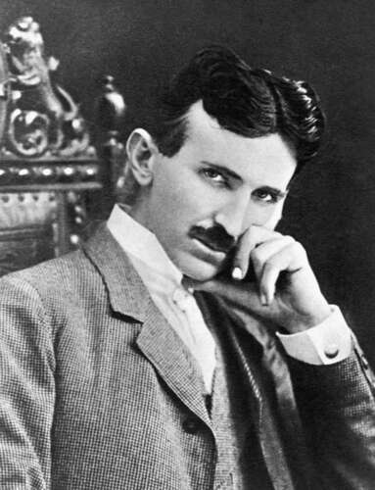
60+ Murdered: Energy Inventors Silenced
Why / How they Nikola Tesla:
The FBI SEIZED his papers within hours of his death at age 86 — under the Office of Alien Property.
He was a naturalized U.S. citizen since 1891. The "Alien Property" claim was a legal FICTION to grab his work.
His papers were reviewed by MIT's John G. Trump — who declared nothing of significance. Many papers remain UNACCOUNTED FOR.
Tesla claimed breakthroughs in wireless power, particle beam weapons, and directed energy — technologies worth TRILLIONS.
Pioneer of AC power, wireless energy, and death rays. Died alone in a hotel room. His work SEIZED by the government he served.
Nikola Tesla
Read List Here:
Dead at Age 86
https://uapmurders.com/energy

Slide 31
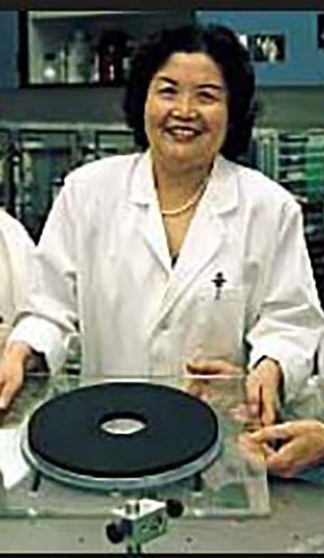
60+ Murdered: Energy Inventors Silenced
Why / How they Ning Li:
Published groundbreaking anti-gravity research, received DOD funding, got TOP SECRET clearance — then VANISHED for 17 years.
Chinese-American physicist at the University of Alabama in Huntsville — the center of U.S. antigravity research.
Suffered brain damage in a 2014 traffic accident and died of ALZHEIMER'S in 2021 at age 78.
Her company AC Gravity received $448,970 in DOD contracts and then went completely DARK.
The most promising antigravity physicist in America — classified, silenced, brain-damaged, dead.
Ning Li
Read List Here:
https://uapmurders.com/energy
Dead at Age 78

Slide 32
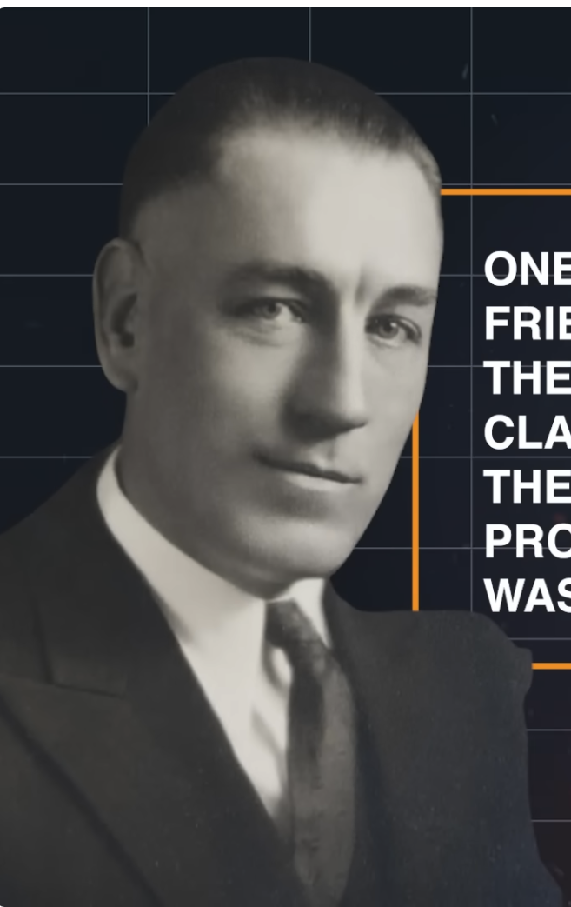
60+ Murdered: Energy Inventors Silenced
Why / How they Thomas Henry Moray:
SHOT AT multiple times. Took a bullet to the LEG in one attack. His lab was RANSACKED.
Invented the "Moray Valve" — a device that extracted usable electricity from "radiant energy" with no power source.
His own assistant Felix Frazer DESTROYED the device with an AX during a lab confrontation in 1941.
Soviet agents reportedly approached him seeking to acquire the technology.
Shot, wounded, ransacked, and then his own assistant smashed it. Died at 81 — the technology died decades earlier.
Thomas Henry Moray
Read List Here:
https://uapmurders.com/energy
Dead at Age 81

Slide 33
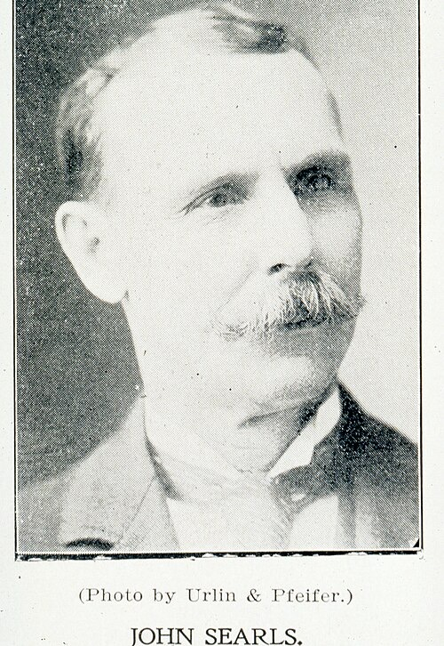
60+ Murdered: Energy Inventors Silenced
Why / How they John Searl:
British inventor of the Searl Effect Generator — a claimed free-energy and anti-gravity device. DECADES of suppression.
His home was hit by ARSON. His equipment was SEIZED. He was IMPRISONED. His wife left him. Financial ruin.
Spent his life fighting for a technology the establishment refused to acknowledge.
Died of pneumonia at age 86 in San Diego County — broke and far from home.
Arson, seizure, prison, poverty, death. The full suppression playbook, applied over a lifetime.
John Searl
Read List Here:
https://uapmurders.com/energy
Dead at Age 86

Slide 34
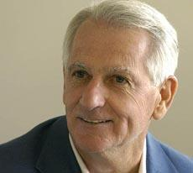
60+ Murdered: Energy Inventors Silenced
Why / How they John Kanzius:
Discovered that radio frequency waves could split hydrogen from SALT WATER — a potential game-changer.
Died at 64 of pneumonia from leukemia treatment — not murdered, but his research STALLED after his death.
No institution continued his work. The technology DIED with the inventor.
He proved you could burn salt water with radio waves. The science was real. The follow-up never came.
Not every suppression requires a bullet. Sometimes they just let the research DIE of neglect.
John Kanzius
Read List Here:
Dead at Age 64
https://uapmurders.com/energy

Slide 35
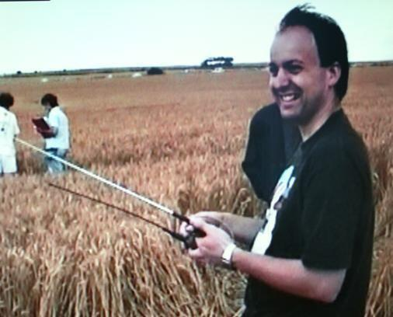
60+ Murdered: Energy Inventors Silenced
Why / How they Paul Vigay:
British computer scientist and UFO researcher found DROWNED off the coast of Portsmouth at age 44.
The coroner called his death "A MYSTERY" — no suicide note, no clear reason to enter the water.
His work involved electromagnetic field analysis and advanced propulsion physics.
Open verdict. A 44-year-old researcher doesn't just walk into the sea for no reason.
Found drowned with no explanation. The coroner's own word: MYSTERY.
Paul Vigay
Read List Here:
Dead at Age 44
https://uapmurders.com/energy

Slide 36
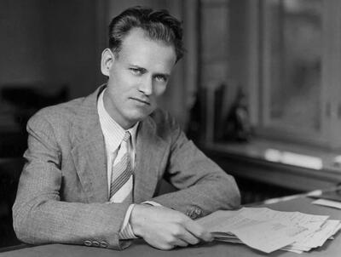
60+ Murdered: Energy Inventors Silenced
Why / How they Philo Farnsworth:
Invented electronic TELEVISION at age 21 — then built the first device to produce nuclear fusion reactions.
His fusion research was DEFUNDED by ITT under pressure from Wall Street in 1966-1967.
The Farnsworth fusor remains the FIRST device to achieve confirmed nuclear fusion — yet never developed for energy.
Died of pneumonia at 64 after years of alcoholism and a nervous breakdown caused by corporate suppression.
Gave the world television, then had his fusion breakthrough KILLED by corporate bean counters.
Philo Farnsworth
Read List Here:
https://uapmurders.com/energy
Dead at Age 64

Slide 37
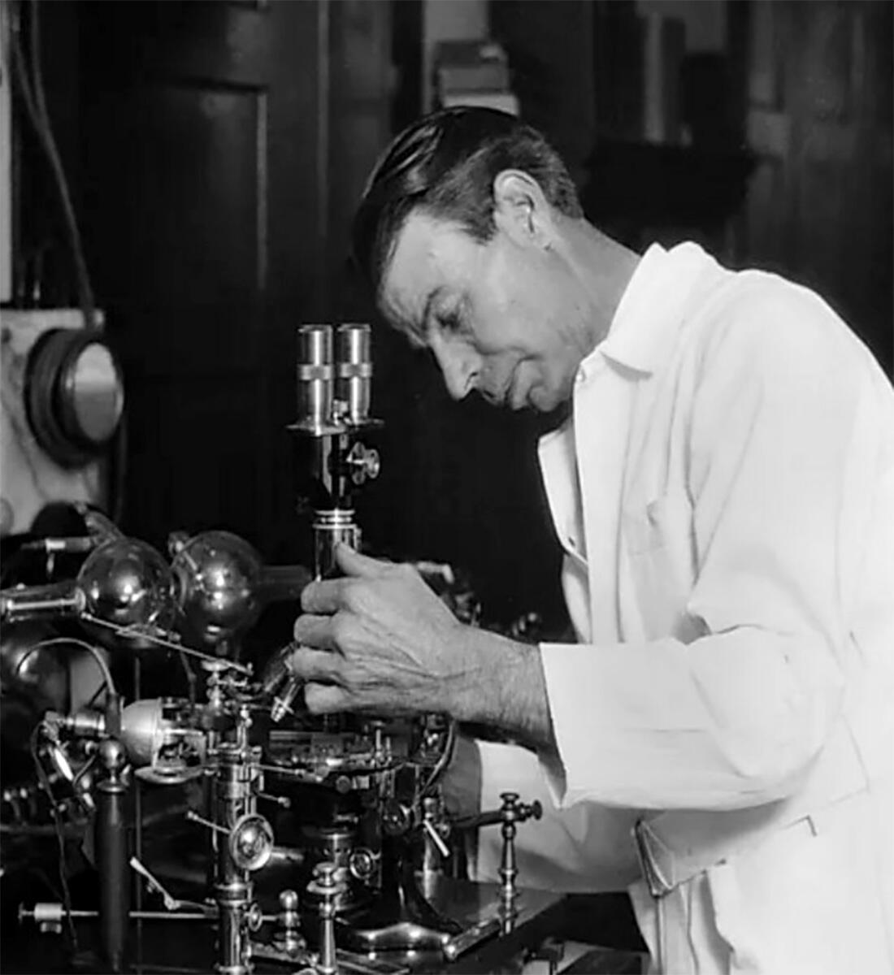
60+ Murdered: Energy Inventors Silenced
Why / How they Royal Rife:
Invented electromagnetic frequency devices for destroying pathogens — the AMA DESTROYED him.
His lab was RAIDED. His equipment was DESTROYED. His business partner was IMPRISONED for 3 years.
Physicians who used his devices were threatened with LICENSE REVOCATION by the AMA.
Driven to alcoholism and exile. Died at 83 of a heart attack complicated by Valium and alcohol overdose.
The AMA systematically bankrupted, raided, and crushed him. One of the most documented suppression cases in history.
Royal Rife
Read List Here:
Dead at Age 83
https://uapmurders.com/energy

Slide 38
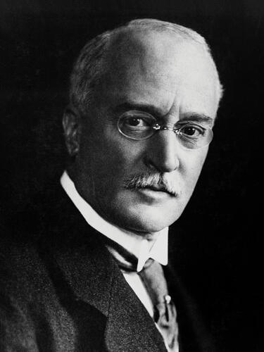
60+ Murdered: Energy Inventors Silenced
Why / How they Rudolf Diesel:
VANISHED from the SS Dresden crossing the English Channel at age 55. Body found days later in the North Sea.
He was heading to meet the British Royal Navy about powering submarines with his diesel engine.
His cabin bed was unslept in. His hat and coat were folded neatly under the deck railing.
Bank accounts nearly empty. He gave his wife 20,000 marks in cash before departing — as if he knew.
Theories: German intel killed him to stop the British deal. Oil interests killed him to protect petroleum. In 1913.
Rudolf Diesel
Read List Here:
Dead at Age 55
https://uapmurders.com/energy

Slide 39
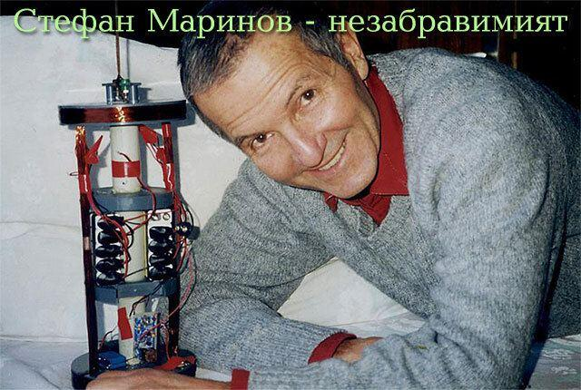
60+ Murdered: Energy Inventors Silenced
Why / How they Stefan Marinov:
Bulgarian physicist FELL from a university staircase in Graz, Austria at age 66 — ruled SUICIDE.
Russian physicist Lev Sapogin claimed Marinov "was THROWN out of the window by unknown people."
Despite leaving letters requesting people be notified, police DID NOT act on the requests.
His son — Deputy Minister of Industry of Bulgaria — was not informed for at least TWO WEEKS.
No news release about his death. Researching unconventional electromagnetic energy. Fell from a building.
Stefan Marinov
Read List Here:
Dead at Age 66
https://uapmurders.com/energy

Slide 40
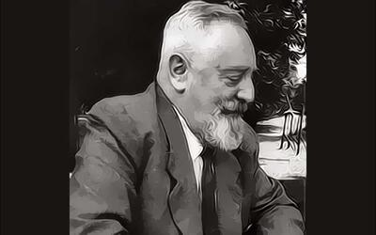
60+ Murdered: Energy Inventors Silenced
Why / How they Viktor Schauberger:
Austrian inventor of "implosion" vortex energy technology — brought to the U.S. and COERCED into signing away all rights.
Held for THREE MONTHS in America. Forced to sign documents forbidding him from continuing his research.
All his documents and models were CONFISCATED.
DIED FIVE DAYS after returning to Austria. His son described him as "a very disillusioned man."
They took everything — his technology, his documents, his rights. He died five days later of a broken heart.
His last words: "They have taken everything from me. I don't even own myself anymore."
Viktor Schauberger
Read List Here:
https://uapmurders.com/energy
Dead at Age 73

Slide 41

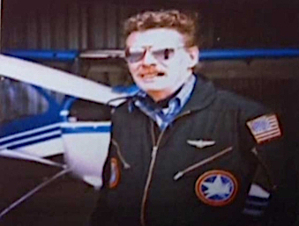
60+ Murdered: Energy Inventors Silenced
Why / How they Paul Bennewitz:
Electrical engineer DELIBERATELY DRIVEN TO A MENTAL BREAKDOWN by a coordinated Air Force disinformation campaign.
He intercepted classified military signals near Kirtland AFB — so they DESTROYED HIS MIND instead of briefing him.
Built precision instruments for NASA and the military through his company Thunder Scientific Corporation.
AFOSI agent William Moore publicly CONFESSED to participating in the operation at a 1989 MUFON conference.
They didn't kill him. They made him crazy. A documented, confessed psychological operation against a U.S. civilian.
Paul Bennewitz
Read List Here:
https://uapmurders.com/energy
Dead at Age 75

Slide 42
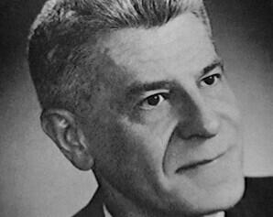
60+ Murdered: Energy Inventors Silenced
Why / How they Wilbert Smith:
Canadian government engineer who ran Project Magnet — Canada's official magnetic energy/propulsion program.
Died of cancer at age 52 after instructing his wife to HIDE all his research files.
Within DAYS of his death, intelligence representatives from THREE nations approached his wife seeking the files.
He knew they'd come for his research. His deathbed instruction was: HIDE EVERYTHING.
When three countries' spies show up at your widow's door, you were working on something REAL.
Wilbert Smith
Read List Here:
Dead at Age 52
https://uapmurders.com/energy

Slide 43
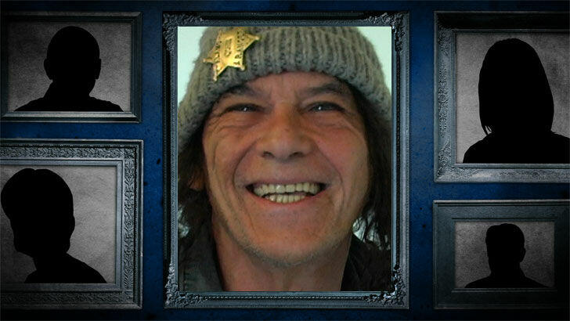
60+ Murdered: Energy Inventors Silenced
Why / How they John Hutchison:
Canadian inventor whose lab was SEIZED by the government on direct orders from PRIME MINISTER Brian Mulroney.
A Supreme Court judge ordered his equipment RETURNED — the government KEPT IT ANYWAY.
His lab contained Tesla equipment replications and was the site of the "Hutchison Effect" — levitation and metal fusion.
U.S. military officials including Lt. Col. John Alexander visited his lab. Then the government TOOK everything.
SEIZED in 1990. Court ordered return. Government DEFIED the court. Evicted again in 2010. Still alive and still suppressed.
John Hutchison
Read List Here:
https://uapmurders.com/energy

Slide 44
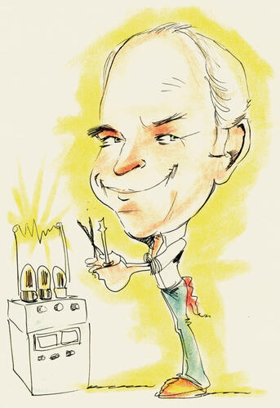
60+ Murdered: Energy Inventors Silenced
Why / How they Ken Shoulders:
The "father of vacuum microelectronics" — discovered charge clusters that implied revolutionary energy generation.
Richard Feynman initially DISMISSED his findings, then admitted Shoulders was CORRECT.
Worked under CIA contract and deliberately SELF-CENSORED, knowing his discoveries would be suppressed.
Offered his research to dozens of companies and government agencies including the VP's office. NOBODY was interested.
Died at 86 of natural causes. The suppression wasn't violent — it was total institutional SILENCE.
Ken Shoulders
Read List Here:
Dead at Age 86
https://uapmurders.com/energy

Slide 45
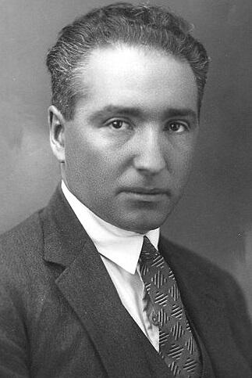
60+ Murdered: Energy Inventors Silenced
Why / How they Wilhelm Reich:
The FDA BURNED SIX TONS of his books — the only government-sanctioned book burning in U.S. history.
Developed orgone energy accumulators. The government didn't just ban the devices — they banned the WORD "orgone" in print.
IMPRISONED for contempt of court. Died of heart failure in federal prison at age 60.
He died ONE DAY before he was eligible to apply for parole. One single day.
They burned his books, banned his words, locked him up, and he died the day before freedom. In America.
Wilhelm Reich
Read List Here:
Dead at Age 60
https://uapmurders.com/energy

Slide 46
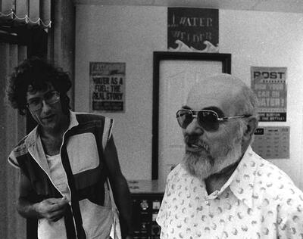
60+ Murdered: Energy Inventors Silenced
Why / How they Yull Brown:
Invented "Brown's Gas" (HHO) — a water-derived fuel that could cut through metals and neutralize RADIOACTIVE WASTE.
Declared an "ENEMY OF THE STATE" in Bulgaria. Fled to Australia.
Held valuable patents. Demonstrated his technology publicly. Died PENNILESS at 75.
His gas could neutralize radioactive waste — a multi-TRILLION dollar problem solved.
Enemy of the state, patents in hand, technology proven, died broke. The full suppression arc.
Yull Brown
Read List Here:
Dead at Age 75
https://uapmurders.com/energy

Slide 47
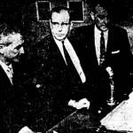
60+ Murdered: Energy Inventors Silenced
Why / How they Otis T Carr:
Protege of Nikola Tesla who claimed to have built an ANTIGRAVITY spacecraft — the OTC-X1.
ARRESTED on fraud charges just before a scheduled public demonstration. The demo was sabotaged.
He was suddenly "hospitalized" with a mysterious illness right before the demonstration.
Convicted, IMPRISONED, equipment confiscated. The FBI maintained a file on him.
Died PENNILESS in a Pittsburgh slum. From Tesla's protege to total destruction.
Otis T Carr
Read List Here:
Dead at Age 77
https://uapmurders.com/energy

Slide 48
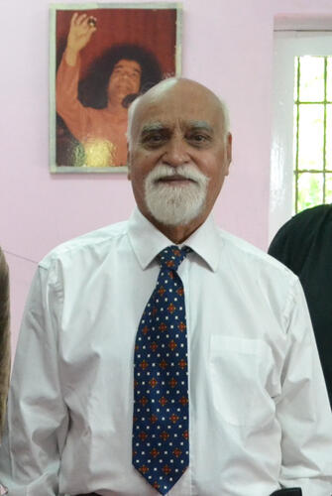
60+ Murdered: Energy Inventors Silenced
Why / How they Paramahamsa Tewari:
Retired Executive Director of Nuclear Projects for India — one of the most senior nuclear officials in the country.
Built the Tewari Reactionless Generator claiming over 250% EFFICIENCY — extracting energy from space itself.
India reportedly PERMITTED development despite alleged THREATS from the UK, US, and Saudi Arabia.
His work received commendation from Nobel Laureates early in his career.
Died at 80 of natural causes. One of the few who had a government BACKING him instead of hunting him.
Paramahamsa Tewari
Read List Here:
https://uapmurders.com/energy
Dead at Age 80

