Slide 1
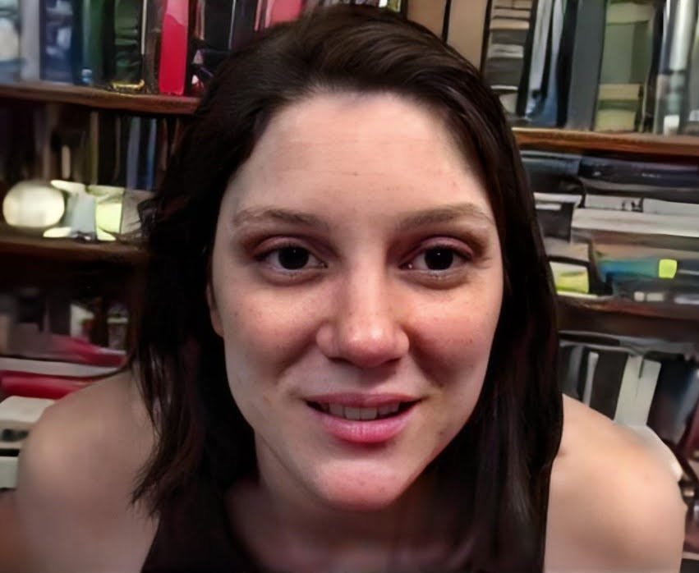
40+ Murdered: Physics Breakthroughs Hidden
Why / How they Amy Eskridge:
DEAD at 34 in Huntsville, Alabama — a retired UK intelligence officer told Congress she was MURDERED with DIRECTED ENERGY WEAPONS.
Co-founded the Institute for Exotic Science researching ANTIGRAVITY, metamaterials, and gravity modification.
Her father was a retired NASA plasma physics engineer — she needed NASA APPROVAL before presenting her antigravity findings.
Based at University of Alabama in Huntsville — same campus where another antigravity researcher, Ning Li, was targeted and SILENCED.
She told colleagues she was ready to bring antigravity research "into the open." She never got the chance.
Amy Eskridge
Read List Here:
Dead at Age 34
https://uapmurders.com/physics

Slide 2
Amy Eskridge (~2020) — Antigravity researcher, officially ruled suicide but alleged
murder via directed energy weapons per UK intelligence officer's testimony to Congress.
Was planning to present novel antigravity findings that required NASA approval.
- Mark McCandlish (2021) — Aerospace illustrator and Disclosure Project witness, gunshot
wound ruled suicide. Was about to testify before the Senate Intelligence Committee about
classified alien reproduction vehicle programs.
- Karl Wolfe (2018) — USAF veteran with top secret crypto clearance, struck by
tractor-trailer while cycling, no charges filed, driver never publicly identified.
Testified under oath about artificial structures on the far side of the Moon in
classified NASA imagery.
- Jeffrey Bradstreet (2015) — Gunshot wound to chest, found in a river three days after
the FDA raided his clinic, ruled suicide. GcMAF/nagalase researcher who testified before
Congress on vaccine safety.
- Mitchell Gaynor (2015) — Found dead in woods near his country home, ruled suicide.
Cornell-affiliated oncologist pioneering integrative cancer therapy; 11th holistic doctor
to die in a 90-day wave.
- Nicholas Gonzalez (2015) — Apparent cardiac event but autopsy did NOT confirm heart
attack, final cause never publicly clarified. Cornell-trained physician whose
enzyme-based cancer protocol threatened pharmaceutical industry.
- Timothy Cunningham (2018) — CDC epidemiologist found in the Chattahoochee River seven
weeks after vanishing, ruled suicide. Left all belongings behind; police admitted they
could not explain how his body got into the river.
- Fred Bell (2011) — Nuclear physicist who died within 48 hours of filming an interview
with Jesse Ventura about directed energy weapons and classified programs. Official cause
was heart disease.
- Monica Jacinto Reza (2025) — Vanished hiking, no trace found, declared dead four days
later while search-and-rescue was still active. Co-inventor of the Mondaloy superalloy
critical to national security rocket programs.
- William McCasland (2026) — Retired USAF Major General, vanished from his Albuquerque
home, FBI involved. Commanded Air Force Research Laboratory ($4.4B portfolio) spanning
plasma science, directed energy, and advanced propulsion; connected to UAP disclosure via
DeLonge/Podesta WikiLeaks emails.
- Jason Thomas (2025) — Novartis assistant director, left home without phone, wallet, or
coat; body found in a frozen lake three months later. Vanished three days before an MIT
physicist was shot dead 10 miles away; part of the five-scientist cluster named by Rep.
Tim Burchett.

Slide 3
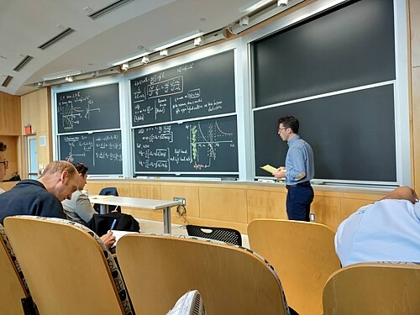
40+ Murdered: Physics Breakthroughs Hidden
Why / How they Nuno Loureiro:
SHOT DEAD at his home in Brookline, Massachusetts on December 15, 2025. He was 47.
Director of MIT's Plasma Science and Fusion Center — one of the world's LEADING fusion research facilities.
Received the Presidential Early Career Award from Joe Biden just months before his MURDER.
His breakthrough: proving that 50-year-old textbook physics on magnetic reconnection was FUNDAMENTALLY wrong.
Survived by his wife and children. Portuguese-born, Herman Feshbach Professor of Physics at MIT.
Nuno Loureiro
Read List Here:
https://uapmurders.com/physics

Slide 4
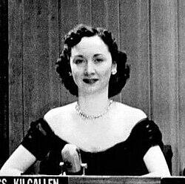
40+ Murdered: Physics Breakthroughs Hidden
Why / How they Dorothy Kilgallen:
DEAD at 52 — found in her Manhattan townhouse. Ruled "CIRCUMSTANCES UNDETERMINED" by the medical examiner.
America's most famous female journalist — 20 MILLION readers, CBS star of What's My Line? for 15 years.
In 1955 she published a front-page story: a British Cabinet official confirmed UFOs were REAL and had been examined.
She was also investigating the JFK ASSASSINATION and had a private interview with Jack Ruby.
Told her lawyer: "I'm going to break the real story and have the biggest SCOOP of the century." She never did.
Dorothy Kilgallen
Read List Here:
Dead at Age 52
https://uapmurders.com/physics

Slide 5
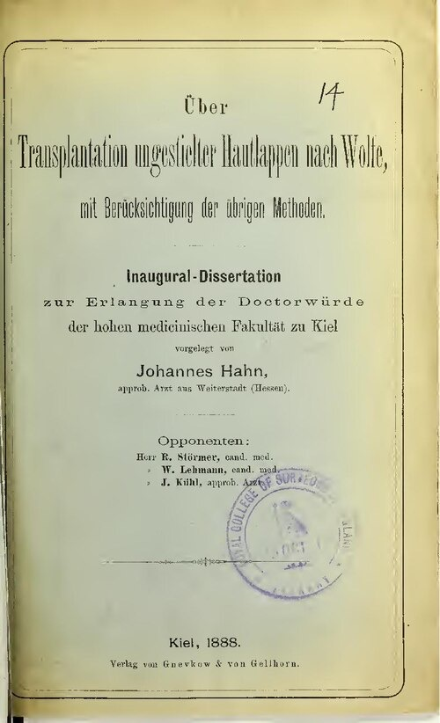
40+ Murdered: Physics Breakthroughs Hidden
Why / How they Karl Wolfe:
STRUCK AND KILLED by a tractor-trailer while cycling on October 10, 2018. He was 74.
Former Air Force sergeant with TOP SECRET CRYPTO clearance who testified about structures on the far side of the MOON.
At the 2001 Disclosure Project, he swore under oath that he was shown NASA Lunar Orbiter photos of ARTIFICIAL structures.
Worked as a precision electronics technician at Langley Air Force Base processing CLASSIFIED imagery.
Born and raised in Lansing, New York — killed in Lansing, New York. Youngest of seven children.
Karl Wolfe
Read List Here:
Dead at Age 74
https://uapmurders.com/physics

Slide 6
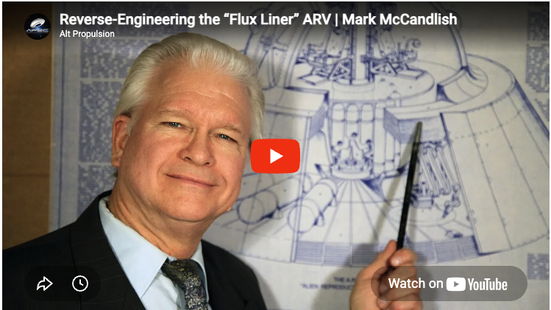
40+ Murdered: Physics Breakthroughs Hidden
Why / How they Mark McCandlish:
DEAD from a GUNSHOT wound on April 13, 2021 — after reportedly offering to testify before the Senate Intelligence Committee.
Aerospace illustrator who spent 30 years producing the most detailed engineering analysis of a US-built ANTIGRAVITY craft.
His source saw THREE disc-shaped craft HOVERING silently at Norton Air Force Base in 1988.
Testified at the 2001 Disclosure Project describing the Alien Reproduction Vehicle with precise TECHNICAL specifications.
Killed in Redding, California. He had just presented his most detailed breakdown of the craft's CAPACITOR propulsion system.
Mark McCandlish
Read List Here:
Dead at Age 66
https://uapmurders.com/physics

Slide 7
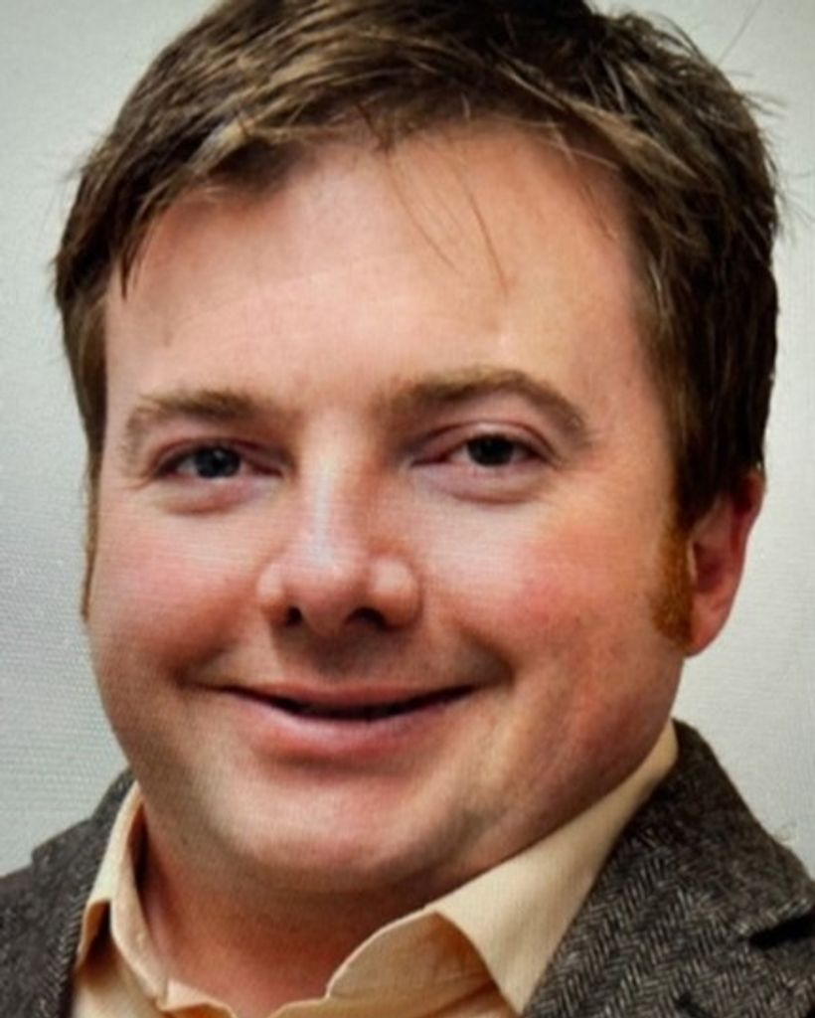
40+ Murdered: Physics Breakthroughs Hidden
Why / How they Christopher Fallen:
Former HAARP chief scientist found BOUND with duct tape, belt around his neck, head wrapped in tape. ASPHYXIATED in his own home. Age 46.
Senior physicist at the Air Force Research Laboratory working on CLASSIFIED ionospheric and plasma weapons research.
One suspect convicted of FIRST-DEGREE murder. The co-defendant fled to El Paso and died of an OVERDOSE before trial.
His death was the FIRST in a cluster of defense scientist deaths across New Mexico in 2024.
Worked at Kirtland Air Force Base — home to directed energy weapons, space vehicles, and some of America's most SECRET programs.
Christopher Fallen
Read List Here:
https://intelligencemurders.com/intel
Dead at Age 46

Slide 8
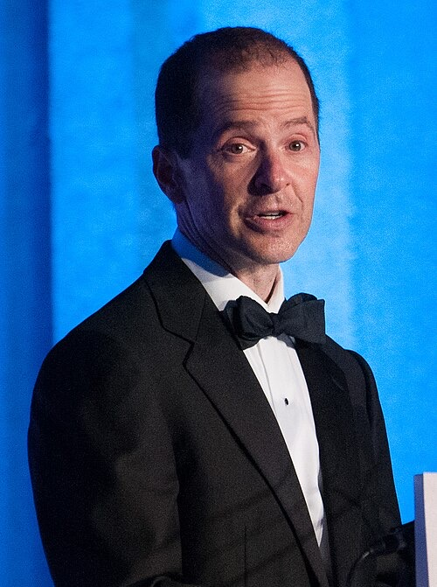
40+ Murdered: Physics Breakthroughs Hidden
Why / How they Max Spiers:
DEAD at 39 in Warsaw, Poland — reportedly VOMITED liters of black liquid before dying on July 16, 2016.
Days before, he texted his mother: "If anything happens to me, INVESTIGATE."
British UFO researcher who investigated secret military MIND CONTROL programs and "super soldier" experiments.
Father of two children. Born in Canterbury, England. His mother Vanessa fought publicly for answers.
Polish authorities initially found "no evidence of a crime." His mother demanded a proper investigation.
Max Spiers
Read List Here:
Dead at Age 40
https://uapmurders.com/physics

Slide 9
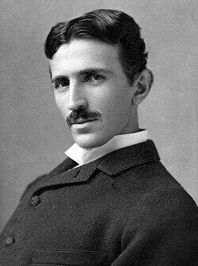
40+ Murdered: Physics Breakthroughs Hidden
Why / How they Nikola Tesla:
DIED January 7, 1943 — the government SEIZED 80 trunks of his papers within hours. Twenty trunks were NEVER returned.
Inventor of AC electricity, wireless power, and directed energy weapons — 300+ PATENTS that built the modern world.
FBI Director Hoover personally ordered Tesla's papers classified TOP SECRET.
The government sent an MIT physicist to evaluate the papers and declared them "nothing of significant VALUE." Nobody believes it.
He lit 200 lamps from 25 miles away WITHOUT WIRES in 1899. His Wardenclyffe Tower would have given the world FREE energy.
Nikola Tesla
Read List Here:
Dead at Age 87
https://uapmurders.com/physics

Slide 10
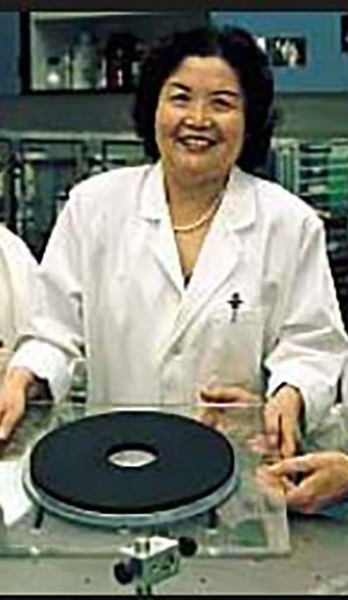
40+ Murdered: Physics Breakthroughs Hidden
Why / How they Ning Li:
DIED July 27, 2021 — physicist who published PEER-REVIEWED theory on generating gravity using superconductors.
Received a 48,970 Department of Defense GRANT for antigravity research. Results were NEVER published.
Her son confirmed she continued working for the DoD but stopped publishing after getting a TOP SECRET clearance.
In 2014, a vehicle accident destroyed her COGNITIVE capacity — ending her ability to continue research.
Chinese-American physicist at University of Alabama in Huntsville. Her work was CLASSIFIED, not abandoned.
Ning Li
Read List Here:
Dead at Age 78
https://uapmurders.com/physics

Slide 11
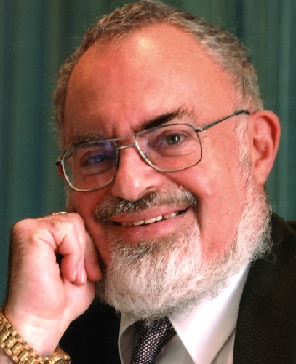
40+ Murdered: Physics Breakthroughs Hidden
Why / How they Stanton Friedman:
DIED May 13, 2019, at age 84 — nuclear physicist who became the world's foremost SCIENTIFIC UFO researcher.
Worked on CLASSIFIED fission and fusion rocket programs at GE, Westinghouse, McDonnell Douglas, and TRW.
Proposed magnetohydrodynamic propulsion as the physics behind UFO flight — based on his hands-on NUCLEAR experience.
Testified before Congress in 1968: "The evidence is OVERWHELMING that Earth is being visited."
Gave over 700 lectures at colleges and conferences. The original Roswell researcher. Natural causes at 84.
Stanton Friedman
Read List Here:
https://uapmurders.com/physics

Slide 12
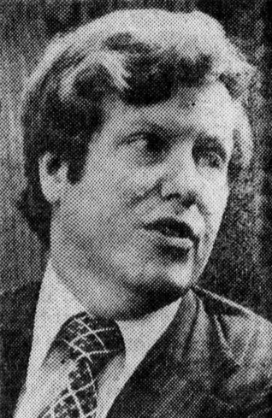
40+ Murdered: Physics Breakthroughs Hidden
Why / How they Harald Malmgren:
DIED February 13, 2025 — served four US presidents as economist and diplomat.
In his final year, claimed he personally HANDLED debris from a crashed UFO and witnessed a 1962 craft SHOOT-DOWN.
Said he held an Atomic Energy Commission Q-CLEARANCE — the highest level for nuclear and physics secrets.
DEBUNKED after death: declassified FBI files proved he NEVER held a Q-clearance and FABRICATED key claims.
Cautionary tale: even credentialed officials can introduce FALSE data points into the UAP evidence base.
Harald Malmgren
Read List Here:
https://uapmurders.com/physics

Slide 13
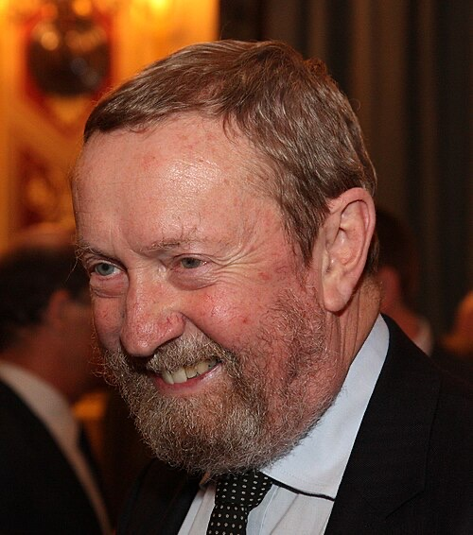
40+ Murdered: Physics Breakthroughs Hidden
Why / How they John Bedini:
DIED November 5, 2016, at age 67 in Coeur d'Alene, Idaho — free energy inventor for four decades.
Built electromagnetic motor-generators that allegedly pulled energy from the QUANTUM VACUUM.
His Bedini Motor design was replicated by thousands of experimenters worldwide — the most OPEN-SOURCE free energy device ever.
Former audio engineer who founded Bedini Electronics — his amplifiers OUTPERFORMED the industry.
Collaborated with Tom Bearden on scalar electromagnetics. Claimed the energy establishment had SUPPRESSED radiant energy for a century.
John Bedini
Read List Here:
Dead at Age 67
https://uapmurders.com/physics

