Slide 1
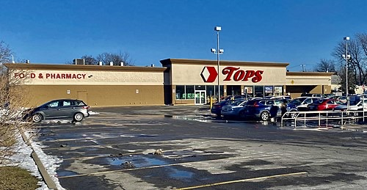
80+ Murdered: UAP Experts Exposed
Why / How they Aaron Salter Jr:
SHOT and KILLED at age 55 while working as a security guard at a Buffalo supermarket.
Retired Buffalo police officer who had demonstrated a WATER-POWERED CAR prototype on local television just two months before his death.
His water-car tech echoes Stanley Meyer — another water fuel inventor who DIED under suspicious circumstances.
Hailed as a HERO for firing back at the mass shooter and trying to save lives.
30-year law enforcement veteran, beloved member of the Buffalo community.
Aaron Salter Jr
Read List Here:
Dead at Age 55
https://uapmurders.com/uaps

Slide 2
⏺ - Mark McCandlish (2021) — Aerospace illustrator, gunshot to head ruled suicide.
Was about to testify before Senate Intelligence Committee about the Alien
Reproduction Vehicle program. Redding, CA.
- Amy Eskridge (2022) — Antigravity/advanced propulsion researcher, gunshot
ruled suicide. Retired UK intelligence officer alleged she was "murdered by a
private aerospace company." Huntsville, AL.
- John Rossi (2016) — Two-star general commanding Space and Missile Defense
Command, hanging ruled suicide. Died 2 days before promotion to 3-star. Claims
he refused to transfer nuclear material to private contractors. Redstone
Arsenal, AL.
- Karl Wolfe (2018) — USAF veteran and Disclosure Project witness, struck by
tractor trailer while cycling. Testified about classified NASA photos of alien
structures on the Moon. Lansing, NY.
- Philip Haney (2020) — DHS founding member and counterterrorism whistleblower,
single gunshot wound ruled suicide after 2-year investigation. Amador County,
CA.
- Fred Bell (2011) — Claimed MKULTRA participant with CIA handler, died of
sudden heart failure within 48 hours of filming interview with Jesse Ventura
about classified beam weapon technology.
- Carl Grillmair (2026) — Caltech/IPAC scientist working on NEO Surveyor and
dual-use infrared detection technology, shot dead on his porch by a man whose
felony weapons charges had been dismissed 11 days earlier. Lived/worked in
California 30+ years.

Slide 3
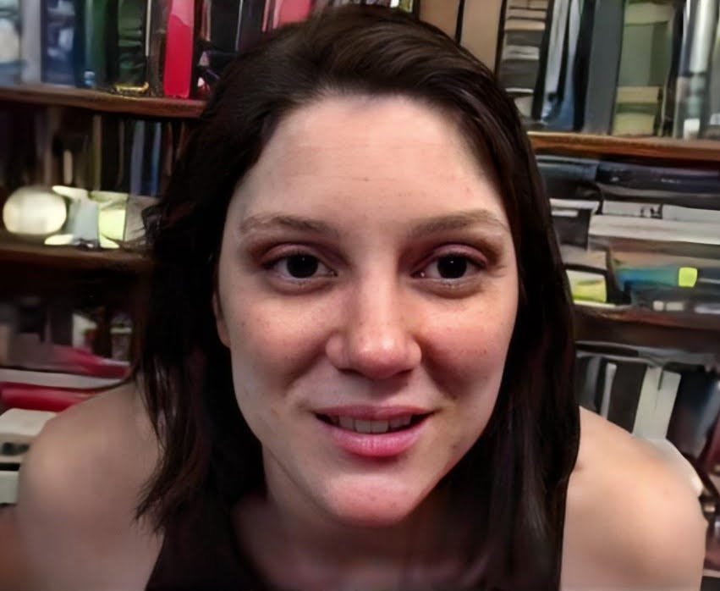
80+ Murdered: UAP Experts Exposed
Why / How they Amy Eskridge:
Found DEAD from a GUNSHOT wound at age 34 in Huntsville, Alabama. Ruled SUICIDE.
Co-founder of the Institute for Exotic Science — researching ANTIGRAVITY and advanced propulsion.
Retired UK intelligence officer Franc Milburn alleged to CONGRESS she was MURDERED by a private aerospace company using directed energy weapons.
Had planned to present novel antigravity work but needed NASA approval first — she wanted to bring it "into the open."
No police reports, autopsy findings, or coroner's statements have EVER been publicly released.
Ning Li, another antigravity researcher in the SAME city, was struck by a vehicle on campus — causing permanent brain damage.
Amy Eskridge
Read List Here:
Dead at Age 34
https://uapmurders.com/uaps

Slide 4
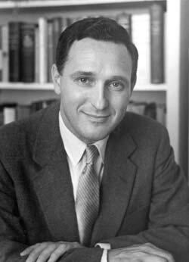
80+ Murdered: UAP Experts Exposed
Why / How they Andrija Puharich:
FELL down a flight of stairs and DIED at age 76 — a method nearly impossible to distinguish from being pushed.
Held U.S. Patent 4,394,230 for splitting water molecules into hydrogen fuel — a technology that could have made oil obsolete.
His home and laboratory were DESTROYED by ARSON in 1979 — he blamed the CIA.
Deeply connected to MKULTRA, Project ARTICHOKE, and Army chemical warfare research.
Allegedly received direct CIA ASSASSINATION threats and capitulated after a meeting with Rockefeller interests.
Died impoverished, waiting for a social security check, unable to afford to move after eviction.
Andrija Puharich
Read List Here:
Dead at Age 76
https://uapmurders.com/uaps

Slide 5
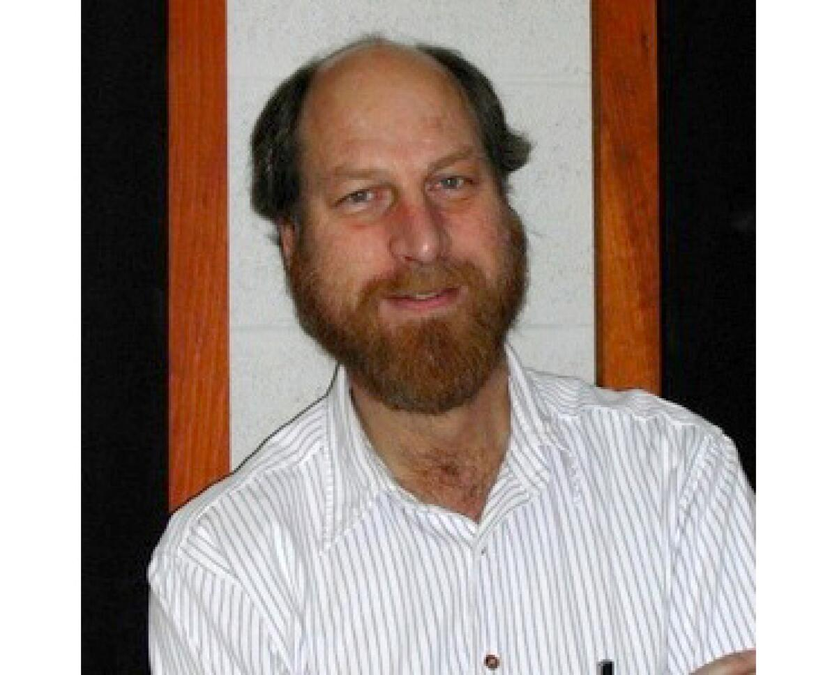
80+ Murdered: UAP Experts Exposed
Why / How they Carl Grillmair:
SHOT and KILLED on his porch at age 67 in rural California — February 2026.
Caltech astrophysicist with 147 peer-reviewed papers who validated instruments for NEO Surveyor — the telescope built to detect objects that could HIT EARTH.
The suspect was found on his property with an unregistered rifle 58 days earlier — arrested, then charges DISMISSED 11 days before the killing.
Suspect returned and SHOT him dead. Detectives say they did not know each other. No motive disclosed.
His infrared detection algorithms are DUAL-USE: the same math that finds asteroids can find enemy satellites.
Part of the 2025-2026 scientist cluster — murdered two months after MIT plasma physicist Nuno Loureiro was SHOT.
Carl Grillmair
Read List Here:
Dead at Age 67
https://uapmurders.com/uaps

Slide 6
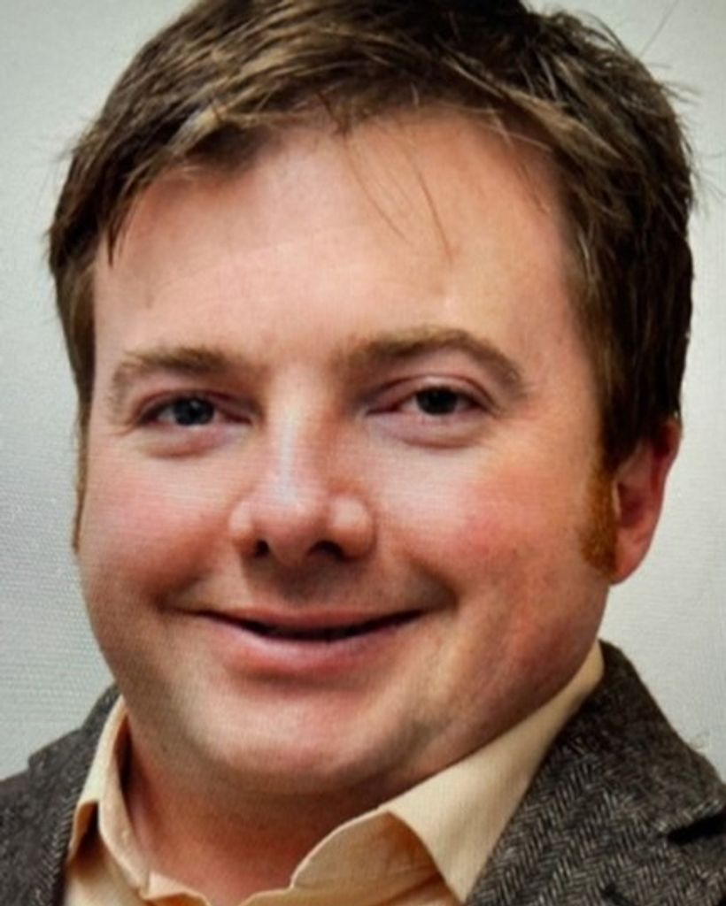
80+ Murdered: UAP Experts Exposed
Why / How they Christopher Fallen:
Former HAARP chief scientist found BOUND and ASPHYXIATED in his Albuquerque home at age 46 — February 2024.
Head wrapped in tape, plastic bag secured with belt around his neck, hands and shins bound with duct tape.
Held CAPTIVE for approximately three days before dying — photographed during captivity by his killers.
AFRL senior research physicist specializing in ionospheric plasma physics and DIRECTED ENERGY.
Co-suspect died of a drug OVERDOSE before trial — eliminating his testimony forever.
His murder in the Albuquerque defense corridor preceded the 2025-2026 New Mexico scientist cluster.
Christopher Fallen
Read List Here:
https://uapmurders.com/uaps
Dead at Age 46

Slide 7
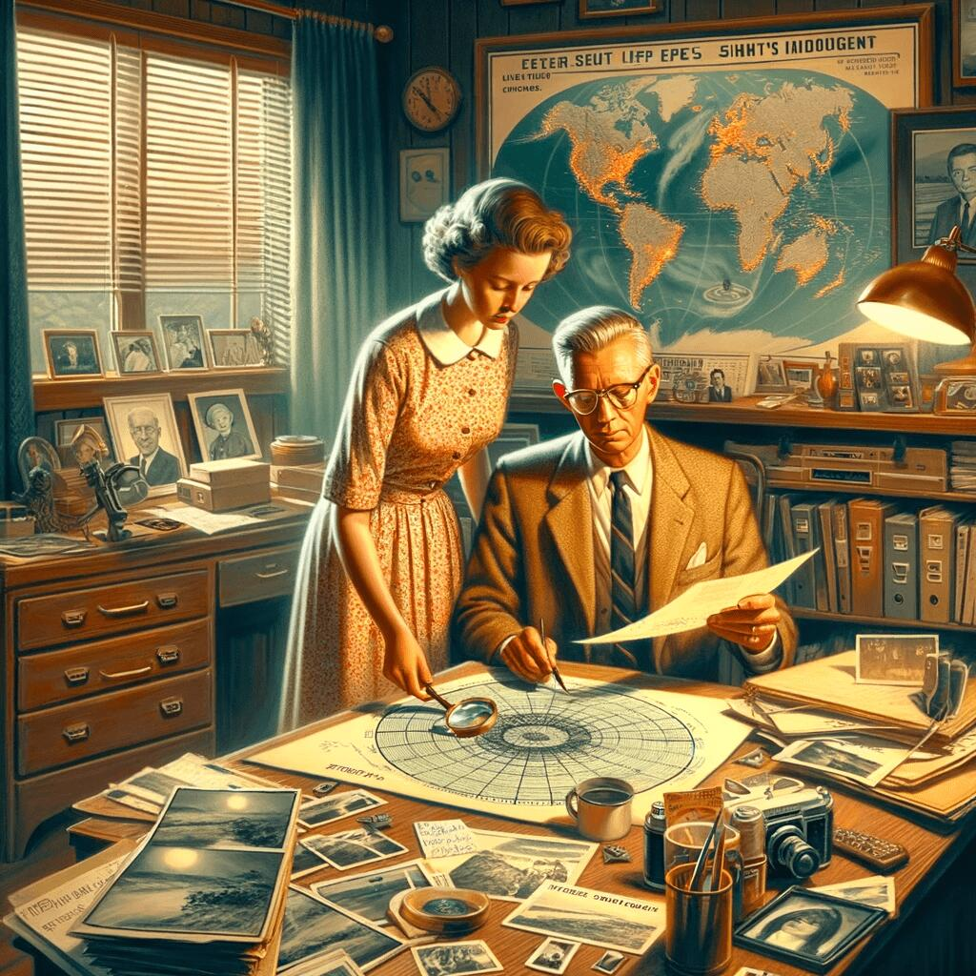
80+ Murdered: UAP Experts Exposed
Why / How they Coral Lorenzen:
Co-founder of APRO — one of the world's oldest civilian UFO research organizations — DIED at age 63.
Her husband Jim died of cancer just two years earlier. Both founders gone within 24 months.
APRO had operated for 36 YEARS with investigators in over 50 countries — it DISSOLVED after their deaths.
Died on her exact BIRTHDAY — April 12, 1988.
Their deaths removed one of the most important independent checks on government UFO narratives.
Coral Lorenzen
Read List Here:
Dead at Age 63
https://uapmurders.com/uaps

Slide 8
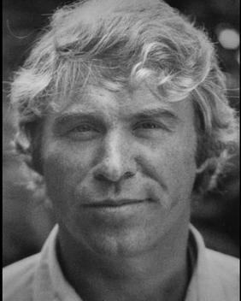
80+ Murdered: UAP Experts Exposed
Why / How they Danny Casolaro:
Found DEAD in a hotel bathtub at age 44 — wrists SLASHED 12 times, one cut severing a tendon.
Was investigating "The Octopus" — connecting PROMIS software, Iran-Contra, Area 51, and Majestic 12.
Told his brother days before: "If something happens to me, don't believe it was an ACCIDENT."
His research files and briefcase of evidence VANISHED from the hotel room — never recovered.
The hotel room was CLEANED by a professional crew the next day, destroying forensic evidence.
The House Judiciary Committee found the police investigation INADEQUATE.
Danny Casolaro
Read List Here:
Dead at Age 44
https://uapmurders.com/uaps

Slide 9
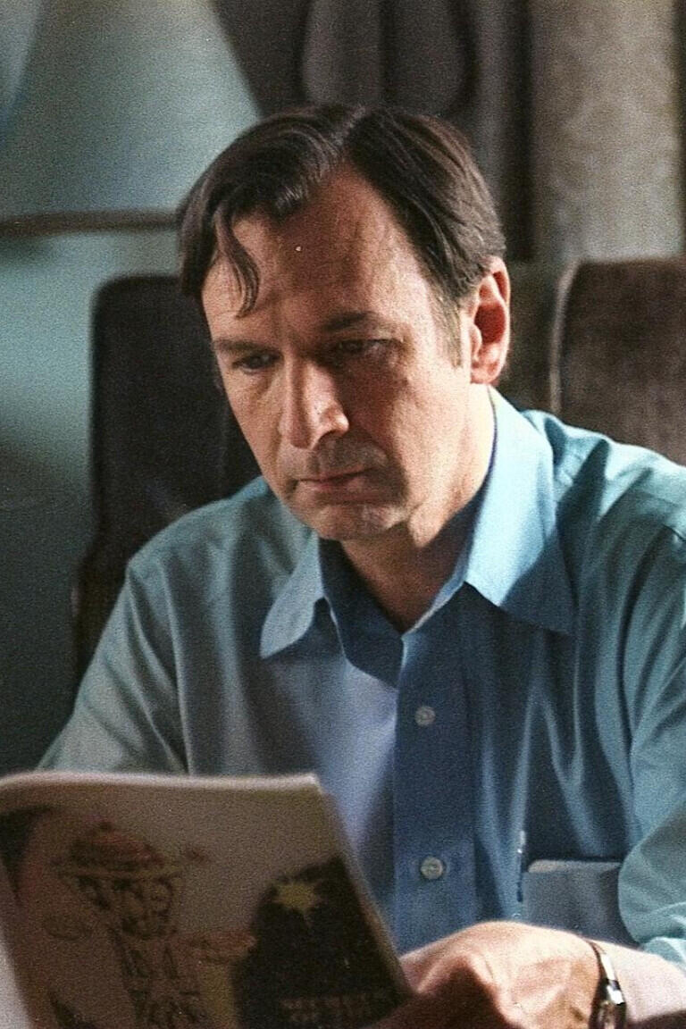
80+ Murdered: UAP Experts Exposed
Why / How they Don Elkins:
Physics professor and Boeing 727 captain who SHOT himself at age 54 — ruled SUICIDE.
Co-author of the Ra Material (Law of One) — one of the most influential channeled UFO contact texts.
Suffered a year of severe mental deterioration that collaborators described as rapid and inexplicable.
A brilliant, disciplined man who had been stable for DECADES suddenly lost his grip on reality.
His collaborators documented the decline in detail — raising questions about what caused it.
Don Elkins
Read List Here:
Dead at Age 54
https://uapmurders.com/uaps

Slide 10
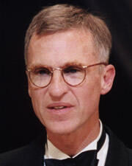
80+ Murdered: UAP Experts Exposed
Why / How they Don Wiley:
One of America's top microbiologists — VANISHED after a banquet at age 57. Body found in the Mississippi River 300 miles downstream.
His rental car was found on a bridge with the engine RUNNING and keys in the ignition.
The bridge has SIX-FOOT-HIGH fences specifically designed to prevent accidental falls — the FBI said he "fell."
Harvard professor and Howard Hughes Medical Institute researcher specializing in the human immune system.
Second death in the 2001-2002 microbiologist cluster — Benito Que was BEATEN to death just 3 days earlier.
Found five weeks after disappearing, body badly decomposed.
Don Wiley
Read List Here:
Dead at Age 57
https://uapmurders.com/uaps

Slide 11
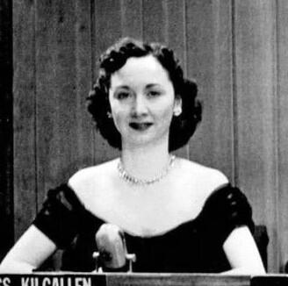
80+ Murdered: UAP Experts Exposed
Why / How they Dorothy Kilgallen:
Found DEAD at age 52 from alcohol and barbiturates — in a room she NEVER used, fully dressed and made up.
The only journalist to get a private interview with Jack Ruby. Published his sealed Warren Commission testimony.
One of the first mainstream journalists to break the story that British military was investigating UFOs (1954).
Her investigative notes and JFK assassination file VANISHED and have never been found.
Told friends she was about to "blow the JFK case wide open."
Medical examiner ruled "circumstances UNDETERMINED" — not suicide, not accident.
Dorothy Kilgallen
Read List Here:
https://uapmurders.com/uaps
Dead at Age 52

Slide 12
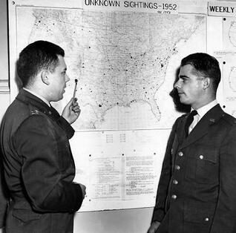
80+ Murdered: UAP Experts Exposed
Why / How they Edward Ruppelt:
DEAD of a heart attack at age 37 — the man who coined the term "unidentified flying object."
First director of Project Blue Book — the Air Force's official UFO investigation.
Originally wrote the definitive insider account exposing government UFO secrecy.
Then REVERSED himself, adding debunking chapters that contradicted everything he had written.
Died of a "sudden" heart attack shortly after the reversal — at an age when heart attacks are rare.
His flip and death raised questions about whether he was pressured into recanting.
Edward Ruppelt
Read List Here:
Dead at Age 37
https://uapmurders.com/uaps

Slide 13
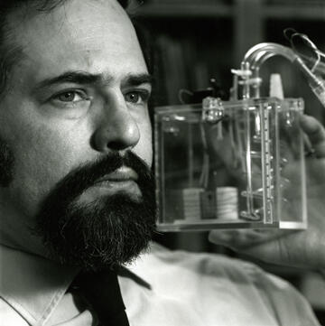
80+ Murdered: UAP Experts Exposed
Why / How they Eugene Mallove:
BEATEN to death at age 56 — 32 LACERATIONS, crushed trachea, found outside a rental property in Connecticut.
Chief science writer at MIT who resigned after MIT allegedly falsified cold fusion data.
Founded Infinite Energy magazine — the leading publication for cold fusion and new energy research.
KILLED just days before a major appearance on Coast to Coast AM radio to discuss a breakthrough.
His murder was eventually attributed to tenants in a rental property dispute — but the timing haunts researchers.
Arguably the most important advocate for cold fusion in America — permanently silenced.
Eugene Mallove
Read List Here:
Dead at Age 56
https://uapmurders.com/uaps

Slide 14
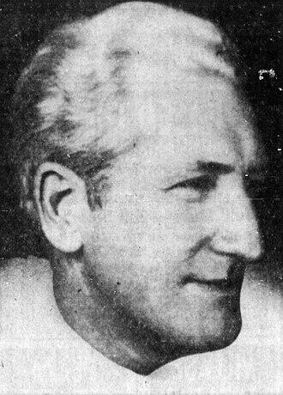
80+ Murdered: UAP Experts Exposed
Why / How they Frank Scully:
Author of "Behind the Flying Saucers" (1950) — one of the first books to claim the U.S. government recovered crashed UFOs.
DIED of a heart attack at age 72 in Palm Springs, California.
His book reported two crashed saucer recoveries with alien bodies — predating the Roswell narrative by decades.
His reputation was DESTROYED when his main source was convicted of fraud — but some claims later gained credibility.
Died on June 23, 1964 — the same date Frank Edwards would die three years later.
Frank Scully
Read List Here:
Dead at Age 72
https://uapmurders.com/uaps

Slide 15
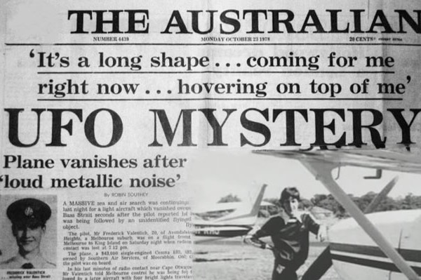
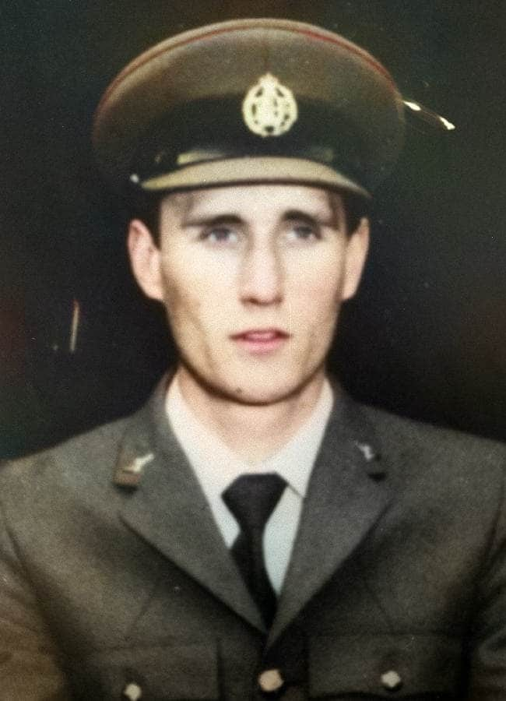
80+ Murdered: UAP Experts Exposed
Frederick Valentich:
Australian pilot who VANISHED at age 20 over Bass Strait after radioing: "It is NOT an aircraft."
His last transmission described a large unknown object hovering above him with four bright lights.
Neither his body nor his Cessna 182 were EVER recovered.
His final words on tape: metallic scraping sounds, then SILENCE. Then nothing. Forever.
Multiple independent witnesses reported UFO sightings in the same area that evening.
The Australian Department of Transport concluded: "The reason for the disappearance has NOT been determined."
Frederick Valentich
Read List Here:
https://uapmurders.com/uaps
Dead at Age 20

Slide 16
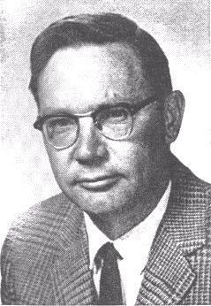
80+ Murdered: UAP Experts Exposed
Why / How they James McDonald:
Senior atmospheric physicist found DEAD in the Arizona desert at age 51 — SHOT in the head with his own revolver.
The most scientifically credentialed UFO researcher of his era — University of Arizona professor who testified before Congress.
His career was SYSTEMATICALLY DESTROYED: the CIA leaked information about his personal life to discredit him.
His marriage collapsed. His funding dried up. His colleagues turned on him. Then he was found dead.
Ruled SUICIDE — but the career destruction → isolation → death pipeline matches intelligence playbooks.
The pattern: discredit, isolate, destroy, eliminate.
James McDonald
Read List Here:
Dead at Age 51
https://uapmurders.com/uaps

Slide 17
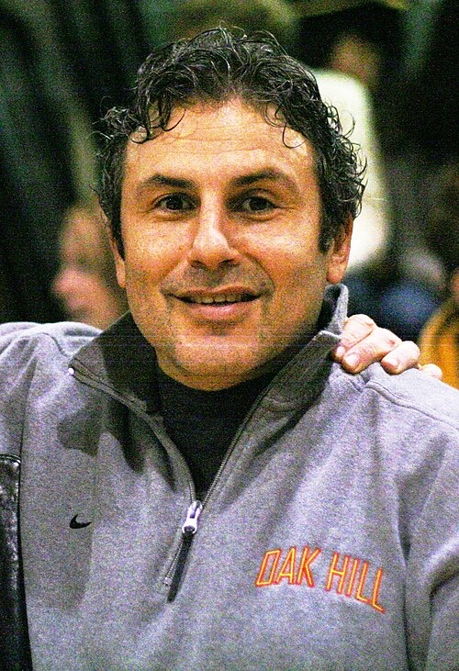
80+ Murdered: UAP Experts Exposed
Why / How they Jacob Prichard:
Wright-Patterson AFRL employee who SHOT his wife, then SHOT Jaime Gustitus, then KILLED himself — October 2025.
The murder-suicide took place at a government building — not a domestic setting.
Wright-Patterson is the base at the CENTER of UFO crash retrieval lore (Hangar 18, Project Blue Book).
His wife Jaymee worked in AFRL finance. Gustitus was an AFRL analyst with Top Secret/SCI clearance.
Two AFRL employees dead at the base connected to the most sensitive classified programs in the country.
Jacob Prichard
Read List Here:
https://uapmurders.com/uaps
Dead at Age 34

Slide 18

80+ Murdered: UAP Experts Exposed
Why / How they Gaurav Tiwari:
India's most famous paranormal investigator found DEAD by hanging at age 32 in New Delhi. Ruled SUICIDE.
Founded the Indian Paranormal Society and investigated thousands of cases across India.
Had told his wife and family that a "negative force" was pulling him toward it.
No history of depression. No suicide note. His family was adamant it was NOT suicide.
Had been receiving THREATS related to his investigations in the months before his death.
A young, vibrant researcher at the peak of his career — gone overnight.
Gaurav Tiwari
Read List Here:
Dead at Age 32
https://uapmurders.com/uaps

Slide 19
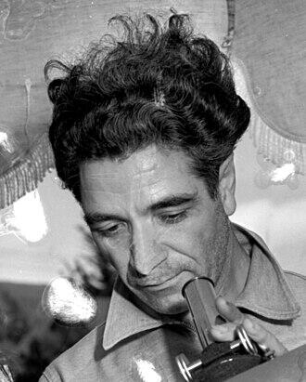
80+ Murdered: UAP Experts Exposed
Why / How they George Adamski:
The most famous UFO contactee of the 1950s — DIED of a heart attack at age 74 in Silver Spring, Maryland.
Claimed direct contact with beings from Venus and other planets — published bestselling books about his experiences.
Met with Pope John XXIII at the Vatican in 1963 and was allegedly given a secret papal blessing.
Taken less seriously than other researchers — yet his contacts and influence were extraordinary.
His death from a heart attack fits the pattern documented by Otto Binder of sudden cardiac deaths among UFO figures.
George Adamski
Read List Here:
Dead at Age 74
https://uapmurders.com/uaps

Slide 20
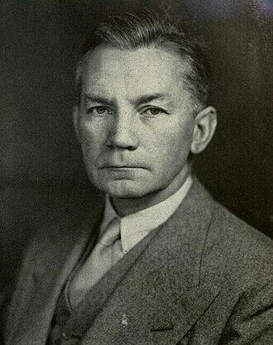
80+ Murdered: UAP Experts Exposed
Why / How they James Forrestal:
First U.S. Secretary of Defense — FELL from the 16th floor of Bethesda Naval Hospital at age 57.
The Navy review board did NOT formally conclude suicide — only that the fall caused his death.
Was being held in the hospital against his will — his brother was told he could NOT visit.
Allegedly knew about the Roswell crash recovery and was part of the original Majestic 12 group.
A bathrobe sash was found knotted around his neck. Broken glass littered the room. Scratch marks on the windowsill.
The most powerful military official in America — silenced permanently.
James Forrestal
Read List Here:
Dead at Age 57
https://uapmurders.com/uaps

Slide 21
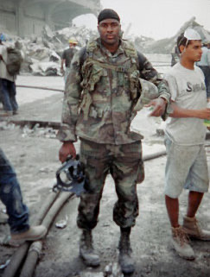
80+ Murdered: UAP Experts Exposed
Why / How they Jason Thomas:
Novartis chemical biology director who VANISHED on December 12, 2025 at age 45.
His body was found THREE MONTHS later in Lake Quannapowitt, Massachusetts — March 2026.
Police said "no foul play suspected" — but the medical examiner has NOT released cause of death.
Part of the 2025-2026 scientist cluster that includes murdered and missing defense researchers.
A pharmaceutical scientist with cutting-edge expertise who simply disappeared one December night.
Jason Thomas
Read List Here:
Dead at Age 45
https://uapmurders.com/uaps

Slide 22
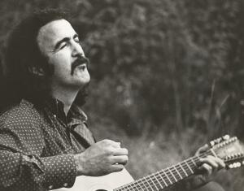
80+ Murdered: UAP Experts Exposed
Why / How they Jim Sullivan:
Singer-songwriter who recorded an album called "U.F.O." — then VANISHED in the New Mexico desert at age 35.
His album featured lyrics about highway travel, leaving family, and alien encounters — eerily prophetic.
Disappeared near Santa Rosa, New Mexico while driving cross-country. His VW Bug was found abandoned.
His belongings were inside the car but Jim was GONE. No body was ever found.
Vanished in the same New Mexico desert corridor where defense scientists would later disappear decades later.
Jim Sullivan
Read List Here:
Dead at Age 35
https://uapmurders.com/uaps

Slide 23
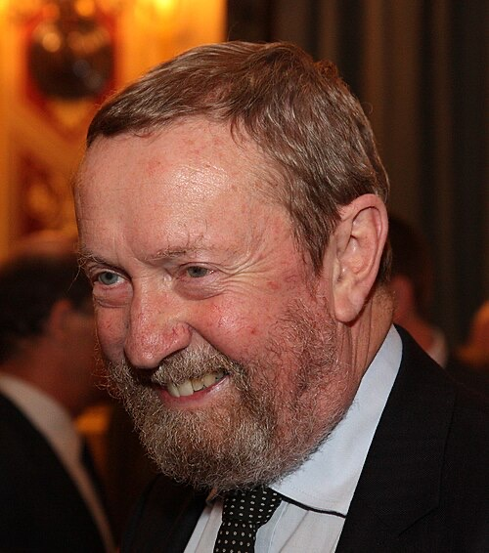
80+ Murdered: UAP Experts Exposed
Why / How they John Bedini:
Free energy pioneer who DIED SUDDENLY at age 67 in 2016 — cause never publicly disclosed.
Built electromagnetic energy recovery devices that were demonstrated publicly for decades.
His "Bedini Motor" became the most replicated alternative energy device in the free energy community.
Despite thousands of replications, the technology never reached commercial production.
Another inventor whose sudden death coincided with decades of work that threatened the energy establishment.
John Bedini
Read List Here:
Dead at Age 67
https://uapmurders.com/uaps

Slide 24
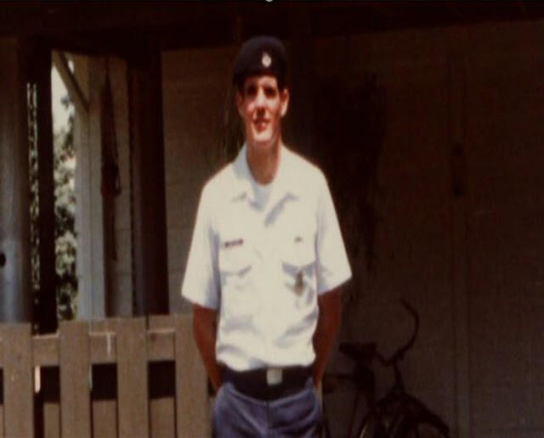
80+ Murdered: UAP Experts Exposed
Why / How they John Burroughs:
U.S. Air Force witness to the Rendlesham Forest UFO incident of December 1980 — suffered PERMANENT RADIATION INJURIES.
The VA initially DENIED his medical claims — saying his military records from that period were classified.
Eventually received a full VA disability rating after Senator John McCain intervened.
His medical records from the Rendlesham period were classified at a level normally reserved for nuclear secrets.
ALIVE but permanently damaged — proof that UAP encounters cause real physical harm that the government covers up.
John Burroughs
Read List Here:
https://uapmurders.com/uaps

Slide 25
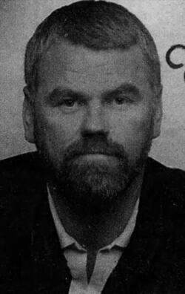
80+ Murdered: UAP Experts Exposed
Why / How they Jim Keith:
Conspiracy author who DIED at age 49 from a blood clot after knee surgery — at Burning Man, he fell off a stage.
Wrote "Black Helicopters Over America" and "The Octopus" — continuing Danny Casolaro's investigation.
Told a friend before surgery: "I have this feeling that if they put me under, I'm not going to wake up."
Died of a pulmonary embolism during a routine knee operation. He never woke up.
His premonition and the connection to Casolaro's lethal investigation make this deeply unsettling.
Jim Keith
Read List Here:
Dead at Age 49
https://uapmurders.com/uaps

Slide 26
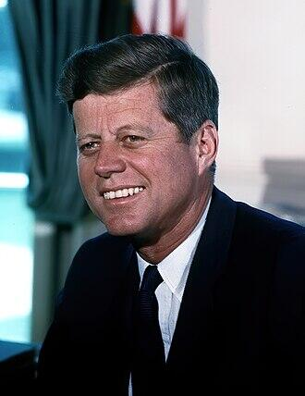
80+ Murdered: UAP Experts Exposed
Why / How they John F Kennedy:
ASSASSINATED at age 46 in Dallas, Texas — the President of the United States, shot in broad daylight.
Some researchers link his murder to his alleged interest in UFO/UAP programs and desire for disclosure.
Reportedly requested CIA briefings on UFO programs — a memo dated November 12, 1963, ten days before his death.
The Warren Commission blamed a lone gunman — but the House Select Committee concluded a "probable conspiracy."
His death changed the trajectory of American transparency on national security secrets forever.
John F Kennedy
Read List Here:
Dead at Age 46
https://uapmurders.com/uaps

Slide 27
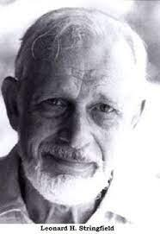
80+ Murdered: UAP Experts Exposed
Why / How they Leonard Stringfield:
Pioneer of UFO crash-retrieval research who DIED of lung cancer at age 74.
Published SEVEN Status Reports documenting alleged government recovery of alien craft — the most extensive such research ever.
Former military intelligence officer who became the world's leading crash-retrieval researcher.
Founded CRIFO — one of the largest civilian UFO organizations in the 1950s.
His death from lung cancer adds to the cluster of prominent UFO researchers dying of cancer.
Leonard Stringfield
Read List Here:
Dead at Age 74
https://uapmurders.com/uaps

Slide 28
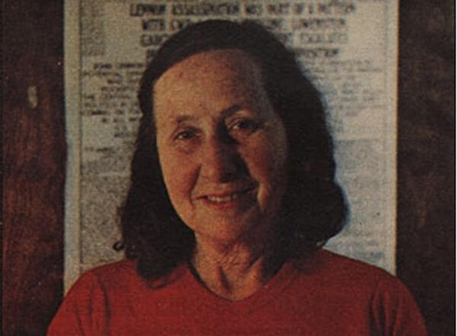
80+ Murdered: UAP Experts Exposed
Why / How they Mae Brussell:
Pioneering conspiracy researcher and radio host who DIED of fast-acting cancer at age 66.
Received DEATH THREATS seven months before her cancer diagnosis.
Broadcast weekly for over 17 years, connecting dots between intelligence operations and political assassinations.
Her cancer progressed with unusual speed — from diagnosis to death in months.
The death threat followed by fast-acting cancer mirrors the pattern seen with Karla Turner and other researchers.
Mae Brussell
Read List Here:
Dead at Age 66
https://uapmurders.com/uaps

Slide 29

80+ Murdered: UAP Experts Exposed
Why / How they Mark McCandlish:
Aerospace illustrator found DEAD from a shotgun blast to the head at age 65. Ruled SUICIDE.
Was scheduled to testify before a Senate committee about CLASSIFIED antigravity craft — died days before.
Created the famous "Flux Liner" illustration of a secret antigravity vehicle based on firsthand testimony.
Testified at the 2001 Disclosure Project National Press Club event about alien reproduction vehicles.
His friend who attended the secret air show where the craft was displayed ALSO died under suspicious circumstances.
KILLED right before his most important testimony — the pattern is unmistakable.
Mark McCandlish
Read List Here:
https://uapmurders.com/uaps
Dead at Age 65

Slide 30
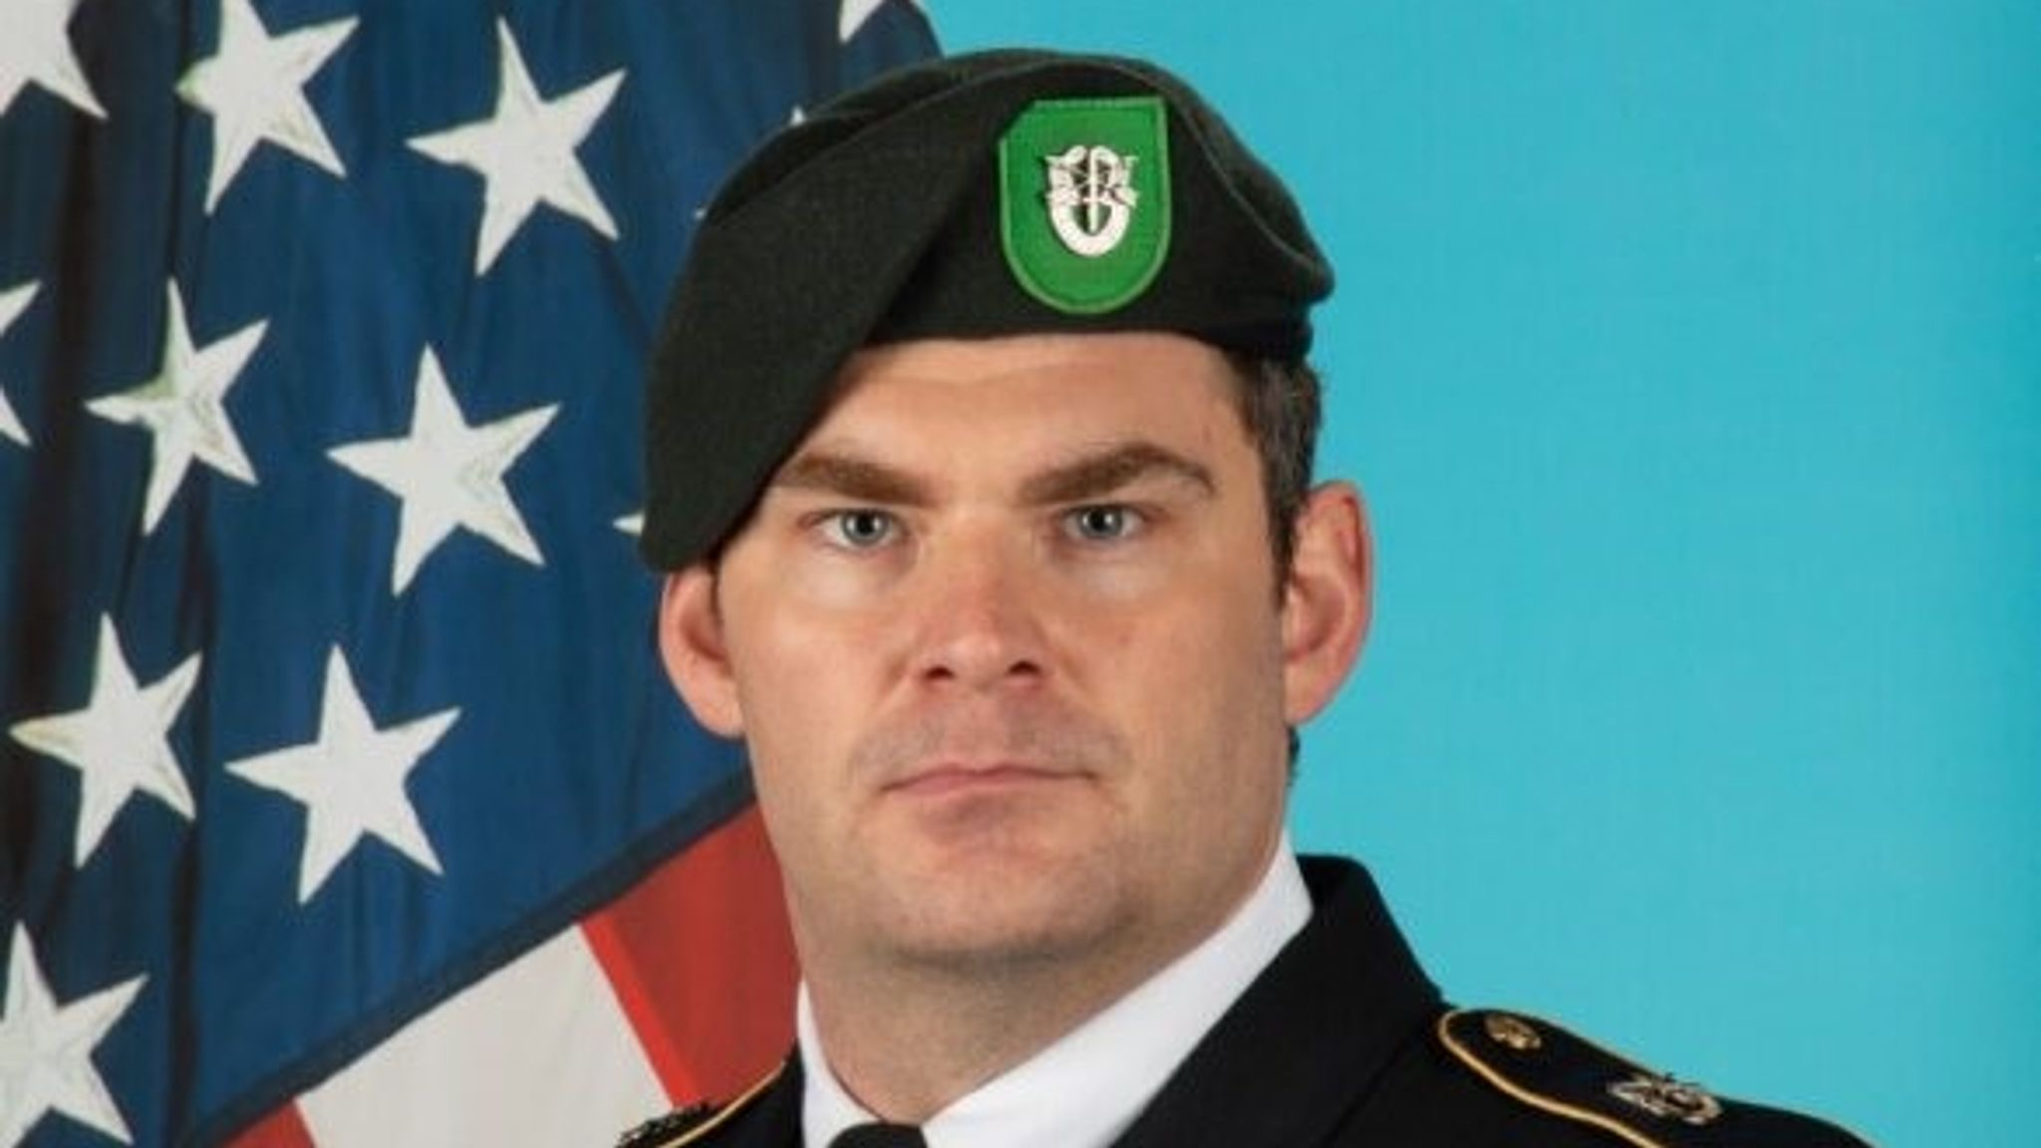
80+ Murdered: UAP Experts Exposed
Why / How they Matthew Livelsberger:
Green Beret who SHOT himself in a Cybertruck loaded with explosives outside Trump International Hotel — age 37.
Detonated the vehicle on New Year's Day 2025 in Las Vegas.
Left manifestos expressing frustration with government secrecy and corruption.
Special Forces operative with access to classified programs and advanced technology.
His dramatic and public death raised questions about what he knew and what pushed him to the edge.
Matthew Livelsberger
Read List Here:
Dead at Age 37
https://uapmurders.com/uaps

Slide 31
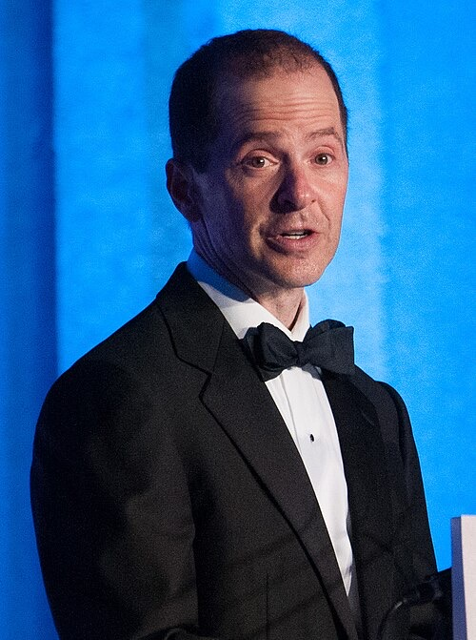
80+ Murdered: UAP Experts Exposed
Why / How they Max Spiers:
UFO and conspiracy researcher who DIED at age 39 in Warsaw, Poland — found dead on a sofa.
Texted his mother days before: "If anything happens to me, investigate."
VOMITED black liquid before dying — witnesses described it as disturbing and abnormal.
Had traveled to Poland to give a presentation on government cover-ups and secret programs.
Officially died of pneumonia and drug intoxication — but his mother fought for years to get an inquest.
A young researcher who predicted his own death, then died in a foreign country.
Max Spiers
Read List Here:
Dead at Age 39
https://uapmurders.com/uaps

Slide 32
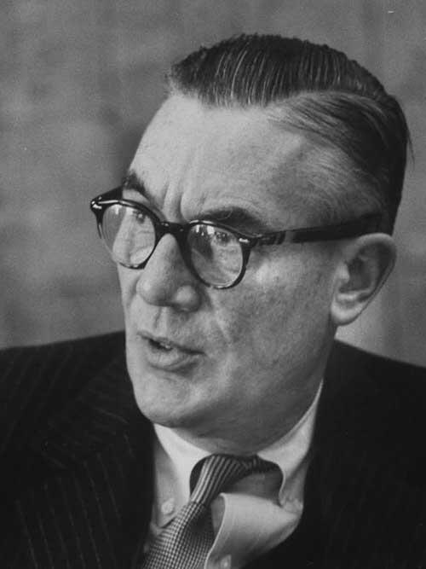
80+ Murdered: UAP Experts Exposed
Why / How they Morris Jessup:
UFO researcher found DEAD from carbon monoxide poisoning at age 59 — hose from exhaust to car window. Ruled SUICIDE.
Author of "The Case for the UFO" — the book that prompted the famous Philadelphia Experiment annotations.
The Navy took his annotated book seriously enough to reproduce it in a limited classified print run.
Was deeply depressed after his career collapsed — but the car exhaust method mirrors intelligence assassination technique.
His death came as he was preparing new research into anti-gravity and unified field theory.
Morris Jessup
Read List Here:
Dead at Age 59
https://uapmurders.com/uaps

Slide 33
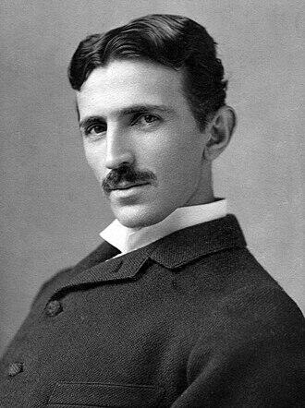
80+ Murdered: UAP Experts Exposed
Why / How they Nikola Tesla:
Visionary inventor who DIED at age 86 in his hotel room — the FBI SEIZED his papers within hours.
His directed energy weapon research, wireless power transmission, and particle beam technology vanished into classified files.
Invented alternating current, radio, and technologies decades ahead of his time.
Died impoverished and alone at the Hotel New Yorker — one of history's greatest minds, abandoned.
The Alien Property Custodian (a WWII agency) took custody of his papers — despite Tesla being a U.S. citizen.
What the government found in those files has never been fully disclosed.
Nikola Tesla
Read List Here:
Dead at Age 86
https://uapmurders.com/uaps

Slide 34
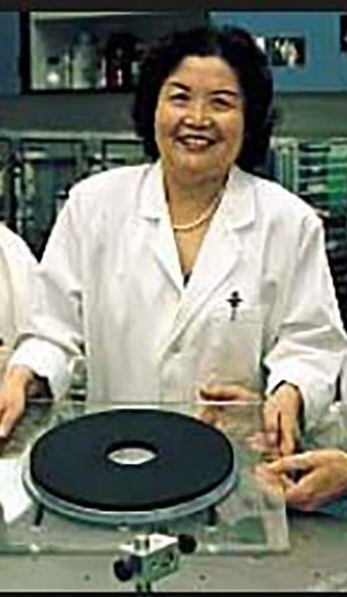
80+ Murdered: UAP Experts Exposed
Why / How they Ning Li:
Chinese-American physicist who published groundbreaking antigravity research — then DISAPPEARED from public life.
Received a $448,970 DOD grant for her company AC Gravity — then went completely SILENT.
Was STRUCK by a vehicle on the UAH campus — causing permanent brain damage.
In the SAME city (Huntsville, Alabama) where Amy Eskridge was later found dead from a gunshot wound.
Two antigravity researchers in the same city, both neutralized. One by vehicle. One by bullet.
Died of Alzheimer's in 2021 at age 78 — but her research had been silenced decades earlier.
Ning Li
Read List Here:
https://uapmurders.com/uaps
Dead at Age 78

Slide 35
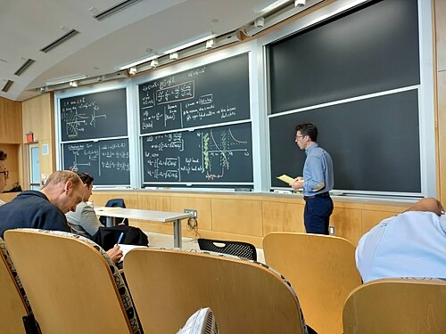
80+ Murdered: UAP Experts Exposed
Why / How they Nuno Loureiro:
MIT professor and director of the Plasma Science and Fusion Center — SHOT and KILLED at age 47 in Brookline, Massachusetts.
One of the world's leading plasma physics researchers — his work had implications for fusion energy and defense.
MURDERED in December 2025 — two months before Caltech astrophysicist Carl Grillmair was also SHOT dead.
Part of the 2025-2026 scientist cluster that has sent chills through the defense research community.
A brilliant 47-year-old Portuguese-born scientist killed outside his home.
Nuno Loureiro
Read List Here:
Dead at Age 47
https://uapmurders.com/uaps

Slide 36
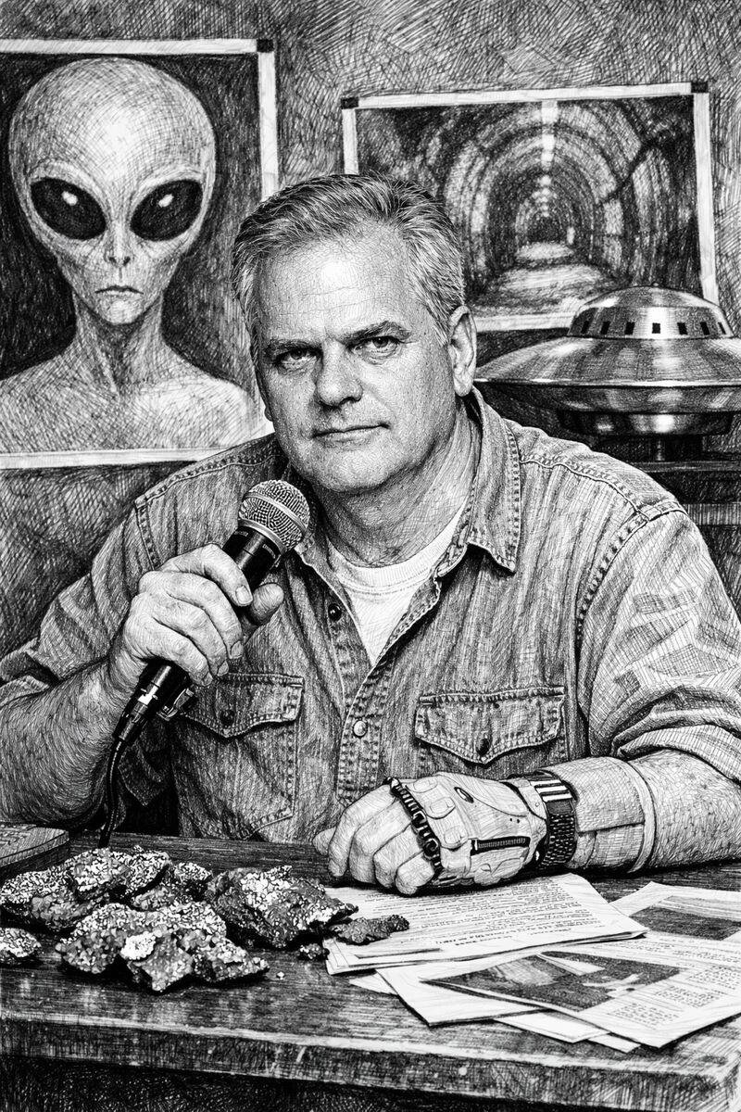
80+ Murdered: UAP Experts Exposed
Why / How they Phil Schneider:
Found DEAD with a rubber catheter tube wrapped THREE TIMES around his neck at age 48. Ruled SUICIDE.
NO FINGERPRINTS were found on the catheter tube — impossible if he strangled himself.
Lectured publicly for two years about deep underground military bases and alien encounters.
Claimed he survived a firefight with aliens in an underground base beneath Dulce, New Mexico.
Told audiences repeatedly: "If I ever 'commit suicide,' I was MURDERED."
Missing fingers on one hand — which he said were blown off in the underground firefight.
Phil Schneider
Read List Here:
Dead at Age 48
https://uapmurders.com/uaps

Slide 37
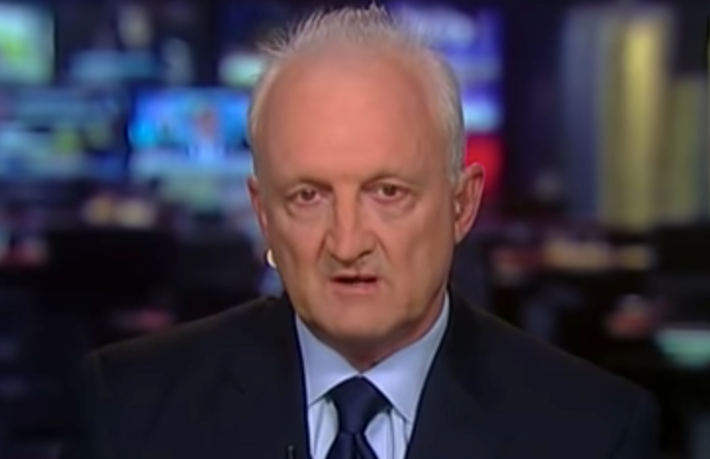
80+ Murdered: UAP Experts Exposed
Why / How they Philip Haney:
DHS whistleblower found SHOT in a park-and-ride lot at age 66. Ruled SUICIDE two years later.
Exposed how the Obama administration SHUT DOWN investigations into Islamic terror networks.
Was about to publish a new book with additional explosive revelations when he was found dead.
Found with a single gunshot wound next to his vehicle — but his laptop and phone were MISSING.
Friends and colleagues were unanimous: he was NOT suicidal. He was energized and planning his future.
Philip Haney
Read List Here:
Dead at Age 66
https://uapmurders.com/uaps

Slide 38
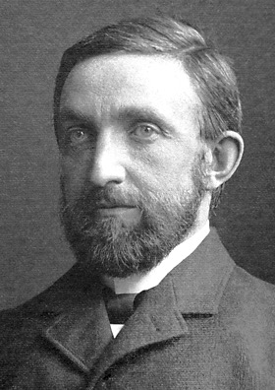
80+ Murdered: UAP Experts Exposed
Why / How they Philip Leonard:
LANL high-explosives chemist KILLED in a head-on car crash at age 44 on the road to Los Alamos.
Died February 2024 — the same month former HAARP chief scientist Christopher Fallen was murdered in Albuquerque.
Worked at Los Alamos National Laboratory on explosives research with defense applications.
The crash occurred on NM-501 near the LANSCE facility — deep in the Los Alamos security zone.
Two defense scientists dead in New Mexico in the same month — one year before the 2025 disappearance cluster began.
Philip Leonard
Read List Here:
Dead at Age 44
https://uapmurders.com/uaps

Slide 39
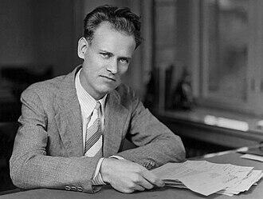
80+ Murdered: UAP Experts Exposed
Why / How they Philo Farnsworth:
The inventor of TELEVISION whose fusion energy research was DEFUNDED and classified.
Developed a working fusor — a nuclear fusion device — that achieved real fusion reactions in the 1960s.
ITT Corporation bought his lab, then SHUT DOWN his fusion research despite its promise.
Died at age 64 of pneumonia in 1971 — broken by decades of having his greatest work suppressed.
The man who gave the world television was denied the chance to give the world clean energy.
Philo Farnsworth
Read List Here:
Dead at Age 64
https://uapmurders.com/uaps

Slide 40
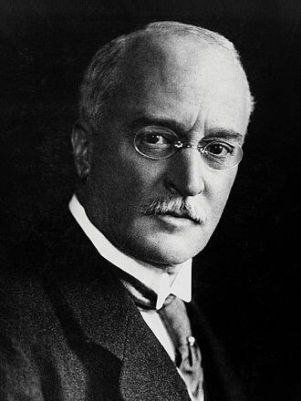
80+ Murdered: UAP Experts Exposed
Why / How they Rudolf Diesel:
Inventor of the DIESEL ENGINE who VANISHED from a ship crossing the English Channel in 1913.
His body was found floating in the sea days later — but was too decomposed for autopsy.
Was on his way to England to discuss licensing his engine to the British Navy.
Multiple parties had motive: oil companies, coal interests, and rival nations.
The most famous inventor disappearance in history — and the first to demonstrate the inventor-death pattern.
Rudolf Diesel
Read List Here:
Dead at Age 55
https://uapmurders.com/uaps

Slide 41
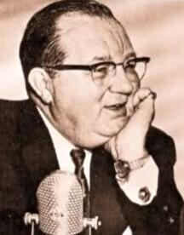
60+ Murdered: Energy Inventors Silenced
Why / How they Frank Edwards:
Prominent UFO author and radio broadcaster — DIED of a heart attack at age 59.
Died on the EXACT 20th anniversary of Kenneth Arnold's 1947 sighting — the event that launched the UFO era.
Bestselling books, national radio audience, one of the most influential early UFO researchers.
Heart attack on the most symbolically significant date in UFO history. Coincidence? At 59?
His death came during a period when multiple early UFO researchers died or were SILENCED.
Frank Edwards
Read List Here:
Dead at Age 59
https://uapmurders.com/energy

Slide 42
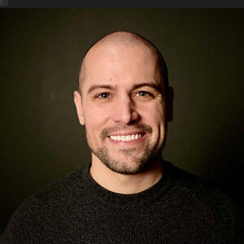
80+ Murdered: UAP Experts Exposed
Why / How they Ryan Graves:
Former Navy F/A-18 pilot who became the FIRST active-duty military pilot to publicly testify before Congress about UAPs.
Founded Americans for Safe Aerospace — a UAP advocacy organization for military witnesses.
Described daily UAP encounters during his Navy service that posed real FLIGHT SAFETY risks.
Testified alongside David Grusch in the historic July 2023 House Oversight hearing.
ALIVE but AT RISK — his public advocacy makes him a target for those who want disclosure stopped.
Ryan Graves
Read List Here:
https://uapmurders.com/uaps

Slide 43
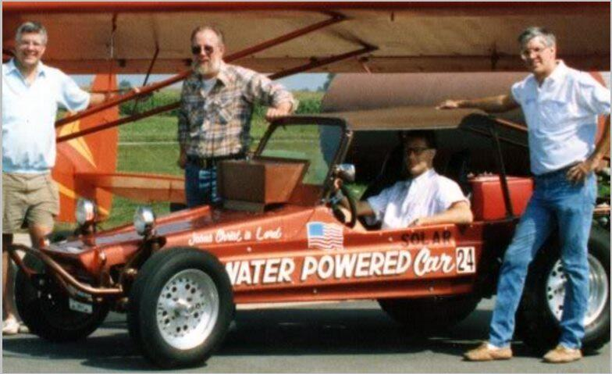
80+ Murdered: UAP Experts Exposed
Why / How they Stanley Meyer:
His last words: "They POISONED me." Then he COLLAPSED at a restaurant and died at age 57.
Invented a water fuel cell that could run a car on WATER — demonstrated it publicly multiple times.
Was meeting with Belgian investors at a restaurant in Grove City, Ohio when he fell ill.
Coroner ruled cerebral aneurysm — but Meyer's family insists he was healthy and was targeted.
Turned down millions from the auto industry to keep the technology available to the PUBLIC.
The most famous case of an energy inventor dying at the exact moment of commercialization.
Stanley Meyer
Read List Here:
Dead at Age 57
https://uapmurders.com/uaps

Slide 44
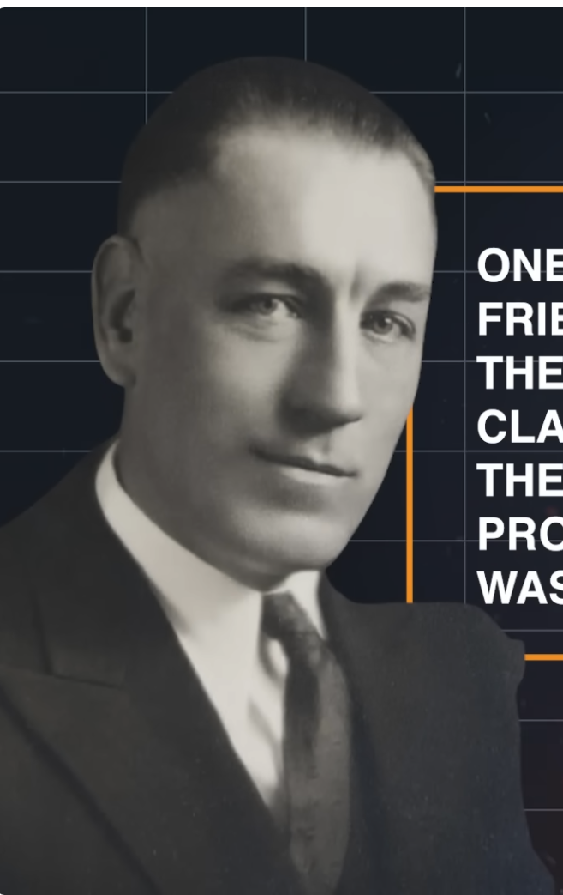
60+ Murdered: Energy Inventors Silenced
Why / How they Thomas Henry Moray:
SHOT AT multiple times. Took a bullet to the LEG in one attack. His lab was RANSACKED.
Invented the "Moray Valve" — a device that extracted usable electricity from "radiant energy" with no power source.
His own assistant Felix Frazer DESTROYED the device with an AX during a lab confrontation in 1941.
Soviet agents reportedly approached him seeking to acquire the technology.
Shot, wounded, ransacked, and then his own assistant smashed it. Died at 81 — the technology died decades earlier.
Thomas Henry Moray
Read List Here:
https://uapmurders.com/energy
Dead at Age 81

Slide 45
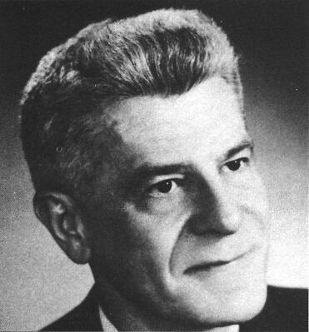
80+ Murdered: UAP Experts Exposed
Why / How they Wilbert Smith:
Canadian government engineer who ran PROJECT MAGNET — Canada's official UFO study — concluded UFOs were EXTRATERRESTRIAL.
DIED of cancer at age 52 — adding to the pattern of UFO researchers dying of cancer.
His classified memo confirmed that UFOs were "the most highly classified subject" in the U.S. government.
Recovered a piece of a UFO that was analyzed by the Canadian government before being returned.
A government scientist who proved UFOs were real — then died of cancer at a young age.
Wilbert Smith
Read List Here:
Dead at Age 52
https://uapmurders.com/uaps

Slide 46
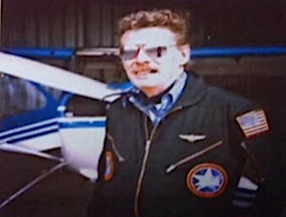
80+ Murdered: UAP Experts Exposed
Why / How they Paul Bennewitz:
UFO investigator who was deliberately DRIVEN INSANE by the Air Force Office of Special Investigations (AFOSI).
Lived near Kirtland AFB and detected genuine anomalous signals — the government's response was to gaslight him.
AFOSI agent Richard Doty fed him disinformation until Bennewitz suffered a complete mental BREAKDOWN.
Was hospitalized in a psychiatric facility — a confirmed case of government psychological warfare against a civilian.
Died at age 75 in 2003 — but his mind was destroyed decades earlier by his own government.
The most thoroughly documented case of intelligence agencies deliberately destroying a UFO researcher.
Paul Bennewitz
Dead at Age 75
Read List Here:
https://uapmurders.com/uaps

Slide 47
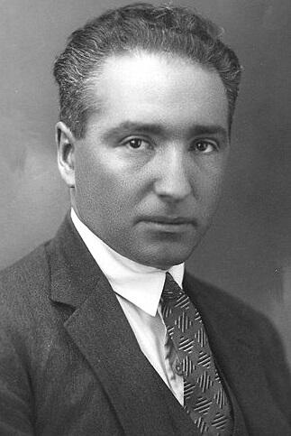
80+ Murdered: UAP Experts Exposed
Why / How they Wilhelm Reich:
His BOOKS were BURNED by order of a U.S. federal court — the only government book burning in American history.
DIED in federal prison at age 60 — ONE DAY before he was eligible for parole.
Invented orgone energy accumulators and cloudbusters — devices the FDA sought to destroy.
Over SIX TONS of his publications were incinerated by court order.
An Austrian-American physician and scientist, imprisoned for refusing to stop his research.
The U.S. government burned his books, locked him in prison, and he died the day before freedom.
Wilhelm Reich
Read List Here:
Dead at Age 60
https://uapmurders.com/uaps

Slide 48
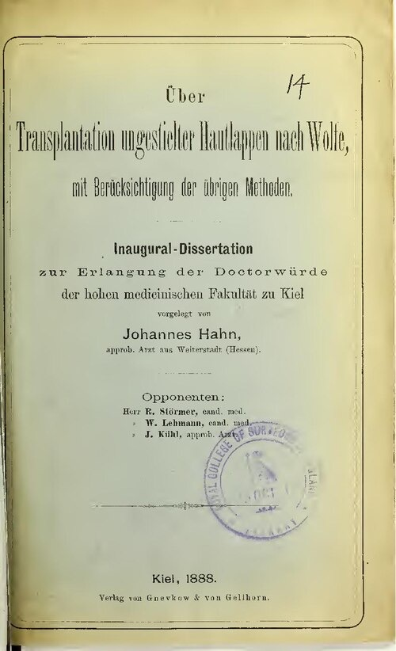
80+ Murdered: UAP Experts Exposed
Why / How they Karl Wolfe:
Air Force analyst who revealed photos of STRUCTURES on the far side of the moon — KILLED in a hit-and-run at age 74.
Struck by a tractor trailer while cycling near his home in Lansing, New York — October 2018.
Testified at the 2001 Disclosure Project National Press Club event about what he saw at NSA's Langley facility.
Described being shown photographic evidence of a BASE on the lunar surface during his Air Force service.
The hit-and-run came 17 years after he went public — but the pattern of vehicular "accidents" is well established.
Karl Wolfe
Read List Here:
Dead at Age 74
https://uapmurders.com/uaps

