Slide 1
Quantum Leap Incorporation Form Application
G1T3
Bernice Teo
Bryan Tan
Elton
Hong Ming
Ken Ming
Zhe Liang
Zhe Xiang

Slide 2


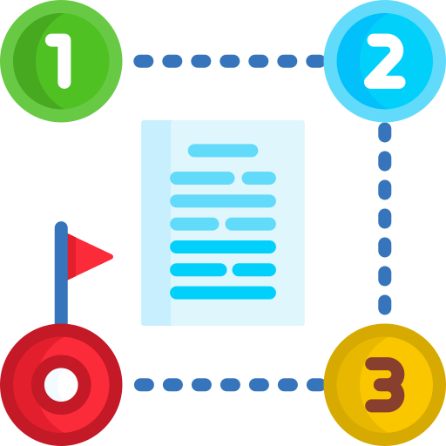
We wanted to fulfill 3 objectives with our app
Scalability
Visibility
Efficiency
Ensure that app is customizable to provide Quantum Leap with the flexibility it needs as it grows
Even as the number of projects and forms increases, they are still easy to track and manage
Stakeholders can process and assign workflows easily without delays with the intuitive design

Slide 3



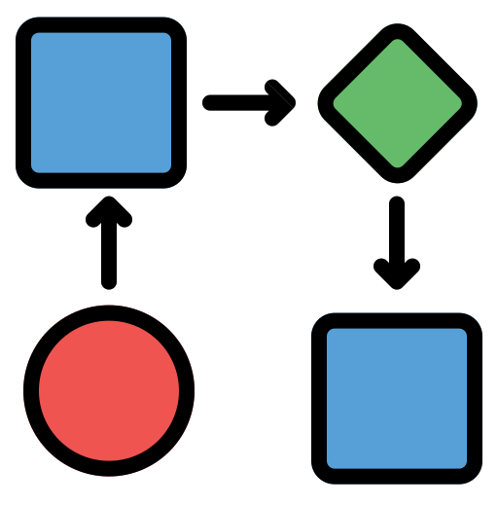

The key features of our app are in line with what was expected by Quantum Leap
Project Management
Form Builder
Versioning
One stop channel to create and manage projects
Customizable form builder to build any form imaginable
Auditable forms with the additional functionality of generating printouts
Workflow Management
Account Management
Assign forms to users and email reminders to vendors
Manage new and existing vendors using our web application

Slide 4




...and the features were expanded on to give the app higher quality of functionality
Dashboard
Form Builder
Gain quick and clear insights into entire organization’s progress
Implemented to give modularity and full customizability of forms
Flexible Emailing
Clean and Intuitive Frontend
Automated messages are sent at specific intervals before due date, and users can also send customized emails
Layouts and designs are simple, easy to navigate and made with the users in mind

Slide 5






Client-Server Architecture: A clear segmentation of code
Backend
Controller Layer
Service Layer
Repository Layer
Database
Frontend

Slide 6



React.js was used as the frontend for the app
Speed
Flexibility
Maintainability
Fast rendering, which enables the app the perform well even as it scales
Offers high reusability of components that comes with the rich ui libraries while giving a lot of flexibility for customization
Easy to maintain due to its modular structure, and prevalent usage in the industry

Slide 7



Material UI was leveraged to create a professional, responsive and pleasant user experience
What is Material UI?
What’s in it for you?
1
Library that offers a wide range of components
1
Simple and intuitive user interface
2
Styling framework that is compatible with React.js
2
Consistent look and feel across the app
3
3
Industry level consistency of icons, designs and UX
Maintained by Google

Slide 8




Backend: Open source libraries and tools were used to ensure longevity of the solution in years to come
Backend Framework
Emailing
PDF Generator
Security
1
MVC model makes code easy to understand
2
Easy to replace parts of the backend to scale
3
Able to use the app without external plugins

Slide 9

Project Demo
A run though of our app

Slide 10



Conclusion: What does this mean for Quantum Leap?
Better satisfaction
Visibility aids employees in project management, enable easy liaising with vendors, raising employees’ and vendors’ satisfaction
Better credibility
Digital forms make auditing vendors much easier, increasing Quantum Leap’s credibility
Better Automation
Onboarding process is significantly smoothened as app can be used for other administrative tasks/forms

Slide 11
Thank you!

