Slide 1
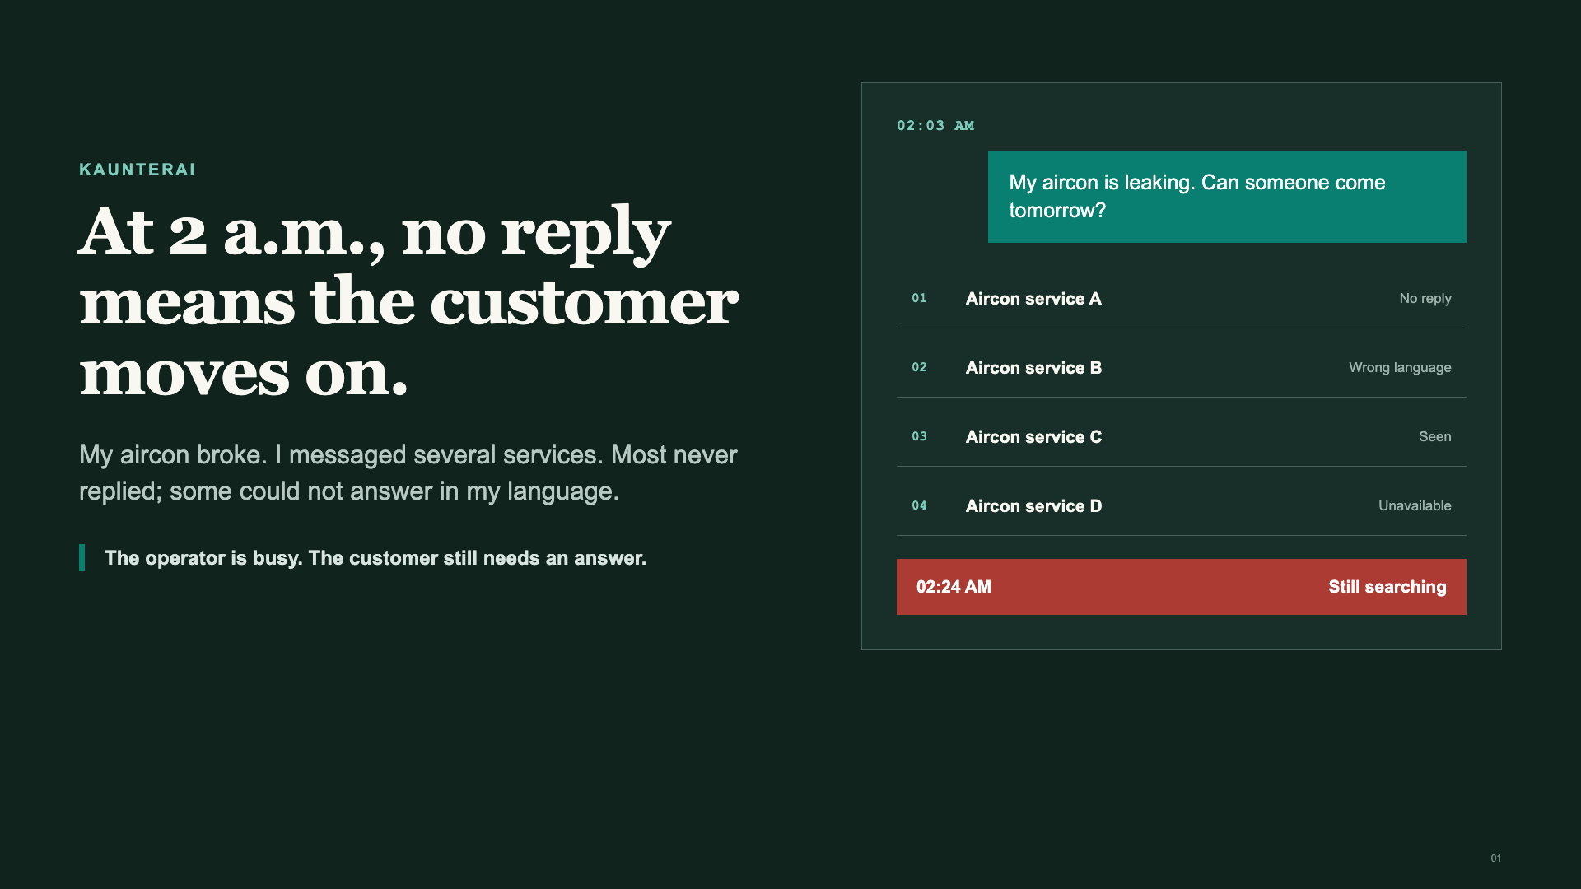
Notes:
TARGET: 25 seconds.,Good morning. My name is Bryan, and I built this because my own aircon broke.,At around two in the morning, I searched Facebook and messaged multiple aircon services. Many never replied. Others could not meet me in the language I preferred.,The operator was probably on another job. But as the customer, I kept searching.,BOUNDARY: This is Bryan's personal experience, not a national lost-booking statistic.

Slide 2
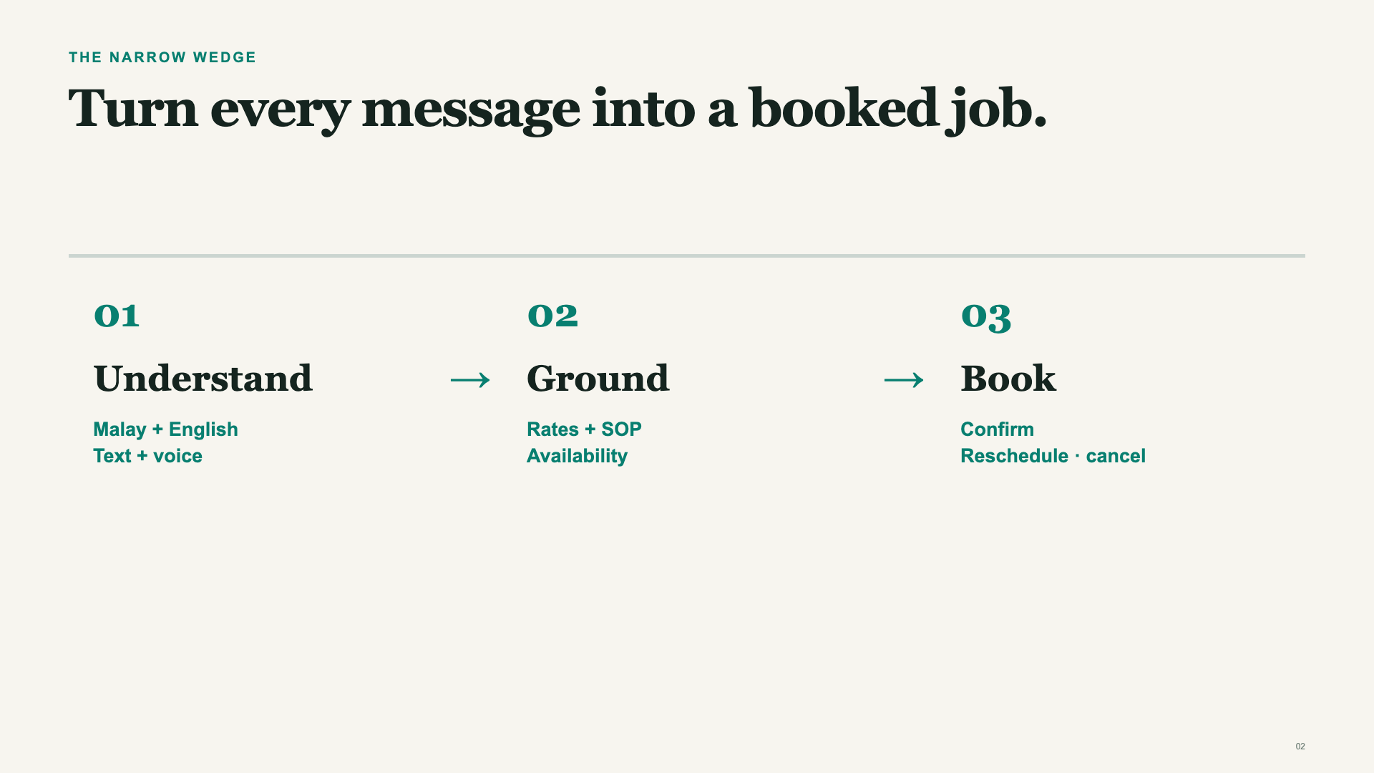
Notes:
TARGET: 25 seconds.,KaunterAI makes that first message the start of a completed workflow.,It receives Malay or English text and voice notes, preserves an English meaning for the operator, grounds the answer in the rate card and actual availability, then books, reschedules, or cancels through typed tools.,Mandarin exists in supporting translation and voice infrastructure, but it is the next language to validate for this aircon workflow.

Slide 3
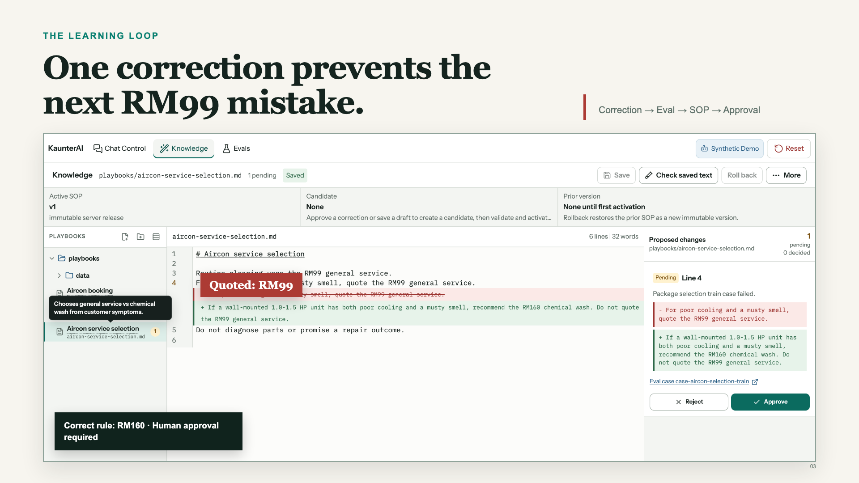
Notes:
TARGET: 30 seconds.,The most important part is not that the agent can answer. It is that the agent can learn from a mistake without changing the business silently.,Here the customer needed the supported RM160 chemical wash, but the agent quoted the RM99 general service.,The correction creates a failed Eval. KaunterAI proposes one exact line in the SOP. A human can approve or reject it.,Do not discuss candidates, activation, or rollback unless a judge asks. Those mechanics exist, but they are not the story.

Slide 4
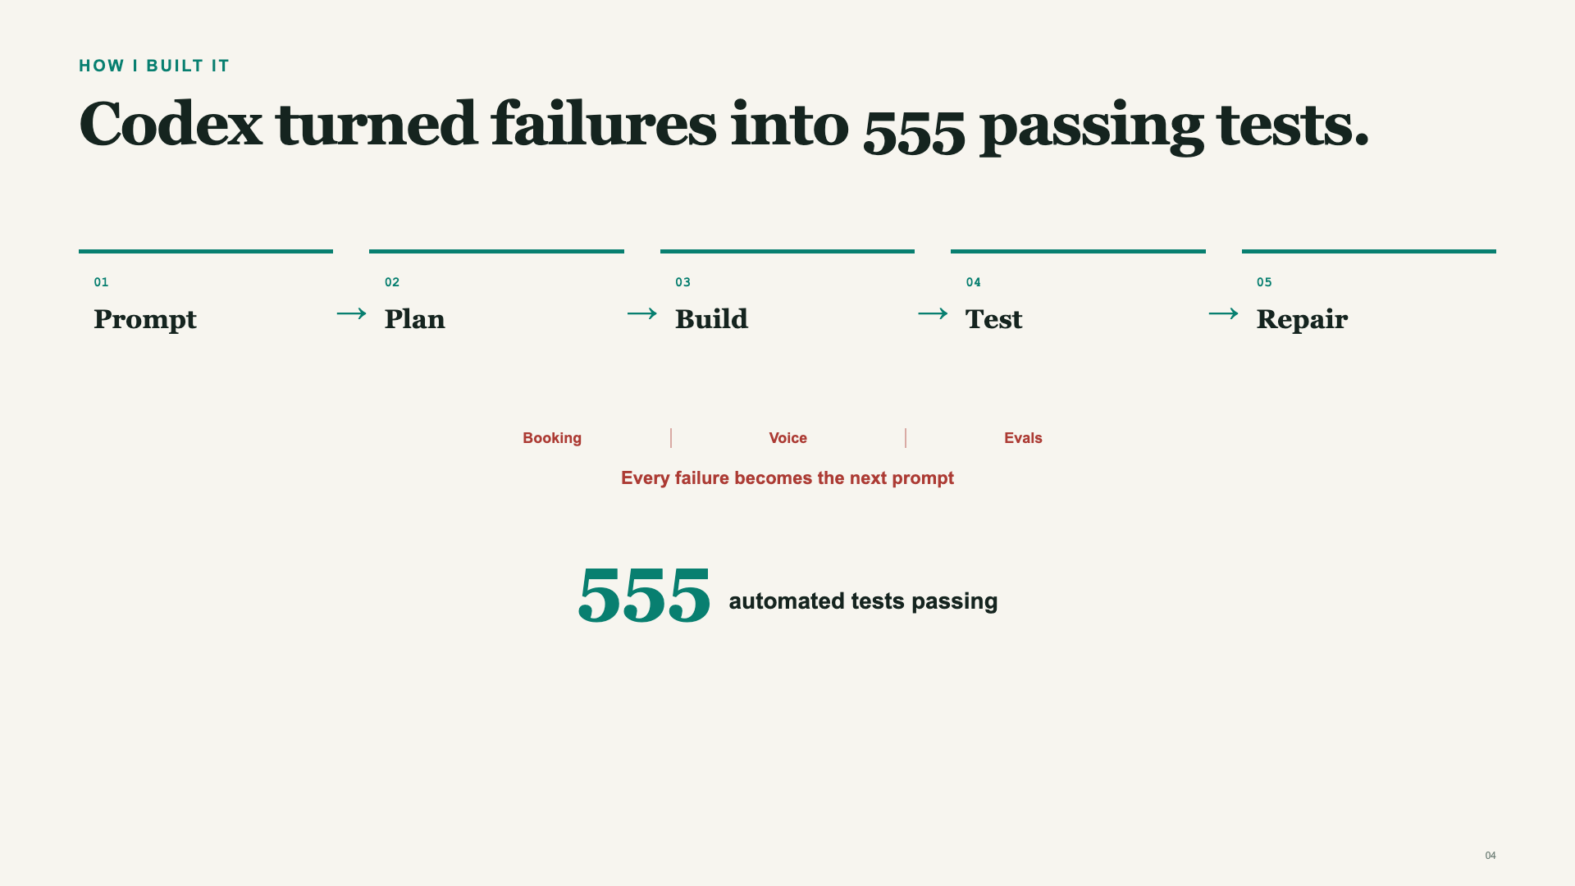
Notes:
TARGET: 30 seconds.,I used Codex as a self-correcting engineering loop, not as a one-shot code generator.,I describe the result and constraints, turn them into an implementation Markdown file, and let Codex run one-to-two-hour implementation loops.,It builds, runs the tests, inspects what failed, repairs the implementation, and repeats.,That loop covered booking conflicts, multilingual voice, Eval correction, and release behavior.,CURRENT PROOF: npm test passed 555 tests across 82 files on 18 July 2026.

Slide 5
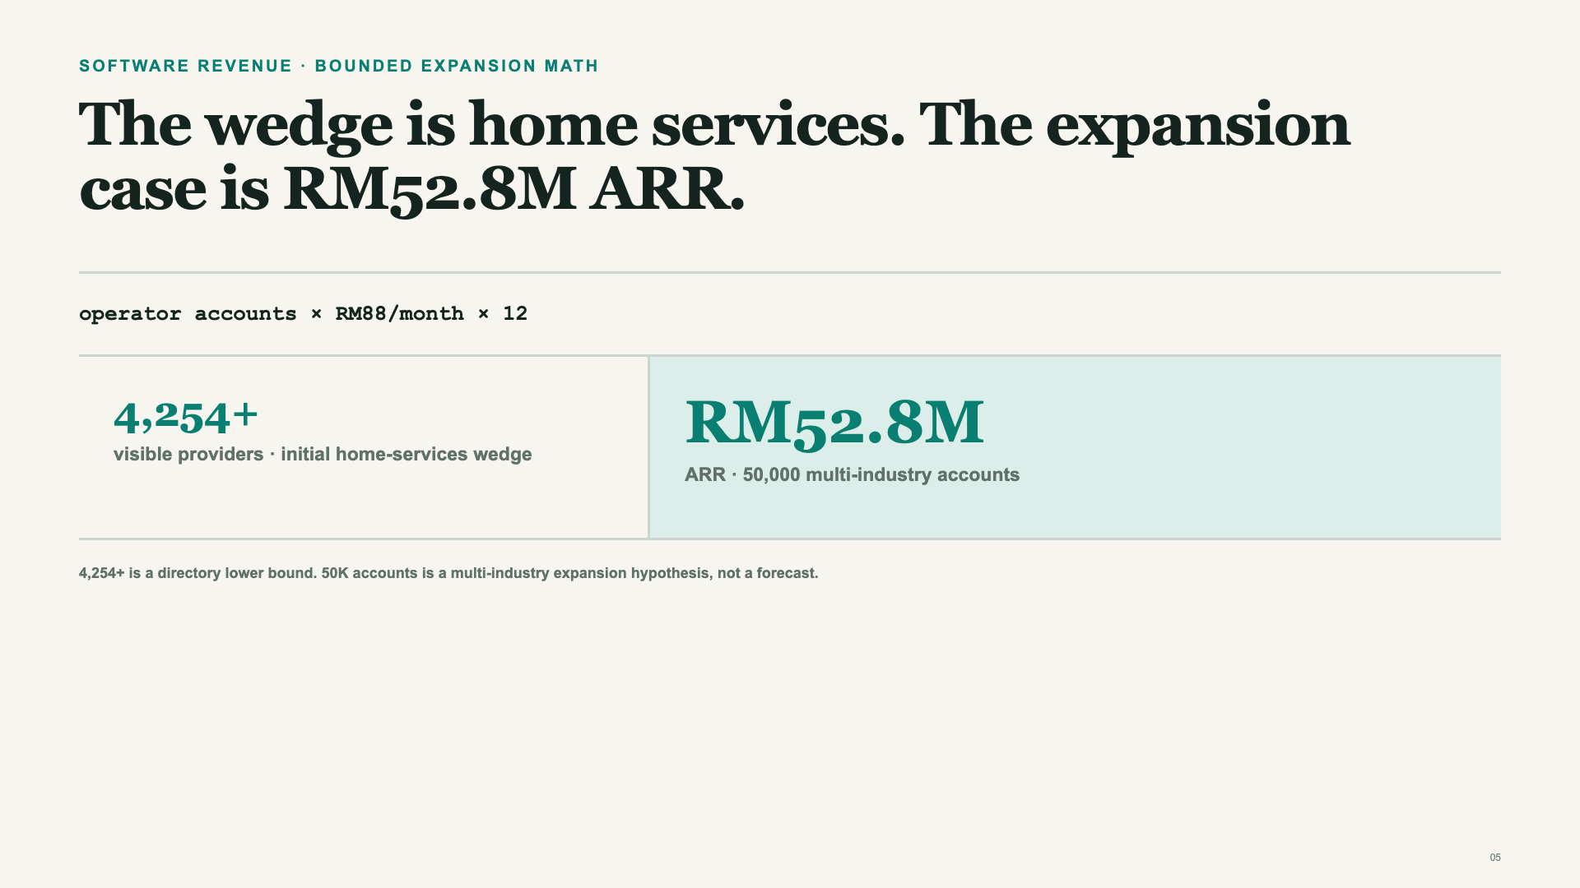
Notes:
TARGET: 25 seconds.,KaunterAI sells software subscriptions, not aircon servicing.,The 4,254-provider directory is evidence of an observable home-services wedge, not a revenue forecast or complete market count.,The bounded expansion case stops at fifty thousand multi-industry accounts. At RM88 per month, that produces RM52.8 million ARR.,Aircon creates the first operating relationship; customer-led capabilities and adjacent industries expand the account base.,BOUNDARY: Fifty thousand accounts is a multi-industry expansion hypothesis, not a Malaysia home-services count or forecast. RM88 is a starter-price hypothesis to validate through paid pilots.,PRICING BENCHMARK: https://www.servicem8.com/us/pricing

Slide 6
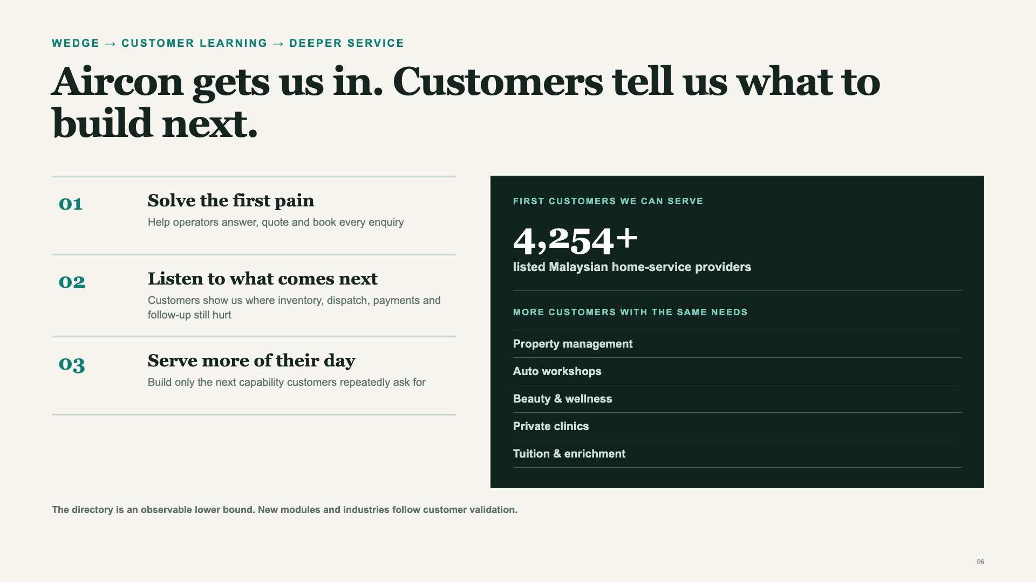
Notes:
TARGET: 25 seconds.,Aircon is the foot in the door, not the final product boundary.,SeekHomeFix lists more than 4,254 Malaysian home-service providers. That is a visible directory lower bound, not an official registry or complete TAM.,We start by helping operators answer, quote, and book every enquiry.,Then customers tell us what remains painful: inventory, dispatch, payments, invoicing, preventive maintenance, follow-up, or staff scheduling.,We build the next capability only after customers repeatedly ask for it, then test the same needs in property management, auto workshops, beauty and wellness, private clinics, and tuition centres.,BOUNDARY: Adjacent industries and future modules require customer validation; they are not shipped proof.,SOURCE: https://seekhomefix.my/

Slide 7
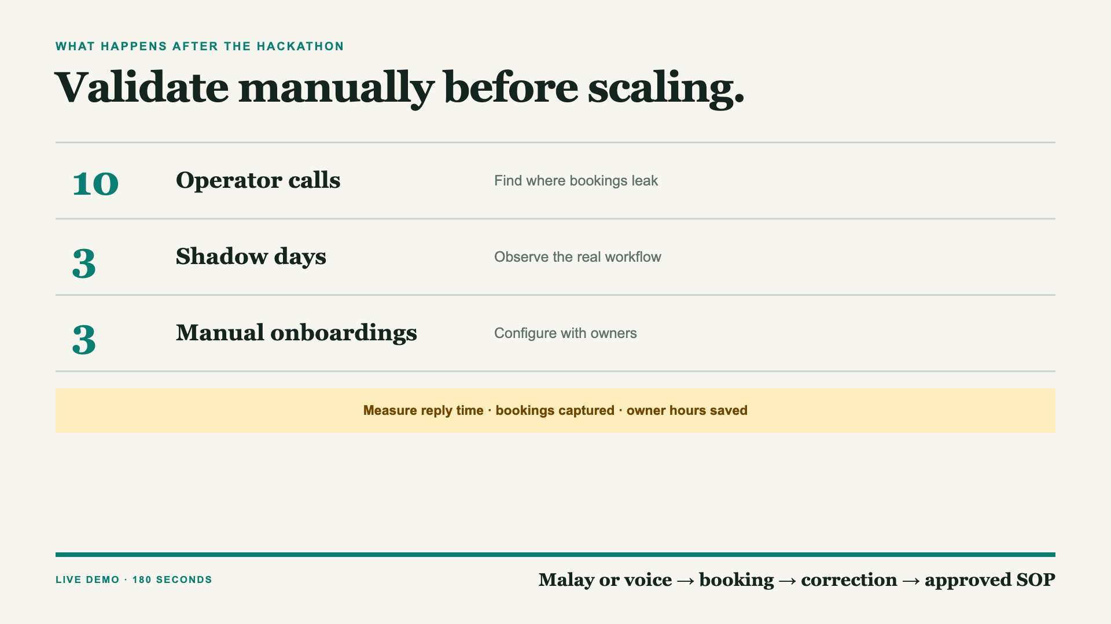
Notes:
TARGET: 20 seconds, then leave the deck.,The next step is not advertising. It is doing things that do not scale.,I will call ten Klang Valley operators, shadow three real service days, and manually onboard three workflows with the operator in the room.,I will measure reply time, bookings captured, and owner hours saved.,Now I will show the working loop: Malay or voice, a grounded booking, a correction, and a human-approved SOP change.,SOURCE: https://www.ycombinator.com/blog/ycs-essential-startup-advice,SOURCE: https://www.paulgraham.com/ds.html

Slide 8
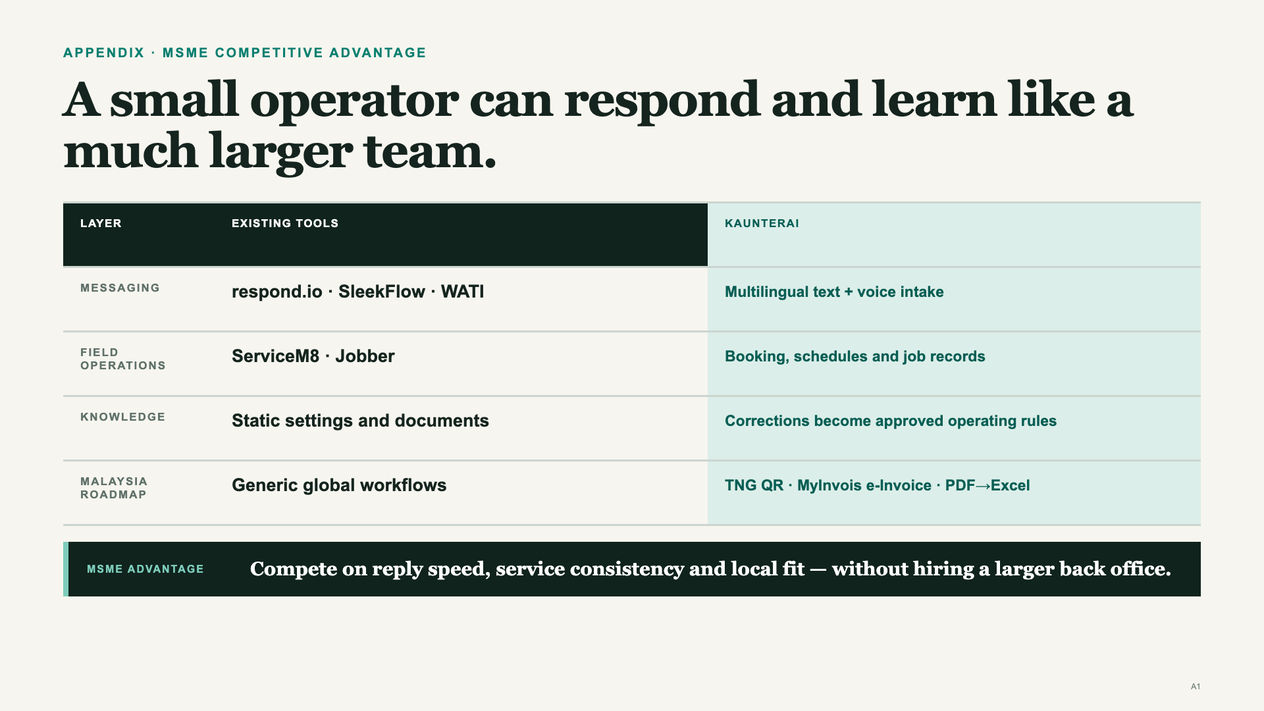
Notes:
APPENDIX ONLY.,The MSME advantage is practical: reply while the team is on-site, convert more enquiries into bookings, and keep service decisions consistent without hiring a larger back office.,KaunterAI must still reach category parity on messaging, booking, schedules, and job records.,The durable wedge is governed vertical knowledge: correction evidence becomes a proposed operating rule that a human approves, so the operator's service quality can compound.,The Malaysia roadmap adds TNG QR handling, MyInvois e-Invoice workflows, and PDF extraction into structured Excel records.,The strategy is one vertical first, then reuse the workflow and localization layer across adjacent field services.,BOUNDARY: TNG QR, MyInvois, and PDF-to-Excel are roadmap items, not current shipped proof.,BOUNDARY: This positioning is based on public product capabilities, not measured market share.

Slide 9
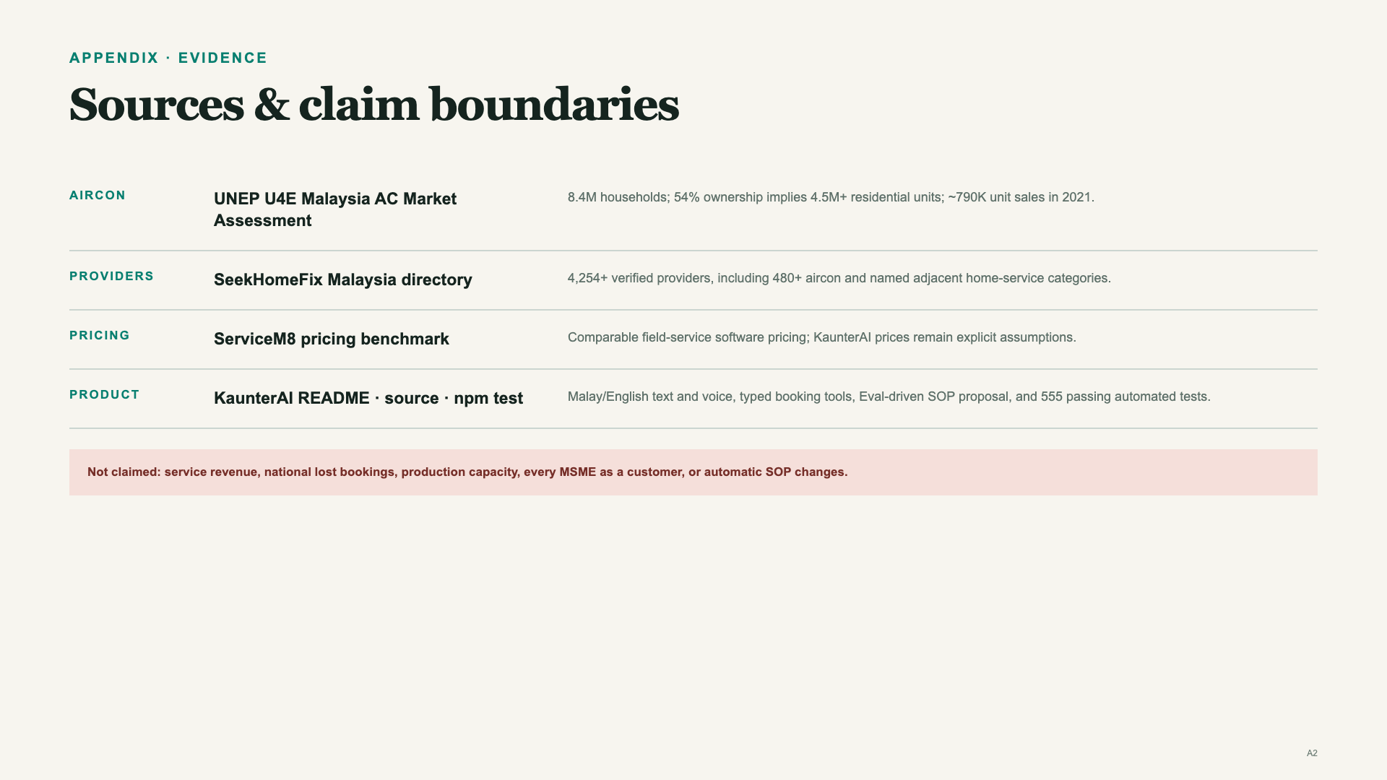
Notes:
APPENDIX ONLY.,Aircon market assessment: https://united4efficiency.org/wp-content/uploads/2024/03/AC-Market-Assessment-Report_Final_240518.pdf,Observable Malaysian provider directory: https://seekhomefix.my/,Field-service pricing benchmark: https://www.servicem8.com/us/pricing,YC startup advice: https://www.ycombinator.com/blog/ycs-essential-startup-advice,Paul Graham: https://www.paulgraham.com/ds.html,Repository: https://github.com/BryanTheLai/codex-july-hackathon-official,Verified product command: npm test,Not claimed: aircon-service revenue, national lost bookings, production capacity, every MSME as a customer, or automatic SOP changes.

