Slide 1
汇报人：xxx 汇报时间：xxxx
南京大学PPT模板

Slide 2
01.
年度工作概述
print the presentation and make it into a film a wider field
02.
工作完成情况
CONTENT
print the presentation and make it into a film a wider field
03.
工作存在不足
print the presentation and make it into a film a wider field
04.
明年工作计划
print the presentation and make it into a film a wider field

Slide 3
01
年度工作概述
The user can demonstrate on a projector or computer, or print the presentation and make it into a film to be used in a wider field The user can demonstrate

Slide 4




年度工作概述
print the presentation and make it into a film a wider field
The user can demonstrate on a projector or computer, or print the presentation and make it into a film to be used in a wider field.
The user can demonstrate on a projector or computer, or print the presentation and make it into a film to be used in a wider field.
The user can demonstrate on a projector or computer, or print the presentation and make it into a film to be used in a wider field.

Slide 5
年度工作概述
print the presentation and make it into a film a wider field
标题文字添加
标题文字添加
The user can demonstrate on a projector or computer, or print the presentation and make it into a film to be used in a wider field.
The user can demonstrate on a projector or computer, or print the presentation and make it into a film to be used in a wider field.
标题文字添加
标题文字添加
The user can demonstrate on a projector or computer, or print the presentation and make it into a film to be used in a wider field.
The user can demonstrate on a projector or computer, or print the presentation and make it into a film to be used in a wider field.

Slide 6



年度工作概述
print the presentation and make it into a film a wider field
标题文字添加
The user can demonstrate on a projector or computer, or print the presentation and make it into a film to be used in a wider field.
标题文字添加
The user can demonstrate on a projector or computer, or print the presentation and make it into a film to be used in a wider field.

Slide 7
02
工作完成情况
The user can demonstrate on a projector or computer, or print the presentation and make it into a film to be used in a wider field The user can demonstrate

Slide 8


工作完成情况
print the presentation and make it into a film a wider field
标题文字添加
The user can demonstrate on a projector or computer, or print the presentation and make it into a film to be used in a wider field.
标题文字添加
The user can demonstrate on a projector or computer, or print the presentation and make it into a film to be used in a wider field.

Slide 9
工作完成情况
print the presentation and make it into a film a wider field
标题文字添加
The user can demonstrate on a projector or computer, or print the presentation and make it into a film to be used in a wider field.
21.3
标题文字添加
The user can demonstrate on a projector or computer, or print the presentation and make it into a field.
96.8
标题文字添加
43.5
The user can demonstrate on a projector or computer, or print the presentation and make it into a film to be used in a wider field.
The user can demonstrate on a projector or computer, or print the presentation and make it into a film to be The user can demonstrate on a projector or computer, or print the presentation and make it into a film to be used in a wider field.used in a wider field

Slide 10
工作完成情况
print the presentation and make it into a film a wider field
1
标题文字添加
The user can demonstrate on a projector or computer, or print the presentation and make it into.
标题文字添加
The user can demonstrate on a projector or computer, or print the presentation and make it into a film to be used in a wider field. The user can demonstrate on a
2
标题文字添加
3
The user can demonstrate on a projector or computer, or print the presentation and make it.

Slide 11
03
工作存在不足
The user can demonstrate on a projector or computer, or print the presentation and make it into a film to be used in a wider field The user can demonstrate

Slide 12




工作存在不足
print the presentation and make it into a film a wider field
标题文字添加
标题文字添加
The user can demonstrate on a projector or computer, or print the presentation and make it into a film to be used in a wider field.
The user can demonstrate on a projector or computer, or print the presentation and make it into a film to be used in a wider field.
标题文字添加
标题文字添加
The user can demonstrate on a projector or computer, or print the presentation and make it into a film to be used in a wider field.
The user can demonstrate on a projector or computer, or print the presentation and make it into a film to be used in a wider field.

Slide 13
工作存在不足
print the presentation and make it into a film a wider field
标题文字添加
标题文字添加
The user can demonstrate on a projector or computer, or print the presentation and make it into a film to be used in a wider field.
The user can demonstrate on a projector or computer, or print the presentation and make it into a film to be used in a wider field.
01
02
标题文字添加
03
04
标题文字添加
The user can demonstrate on a projector or computer, or print the presentation and make it into a film to be used in a wider field.
The user can demonstrate on a projector or computer, or print the presentation and make it into a film to be used in a wider field.

Slide 14
04
明年工作计划
The user can demonstrate on a projector or computer, or print the presentation and make it into a film to be used in a wider field The user can demonstrate

Slide 15
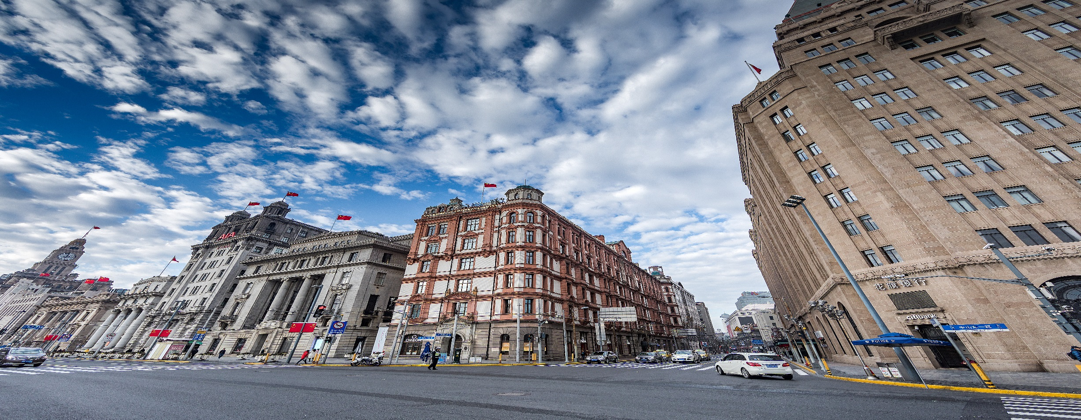
明年工作计划
print the presentation and make it into a film a wider field
标题文字添加
The user can demonstrate on a projector or computer, or print the presentation and make it into a film to be used in a wider field.
The user can demonstrate on a projector or computer, or print the presentation and make it into a film to be used in a wider field.
The user can demonstrate on a projector or computer, or print the presentation and make it into a film to be used in a wider field.

Slide 16




明年工作计划
print the presentation and make it into a film a wider field
1
标题文字添加
标题文字添加
The user can demonstrate on a projector or computer, or print the presentation and make it into a film to be used in a wider field.
The user can demonstrate on a projector or computer, or print the presentation and make it into a film to be used in a wider field.
2
4
标题文字添加
标题文字添加
The user can demonstrate on a projector or computer, or print the presentation and make it into a film to be used in a wider field.
The user can demonstrate on a projector or computer, or print the presentation and make it into a film to be used in a wider field.
3

Slide 17
明年工作计划
print the presentation and make it into a film a wider field
标题文字添加
The user can demonstrate on a projector or computer, or print the presentation and make it into a film to be used in a wider field.
标题文字添加
The user can demonstrate on a projector or computer, or print the presentation and make it into a film to be used in a wider field.
标题文字添加
The user can demonstrate on a projector or computer, or print the presentation and make it into a film to be used in a wider field.
标题文字添加
The user can demonstrate on a projector or computer, or print the presentation and make it into a film to be used in a wider field.

Slide 18
汇报人：xxx 汇报时间：xxxx
谢谢观看

