Slide 1

NVDIMM Internals And
Data Center Workload Profile
Intel AIPG/SSP
fan.du@intel.com
fengguang.wu@intel.com

Slide 2

Outline
NVDIMM Basics
Data Center Workload Profile

Slide 3
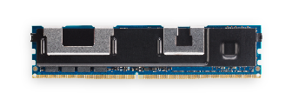

Intel® Optane™ DC Persistent Memory - Product Overview
Cascade Lake
Non-Volatile Memory Pool
Memory
App Direct
Storage
IMC
IMC
DCPMM*
DRAM, or
DRAM as cache
DDR4 DRAM*
DIMM Capacity
128, 256, 512GB
Speed
2666 MT/sec
Capacity per CPU
3TB (not including DRAM)
1
MEMORY mode
● Large memory at lower cost
2
APP DIRECT mode
● Low latency persistent memory
DDR4 electrical & physical
Close to DRAM latency
Cache line size access
● Persistent data for rapid recovery
Storage over APP DIRECT
● Fast direct-attach storage
* DIMM population shown as an example only.

Slide 4
OS transparent Usage
HW 2LM (Memory Mode)
OS transparent
OS visible size: DCPMM size
Memory Mode
(MM)
DCPMM
Volatile
DRAM
Cache
Memory Mode
(2nd Level Memory)
Volatile with DRAM caching

Slide 5
OS Visible Usage - App Direct Interfaces
Block Device /dev/pmemX.Y
Char Device /dev/daxX.Y
Memory only NUMA node

Slide 6
Heterogeneous Memory Tiering Ideas
HBM
DRAM
NVDIMM(DCPMM)
Memory mode
NUMA node
Heterogeneous memory solutions:
Software-Defined Far Memory in Warehouse-Scale Computers Paper
HMEM: https://lkml.org/lkml/2019/10/16/1187
https://arxiv.org/abs/1907.12014
Question:
How to know workload fit best to what types of memory beforehand?

Slide 7
Outline
NVDIMM Basics
Data Center Workload Profile

Slide 8
DCPMM Profiling Tool - Why
Customer puzzles
Shall I use Intel DCPMM for my workload? => good performance (per $)?
If yes, how much AEP to be deployed? => best DRAM:AEP ratio?
Fix chicken-and-egg problem by providing a measuring tool
Run everywhere in legacy customer environment
Measure online get real characteristics
Generate reports that help make Intel DCPMM deployment decision

Slide 9
DCPMM Profiling Tool - Metrics
Just put task in AEP
Memory Bandwidth
Idle, or
Low read/write BW, esp. write BW, or
Lots of cold pages that meet (2)
Memory Capacity
Large, or
Large comparing to BW, or
Large percent of cold pages
Memory Latency
Not sensitive
need hotness
scan & migration
App specific
Not auto detectable

Slide 10
DCPMM Profiling Tool - Report contents
Task metrics | value | threshold
Total BW | MB/s | -
Read%, Write% | %
Seq%, Rnd% | %
BW-per-GB histogram | plot distribution curve and the threshold line | -
Cold pages BW | MB/s | -
Cold BW percent | % | Customer defined, if latency sensitive
Cold pages percent | % | > System AEP% e.g. > 50-80%
Hot drift rate | %/minute | < 5% AEP BW on added costs e.g. < 1%/minute
IPC: insn per cycle local vs remote DRAM | % dropped

Slide 11
DCPMM Profiling Tool - Methodology

Slide 12
Task Bandwidth Distribution
 | hot | cold
size | 25% | 75%
bandwidth | 89.6% | 10.4%
Reference AEP MB-per-GB
X axis: RefCount 19 => 0
Test: sysbench random reads in Gaussian distribution

Slide 13
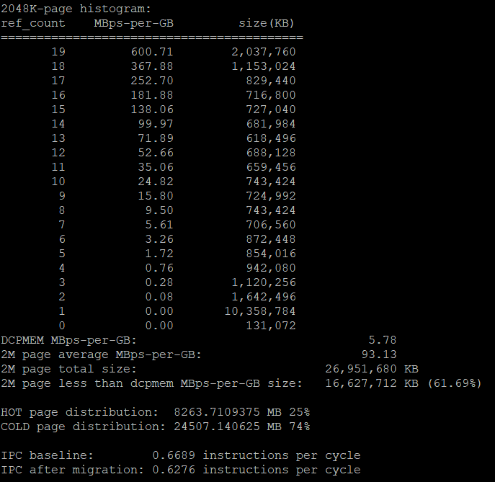
DCPMM Profiling Tool – Sample Log

Slide 14
Recap
NVDIMM basics
How to get insights of workload in tiered memory
Source Code:
https://github.com/intel/memory-optimizer/blob/master/profile_tool/README

Slide 15
Legal Information
INFORMATION IN THIS DOCUMENT IS PROVIDED IN CONNECTION WITH INTEL® PRODUCTS. EXCEPT AS PROVIDED IN INTEL'S TERMS AND CONDITIONS OF SALE FOR SUCH PRODUCTS, INTEL ASSUMES NO LIABILITY WHATSOEVER, AND INTEL DISCLAIMS ANY EXPRESS OR IMPLIED WARRANTY RELATING TO SALE AND/OR USE OF INTEL PRODUCTS, INCLUDING LIABILITY OR WARRANTIES RELATING TO FITNESS FOR A PARTICULAR PURPOSE, MERCHANTABILITY, OR INFRINGEMENT OF ANY PATENT, COPYRIGHT, OR OTHER INTELLECTUAL PROPERTY RIGHT.
Intel may make changes to specifications, product descriptions, and plans at any time, without notice.
All dates provided are subject to change without notice.
Intel is a trademark of Intel Corporation in the U.S. and other countries.
*Other names and brands may be claimed as the property of others.
Copyright © 2007, Intel Corporation. All rights are protected.

Slide 16


