Slide 1
Welcome to Hoffman2
Week1

Slide 2
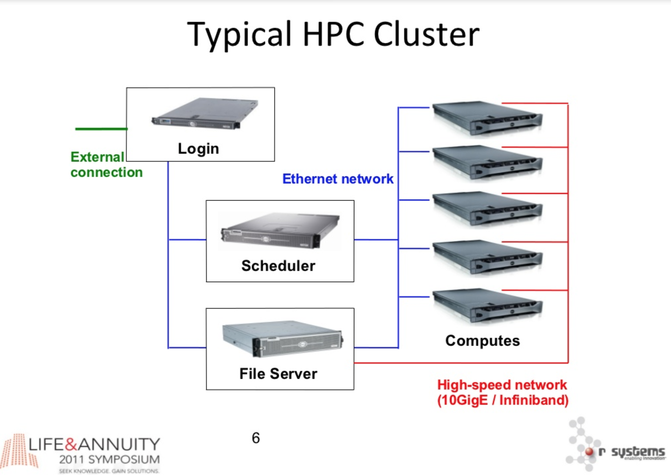


Slide 3
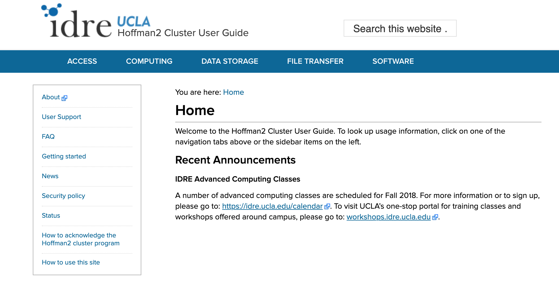
https://www.hoffman2.idre.ucla.edu/

Slide 4
https://www.hoffman2.idre.ucla.edu/

Slide 5
What is the Shell
a simple language with a command-line interface
read-evaluate-print loop
primary purpose is to read commands and run other programs
good for automating repetitive tasks
Used to access networked machines (e.g. HOffman2)
Notes:
Type a command, hit enter, something happens, waits for you to do something else

Slide 6
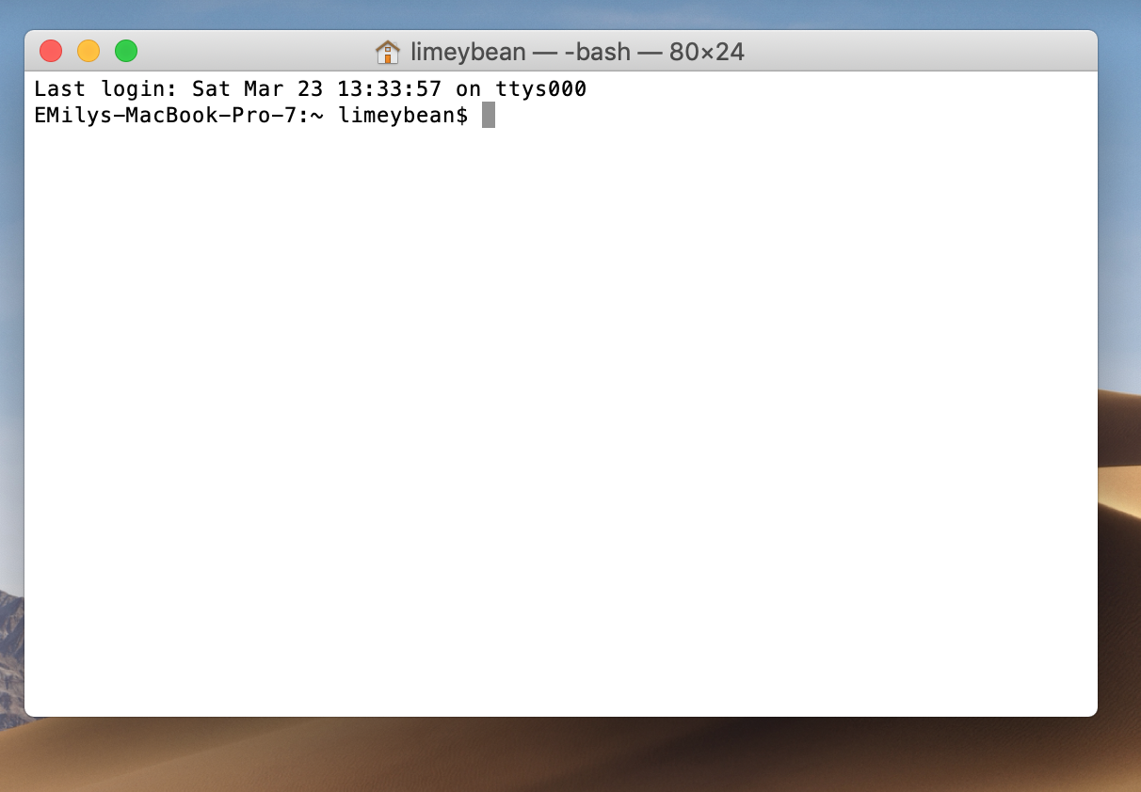
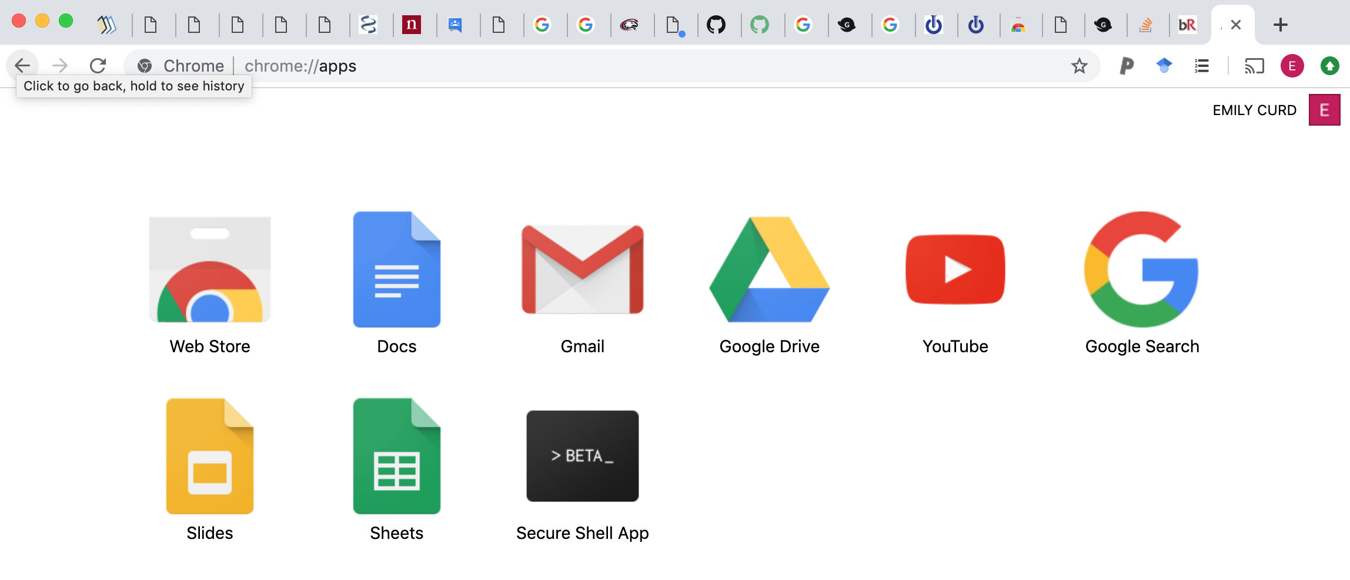
How do I access Hoffman2?
Terminal Mac/Unix and Linux
SSH Client for PC
web-based SSH
https://www.hoffman2.idre.ucla.edu/access/
Notes:
Cygwin
Putty
Chrome ssh -> https://chrome.google.com/webstore/detail/secure-shell-app/pnhechapfaindjhompbnflcldabbghjo
Firefox ssh -> https://addons.mozilla.org/en-US/firefox/addon/sshgate-ssh-client-terminal/?src=search

Slide 7
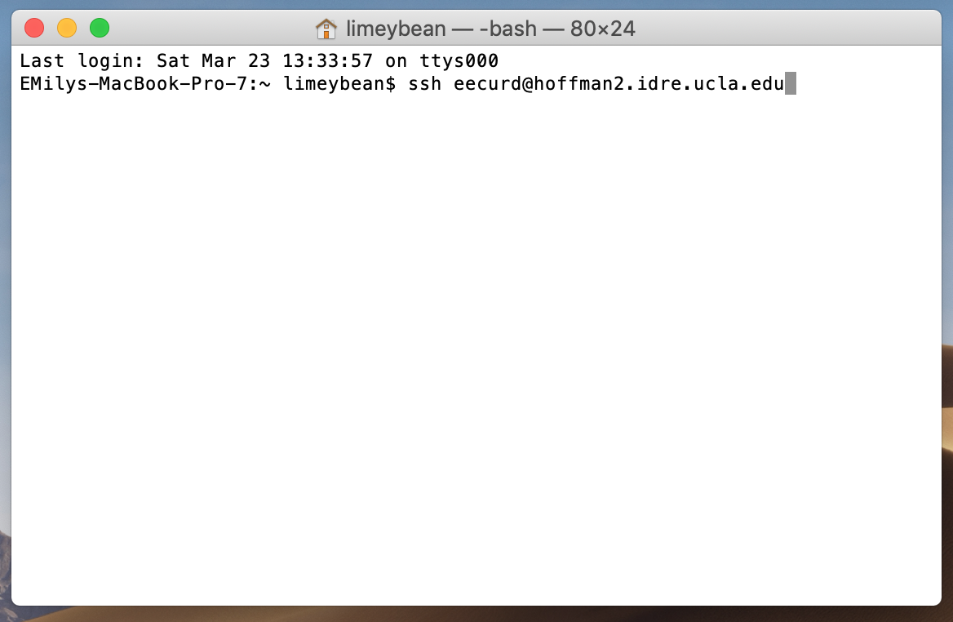
How do I login to Hoffman2?
ssh login_id@hoffman2.idre.ucla.edu

Slide 8
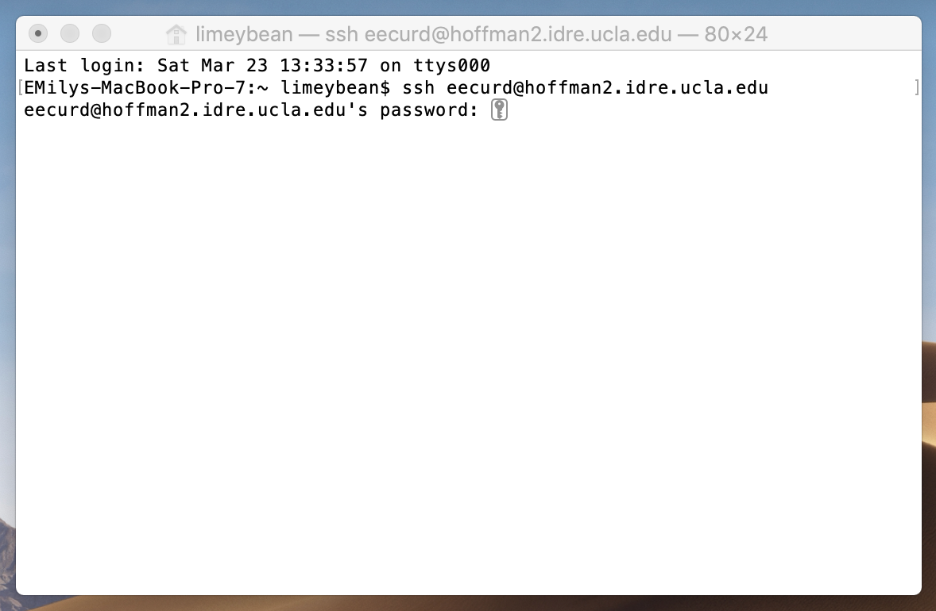
How do I login to Hoffman2?

Slide 9
Fingerprint the first time you connect...
SHA256:
kah9BJwSzrlFnVp9Tg+El2IdcCN7JgN5+Ur2RyIdvwM
RSA key:
xotov-buget-sigyv-gozac-derel-dabaz-ryfep-tohyl-pacoc-pukot-zoxex
3c:9c:67:d8:c5:a4:ae:77:07:5f:10:2f:20:4a:75:0f
RSA1 key:
xocen-pufiz-folal-haruf-bahid-fusyg-cihon-merul-mecyn-laton-poxix e5:75:a2:e8:07:a4:52:c4:c1:10:40:bd:bc:55:ed:3a
DSA key:
xuher-gizaf-kedap-labif-mihiz-silys-hosih-hefez-pagiz-baguk-zexux 09:43:5d:54:01:67:f0:ee:6e:be:20:e3:d4:ec:45:ac

Slide 10
What in the heck do I do now?
Check out a compute node
$ qrsh

Slide 11
Do not linger in the Login node
qrsh

Slide 12
What in the heck do I do now?
Check out a compute node
$ qrsh
$ myjob
$ qstat –u <username>

Slide 13
What in the heck do I do now?
Check out a compute node
$ qrsh
$ myjob
$ qstat –u <username>
Basic navigation in the shell…..

Slide 14
How do I use the Shell?
Notes:
So what if no spaces….
command line interface (CLI) the choices are combinations of commands and parameters, more like words in a language

