Slide 1
Front ended
Quick talk about jargon and concepts. Then you make a thing.

Slide 2
Workshop’s Menu
What are the types of components?
Using containers as interfaces
Testing strategies- Implicit and explicit testing
Whats that Redux thing?
Pairing and awkwardness

Slide 3
Component Types- Stateful
Stateful/ Class based
Harder to manage - Hangs on to state, persist data and tend to be overused.
Good for..
User-created data that will later be submitted
Showing different children with different conditions

Slide 4
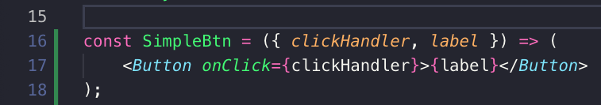
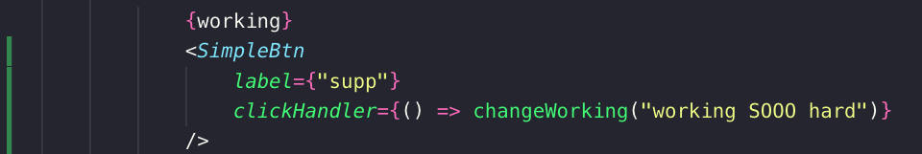
Component Types- State-less
Stateless
Just simple javascript function that return an element or collection.
Easier to work with and test
Passed (read only) props from parents
Must have one global place to manage state
V16.8 added React Hooks (to eliminate stateful in future)

Slide 5
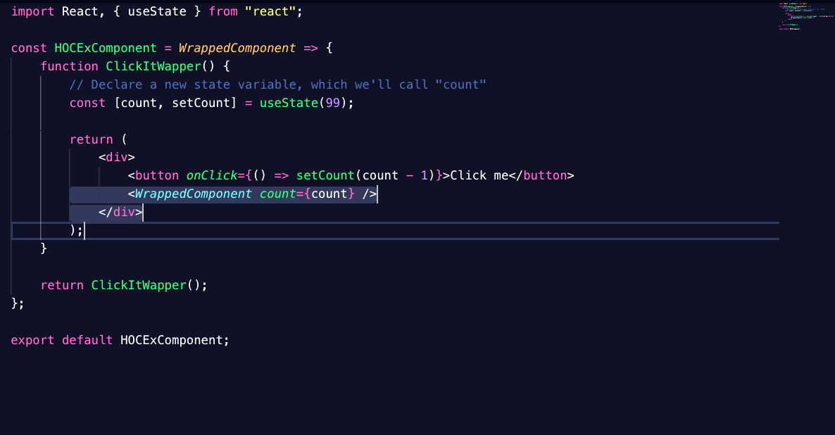
Component Types- HOC
Higher-Order
A Design pattern also known as Decorator Pattern, Allows behavior to be added to our components without affecting other components from the same class (adheres to the SRP)
Abstracts out the logic - much like how redux is used
Data down - actions up design pattern
Accepts the data in its ‘props’, passes that data down to its ‘children’. Actions triggered in those children pass that event up to affect global state

Slide 6
Component Types- HOC

Slide 7
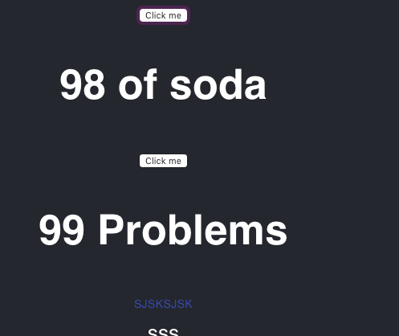
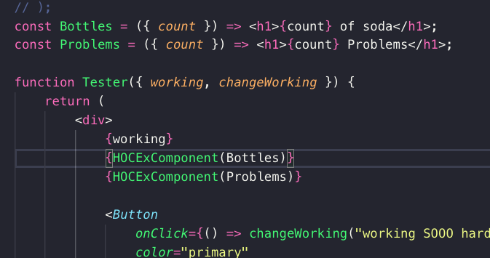
Simple example, but think of what you could do. Styling, API calls.. what else..?

Slide 8
Component Types- Container
Container
Single job simply as possible
Condition A - show PresentationalA with xyz props
Condition B - Show PresentationalB with abc props
Container
Condition
Thing1
Thing2

Slide 9
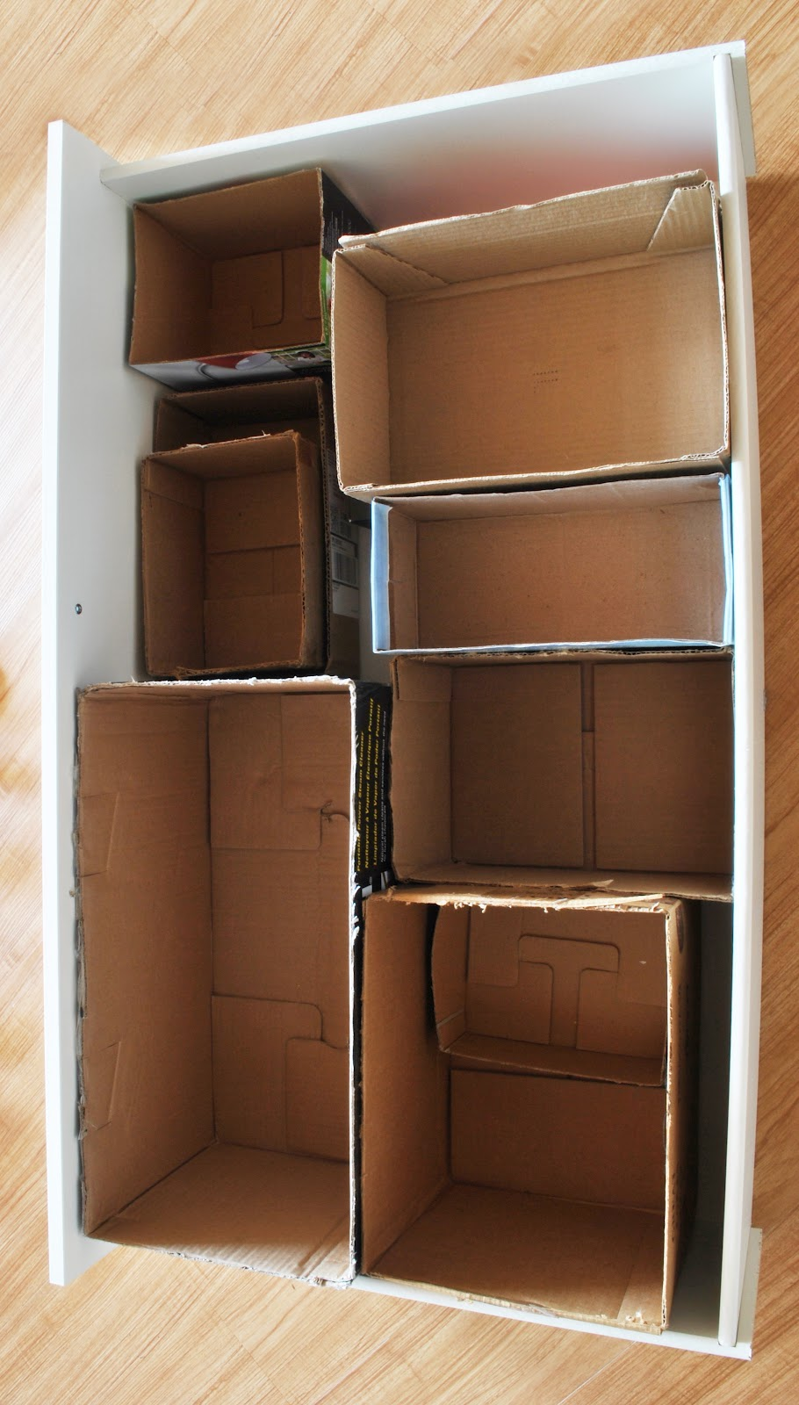
Containers as interfaces
‘Container component’: Definition for this spiel…
A component serving as a contract between the application’s business logic, interface layer or parent component. Feeds its children with what they need to display

Slide 10
Containers as interfaces
Containers are the receipts
in our app’s cookbook.
UserInfoEditContainer
Requirements
Loads current users info
As a appName user I would like to be able to edit the members in my work group
AutoComplete names
Saves on changes

Slide 11
Containers as interfaces
Containers are the receipts
in our app’s cookbook.
Ingredients
‘Steps’ to make receipts
Shows users info
First name, last name, and current list
Loads current users info
UserInfoEditContainer
Makes call to save user.
Updates view Debounced!
As a appName user I would like to be able to edit the members in my work group
Saves on changes
Makes call to get names, formats them. Debounced!
AutoComplete names

Slide 12
Containers as interfaces
PropTypes Define Ingredients
How much? (shape for validation)
Ingredients
userObject: Objectof({
firstName: String
lastName: String.
UsersList: ArrayOf (string)})
First name
last name
current list
Loads current users info
Saves on changes
Makes call to save user.
Returns response
saveUser: Function
success:*userObjectFromAbove*
failure: bool
SearchNames
SelectName
ReqStatus
requestNames: Function
selectName: Function
success: ArrayOf (string)
failure: error
AutoComplete names

Slide 13
Containers as interfaces
Container props become the combination of each ingredient
UserInfoEditContainer
userObject: Objectof({
firstName: String
lastName: String.
UsersList: ArrayOf (string)})
First name
last name
current list
Makes call to save user.
Returns response
saveUser*: Function
success:*userObjectFromAbove*
failure: bool
Without Redux-
Ingredients become larger…
‘*’ denotes function ownership on ingredient when no-redux.
They must be able to ‘pass-back’ results of their async calls
SearchNames
SelectName
ReqStatus
requestNames*: Function
selectName: Function
success: ArrayOf (string)
failure: error

Slide 14
Containers as interfaces
Container props become the combination of each ingredient
Loads current users info
UserInfoEditContainer
(using redux)
userObject: Objectof({
firstName: String
lastName: String.
UsersList: ArrayOf (string)}),
saveUser*: Function
success:*userObjectFromAbove*
failure: bool,
requestNames*: Function
selectName: Function
success: ArrayOf (string)
failure: error
userObject: Objectof({
firstName: String
lastName: String.
UsersList: ArrayOf (string)})
Saves on changes
saveUser*: Function
success:*userObjectFromAbove*
failure: bool
AutoComplete names
requestNames*: Function
selectName: Function
success: ArrayOf (string)
failure: error

Slide 15
Containers as interfaces
Seems like a lot of work Bryan…
Well defined propTypes tell the next dev what to expect
Large components read like a book. Container components utilizing presentational components read like a comic strip
Testing.

Slide 16
Testing Strategies
Explicit Testing
React use-cases
Great for logic outside react components
Function tested - what goes in/ what goes out
Test are able to show structure of data and explain how it is being used.
Object have every method tested
Fail/success cases very important
Selectors, reducers and utilities
Asynchronous logic
HOCs

Slide 17
Testing Strategies
Implicit Testing
React use-cases
Test for the user
No need to test each method, just alter conditions and check for expectations
Anything the user will touch (all components

Slide 18
Redux

Slide 19
Redux
Are connected
Usage
They import actions and utilize selectors to pass props to children
Allows for the separation of most logic from components
Group a shared object for several containers to use as state
Separation of concerns
More presentational / functional components
Containers
Nothing
Else

Slide 20
Redux
Usage for our containers
State
Editor
User
Photo
Elements
Photo | URI | “www.s3”
 | Scale | {x:1, y:2}
 | Position | {x:0, y: 0}
User | Name | “Beels”
 | Email | “beelzAndWheels@aol.com”
 | Image | “someS3.com”

Slide 21
Redux
Usage for our containers
Full State
Photo state
selector for photoUri
Container
Render:
{photoUri && <PresentationalComponent photoUri={photoUri}/>}

Slide 22
Redux
Middleware Choices
Bryan’s favorite: Redux-logic
Async handling- promises vs observables
Debugging
This does that…
Make your own
Testing- virtual time, injection, very clean
Logic- give a ‘logic' a list of actions to listen for, on hearing - does a thing
Uses observables (make your own pipes or use the huge amount rxjs gives us!)
In logic handling, you can take an ugly response and clean it up to take work off actions and reducers

Slide 23
Todays workshop
Hello World!

Slide 24
Todays workshop
To-do list!

Slide 25
Todays workshop
Berkadiatoe!

Slide 26
Todays workshop
Really.. yes.
Berkadiatoe!
Sprint style
Time Limit (I have an airHorn)
Pairing (One drives then we all drop and switch)
Half groups use redux, other half not so lucky

Slide 27
BerkadiaToe: 1st Sprint
github.com/Bryanschauerte/frontEndArchPresentation

Slide 28
BerkadiaToe: 1st Sprint(30 mins)
As a Berkadiatoe user, I would like to play Berkadiatoe
First click on a TickBox changes the color and marks it with an ‘X'
Second click on a TickBox changes the color and marks it with an ‘O’
Winner is declared when three ‘X’s or three ‘O’ are in a horizontal, vertical or diagonal line
When there is a winner, playerX or PlayerO is shown with option to start over
github.com/Bryanschauerte/frontEndArchPresentation

Slide 29
1st Sprint Discussion
Wait a tic, lets talk about it
What strategy did you use?
Did you test?
How?
Problems?
What could be better?
github.com/Bryanschauerte/frontEndArchPresentation

Slide 30
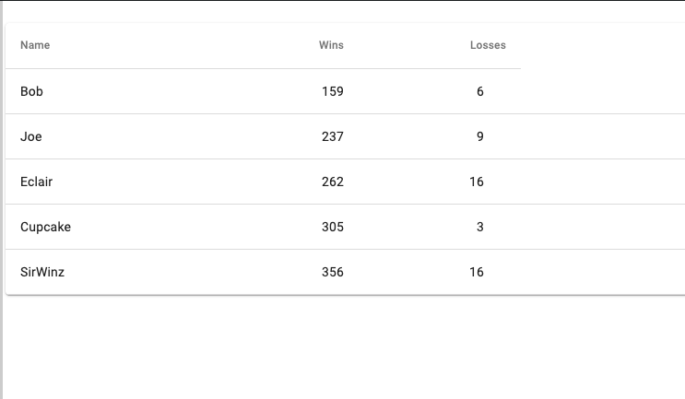
BerkadiaToe: 2nd Sprint(20 mins)
As a Berkadiatoe user, I would like to play Berkadiatoe
Players enter their names before the start (material ui.. make it pretty)
Who’s turn is displayed
Scoreboard added in the winner screen
Stretch Goal: it… SAVES
github.com/Bryanschauerte/frontEndArchPresentation

Slide 31
2nd Sprint Discussion
Wait a tic, lets talk about it
What strategy did you use?
Did any structure change?
Problems?
What could be better?
github.com/Bryanschauerte/frontEndArchPresentation

Slide 32
BerkadiaToe: 3nd Sprint
As a Berkadiatoe user, I would like to play Berkadiatoe
Players can play against P-Bear
P-Bear ALWAYS wins or ties
github.com/Bryanschauerte/frontEndArchPresentation

Slide 33
3rd Sprint Discussion
Wait a toc, lets talk about it
Is that Bear winning?
How did you do it?
We want to play hangman now. How can we add it?
github.com/Bryanschauerte/frontEndArchPresentation

Slide 34
Application’s world
service
service
service
service
service
service
Response
Response
Response
Response
Response
Response
(Wishful thinking)
Data Request
Data Request
Data Request
Data Request
Data Request
Data Request
Business Logic
Business Logic
Business Logic
Business Logic
Business Logic
Business Logic

Slide 35




Application’s world
service
service
service
someView
someView
Response
Feature
Feature
Response
Response
Feature
Feature
Feature
Feature
Feature
Feature
someView
(Wishful thinking)
Data Request
someView
Data Request
Data Request
Feature
Feature
Feature
Feature
Feature
Feature
Feature
Feature
Business Logic
Business Logic
Business Logic
*Usage of Business Logic*

Slide 36
A Bit More Likely
service
service
service
someView
someView
Response
Response
Response
Data Request
someView
someView
Data Request
Data Request
Business Logic
Business Logic
Business Logic
*Usage of Business Logic*

