Slide 1
BAKERY SALES FORECASTING WITH MACHINE LEARNING
PRESENTED BY
ANNA PETRI
TILON JÜRGENSEN
LINUS UZOEWULU

Slide 2
Self-created variables
Variable | Description
Wochentag | Day of the week (0=Monday, …, 6=Sunday)
Monat | Month of the year (1-12)
IstWochenende | 1 if Saturday/Sunday, else 0
KW | Calendar week number
TagSeitWochenstart | Day since start of week (0-6)
Sin_Monat, Cos_Monat | Sine and cosine encoding of month (seasonality)
Wetter_extrem | 1 if temperature <0°C or >30°C, else 0
Temp_Step | Categorical binning of temperature (cold, mild, hot)
Temp_Wind | Product of temperature and wind speed

Slide 3
Self-created variables
Variable | Description
Ferienzeit | 1 if school holiday, else 0
FerienName, FerienName_Code | Name/code of the holiday period
Feiertag | 1 if public holiday, else 0
KielerWoche | 1 if during Kieler Woche event, else 0
Temperatur_2 | Temperatur^2
Umsatz_lag_1 | Sales from the previous day (1 day lag)
Umsatz_lag_7 | Sales from one week ago (7 days lag)

Slide 4
Self-created variables
Variable | Description
Weather Code Clustering
Cluster_0 | 0; no observation
Cluster_1 | 1-12, 40-49; clouds and fog
Cluster_2 | 50-55, 58-63, 65, 80-81; rain and drizzle
Cluster_3 | 20-23, 25-29; end of precipitation and weather
Cluster_4 | 13-19, 91-97, 99; thunderstorms and special weather phenomena
Cluster_5 | 68-79, 83-90; snow, sleet and hail
Cluster_6 | 30-39, 98; sandstorms and snowstorms
Cluster_7 | 24, 56-57, 66-67; freezing precipitation & freezing drizzle

Slide 5
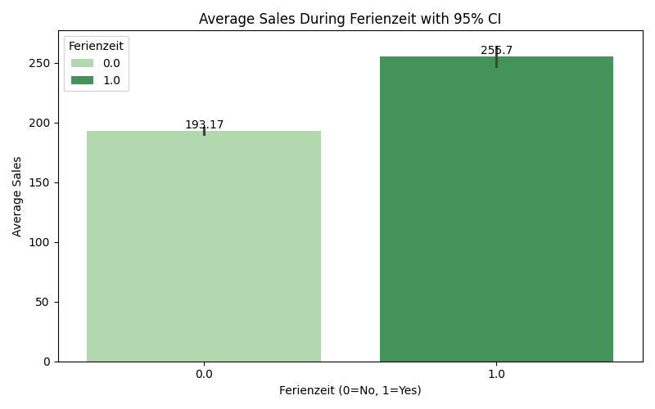
Bar charts for self-created variables
School holiday =

Slide 6
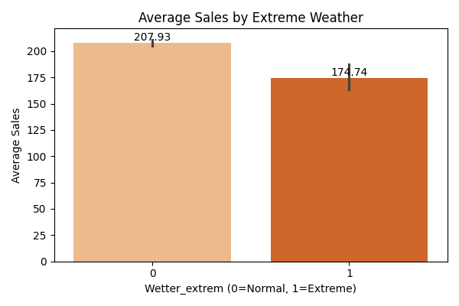
Bar charts for self-created variables

Slide 7
missing value imputation
Wettercode (about 25% missing):
kNN-Imputation (kNNImputer with 5 nearest neighbors)
Bewoelkung (<1% missing)
kNN-Imputation (kNNImputer with 5 nearest neighbors)
Temperatur:
Interpolated
kNN
Windgeschwindigkeit
Filled with median
kNN

Slide 8
Linear model optimization
Used features:
Warengruppe (large impact, improvement of 70%)
Temperatur, Temperatur_2 (almost no impact)
KielerWoche
Monat
IstWochenende
Feiertag
Ferienzeit
Umsatz_lag_1 (improvement of 3%)
Umsatz_lag_2 (almost no impact)
Wettercode (Cluster_1,… Cluster_6)

Slide 9
Linear model optimization
Model equation:
Umsatz = 90.5660 + 4.4465 * Temperatur - 0.4527 * Temperatur_2 + 23.0578 * KielerWoche + 36.4669 * IstWochenende - 49.6721 * Feiertag + 19.6123 * Ferienzeit + 24.0831 * Umsatz_lag_1 + 1.0166 * Umsatz_lag_7 + 265.9288 * Warengruppe_2 - 21.1821 * Warengruppe_3 - 59.6554 * Warengruppe_4 + 144.6081 * Warengruppe_5 - 150.9201 * Warengruppe_6 + 17.9822 * Monat_2 + 7.3783 * Monat_3 + 12.2037 * Monat_4 + 24.4876 * Monat_5 + 28.8565 * Monat_6 + 48.2495 * Monat_7 + 63.4480 * Monat_8 + 27.9586 * Monat_9 + 27.2881 * Monat_10 + 13.6632 * Monat_11 + 10.9786 * Monat_12 + 20.0927 * Cluster_1 + 15.6214 * Cluster_2 + 14.0265 * Cluster_3 + 15.7960 * Cluster_4 + 17.7035 * Cluster_5 + 7.3258 * Cluster_6

Slide 10
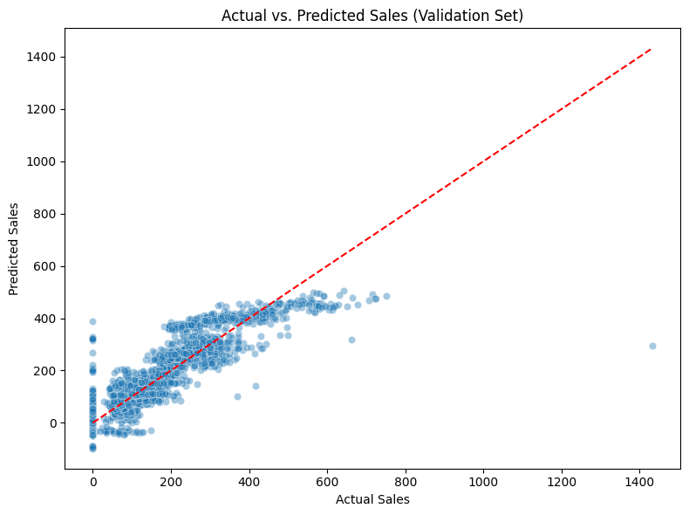
Linear model optimization
Adjusted R^2: 0.752
Validation R^2: 0.744

Slide 11
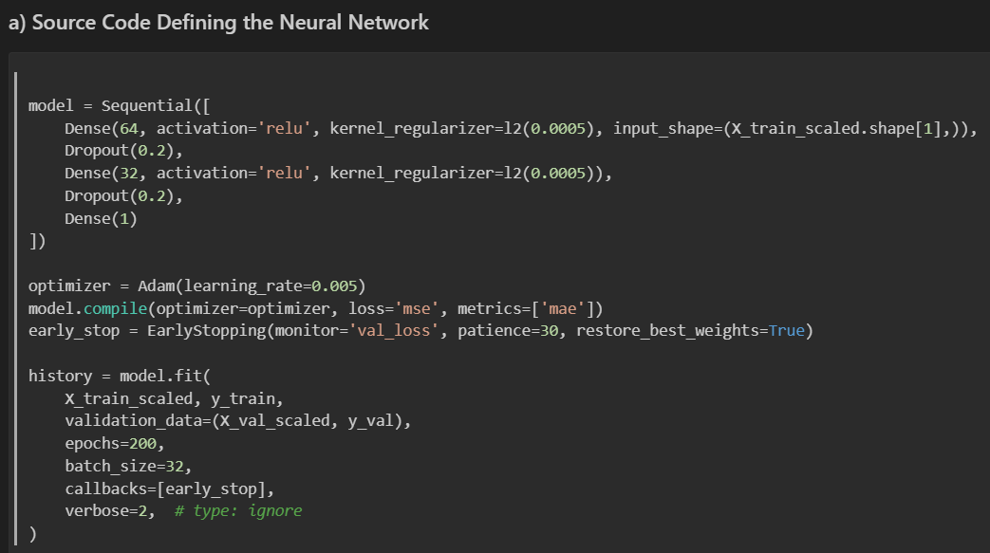
Neuronal network optimization

Slide 12
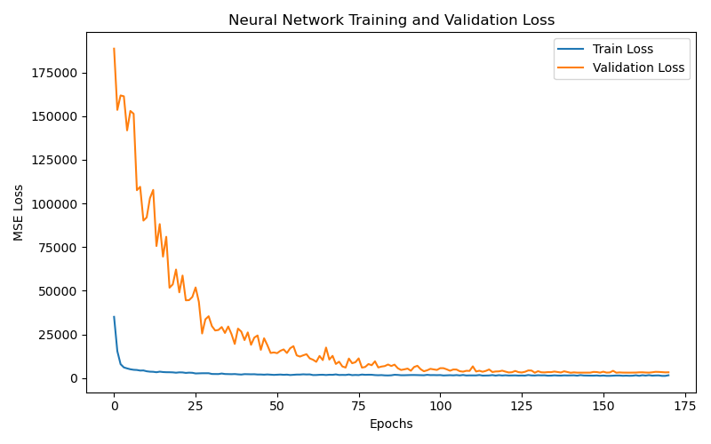
Neuronal network optimization

Slide 13
Neuronal network optimization
Overall Validation MAPE: 21.21%
MAPE by Product Group (Warengruppe):
Warengruppe 1: 24.17%
Warengruppe 2: 13.25%
Warengruppe 3: 22.27%
Warengruppe 4: 23.43%
Warengruppe 5: 16.55%
Warengruppe 6: 61.81%

Slide 14
Random forest optimization
From scikit-learn
Key settings:
N-estimators=200
Max_depth=25
Min_samples_split=5
Random_state=42
Features were not scaled (tree-based models don't require scaling)
The model was trained on the same feature set as the NN, including all engineered variables

Slide 15
Random forest optimization​
Overall Validation MAPE: 16.84% (best overall score)
MAPE by Product Group (Warengruppe):
Warengruppe 1: 18.07%
Warengruppe 2: 11.04%
Warengruppe 3: 17.31%
Warengruppe 4: 18.95%
Warengruppe 5: 13.32%
Warengruppe 6: 49.88%

Slide 16
Worst fail
Linear Model Optimization:
Weather code clustering had no impact but resulted in a shorter model equation.
Leaving out Temperatur and Umsatz_lag_7 had no effect on the adjusted R².
Normalization of numerical features (Temperatur, Umsatz_lag_1) had only a minor impact.
In General:
Generating the submission file with IDs that correctly matched the sample submission was unexpectedly difficult. ChatGPT struggled with this, and we had to adjust the output several times.

Slide 17
Best improvement
The product group feature led to a 70% improvement in the linear model's adjusted R².
Dropout (0.2) reduced overfitting and led to lower validation loss.
EarlyStopping with patience=30 helped by restoring the best weights before overfitting started.
Adam optimizer adaptively adjusted the learning rate for each parameter, which improved convergence stability.

Slide 18
Thank you for your attention!

