Slide 1



Game Report: Milwaukee Bucks vs Oklahoma City Thunder NBA Cup Final 12/17/2024
By: Bryant Connolly

Slide 2

Game Context
In the NBA Cup Final between the Milwaukee Bucks and the Oklahoma City Thunder, the Bucks prevailed 97 to 81.
Giannis Antetokounmpo and Shai Gilgeous-Alexander led their teams in scoring with 26 and 23.
The game was competitive in the first half, but the Bucks extended their lead by outscoring the Thunder 26 to 14 in the third quarter.
The Thunder team shot 33.7% overall, with 15.6% from three-point range. In the third quarter, they shot 26.3% field goal percentage and 28.6% from three-point range. (Had FG% of 48.2 and 3P% of 31.3 previously).
Notes:
Project Scope: This project analyzes shot-level data from the Dec. 17, 2024, Emirates Cup Final between the Bucks and Thunder.
Project Goal: The goal of this project is to create a full game report using every shot to examine shot quality, location, timing, and player behavior.

Slide 3
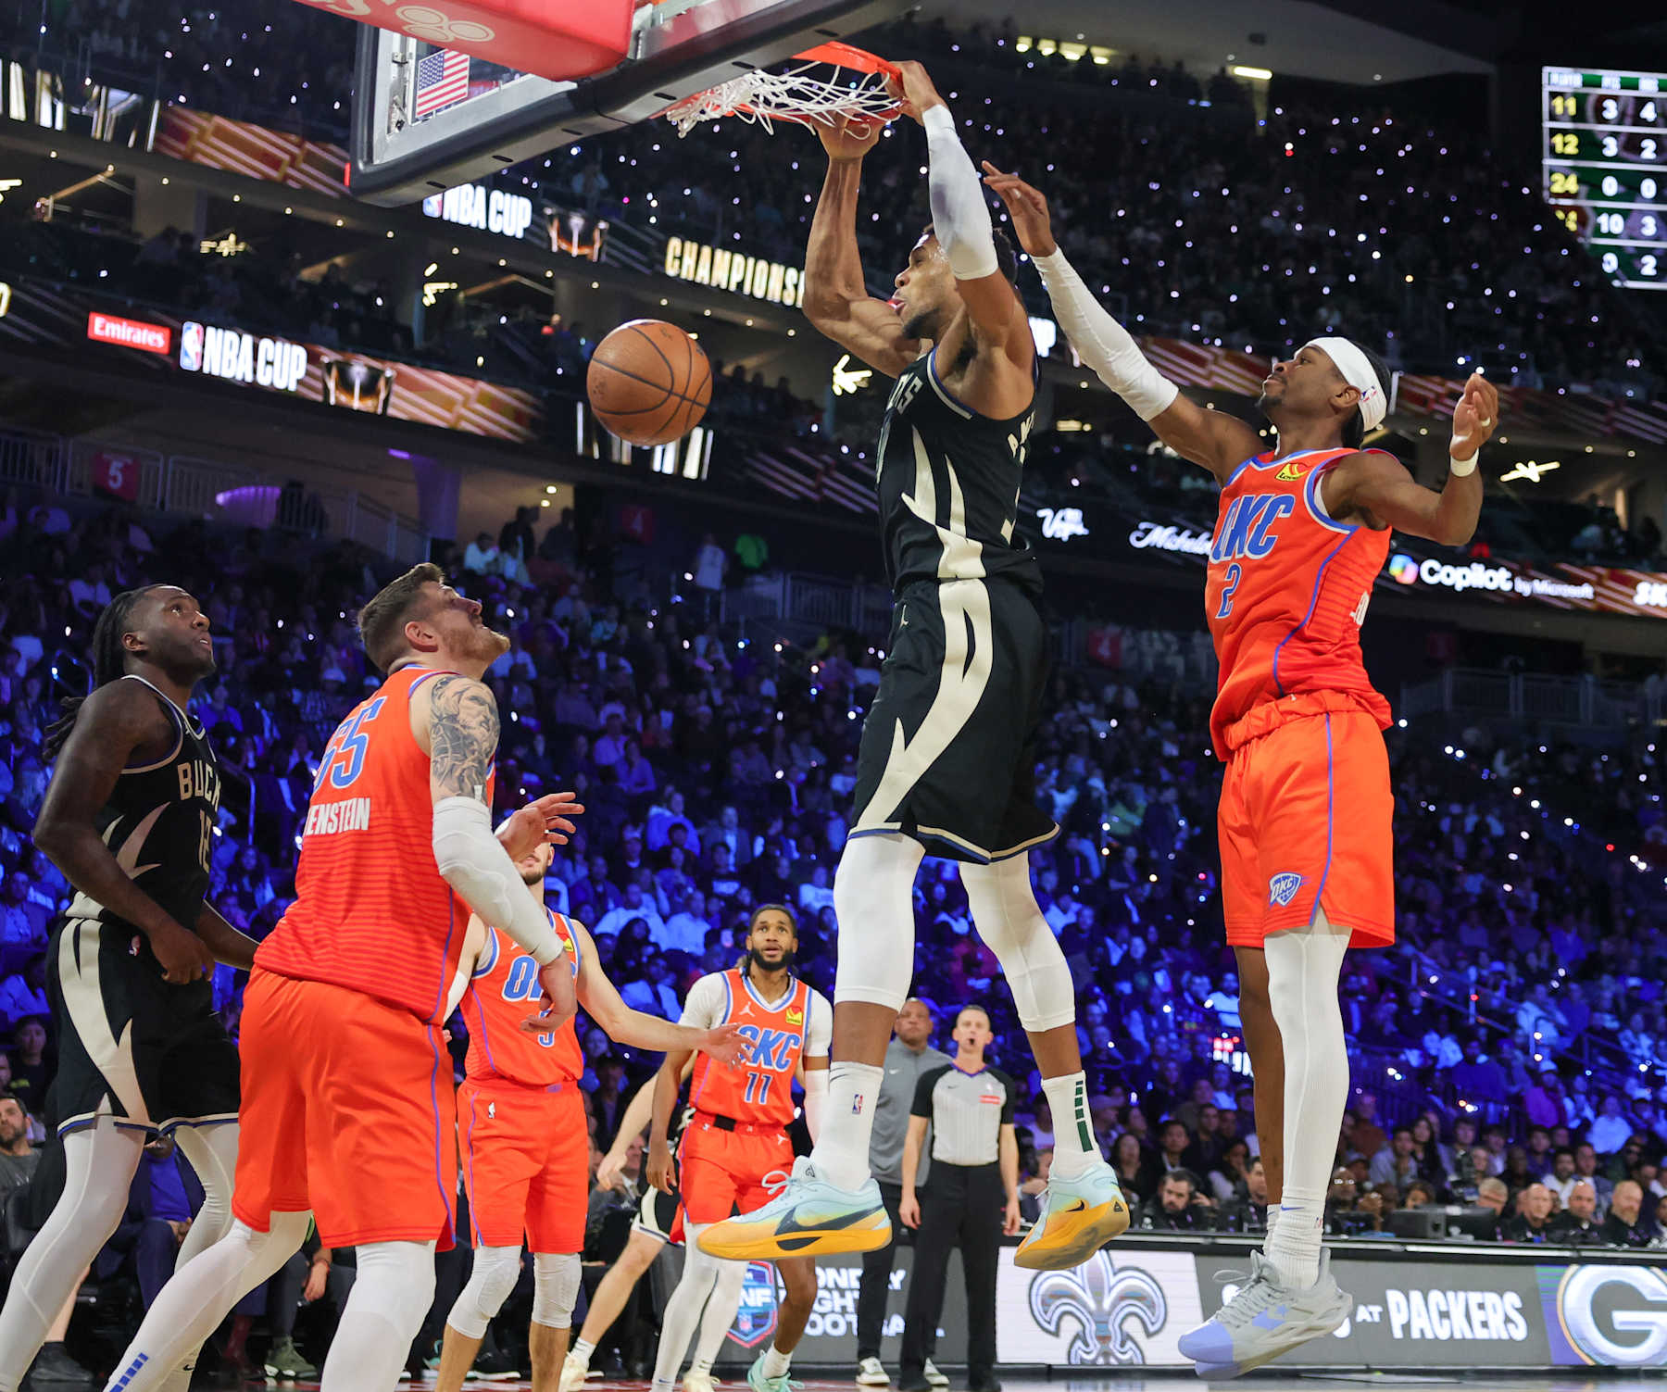
How the Bucks Won Their First NBA Cup: 5 Key Takeaways
Milwaukee Scored From All Over the Floor The Bucks spread their shot attempts across the half court — inside, mid-range, and beyond the arc — keeping OKC’s defense off balance. In contrast, OKC mostly attacked from the middle and became predictable.
Defensive Game Plan Worked on OKC’s Star Shai Gilgeous-Alexander was held to lower shot quality than usual. Milwaukee’s defensive pressure limited his ability to take over the game.
Clutch Execution Made the Difference The Bucks outperformed the Thunder during key stretches — especially late in the 1st half and especially in the 3rd quarter — swinging momentum in their favor.
More Efficient with Similar Shot Quality Despite both teams generating comparable shot quality, the Bucks were significantly more efficient in converting those chances, reflecting better shot selection and execution.
Room to Grow: High-Quality Shooters Underperformed Players like Prince and Jackson Jr. had great opportunities but didn’t convert. Focusing on confidence and rhythm could unlock more scoring potential.

Slide 4
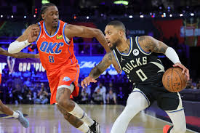
Bucks' Shot Efficiency and Zone Control Outpaced Thunder
Milwaukee demonstrated a stronger performance within the paint, right wing, and corner areas of the court. (A2: Shot Chart For the Bucks & Thunder & (A3:Shot Zone & Shot Type Percentages).
The Bucks were more efficient on layups and post attempts, while OKC struggled with 3-point shooting. (A3: Shot Zone & Shot Type Percentages).
Milwaukee distributed shots more evenly compared to the Thunder, and the Thunder relied on mid-range jumpers (A2: Shot Chart For the Bucks & Thunder).
The Bucks demonstrated superior perimeter efficiency, hitting 41% of their outside shots vs OKC’s 16% (A1: Shot Chart For the Bucks & Thunder).

Slide 5
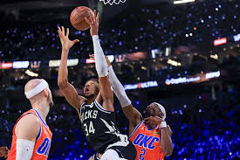
Efficiency Under Pressure: Milwaukee Delivered, OKC Faltered
While both the Thunder and Bucks had a similar Shot Quality, the Bucks had a much better field goal percentage. (A4: Average Shot Quality Team & Individual)
Several Bucks players posted exceptionally high FG% during the final 4 minutes of the first half and throughout the 3rd quarter (A6: Individual Shot Quality & Field Goal Percentage (Important Time).
The Thunder had several players with a high shot quality percentage, but not all converted their attempts during the game. (A5,A6,A7)
The bucks did a great job containing Shai throughout the game 10th in Shot quality overall and had a 30.8% FG% (A5:Individual Shot Quality & Field Goal Percentage)

Slide 6
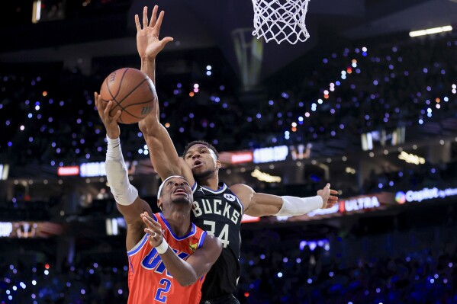
Bucks Capitalized on Limited Open Looks; Thunder Failed to Convert
The Bucks took advantage of lightly contested shots as they shot much higher compared to OKC (48% to 17%). (A10: Contest Level Graph Results & Defender Distance FG%)
Bucks players not only scored more efficiently than the Thunder, but also effectively defended Shai — limiting him to 10th in Points Per Shot. (A9: Points Per Shot Top 10)
The Thunder did not capitalize on field goals when the defender distancer was more than 6 ft whereas the bucks were able to. (A10 & A11)
While the Bucks outperformed the Thunder from three, only two of their attempts were uncontested — indicating a need to improve spacing and generate more open looks. (A8: Shot Contest Model)

Slide 7

What the Data Reveals About the Bucks’ Shot Success (A12)
Key Drivers: Shot area, shooter speed, and clock pressure were top predictors — confirming Milwaukee’s edge in efficient zones and quick execution.
Game Alignment: Model features reflect game trends: Bucks created quality looks, moved well, and converted under pressure.
Model Limitations: The model struggled to predict which shots would go in — showing that things like confidence, momentum, and timing still play a big role.

Slide 8

Analytical Insights Behind the Bucks’ Victory
1. Efficient Shot Conversion
Milwaukee finished above expected shot quality (qSQ), converting both contested and open looks. OKC, despite similar opportunities, underperformed.
2. Missed Open Opportunities by OKC
Thunder shooters converted just 17% of attempts when the defender was 6+ feet away, compared to a much higher efficiency from the Bucks.
3. Defensive Pressure on Key Players
Milwaukee held Shai Gilgeous-Alexander to 10th in Points Per Shot despite his usual efficiency, and limited OKC’s success on lightly contested shots.
5. Pivotal Stretches in the First Half and Third Quarter Defined the Game Milwaukee pulled away during the third quarter, shooting 15% better than OKC in that stretch. It proved to be the decisive turning point.
4. More Effective Use of Floor Space Bucks thrived in the paint and corner/right wing zones. In contrast, OKC struggled in traditionally high-efficiency areas like corner 3s and midrange.

Slide 9

Next Steps
Start Stronger in Early Quarters
Milwaukee’s slow first-half start left room for risk. Emphasize pace, spacing, and play execution early to set the tone.
2. Keep Pressure on Opposing Stars
The Bucks limited Shai's shot quality and scoring. Use a similar defensive strategy to contain the next opponent’s primary scorer.
3. Evaluate High-Quality Shooters Who Underperformed
Jackson Jr. and Prince had great shot quality but low conversion — focus on boosting confidence and consistency.
4. Keep Creating Space — and Contesting It
MIL shot over 50% when defenders were 6+ feet away, while OKC missed many of those same looks. Maintain offensive spacing and defensive pressure to swing efficiency.
5. Optimize Shot Selection Based on Contest Level
Bucks took a balanced mix of uncontested and lightly contested shots across distances. Keep prioritizing cleaner looks and avoiding rushed attempts.

Slide 10
Executive Summary: Bucks vs Thunder (NBA Cup Final)
Scoring Versatility: Milwaukee attacked from all zones; OKC focused too narrowly on the midrange.
Efficiency on Equal Quality: Both teams had similar shot quality, but the Bucks finished at a much higher rate.
Defensive Pressure on Shai: The Bucks contained OKC’s lead scorer by reducing his shot quality through targeted matchups.
Momentum in Clutch Moments: Milwaukee dominated the 3rd quarter and end of the 1st half to take control.
Missed Opportunities from Role Players: Despite strong shot quality, Prince and Jackson Jr. couldn’t convert — a margin for future improvement.
Milwaukee's 97–81 win over OKC was driven by balanced scoring, high-efficiency shooting, and smart defensive execution

Slide 11
Appendix

Slide 12
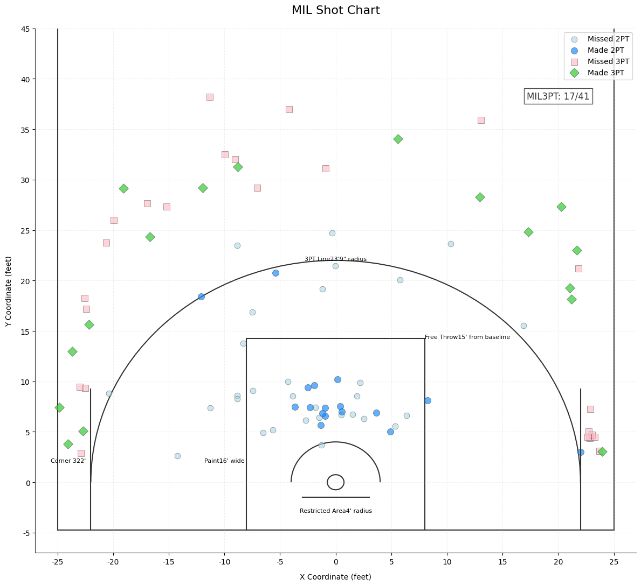
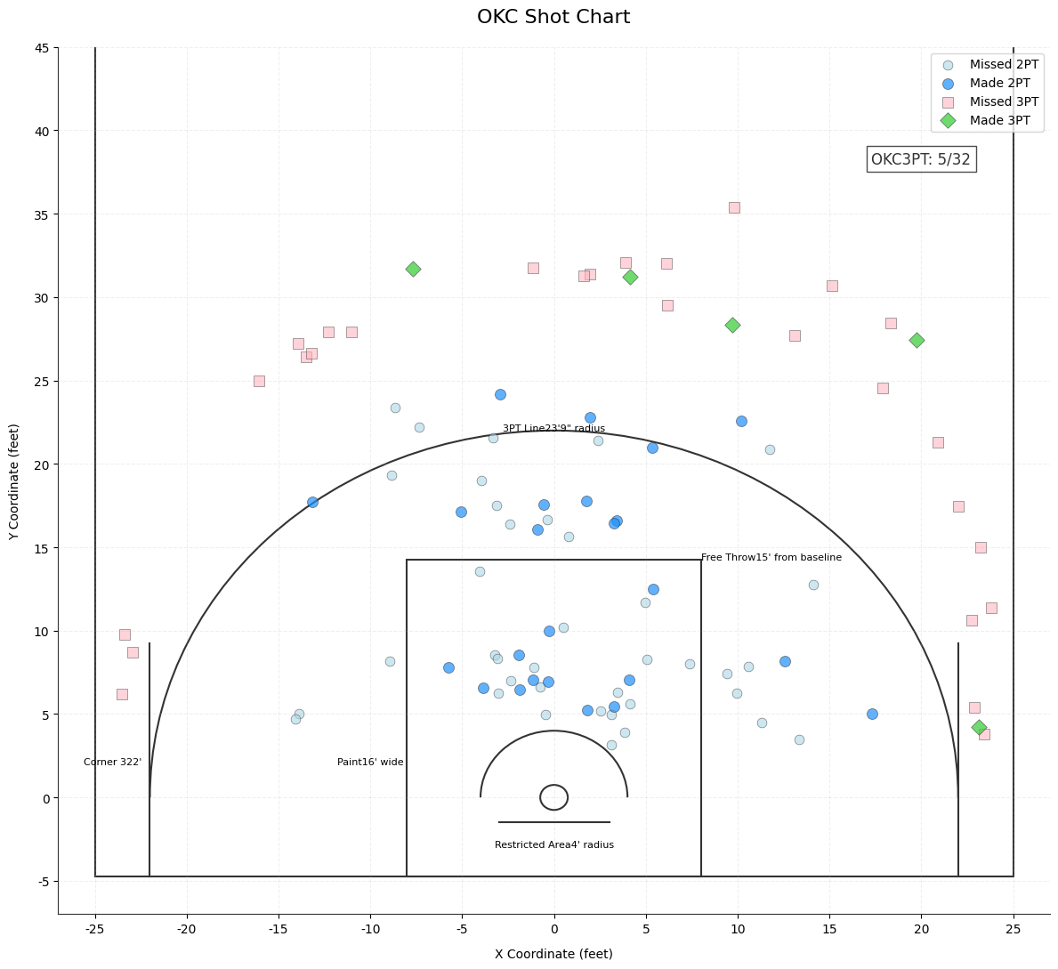
A1: Shot Chart For the Bucks & Thunder
Notes:
This graphic here demonstrates the shot chart comparison between OKC and Milwaukee throughout the entirety of the game.

Slide 13
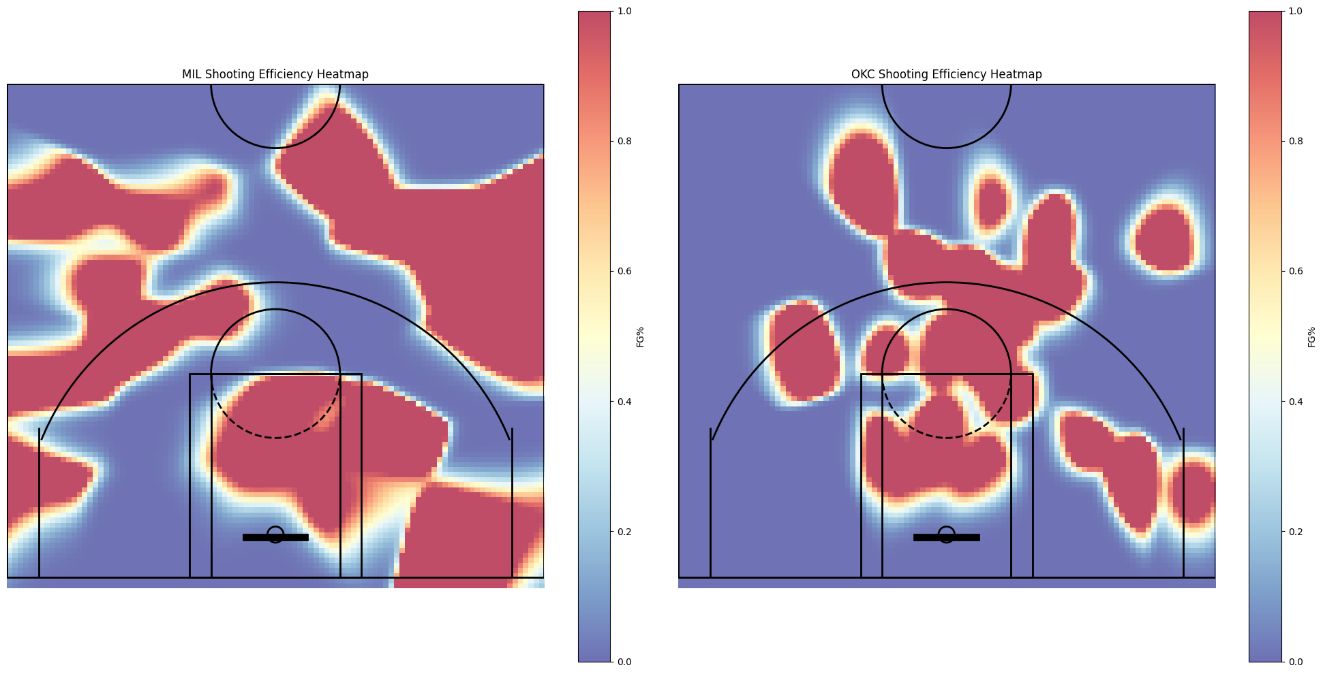
A2: Shooting Efficiency Between MIL VS OKC
Notes:
This Shooting Efficiency heatmap is a copy from the shot chart but it shows where from the half court that OKC and Mil made their shots throughout the entirety of the game.

Slide 14
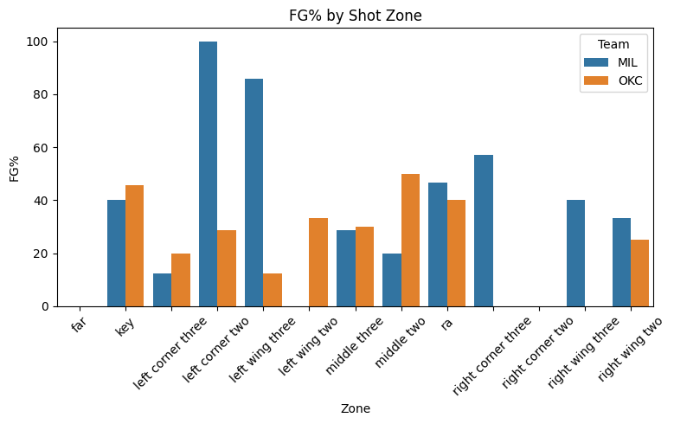
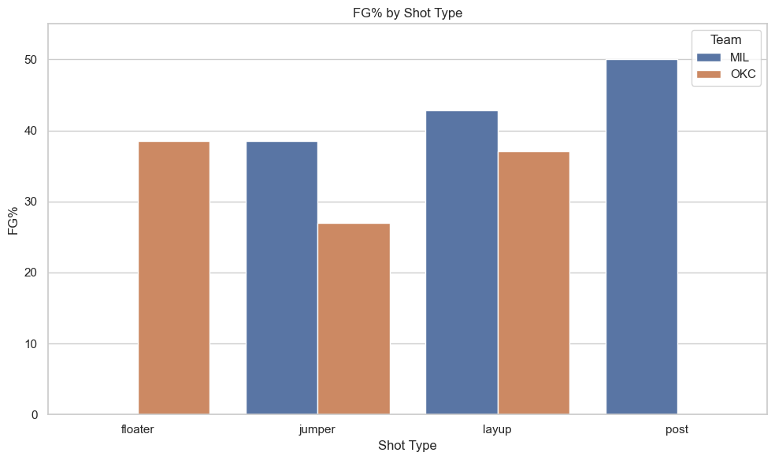
A3: Shot Zone & Shot Type Percentages
Field Goal % by Shot Zone MIL VS OKC
Field Goal % by Shot Type MIL VS OKC
Notes:
This slide is included to break down and compare the field goal percentage by shot zone and shot type between Milwaukee and Oklahoma City. By visualizing the data this way, we can highlight not just where shots were taken, but how well each team executed from those locations. It provides valuable insight into team shot selection strategies, efficiency by location, and offensive diversity. This helps support the broader narrative that Milwaukee’s scoring success was not just about volume but about smart, high-efficiency shooting from a wide range of court positions and shot styles.
Milwaukee displayed superior shooting efficiency across both perimeter and interior zones. They were particularly dominant on corner and wing three-point shots, and outperformed OKC in layups and post plays. Meanwhile, OKC’s field goal percentage lagged behind in most areas — especially on the right side of the floor, where they struggled to convert. This contrast highlights how Milwaukee's shot variety and zone efficiency created a scoring edge, while OKC’s more limited success from specific zones constrained their offensive output.

Slide 15
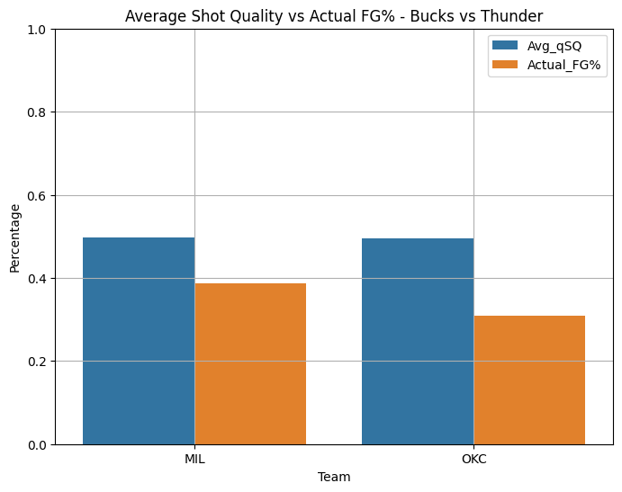
A4: Average Shot Quality Team & Individual
Notes:
This slide was added to show the difference between average shot quality and actual field goal percentage for each team. Shot quality reflects the likelihood of a shot going in based on context (e.g., location, defender distance), while actual FG% tells us what really happened. Comparing these side-by-side helps reveal which team outperformed or underperformed their shot opportunities. This is critical to understanding the role of execution versus opportunity — it's not just about creating good shots, but capitalizing on them. The chart emphasizes how execution quality played a key role in the outcome.
Both Milwaukee and OKC generated similar shot quality, but Milwaukee converted at a noticeably higher rate. This gap between expected and actual performance shows that Milwaukee executed more efficiently, making the most of their chances. In contrast, OKC underperformed relative to the quality of looks they created, which significantly impacted their scoring output. This reinforces the idea that shot creation alone isn’t enough — conversion matters, especially in a high-stakes game.

Slide 16
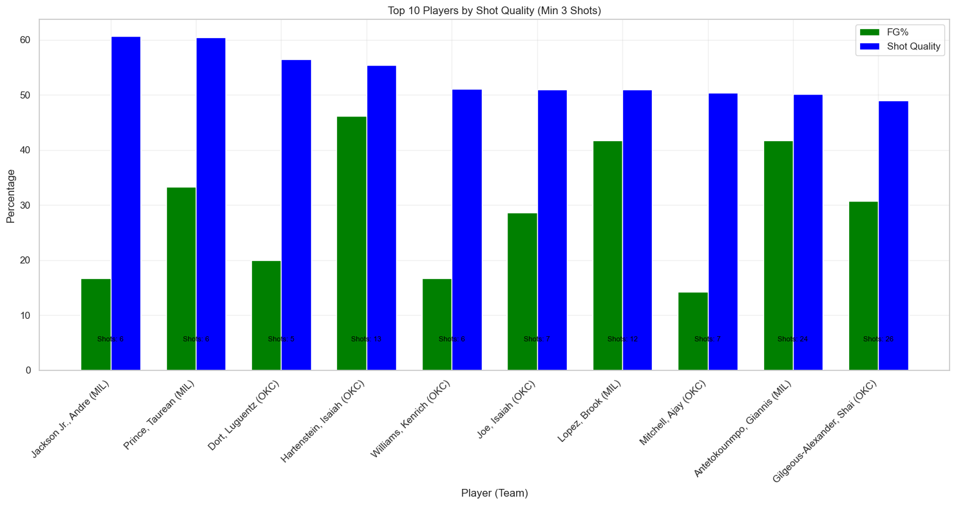
A5:Individual Shot Quality & Field Goal Percentage
Notes:
This slide was included to dive deeper into individual player performance, highlighting how players on both teams performed relative to the quality of shots they were taking. By comparing each player's shot quality (expected FG%) and actual field goal percentage, we can identify who outperformed or underperformed expectations. This analysis reveals which players were creating good looks but failing to convert, and which players were either hitting tough shots or struggling overall — critical for evaluating both shot selection and execution at the player level.
Andre Jackson Jr. and Taurean Prince had two of the highest shot quality ratings but also some of the lowest conversion rates, suggesting Milwaukee left points on the floor despite good opportunities. Isaiah Joe and Lu Dort for OKC showed stronger alignment between shot quality and FG%, but others like Jalen Williams underperformed. This slide reinforces that execution — not just opportunity — drove Milwaukee’s win, and that optimizing performance from role players could further increase their offensive ceiling.

Slide 17
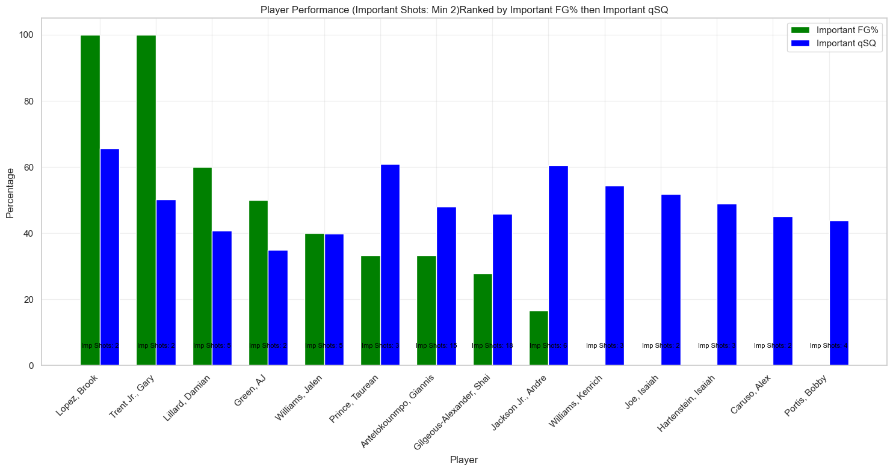
A6: Individual Shot Quality & Field Goal Percentage (Important Time)
Notes:
This slide highlights individual player performance during high-pressure moments, defined as “important time” — specifically, the final 4 minutes of each half and the entire 3rd quarter, when scoring swings and defensive intensity have the most impact. By comparing field goal percentage to shot quality during these moments, this analysis identifies which players stepped up in key situations and who fell short. It’s valuable for assessing clutch performance and identifying areas for strategic improvement late in games.
Brook Lopez and Gary Trent Jr. stood out by converting high shot quality into high efficiency, making critical contributions during important stretches. In contrast, players like Andre Jackson Jr. had quality looks but underperformed, limiting potential scoring impact during key windows. This underscores how Milwaukee’s edge in clutch-time execution — particularly from experienced players — helped secure control in pivotal moments like the third quarter and late-game possessions.

Slide 18
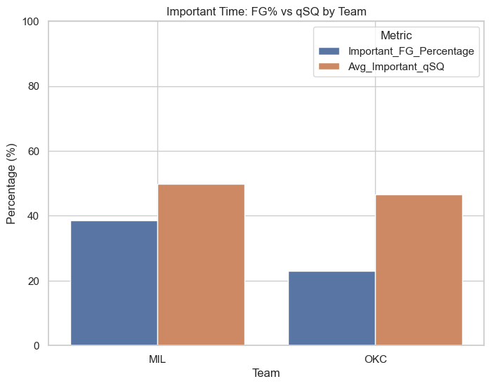
A7: Important Time: Last 4 Minutes of 1st and 2nd Quarters, Full 3rd Quarter (OKC vs MIL)
Notes:
Important time in this context was calculated in this case instead of clutch because in this game the game was not decided in the fourth quarter and the game was out of reach, instead we looked into the last 4 minutes for both the first and second quarter but also included the entirety of the third as these were integral part of the game where it turned to the Bucks favor and we wanted to deeper dive in this part of the game.

Slide 19
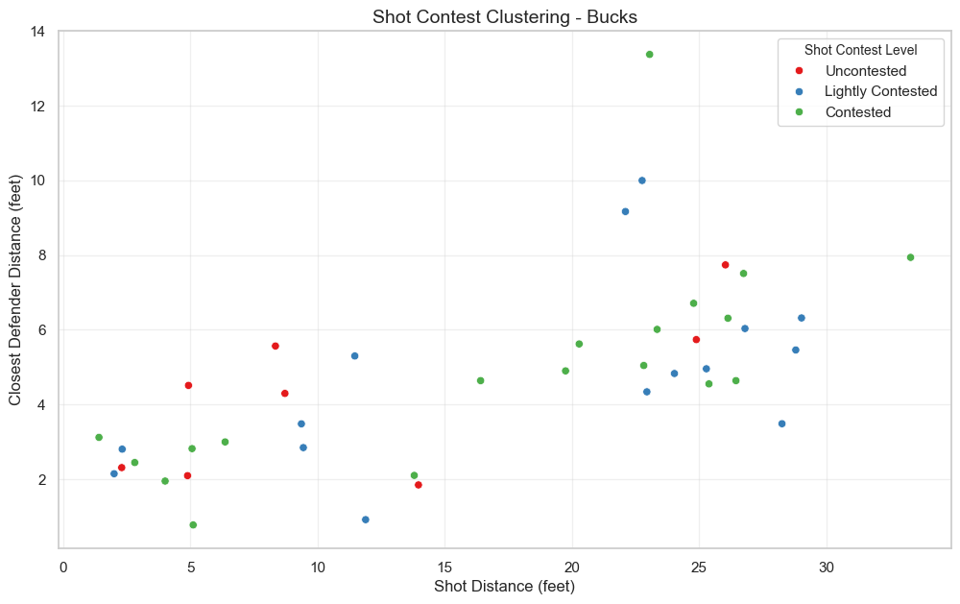
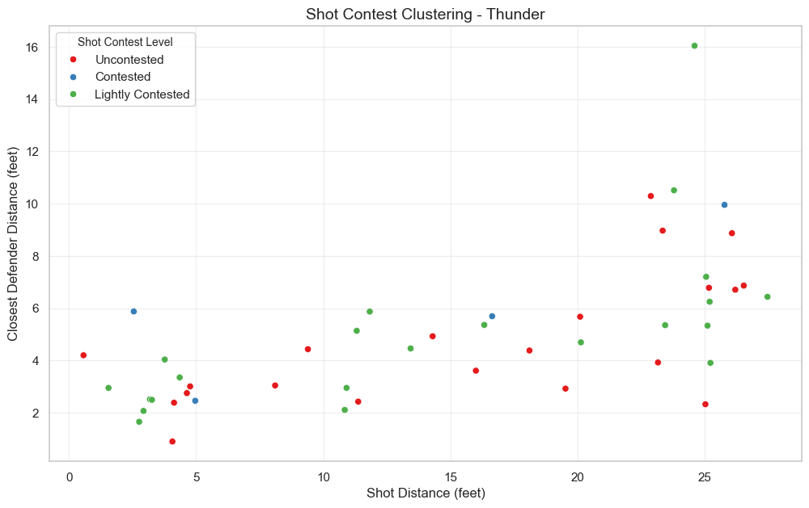
A8: Shot Contest Model
Notes:
This slide visually demonstrates how shot distance and defender proximity clustered across different levels of contest (uncontested, lightly contested, contested) for both the Bucks and Thunder. I included it to highlight the defensive shot pressure each team applied and how that may have influenced shot quality and overall shooting performance. It helps explain not just where shots came from, but how well-defended they were — offering important context behind the FG% and shot quality data shown in earlier slides.
Milwaukee's chart shows a wider spread of uncontested and lightly contested shots, especially at longer distances, suggesting better spacing and shot creation. In contrast, OKC's shot profile shows a higher concentration of contested looks, even on mid-range and shorter attempts. This pattern indicates that the Bucks did a better job of generating clean looks, while their defense forced OKC into tighter, more heavily contested shots, likely contributing to their lower shooting efficiency.

Slide 20
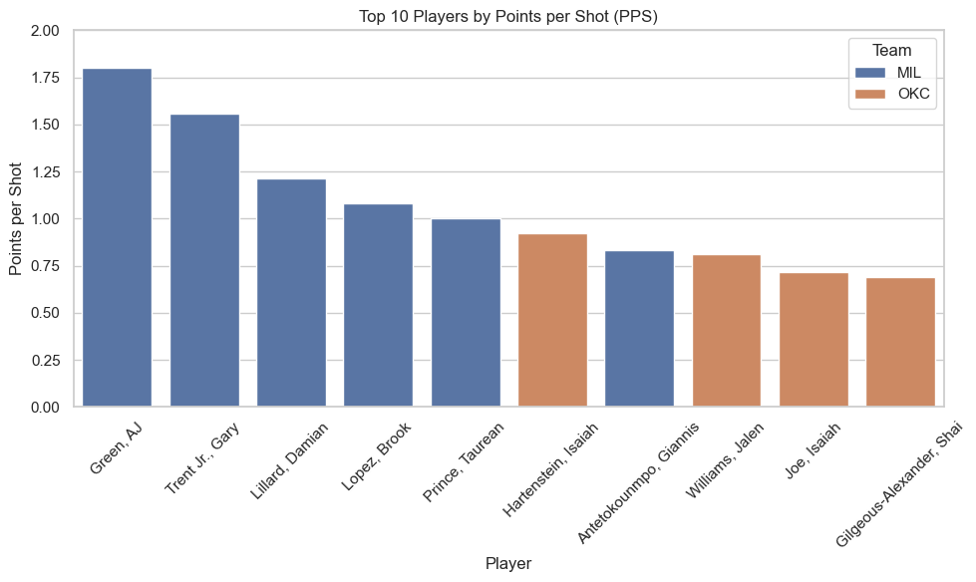
A9: Points Per Shot Top 10
Notes:
This slide showcases the top 10 players in Points Per Shot (PPS) to highlight the most efficient scorers on a per-attempt basis. It was included to move beyond raw scoring volume and focus on shot efficiency, which is a more meaningful indicator of offensive value. By comparing players from both teams, the chart gives a clear sense of who maximized their scoring opportunities and how that efficiency contributed to their team’s overall performance.
Milwaukee players dominated the top of the PPS rankings, with Andre Jackson Jr., Gary Trent Jr., and Damian Lillard leading the list — each averaging over 1.4 points per shot. This reflects not only strong shot selection but also high conversion in efficient areas. In contrast, OKC’s top contributors had noticeably lower PPS, indicating they weren’t maximizing shot opportunities as effectively. This efficiency gap played a key role in the scoring disparity between the teams.

Slide 21
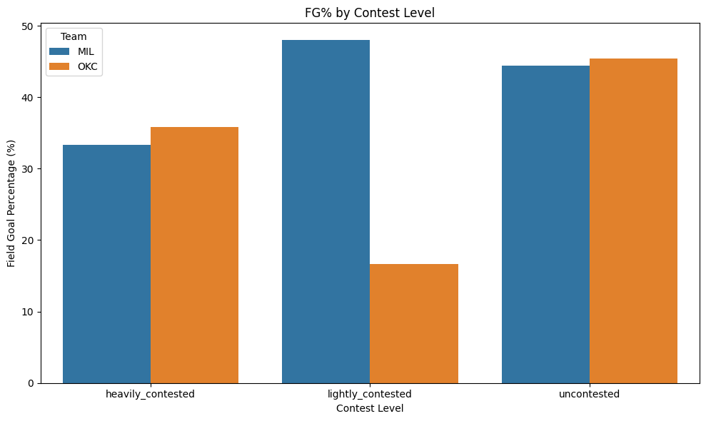
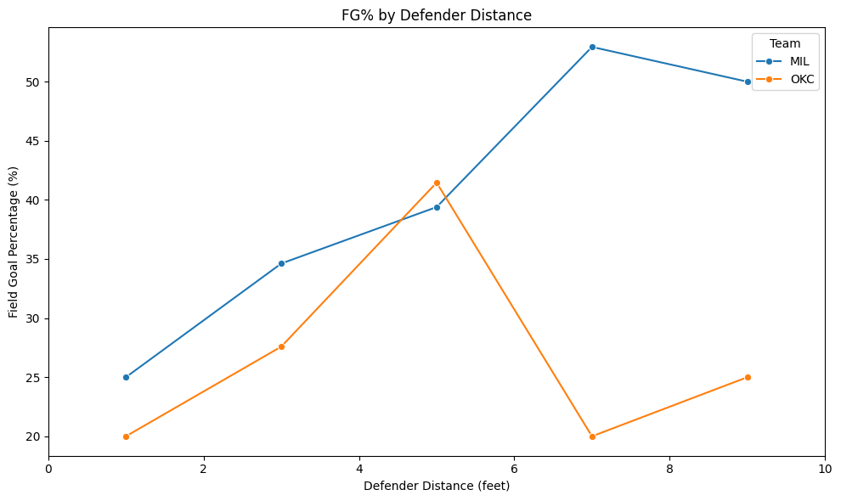
A10: Contest Level Graph Results & Defender Distance FG%
Notes:
This slide compares how each team performed based on shot contest levels and defender proximity at the time of the shot. It was included to show how shot pressure (contest level) and spacing (defender distance) impacted field goal efficiency. The left graph categorizes shots by contest level (heavily, lightly, uncontested), while the right graph shows FG% based on precise defender distance in feet. Together, they help explain which team was better at generating — and converting — quality looks against various levels of defensive pressure.
Milwaukee had a clear advantage in lightly contested shots, converting at a much higher rate than OKC. While both teams had similar performance on uncontested looks, OKC struggled heavily when defenders were near — especially in the 4–6 ft range. The defender distance chart also shows that Milwaukee’s FG% peaked at 6+ feet, maintaining solid efficiency even with defenders nearby. This confirms that the Bucks not only created more favorable shooting conditions but also executed better under moderate contest, a major factor in their win.

Slide 22
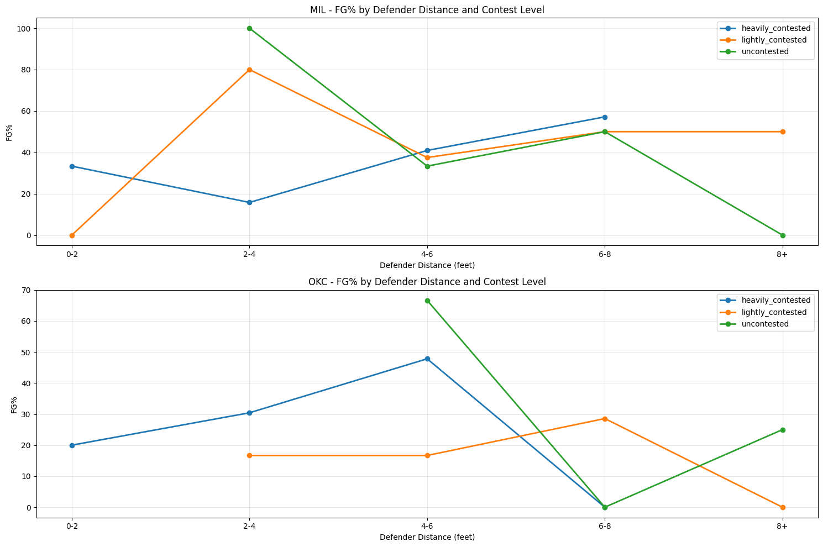
A11: Distance of Defender and Contest level
Notes:
This slide breaks down field goal percentage by both defender distance and contest level — allowing us to evaluate how the precision of contest pressure (in feet) interacts with subjective shot contest categories (heavily, lightly, uncontested). It was included to provide a nuanced view of how each team handled defensive pressure at various ranges, offering insight into spacing, shot discipline, and finishing under different levels of resistance. This dual-layer analysis strengthens the connection between analytics and in-game defensive strategy.
Milwaukee showed greater consistency and efficiency across nearly all contest levels and defender distances. Notably:
MIL converted lightly contested shots most efficiently at 2–6 ft and stayed effective even at 6–8 ft.
OKC’s performance dropped sharply on uncontested shots beyond 6 feet and struggled particularly when defenders were in the 4–6 ft range. This highlights how the Bucks not only created better spacing but also handled pressure more effectively at multiple ranges, reinforcing their edge in shot execution and contest resilience.

Slide 23
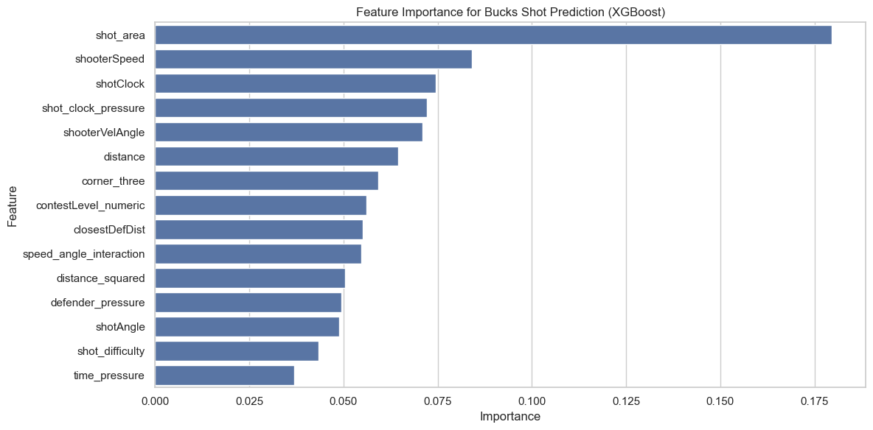
A12: Shot Prediction For the Milwaukee Bucks
Notes:
This slide presents the feature importance results from a Gradient Boosting (XGBoost) model trained to predict shot success for the Milwaukee Bucks. It was included to show which contextual factors most influenced shot outcomes, helping explain how and why certain attempts were more likely to go in. This type of model-based analysis gives weight to the patterns observed in previous slides and bridges the gap between descriptive stats and predictive insight — making it valuable for both performance evaluation and future decision-making.

Slide 24
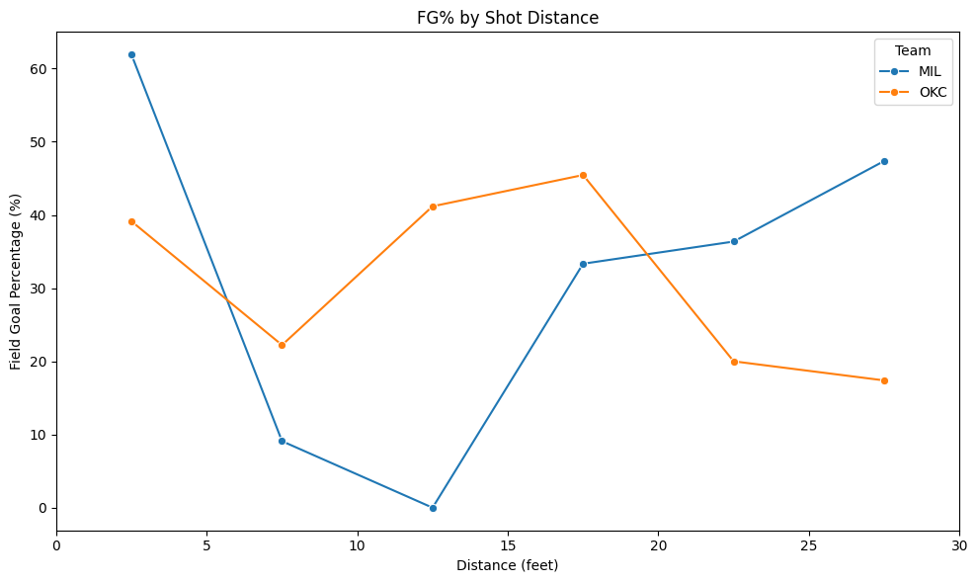
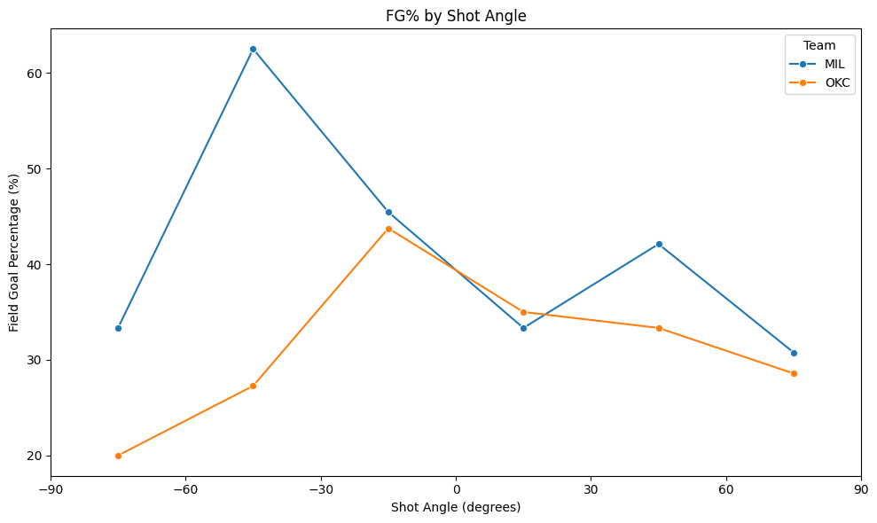
Field Goal Percent (Angle & Shot Distance)
Notes:
Extra analysis on Shot Distance and FG and Shot Angle for both teams this game.

