Slide 1

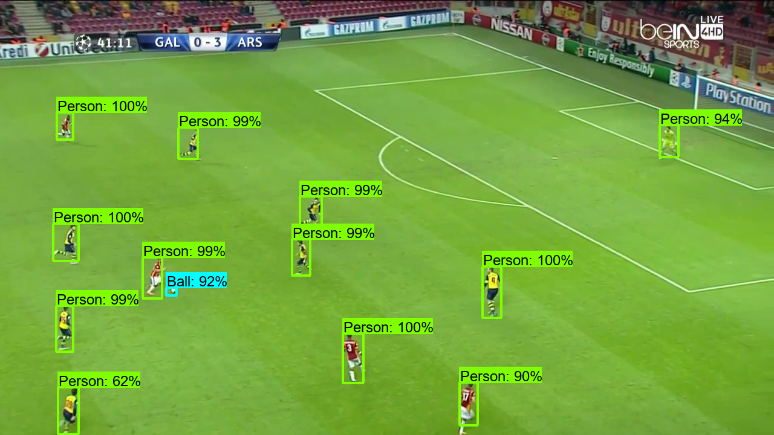
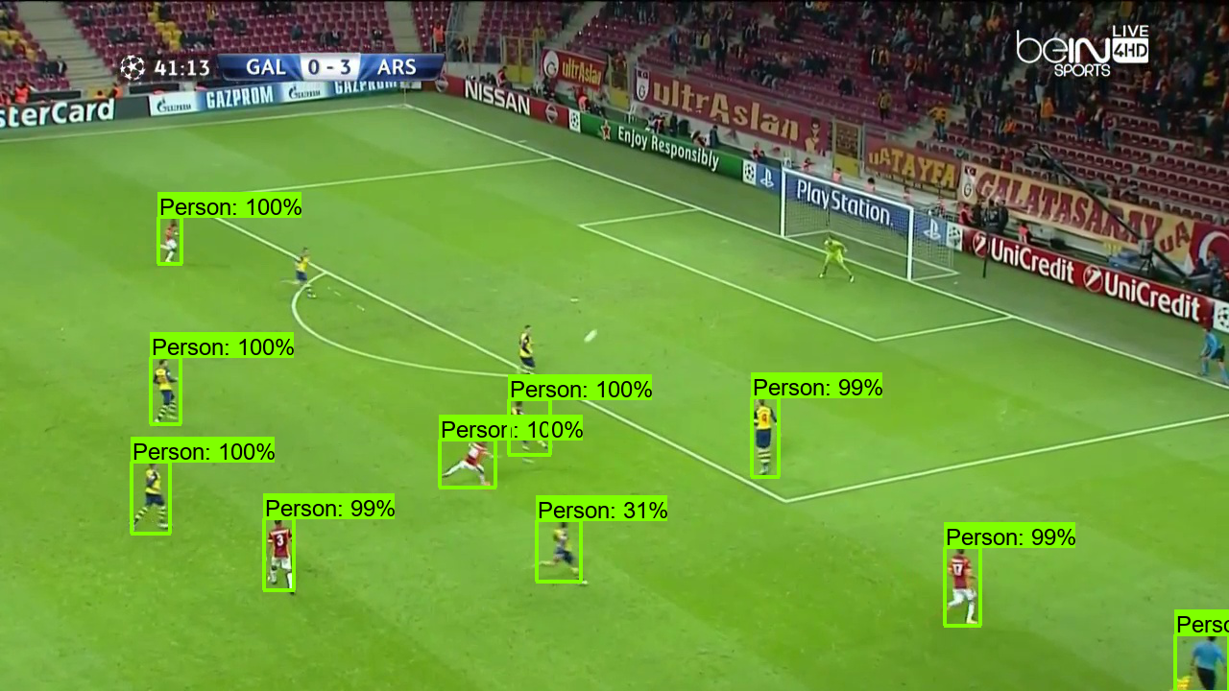
Computer Vision Approach to Football Player Mapping
Bryant Cornwell, Seth Mize, Lucas Franz, Luddy School of Informatics, Computing, and Engineering, Indiana University
Abstract
Methods
Results
Professional sports industries continue to increase their reliance upon analytics, one of the primary being the tracking of player movement. In football (soccer) this is even more prioritized as the game relies upon player positioning and movement on a vast playing surface. Modern techniques utilize wearable technology to accomplish this. This project argues that through the adaptation of existing computer vision techniques the same results can be achieved and democratized. Utilizing image channel thresholding, Hough Transformations, algebra, linear algebra, and a deep neural network, our results illustrate the possibilities of transforming player and ball locations from broadcast images into a 2-dimensional overhead coordinate space.
Object Detection Model:
Self-Labelled Image Dataset
TensorFlow 2 Object Detection API
Pre-Trained Model: Faster R-CNN with the COCO Dataset
Figure 1. Detected Objects for Frame #3 (left) and Frame #112 (right) of 807-2 Test Clips.
Background
Previous work on football player detection and tracking have been explored using computer vision techniques recorded football games.
Conclusion
Object recognition for event tracking and statistical analysis.

