Slide 1
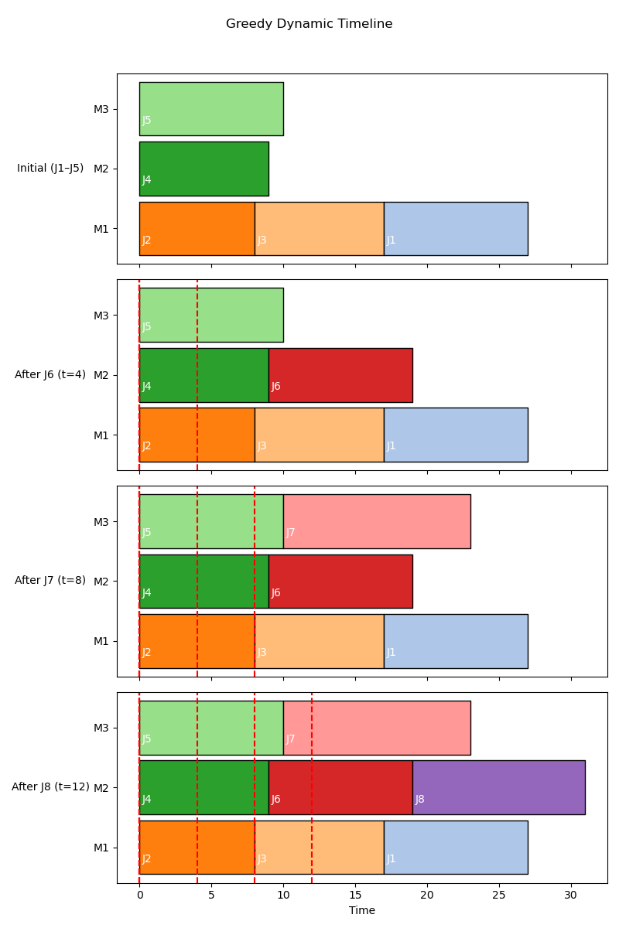
Greedy Dynamic Timeline

Slide 2
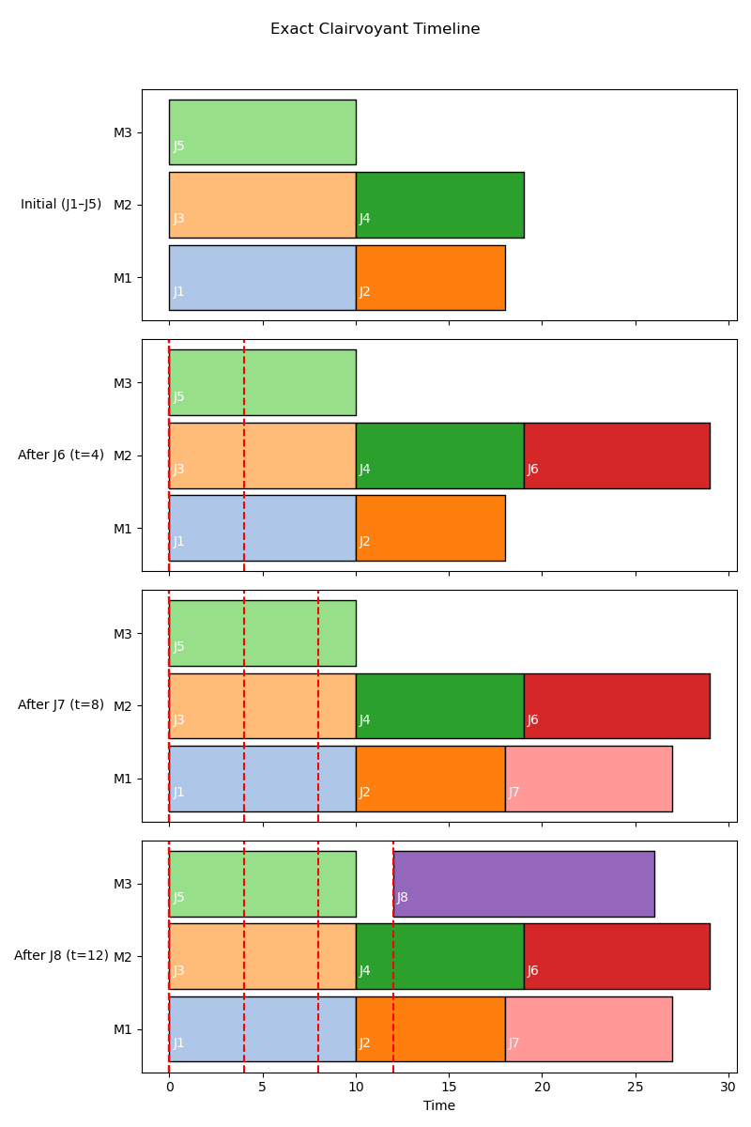
Exact Clairvoyant Timeline

