Slide 1
Simulation of Predatory Evolution Using Evolutionary Game Theory and Statistically Weighted Path Finding.
Bryce Camuso

Slide 2



Important Terms
Predatory Evolution: How predators evolve to counter prey strategies.
Evolutionary Game Theory: The branch of game theory that looks at games that are played readily to study how strategies change and learn.
Statistically Weighted Path Finding: A way to calculate the weight of a tile using multiple factors/criteria summed together.
Predator/Prey Dynamics: The branch of evolutionary study that looks at interactions between predators and prey.
Coevolution: How the two species evolve and effect each others evolution.

Slide 3
Basics of the Project
Designed using Discrete Event Driven Simulation principles
Built using Python 3.14.4
Representing the map as a 2d array
Map contains 3 tile types of a plain, bush, and tree tile
Built on Python Class inheritance
Simulation is split into 4 phases
Simulation contains 3 different prey items (rabbit, mouse, and bird)

Slide 4
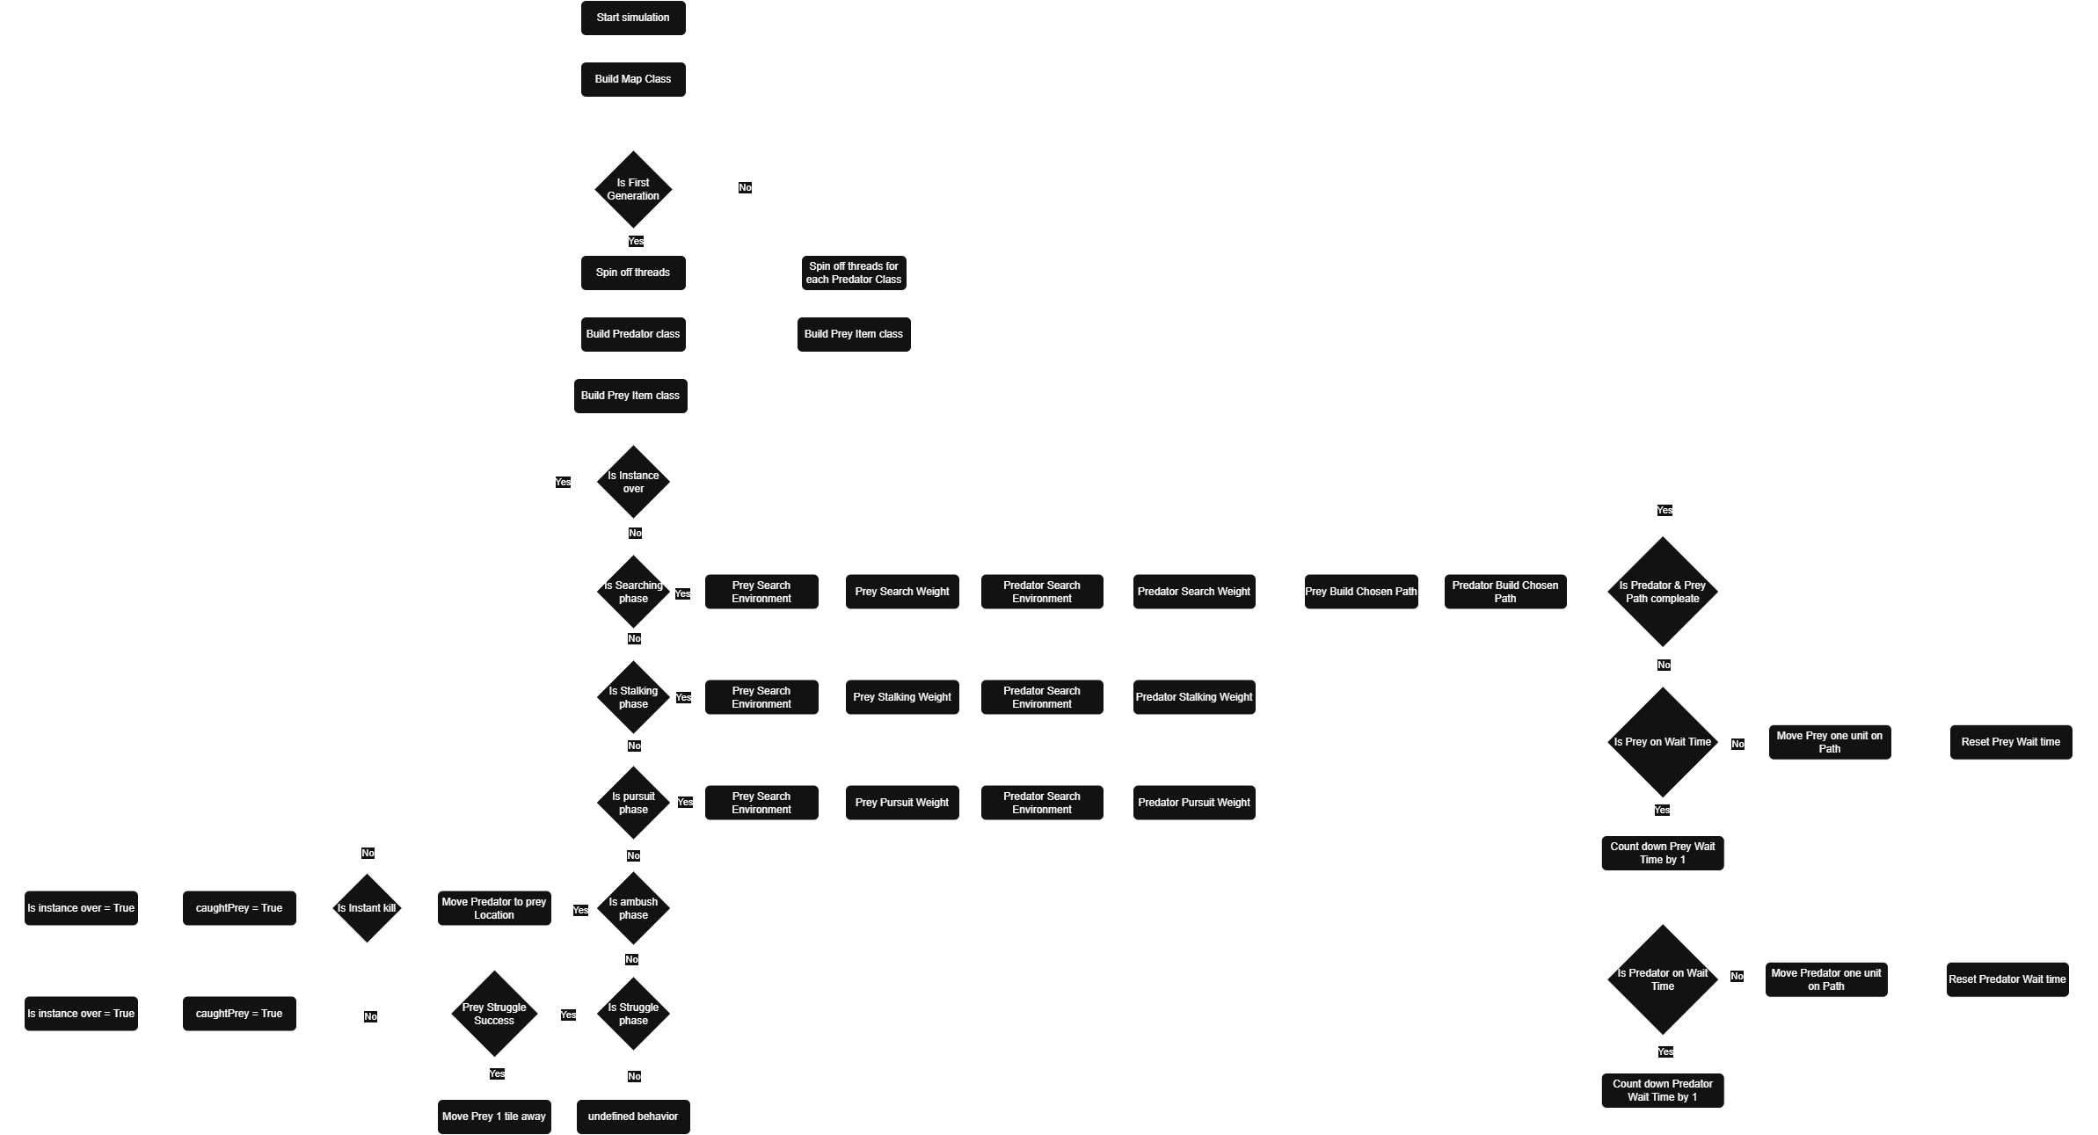
Basics of the Project (Continued)

Slide 5
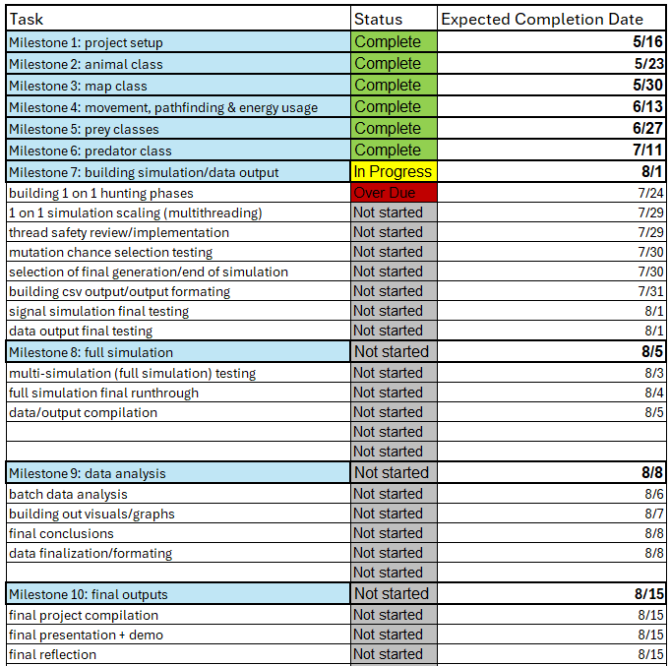
Current Progress

Slide 6
Design Rationality
Why use Python?
Most used language for simulations
Why a Discreate Event Driven simulation?
I wanted to capture more random behaviors that are seen in the real world.
Why a 2d environment?
Due to time constraints, I limited the scope of this project.
Why statically weight path finding?
It has built in randomness that helps simulate real decision making in animals.
Why Evolutionary Game theory for analysis?
The simulation was inspired by game theory games and falls under the branch of evolutionary game theory.

Slide 7
Demo

