Slide 1
Simulation of Predatory Evolution Using Evolutionary Game Theory and Statistically Weighted Path Finding.
Bryce Camuso

Slide 2



Important Terms
Predatory Evolution: How predators evolve to counter prey strategies.
Evolutionary Game Theory: The branch of game theory that looks at games that are played readily to study how strategies change and learn.
Statistically Weighted Path Finding: A way to calculate the weight of a tile using multiple factors/criteria summed together.
Predator/Prey Dynamics: The branch of evolutionary study that looks at interactions between predators and prey.
Coevolution: How the two species evolve and effect each others evolution.

Slide 3
Basics of the Project
Designed using Discrete Event Driven Simulation principles
Built using Python 3.14.4
Representing the map as a 2d array
Map contains 3 tile types of a plain, bush, and tree tile
Built on Python Class inheritance
Simulation is split into 4 phases
Simulation contains 3 different prey items (rabbit, mouse, and bird)

Slide 4
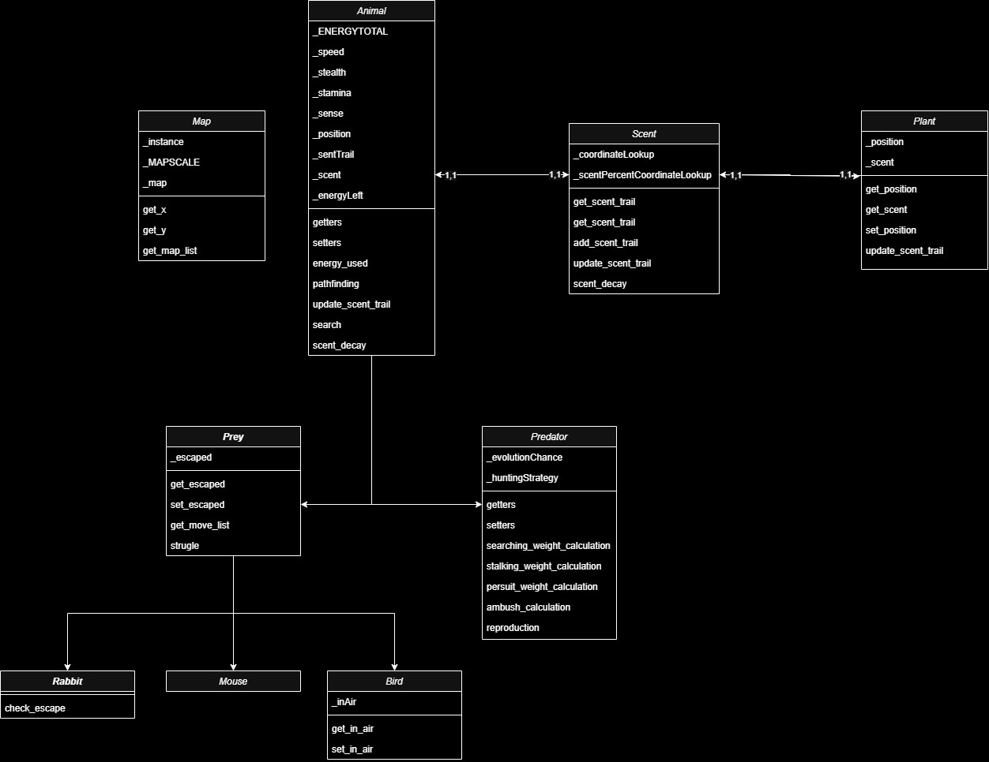
Basics of the Project (Continued)

Slide 5
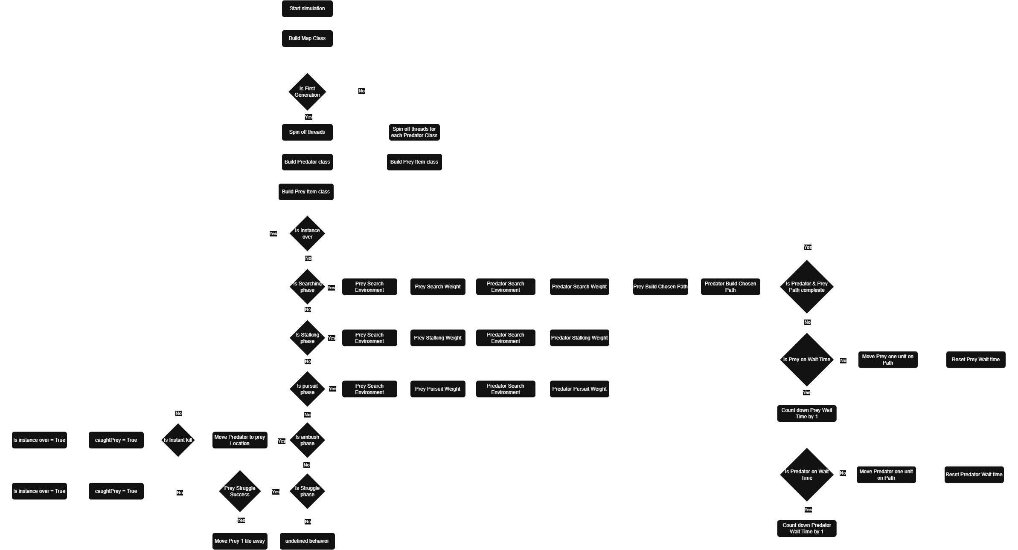
Basics of the Project (Continued)

Slide 6
Design Rationality
Why use Python?
Most used language for simulations
Why a Discreate Event Driven simulation?
I wanted to capture more random behaviors that are seen in the real world.
Why a 2d environment?
Due to time constraints, I limited the scope of this project.
Why statically weight path finding?
It has built in randomness that helps simulate real decision making in animals.
Why Evolutionary Game theory for analysis?
The simulation was inspired by game theory games and falls under the branch of evolutionary game theory.

Slide 7
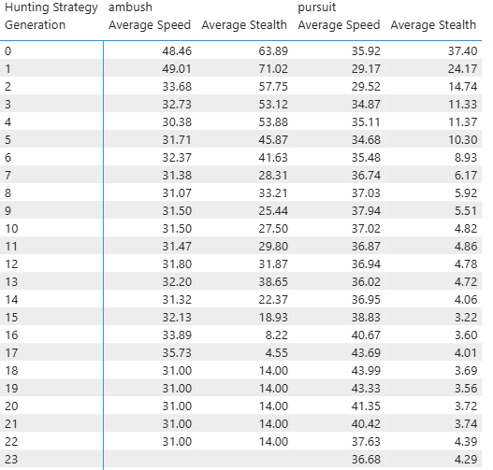
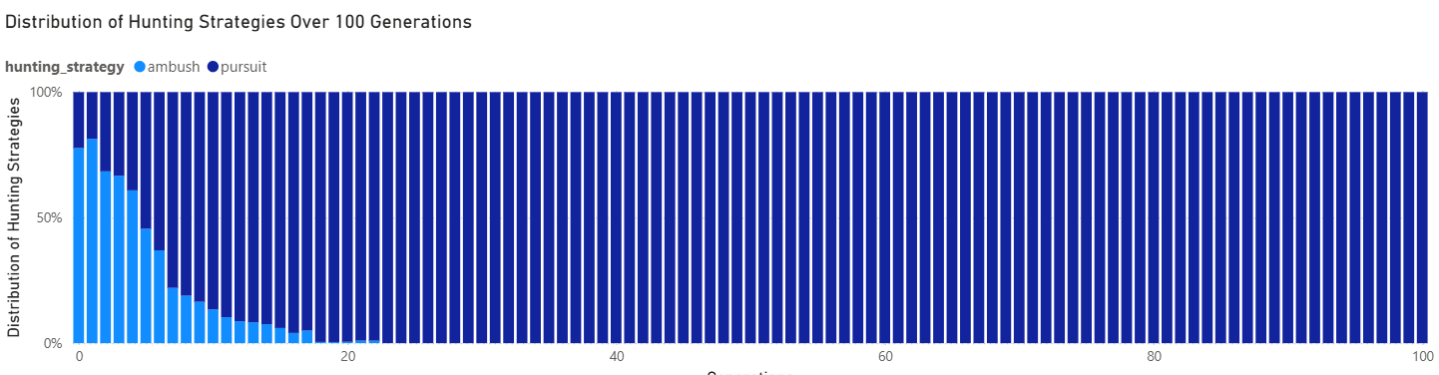
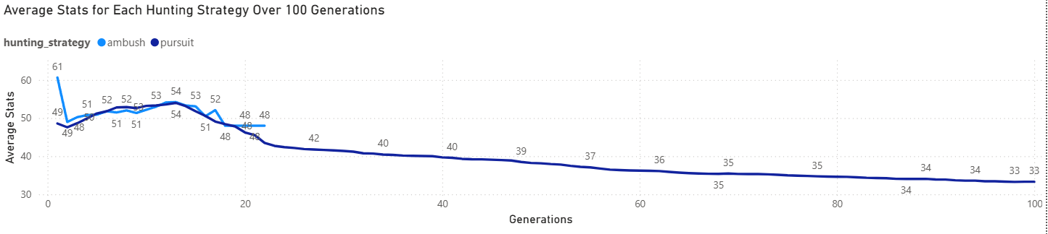
Results (Rabbits)
Pursuit predators gained dominance
Ambush went extinct at generation 22
Speed was optimized for

Slide 8
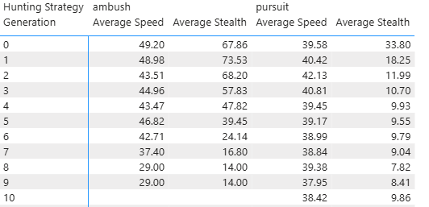
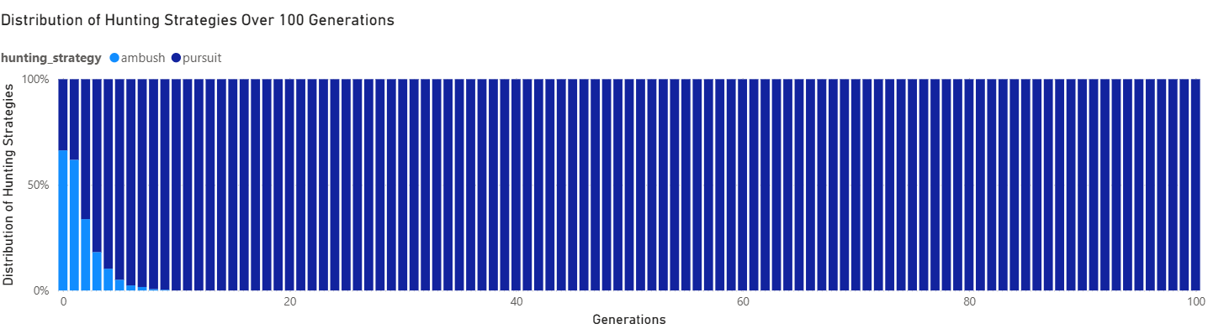
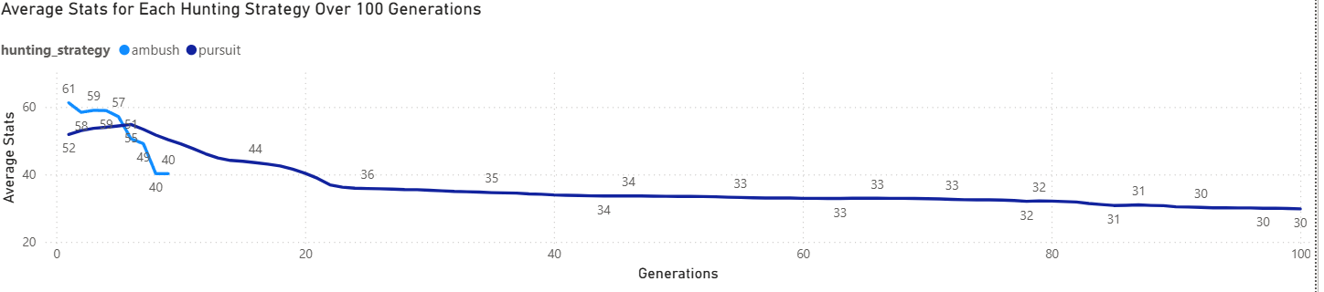
Results (Mice)
Pursuit predators gained dominance
Ambush went extinct at generation 9
Speed was optimized for

Slide 9
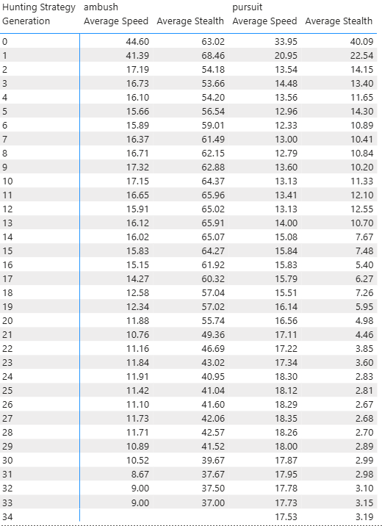
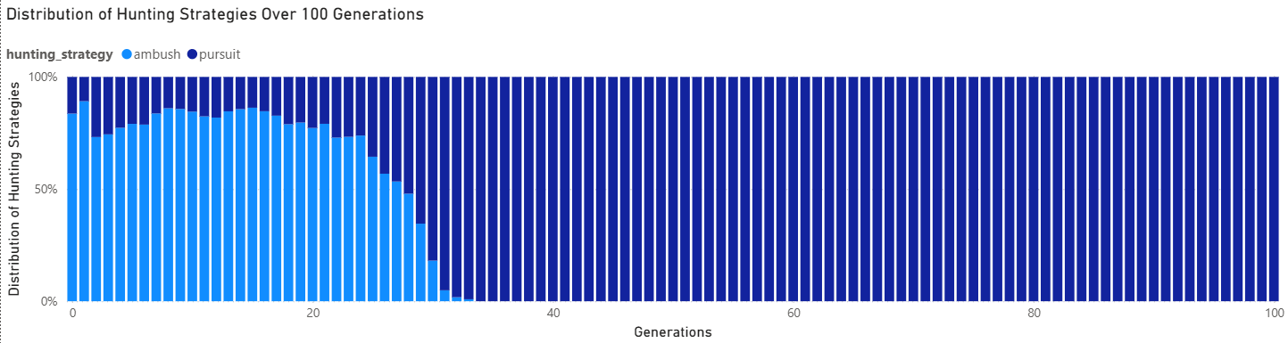
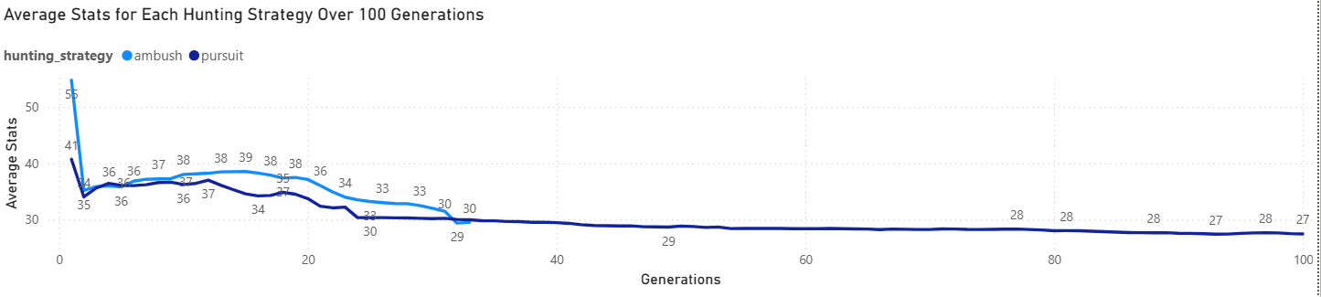
Results (Birds)
Pursuit predators gained dominance
Ambush went extinct at generation 33
Stealth was originally optimized for but fell in later generations

Slide 10
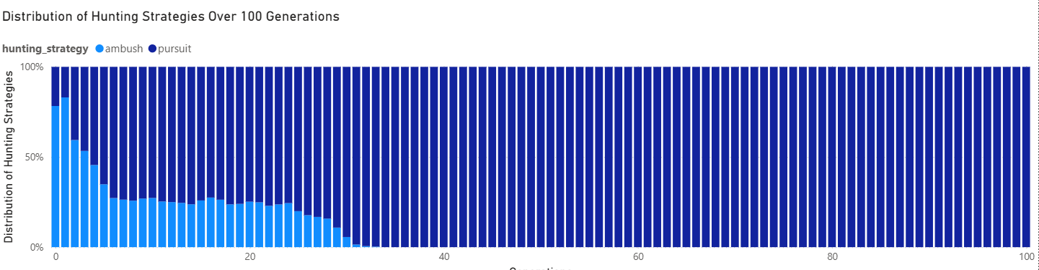
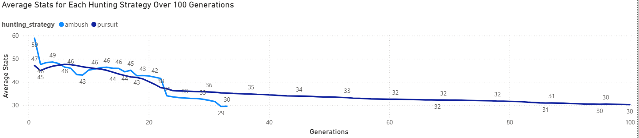
Results
Overall trends show that pursuit predators became the dominant trait in all three simulations.

Slide 11
Discussions
The simulation was skewed towards pursuit predators.
Initial trends reflect expected results
Ambush predators perform poorly against mice and well against birds
Further testing is needed to better refine the simulation so that initial trends are reflected across the whole simulation.

Slide 12
Limitations
Time: Six months to plan, research, and develop the simulation
Testing: Better testing plans and more tests with both populations combined to limit the results from being so skewed.
Performance: Simulation ran into time and computational bottlenecks that limited the ability to do large-scale testing.

Slide 13
Future work
Better testing to fix the system’s bias and allow for better results.
More testing of different criteria to figure out better methods of selecting predators for the next generation

Slide 14
Demo

