Slide 1
Automated Testing Framework for Sugarlabs
Team JAB - Julius Alipala, Alex Austin, Bryce Barrett

Slide 2
Project Goals + History
We were tasked with selecting a Humanitarian Open-Source software project to develop an automated testing framework for that would include 25 test cases to be run.
Initially we chose “Miradi”, which is an adaptive management software to be used for conservation projects.
Build process pulled from a url that 404s
Latest commits were more than a year old, so we realized that Miradi was a dead project. We then decided to try using Amara
Amara
Application for providing video captioning
Development uses Docker, which did not mix well with our VM
We then choose Sugar for our project

Slide 3

What is Sugarlabs?
Sugar Labs is a collaborative learning application geared towards children
Wide range of activities allows for a custom tailored learning experience
Instructors can choose from hundreds of existing activities
Anyone can create an activity and upload it to the activities database
Community driven project
Origins in the One Laptop per Child project
Those who share the goals of Sugar Labs are encouraged to help extend the platform
Translated into 170 languages

Slide 4
Why We Choose Sugar Labs
Many testable features
Written in Python
Active community
Clear documentation for setting up a development environment

Slide 5
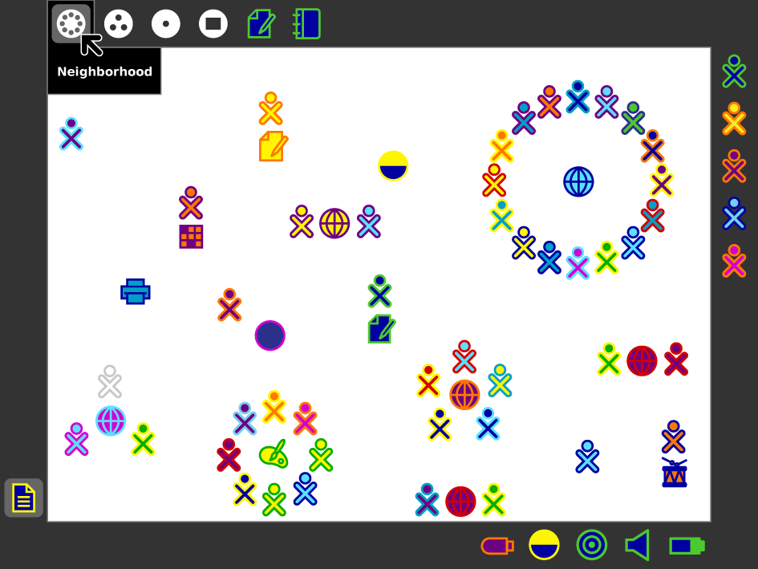
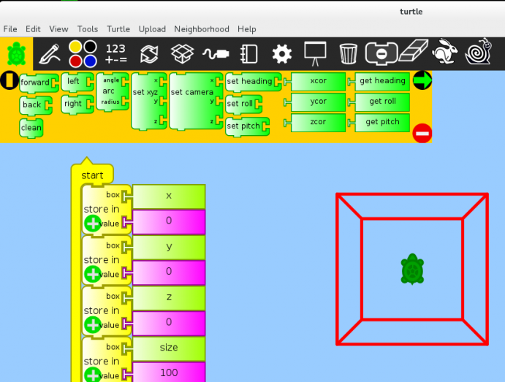
Features

Slide 6
Initial Experience
Despite documentation detailing how to set up a development environment, not all methods worked for our machines
Initially came across problems running the existing tests
Mostly Came from lack of experience with Python testing
Some tests had errors (one had a spelling error on an import statement)
We were able to run a majority of the existing tests after few days of experimentation

Slide 7
Results of Pre-Existing Tests
-11 Tests, 6 initially pass, but later moved up to 8
-Many had import errors, but it is possible that there were spelling errors in imports (as one had)
-One test only passed when run in the Sugar environment itself
-Pre-existing tests are 2 years old, some may begin to fail as the software is updated

Slide 8
Planning Phase
We had initially planned on creating test cases for the notifications, friends, and journal components of Sugar Labs
During this period, we found that there was very little documentation for the classes and methods
We had to spend more time in order to decipher the purpose of many methods
Some components, such as the journal, had to be set aside since we were unable to determine how to design tests due to their complexity
Sugar developer Sam Parkinson, in regards to journal.py, replied with “I’ve literally never run them successfully myself. There seems to be layers and layers in indirection, and I’m not sure how it is intended to work.”
We had to modify our initial plan and look at other components in order to design more test cases
Our final test cases consisted of the friends, neighborhood, agepicker, clipboard, normalize, and keepicon components

Slide 9
Testing Framework
Currently consists of 25 test cases
Tests the friends, neighborhood, agepicker, clipboard, normalize, and keepicon components
Automated testing for any number of test cases
Results displayed at the end of testing
Failures tested through fault injection

Slide 10
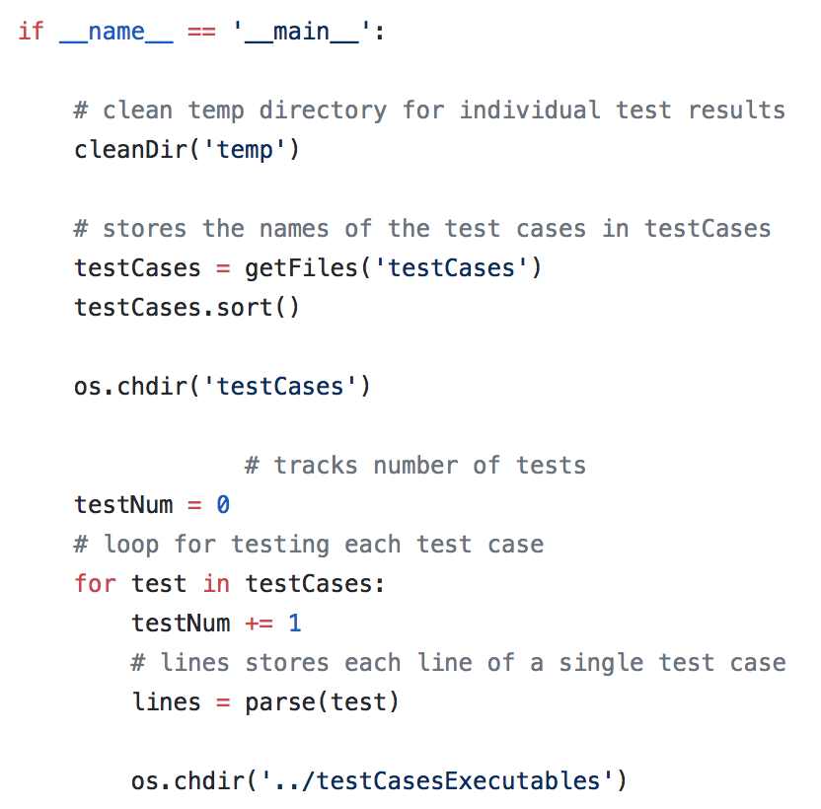
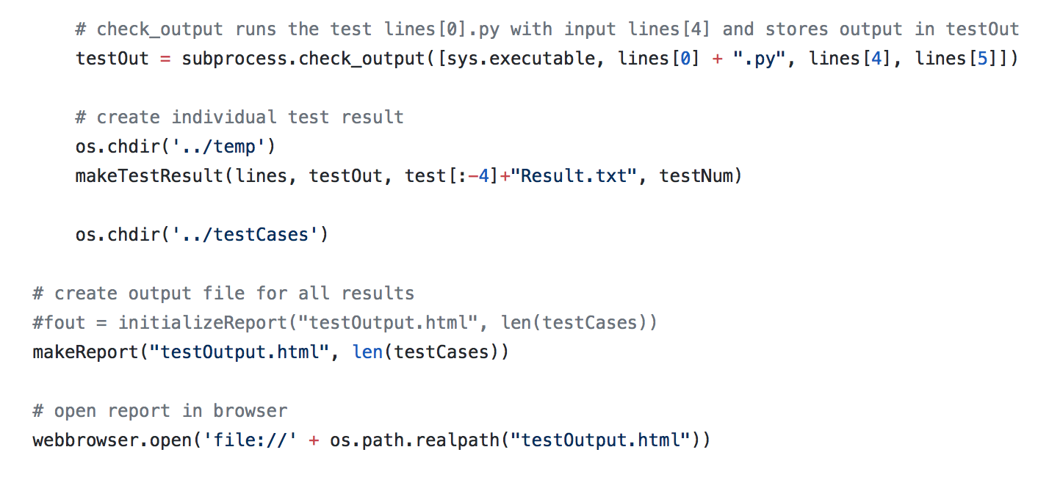
Testing Framework

Slide 11
Test Cases Overview
-For friends.py, we created numerous tests for the methods make_friend() and remove_friend() utilizing a variety of valid and invalid inputs.
-For normalize.py, we created a test for both active and passive normalization.
-For clipboard.py, we tested the add_object() and delete_object() functions with several inputs/scenarios.
-For keepicon.py, we had tests to ensure proper values were set at initialization
-For agepicker.py, we had tests for calculate_birth_timestamp() and calculate_age()
-For neighborhood.py we had tests for the add_buddy(), remove_buddy(), current_buddies() function

Slide 12
Test Case Format
Test Case 21
test_add_clipboard_identicalHash -Test Case Executable to be called
Ensures that no two objects can be hashed to the same index -Requirement specification
Clipboard.py -Component being tested
Add_object -method being tested
"Name of object to add",34,"Second object to add",34 -Inputs
None -Expected outputs

Slide 13
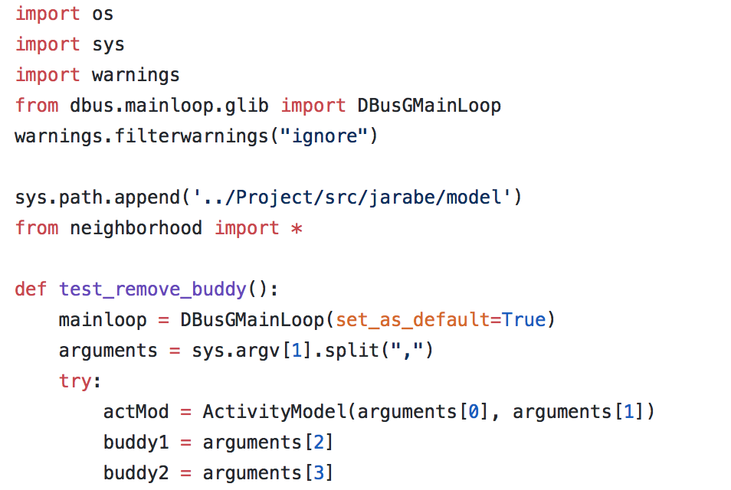
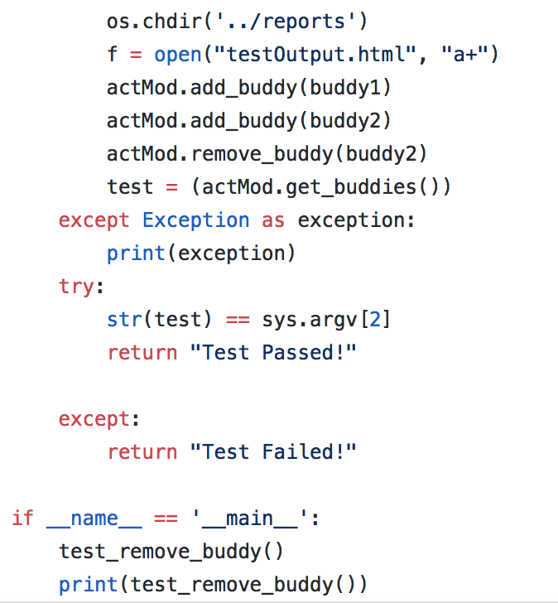
Test Case Executable Format

Slide 14
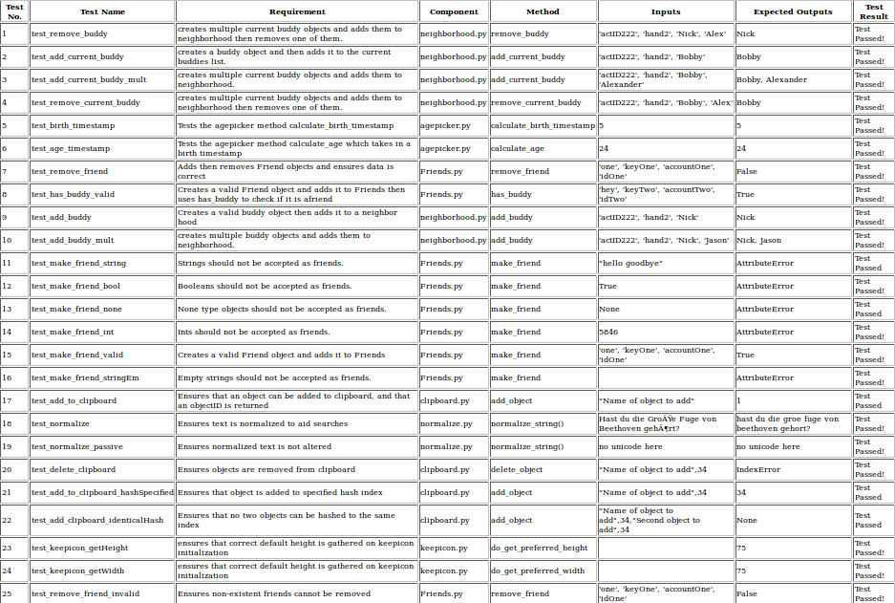
Test Results

Slide 15
Fault Injections
-The next phase in our project was to inject five faults into our code. The faults injected were:
On the addToClipboard function in clipboard.py, we removed it’s check to see if there was an object at specified hash, making it so that the old object was overwritten.
In calculate_age() and calculate_birth_timestamp() in agepicker.py, we introduced faulty arithmetic to age calculation (replaced / and * operators with +)
In add_friend() in friends.py the line self._friends[buddy_info.get_key()] = buddy_info was removed
In normalize.py, we changed the normalization from NKFD to NKF

Slide 16
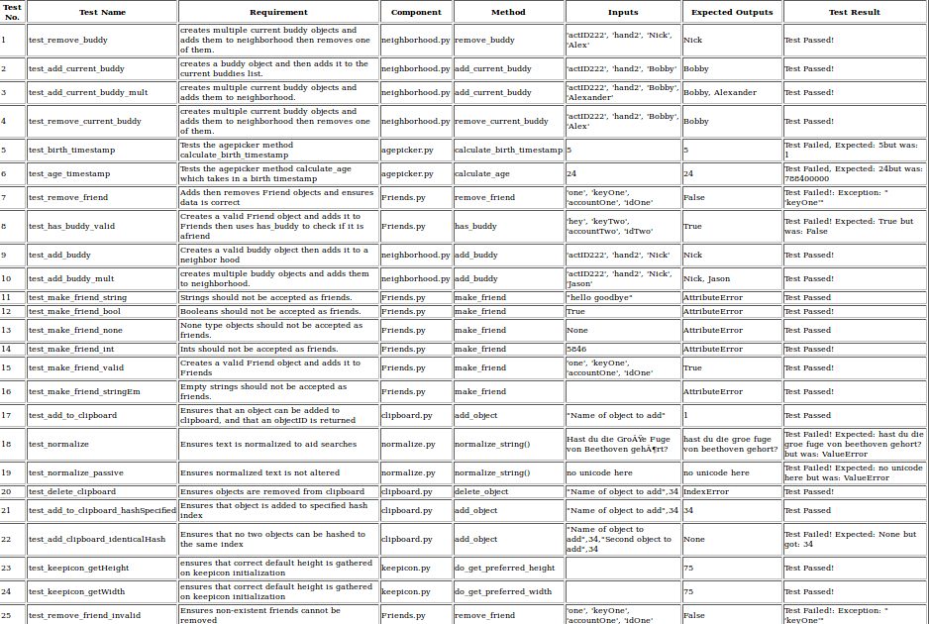
Fault Injection Results

Slide 17
Experience after Project
-Scripting with Bash and Python
-Automated Testing Frameworks
-Working on existing projects
-Document Code(even in python)
-Communication

