Slide 1
IQ Lounge

Slide 2
Team Members Roles
Bryce Kurek - Team Lead
Kyle Frudakis Back- End Lead
Carlos Castellanos - Front-End Lead
Dunyagozel Durdyyeva - Product Owner
James Goedmakers - Scrum Master

Slide 3
Purpose
During the outbreak of COVID, most of us have been stuck in our homes unable to interact with the world, IQ Lounge provides a safe and secure place where people can communicate and discuss anything they wish. With a focus on making the website easy to use for students.

Slide 4
Functionalities
IQ Lounge provides a range of functions currently fit for use
Login/Registration
A user may wish to create an account, this allows them to log in and use the general discussion room
General Discussion
A user that has made an account may wish to interact with other users, after logging in they can enter a comment in the discussion to communicate with other users.
Help page
A user may have a question as to how the website works or how to create an account and may find answers with this function.

Slide 5
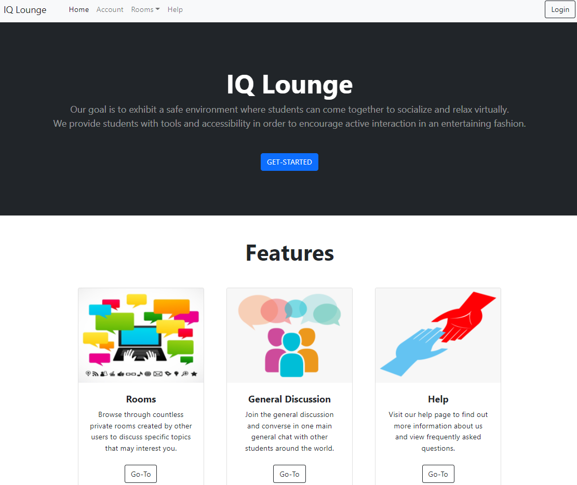
Notes:
Kyle

Slide 6
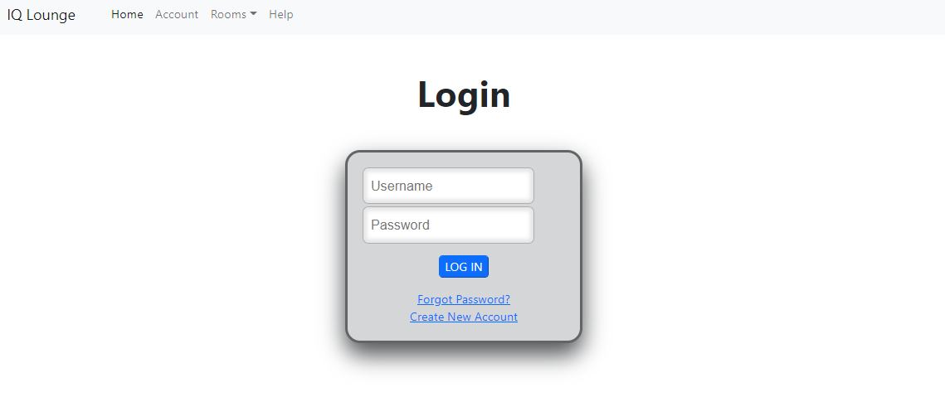
Notes:
Kyle

Slide 7
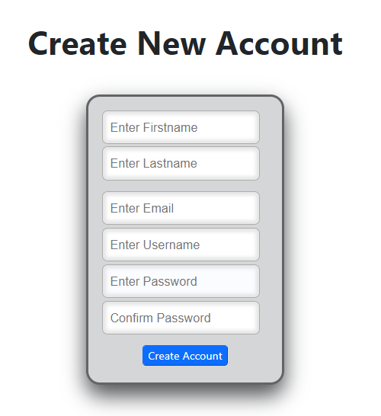
Notes:
Kyle

Slide 8
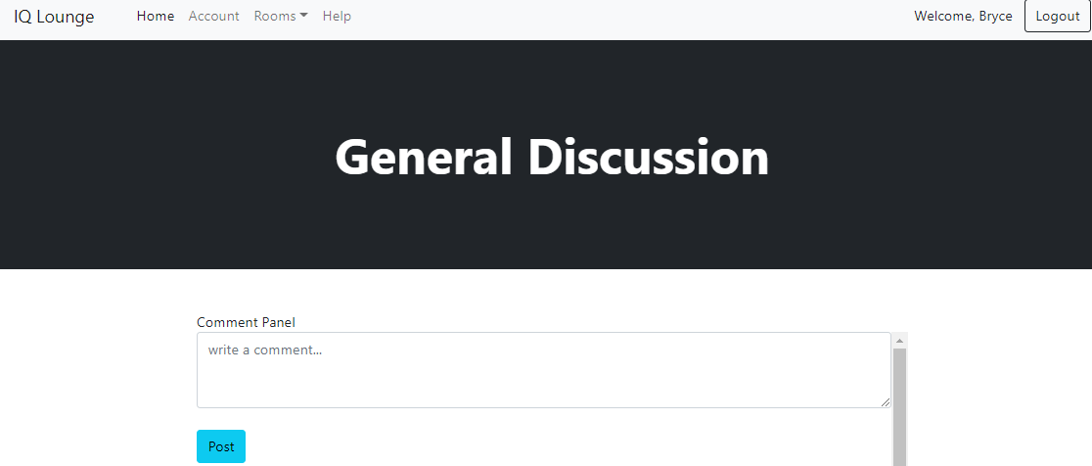
Notes:
Kyle

Slide 9
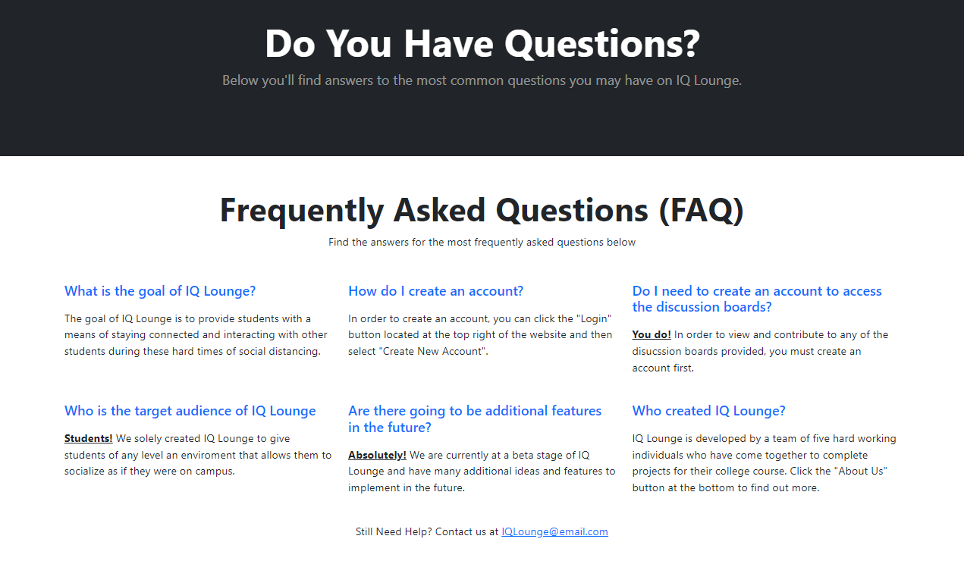
Notes:
Kyle

Slide 10
Target Audience
The target customers of the IQ Lounge Social Media website are college student of age group in range 18-35, 50% male and 50% female users who want to stay in touch virtually during pandemic, share findings, and learn from other students. The main challenge is populating the platform with interesting and informative content to attract young people to socialize and be open-minded. Preferred content is topics related to each student’s major, personal interests, such as games, food, health, sports, etc.

Slide 11
Finished Features
Creating new account
Store user information
Password encryption
Secure login
Creating post on a Discussion Page
Store posts in database table

Slide 12
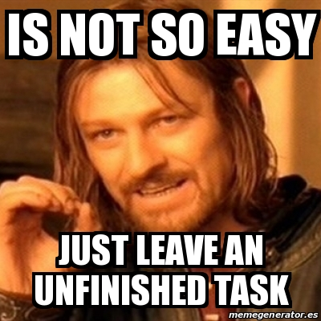
Unfinished Features
Creating rooms
Edit account
Room Search

Slide 13
Non-functional Requirements
Data Security
Passwords stored and passed to the database are encrypted
Training
Users do not require any training time to use the site barring basic knowledge
Compatibility
The site works with Google Chrome, Mozilla Firefox, Microsoft Edge, Apple’s Safari

Slide 14
Lessons Learnt
Breaking down tasks helps to reduce the propensity to procrastinate or defer tasks.
The more communication the better, the more everyone knows about the project as a whole contributes to more ideas being shared on how to progress.
The importance of collaboration software such as Github and Jira to keep everyone and everything organized.
Documentation and staying organized is vital in the success of the project.
Knowledge of members’ prior experience and proficiencies is important for assigning the right work for the right person.

