Slide 1
Comparative Analysis of Heuristic Algorithms
for the Capacitated Vehicle Routing Problem
Greedy Nearest Neighbor · Clarke-Wright Savings · Local Search (2-opt)
Bryson Bargas | Noah Boggess
CSC-2400 Design of Algorithms · Tennessee Technological University · April 2026

Slide 2
What is the Vehicle Routing Problem?
CVRP Algorithm Comparison
A fleet of vehicles must deliver goods to a set of customers
from a central depot, while respecting capacity and minimizing total travel distance.
Depot & Customers
Objective
Constraint
Coverage
Minimize total travel distance across all routes.
Each vehicle has a fixed maximum capacity.
Every customer is visited exactly once.
Depot
1 / 11

Slide 3
Why is VRP Difficult?
CVRP Algorithm Comparison
NP-Hard
Solution Space Growth
For n customers, the number of route arrangements grows on the order of n! (factorial).
VRP is a generalization of the Traveling Salesman Problem.
No known polynomial-time exact algorithm exists.
n = 10
3.6 million
Exact solutions become infeasible as customer count grows.
n = 20
2.4 x 10^18
n = 50
3.0 x 10^64
Why we use heuristics
Heuristics
Approximation
Practical Use
Fast methods that find good (near-optimal) solutions without guaranteeing the optimum.
Trade exactness for runtime — essential at scale.
Real logistics fleets need answers in seconds, not days.
2 / 11

Slide 4
Algorithms Implemented
CVRP Algorithm Comparison
01
Baseline
02
Constructive Heuristic
03
Improvement Heuristic
Greedy Nearest Neighbor
Clarke-Wright Savings
Local Search (2-opt)
Constructs each route by repeatedly visiting the closest feasible customer until capacity is reached.
Starts with one route per customer, then merges routes greedily based on the savings each merge produces.
Refines an existing solution by reversing route segments whenever the swap produces a shorter total path.
Time Complexity
Time Complexity
Time Complexity
O(n²)
O(n² log n)
O(k · n²)
Greedy serves as the baseline; Clarke-Wright and Local Search aim to improve on it.
3 / 11

Slide 5
Research Questions
CVRP Algorithm Comparison
Defined prior to running any experiments
1
How does solution quality (total distance) compare between Greedy and Clarke-Wright?
2
Does Local Search significantly improve the Greedy solution?
3
How do the algorithms compare in terms of runtime efficiency?
4
What trade-offs exist between solution quality and computational cost?
Hypothesis
Clarke-Wright will produce shorter routes than Greedy. Local Search will further improve Greedy's solution at the cost of additional runtime.
4 / 11

Slide 6
Experiment Setup
CVRP Algorithm Comparison
Datasets
Repetitions
Baseline
Solomon Benchmark
5 runs per dataset
Greedy Nearest
C101, C201, R101,
per algorithm
Neighbor solution
R201, RC101
(75 algorithm runs)
Brute force omitted
100 customers each
(exponential cost)
System
Metrics
Intel i9-11900H
Total route distance
@ 2.50 GHz
Vehicles used
32 GB RAM
Wall-clock runtime
Windows 11
% improvement
5 / 11

Slide 7
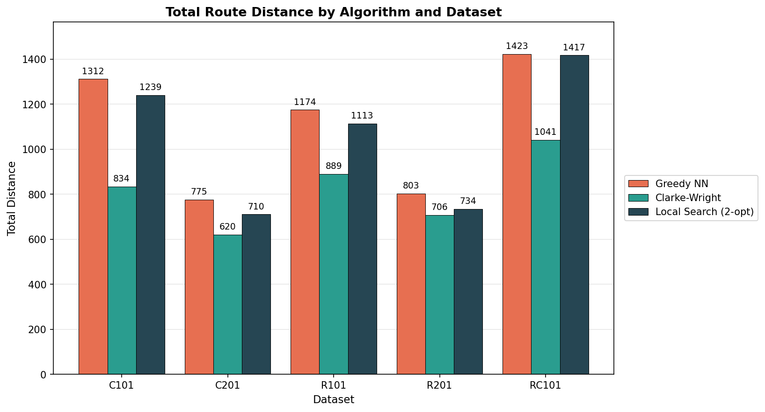
Results - Total Route Distance
CVRP Algorithm Comparison
Key Takeaway
Clarke-Wright wins on every dataset
Greedy produces the longest routes on every dataset
Local Search lands between Greedy and Clarke-Wright
Best on each dataset
Clarke-Wright (5/5)
Worst on each dataset
Greedy NN (5/5)
Figure 1 - Total Route Distance by Algorithm and Dataset
6 / 11

Slide 8
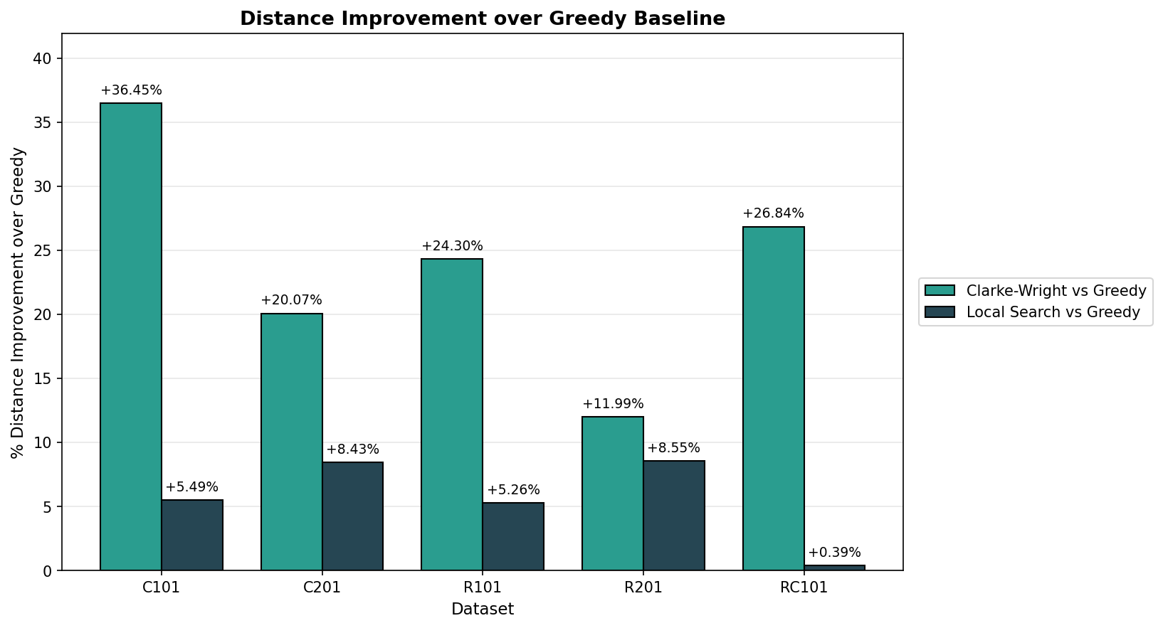
Results - Distance Improvement over Greedy
CVRP Algorithm Comparison
Range of Improvement
Clarke-Wright vs Greedy
+11.99% to +36.45%
Best: C101
Worst: R201
Local Search vs Greedy
+0.39% to +8.55%
Best: R201
Worst: RC101
Clarke-Wright wins 5/5
On every dataset, the savings algorithm beats both other methods on distance.
Figure 2 - Distance Improvement over Greedy Baseline
7 / 11

Slide 9
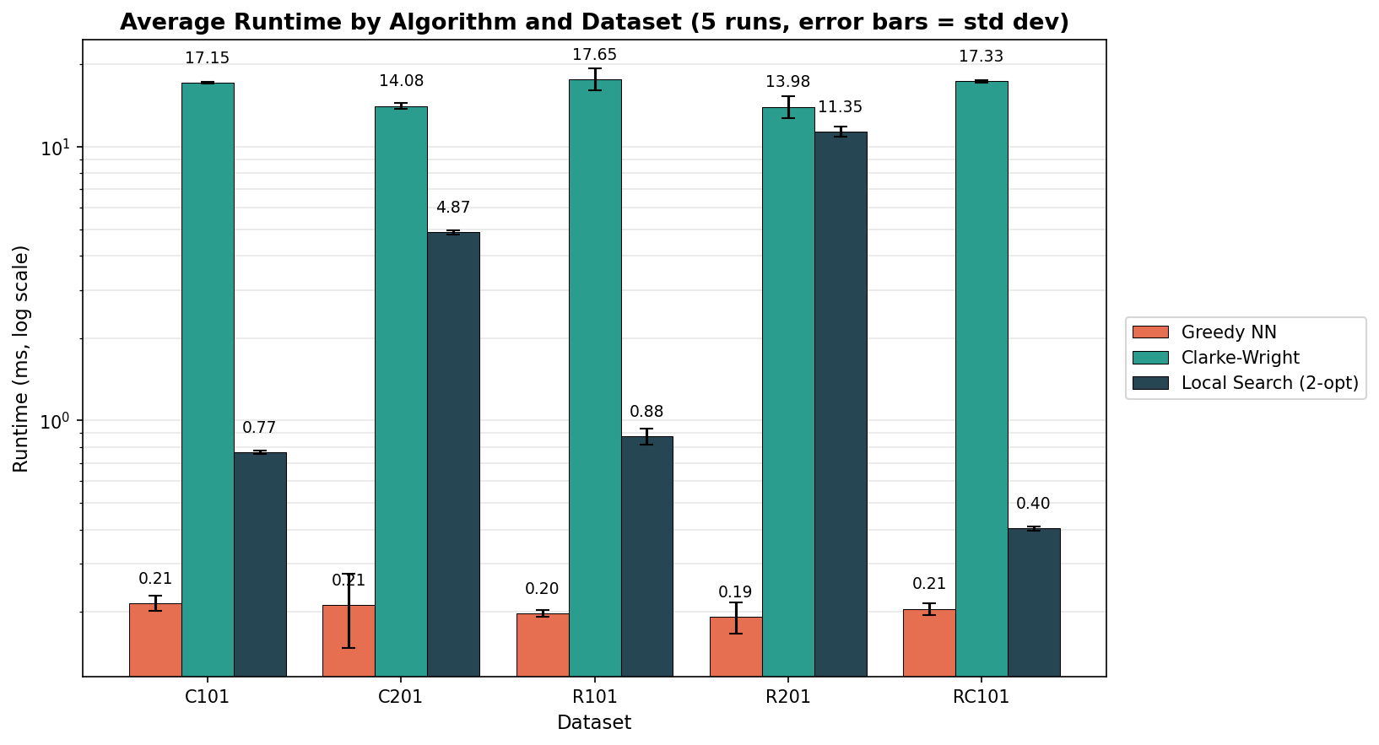
Results - Runtime
CVRP Algorithm Comparison
Average Runtime
Greedy
about 0.2 ms
Stable across all datasets
Clarke-Wright
14 - 18 ms
Sort dominates runtime
Local Search
0.4 - 11 ms
Depends on convergence passes
Log scale · 5 runs each
Figure 3 - Average Runtime by Algorithm and Dataset (5 runs, error bars = std dev)
8 / 11

Slide 10
Key Insights
CVRP Algorithm Comparison
5 / 5
The savings-based merging strategy is the most consistent winner — it does not lose to either competitor on any of the five Solomon instances.
datasets where Clarke-Wright produced the shortest routes
~ 0.2 ms
Greedy is by far the fastest method. Its weakness is solution quality: it produced the longest routes on every dataset.
average Greedy runtime, regardless of dataset
0.4 - 11 ms
2-opt's runtime depends on how many improvement passes its starting solution requires. Quality gain ranged from a marginal 0.39% to a meaningful 8.55%.
Local Search runtime range - highly variable
9 / 11

Slide 11
Limitations & Future Work
CVRP Algorithm Comparison
Limitations
Future Work
Heuristic only
Scaling study
No exact / optimal solution was computed for true ground-truth comparison.
Generate larger problem sizes (n = 200, 500, 1000) to compare empirical growth against theoretical complexity.
2-opt local minima
Add an exact solver
Local Search can get stuck in local optima it cannot escape with single edge swaps.
Implement a branch-and-bound or MILP solver as a true optimal baseline for small instances.
Greedy savings
Randomized restarts
Clarke-Wright merges greedily — early merges can block later, better merges.
Mitigate Local Search's local minima problem by restarting from many Greedy seeds.
Single problem size
Hybrid pipeline
All five datasets contain 100 customers; we did not test how each method scales.
Apply 2-opt to Clarke-Wright output instead of Greedy output to combine the strengths of both.
10 / 11

Slide 12
Questions?
CVRP Algorithm Comparison
Q/A
10 / 11

