Slide 1
Board Game Home Parties
You bring the party, we’ll bring the fun!

Slide 2
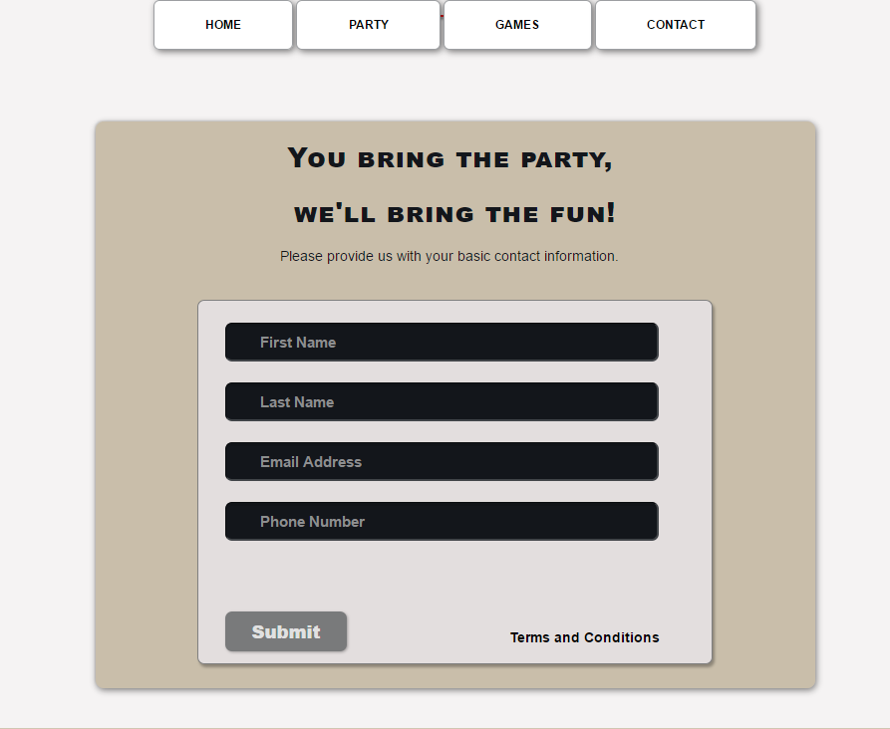
First: Make contact
Fill out our friendly form to let us know you are having a party.

Slide 3

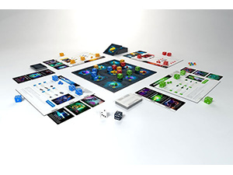
Second: Schedule & select games
You’ll get access to our scheduling app, where you select the schedule and…
Choose the games you are interested in trying out.

Slide 4

Third: Party time!
One of our Game Experts will deliver the games to your party and…
Provide the level of gaming assistance you desire:
From just dropping off the games.
To playing the entire game with your group to make sure everything goes smoothly.

Slide 5
Fourth: Return the Games
After the party:
put the games in the provided return box
put it outside your door.
We’ll take it from there!

Slide 6
Fifth: Do it again!
Make your next party great with more games!
You bring the party,
We’ll bring the fun!

