Slide 1




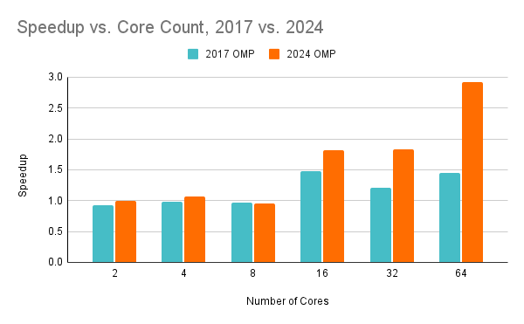
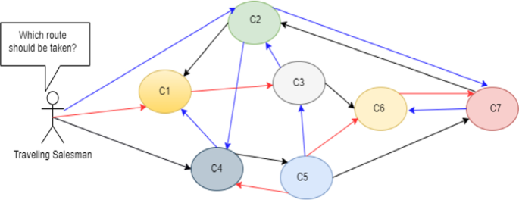
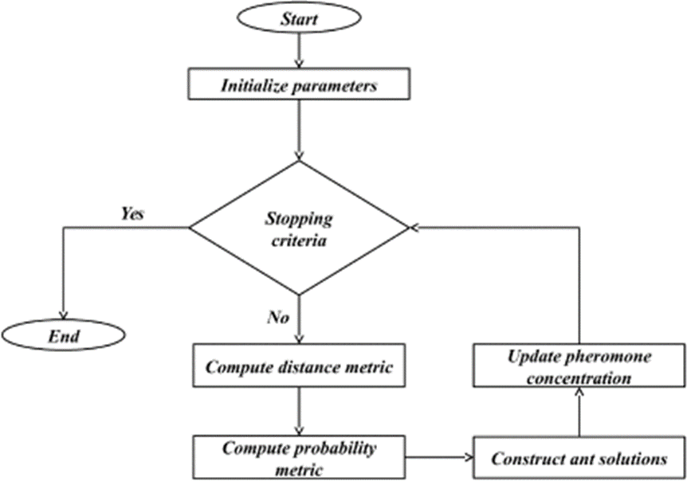
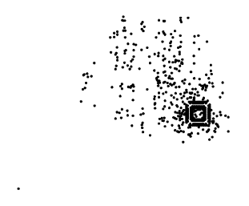
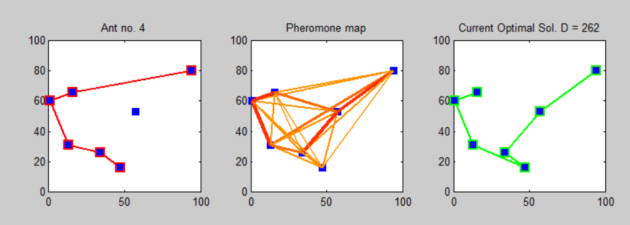
Traveling Salesman Heuristics: CPU Parallelization
CS 470
TSP and ACO Background
The Team
Parallelism Experiments
The Traveling Salesman Problem (TSP) is a problem about finding the shortest Hamiltonian cycle (i.e., a cycle that visits all vertices exactly once) in a complete graph. Exact-solver algorithms are in O(n!) time and are heavily computation intensive. The TSP is a famous NP-hard problem, meaning it is an optimization problem for which no known algorithm can find a globally optimal solution in polynomial time, but if a solution is provided, its optimality can be verified in polynomial time.
Ant Colony Optimization (ACO) is a technique for finding the best path through a graph with the use of “ants” which traverse the graph leaving a pheromone trail for future ants to follow, eventually leading to the most optimal path. It is modeled off pheromone-based communication, one of the most effective ways of communication widely observed in nature.
Our implementation was built on the codebase used and modified by a previous CS 470 research group, who submitted their findings in 2017.
Our initial approach was to develop a CUDA implementation that used the GPU for parallelization. However, due to the high degree of coupling in the existing codebase and frequent accesses to variables in global memory, this proved to be unfeasible.
We instead changed our approach to using OpenMP for parallelization on the CPU, which the 2017 research group had also used.
They had focused on parallelizing the “Construct ant solutions” phase. We chose to parallelize the “Update pheromone concentration” phase as well.
We thought to speed up the methods that dealt with the worst-case scenarios of the algorithm, causing it to reach an optimal solution faster.
Bryden Mollenauer
Ethan Baldwin
Dominic Ortolano
Performance and Results
void mmas_evaporation_nn_list( void )
{
long int i, j, help_city;
TRACE ( printf("mmas specific evaporation on nn_lists\n"); );
#pragma omp parallel for private(j, help_city) shared(pheromone)
for ( i = 0 ; i < n ; i++ ) {
for ( j = 0 ; j < nn_ants ; j++ ) {
help_city = instance.nn_list[i][j];
pheromone[i][help_city] = (1 - rho) * pheromone[i][help_city];
if ( pheromone[i][help_city] < trail_min )
pheromone[i][help_city] = trail_min;
}
}
}
The Problem
Conclusions and Future Work
Due to the TSP being O(n!), the time it takes to find the solution skyrockets as the problem size increases, rendering the algorithm unfeasible for large problem sets. ACO can be used as a heuristic to find a nearly optimal solution within a certain threshold of the optimal solution, making the runtime more manageable. Our project focuses on using OpenMP to parallelize an ACO-TSP implementation, improving the runtime while maintaining the accuracy of the solution. Below is a visual representation of how an ACO solution finds the optimal path.
In both implementations, the speedup increases with the number of cores allocated to the program, while the problem size (vertex count = 493) remains constant.
This is evidence for the algorithm exhibiting strong scaling. This is consistent with the research done in 2017.
Our implementation scales significantly better, having approximately double the speedup with the maximum number of cores (64).
The most potential for improving the performance of a parallel ACO-TSP is in a GPU-powered implementation. While we were unable to successfully create a CUDA implementation of ACO, we still believe that it is possible. Specific approaches could be:
Assigning one CUDA thread to each ant in the algorithm (i.e., a “coarse-grained” implementation).
Assigning one CUDA block to each ant in the algorithm, with each thread in the block handling different probability computations (i.e., a “fine-grained” implementation).
We tested both the previous research group’s OpenMP ACO-TSP implementation (2017 OMP) and our implementation (2024 OMP) on the TSP problem “d493” (shown on the right), which consists of 493 vertices. The speedup for both implementations is calculated by comparing the runtime to a serial implementation of ACO-TSP.
References
Tripathy, Abhijit. “Travelling Salesman Problem (Basics + Brute Force Approach).” OpenGenus IQ: Computing Expertise & Legacy, OpenGenus IQ: Computing Expertise & Legacy, 5 Sept. 2020, iq.opengenus.org/travelling-salesman-problem-brute-force/.
Menezes, Breno A. M., et al. “Parallelization Strategies for GPU-Based Ant Colony Optimization Solving the Traveling Salesman Problem.” 2019 IEEE Congress on Evolutionary Computation (CEC), 2019, pp. 3094–101. IEEE Xplore, https://doi.org/10.1109/CEC.2019.8790073.
https://github.com/mastqe/470-gputsp/tree/master.

