Slide 1
Oracle IPS – Fast Formula Liquid Hub
02 - Payroll (Common Fast Formula Types)

Slide 2





Oracle HCM | Payroll | Fast Formula
Agenda

Slide 3
Oracle HCM | Payroll
FF Essentials: Review

Slide 4
Oracle HCM | Fast Formula | FF Structure
Fast Formula Structure
Section
Alias
Default
Initialization
Formula or Calculation
Return
Best practices
Always Indent with three spaces
Align all “=” or “IS” characters to make the formula more readable.
Always use comments to provide additional information on your code.
Provide DEFAULT values in all DBIs and input values
Initialize all local variables
Always check for zero divisors to prevent the ‘cannot divide to zero’ error

Slide 5
Oracle HCM | Fast Formula | FF Structure
/************************************************************************************************
* FORMULA NAME: DS_PY_RPT_RATE_OF_PAY *
* FORMULA TYPE: Oracle Payroll *
* DESCRIPTION: This formula is to retrieve Overtime Earnings and Overtime Hours to calculate *
* the Regular Rate of Pay for each week for paycheck/payslip. *
* *
* Change History *
* Ver Date Author CR/BUG # Description *
* --- --------------- ------------------- ---------- --------------- *
* 1.0 2021-03-10 Denise Santos PC-35233 Retrieve regular rate of pay for each *
* week. *
* *
************************************************************************************************/_
/* ALIAS, if any */
/* ========================= DEFAULT SECTION BEGIN ========================= */
/* ========================= DEFAULT SECTION END ========================= */
INPUTS ARE Rate_of_Pay_1
/* ========================= INITIALIZATION SECTION BEGIN ========================= */
lc_formula = '[DS_PY_RPT_RATE_OF_PAY]'
l_dummy = PAY_INTERNAL_LOG_WRITE(' ----- START '|| lc_formula || ' ----- ' )
/* ========================= INITIALIZATION SECTION END ========================= */
/* ========================= FORMULA SECTION BEGIN ========================= */
/* ========================= FORMULA SECTION END ========================= */
/* ========================= RETURN CONDITIONS START ========================= */
l_dummy = PAY_INTERNAL_LOG_WRITE(' ----- END '|| lc_formula || ' ----- ' )
RETURN ln_RateOfPay1, ln_RateOfPay2
/* ========================= RETURN CONDITIONS END ========================= */
Notes:
IS_EXECUTE('FORMULA_NAME')

Slide 6
Oracle HCM | Payroll | Fast Formula
Common Concepts
The INPUTS for Fast Formulas being used in an element are their input values, you just need to replace underscore with the special characters.
Calling a formula
SET_INPUT, EXECUTE, GET_OUTPUT
CALL_FORMULA
Logging of Formulas
ESS_LOG_WRITE
PAY_INTERNAL_LOG_WRITE
Calling UDTs
GET_TABLE_VALUE(TABLE,COLUMN,ROW,DEFAULT-VALUE)
Calling Value Sets
GET_VALUE_SET(‘Value Set Name’, ‘Bind Parameter’)

Slide 7
Oracle HCM | Payroll
Fast Formula Type: Input Validation

Slide 8
Oracle HCM | Payroll | Fast Formula
Input Validation Type
Validate one or more element entry values
Page Section | Field | Purpose
Element Details or Element Eligibility | Validation Formula | Validates one or more entry values for the element based on entries in other entry values.
Element Details or Element Eligibility | Calculation Formula | Provides values for one or more entry values using a calculation formula that takes input from these entry values or other entry values.
Element Details or Element Eligibility | Defaulting Formula | Provides default values for one or more entry values.
Input Value | Validation Formula | Validates one entry value independent of others.
Notes:
https://docs.oracle.com/en/cloud/saas/human-resources/21c/oapff/formulas-for-payroll.html#OAPFF1511389

Slide 9
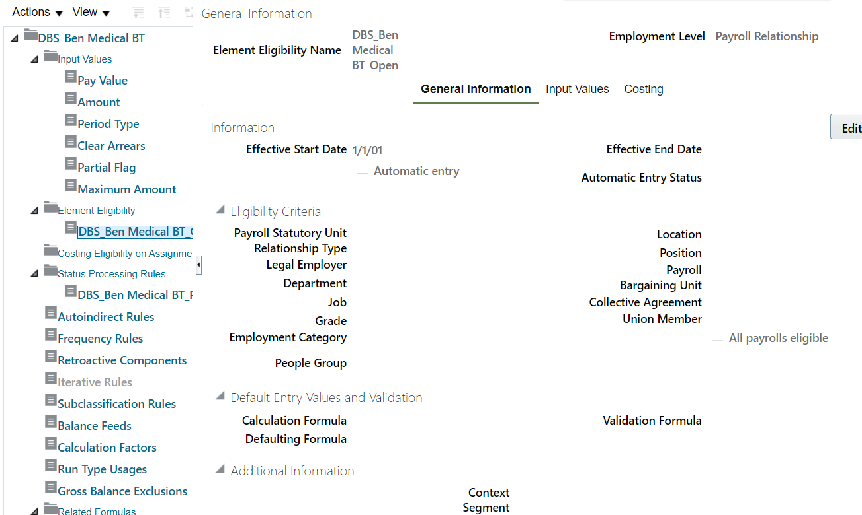
Oracle HCM | Payroll | Fast Formula
Input Validation Type

Slide 10
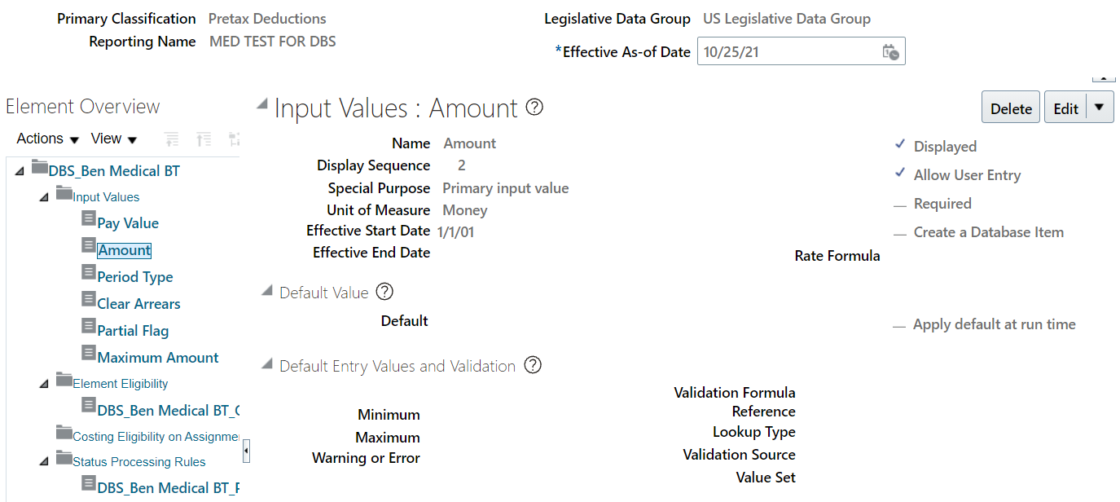
Oracle HCM | Payroll | Fast Formula
Input Validation Type

Slide 11
Oracle HCM | Payroll | Fast Formula
Input Validation Type - INPUTS
Formula Usage | Input Variables | Comments
Validation formula at input value level | entry_value | Passes the value to be validated. You must declare the input variable as the appropriate type for the element input value.
Validation formula at element or element eligibility level | Any element input value name that corresponds to an entry value. | Replace spaces in the input value name with underscores in the input variable name. It doesn't matter whether you use uppercase or lowercase for the name.
Defaulting formula | None | Use database items or other logic instead.
Calculation formula | Any element input value name of an entry value. | Replace spaces with underscores. You need not provide all of the available entry values.

Slide 12
Oracle HCM | Payroll | Fast Formula
Input Validation Type - RETURN
Formula Usage | Return Values | Comments
Validation formula at any level. | formula_status | Must be either 'S' (success) or 'E' (error). Required.
Validation formula at any level. | formula_message | The text of the message is passed to the user if the validation fails. Optional.
Defaulting formula | Any element input value name of an entry value. | A return value overrides any default value that’s provided on the input value in the element or element eligibility record.
Calculation formula | Any element input value name of an entry value. | You don't need to return all of the available entry values. You can return the entry values that were passed as input variables or other entry values.

Slide 13
Oracle HCM | Payroll | Fast Formula
Input Validation Type - EXAMPLE
User can only enter 10, 40 or 80
INPUTS ARE ENTRY_VALUE
IF (ENTRY_VALUE <> 10 AND ENTRY_VALUE <> 40 AND ENTRY_VALUE <> 80) THEN
(
FORMULA_MESSAGE = 'The amount is invalid, enter an amount of $10, $40, or $80.'
FORMULA_STATUS = 'E'
)
RETURN FORMULA_STATUS, FORMULA_MESSAGE

Slide 14
Oracle HCM | Payroll
Fast Formula Type: Oracle Payroll

Slide 15
Oracle HCM | Payroll | Fast Formula
Oracle Payroll
Fast Formula Type
Commonly used code in Oracle Payroll?
What do we usually see in generated fast formulas?
How do we know where do we need to modify a specific requirement? (Base, Calculator or Results FF)

Slide 16
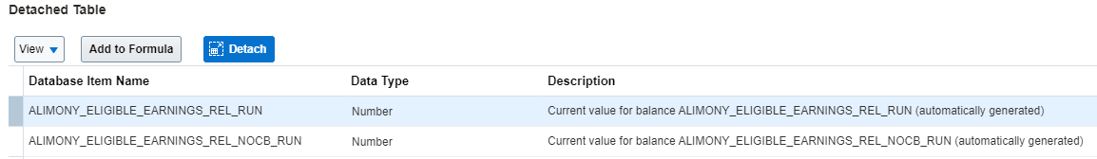
Oracle HCM | Payroll | Fast Formula
Oracle Payroll Fast Formula Type
Accessing balances in fast formulas
Balances have a DBI for each balance dimension
FORMAT: BALANCE_NAME_BALANCE_DIMENSION
DEFAULT FOR ALIMONY_ELIGIBLE_EARNINGS_REL_RUN IS 0
bal_def = ALIMONY_ELIGIBLE_EARNINGS_REL_RUN
RETURN bal_def

Slide 17
Oracle HCM | Payroll | Fast Formula
Oracle Payroll
Fast Formula Type
Payrel level element accessing assignment level info

Slide 18
Oracle HCM | Payroll
Fast Formula Type: Payroll Access to HR

Slide 19
Oracle HCM | Payroll | Fast Formula
Payroll Access to HR Formula Type
Overview
Used to get employee’s HR details and return value to desired Fast Formula
HR Details are not available on different types of Fast Formula.
Multiple Fast Formulas could call the Payroll Access to HR FF using “Mode”

Slide 20
Oracle HCM | Payroll | Fast Formula
Payroll Access to HR Formula Type
Call Formula Example 1
CALL_FORMULA( ‘FFLH_GET_HR_VALUE'
, l_assignment_id > 'HR_ASSG_ID'
, 'ASG_EFFCT_START' > 'MODE'
, l_eff_date> ‘l_actual_end_date’
, l_asg_start_date < 'X_OUTPUT_DT' DEFAULT '1951/01/01 00:00:00'
)
Call Formula Example 2
CALL_FORMULA( ‘FFLH_GET_HR_VALUE'
, l_assignment_id > 'HR_ASSG_ID'
, ‘STD_WORKING_HOURS’ > 'MODE'
, l_eff_date > ‘l_actual_end_date’
, l_std_hours < 'X_OUTPUT' DEFAULT 0)

Slide 21
Oracle HCM | Payroll | Fast Formula
Payroll Access to HR Formula Type
FFLH_GET_HR_VALUE
X_OUTPUT = 0
X_OUTPUT_DT = '1951/01/01 00:00:00' (Date)
IF mode = 'STD_WORKING_HOURS' THEN
(
CHANGE_CONTEXTS (EFFECTIVE_DATE = l_actual_end_date)
(X_OUTPUT = PER_ASG_STANDARD_WORKING_HOURS)
)
ELSE IF mode = 'ASG_EFFCT_START' THEN
(
CHANGE_CONTEXTS (EFFECTIVE_DATE = l_actual_end_date)
(X_OUTPUT_DT = PER_ASG_EFFECTIVE_START_DATE )
)
ELSE IF mode = 'ASG_EFFCTIVE_END_DATE' THEN
(
CHANGE_CONTEXTS(EFFECTIVE_DATE = l_actual_end_date)
(X_OUTPUT_DT = PER_ASG_EFFECTIVE_END_DATE)
)
l_log = PAY_INTERNAL_LOG_WRITE('X_OUTPUT_DT : '||to_char(X_OUTPUT_DT))
l_log = PAY_INTERNAL_LOG_WRITE(‘X_OUTPUT : '||to_char(X_OUTPUT))
RETURN X_OUTPUT, X_OUTPUT_DT

Slide 22
Oracle HCM | Payroll | Fast Formula
Payroll Access to HR Formula Type
Payroll Relationship Level Element accessing Assignment Level data
/* add context variables to be called in payroll access to hr */
l_date_earned = GET_CONTEXT(DATE_EARNED, PAY_EARN_PERIOD_END)
l_el_date = PAY_EARN_PERIOD_END
l_hr_rel_id = GET_CONTEXT(PAYROLL_RELATIONSHIP_ID, 0)
l_hr_assignment_id= GET_CONTEXT(PAYROLL_ASSIGNMENT_ID, 0)
l_entry_level = ENTRY_LEVEL
i = 1
while (RUN_INCLUDED_PAYROLL_ASGS.EXISTS(I)) LOOP
(
CHANGE_CONTEXTS(PAYROLL_ASSIGNMENT_ID = RUN_INCLUDED_PAYROLL_ASGS[I])
(
HR_ASGS[I] = ASG_HR_ASG_ID
)
i = i + 1
)
l_assignment_id = HR_ASGS[1]

Slide 23
Oracle HCM | Payroll | Fast Formula
Payroll Access to HR Formula Type
Payroll Relationship Level Element accessing Assignment Level data
CALL_FORMULA(‘FFLH_GET_ANNUAL_SALARY',
l_assignment_id > 'HR_ASSIGN_ID',
l_trm_id > 'HR_TRM_ID',
l_hr_rel_id > 'HR_REL_ID' ,
l_el_date > 'HR_EFFECTIVE_DATE',
entry_level > 'HR_ENTRY_LEVEL',
l_full_time_salary < 'L_FULL_TIME_SALARY' DEFAULT 0
)
l_dummy = PAY_INTERNAL_LOG_WRITE('Formula_Name|| 'l_full_time_salary : '||to_char(l_full_time_salary))
IF l_full_time_salary >90000 then
(
er_contribution = 20
)
/*end addition */
)
Return l_full_time_salary

Slide 24
Oracle HCM | Payroll | Fast Formula
Payroll Access to HR Formula Type
Payroll Relationship Level Element accessing Assignment Level data
DEFAULT FOR CMP_ASSIGNMENT_SALARY_ANNUAL_FULLTIME_AMOUNT IS 0
Inputs are hr_assign_id,
hr_trm_id,
hr_rel_id,
hr_effective_date (date),
hr_entry_level (text)
l_hr_effective_date=hr_effective_date
l_hr_assign_id = hr_assign_id
l_hr_trm_id=hr_trm_id
l_hr_rel_id=hr_rel_id
l_hr_entry_level = hr_entry_level
IF l_hr_entry_level = 'PR' THEN
(
CHANGE_CONTEXTS (EFFECTIVE_DATE = l_hr_effective_date,HR_ASSIGNMENT_ID = l_hr_assign_id,HR_TERM_ID = l_hr_trm_id,HR_RELATIONSHIP_ID = l_hr_rel_id)
(
l_full_time_salary = CMP_ASSIGNMENT_SALARY_ANNUAL_FULLTIME_AMOUNT
)
)
Return l_full_time_salary

Slide 25
Oracle HCM | Payroll | Fast Formula
Payroll Access to HR Formula Type
Payroll Relationship Level Element accessing assignment level data
IF l_hr_entry_level = 'PR' THEN
(
CHANGE_CONTEXTS (EFFECTIVE_DATE = l_hr_effective_date,HR_ASSIGNMENT_ID = l_hr_assign_id,HR_TERM_ID = l_hr_trm_id,HR_RELATIONSHIP_ID = l_hr_rel_id)
(
l_full_time_salary = CMP_ASSIGNMENT_SALARY_ANNUAL_FULLTIME_AMOUNT
)
)
Return l_full_time_salary

Slide 26

Oracle HCM | Payroll | Fast Formula
Activity 2.1 - Create an input value validation FF
Notes:
Kahoot

Slide 27
Oracle HCM | Payroll | Fast Formula
Activity 2.2 - Retrieve element entry value, balances using DBI
Notes:
Kahoot

Slide 28
Oracle HCM | Payroll | Fast Formula
Activity 2.3 – Create a Payroll Access to HR FF
Notes:
Kahoot

Slide 29
Oracle HCM | Payroll | Fast Formula
Activity 2.4 - Retrieve data from UDT
Notes:
Kahoot

Slide 30
Oracle HCM | Payroll
Fast Formula Type: Skip Rule

Slide 31
Oracle HCM | Payroll | Fast Formula
Skip Rule
Used to Determine whether to include or exclude the element entry for the person using rules in a formula
Example is once-each-period rule stops recurring element entries from processing more than once in a payroll period.

Slide 32
Oracle HCM | Payroll | Fast Formula
Creating Skip Rule
Select formula type Element Skip in the Formulas window
Use as many input values as you require.
The formula must set and return a local variable of type text, and this variable must be called skip_flag.
If the returned value of this variable begins with the letter y (such as 'Yes'), all processing for the element is skipped. Otherwise, the element processes as normal.

Slide 33
Oracle HCM | Payroll | Fast Formula
Example of Element Skip Rule
IF (service_credit > 40) THEN
skip_flag = ‘yes’
ELSE
skip_flag = ‘no’
return skip_flag

Slide 34
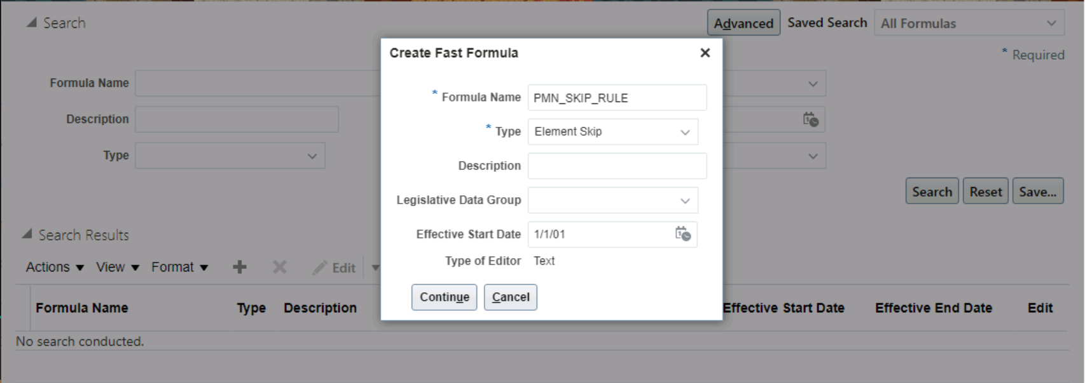
Oracle HCM | Payroll | Fast Formula
Creation Element Skip Rule

Slide 35
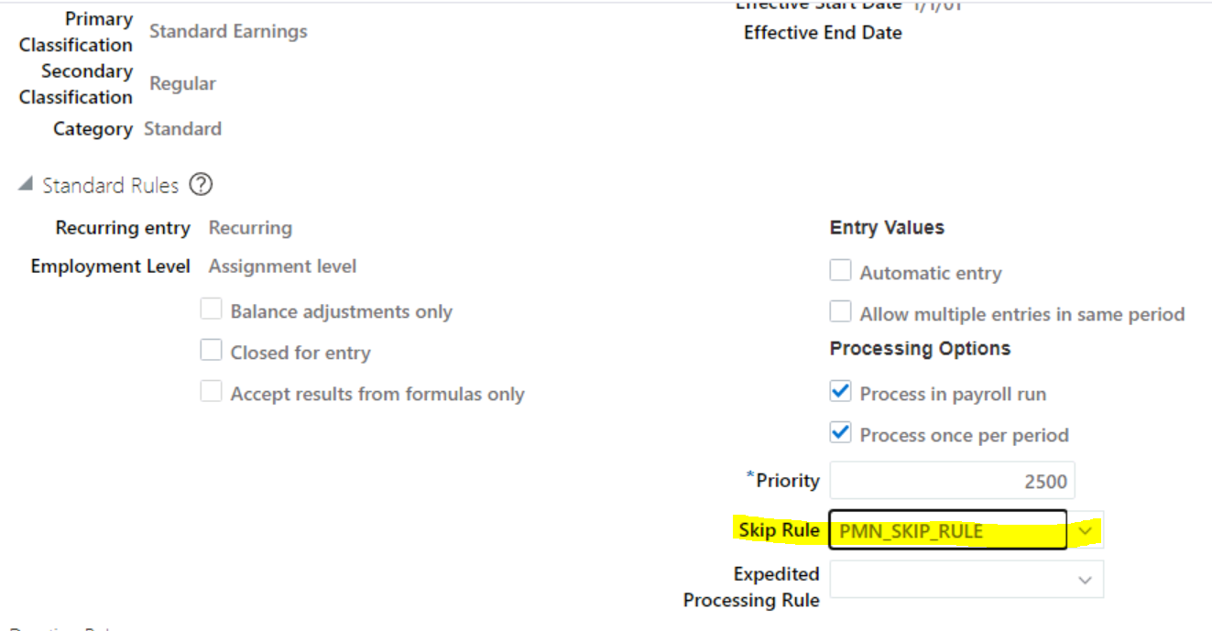
Oracle HCM | Payroll | Fast Formula
Element Skip Rule

Slide 36
Oracle HCM | Payroll
Fast Formula Type: Proration

Slide 37
Oracle HCM | Payroll | Fast Formula
Proration
What is a proration? How to test? How to debug? How to create custom?

Slide 38
Oracle HCM | Payroll | Fast Formula
Activity 2.4 - Create a simple skip rule
Notes:
Kahoot

Slide 39
Oracle HCM | Payroll | Fast Formula
Activity 2.5 - Create a custom proration formula
Notes:
Kahoot

Slide 40
Oracle HCM | Payroll
References
Back to Summary

Slide 41
Oracle HCM | Fast Formula | References
Security
Benefits Administrator
Benefits Manager
Compensation Administrator
Human Capital Management Application Administrator
Human Resource Specialist
Payroll Manager
Payroll Administrator
Job Roles must inherit the Fast Formula View Duty and/or Fast Formula Management Duty roles.

Slide 42
Oracle HCM | Fast Formula | References
Links
Understand Payroll Concepts
Set up payroll process configuration
Fast Formula User Guide
Using fast formula.pdf
Tables and Views

Slide 43
Thank You

