Slide 1
Oracle IPS – Fast Formula Liquid Hub
03 – Payroll Terminologies

Slide 2



Oracle HCM | Payroll | Fast Formula
Agenda

Slide 3
Oracle HCM | Payroll
Payroll Terms: Retro Processing

Slide 4
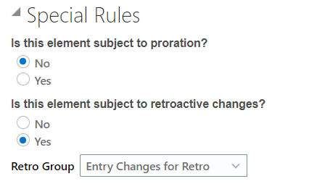
Oracle HCM | Payroll | Fast Formula
Retro Processing
Retroactive processing ensures that your payroll run for the current period reflects any backdated payments and deductions from previous payroll periods. A retroactive event group defines the types of changes that trigger a retroactive event notification.
Within a retroactive event group, select the events that produce notifications if a backdated change occurs. Specify the entity, update type, and attribute, as shown in the examples provided in the following table.
Notes:
https://docs.oracle.com/en/cloud/saas/human-resources/21c/oapff/formulas-for-payroll.html#OAPFF1511389

Slide 5
Oracle HCM | Payroll | Fast Formula
Entry Changes for Retro
Entity | Update Type | Attribute
Element Entry Value | Correction | SCREEN_ENTRY_VALUE
Element Entry | Update | EFFECTIVE_START_DATE
Element Entry | Update | EFFECTIVE_END_DATE
Element Entry | Logical Date Change
Element Entry | Insert
Element Entry | Delete Changes
Notes:
https://docs.oracle.com/en/cloud/saas/human-resources/21c/oapff/formulas-for-payroll.html#OAPFF1511389

Slide 6
Oracle HCM | Payroll | Fast Formula
Retro Processing
Determine if there are records that have changed and needs to be processed
This depends on the element configuration and the event group
Create an element entry with ‘ Retro’ within the period of the process date entered. This will be used in the next payroll run to ‘adjust’ the amount based on the changed data
Notes:
https://docs.oracle.com/en/cloud/saas/human-resources/21c/oapff/formulas-for-payroll.html#OAPFF1511389

Slide 7
Oracle HCM | Payroll | Fast Formula
How to test Retro
Correct data on an existing element entry that has been processed in the previous payroll
Run the retro process (Recalculate Payroll for Retroactive Changes)
The process will create a retro element entry
Run payroll for the next period
Notes:
https://docs.oracle.com/en/cloud/saas/human-resources/21c/oapff/formulas-for-payroll.html#OAPFF1511389

Slide 8
Oracle HCM | Payroll
Payroll Terms: Arrears

Slide 9
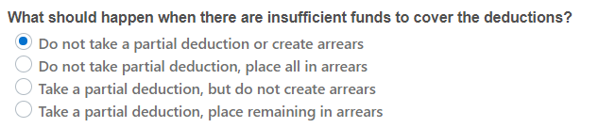
Oracle HCM | Fast Formula | Concepts
Arrears
Term when a person owes money to the company
Depending on the element setup, when Earnings < Deductions:
When “place in arrears” – the remaining deductions will be fed to an Arrear Balance which will then be used in the next payroll process
Logic in CALCULATOR formula

Slide 10
Oracle HCM | Payroll
Payroll Terms: Stop Rule

Slide 11

Oracle HCM | Fast Formula | Concepts
Stop Entry
Deduction elements can be configured as Recurring
And can be configured to stop deduction when a specific amount is reached
Logic in CALCULATOR formula

Slide 12
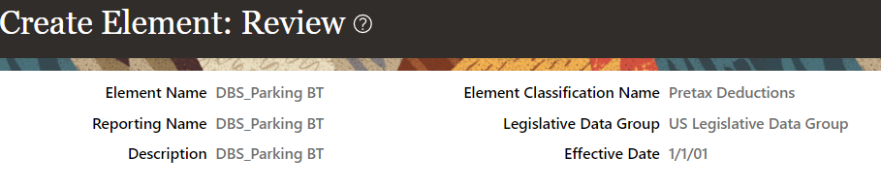
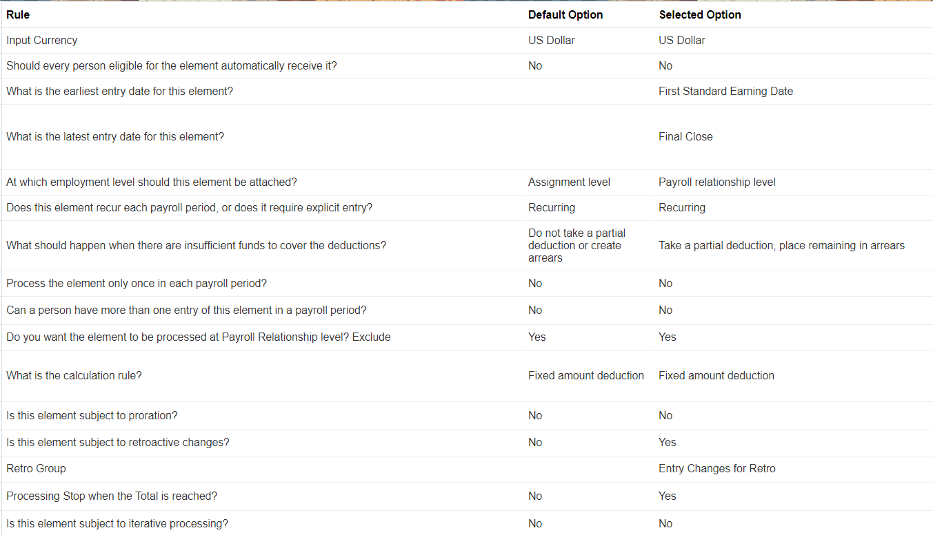
Oracle HCM | Fast Formula | Concepts
Sample Element
with
Total
Owed

Slide 13

Oracle HCM | Payroll | Fast Formula
Activity 3.1 - Calculate retro process
Notes:
Kahoot

Slide 14
Oracle HCM | Payroll | Fast Formula
Activity 3.2 - Calculate element in arrears
Notes:
Kahoot

Slide 15
Oracle HCM | Payroll | Fast Formula
Activity 3.3 - Calculate elements with Total Owed
Notes:
Kahoot

Slide 16
Oracle HCM | Payroll
References
Back to Summary

Slide 17
Oracle HCM | Fast Formula | References
Security
Benefits Administrator
Benefits Manager
Compensation Administrator
Human Capital Management Application Administrator
Human Resource Specialist
Payroll Manager
Payroll Administrator
Job Roles must inherit the Fast Formula View Duty and/or Fast Formula Management Duty roles.

Slide 18
Oracle HCM | Fast Formula | References
Links
Elements
Understand Payroll Concepts
Retroactive pay
Set up payroll process configuration
Fast Formula User Guide
Using fast formula.pdf
Tables and Views

Slide 19
Thank You

