Slide 1



OTBI/OBIEE Different Views
Presented By: Rio Bunquin
October 27, 2022

Slide 2
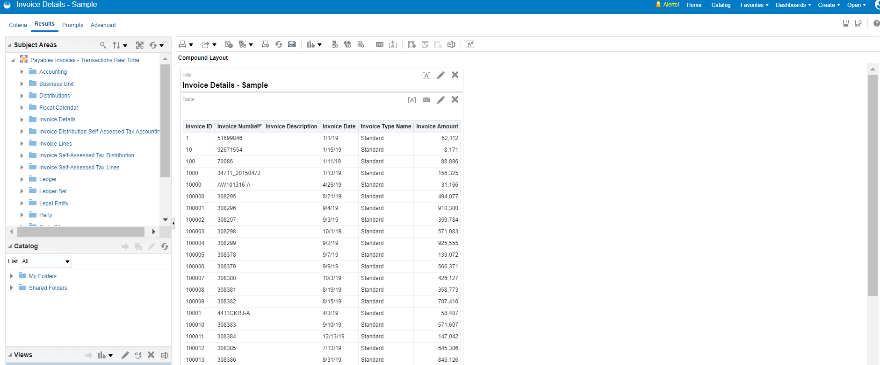
What are Views?
A view is a visual representation of the results of an analysis. Views give you different ways of looking at your data to help you discover patterns, trends, outliers, and other interesting characteristics

Slide 3
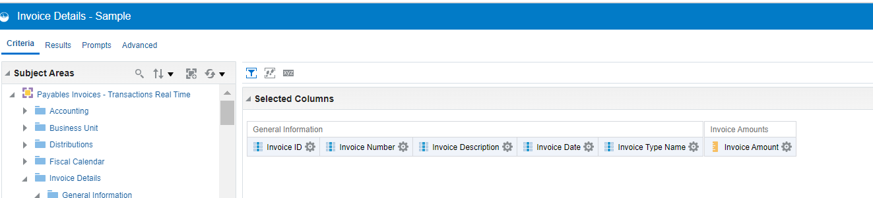
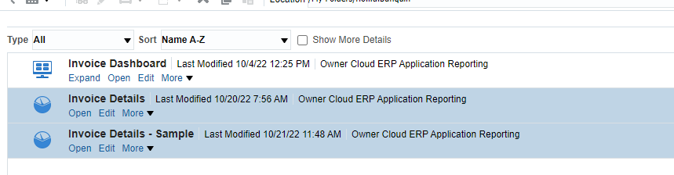
What are Analysis?
An analysis is a query against your organization's data that provides you with answers to business questions. Analyses enable you to explore and interact with information visually in tables, graphs, pivot tables, and other data views. You can also save, organize, and share the results of analyses with others.

Slide 4
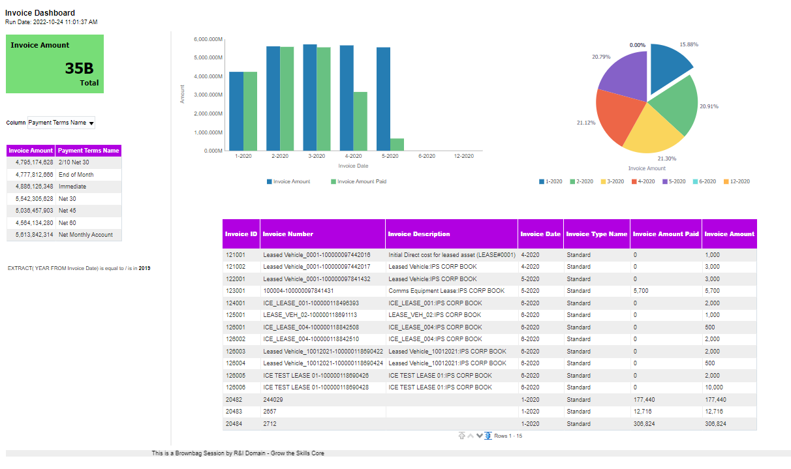

Slide 5
Title

Slide 6
Static Text

Slide 7
Performance Tile

Slide 8
Table

Slide 9
Bar Graph

Slide 10
Pie Chart

Slide 11
Narrative

Slide 12
Filters

Slide 13
Column Selector

Slide 14
Ticker

Slide 15
Views to be discussed:
Title
Static Text
Performance Tile
Table
Bar Graph
Pie Chart
Narrative
Filters
Column Selector
Ticker

Slide 16
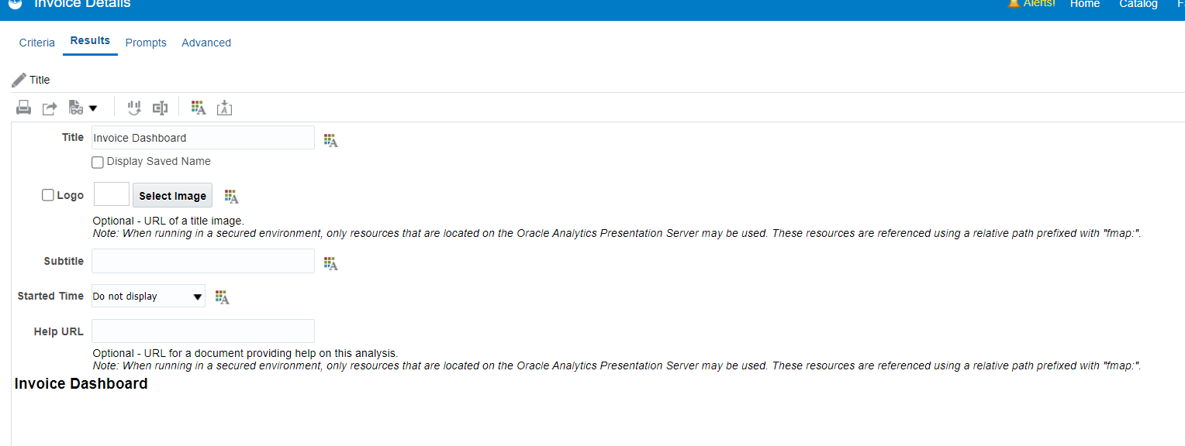
Title
Displays a title, a subtitle, a logo, a link to a custom online help page, and timestamps to the results.

Slide 17
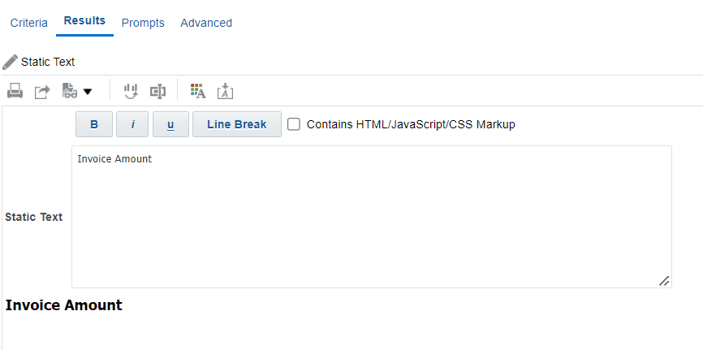
Static Text
Adds static text in the results. You can use HTML to add banners, tickers, ActiveX objects, Java applets, links, instructions, descriptions, graphics, and so on, in the results.

Slide 18
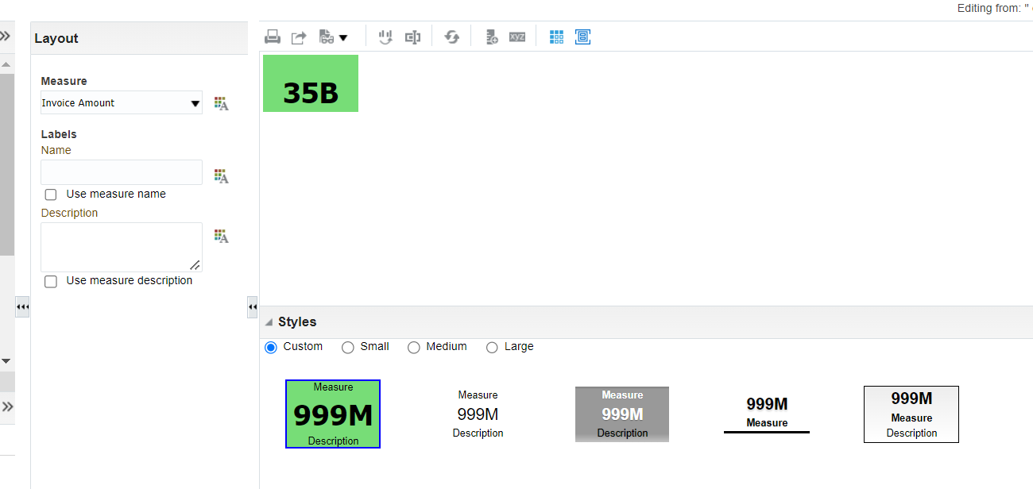
Performance Tile
Displays a single piece of aggregate data. Performance tiles use color, labels, and limited styles to show status and use conditional formatting of the background color or measure value to make the tile visually prominent. For example, if revenue isn’t tracking to target, the revenue value may appear in red.

Slide 19
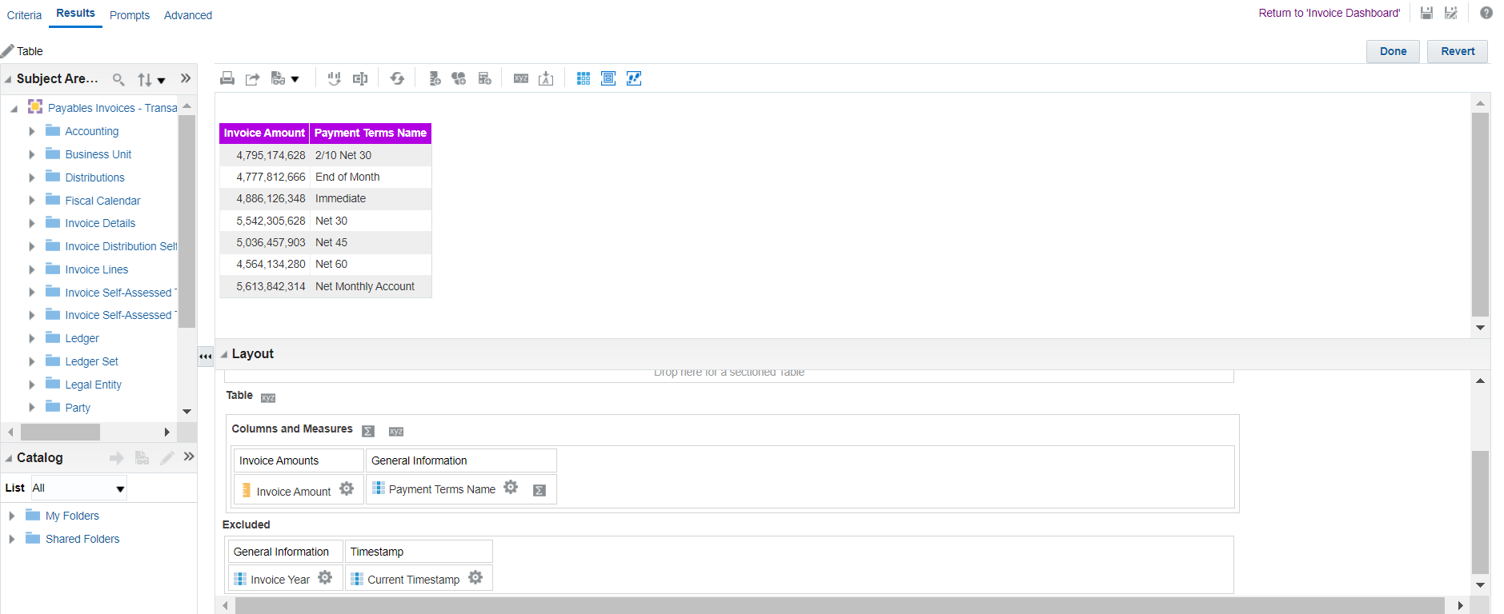
Table
Display data organized by rows and columns. Tables provide a summary view of data and let you see different views of data by dragging and dropping rows and columns.

Slide 20
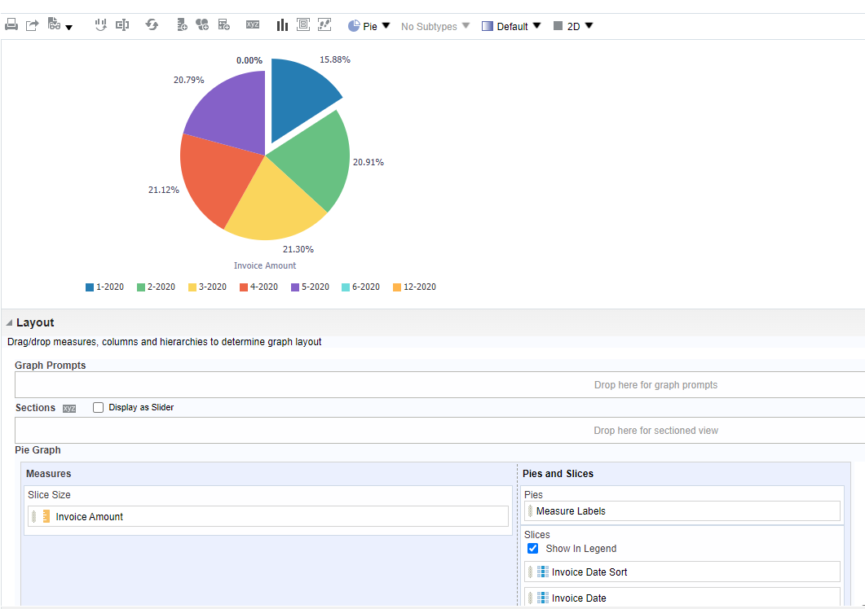
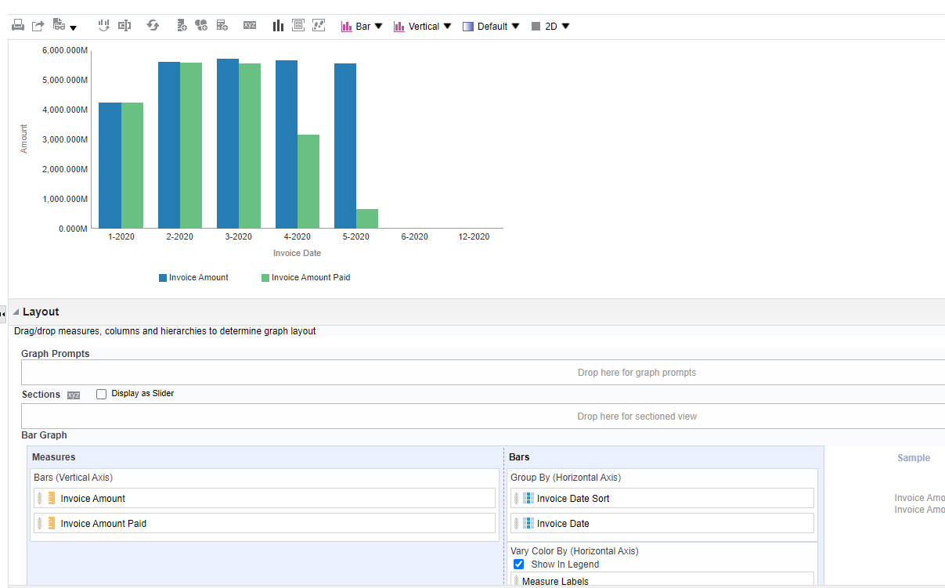
Bar Graph and Pie Chart
Displays numeric information on a background, called the graph canvas.

Slide 21
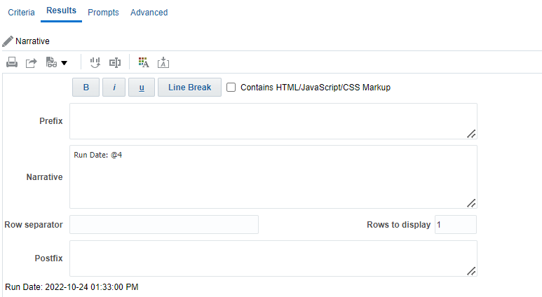
Narrative
Displays the results as one or more paragraphs of text. You can type in a sentence with placeholders for each column in the results and specify how rows should be separated.

Slide 22
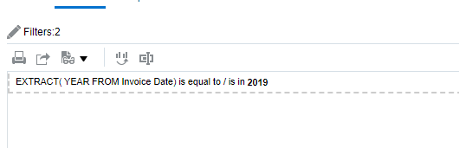
Filters
Displays the filters in effect for an analysis

Slide 23
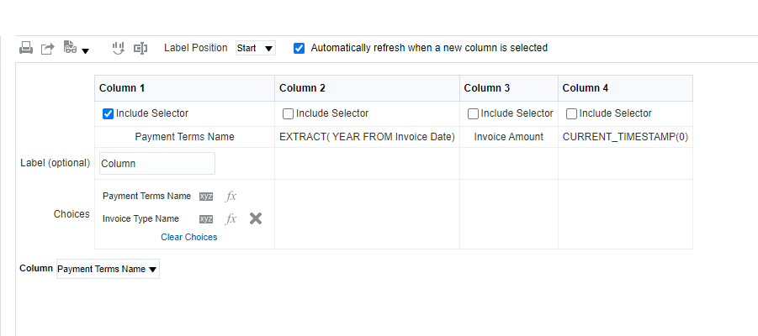
Column Selector
Adds a column selector in the results. A column selector is a set of drop-down lists that contain pre-selected columns. Users can dynamically select columns and change the data that is displayed in the views of the analysis.

Slide 24
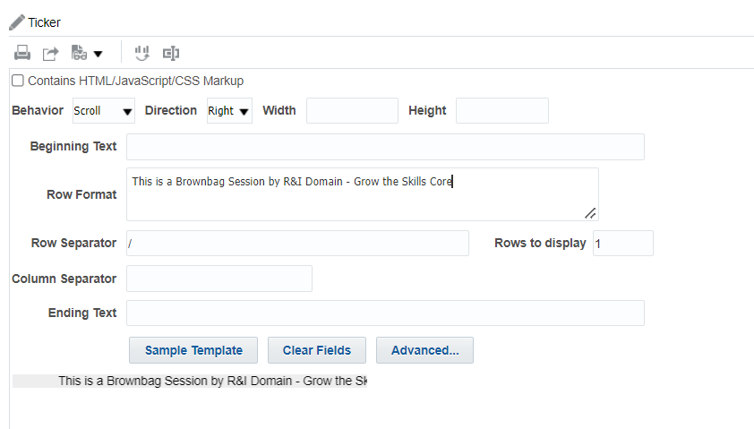
Ticker
Displays the results as a ticker or marquee, similar in style to the stock tickers that run across many financial and news sites on the Internet. You can control what information is presented and how it scrolls across the page.

Slide 25
QUESTIONS?

Slide 26
REFERENCES
Oracle Docs (https://docs.oracle.com/en/cloud/saas/otbi)
Oracle R&I Support Community (https://teams.microsoft.com/l/team/19%3aN5zHHBgzf6V7gP5nSoBwXHjDviCT31EFqT1AV6jWY7M1%40thread.tacv2/conversations?groupId=76bf6248-586a-4638-9925-26f394003399&tenantId=e0793d39-0939-496d-b129-198edd916feb)

