Slide 1
ORACLE HCM CLOUD DATA MODEL

Slide 2
HCM Data Model
01
Intro to HCM
02
Core HR
AGENDA
03
ORC / Talent Acquisition
04
Payroll

Slide 3
CORE HR
Person Information
VS
Employment Information

Slide 4
Person Information vs Employment Information
The following table compares Person Info and Employment Info
Person | Holds personal information such as: Name Date of birth Disability information May also apply to more than one work relationship such as National ID.
Employment | Holds employment information such as: Job Payroll Working Hours This can vary among work relationships and be specific to a legal employer. Note: A person's worker type (for example, employee) is derived from the person's work relationship; it's not part of the person record. A person with multiple work relationships of different types has multiple worker types.

Slide 5
Person Information vs Employment Information
The following table compares Person Info and Employment Info
Person | Employment
Person Address Person Citizenship Person Drivers License Person E-Mail Person Ethnicity Person Legislative Data Person Name Person National Identifier Person Passport Person Phone Person Religion Person Visa | Work Relationship Employment Terms Assignment Assignment Eligible Job Assignment Grade Steps Assignment Supervisor Assignment Work Measure Seniority Hour Working Hour Pattern Assignment Extra Information

Slide 6
Person Information vs Employment Information
The following table compares Person Info and Employment Info
Person | Employment
Person Address Person Citizenship Person Drivers License Person E-Mail Person Ethnicity Person Legislative Data Person Name Person National Identifier Person Passport Person Phone Person Religion Person Visa | Work Relationship Employment Terms Assignment Assignment Eligible Job Assignment Extra Information Assignment Grade Steps Assignment Supervisor Assignment Work Measure Seniority Hour Working Hour Pattern Assignment Extra Information

Slide 7
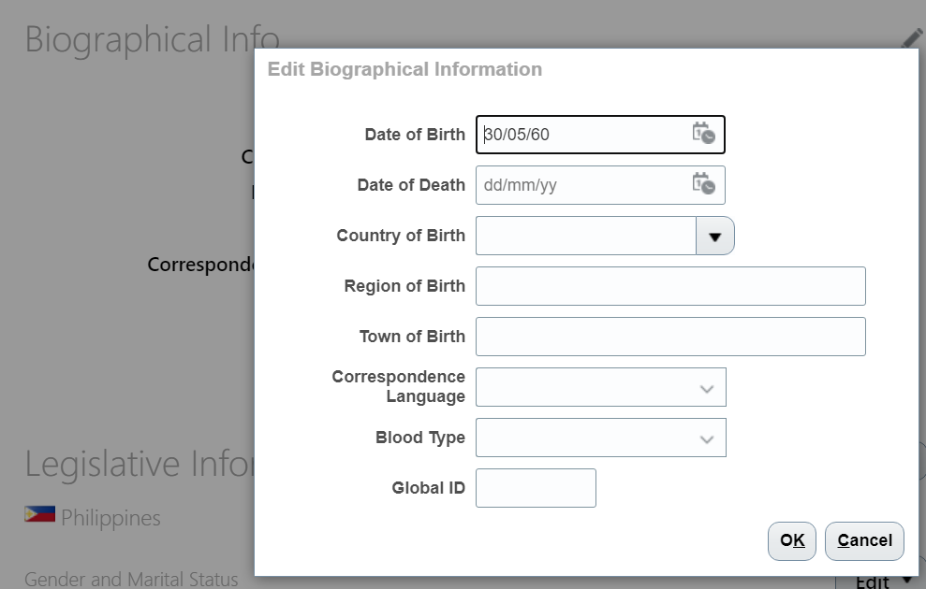
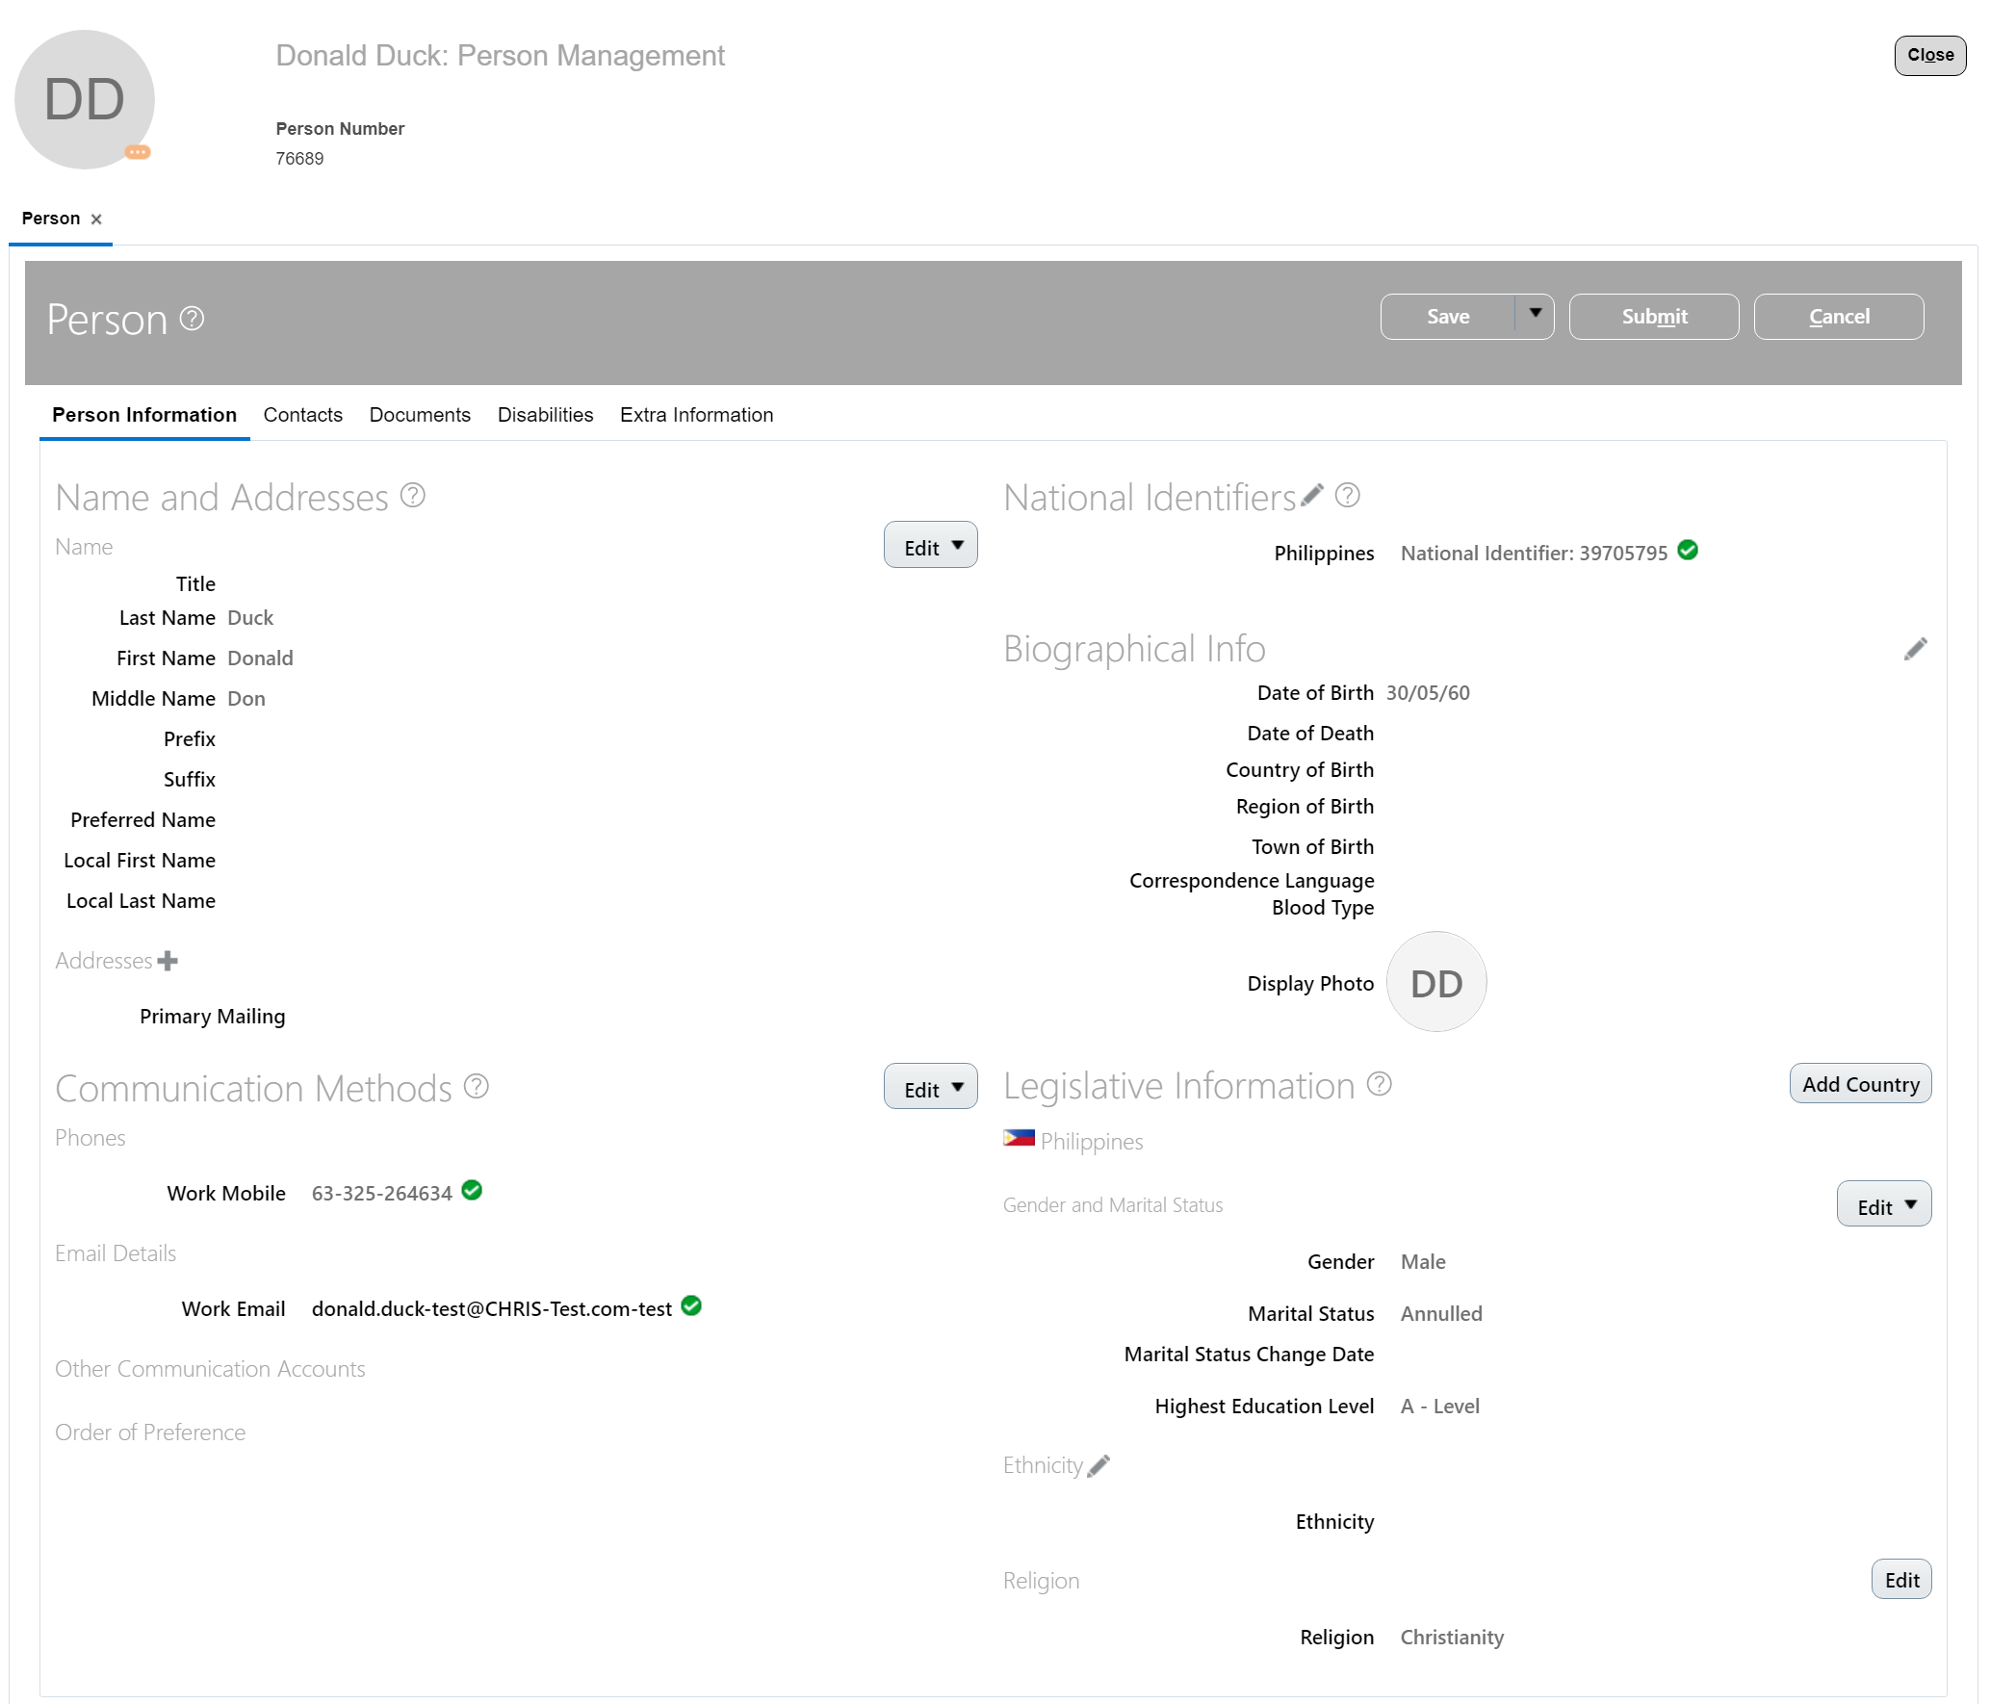
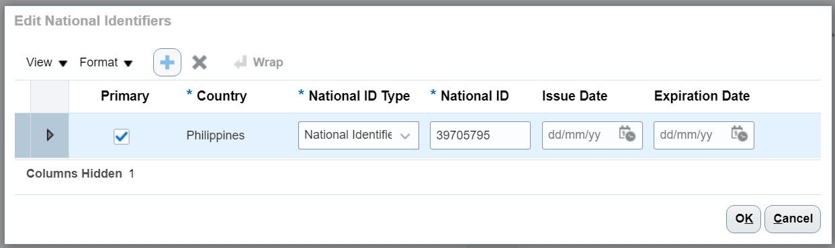
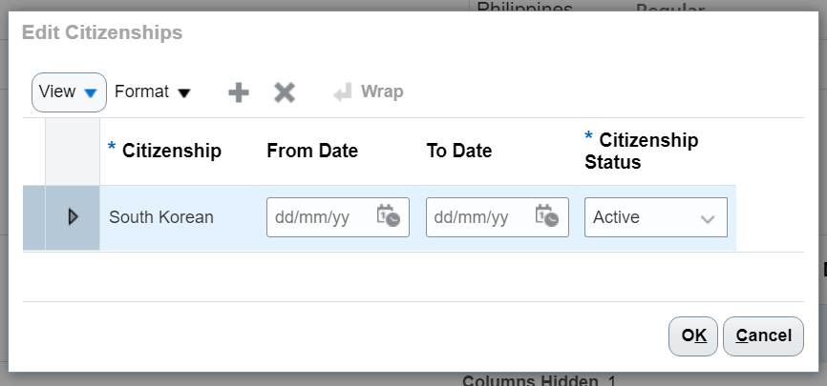
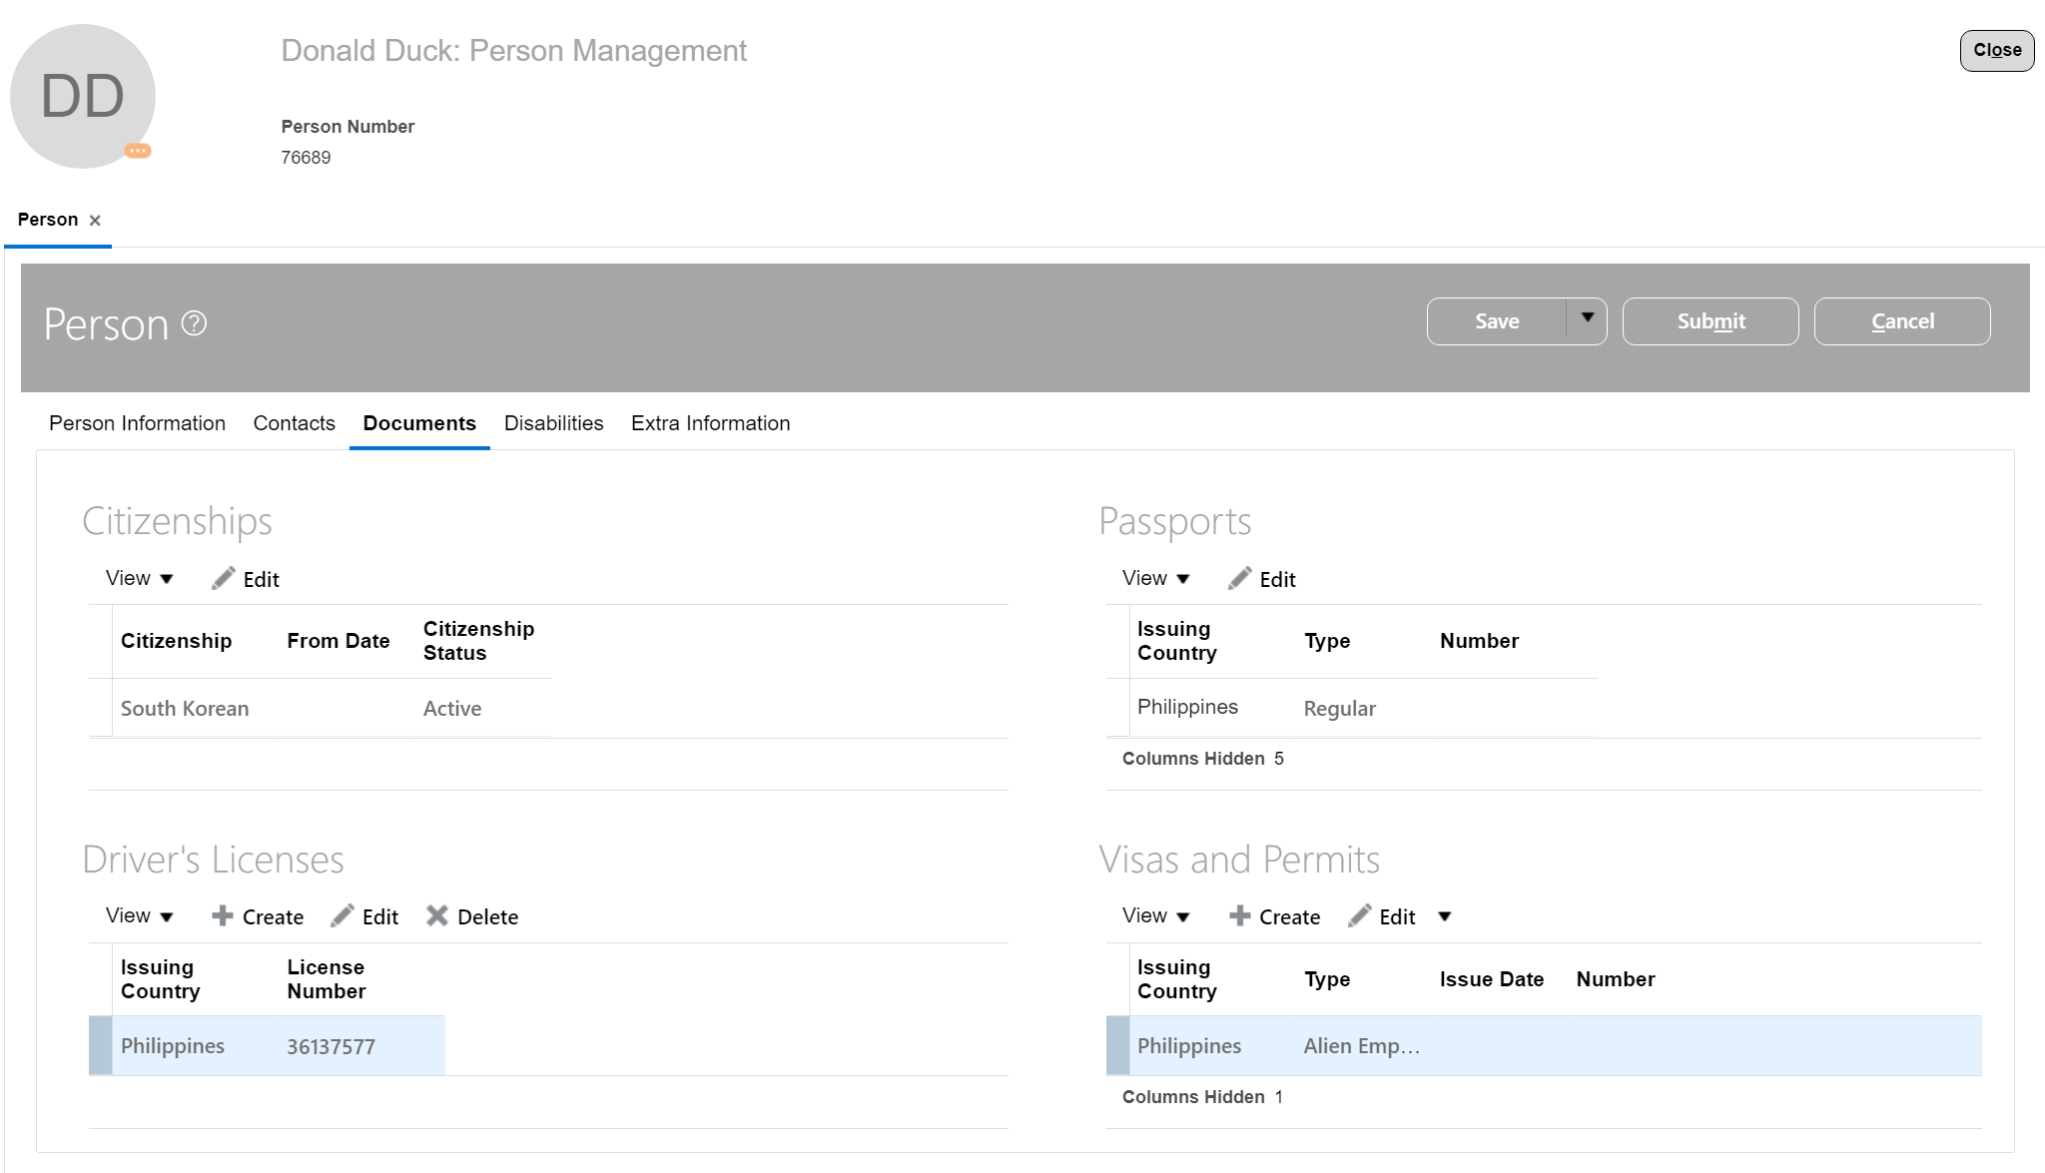
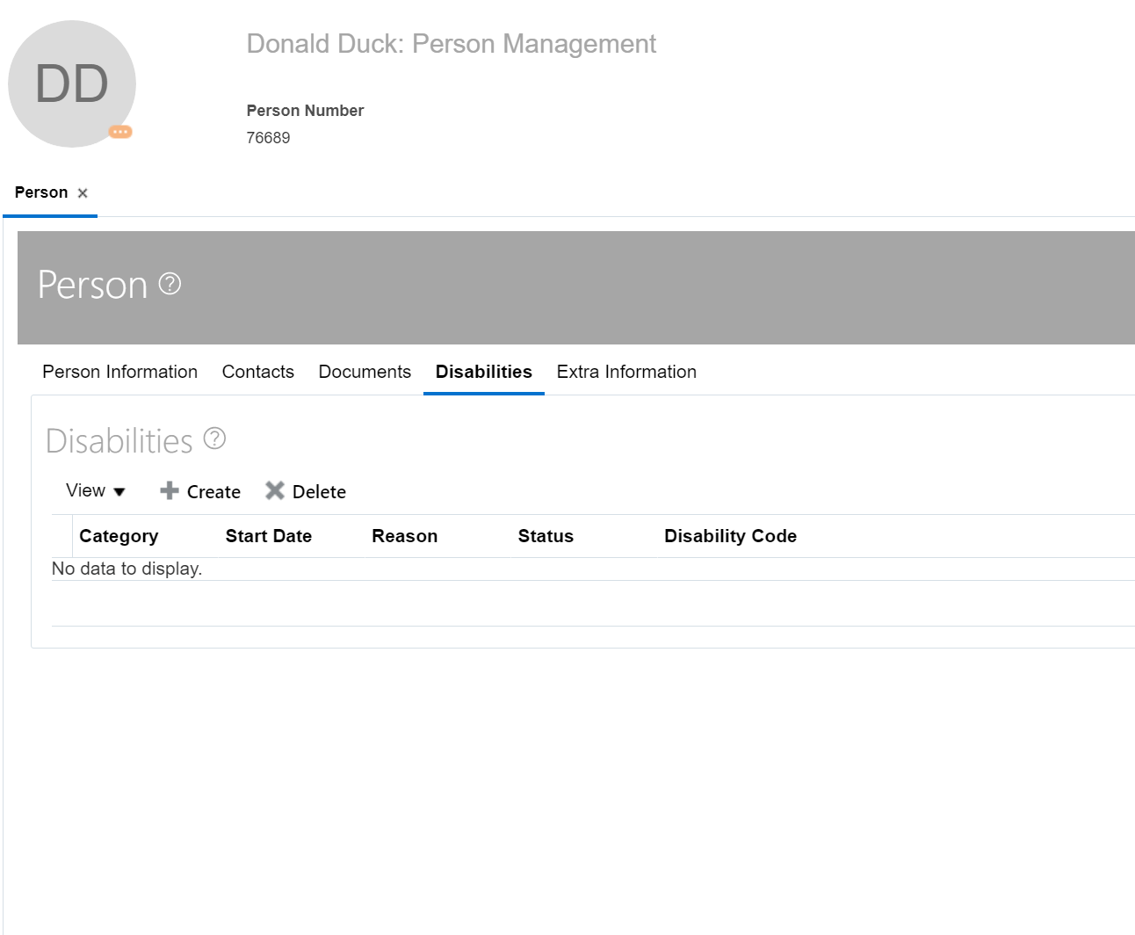
Person Data – Front End (Classic UI)
All workers, nonworkers, and contacts have a single person record in the enterprise identified by a person number.
Home > My Client Groups > Person Management > Person

Slide 8
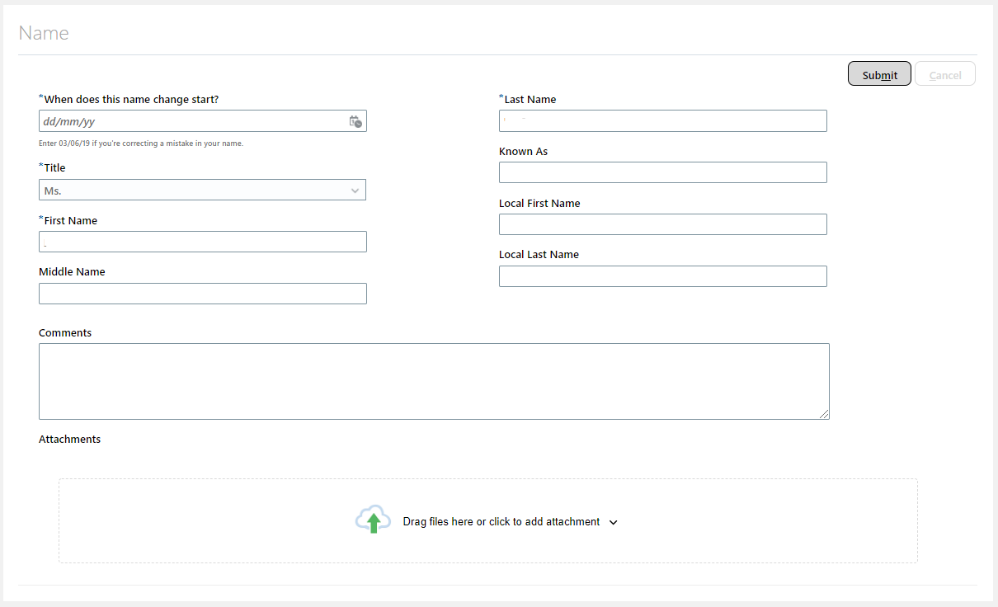
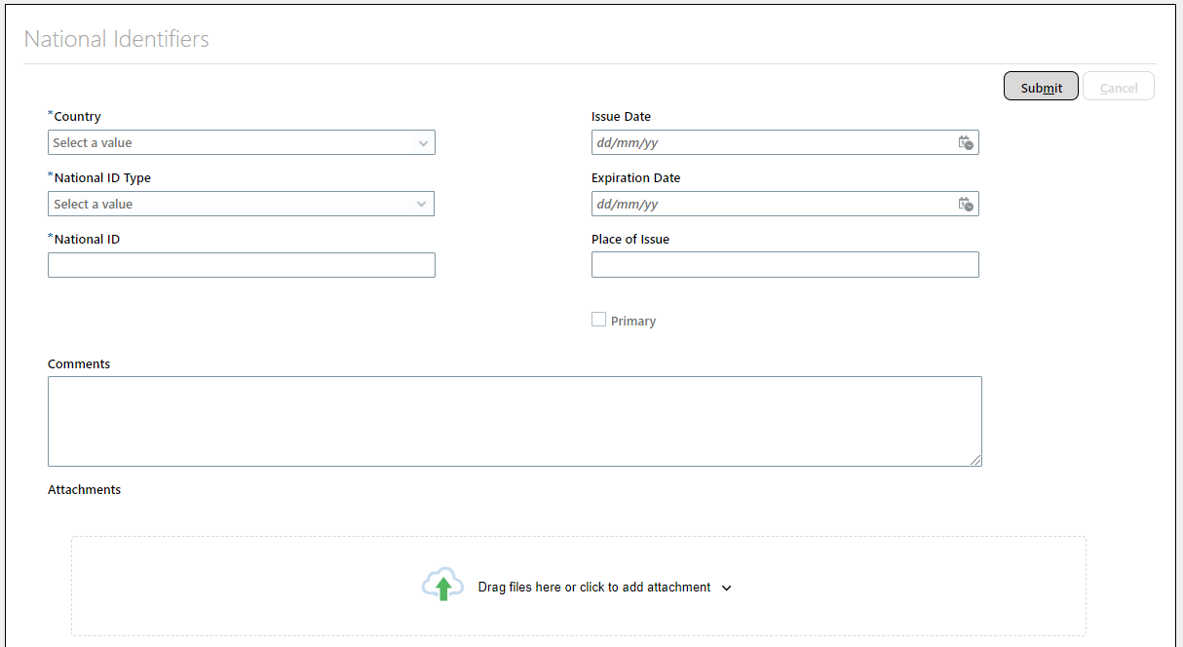
Person Data – Front End (Responsive UI)
• Home > My Client Groups > Personal Details
Person Name
Person National Identifier

Slide 9
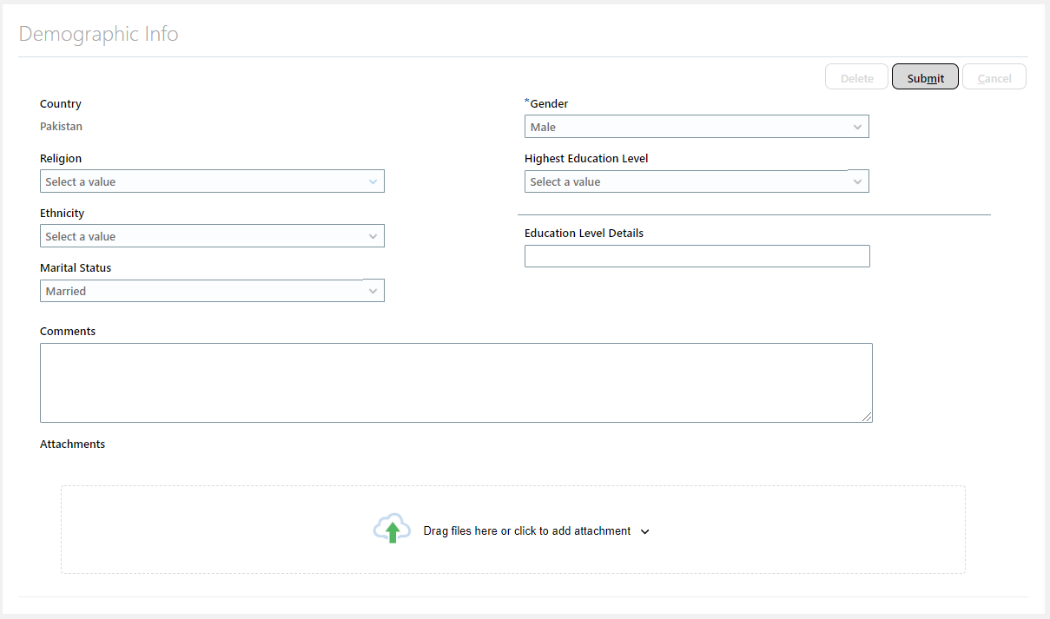
Person Data – Front End (Responsive UI)
• Home > My Client Groups > Personal Details
Person Ethnicity, Person Legislative Data, Person Religion

Slide 10
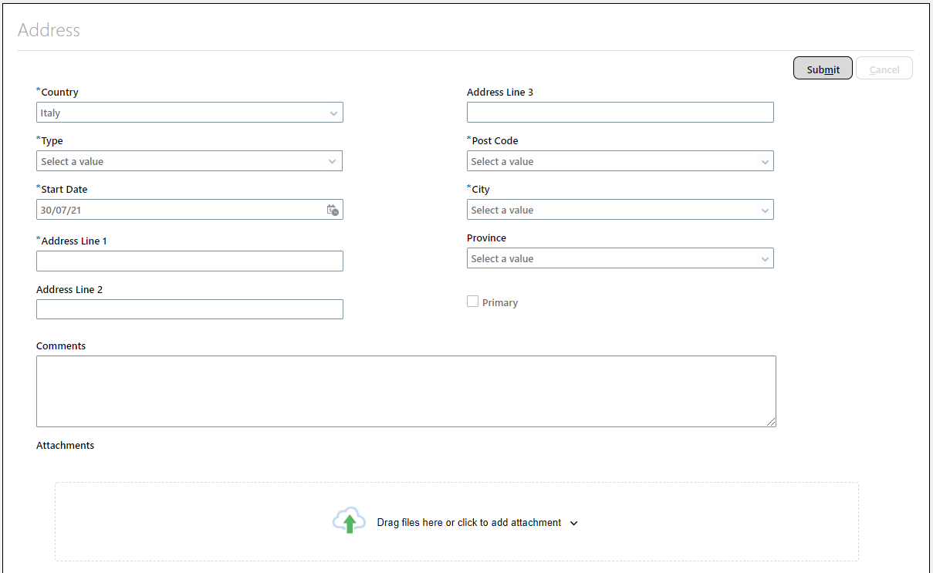
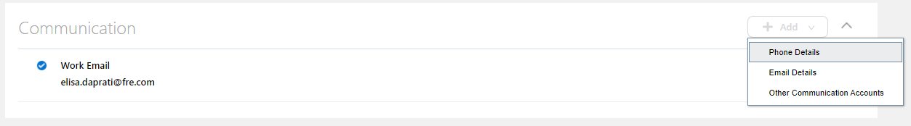
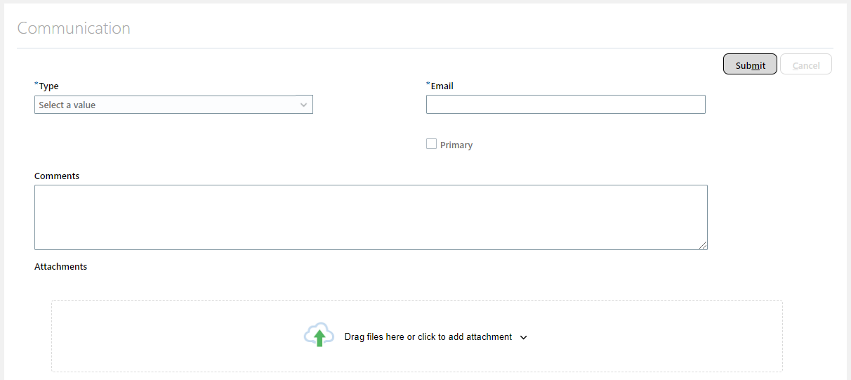
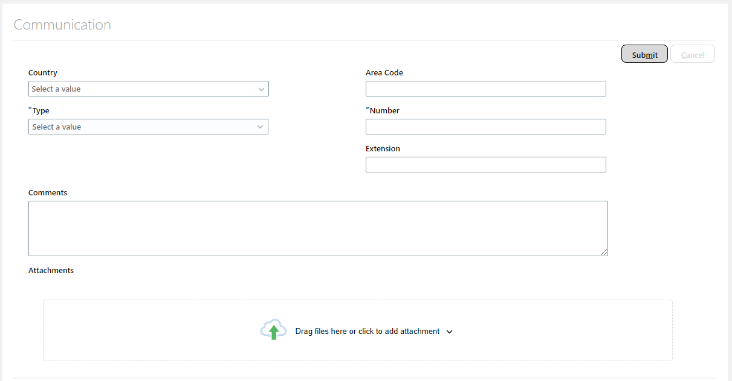
Person Data – Front End (Responsive UI)
• Home > My Client Groups > Contact Info
Person Address
Person E-Mail, Person Phone

Slide 11
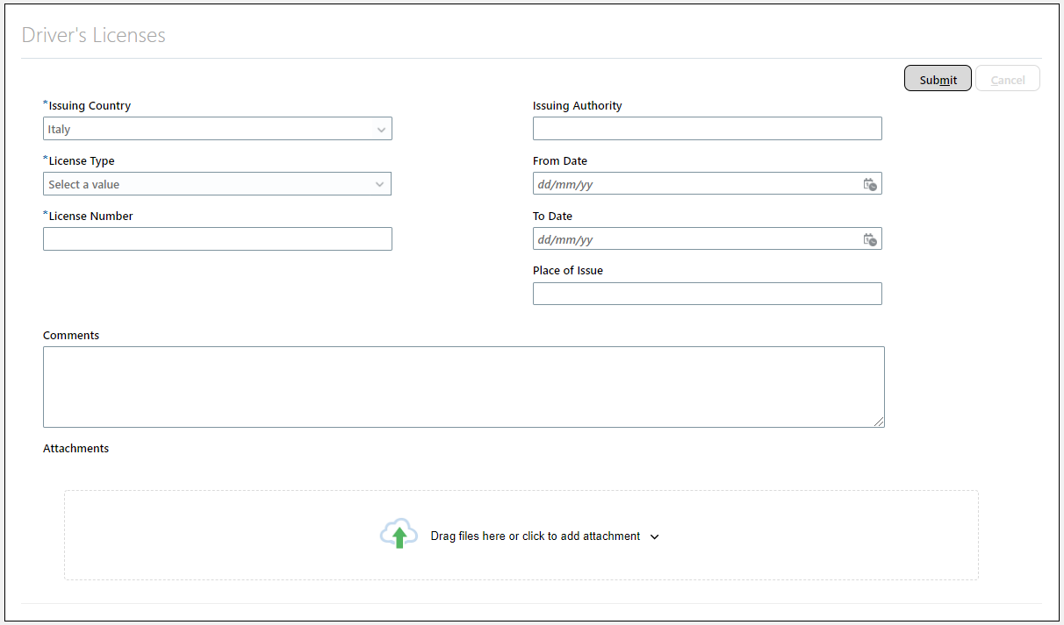
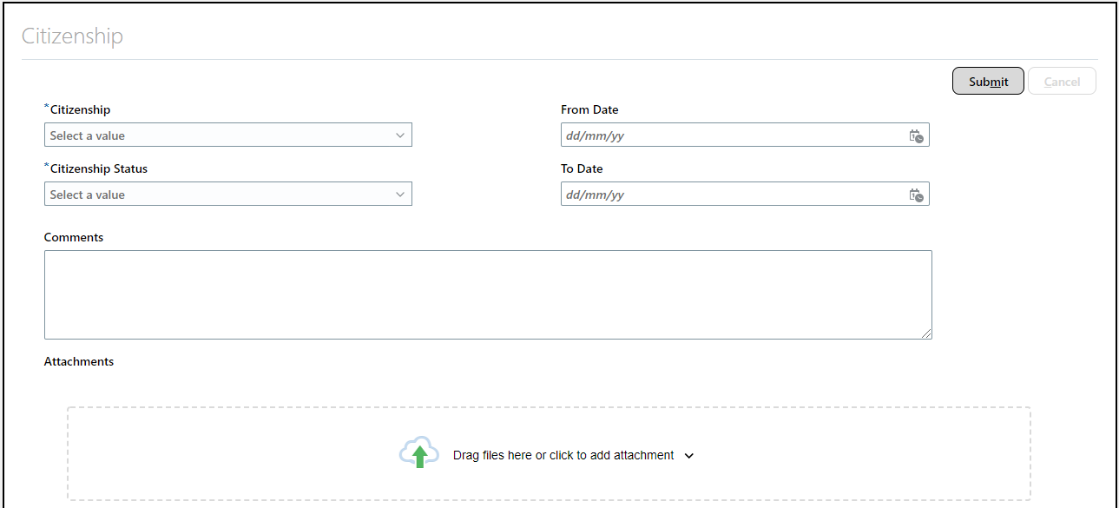
Person Data – Front End (Responsive UI)
• Home > My Client Groups > Identification Info
Person Driver’s License
Person Citizenship

Slide 12
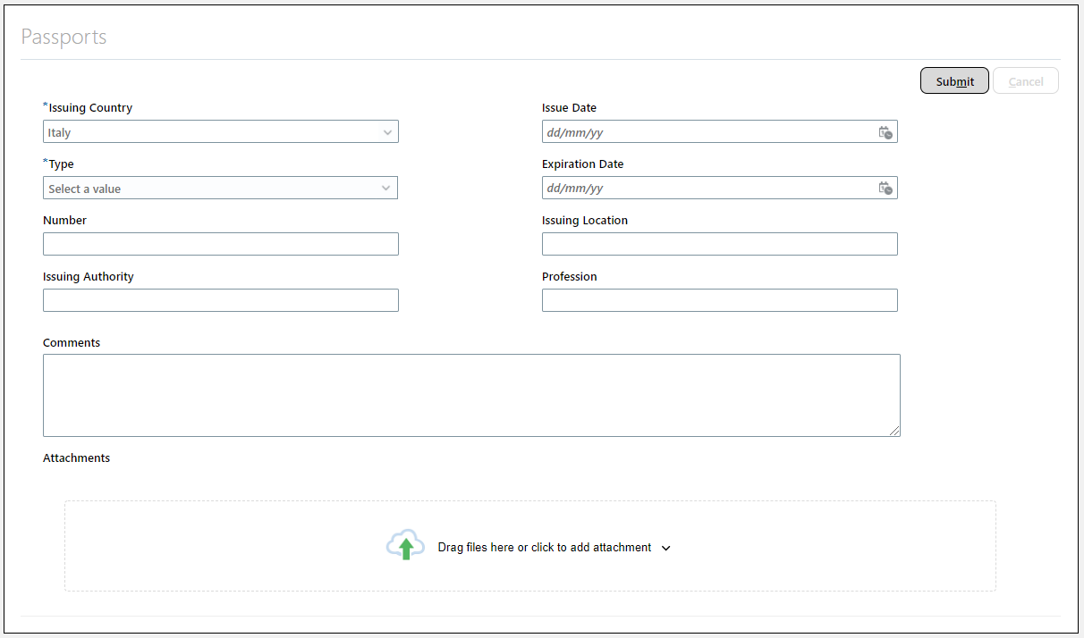
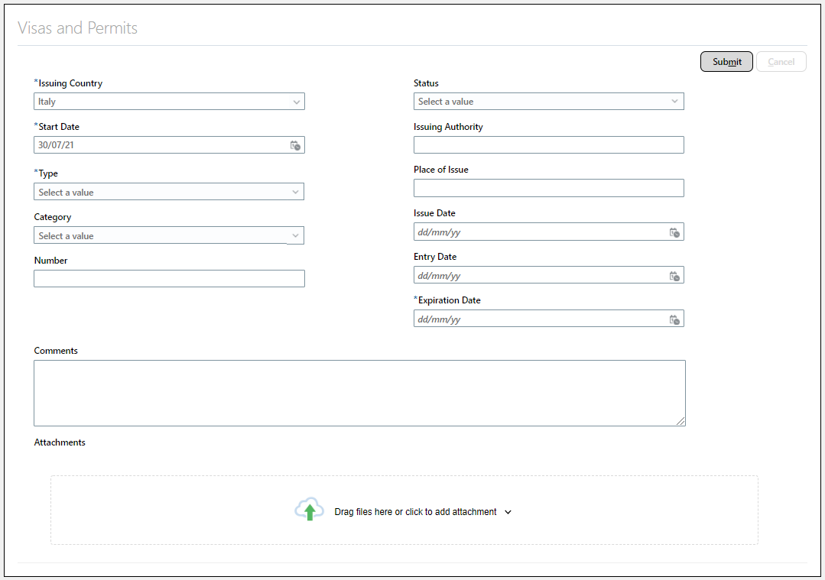
Person Data – Front End (Responsive UI)
• Home > My Client Groups > Identification Info
Person Passport
Person Visa

Slide 13
Person Data
WALKTHROUGH ONLINE

Slide 14
Person Data – ERD (Data Model)
Fusion person model is designed to separate local attributes from global attributes. In eBusiness Suite, person details – name, national identifier, gender, ethnicity etc. are stored in one table, while in Fusion, it is stored in normalized set of tables.

Slide 15
Person Data
COMMONLY USED TABLES and USER ENTITIES
Person Records | Tables | User Entities
Person Address Person Citizenship Person Drivers License Person E-Mail Person Ethnicity Person Legislative Data Person Name Person National Identifier Person Passport Person Phone Person Religion Person Visa | per_all_people_F PER_PERSONS PER_ADDRESSES_F per_citizenships PER_DRIVERS_LICENSES per_email_addresses PER_ETHNICITIES PER_PEOPLE_LEGISLATIVE_F PER_PERSON_NAMES_F PER_NATIONAL_IDENTIFIERS per_passports PER_PHONES per_religions per_visas_permits_f | PER_PER_PEOPLE_HISTORY_UE PER_EXT_SEC_PERSON_UE PER_EXT_PERSON_ADDRESSES_UE PER_EXT_CITIZENSHIPS_UE PER_PER_DRIVERS_LICENSE_TYPES_UE PER_PER_EMAIL_ADDRESSES_UE PER_PER_ETHNICITIES_ALL_UE PER_EXT_PER_ALL_LEGISLATIVE_DETAILS_UE PER_EXT_HISTORY_PERSON_NAMES_UE PER_EXT_NATIONAL_IDENTIFIERS_UE PER_EXT_PASSPORT_UE PER_EXT_ALL_PHONES_UE PER_EXT_RELIGION_UE PER_EXT_VISA_PERMITS_UE

Slide 16
Person Data
Additional Concepts
Concept
Person Number vs Person Id | Number Front End vs Number Back End
Dated vs Date-Effective | From Date vs Effective Start Date End Date vs Effective End Date
Legislative Information | Legislation Code
Look-Up Values | Code vs. Description

Slide 17
Person Data
EXERCISE #1
Client XYZ wanted to have a report readily available that will show all employees who has valid passport. The report will need to contain the following details.
Name (First Name, Middle Name, Last Name)
Passport Information (Issuing Country, Passport Number, Issue Date and Expiration Date)
Primary Address Information (Address Line 1, City, Region 1, Postal Code, Country Description)
Primary Phone Information (Country Code, Area Code, Phone Number)
Work Email (Email Address)
NOTES:
Latest and current data for all data set.
Include in the report the person number for unique identification.
Ensure to still show the employees even if the employees does not have data for Address, Phone or Email.

Slide 18
Person Information vs Employment Information
The following table compares Person Info and Employment Info
Person | Employment
Person Address Person Citizenship Person Drivers License Person E-Mail Person Ethnicity Person Legislative Data Person Name Person National Identifier Person Passport Person Phone Person Religion Person Visa | Work Relationship Employment Terms Assignment Assignment Eligible Job Assignment Grade Steps Assignment Supervisor Assignment Work Measure Seniority Hour Working Hour Pattern Assignment Extra Information

Slide 19
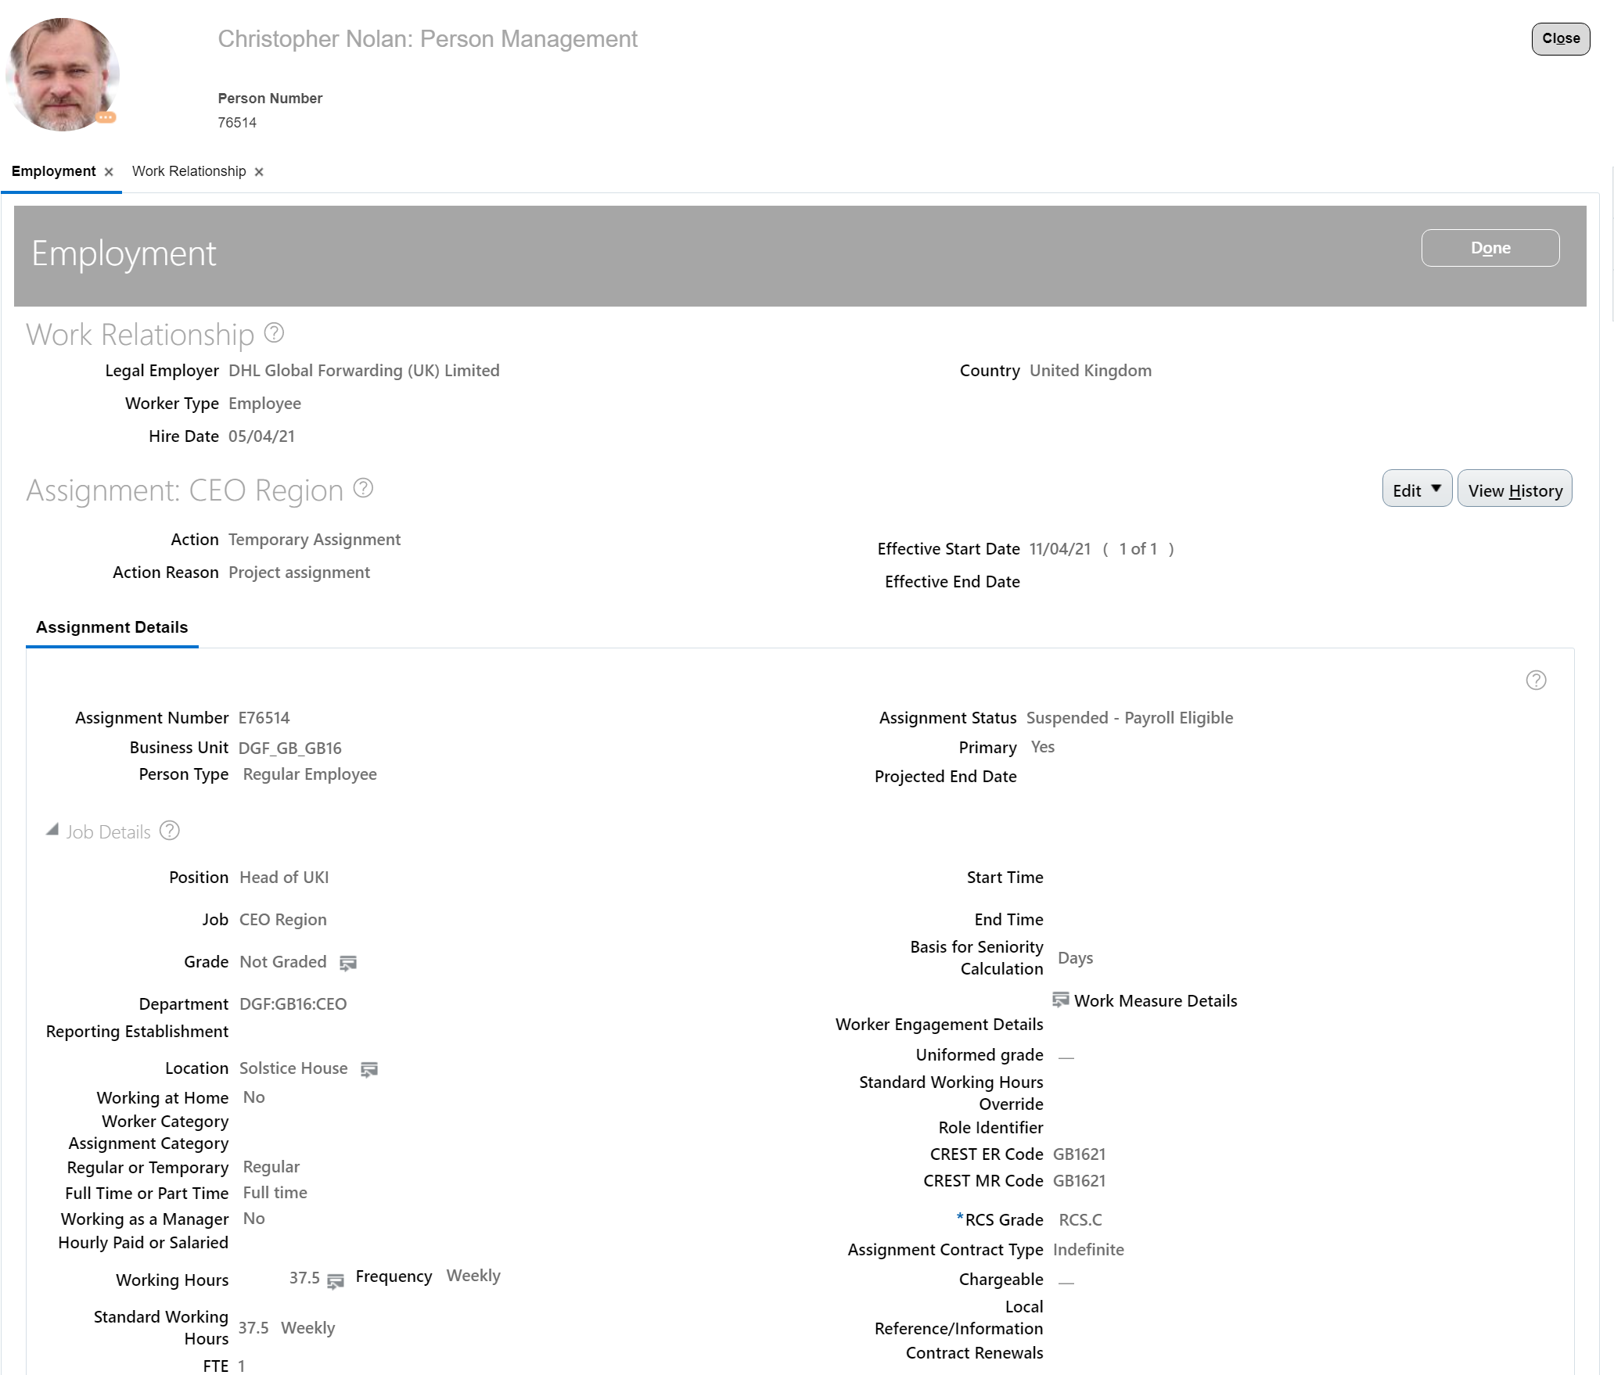
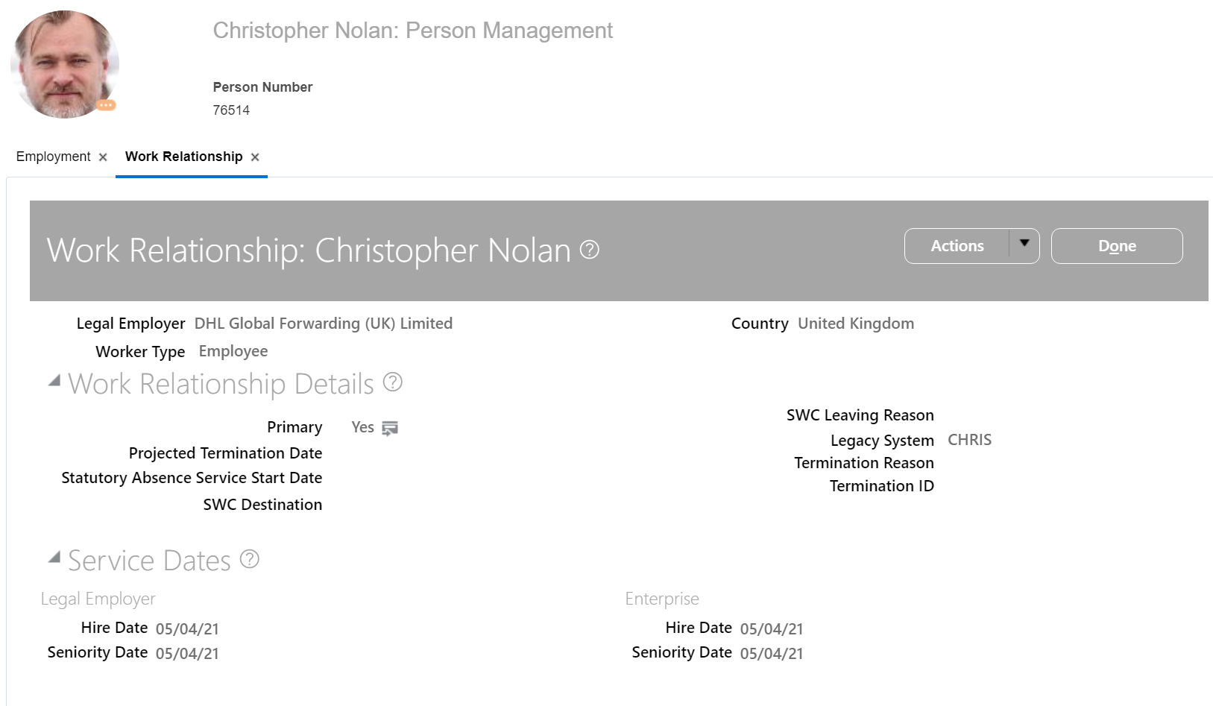
Employment Information – Front End (Classic UI)
The employment model comprises two types of entities, which are work relationships and assignments
A work relationship defines how a person and legal employer are related.
An assignment provides information about a person's role such as job, position, pay, compensation, managers, working hours, and location.
Home > My Client Groups > Work Relationship
Home > My Client Groups > Employment

Slide 20
Employment Information – Front End (Resp UI)
• Home > My Client Groups > Employment Info

Slide 21
Employment Information
WALKTHROUGH ONLINE

Slide 22
Employment Information– ERD (Data Model)
The employment model comprises two types of entities, which are work relationships and assignments
A work relationship defines how a person and legal employer are related.
An assignment provides information about a person's role such as job, position, pay, compensation, managers, working hours, and location.

Slide 23
Employment Information
COMMONLY USED TABLES and USER ENTITIES
Employment Data Record | Tables | User Entities
Work Relationship Employment Terms Assignment Assignment Supervisor Assignment Work Measure Seniority Hour Working Hour Pattern Assignment Extra Information | PER_PERIODS_OF_SERVICE PER_ALL_ASSIGNMENTS_M PER_ASSIGNMENT_SUPERVISORS_F PER_ASSIGN_WORK_MEASURES_F PER_SENIORITY_DATE PER_WORKING_HOUR_PATTERNS_F PER_ASSIGNMENT_EXTRA_INFO_M | PER_EXT_WORK_RELATIONSHIP_ALL_UE PER_EXT_SEC_ASSIGNMENT_UE PER_EXT_HIST_ASG_SUPERVISORS_UE PER_EXT_WORK_MEASURES_UE PER_PER_SENIORITY_DATES_UE PER_ASG_WORKING_HOUR_PATTERNS_UE PER_ASSIGNMENT_EIT_ALL_CONTEXT_UE

Slide 24
Employment Information
Additional Concepts
Concept
Workforce Structure | Enterprise Structure (e.g. Department, Divisions, Location etc…)
Primary Work Relationship & Primary Assignment | A person can have only one primary work relationship. All other work relationships are nonprimary.
Dated vs Date-Effective | From Date vs Effective Start Date End Date vs Effective End Date
Effective Sequence | Effective Latest Change = Y
Assignment Number vs Assignment Id | Number Front End vs Number Back End
Legislative Information | Legislation Code
Look-Up Values | Code vs. Description

Slide 25
Employment Information
EXERCISE #2
HR want to have an inventory of all its employee in all of it Legal Employers of the Company.
Name (First Name, Last Name)
Primary Work Relationship and
[Legal Employer Name], Hire Date, Primary Flag
Primary Active Assignment
Primary Flag, [Department Name], Job Name, Grade Name, Location Name, FTE count
NOTES:
Latest and current data for all data set.
Include in the report the person number for unique identification.
[Ensure to still show the employees even if the employees does not have data for Department/Job/Grade/Location/FTE]

Slide 26
WORKFORCE STRUCTURE
COMMONLY USED TABLES and USER ENTITIES
Workforce Data Record | Tables | User Entities
Position | HR_ALL_POSITIONS_F_TL | PER_POS_POSITION_HISTORY_UE
Departments | HR_ALL_ORGANIZATION_UNITS_F hr_organization_units_f_tl | PER_EXT_SEC_HISTORY_ORGANIZATION_UE
Locations | hr_locations_all_f_vl | PER_EXT_SEC_LOCATION_UE
Jobs | per_jobs_f_vl | PER_EXT_SEC_JOB_UE
Grades | PER_GRADES_F | PER_EXT_SEC_GRADE_UE

Slide 27
Tips and Best Practices
Tips and Best Practices
PER_ASSIGNMENT_F.JKOB_ID PER_ASSIGNMENT_F.LOCATION_ID PER_ASSIGNMENT_F.POSITION_ID
hr_locations_all_f_vl.LOCATION_ID = PER_ASSIGNMENT_F.LOCATION_ID
hr_locations_all_f_vl.COUNTRY hr_locations_all_f_vl.POSTAL_ID

Slide 28
LINKS
Tips and Best Practices
CLOUD DEVELOPER PORTAL
https://docs.oracle.com/en/cloud/saas/human-resources/21c/fawhr/employment-information.html#FAWHR48536
https://docs.oracle.com/en/cloud/saas/human-resources/21c/oedmh/overview.html#overview

Slide 29
ORC / Talent Acquisition
Place subtitle here, GT Sectra Fine Rg 24pt

Slide 30
ORC
Place subtitle here 20pt
TBD

Slide 31
PAYROLL
Place subtitle here, GT Sectra Fine Rg 24pt

Slide 32
Payroll
Place subtitle here 20pt
Payroll Action
--> Weekly / Monthly
--> Payroll Relationship - Per Work Relationship
--> Employee Payroll Data
--> Employee Data

Slide 33
Thank You

