Slide 1



Day 2
COMPENSATION FAST FORMULA TRAINING
Speakers:
JP Mendoza Gladys Espeleta Rusty Rodriguez

Slide 2

AGENDA
Commonly used fast formula types
Participation and Rate Eligibility (Simple)
Compensation Default and Override (Simple)
Compensation Hierarchy Determination (Simple)
Testing, Debugging and Best Practices

Slide 3
Compensation Hierarchy Determination
Create a fast formula that determines the compensation hierarchy of a specific user based on person number. User “Edmund Donohue” should have “Christelle Stevenson” as his plan manager.
Person Number = 1010
Plan Manager Person Number = 1007

Slide 4
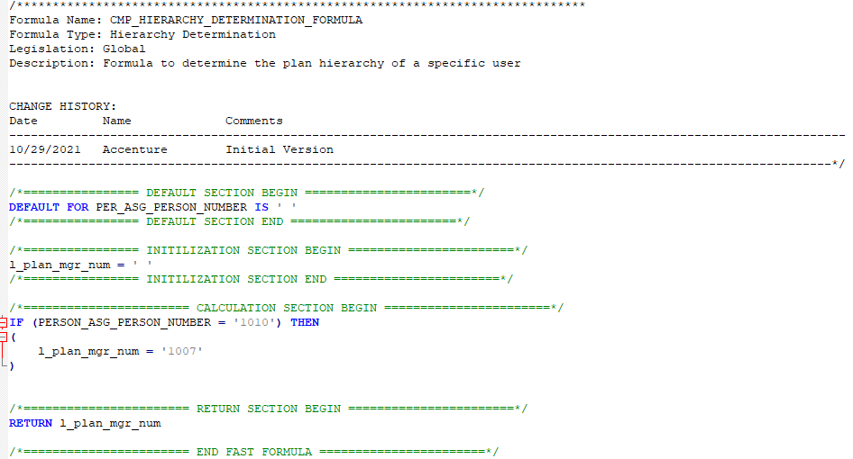

Slide 5
Participation and Rate Eligibility
Create a fast formula that determines the eligibility of the employee based on country, state.
Country = US
State = NY

Slide 6
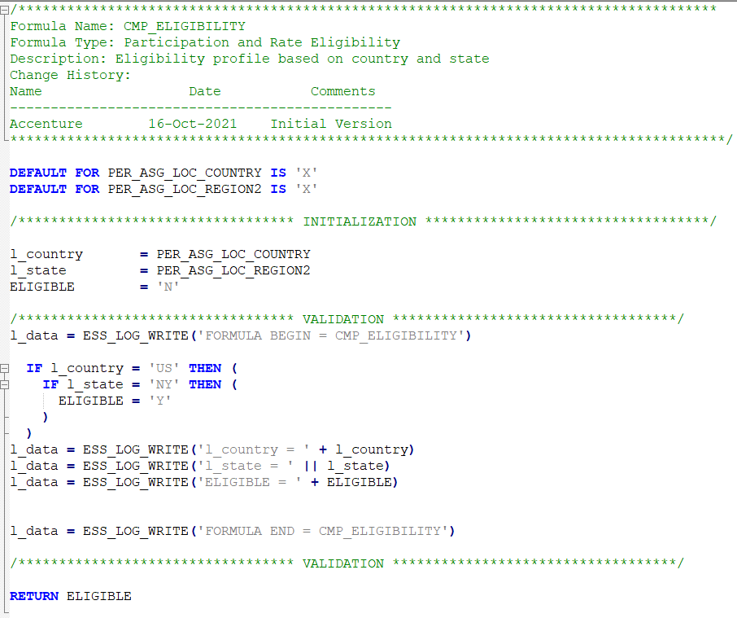

Slide 7
Compensation Default and Override
Used for pulling a data outside the scope of delivered fields in a compensation plan.
Example: Returning a payroll element input value in the compensation worksheet

Slide 8
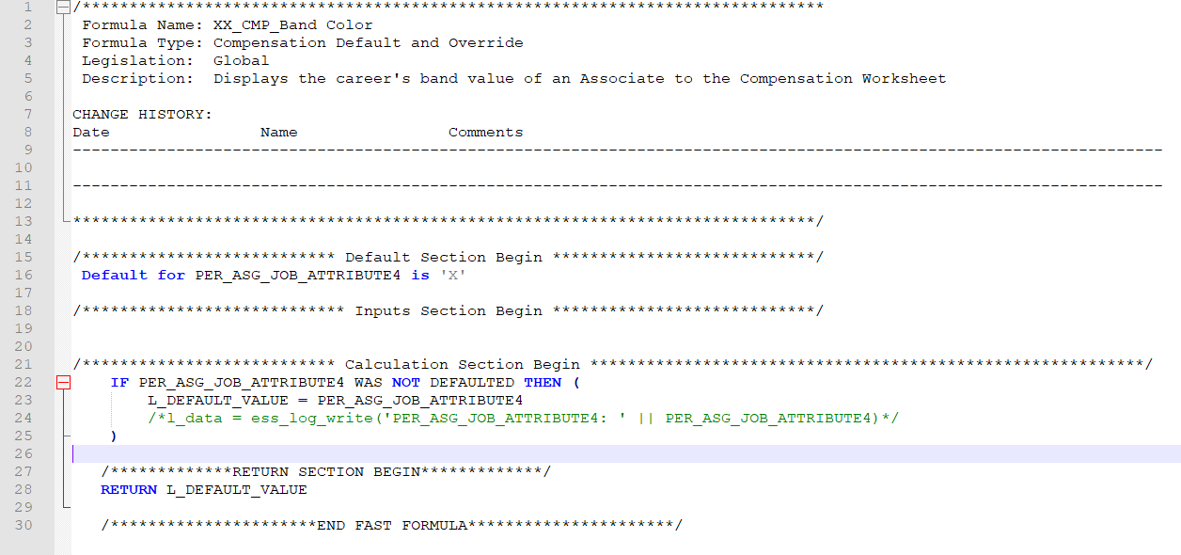

Slide 9
Compensation Hierarchy Determination DEMO
Kindly follow the demo by creating your own formula
FORMAT: <INITIALS>_CMP_HIERARCHY_DETERMINATION
Create a fast formula that determines the compensation hierarchy of a group of users. All users with the job title “Director of IT” should have the “Chief Executive Officer” as their plan manager
Job Code = JOB021
Plan Manager Job Code = JOB030
Test Employee = 779, 757, 1010

Slide 10
Participation and Rate Eligibility
DEMO
Kindly follow the demo by creating your own formula
FORMAT: <INITIALS>_ CMP_ELIGIBILITY
Create a fast formula that determines the eligibility of the employee based on country and state with a city exception.
Country = US
State = NY, CA, IL (except for Chicago)
Test Employees: 1010, 757

Slide 11
Compensation Default and Override DEMO
Kindly follow the demo by creating your own formula
FORMAT: <INITIALS>_ CMP_DEF_OVRRD
Create a fast formula that pulls the job level of an employee.

Slide 12
Testing Hierarchy Determination
1. Go to My Client Groups > Show More > Workforce Compensation Plans
2. Duplicate the “Annual Compensation Plan” and include your initials as a prefix
a. Highlight “Annual Compensation Plan” (Note: Do not click the link)
b. Click the [Duplicate] button
c. New plan name format should be: <INITIALS>_ Annual Compensation Plan
d. Save and Close
3.Click the duplicate compensation plan (<INITIALS>_Annual Compensation Plan)
4.Configure Hierarchies
Source: Formula
Hierarchy Determination Formula: <INITIALS>_CMP_HIERARCHY_ ACTIVITY
Missing Manager Handling: Use primary manager
5.Uncheck “Record missing relationships in batch log files”
6.Click [Save & Close]
7.Go back to My Client Groups > Show More > Run Batch Process
8.Choose “Start Workforce Compensation Cycle”
Plan: <INITIALS>_Annual Compensation Plan
Cycle: 2021 Annual Compensation Review
Status: Open
Individual Person: Search for sample employee (Note: Search by Name)
9. Click [Submit]
10. Click the refresh button until the Status of Start Workforce Compensation Cycle is “Succeeded”
11. Go back to Administer Workers and search for sample employee.
12. Click <INITIALS>_Annual Compensation Plan
13. Go to Status and Hierarchy

Slide 13
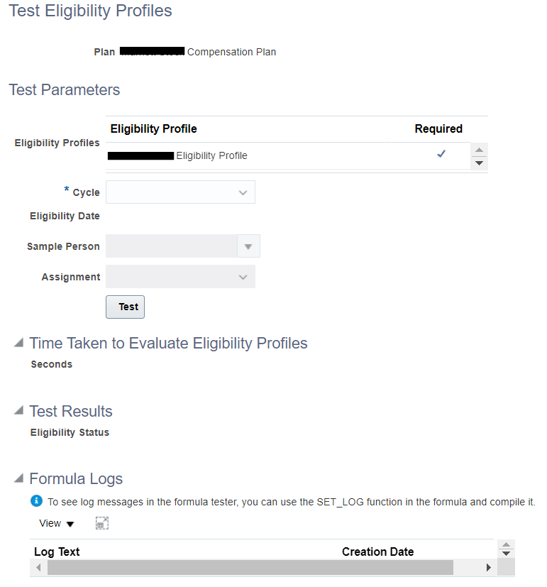
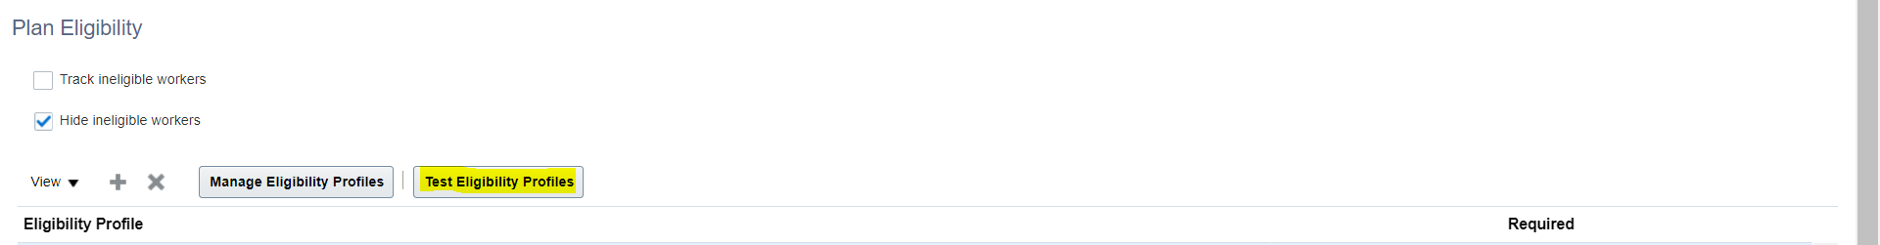
Testing Participation & Rate
Eligibility
Participation and Rate Eligibility
Navigation: My Client Groups > Show More > Compensation > Workforce Compensation Plans > Configure Plan Eligibility

Slide 14
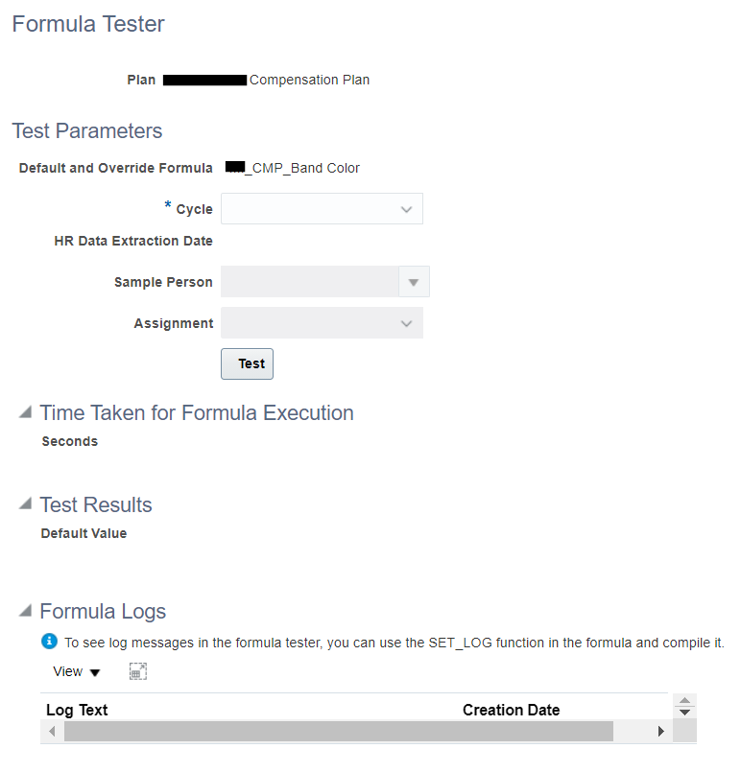
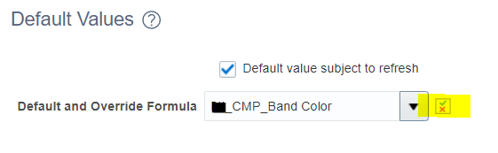
Testing Default & Override
Compensation Default and Override
Navigation: Workforce Compensation Plans > Configure Worksheet Display > Compensation Task Layout > Detail Table > Field Properties: Default Values

Slide 15
Debugging Fast Formulas
Trial and Error on finding the correct DBI
Use Log Writing Function to monitor the results of the fast formula

