Slide 1



Day 3
COMPENSATION FAST FORMULA TRAINING
Speakers:
JP Mendoza Gladys Espeleta Rusty Rodriguez

Slide 2

AGENDA
Commonly used fast formula types
Compensation Hierarchy Determination (Complex)
Participation and Rate Eligibility (Complex)
Compensation Default and Override (Complex)
Q&A

Slide 3
Compensation Hierarchy Determination DEMO
Kindly follow the demo by creating your own formula
FORMAT: <INITIALS>_CMP_HIERARCHY_DETERMINATION_1
Create a fast formula that determines the compensation hierarchy of a group of users. All users with the job title “Director of IT” should have the “Chief Executive Officer” as their plan manager
Job Code = JOB021
Plan Manager Job Code = JOB030
Test Employee = 779, 757, 1010

Slide 4
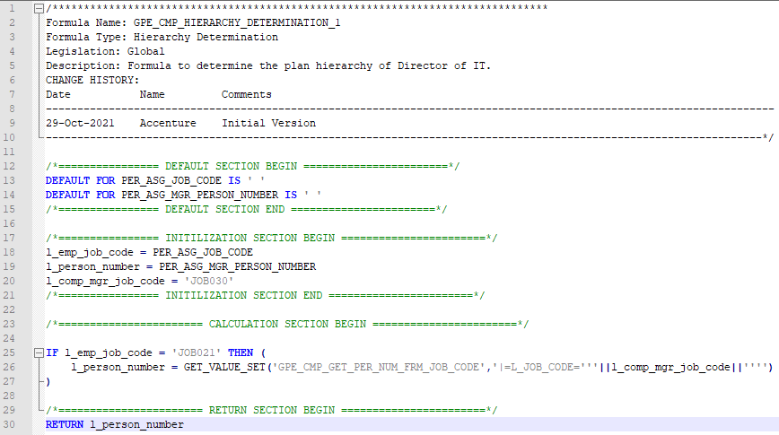
GET_VALUE_SET(‘VALUE_SET_NAME’,’|=PARAMETER=‘’’||PARAM_VALUE||’’’’)

Slide 5
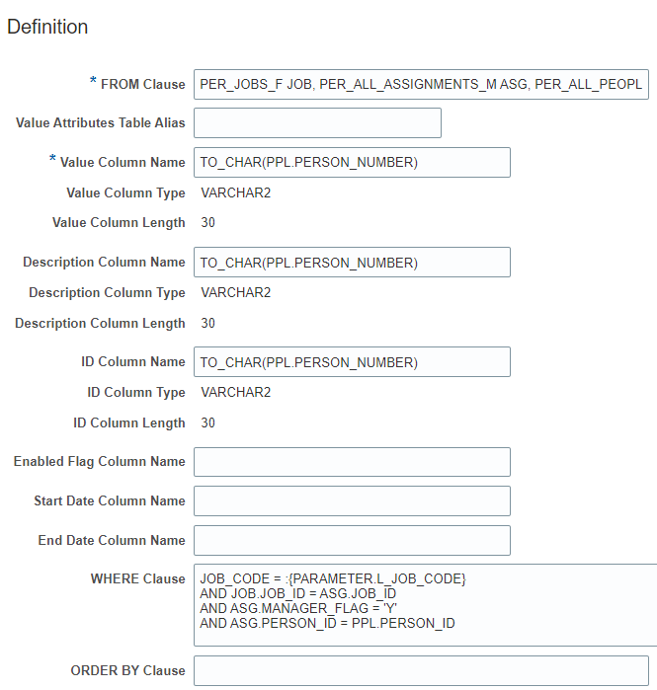
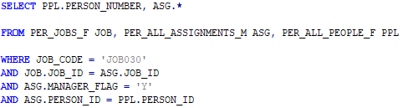
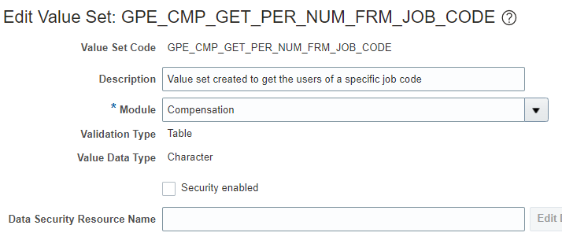
SQL Code
Note: Refer to Oracle Docs for the HCM tables and views
Value Set

Slide 6
Participation and Rate Eligibility
DEMO
Kindly follow the demo by creating your own formula
FORMAT: <INITIALS>_CMP_ELIGIBILITY_1
Create a fast formula that determines the eligibility of the employee based on a User-Defined Table.
Only employees with an overtime rate of 1.5 and above should be eligible to the plan
Test Employees: 775, 285, 1010

Slide 7
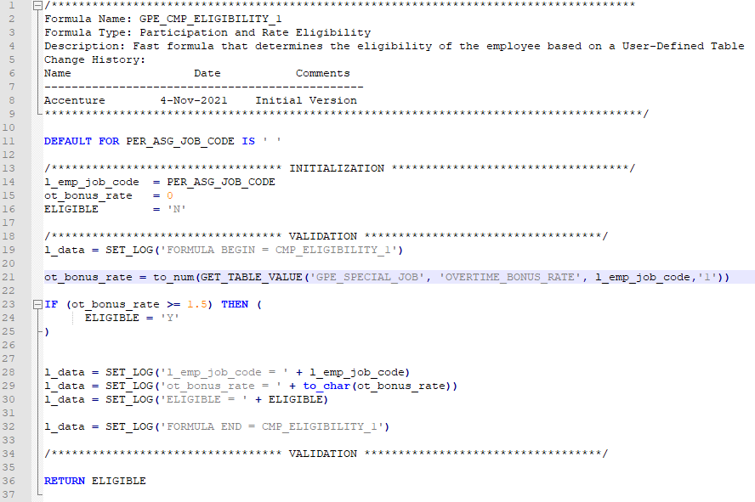
SINGLE PARAMETER: GET_VALUE_SET('VALUE_SET_NAME','|=PARAMETER='''||PARAM_VALUE||'''')
MULTIPLE PARAMETER: GET_VALUE_SET(‘VALUE_SET_NAME','|=PARAMETER1='''||PARAM_VALUE1||''''
||'|PARAMETER2='''||PARAM_VALUE2||''''
||'|PARAMETER3='''||PARAM_VALUE3||'''')

Slide 8
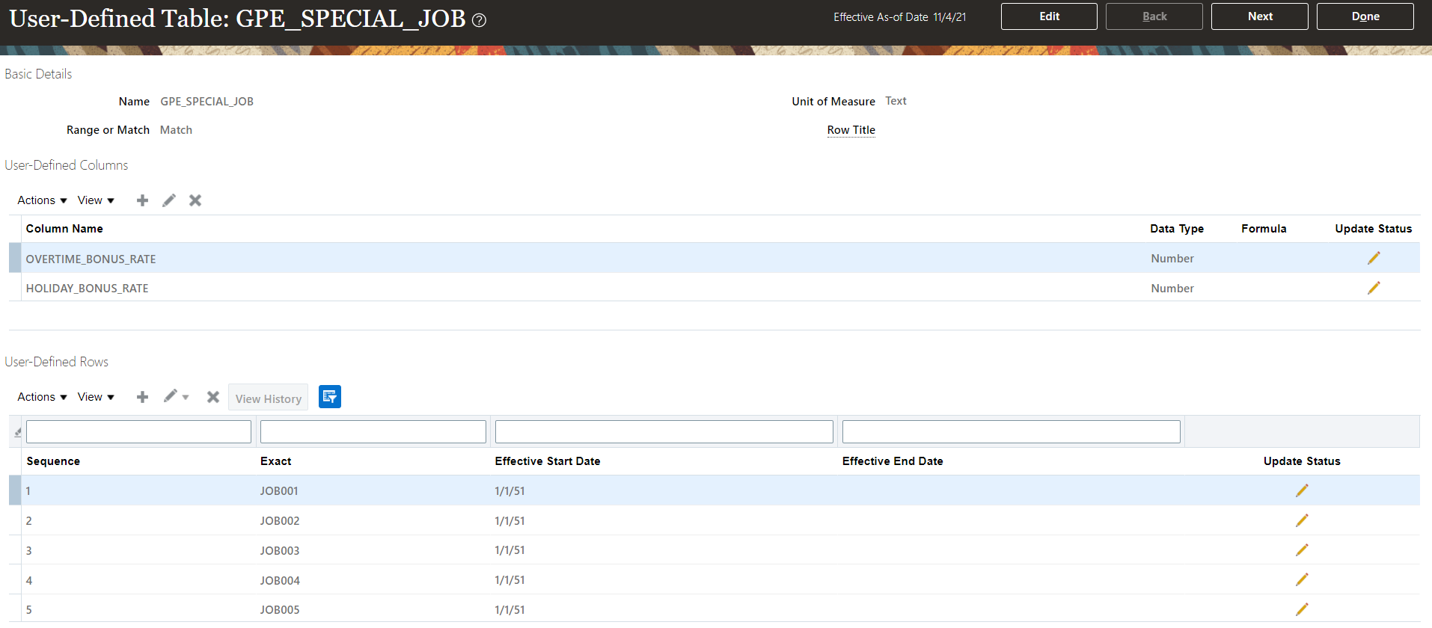
User-Defined Table

Slide 9
User-Defined Table

Slide 10
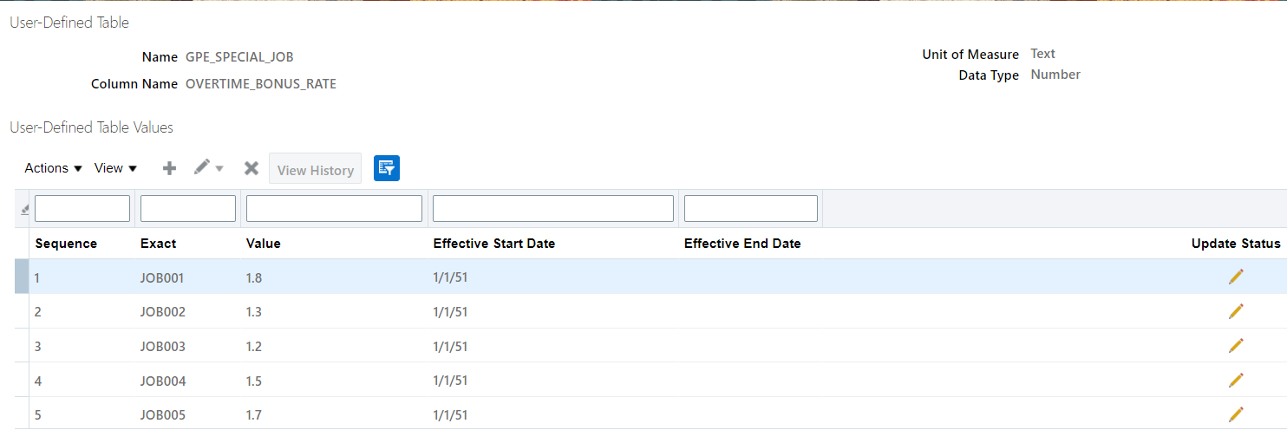
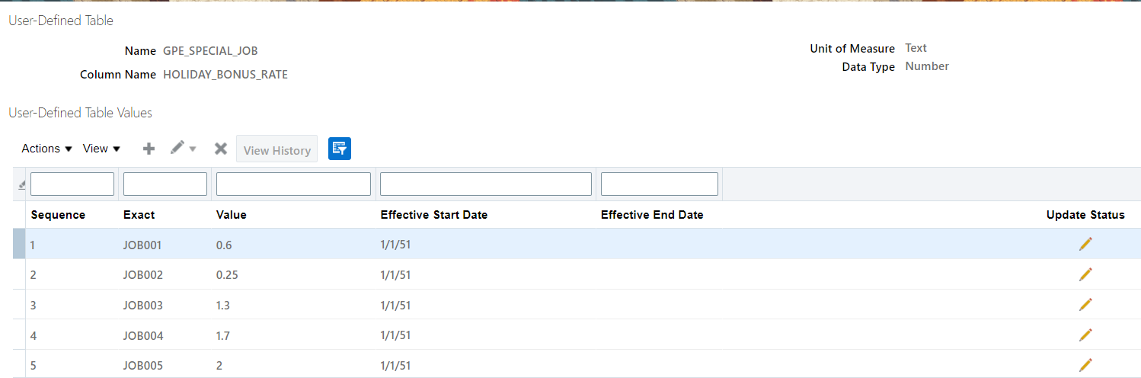

Slide 11
Exact | OVERTIME_BONUS_RATE | HOLIDAY_BONUS_RATE
JOB001 | 1.8 | 0.6
JOB002 | 1.3 | 0.25
JOB003 | 1.2 | 1.3
JOB004 | 1.5 | 1.7
JOB005 | 1.7 | 2

