Slide 1
Teaching Computational Skills in the Natural Sciences using Jupyter Notebooks in a Blended Approach
Funded by the Helmsley Foundation through the
Teaching to Increase Diversity and Equity in STEM (TIDES) Initiative at AAC&U and PKAL
Project team: Doug Blank, Computer Science
Liz McCormack & Mark Matlin, Physics
Steven Neshyba, Chemistry, University of Puget Sound

Slide 2
Our TIDES Project Goals
Improve student learning of computer programming and algorithmic thinking
Integrate computational skill building with subject-specific content
Minimize faculty staffing demands and impact on time-to-degree
Emphasize a culturally-inclusive learning environment to support recruitment and retention of members of traditionally underrepresented groups in STEM
Improve the persistence and success of all students

Slide 3
The Means to Our End….
A set of Jupyter notebook-based “modules” incorporating computational techniques in the context of scientific applications, and exercises to text understanding.
Flipped format: modules are available for reading online; students work together in classes or other work groups to complete the exercises. Peer learning and collaboration take place naturally.
Diversity and inclusivity are promoted through journal reflections, student-generated scientist profiles, and feedback from students & student consultants.

Slide 4
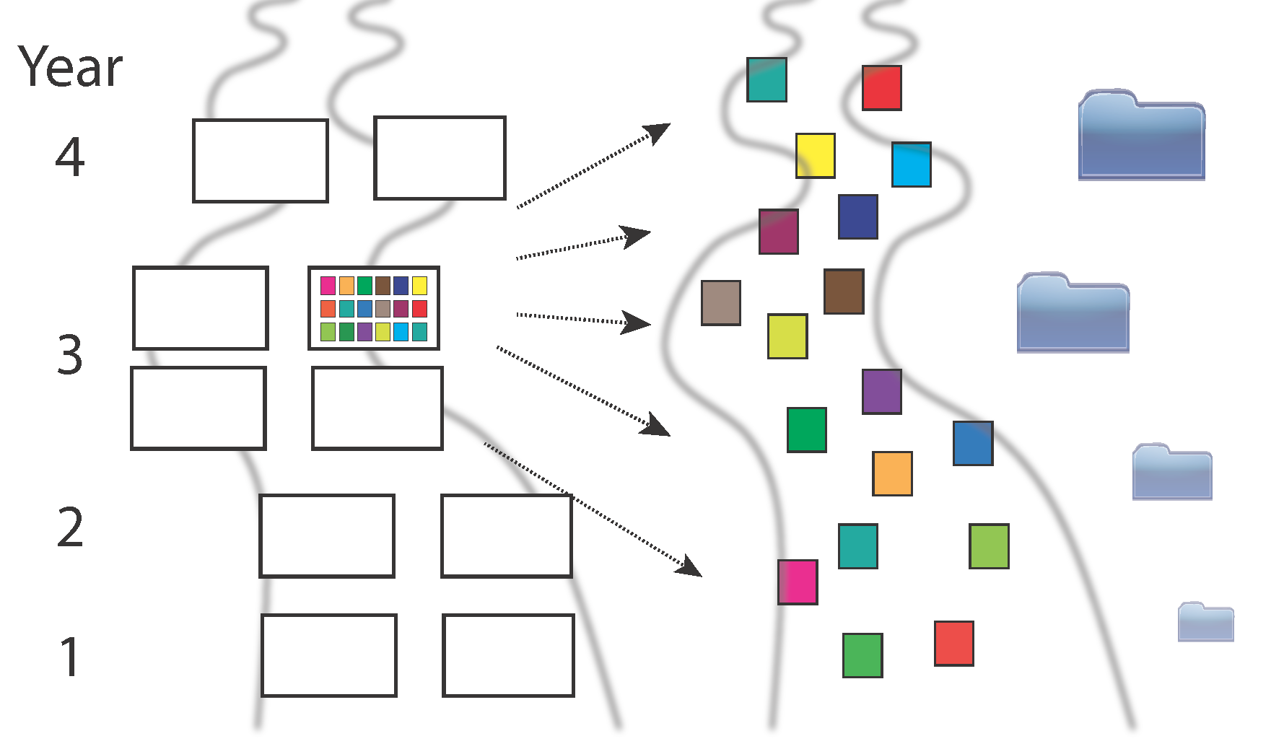
Our Planned Implementation
Modules would be piloted in a one-time course, revised, and embedded in core physics courses throughout the major sequence.
Students will progressively learn and practice computational skills, culminating in an e-portfolio of their work in their senior year.

Slide 5
Pilot– PHYS 350: Computational Methods in the Physical Sciences
Run as a lab course – almost no lecturing.
Students read modules ahead of time, worked on exercises in class.
Collaboration/peer learning took place naturally.

Slide 6
Pilot– PHYS 350: Computational Methods in the Physical Sciences
Student learning objectives:
Become familiar with the computational tools a physical science graduate would be likely to encounter in graduate school, industry, or government labs.
Learn how computers are used to implement the numerical solution of mathematical problems that commonly arise in physical science and engineering contexts.

Slide 7
PHYS 350 Outcomes
Refined set of modules based on student feedback
Experience gained with notebooks on a dedicated Jupyter server
Student-generated scientist profiles
Student journals: module and profile feedback, and reflections
Term projects and E-portfolios
Student survey results (pre- and post-course)

Slide 8
The Modules
Concept: mostly self-contained lessons on specific numerical techniques and applications (now all Jupyter notebooks)
Starting point: Computational Physics, Mark Newman (Python)
“Breakpoints” – quick checks of comprehension, with solutions
Exercises to apply module lessons (start easy, become harder through the sequence of modules). Required students to code algorithms and apply them to solve problems of scientific interest.
All modules include “Recaps” of key points

Slide 9
The Modules
0. Intro to Computing
1. Intro to Python
2. Numerical Errors & Computational Speed
3. Iterative Methods
4. Differentiation
5. Numerical Integration
6. Linear Equations
7. Eigenvalue Equations
8. Modeling Data (curve fits, PCA)
9. Fourier Analysis
10. Ordinary Differential Equations
11. Partial Differential Equations
12. Monte Carlo Methods
13. Object-Oriented Programming
14. Working with Big Data
Notebook example…

Slide 10
Module Applications
Module 3: Iterative Methods
Projectile motion without & with drag, rocket with changing mass, rocket with altitude-dependent gravity
Module 4: Differentiation
Pure math
Module 5: Integration
Compute: mean speed in a Maxwell-Boltzmann distribution, total power flux emitted by a blackbody, Stefan-Boltzmann constant
Module 6: Solution of Linear Equations
Compute currents in a multi-branch circuit
Module 7: Eigenequations
Find: principal axes of a solid, normal modes and frequencies of a set of coupled oscillators (masses on springs, double pendulum), the first 10 energy eigenvalues of a 1-D infinite potential well with linear internal potential.
Module 8: Analyzing Data
Least-squares fit a set of data, compute a covariance matrix, use principal components analysis to find the most important variations in a set of data
Module 9: Fourier Analysis
Compute the transform of a square wave and a sound wave
Module 10: Ordinary Differential Equations
Use Runge-Kutta method to: model vertical motion of a ball, find the ground-state energy of a particle in an infinite well with linear potential, model the exact motion of a simple pendulum
Module 11: Partial Differential Equations:
Compute the electric potential inside a square with sides held at specified values & the temperature along a metal rod with ends held at specified temperatures, plot the shape of a plucked string at a set of times
Module 12: Monte Carlo Methods:
Compute magnetizations of 1-D & 2-D Ising systems, calculate the area of a disk using a Monte Carlo approach
Module 13: Object Oriented Programming:
Model oscillations of diatomic and linear triatomic molecules

Slide 11
PHYS 350: Term Projects
Topics chosen by students; most worked in small groups.
Third- & second-to-last weeks of classes used for project work; last week for presentations
Students submitted presentation slides, code, and 3-5 page paper on project
Oral & written presentations evaluated on clarity, quality, difficulty; peer evaluation

Slide 12
PHYS 350: Term Project Topics
1-D potential well quantum wavefunctions
Calculation of molecular orbitals
Air flow around an airfoil
Fluid flow through a duct
Motions of linear and nonlinear oscillators
Visualization of planet motion in the solar system
Modeling mutations of protein molecules
Fourier analysis of pop songs

Slide 13
Term Project Example
Notes:
This is their simpler example. They also wrote code for a *finite* square well.

Slide 14
PHYS 350: E-portfolios
Completed modules
Scientist profile: slide and text
Term project: slides and text
Journal entries: module feedback, profile feedback, in-class reflection questions
Summative reflections:
What are the most important things you learned and what are your most valuable “take-aways” from the course?
What did you do well in the course?
What area(s) do you want to improve on?
What topic(s) (related to the course) would you like to learn next?

Slide 15
PHYS 350: Lessons Learned
Students need scaffolding for the intro modules.
Remind reader of key Python skills needed for the Exercises.
Be very explicit about desired function inputs & outputs – students need help developing this skill.
Students fairly new to computing take a long time to do even relatively straightforward things.
Server implementation: RAM and swap space are key.
Faculty need knowledge or support to maintain/troubleshoot the server.

Slide 16
Take 2, and 3…
After PHYS 350, introduced Intro to Python module in first 4 weeks of lab component of intro physics for science majors – didn’t work so well.
This year, first 6 modules covered successfully in sophomore-level lab course. Will repeat this coming year.
Will incorporate subsequent modules in junior/senior-level courses as appropriate. Need to provide some structure for collaboration.

Slide 17
Where we are and where we are going…
All modules and support materials on github: github.com/BrynMawrCollege/TIDES (Creative Commons)
Teaching of first (6) modules in lab part of sophomore-level course will continue; plan to distribute others within the major sequence
Will create “Big Data” module
Would like to add exercise applications from other sciences
Hope to share across other STEM and quantitative disciplines, and with other institutions

Slide 18
Thank you!
Questions…?

