Slide 1



Stabilizing Comparable Sales at The Home Depot with Data-Driven Resilience
A proposal exploring how data science can help stabilize fragile comparable sales performance amid weather and housing headwinds.
Chuhan (Brynn) Zhang
Data-Driven Proposal • December 2025

Slide 2





Context: The Potential Challenge at The Home Depot
2024: $152.7B
2025: $159.5B
$41.4B
Key Headwinds
Fiscal 2023 total sales declined 3.0%, comparable sales down 3.2%
Fiscal 2024 total sales grew 4.5%, but comparable sales still declined 1.8%
Q3 2025: sales +2.8%, but comparable sales only +0.2% (U.S. +0.1%)
Weather (fewer storms) and housing market weakness
Source: The Home Depot Q3 2025 Earnings Release (Nov 18, 2025)
Source: Home Depot Investor Relations (2023 Annual Report)
Source: Home Depot Investor Relations (2024 Annual Report)
Source: CEO Ted Decker quote from Q3 2025 earnings
Notes:
"Sales are highly sensitive to storms and housing turnover, which are largely outside Home Depot's direct control, creating unpredictable swings in quarterly performance."

Slide 3
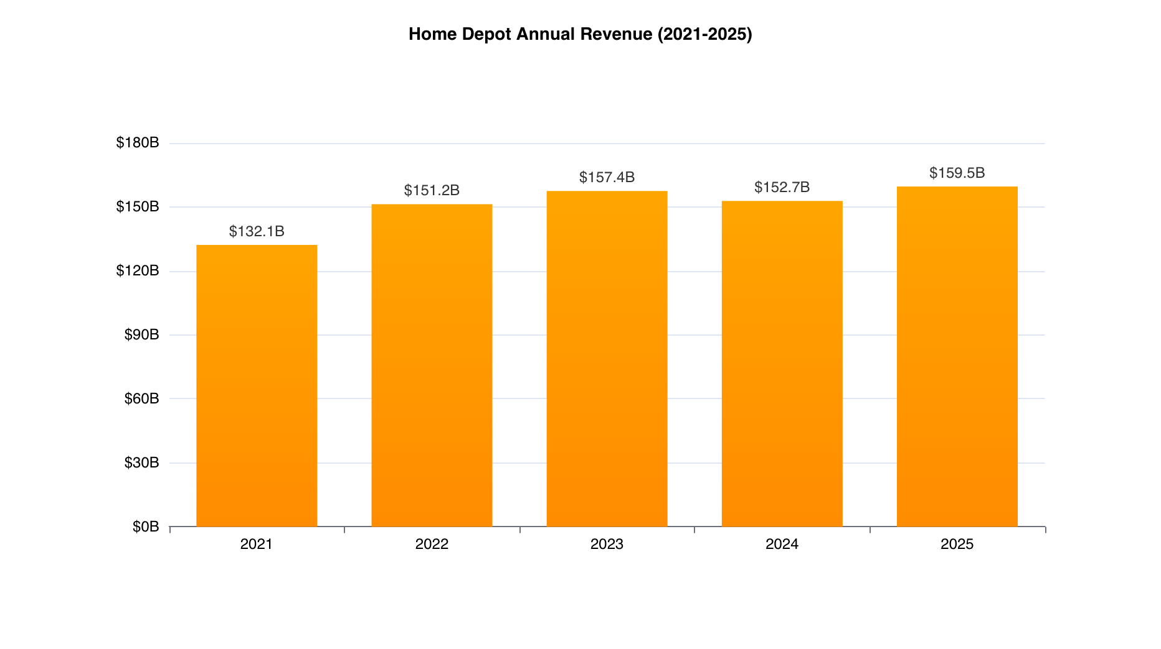
Home Depot's Revenue Scale (2021–2025)

Slide 4
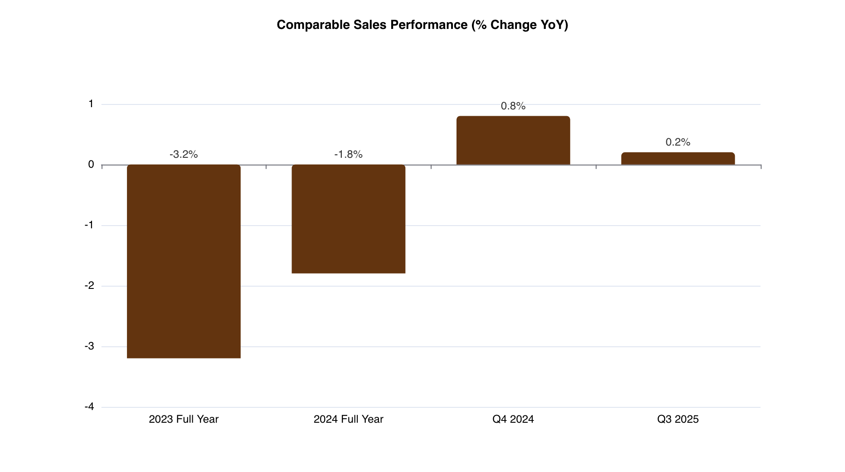
The Weak Link: Comparable Sales Trend

Slide 5


Problem Statement:
Root Causes (External)
Observable Problem
Fewer storms
sluggish housing turnover
elevated mortgage rates
consumer uncertainty
Comparable sales have been inconsistent across recent years despite Home Depot’s strong overall revenue base.
Opportunity
Why Matters
Identify and strengthen the most resilient demand pockets:
Reduce comp volatility
Build more predictable sales performance
Soften the impact of external shocks
Build a Resilience Metrics that quantifies:
Which categories are stable or volatile
Which regions are more weather-sensitive
Which customer segments maintain steady demand
Notes:
As an intern, I’m not changing the macro environment, but I can help quantify where demand is stable versus fragile.
The goal is to support more predictable performance.

Slide 6



Proposed Solution: Comparable Sales Resilience Scorecard
Data Inputs
Analytics Engine
Outputs
●
Weekly/monthly sales at store and region level
●
Volatility: rolling standard deviation of weekly comps by category
●
Category resilience scores
(e.g., roofing = low resilience in no-storm periods; paint = high)
●
Comparable sales by category (roofing, lumber, consumables, paint, etc.)
Recovery: how quickly categories rebound after macro or weather shocks
●
●
Regional vulnerability map
highlighting weather-sensitive geographies
●
Indicators for storm-affected vs normal periods
Digital mix: share of each category flowing through digital channels
●
●
Actionable segments:
“fragile but important” vs “inherently resilient” categories
●
Channel mix: digital, in-store, Pro, and DIY
Resilience Index: composite score blending volatility + recovery patterns
Recommended playbooks:
where to push promo, where to protect margin
●
●
This framework ties directly to Home Depot's strategic priorities: omnichannel optimization, Pro channel growth, and data-driven merchandising.

Slide 7

Deliverables: (What I Can Do)
Phase 1:
Phase 2:
Phase 3:
Action Snippets & Recommendations
Data Intake & Alignment
Resilience Scorecard MVP
Connect to internal sales/comps/category datasets
Align fiscal weeks with external context (storms, housing)
Build prototype notebook with data validation
Deliverable: Clean aligned dataset + notebook template
Identify "fragile but important" categories
Propose low-risk experiments (promo timing, digital attach)
Package findings into decision-ready deck
Deliverable: Experiment proposals + handoff docs
Compute volatility metrics by category/region
Measure recovery speed after macro shifts
Build composite Resilience Index
Create Excel/Tableau dashboard with filters
Deliverable: Working MVP dashboard + Python module

Slide 8



Desired Outcome (how to measure success)
• Targeted Actions
Teams identify “fragile but important” categories and adjust promo/margin strategy to smooth quarterly comp swings.
• Clear Visibility
A simple metrics shows which categories and regions are stable vs. shock-sensitive, which directly addressing HD’s multi-year comp volatility.
• Repeatable Analytics Asset
A Python + Excel/Tableau metrics that continuously monitors stability and flags shifts in sensitive categories.
gain better control of comparable performance by understanding where volatility originates and where stability can be strengthened
Notes:
Why This Matters (Call-Back to Problem Statement)
Home Depot’s comparable sales have been unstable for two years, moving from –3.2% (2023) to –1.8% (2024) with only a small recovery of 0.8% to 0.2% in late 2024–2025.
This instability reflects external pressures — fewer storms, slower housing turnover, higher mortgage rates — that HD cannot directly control.
The Resilience Scorecard provides HD with:
Visibility into which categories stay stable regardless of external shocks
Signals that help the business reduce comp volatility
A tool that guides promo/margin decisions based on stability, not guesswork

Slide 9
Data & Sources:
All data in this proposal comes from official sources: Home Depot investor relations, SEC filings, third-party financial aggregators, and recent news coverage. Below is the complete data dictionary and source citations.
Metric / Data Point
Source
How Used in Proposal
Year / Date
FY 2023 Sales & Comparable Sales
Home Depot 2023 Annual Report (IR)
Support statement: sales fell 3.0%, comps fell 3.2%
Fiscal 2023
FY 2024 Sales & Comparable Sales
Home Depot 2024 Annual Report (IR)
Show sales growth to $159.5B but comps -1.8%
Fiscal 2024
Q4 2024 Comparable Sales
HD IR + Investopedia / AP coverage
First positive comps: +0.8%
Q4 FY2024
Q3 2025 Sales & Comps
Home Depot Q3 2025 Press Release (Nov 18, 2025)
Highlight +2.8% sales vs +0.2% comps; note weather/housing headwinds
Q3 FY2025
Annual Revenue 2021–2025
MacroTrends, WallStreetZen, SEC filings
Revenue chart showing $132.1B to $159.5B trend
2021–2025
2022 Online Sales Share
Home Depot 2022 Annual Report
Estimate ~$22.3B online volume (14.2% × revenue)
Fiscal 2022
2024 HomeDepot.com GMV
ECDB Retailer Data
Reference $21.1B annual online GMV with 0–5% growth
2024
Q3 2025 Online Growth
Digital Commerce 360 / HD Q3 2025 Earnings
Online sales +11% YoY in Q3 2025
Q3 FY2025
Weather & Housing Impacts
CEO Quote (Q3 2025 Earnings), Business Insider, AP News, Market Watch
Document external headwinds: fewer storms, housing weakness
Q3 2025 / Nov 2025

Slide 10


Technical Background: Relevant Past Work
Time-Series Forecasting & Volatility Modeling
Predictive Ranking & Data Pipelines
Classification + Routing Systems
Operational Decision Engines
Stealth Quant Intern
Built ARIMA, Exponential Smoothing, and PyTorch forecasting models
Performed rolling-window volatility analysis and seasonality detection
Designed MLflow A/B testing to compare model stability under different conditions
https://github.com/BrynnZhang/Stealth
NSB Data Science Intern
Cleaned large, messy datasets using SQL, Pandas, PySpark
Built Random Forest / XGBoost ranking model to prioritize high-value items
Delivered reproducible pipelines using Docker, GitHub Actions, DevContainers
https://github.com/BrynnZhang/NSB-Amazon-and-bot
Mental Health LLM Safety Pipeline
Developed multi-class DistilBERT classifier for risk detection
Implemented routing logic to trigger different actions based on risk tier
Built scalable APIs with transformers, LoRA tuning, Flask
NYU Law — Algorithmic Scheduling Project
Created dynamic programming + Gale–Shapley matching system
Reduced manual workload 60%, improved efficiency 22%
https://github.com/BrynnZhang/scheduling-system

Slide 11
Technical Skillset (aligned to the internship)
🔶Python, SQL, Pandas, Polars, PySpark
🔶 Finance Modeling, Forecasting, anomaly detection, time-series analysis
🔶 MLflow, scikit-learn, Transformers, Flask, Docker
🔶 Jupyter, Git, A/B testing, dashboarding (Excel + Python)
Linkedin: https://www.linkedin.com/in/chuhan-zhang-5845a1237/
Github: https://github.com/BrynnZhang

Slide 12
The Home Depot Already Excels—My Goal is to Build Resilience
As a Master's intern, I can create a reproducible, lightweight analytics framework that helps Home Depot stabilize comparable sales by identifying and amplifying resilient demand pockets. Thank you for considering this proposal.

