Slide 1
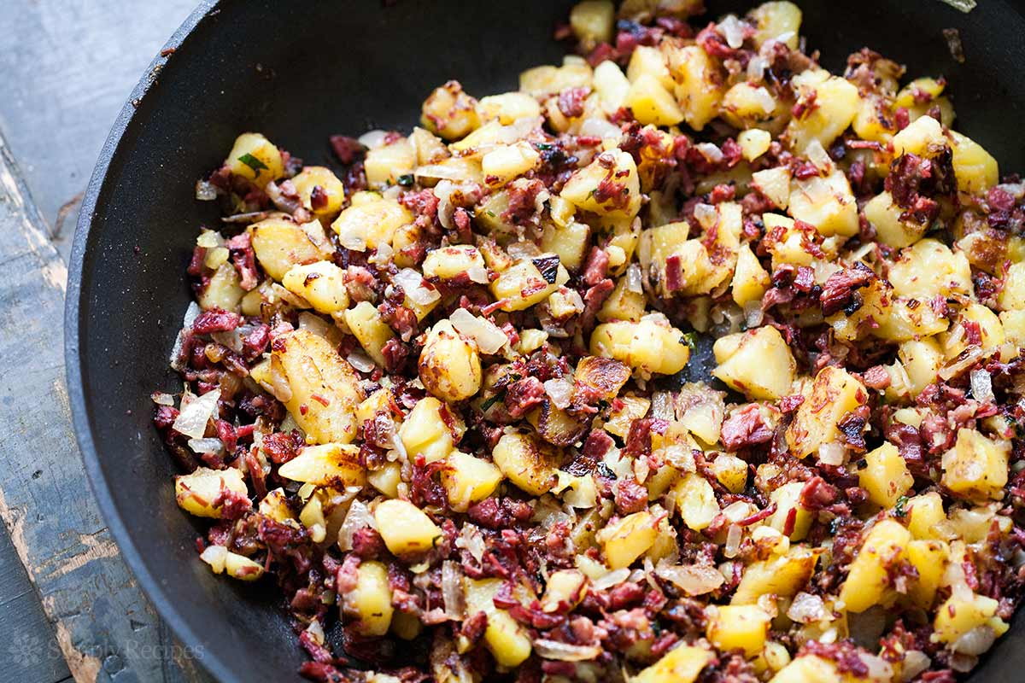
Hashing

Slide 2
What are your ideas?
If we needed a data structure to be able to add, delete, and find items, what would you suggest?
What is the complexity of each of these

Slide 3
What are your ideas?
What is the complexity of each of these?
Ordered array
Unordered array
Ordered linked list
AVL tree

Slide 4
Method | Insert time | Average Search Time
Ordered array
Unordered array
Ordered linked list
AVL Tree
What if log n is too slow? Can we do better?

Slide 5
Method | Insert time | Average Search Time
Ordered array | n/2 | log n
Unordered array | 1 | n/2
Ordered linked list | n/2 | n/2
AVL Tree | log n | log n
What if log n is too slow? Can we do better?

Slide 6
New Data Structure
An associative array, map, symbol table, or dictionary is an abstract data type composed of a collection of (key, value) pairs, such that each possible key appears at most once in the collection.
We don’t need them in order as long as we can find them!

Slide 7
New Data Structure
Operations:
the addition of a pair to the collection
(Rover, [German Shepherd, 70 pounds, 2 years, 26 inches])
the removal of a pair from the collection
the modification of an existing pair
the lookup of a value by key

Slide 8
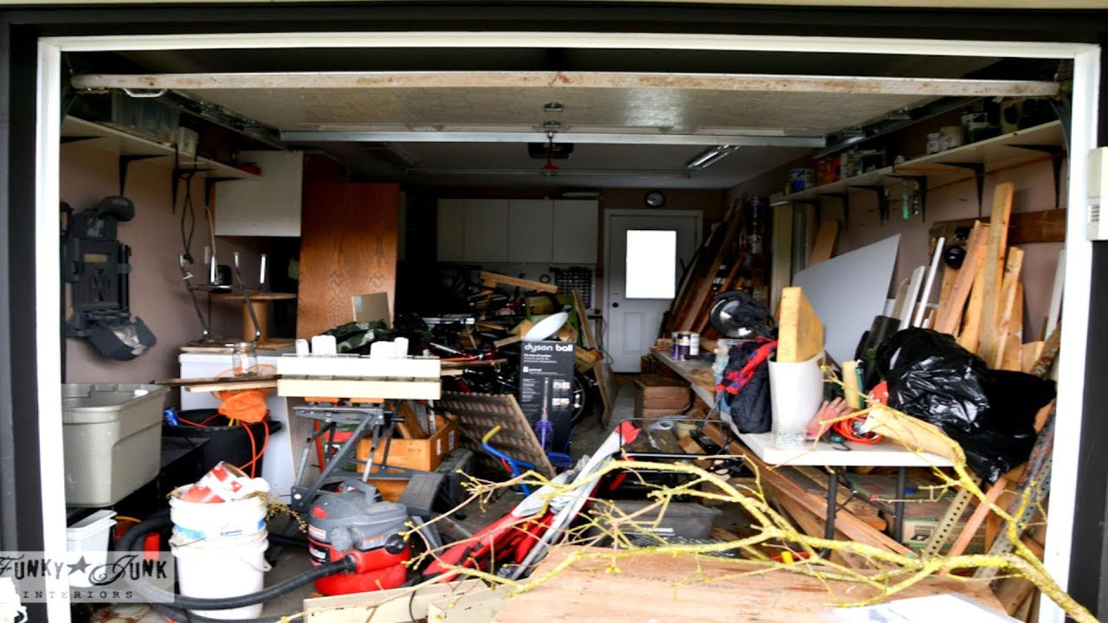
As long as you know where to find it, it doesn’t matter the organization.

Slide 9
Hashing
Suppose we were to come up with a “magic function” that, given a value to search for, would tell us exactly where in the array to look
If it’s in that location, it’s in the array
If it’s not in that location, it’s not in the array
This function would have no other purpose
If we look at the function’s outputs, they probably won’t “make sense”
This function is called a hash function because it “makes hash” of its inputs

Slide 10
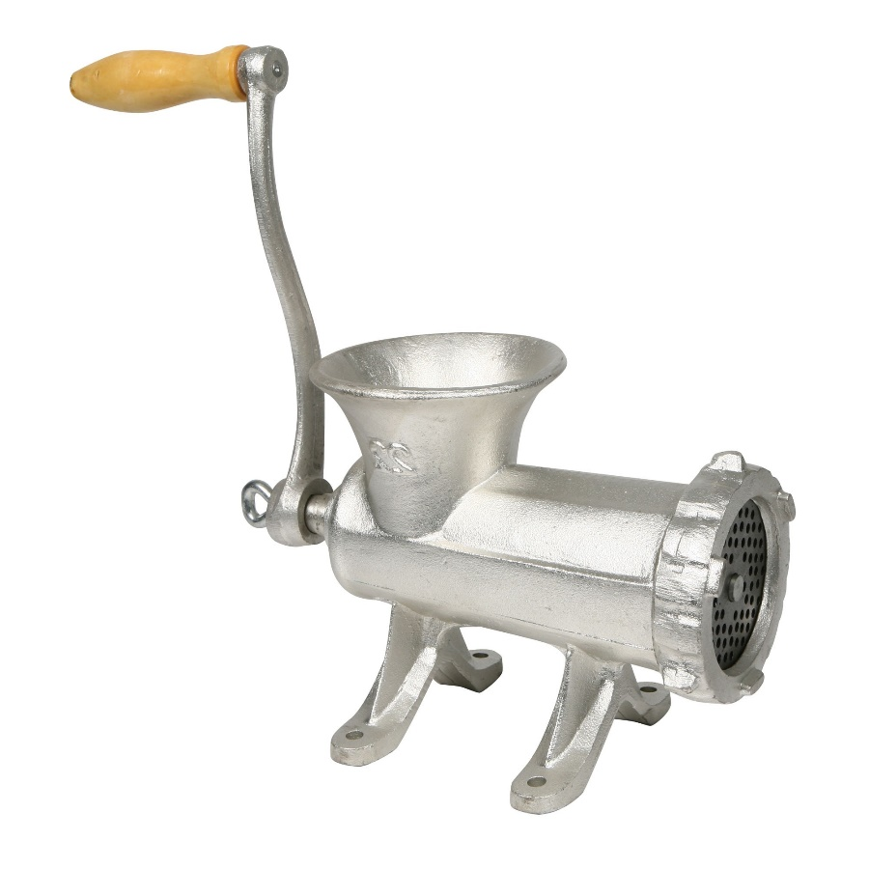
The idea
Key
Hash value is table address

Slide 11
Example (happy) hash function
Suppose our hash function gave us the following values:
hashCode("apple") = 5 hashCode("watermelon") = 3 hashCode("grapes") = 8 hashCode("cantaloupe") = 7 hashCode("kiwi") = 0 hashCode("strawberry") = 9 hashCode("mango") = 6 hashCode("banana") = 2
Why do we call this happy?
0
1
2
3
4
5
6
7
8
9
kiwi
banana
watermelon
apple
mango
cantaloupe
grapes
strawberry

Slide 12


Sets
Sometimes we just want a set of things—objects are either in it, or they are not in it
Who is invited to the party?
What colors do you have?

Slide 13
Map or dictionary
Sometimes we want a map or dictionary—a way of looking up one thing based on the value of another
We use a key to find a place in the map
The associated value is the information we are trying to look up
Hashing works the same for both sets and maps
Most of our examples will be sets
. . .
141
142
143
144
145
146
147
148
key value
robin
robin info
sparrow
sparrow info
hawk
hawk info
seagull
seagull info
bluejay
bluejay info
owl
owl info

Slide 14
A hash function is a function that:
When applied to an Object, returns a number
When applied to equal Objects, returns the same number for each
When applied to unequal Objects, is very unlikely to return the same number for each
Hash functions turn out to be very important for searching, that is, looking things up fast

Slide 15
Finding the hash function
How can we come up with this magic function?
In general, we cannot--there is no such magic function ☹
In a few specific cases, where all the possible values are known in advance, it has been possible to compute a perfect hash function
What is the next best thing?
We attempt to find a good function
We deal with collisions when we have them.
Can we come up with a way of placing info on class members such that the location is computed based on the key itself?

Slide 16

How hard is it to find a good hash function?
Suppose I stored students by their birthday (converted to day number)
July 3 is 184
March 12 is 71.
Do any of us have the same birthday?

Slide 17
How hard is it to find a good hash function?
Consider the birthday paradox – the chances of two people in a room having the same birthdates?
23 people – 50%
60 people – greater than 99%

Slide 18

Why is the probability of collision so great?
Trying to place n people in 365 slots.
Consider that chances that there are no conflicts.
The first person has a 100% chance of no conflicts.
The second person has a 364/365 chance of no conflicts.
The third person has a 363/365 chance …
For 23 people
p =
p= .49

Slide 19
In general, how do we create a hash function for a string? How do we turn a string (for example) into a number that has good properties?

Slide 20
Hash Function 1 – Adding Characters
public static int hash(String key)
{int hashVal = 0;
for (int i=0; i < key.length(); i++)
hashVal += key.charAt(i);
hashVal = hashVal %TABLESIZE;
If (hashVal < 0) hashVal+=TABLESIZE;
return hashVal; }
We treat the characters of the key as numbers. When we add them, we actually get their ASCII value (A = 65, etc.).
Is this a good way? Why?
“gal” and “lag” would map to same value

Slide 21
How can we get a negative number?
Integers are stored in twos complement.
Suppose we're working with 8 bit quantities (for simplicity's sake) and suppose we want to find how -28 would be expressed in two's complement notation. First we write out 28 in binary form.
00011100
Then we invert the digits. 0 becomes 1, 1 becomes 0.
11100011
Then we add 1.
11100100
That is how one would write -28 in 8 bit binary.
Helpful so can just add bits. Try adding 28 and -28.

Slide 22
In Java, mod of a negative can produce a negative
In some languages % gives the modulus (always positive)
In java, % gives remainder:
-21 divided by 4 gives -5 with -1 remainder

Slide 23
Hash Function 2 – Slide and Add
public static int hash(String key)
{int hashVal = 0;
for (int i=0; i < key.length(); i++)
hashVal = hashVal*128 + key.charAt(i);
hashVal = hashVal %TABLESIZE;
if (hashVal < 0) hashVal+=TABLESIZE;
return hashVal; }
This is better as it uses a broader range of values.
“gal” and “lag” would get different codes
Concern is that first elements could be “slid off”
If the number gets too large to store, it throws away most significant bits.

Slide 24
Hash Function 3
public static int hash(String key)
{int hashVal = 0;
for (int i=0; i < key.length(); i++) {
hashVal = (hashVal <<5)^key.charAt( i )^hashVal;
}
hashVal = hashVal %TABLESIZE;
if (hashVal < 0) hashVal+=TABLESIZE;
return hashVal;
}
Since we use or to put the original hashVal back in, we aren’t in danger of losing the effect of the first characters
We can get a negative when int overflows as stored in two’s complement.

Slide 25
Bit operations
int x
What does this do?
x << 5
What does ^ do?
The caret (^) is an exclusive or. Exclusive ors work at the bit level in the following way:
10110110
11001100
-------------
01111010

Slide 26
These are good hash functions.
For board work, I’ll use something easy (such as val%tablesize) so we can compute the hash value in our heads.

Slide 27
Java has a hashCode defined for basic types. User defined types will need to supply the hashCode() function. (Which is what we did with Node)
Public class Employee(
int employeeId;
String name;
Department dept;
@Override
public int hashCode() { // All basic types have a Java supplied hashCode
int hash = 1;
hash = hash * 17 + employeeId;
hash = hash * 31 + name.hashCode();
hash = hash * 13 + (dept == null ? 0 : dept.hashCode());
return hash;
}
}

Slide 28
Example imperfect hash function
Suppose our hash function gave us the following values:
hash("apple") = 5 hash("watermelon") = 3 hash("grapes") = 8 hash("cantaloupe") = 7 hash("kiwi") = 0 hash("strawberry") = 9 hash("mango") = 6 hash("banana") = 2 hash("honeydew") = 6
0
1
2
3
4
5
6
7
8
9
kiwi
banana
watermelon
apple
mango
• We should not be surprised, as the array is getting quite filled.
Now what?
cantaloupe
grapes
strawberry

Slide 29
Collisions
When two values hash to the same array location, this is called a collision
Collisions are normally treated as “first come, first served”—the first value that hashes to the location gets it
We have to find something to do with the second and subsequent values that hash to this same location

Slide 30
In class – suggestion was to have every node in the tree point to a B+ tree.
This is a good thought – but since we think only a few things will be at each position, it is overkill.
But what about a simpler “container” at each location in the hash table?

Slide 31
Separate Chaining
Each location in the hash table is a pointer to a linked list of things that hashed to that location.
Advantages
Collisions are no problem
Overflow is solved as space is dynamic
Deletion is easy
Disadvantages
Links require space
For example: HASH(key) = key % 7 with the data: 5 28 3 108 72 19
Works well, but we have the overhead of references.
0 | 28
1
2 | 72
3 | 3 | 108
4
5 | 5 | 19
6

Slide 32
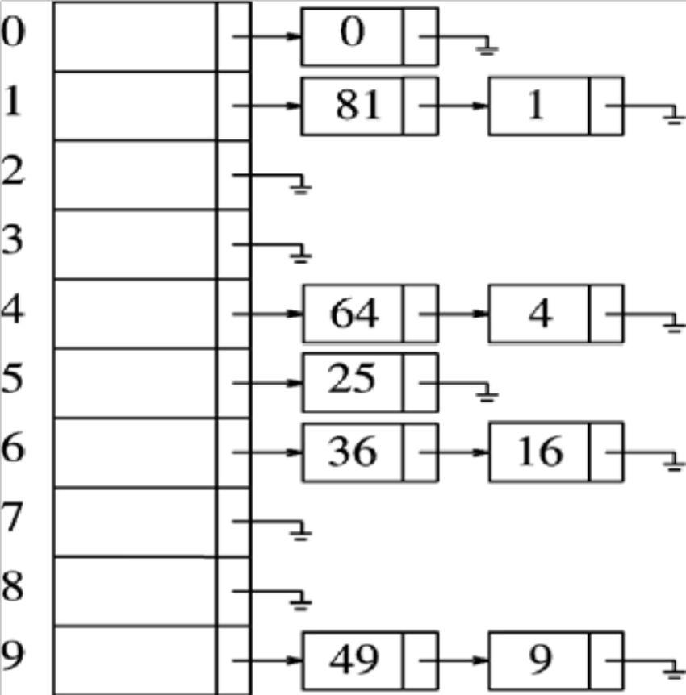
Separate Chaining

Slide 33
search(x)
Find the element whose key is x in the hash table T
Return true if x is found, and false otherwise
Idea: find the correct slot of the hash table T and then traverse the list to search x
Time: linear in the length of the list

Slide 34
Insert(x)
Insert a new element x into the hash table T
Idea: find the correct slot of T and insert x in the front of the list
Time: O(1)

Slide 35
Remove(x)
Remove an element whose key is x from T
Idea: find the correct slot of T and remove x from the list
Time: linear in the length of the list

Slide 36
A Java class interface (separate chaining)
public SeparateChainingHashTable( )
{ this( DEFAULT_TABLE_SIZE );
}
public SeparateChainingHashTable( int desiredSize )
{ theLists = new LinkedList[ nextPrime( desiredSize ) ];
for( int i = 0; i < theLists.length; i++ )
theLists[ i ] = new LinkedList<>( );
}
public void makeEmpty( )
{ for( int i = 0; i < theLists.length; i++ )
theLists[ i ].clear( );
currentSize = 0;
}
What is load factor?
Number of items/size of table
Average number of items per slot.

Slide 37
Advantages/Disadvantages
Easy to handle collisions
Still needs good hash function (as lists could be long, otherwise).
Overhead of creating/manipulating lists

Slide 38
Handling collisions
What can we do when two different values attempt to occupy the same place in an array?
Solution #1: Create a linked list of values that hash to this location
Solution #2: Search from desired spot for an empty location (with wrap)
Will we ever be able to find the values again?
Solution #3: Try again with a second hash function
...and a third, and a fourth, and a fifth, ... to find a better location. How many hash functions would we need????
All these solutions work, provided:
We use the same technique to add things to the array as we use to find things in the array

Slide 39
Finding an empty spot
How would you choose an empty spot?
How would the item ever be located again?

Slide 40
Linear Probing (or Open Addressing)
Use a vacant spot in table following HASH(key) –
“open” addressing means that we find an unused address and use it.
Evaluation
Longer search times
Clustering gets worse and worse (snowballs).
Primary clustering is when two keys that hash onto different values probe the same sequence of locations.
Better if successive probe locations are picked in “different” orders to lessen clustering.

Slide 41
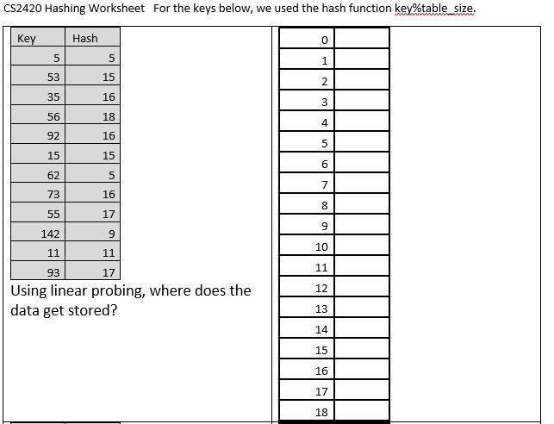

Slide 42
Linear Probing Example: Key%TableSize
Key Desired Hash Loc
5 5
53 15
35 16
56 18
92 16
15 15
5
73 16
55 17
9
11
93 17
Where is the next key I add most likely to go?
93
11

Slide 43
Clustering
One problem with the “linear probing” is the tendency to form “clusters”
A cluster is a group of items not containing any open slots
The bigger a cluster gets, the more likely it is that new values will hash into the cluster, and make it ever bigger
Clusters cause efficiency to degrade
Primary Clustering: keys wanting to go to different locations compete for same next locations.
Solutions to the clustering?

Slide 44
Clustering
Here is a non-solution: instead of stepping one ahead, jump by k each time.
The clusters are still there, they’re just harder to see.
Anything that goes to x, x+k, x+2k, x+3k… compete for the same next location.
Unless k and the table size are mutually prime, some table locations are never checked

Slide 45
What complexity do we expect?
Affected by table size – needs to have extra space.
Affected by quality of hash function. (What are good attributes?)
Which is faster – looking for an item we find or looking for one that is never found?

Slide 46
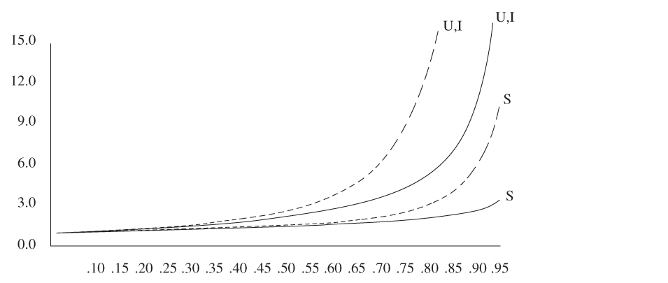
Number of probes plotted against load factor for linear probing (dashed) and random strategy (S is successful search, U is unsuccessful search, and I is insertion)
Number of Probes
Clustering can make
the probing twice as slow
Load Factor - fraction filled

Slide 47
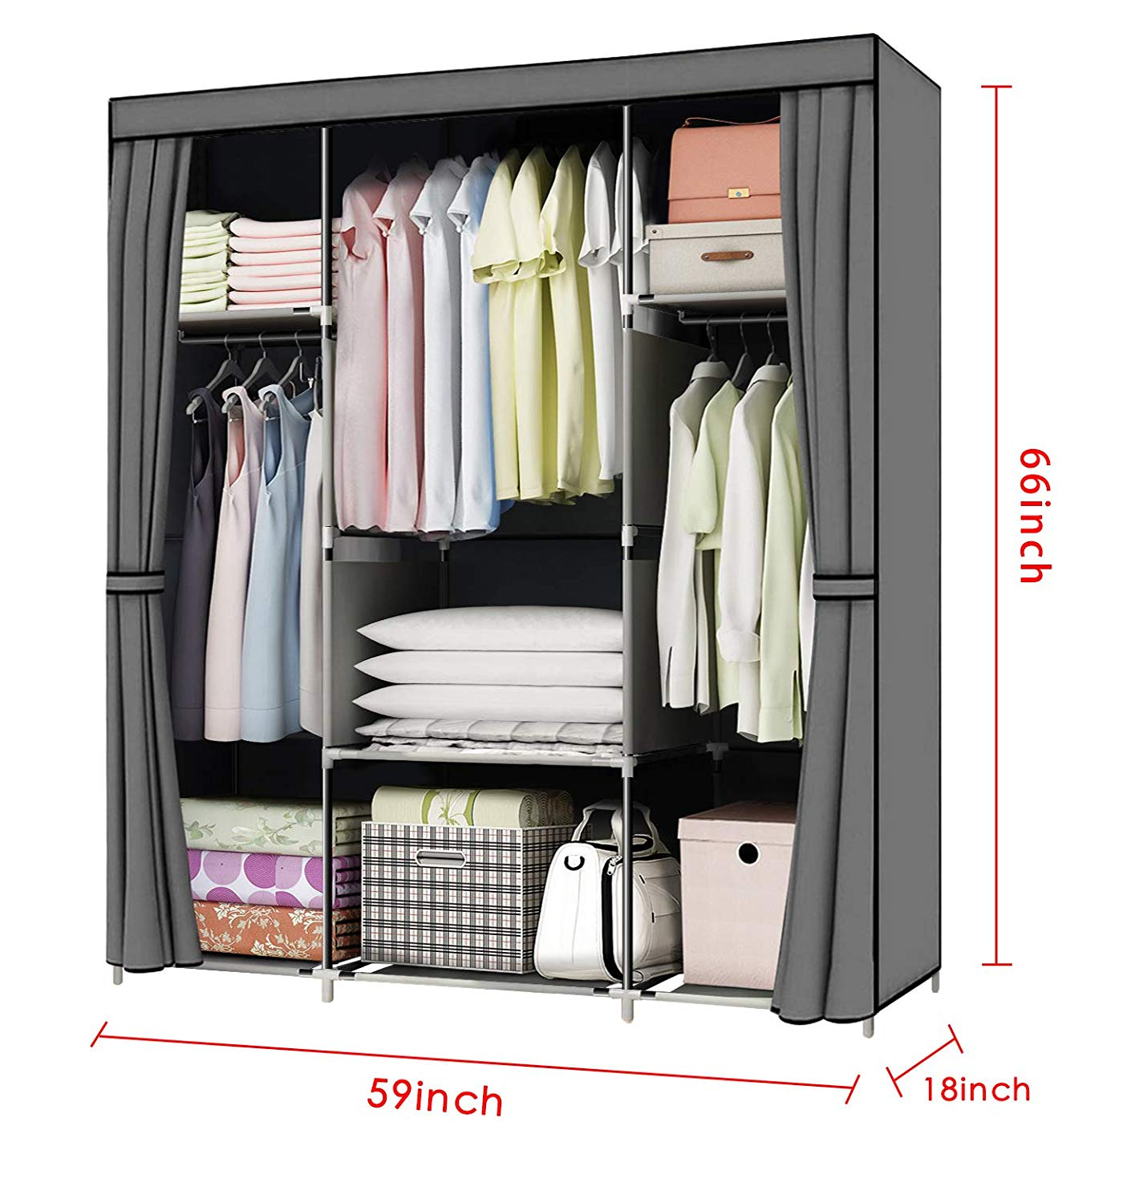
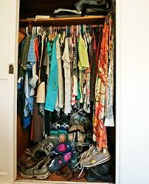
Time Space trade-off
Example: Closet has compartment for everything vs everything goes together?
Which is better?
First is more expensive in building costs, but cheaper in finding things
Second is cheaper in building costs, but more expensive in finding things.

Slide 48
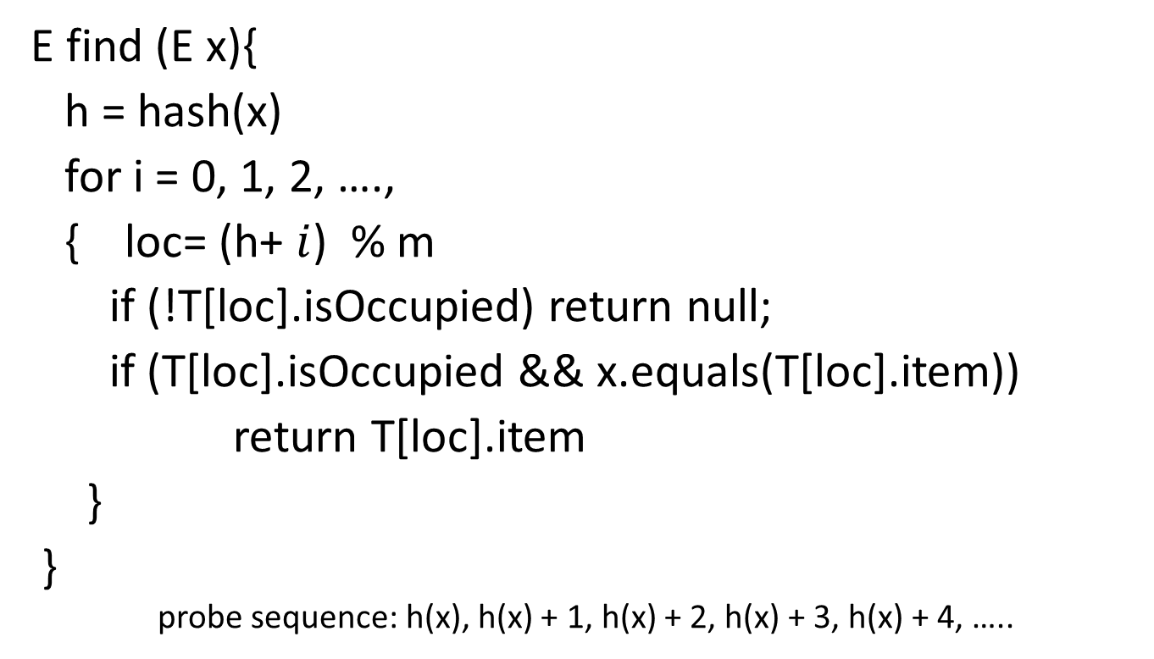
Formally…Open addressing
E find (E x){
h = hash(x)
for i = 0, 1, 2, ….,
{ loc= (h+ $i$) % m
if (!T[loc].isOccupied) return null;
if (T[loc].isOccupied && x.equals(T[loc].item))
return T[loc].item
}
}
probe sequence: h(x), h(x) + 1, h(x) + 2, h(x) + 3, h(x) + 4, …..

Slide 49
Quadratic Probing
Assume the value of the hash function is h= hash(i). Cells are probed according to
h, h+ 1² , h+ 2² , h+ 3² , h+ 4² ,h+ 5² ,
What would advantage of this be?
Can you see why a prime tablesize is important?
Note:
May miss some locations (not find one when one exists).
Suppose have table size of 16, the only possible locations are 1,4, or 9 away from original location. (Try it!)
Can find next location without multiplication

Slide 50
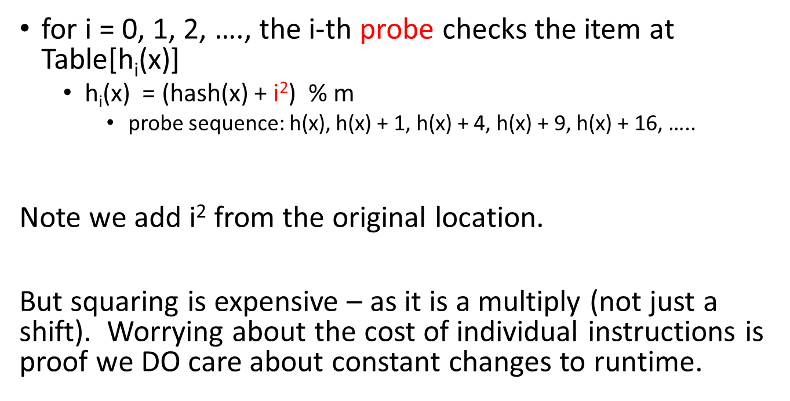
Implementation: only need to change the probe function
for i = 0, 1, 2, …., the i-th probe checks the item at Table[h_{i}(x)]
h_{i}(x) = (hash(x) + $\text{i}\text{2}$) % m
probe sequence: h(x), h(x) + 1, h(x) + 4, h(x) + 9, h(x) + 16, …..
Note we add i² from the original location.
But squaring is expensive – as it is a multiply (not just a shift). Worrying about the cost of individual instructions is proof we DO care about constant changes to runtime.

Slide 51
If we keep a separate offset amount, we can avoid squaring (you will see this in your book’s code)
Hash Location | Difference from Previous | What is formula
h | 0 | offset=1
h+1 | 1 | h=h+offset
h+4 | 3 | offset = offset+2
h+9 | 5
h+16 | 7
h+25 | 9
h+36 | 11

Slide 52
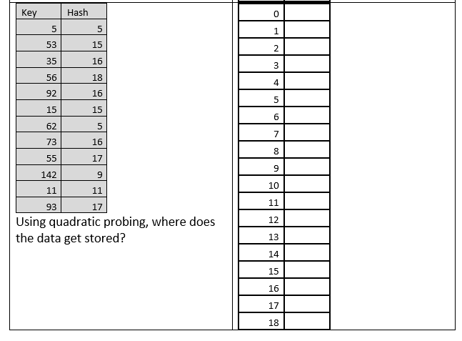
Using your worksheet….

Slide 53
Quadratic Probing
Is primary clustering eliminated? (Do keys that hash to different locations probe the same sequence of cells?)
Secondary clustering: Keys initially hash to the same cell will probe the same sequence cells
Quadratic probing eliminates primary clustering, but not secondary clustering.

Slide 54
Double Hashing (Personalized Increment)
For both linear and quadratic probing, the sequences checked are key independent.
In linear and quadratic probing: Two different keys which hash to same location, keep competing.
What if the increment you used (in open addressing) was different for each key?

Slide 55
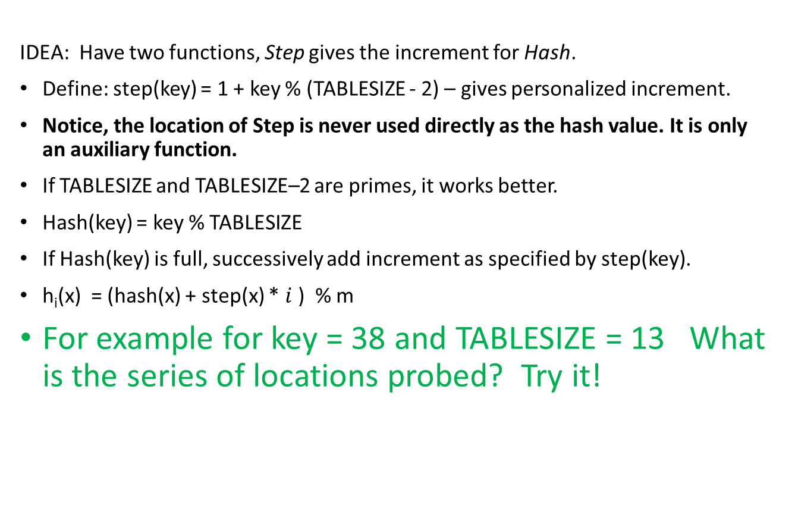
Double Hashing (Personalized Increment)
IDEA: Have two functions, Step gives the increment for Hash.
Define: step(key) = 1 + key % (TABLESIZE - 2) – gives personalized increment.
Notice, the location of Step is never used directly as the hash value. It is only an auxiliary function.
If TABLESIZE and TABLESIZE–2 are primes, it works better.
Hash(key) = key % TABLESIZE
If Hash(key) is full, successively add increment as specified by step(key).
h_{i}(x) = (hash(x) + step(x) * $i$) % m
For example for key = 38 and TABLESIZE = 13 What is the series of locations probed? Try it!

Slide 56
Double Hashing
For example for key = 38 and TABLESIZE = 13
1 + 38 % 11 = 6 The personalized increment.
= 38 % 13 = 12
= (12 + 6) % 13 = 5
= (5 + 6) % 13 = 11
= (11 + 6) % 13 = 4
= (4 + 6) % 13 = 10
= (10 + 6) % 13 = 3
= (3 + 6) % 13 = 9
= (9 + 6) % 13 = 2
= (2 + 6) % 13 = 8
= (8 + 6) % 13 = 1
= (1 + 6) % 13 = 7
= (7 + 6) % 13 = 0
= (0 + 6) % 13 = 6
Notice how hash values jump around over the range of possible values at what appears to be random.
Each of the probe sequences visits all the table locations if the size of the table and the size of the increment are relatively prime with respect to each other.

Slide 57
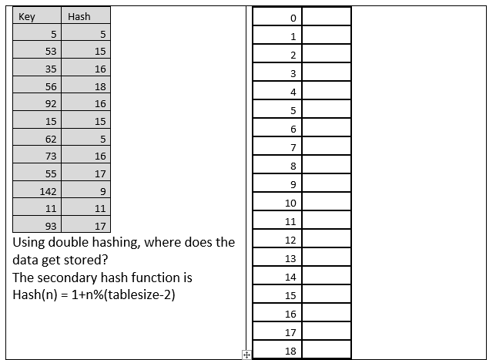

Slide 58
Buckets
Another way to handle collisions is to have each entry in the hash table hold more than one (B) item.
Each entry is called a bucket.
This doesn’t really solve the problem. As soon as the bucket fills up, you still have to deal with collisions.
Would be simpler to just have the original table B times as large.

Slide 59
What do you do when you can’t find a place for a new item? (Or after many deletions, the array is too big for what you need.)
Rehash – create a larger (or smaller) array. Rehash all old elements into new array.
Expensive, but amortized, it is reasonable

Slide 60
Efficiency
Hash tables are actually surprisingly efficient
Until the table is about 70% full, the number of probes (places looked at in the table) is typically only 2 or 3
Sophisticated mathematical analysis is required to prove that the expected cost of inserting into a hash table, or looking something up in the hash table, is O(1)
Even if the table is nearly full (leading to occasional long searches), efficiency is usually still quite high

Slide 61
Deletions
So, how do we delete????
For probing, an empty spot found during a find operation indicates the item is not present.

Slide 62
Deletions
For probing, an empty spot found during a find operation indicates the item is not present.
Solution: use lazy deletion.
Concern: After much activity, almost everything may be marked as “deleted”

Slide 63
Defining an element of array
class Element
{
public int key;
public int flag; // 0: empty; 1: active; 2: deleted
}

Slide 64
int find (int x) : return the index of x (return -1 if x is not in T)
Idea: keep probing the next slot of T
If we find an active slot,
if the key is x, then return the index of the slot
otherwise, probe the next slot
If we find a deleted slot, then probe the next slot
If we find an empty slot, then return -1
If all elements of the table have been checked and x is not found, then return -1

Slide 65
Efficiency of Hashing
load factor = actual-number-of-elements / TABLESIZE
Rehash when exceeds 2/3.
With chaining, the concern is the average length of a chain.
With probing, the concern is the number of probes

Slide 66
Talking Points on Hashing
Properties of a good hash function
Minimize collisions
Fast to compute
Scatter data evenly through hash table. Data may have patterns to them.
Uses all bits of the key – generally helps in scattering non-random data
If mod is used, base should be prime
Chaining methods may be superior to probing, depends on cost of operations. Space expense of storage for links.
Advantages and disadvantages of hashing
Usually lower number of probes than comparison searches (like binary search tree), but could be bad for some sets of data
No order relationship: can’t print all items in order
Cannot look for items close to given key
Cannot findMin or findMax efficiently

Slide 67
What if we wanted to bound lookup times?
If we are willing to spend more time inserting, we have an option.

Slide 68
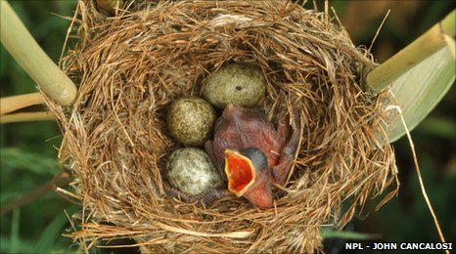
Cuckoo Hashing Section 5.7.2
Cuckoo hashing worst-case constant lookup time.
The name derives from the behavior of some species of cuckoo, where the cuckoo chick pushes the other eggs or young out of the nest when it hatches; analogously, inserting a new key into a cuckoo hashing table may push an older key to a different location in the table.

Slide 69
Use two hash tables.
There are two hash functions, one for each table.
If the first location is occupied, it pushes the existing key to its alternative spot in the other table.
This displaced key is then inserted in its alternative location, again kicking out any key that might reside there, until a vacant position is found, or the procedure enters an infinite loop. In the latter case, the hash table is rebuilt using new hash functions:

Slide 70
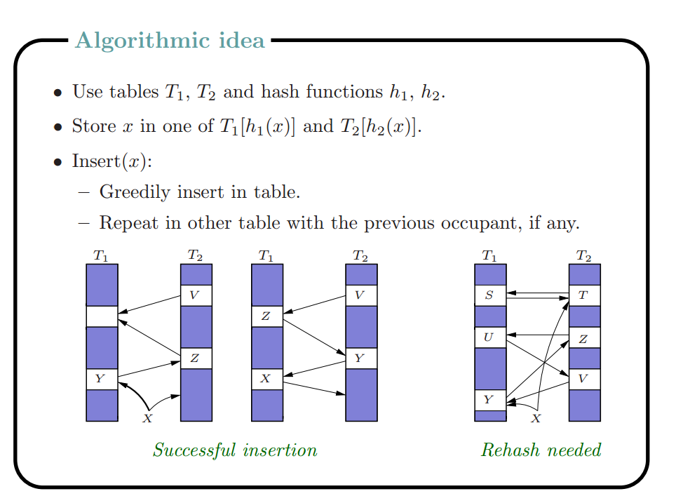

Slide 71
Insertion (Tables t1 and t2)
void insert (E x){
if find(x) return; // don’t insert duplicates
loop maxLoop times{
loc1 = h1(x);
if (t1[loc1].isempty){ t1[loc1]=x; return;}
y=t1[loc1];
t1[loc1]=x;
loc2 = h2(y);
if (t2[loc2].isempty){ t2[loc2]=y; return;}
x=t2[loc2];
t2[loc2]=y;
}
rehash();
insert(x)
}

Slide 72
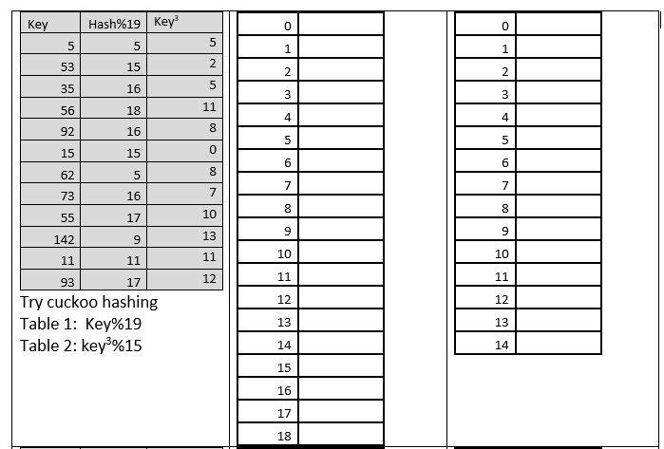
From your worksheet…

Slide 73
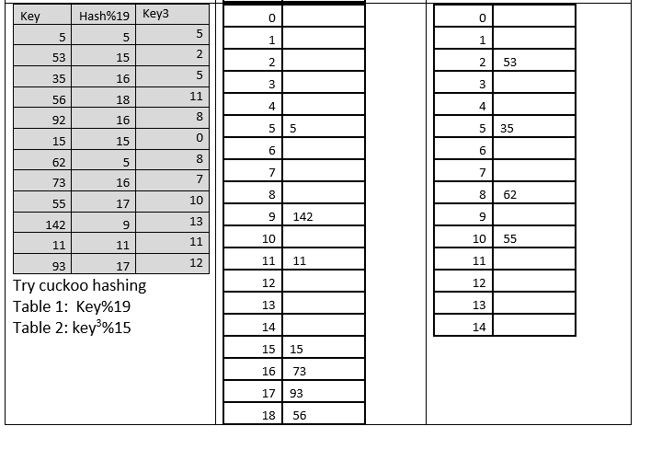

Slide 74
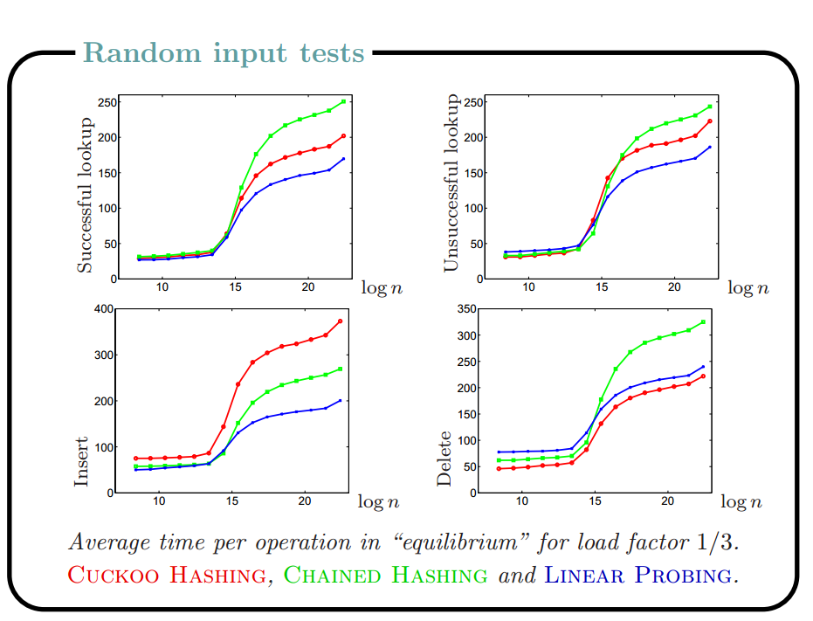
n is the number of elements in table
Notes:
X axis appears to be number of items in the table (log n) with a load factor of no more than 1/3.

Slide 75
Advantages/Disadvantages of cuckoo hash
worst-case constant lookup and deletion times
the avoidance of lazy deletion and extra data Why?
the potential for parallelism
the insertion time is expected to be constant time as long as the load factor is below 1/2
extremely sensitive to the choice of hash functions; the inventors of the cuckoo hash table reported that many of the standard hash functions that they attempted performed poorly in tests.

