Slide 1
Budget App 2.0
Bryson Meiling

Slide 2
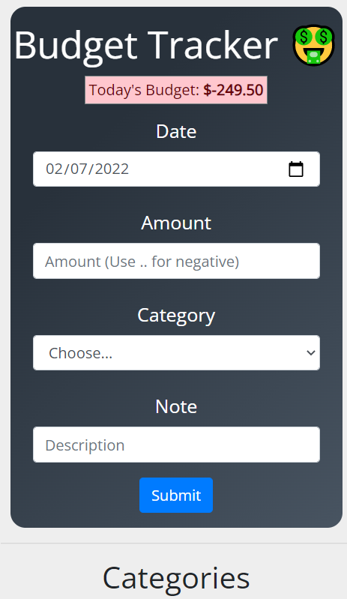
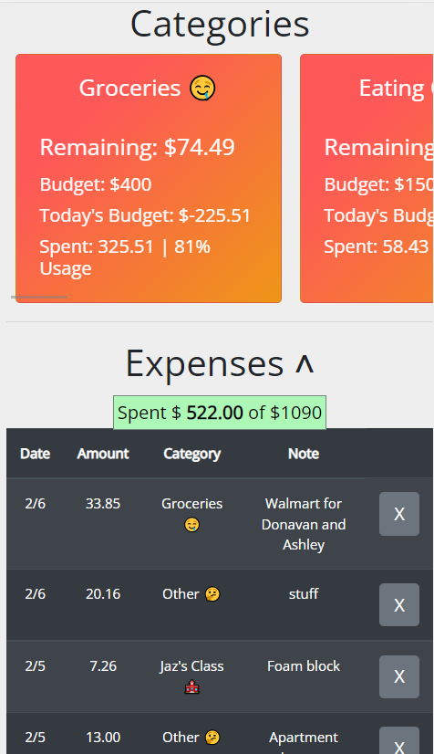
Old Design
Functionally, it worked.
Designed for myself and my wife.
We wanted:
Manually enter in transactions for conscientious spending
A “Envelope type” system of categories that expenses took out of
An overall expense total
To see the different categories and transactions we spent
However, we noticed, it was ugly ☹

Slide 3
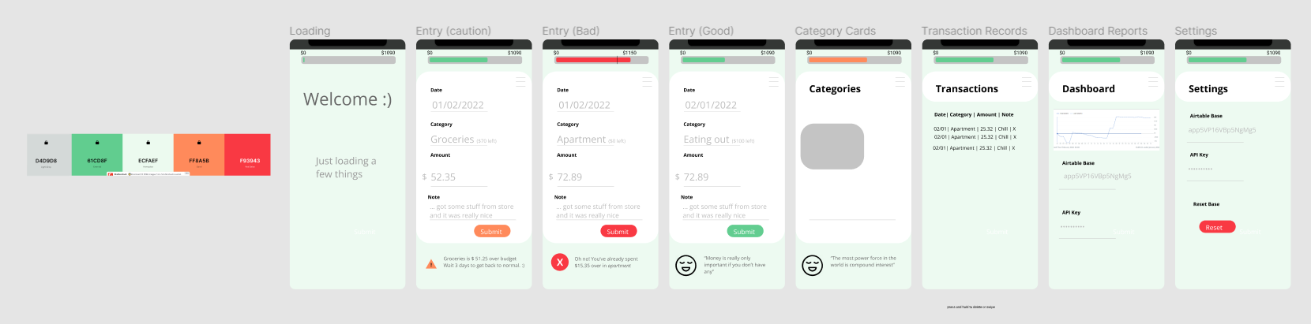
New Design Prototypes
Worked with Figma to sketch what the app could look like
Created multiple designs and styles and collaborated with key stakeholders. Aka “my wife”
Worked with Coloors.co and other design tools to have pleasing color choice and UI/UX layout.

Slide 4
Architecture and Planning
# Budget App 2.0
> *Here we go again* ## Statement of Need
This is a lightweight app that helps people keep track of their expenses according to a "envelope system" ## General Concept
Using a free backend hosted by *Airtable* and on *Github Pages* by taking advantage of static website hosting. The frontend is developed using *Next.Js*.
- [Link to Figma Designs](https://www.figma.com/file/81hMwskA3KPJOQjupdAdnn/Budget-App-2.0?node-id=0%3A1) ## Requirements
- Must connect to one base inside *Airtable*.
- Must be able to delete or alter transactions and be reflected in *Airtable*
- Must be able to delete or alter categories and be reflected in *Airtable*
- Must be reasonably secure holding and using the *baseID* and *API Key*
- Must be able to remember the *base ID* and *API Key* for 30 days before asking again.
- Must be statically hosted on github (or other site in the future)
- Must be able to remember user name, and other settings
- Must redirect to settings page if the app is not logged in
- Must be able to download all transactions as a csv or copy them to a clip board. Also can filter ti by month or year.
- Must be able to set up a *Airtable* base by itself and make a new empty tables. This way a new user can make an *Airtable* account, give the base id and api key, and they rest is taken care of
-
## Maybes
- The transaction should record which user make it
-
## Specifications
- *Airtable's* free tier can only collect up to 1200 records. Maybe I store records in json form instead of in a relational db way. *Airtable's* long text field type has a limit of 100,000 characters. That might be useful for json storage.
- I could store a months worth of transaction in a json object in one
- Make a table called settings for the user's static state info

Slide 5
Architecture and Planning
Using Specification and Requirements, created a plan of the project before starting
Following an agile method, start executing on the requirements (V1) and then altered the design as I went

Slide 6
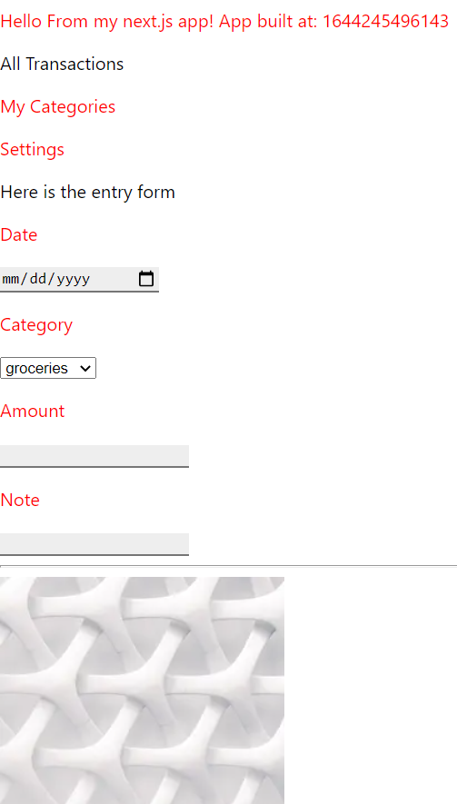
Roughing out the app
Began by using Next.JS and just plain text and input features to rough out the functionality of the design.
This functionality would be coupled with UI/ UX design to bring a working and beautiful app.

