Slide 1
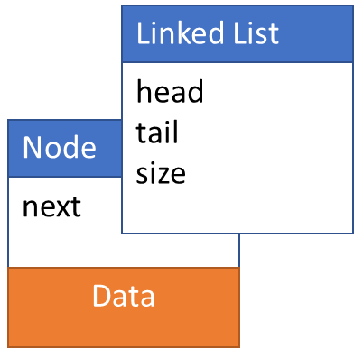
List ADT with Linked List
Operations:
initialize()
append()
prepend()
insertAfter()
remove()
search()
print()
typedef struct linkedList
{
int size;
Node *head;
Node *tail;
} LinkedList;
typedef struct node
{
int data;
struct node *next;
} Node

Slide 2
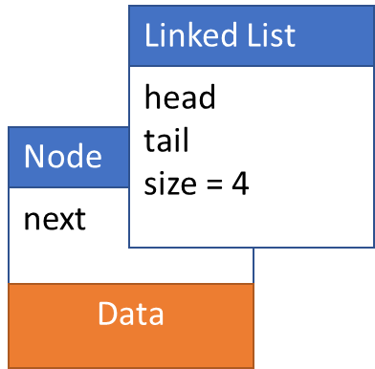
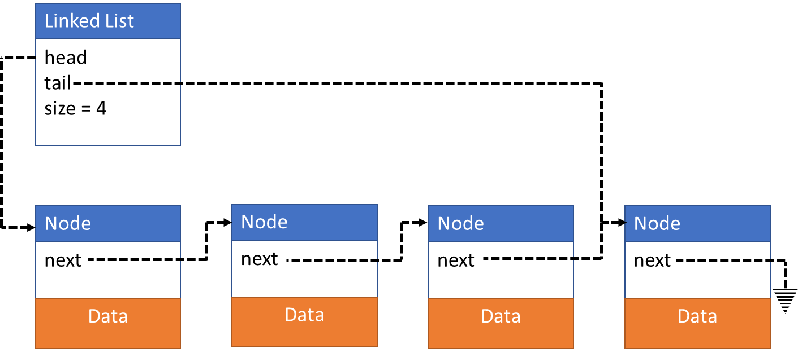
Single Linked List

Slide 3
Initialize()

Slide 4
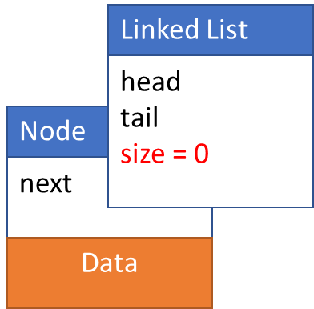
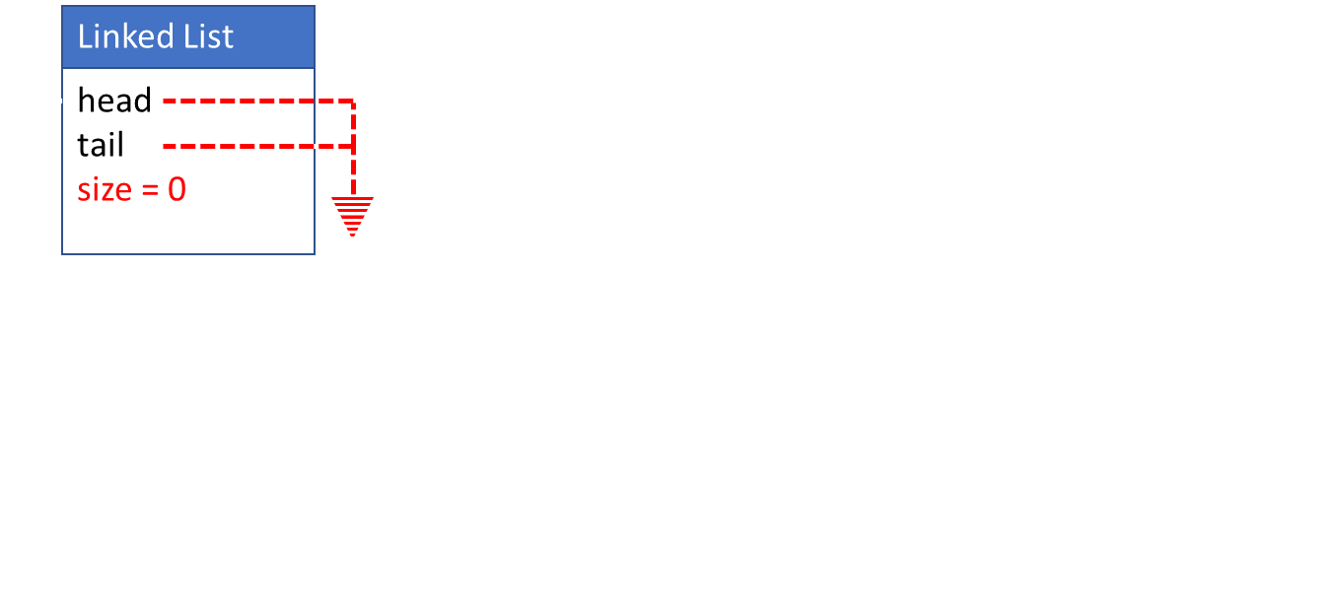
LinkedList* initialize()
LinkedList* list;
list = malloc(sizeof(LinkedList));
list->head = NULL;
list->tail = NULL;
list->size = 0;
return list;
Node* initializeNode(newData)
Node *newNode;
newNode = malloc(sizeOf(Node));
newNode->data = newData
newNode->next = NULL;
return newNode;

Slide 5
append(newData)

Slide 6
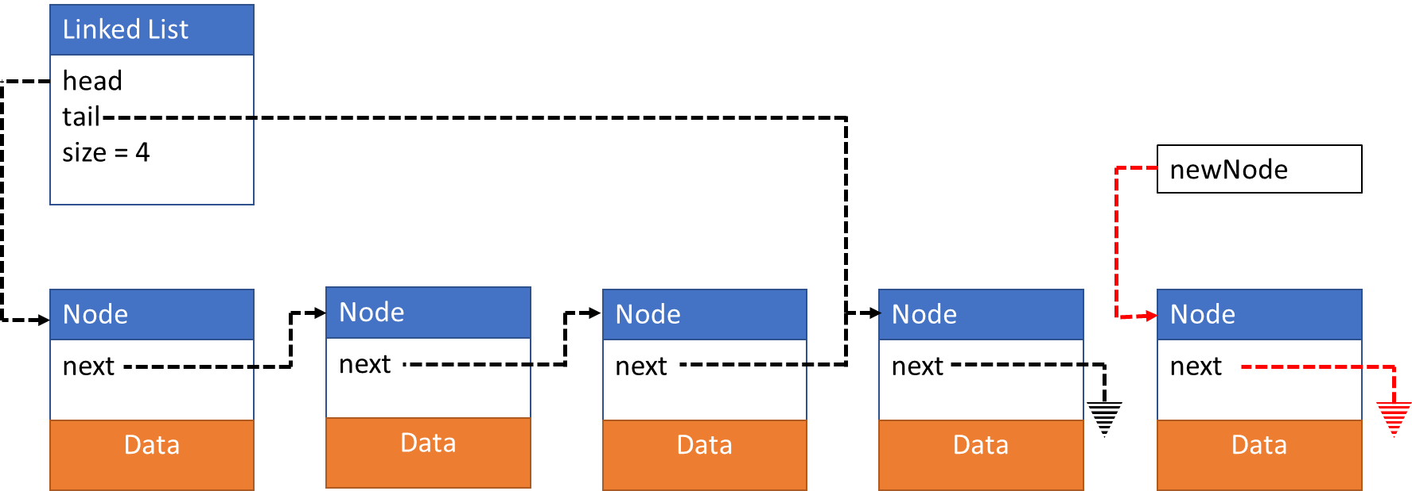
append(newData)
Create new node
Update tail->next
Update tail
Update size
Node *newNode;
newNode = intializeNode(newData);

Slide 7
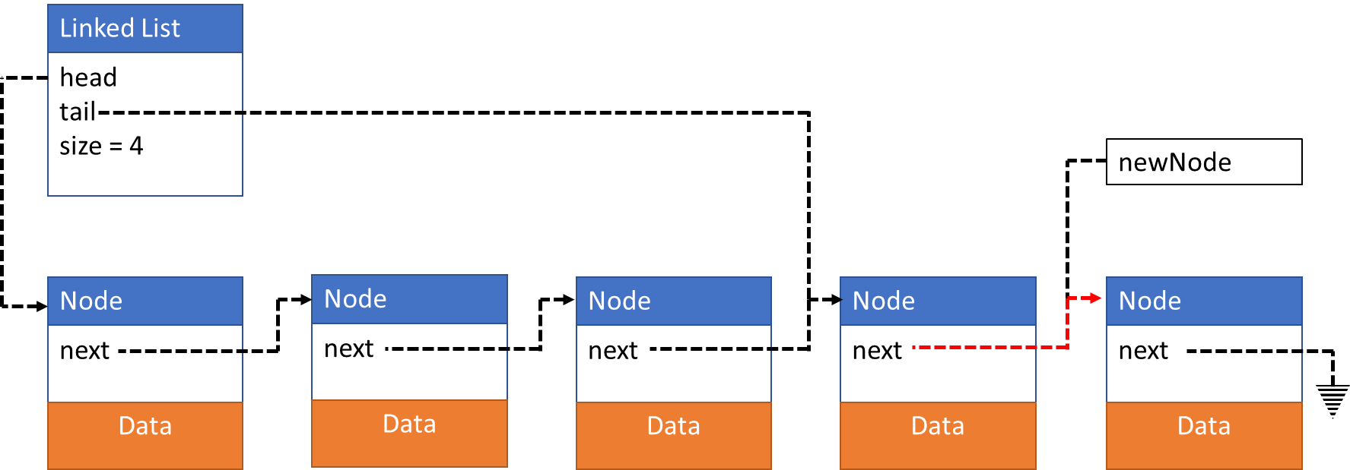
append(newData)
Create new node
Update tail->next
Update tail
Update size
list->tail->next = newNode;

Slide 8
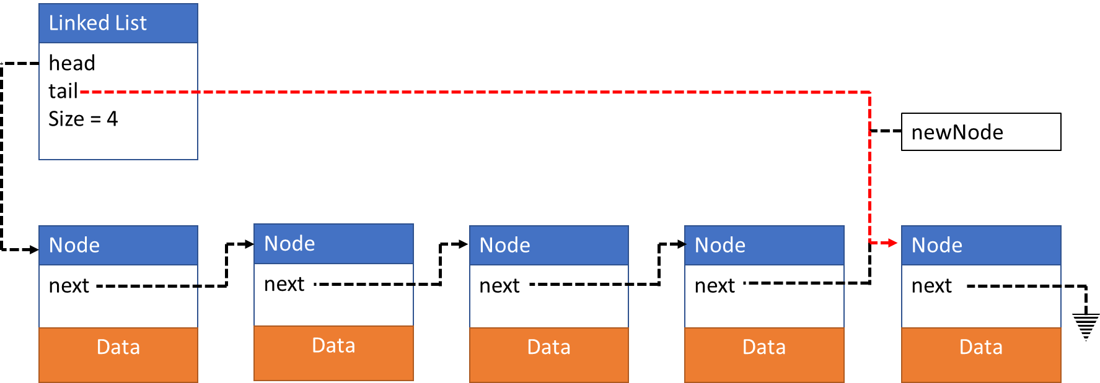
append(newData)
Create new node
Update tail->next
Update tail
Update size
list->tail = newNode;

Slide 9


append(newData)
Create new node
Update tail->next
Update tail
Update size
list->size = list->size + 1;

Slide 10
prepend(newData)

Slide 11
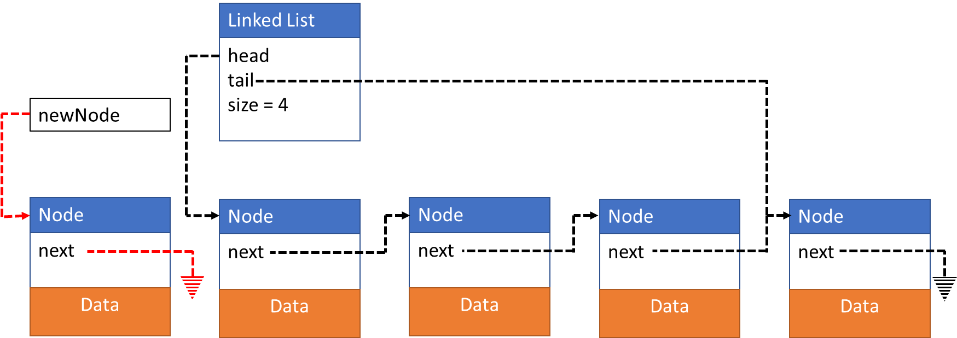
prepend(newData)
Create new node
Update newNode->next
Update head
Update size
Node *newNode;
newNode = intializeNode(newData);

Slide 12
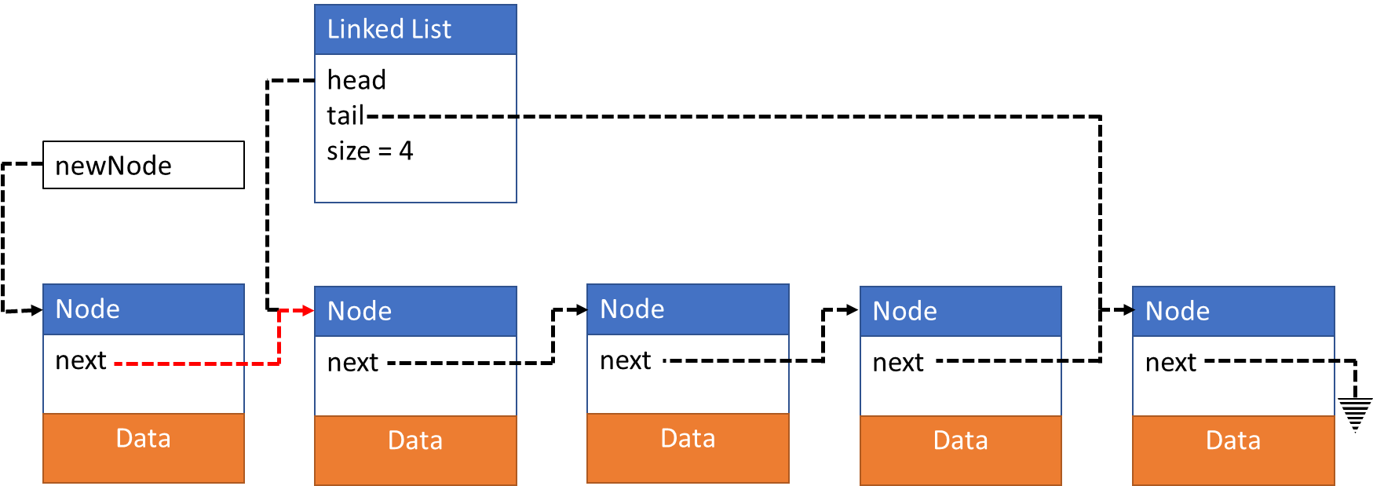
prepend(newData)
Create new node
Update newNode->next
Update head
Update size
newNode->next = list->head;

Slide 13
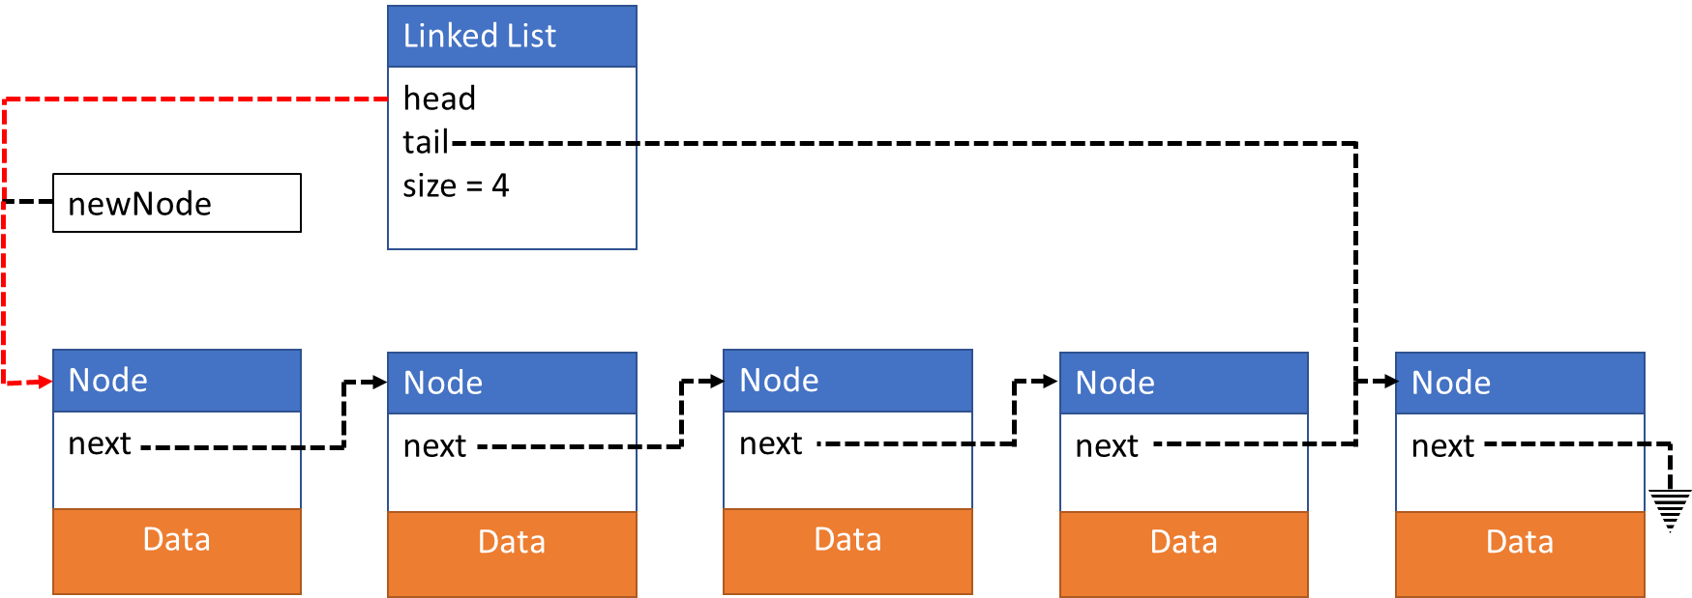
prepend(newData)
Create new node
Update newNode->next
Update head
Update size
list->head = newNode;

Slide 14

prepend(newData)
Create new node
Update newNode->next
Update head
Update size
list->size = list->size + 1;

Slide 15
insertAfter(newData, afterData)
Board work

Slide 16
InsertAfter(newData, afterData)
Node *newNode;
newNode = intializeNode(newData);
Node * currentNode = list->head;
while(currentNode != NULL)
{
if(currentNode->data == afterData)
{
if(currentNode == list->tail)
{
currentNode->next = newNode;
list->tail = newNode;
} else if (currentNode == list->head)
{
newNode->next = head->next;
list->head->next = newNode;
} else
{
newNode->next = currentNode->next;
currentNode->next = newNode;
}
} else {
currentNode = currentNode->next;
}
}

