Slide 1
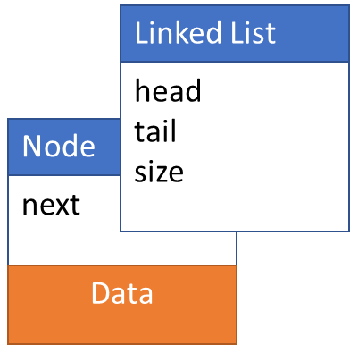
Queue ADT with Linked List
Operations:
initialize()
enqueue()
peek()
dequeue()
isEmpty()
getLength()
print()
typedef struct linkedList
{
int size;
Node *head;
Node *tail;
} LinkedList;
typedef struct node
{
int data;
struct node *next;
} Node

Slide 2
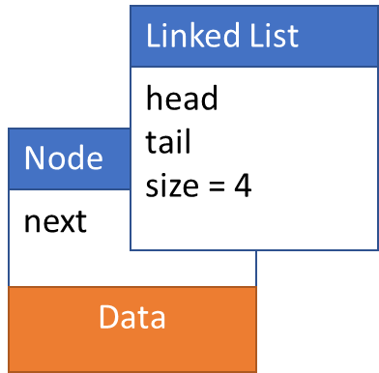
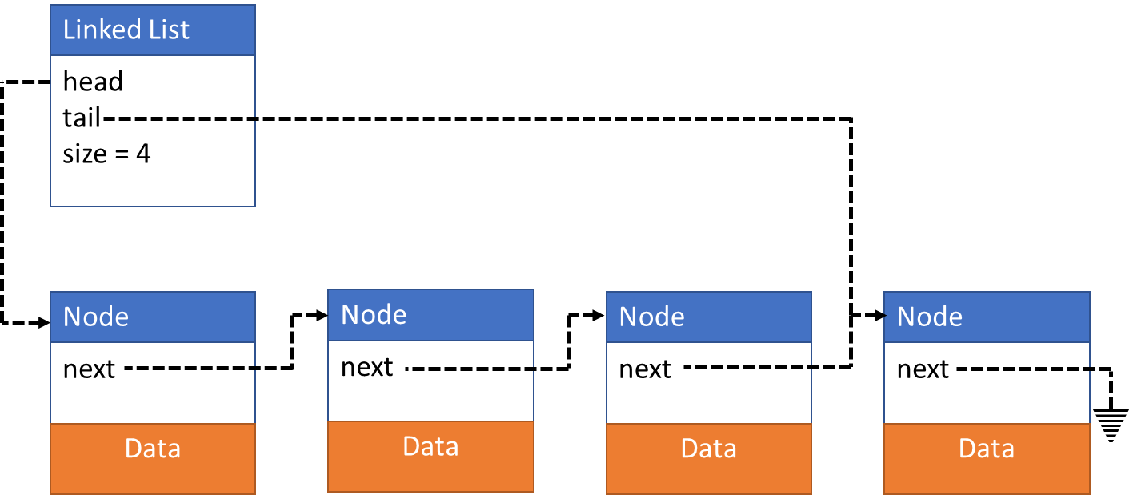
Single Linked List

Slide 3
Initialize()

Slide 4
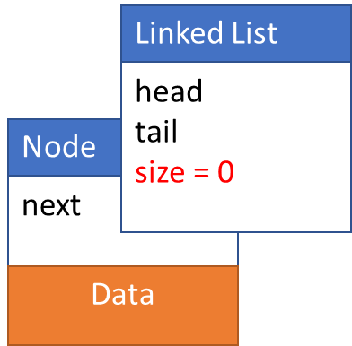
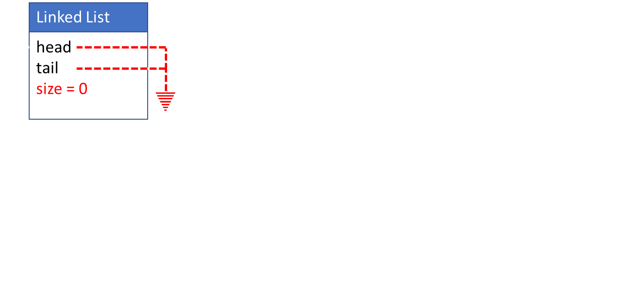
initialize()
typedef LinkedList Queue; //in header
Queue *queue;
queue = malloc(sizeof(Queue));
queue->head = NULL;
queue-> tail = NULL;
size = 0;
return queue;
Node* initializeNode(newData)
Node *newNode;
newNode = malloc(sizeOf(Node));
newNode->data = newData
newNode->next = NULL;
return newNode;

Slide 5
enqueue(newData)

Slide 6
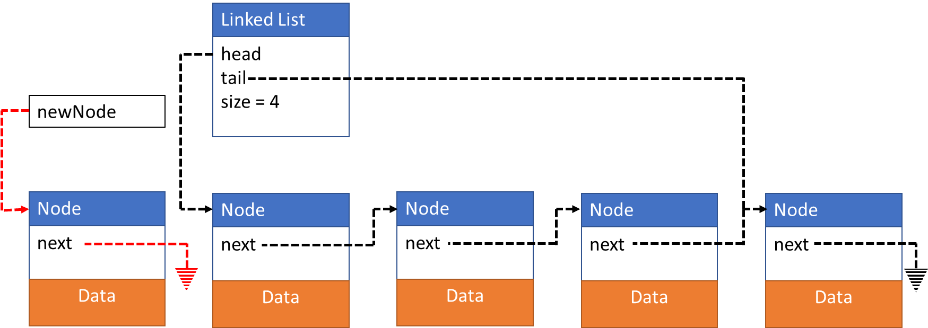
enqueue(newData)
Create new node
Update newNode.next
Update head
Update size
Node *newNode;
newNode = intializeNode(newData);

Slide 7
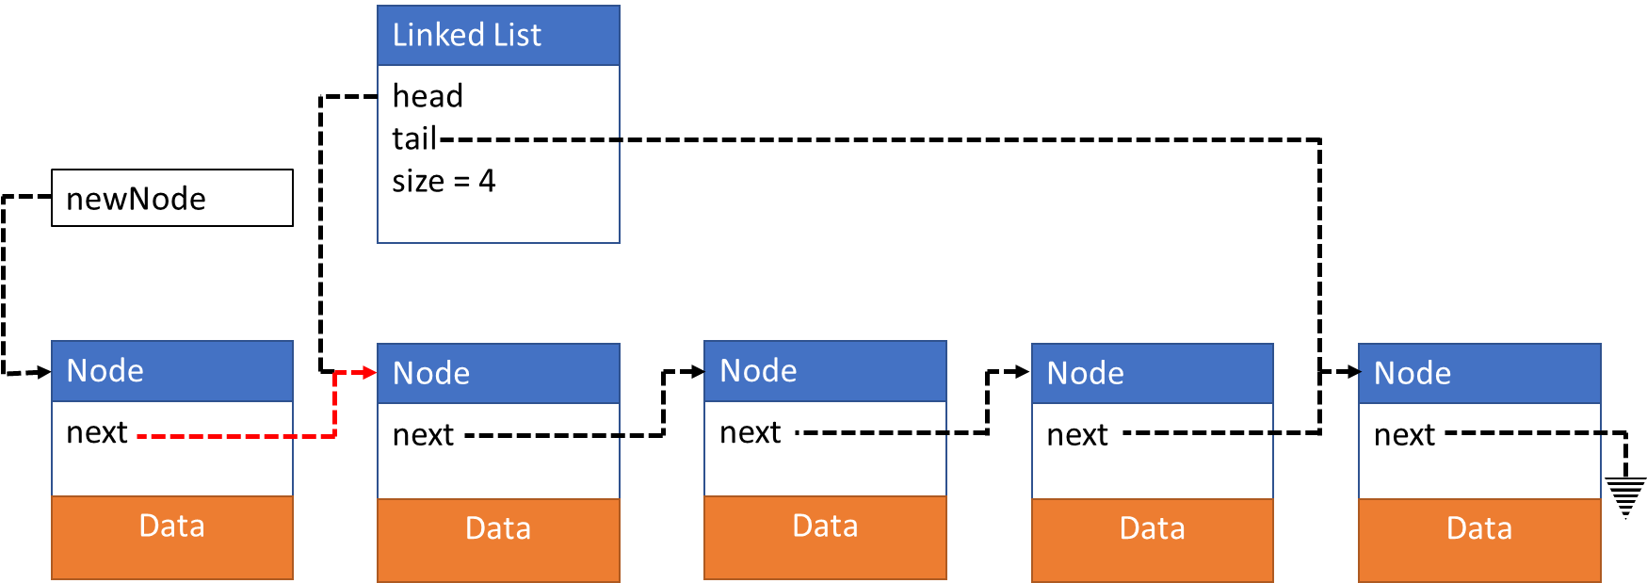
enqueue(newData)
Create new node
Update newNode.next
Update head
Update size
newNode->next = queue->head;

Slide 8
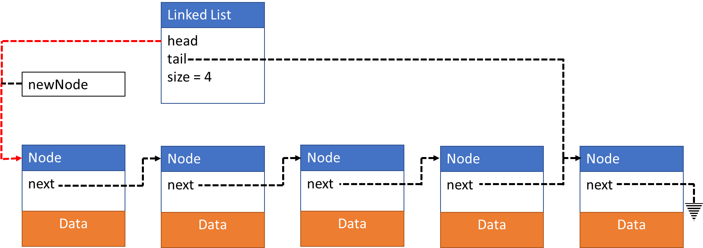
enqueue(newData)
Create new node
Update newNode.next
Update head
Update size
queue->head = newNode;

Slide 9


enqueue(newData)
Create new node
Update newNode->next
Update head
Update size
queue->size = queue->size + 1;

Slide 10
Data peek()

Slide 11
Data peek()
Copy data at head
Return data copy
Data returnData;
returnData = queue->head->data;

Slide 12
Data peek()
Copy data at head
Return data copy
Return returnData;

Slide 13
Data dequeue()
Board work

Slide 14
Data dequeue()
// THIS IS FOR A QUEUE WHERE FRONT IS AT TAIL
Data returnData;
returnData = queue->tail->data;
Node *tempNode;
tempNode = queue->head->next;
for(int i = 0; i < (queue->size – 1); i++)
tempNode = tempNode->next;
free(queue->tail)
queue->tail = tempNode;
tempNode->next = NULL;
return returnData;
// THIS IS FOR A QUEUE WHERE FRONT IS AT HEAD
Data returnData;
returnData = queue->head->data;
Node *tempNode;
tempNode = queue->head->next;
free(queue->head)
queue->head = tempNode;
return returnData;

